Slide 1
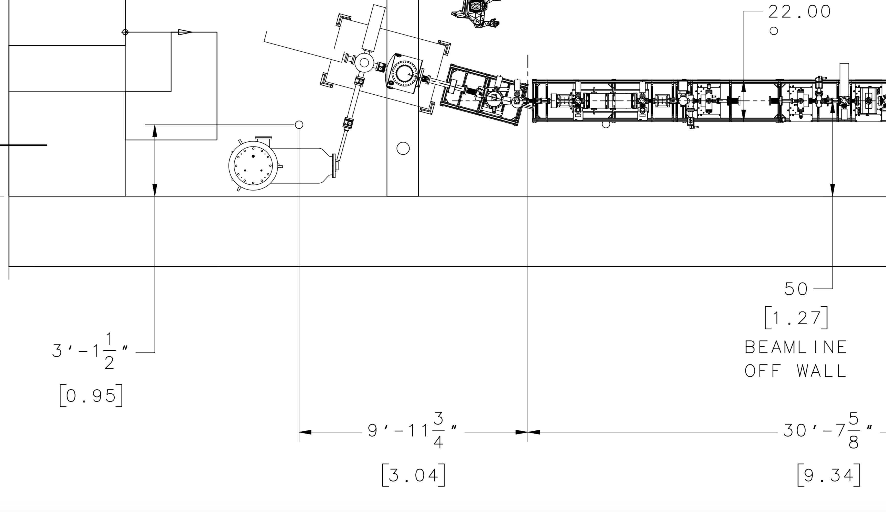
ELEGANT
(20 CM FROM PHOTOCATHODE)
X= 10.6125874 m
Y= 21.0668000 m
Z= 31.6581390 m
ME Start Point Y-Chamber Flange
ELEGANT : END DK05A
X=10.0 + (1.27000 – 0.95250) = 10.31750 m
Y=20.0 + 1.06680 = 21.06680 m
Z=30.0 + 3.04165 = 33.04165 m
Survey
Reference
Monument
X=10.0 m
Y=20.0 m
Z=30.0 m
Beam line elevation 42”
1.06689 m
X
Right-Handed
1.27000 m
Y
Z
0.95250 m
3.04165 m

