Slide 1
Summary of recent investigations of laser system which can reproduce observed beam data before/after vacuum event
3/28/24
J. Grames (based on recent studies of many people)

Slide 2
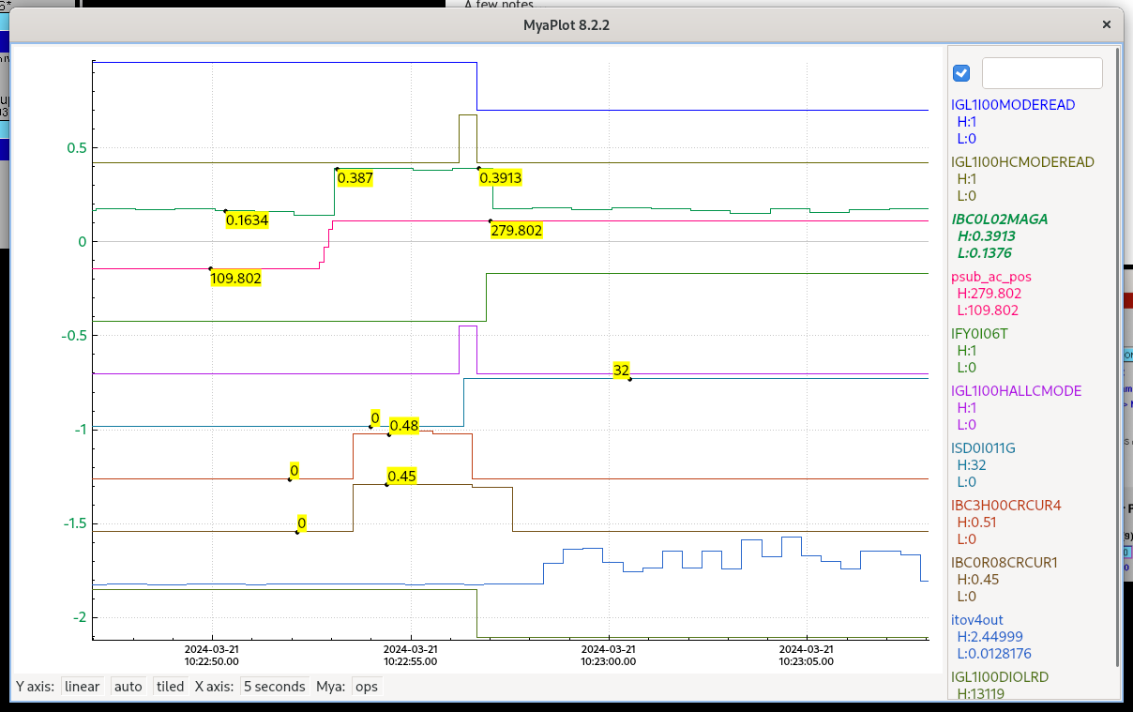
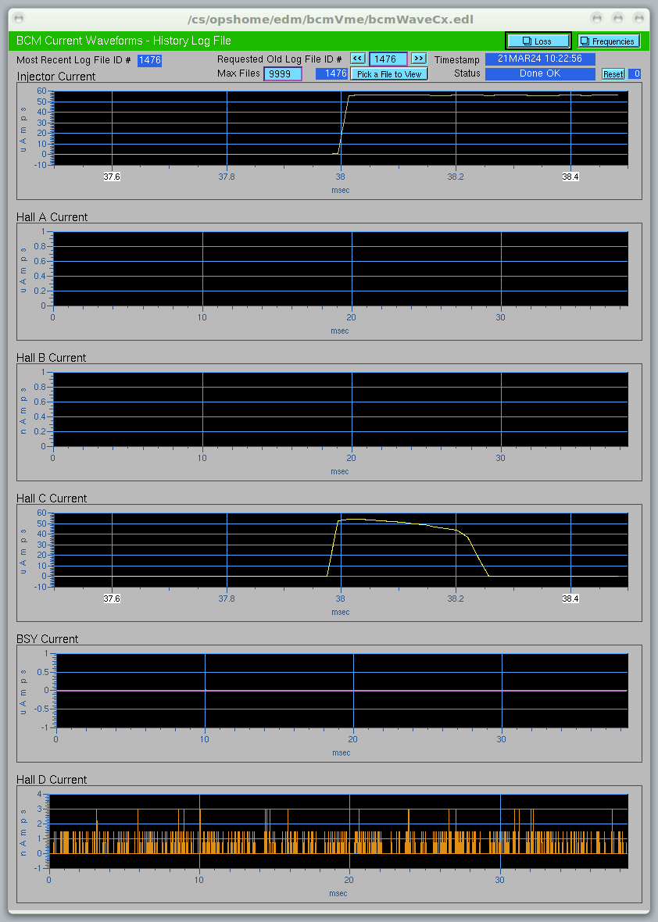
Challenge: Explain the archived data show both persistent/low intensity (hours <1 uA) in Beam Sync before/after vacuum event AND rapid/high intensity (millisecond >50uA) in Viewer Limited during vacuum event.
https://logbooks.jlab.org/entry/4271296
https://logbooks.jlab.org/entry/4270693

Slide 3
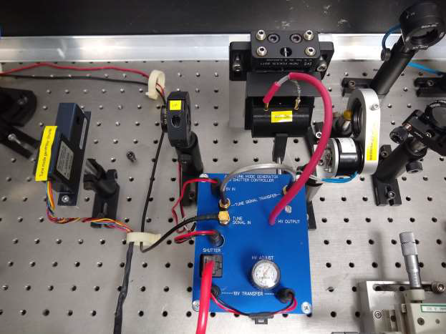
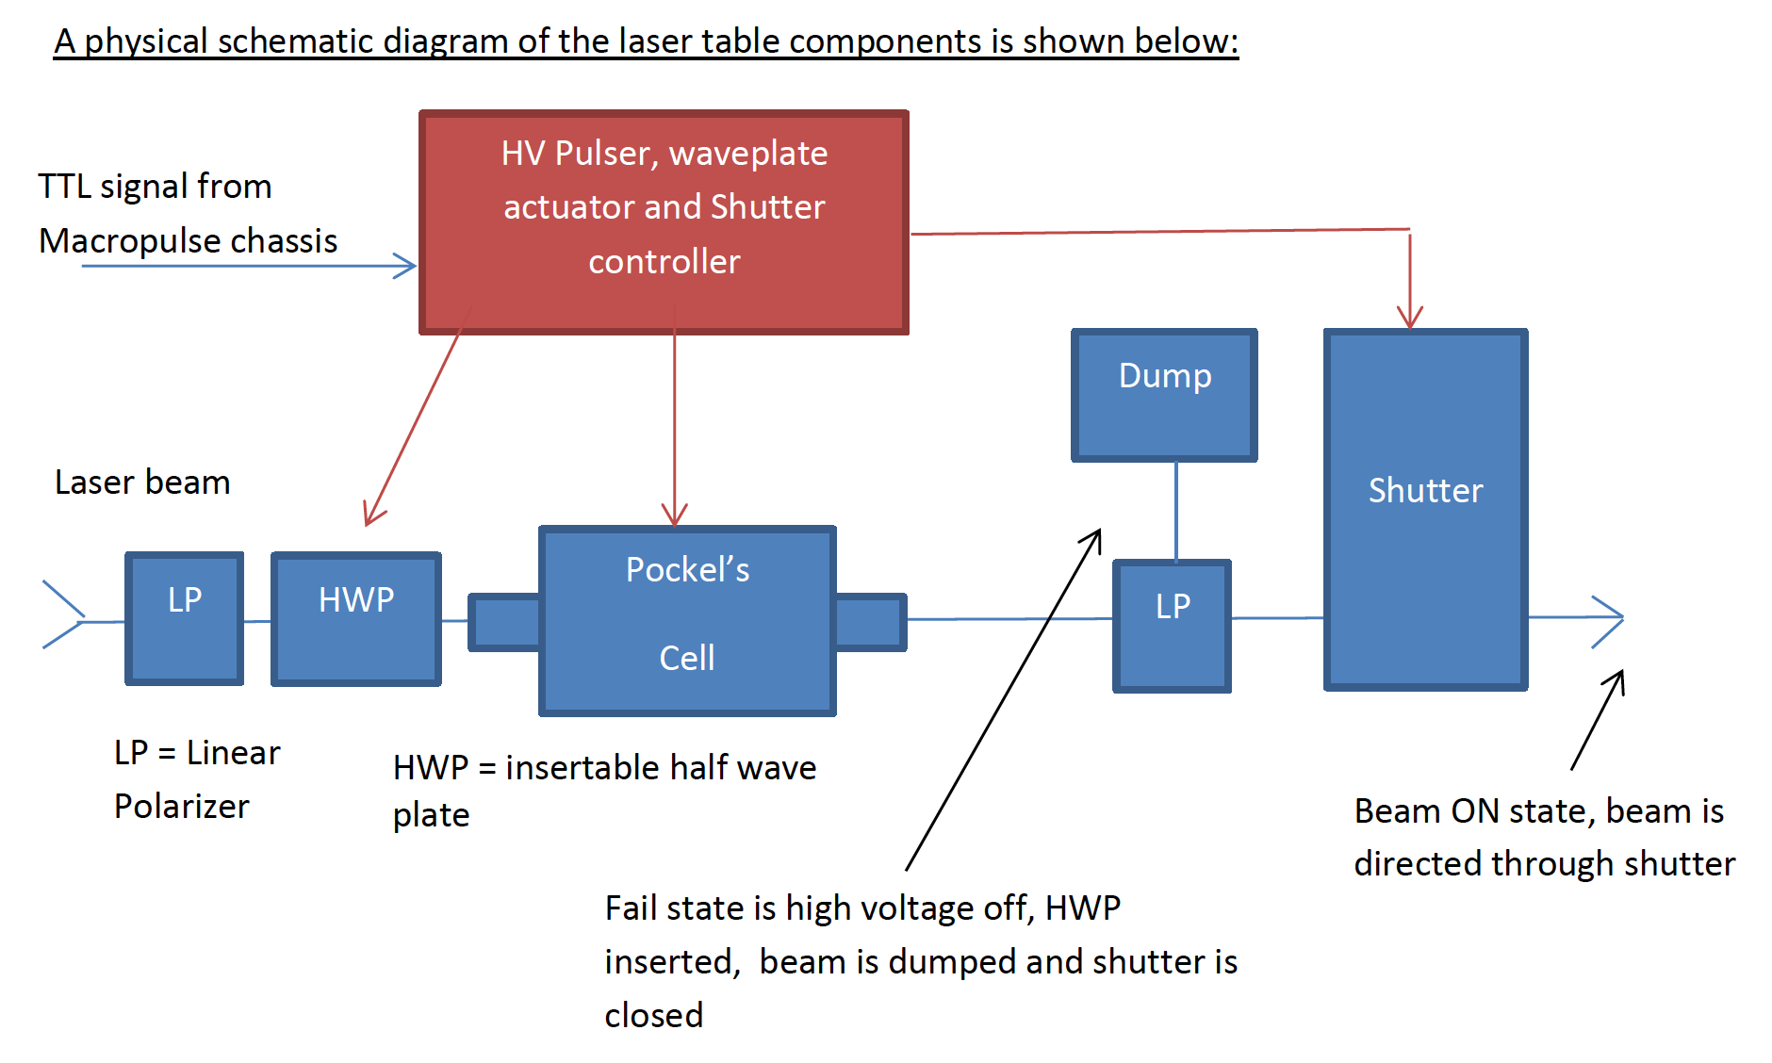
Pockels
Cell
HWP
Shutter
Atten
LP
LP
The shutter is always the first thing to close and the last thing to open after it has made its decision on the mode it sees.

Slide 4
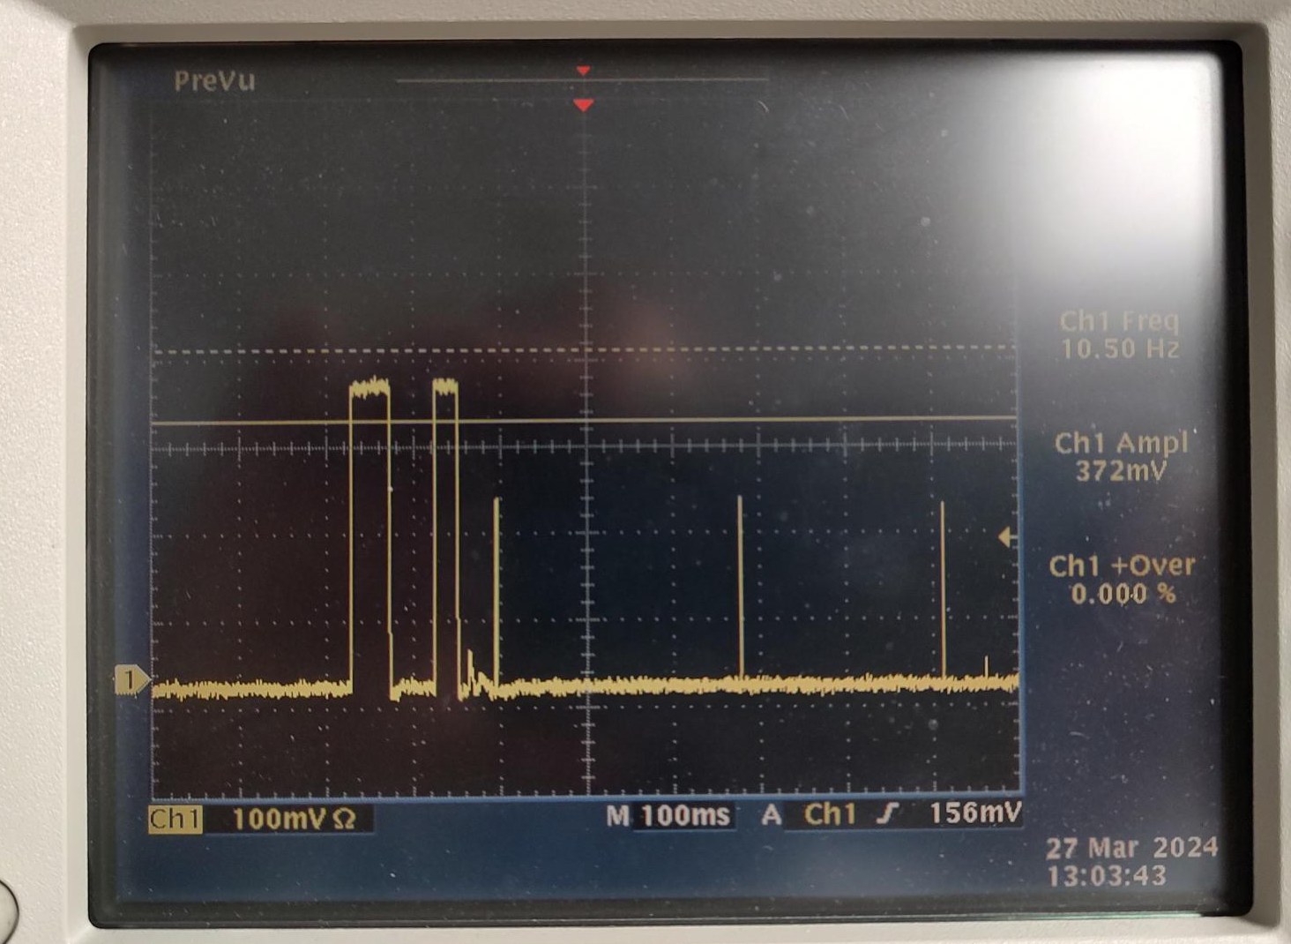
During transition to Viewer Limited this long (10’s msec) would normally be shuttered
Shutter would then open, allowing Viewer Limited pulses
(0.004 msec) to pass
Archiver data shows shutter was open during Beam Sync

Slide 5
Blind spots: There are 12 possible usual Operations state changes (4x4 – 4). Of these there are two slow (>msec) transitions (waveplate/shutter) which go from a lower beam mode to a higher beam mode. Both of these are vulnerable to delivering unintended higher current pulses if the laser shutter is not initially closed.
After
 | BS | VL | TM | CW
BS Shutter closed Waveplate In | ------------------ | Waveplate Out Waveplate In Shutter Opens | Waveplate Out Waveplate In Shutter Opens | Waveplate Out Shutter Opens
VL Shutter open Waveplate In | Shutter Closes | ------------------ | No change | Waveplate retracts
TM Shutter open Waveplate In | Shutter Closes | No change | ------------------ | Waveplate retracts
CW Shutter open Waveplate out | Shutter closes Waveplate inserts | Shutter closes Waveplate Inserts Shutter opens | Shutter closes Waveplate Inserts Shutter opens | ------------------
Before

Slide 6
Documentation: This (upgraded) version of the tune mode generator has been used since late 2016. The requirements document, alignment procedure and schematics are documented.
https://wiki.jlab.org/ciswiki/index.php/Tune_Mode_generators
Under review: The timing of the components is based on a real time TTL waveform from the SCAM control module.
Passive chips (no programming) ensures no coding latency.

Slide 7
Path Forward:
The system appears to be functioning reliably – tested each of the laser four days. It should be noted that the power to the TMG passes through the PSS system. The TMG fails safe without power. However on each access to investigate the TMG the unit is power cycled and reset. This could possibly have cleared an errant fault.
Short term – It is sensible to replace the laser shutter and the TMG control unit, to test them at the UITF.
Long term – We can develop and review a new design which is more fault tolerant.

