Slide 1
LERF/FEL SF₆ Gas Transfer System
Kevin Jordan (installed the system in the late 1990s) and
Carlos Hernandez-Garcia documented in September 2021

Slide 2
Overview
The gun high voltage power supply is a Crockroft-Walton 500 kV 10 mA DC generator (HVPS) immersed in a tank filled to 10 psig of SF₆.
The LERF gun is also immersed in SF₆ inside an aluminum tank sharing the SF₆ volume with the HVPS.
The pressure relief valve RV1S002 will open at 15 psig. This valve vents into the LERF vault and is connected to the HVPS tank in the injector pit.
During gun maintenance, it is necessary to open the gun tank, thus the SF₆ needs to be transferred to a storage bag. The storage bag is located in the opposite side of the LERF vault
The following slides describe the SF₆ gas transfer system, designed and built by Kevin Jordan in the late 1990s.
This is an attempt to document it

Slide 3
SF₆ transfer system requirements
The SF₆ should be able to be transferred manually between the storage bag and the high voltage tank and/or gun without significant loss of gas or contamination
The HVPS tank has an instrument air connection for back filling after the SF₆ has been transferred
The tank pressure ion the tank must never exceed 15 PSIG, see pressure vessel section
Tank must be evacuated prior to filling with SF₆
Tank pressure relief is vented into the LERF vault
A relief valve is connected adjacent to the HVPS SF6 tank

Slide 4
SF₆ hazards and MSDS
On Line MSDS (http://www.ncf.uic.edu/MSDS/SF6.pdf)
EMERGENCY OVERVIEW: Sulfur Hexafluoride is a colorless, odorless, non-toxic, non-flammable gas which is shipped as a liquefied gas. The liquefied gas will rapidly boil at standard temperatures and pressures. The main health hazard associated with releases of this gas is asphyxiation, by displacement of oxygen. Contact with the liquefied gas can cause frostbite to any contaminated tissue. SF₆ is not flammable or reactive under typical emergency response situations.
ODH (Asphyxiant) in high concentrations
Gas is heavier than air
Contact with liquid may cause cold burns/frostbite.
The hazard of asphyxiation is often overlooked and must be stressed during operator training

Slide 5
SF₆ hazards and MSDS cont.
10. STABILITY and REACTIVITY
STABILITY: Normally stable, inert gas. DECOMPOSITION PRODUCTS: Sulfur oxides and hydrogen fluoride.
MATERIALS WITH WHICH SUBSTANCE IS INCOMPATIBLE: SF₆ is non-reactive with most chemicals. SF₆, however, can react violently with disilane. Sulfur Hexafluoride is only stable at elevated temperatures [e.g., 204°C (> 400°F)] when contained in aluminum, stainless steel, copper, brass, or silver. Other metals can cause slow decomposition to sulfur-fluoride compounds. If this decomposition occurs in the presence of oxygen, thionyl fluoride compounds can be generated.
EVEN if there were arcing in HVPS tank the SF₆ would not create thionyl fluoride compounds since it is not in the presence of Oxygen! See above
We do not use the gas at elevated temperatures
The gas is NOT present when the gun is baked
The pumps used in the gas transfer do not reach these high temperatures

Slide 6
SF₆ Hazards & MSDS cont.
11. TOXICOLOGICAL INFORMATION
TOXICITY DATA: The following data are for SF₆:
Standard human toxicity values are not available.
Intravenous-Rabbit, adult LD50: 5790 mg/kg
Male rats were exposed for periods of 16-24 hours to 20% oxygen and 80% SF₆ at 1 atmosphere ambient pressure showed no changes.
SUSPECTED CANCER AGENT: SF₆ is not found on the following lists: FEDERAL OSHA Z LIST, NTP,
CAL/OSHA, IARC; therefore it is not considered to be, nor suspected to be a cancer-causing agent by these agencies.
IRRITANCY OF PRODUCT: Contact with rapidly expanding gases can cause frostbite and damage to exposed skin and eyes.
SENSITIZATION OF PRODUCT: SF₆ is not known to be a sensitizer in humans with prolonged or repeated exposure.
REPRODUCTIVE TOXICITY INFORMATION: Listed below is information concerning the effects of SF₆ on the human reproductive system.
Mutagenicity: SF₆ is not expected to cause mutagenic effects in humans.
Embryotoxicity: SF₆ is not expected to cause embryotoxic effects in humans.
Teratogenicity: SF₆ is not expected to cause teratogenic effects in humans.
Reproductive Toxicity: SF₆ is not expected to cause adverse reproductive effects in humans.

Slide 7
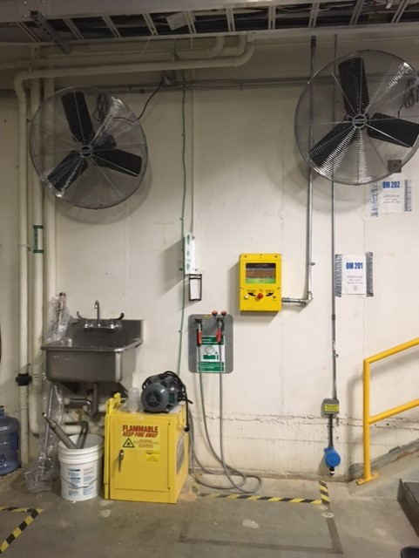
SF₆ Gas ODH Hazard Mitigation
The storage bag is located at the opposite end of the LERF vault
There is one ODH sensor located in the injector pit below one of the fans near the arm/safe box
There are two fans mounted to the east wall of the injector pit that must be turned off during SF₆ gas transfer operations.

Slide 8
Tank Pressure Vessel Hazards
This tank has been hydro’d; pressure tested with water to 22 PSIG
This tank is NOT a certified pressure vessel!
Therefore there must be a relief of sufficient capacity to prevent the tank pressure from exceeding 15 PSIG to be in compliance with ASME codes
REPEAT; The relief MUST keep tank pressure under 15 PSIG regardless of source gas
The instrument air is used to back-fill tank once the SF₆ has been transferred to the storage bag
The supply line is interlocked to a tank pressure switch such that the air is shut down at 5 psig

Slide 9
15 PSIG Relief valve

Slide 10
LERF SF₆ transfer system
The total volume of the tanks and the transmission pipe is 236 cubic feet.
Since the tanks are at 10 psi after filling with gas and during operation
Roll-up door
Storage bag
Cylinder Rack
FEL Vault
HVPS
Tank
Bladder
Gun
Tank
Pump
HVPS
Tank
Gun
Tank
SF₆ System Configuration

Slide 11
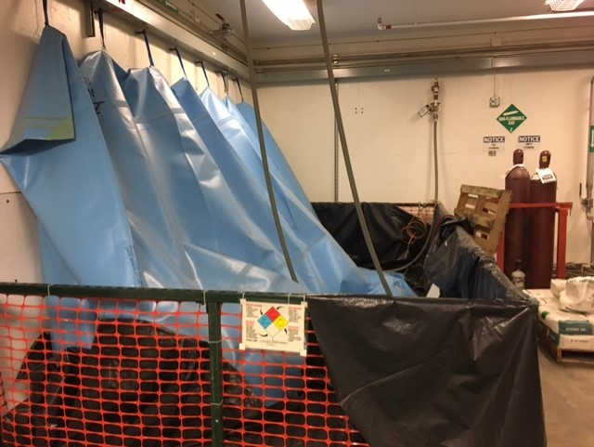
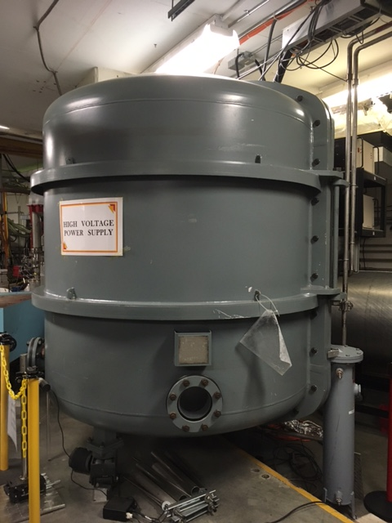
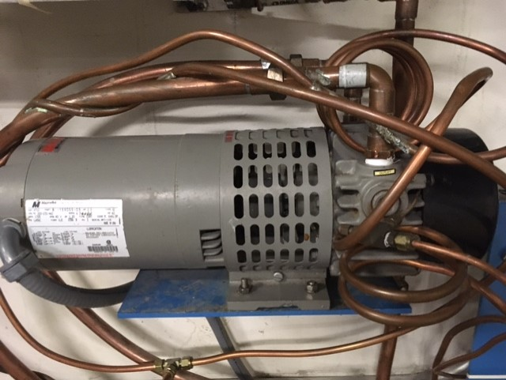
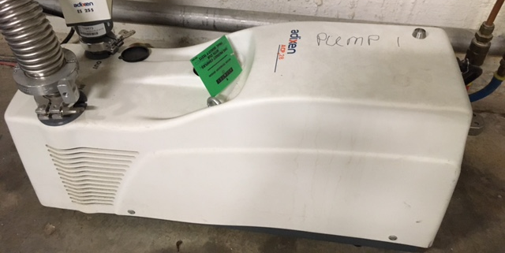
LERF SF₆ system configuration
SF₆
Storage bag
Pressure Transducer &
Pressure Interlock Sw.
#8
Vent
Outside
High Voltage
Tank
#10
#2
Thomas Vane
TA-210-P
#1
#3
12 PSI
Relief
#2
#1
#6
#9
#2
#4
#5
#7
Instrument
Air Connection
Pfeiffer
ACP15

Slide 12
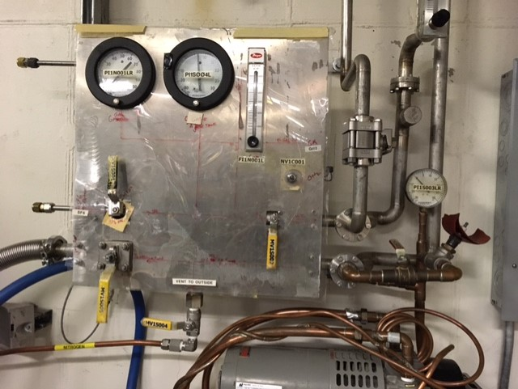
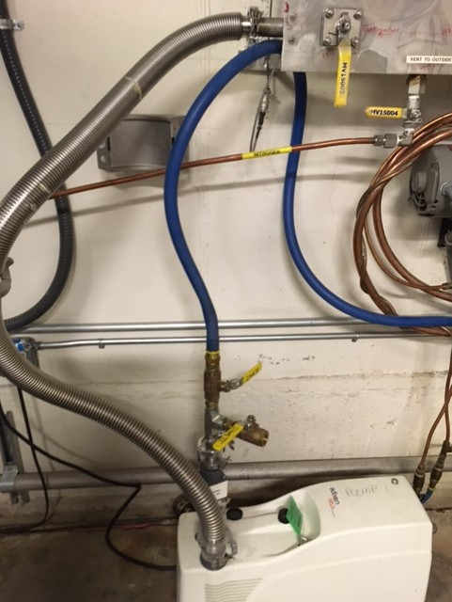
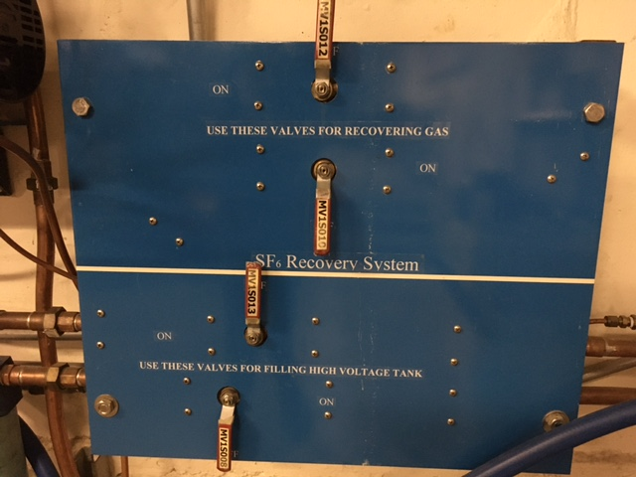
SF₆ System valve configuration

Slide 13
Gas transfer Logic: Filling Tank with SF₆
Evacuate tank to 125 Torr (25 in Hg Vac)
Open valves to let gas from bag equalize pressure to 0 PSIG in tank
Backfill tank to 10 PSIG using Vane pump
Turn OFF pump & close valves; Process complete!
Tank open to air
Evacuate tank
venting outside
No
< 26 in Hg
YES
Open SF₆
back-fill valves
No
~ 0 PSIG
Detailed procedure in next slide
YES
Valve in & run
Thomson pump
YES
No
HVPS Ready for
High Voltage
Turn off pumps
& close valves
10 PSIG

Slide 14
Gas Transfer Procedure; Fill Tank to 10 PSIG of SF₆
Initial condition: Tank open to air
Close tank and ensure that all bolts are in place and properly tightened.
Ensure valves MV1A035, FI1S001L, MV1S002, MV1S004, MV1S008, MV1S010, and MV1S015 are closed. Ensure valves MV1S003, MV1S005, MV1S006, and MV1S007 are open.
Turn on AC power to pump P1 and start evacuating the system by slowly throttling the pump valve MV1S016 open until the pump can handle the valve being fully open.
When the tank reaches 26 in. of Hg, close valves MV1S005 and MV1S016 on vacuum pump P1. Then turn off AC power to the vacuum pump.
Ensure valves MV1S005, MV1S004, and MV1S003 are closed. Start backfilling the tank by opening valves MV1S015, MV1S013, MV1S012, MV1S010, MV1S008, and MV1S007. The differential pressure between the SF₆ bladder and the tank will push the SF₆ into the tank. When pressure gauges PI1S001LR and PI1S003LR read above 5 in. of Hg, close valves MV1S012 and MV1S010.
Turn on the AC power to rotary pump P2 and immediately open valves MV1S009, MV1S011, and MV1S014.
When the pressure gauge PI1S001LR reads 10 psig, close valve MV1S007 and quickly shut off AC power to rotary pump P2. Then close valves MV1S013, MV1S011, MV1S009, MV1S008, MV1S006, MV1S014, and MV1S015. The final tank pressure must be between 5 and 12 psig.
Notice: Under no circumstances ever exceed 15 psig system operating pressure as the pressure relief valve RV1S002 will open at this pressure. Assume the pressure will increase 1 psig due to the power supply heating the insulating gas.

Slide 15
Gas Transfer Logic: Recover SF₆ gas and backfill with 0 PSIG instrument air
Initial conditions: HV Tank @10 PSIG SF₆
Equalize pressure
When tank is 0 PSIG turn on pumps # 2
Evacuate tank; recovering gas until pressure is 20 inHg
Shut off pump #1 and turn on pump # 2.
Evacuate tank until pressure < 26 inHg
Shut off pumps and close valves
Backfill tank with instrument air
When tank pressure reaches 0 PSIG close valve instrument air feed valve
High voltage tank is ready for maintenance
Tank 10 PSIG SF₆
Equalize
pressure
No
0 PSIG
YES
Open Valves
& turn on pumps
No
~ 0 PSIG?
YES
Detailed procedure in next slide
Turn off pumps
Vent to Inst. air
YES
No
Gun ready for
maintenance
Close valves
0 PSIG

Slide 16
Gas transfer procedure: Recover SF₆ gas and backfill tank to 0 PSIG of instrument air
Initial condition: Tank filled to 10 PSIG of SF6 and all valves closed
Ensure valves MV1S003, MV1S005, and MV1S004 are closed.
Open valves MV1S006, MV1S007, MV1S008, MV1S010, MV1S012, MVlS0l3, MV1S009, MV1S011, MV1S014, and MV1S015. The differential pressure between the SF₆ bladder and the tank will push the SF₆ into the bladder.
When pressure gauges PI1S001LR and PI1S003LR read about 5 psig, close valves MV1S008 and MV1S013 and then turn on AC power to rotary pump P2.
When pressure gauges PI1S001LR and PI1S003LR read about 25 in of Hg, close valve MV1S007, quickly turn off AC power to rotary pump P2. Then close valves MV1S006, MV1S009, MV1S010, MV1S011, MV1S012, MV1S014, and MV1S015.
Ensure valves MV1A035, MV1S002, and flow meter valve FI1S001L are closed.
Ensure valve MV1A034 is open and regulator FR1A001 is set to 15 psig.
Open valve MV1A035, MV1S003, set flow meter valve FI1S001L to 1800 SCFH, and closely monitor the tank pressure gauge PI1S001LR.
When the tank pressure gauge reads 0.25 psig, close the flow meter valve FI1S001L. Close valves MV1S003, MV1A035, and MV1A034. Open valves MV1S006 and MV1S004 to vent the tanks to atmosphere.
Remove the bolts on the tank door that needs to be opened and open the appropriate tank door.
Close MV1S004. Ensure all other valves are closed and pumps are off. This procedure is finished.

