Slide 1
GPT Simulations for Upgrade Injector
Alicia Hofler – April 17, 2020

Slide 2
Model
Gun to Choppers (02/07/2020 layout)
  Wiens upstream of Prebuncher
    VWien center z=2.91 m
    Hwien center z=4.34 m
  Prebuncher center z=4.66 m
  A1 3 mm diameter z=5.99 m
  A2 6 mm diameter z=6.69 m
Chopper exit to Booster
  Buncher shifted to midpoint between choppers and 2-cell of booster
  MFX0I06 before Buncher
  MFX0I07 midway between Buncher and 2-cell
Booster exit to entrance of full module
  Present CEBAF layout
Field maps
  Gun: 200 kV small mushroom 3D field map
  Prebuncher and Buncher from CEBAF model
  Booster
    2-cell
    7-cell
  Solenoids
    FG from CEBAF model (single wound)
    FA from CEBAF model (counter wound)
    Jay’s FY solenoid design for chopper solenoids (counter wound)
    Jay’s FX solenoid design for remainder (counter wound)
Omitted elements:
  15 degree bend
  Chopper system
  Wiens
    15 mm diameter Wien length aperture included for each Wien
  Wien triplets/quads

Slide 3
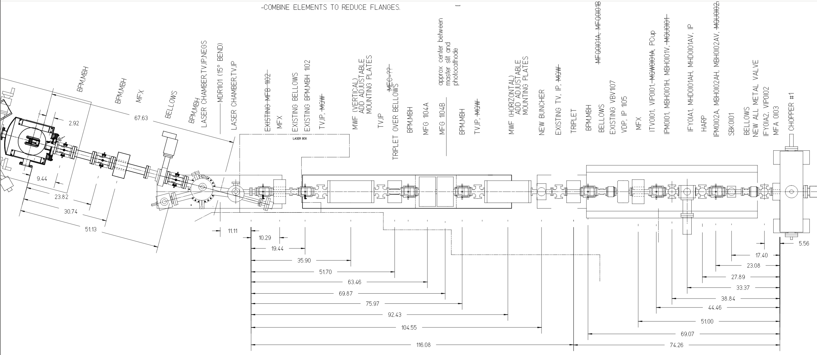
Layout 02/07/2020
*
*
A1
A2
*
V
Wien
*
H
Wien
*
*
P
*
*
MFX
*
MFG
MFA

Slide 4
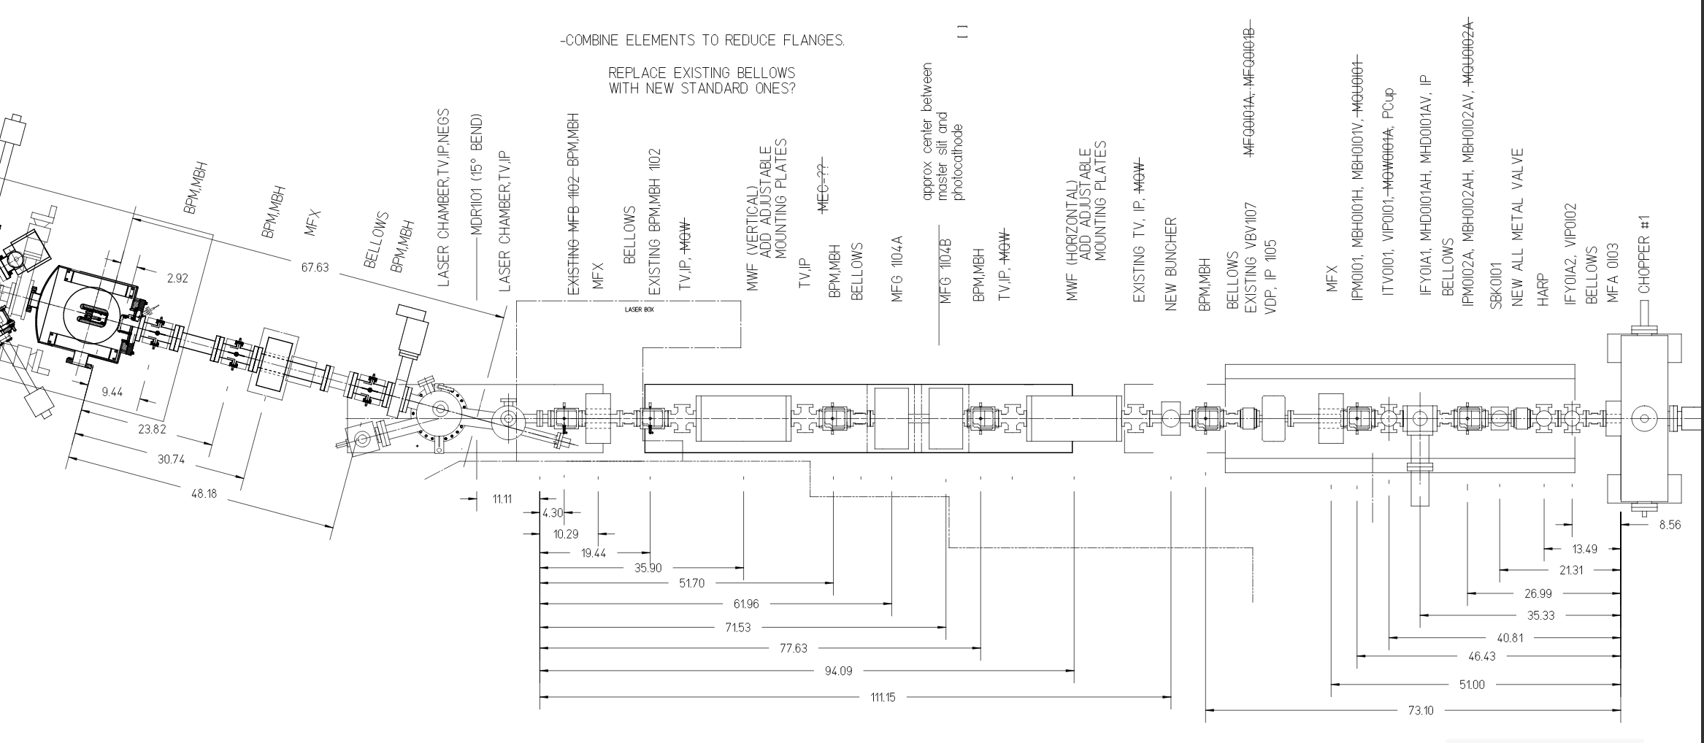
Layout 03/26/2020 – position changes noted
*
*
A1
A2
*
V
Wien
*
H
Wien
*
*
P
7.62 cm
-3.81 cm
*
both
4.22 cm
4.98 cm
*
MFX
*
MFG
16.76 cm
MFA

Slide 5
Optimization
170 uA beam current
499 MHz laser frequency
1000 macroparticles
Prebuncher phase fixed at zero-crossing
FGs fixed +/-45º
  MFG1I04A 1227.12 mA
  MFG1I04B -1238.23 mA
Chopper FYs fixed
  Present 130 kV setting scaled to 200 kV
  0.975 – 0.995 A
Population size: 120
Minimize at the entrance of full module
  Bunchlength
  Transverse emittance
Constraints
  Transmission
  Bunchlength at master slit (< 111 ps)
  Kinetic energy into Booster (180-220 keV)
  Kinetic energy at full module (4-9 MeV)
  Kinetic energy sigma (< 5.6 keV)
2 pairs of fake correctors
  Between gun and first solenoid
  Put beam on axis into first solenoid
Selected solutions
  Bunchlength is continuously decreasing between the Booster and full module
  At entrance of full module
    Transverse emittance < 0.25 mm mrad
    Kinetic energy sigma < 5.6 keV
    Bunchlength < 0.5 ps
  92.4% transmission (all final solutions)
    All particle loss at gun/cathode
  Kinetic energy 7.8-8.9 MeV

Slide 6
Front: Emittance vs. bunchlength with MFX1 and Prebuncher settings

Slide 7
MFX1 effective: Bunchlength and Beam Size (beam size < 1 mm)
PB stronger bunching
PB weaker bunching

Slide 8
MFX1 little or no effect: Bunchlength
PB stronger bunching
PB weaker bunching

Slide 9
MFX1 little or no effect: Beam Size
PB stronger bunching
PB weaker bunching

Slide 10
Settings

Slide 11
Other tasks using 03/26/2020 layout
Wiens added to input file
  Remove residual field (noise) from non-dominant transverse E and B field components (force Ex=By=0)
    Vwien
      Ideally
        on-axis Ex,By > 0
        Ey,Ez,Bx,Bz = 0
      Fieldmaps
        on-axis Ex,By > 0
        Ey,Ez,Bx,Bz with relatively smaller amplitudes around 0
        New Ey and Bx
          Ey(x,y,z) = [Ey(x,y,z) - Ey(x,-y,z)]/2
          Bx(x,y,z) = [Bx(x,y,z) - Bx(-x,y,z)]/2
  Confirmed proper scaling for dipole and HV field maps are realistic using EPICS setpoints
Check efficacy of correctors upstream of FGs for different FG settings
Check effect of Vwien settings on beam size for a given setup
Optimize set up with VWien for 90º

