Slide 1
Desirable BCM Performance
Vashek Vylet
UITF BCM discussion, October 21, 2016

Slide 2
Radiation Exposure Constraints
Normal operation (per Shielding Policy)
< 250 mrem/y in occupied RCAs
< 100 mrem/y in other occupied areas (< 50 μrem/h)
< 10 mrem/y at site boundary
Max. credible accident: <15 rem per incident

Slide 3
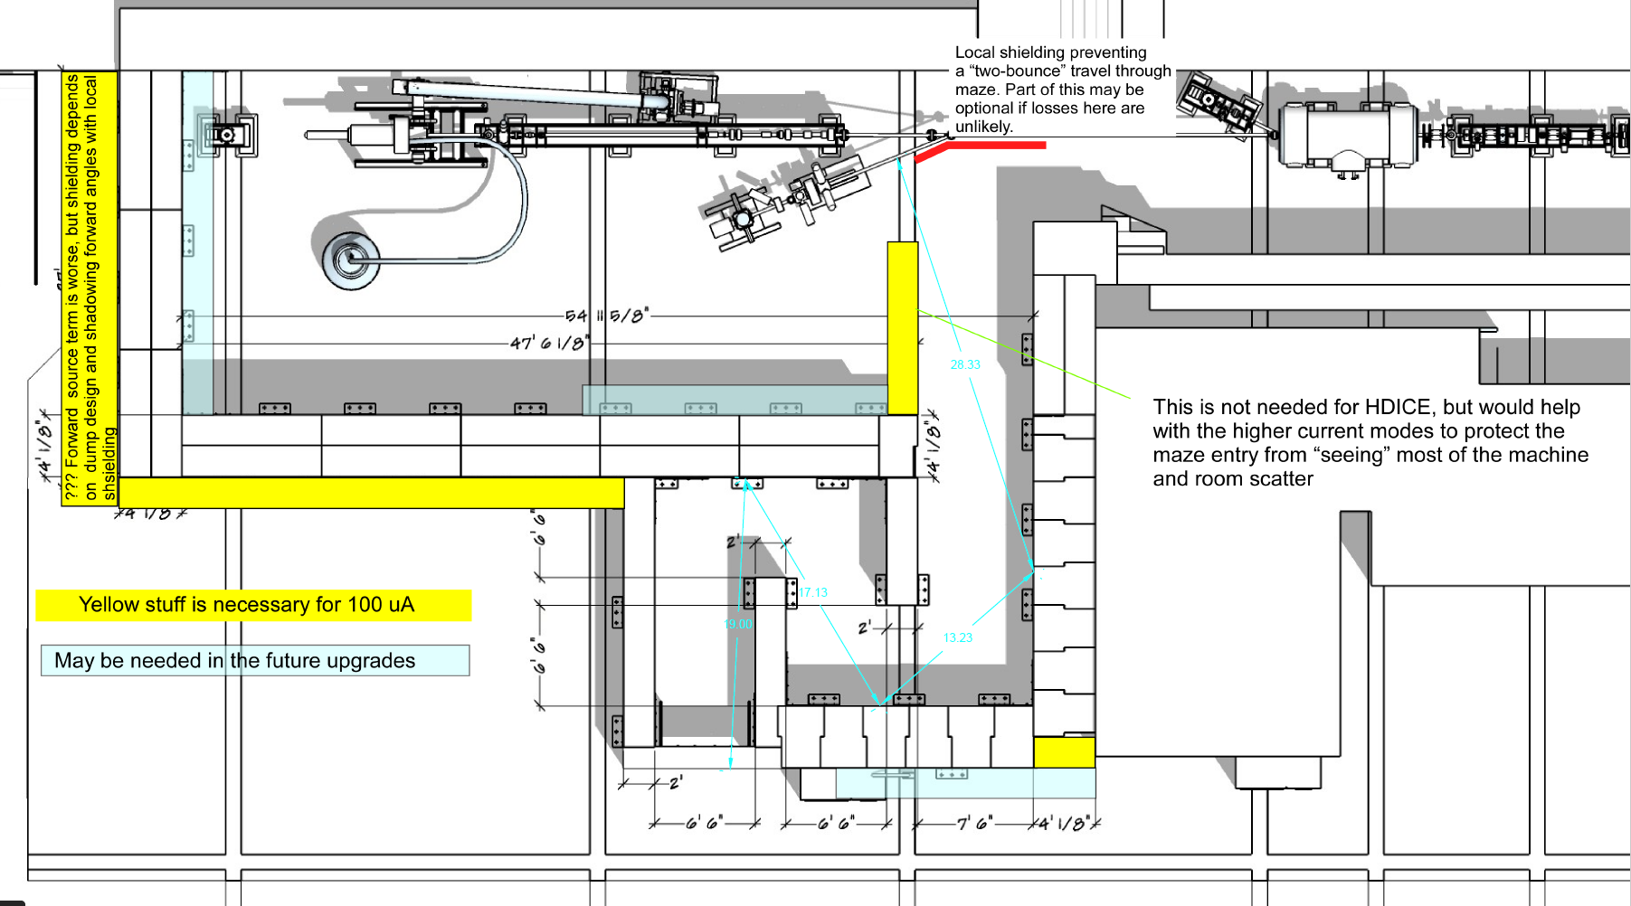
Layout
CAVE 1
CAVE 2

Slide 4
Shielding Design – Phase 1
CAVE 2
– HDIce operation at 10 MeV for 900 h/y
I_{av} = 5 nA for 80% of time
I_{av} = 100 nA for 20% of time (180 h)
concrete shielding: 4 ft lateral and 1.75 ft roof
CAVE 1
I_{av} = 100 μA when not running HDIce, beam terminated in FC before Cave 2
55”/27” lateral and 30” roof shielding

Slide 5
Cave 2
TOTAL BEAM LOSS | D [mrem/h] | Note
Cave 2, 1 uA, side | 0.44 | RCA
Cave 2, 1 uA, roof | 55.21 | RA
Cave 2, 100 nA, side | 0.044 | just < RCA
Cave 2, 100 nA, roof | 5.52 | RA
If total losses above are very unlikely, how can we justify a lower loss assumption?
A loss of 200 nA may be tollerated, considering HDIce will run only 900 h/y
BCM should reliably catch I_{av} > 200 nA within ≤ 2 minutes

Slide 6
Cave 1
Cave 1 shielding as is; I_{av} = 100 μA is desired in cave 1
Cave 2 has 4 ft forward and lateral concrete shielding, with a 1.75 ft thick roof
Beam ends in a well shielded FARC at 42” beam height

Slide 7
Cave 1 at 100 μA
CAVE 1 | Dose rate
 | [mrem/h] | Note
Side 100% loss | 41 | RA
Side 1% loss | 0.4 | RCA
High Side 1% loss | 26 | RA
30”
Thinner wall may be an issue for stairs (and ground due to skyshine).
Cable penetrations under
west wall must be filled
with grout or similar
28”
27”

Slide 8
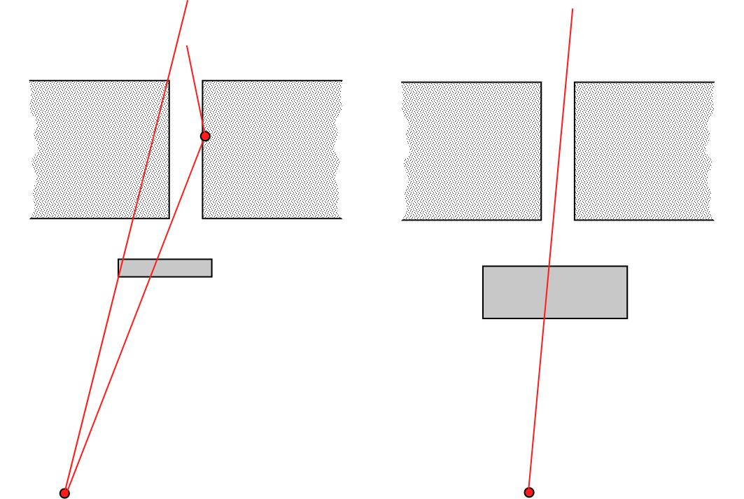
Cave 1 at 100 μA
CAVE 1 | Dose rate
 | [mrem/h]
Roof 100% loss | 2973
Roof 1% | 30
Penet* 100% | 40621
Penet* 1% | 406
* with current 3.25" Fe shield
30” concrete
3” steel
7.8” steel
Penetrations are above the beamline – about 8” of steel is needed for same attenuation as the 30” concrete slab. Roof will have to be inaccessible; Depending on results of measurements, full 100 μA may not be feasible at 10 MeV;
Existing BCM would catch a 1% loss (1μA)

Slide 9
Summary
Side shielding can (just) handle a full 100 nA loss continuously, if we forget skyshine
Short episodes of higher beam loss can be tolerated as mis-stearing, providing they are reliably terminated in < 2 min
Recommendation: BCM should reliably detect beam loss of 200 nA at most

