Slide 1
Positron Capture Scheme Simulation Results
Objective of the Work
Specific Design Parameters
Positron Source Target
Beamlines
Pros, Cons, and Challenges
Simulation Results
Discussion
Mark Stefani

Slide 2
Project Goals and Goals of This Meeting
Project:
Aim to provide polarized and unpolarized positrons to halls A, B, and C
Green field approach investigating range of energy and collection concepts for positrons
Unique aspects: polarization, energy, and CW current requirements
Main focus has been on developing a beamline to deliver 123 MeV beam into the north linac
Meeting:
Review and discuss beamline and general approach
Receive and analyze constructive criticism of design
Discuss other potential modes of achieving project goals

Slide 3
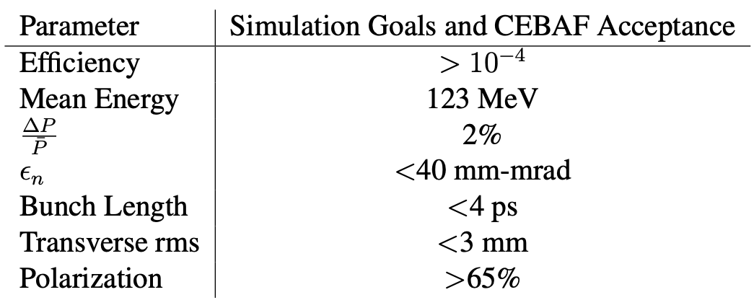
Positron Capture Beam Parameters
Ideally, two modes of operation will be possible
-Delivery of polarized positrons with an efficiency of 10e-4
-Delivery of unpolarized positrons with an efficiency of 10e-3
CEBAF North Linac acceptance values are based on simulation work done by Yves Roblin

Slide 4
Initial beam and target
Positron generated in GEANT4
W target, Z= 74
Bremsstrahlung: Z dependence ~ $Z^{2}$
Pair production: Z dependence ~ $Z^{2}$
Target Thickness= 4 mm
3 million particles
$e^{−}$ beam:
123 MeV
1 mA
Spot size 1 mm
90% polarization

Slide 5
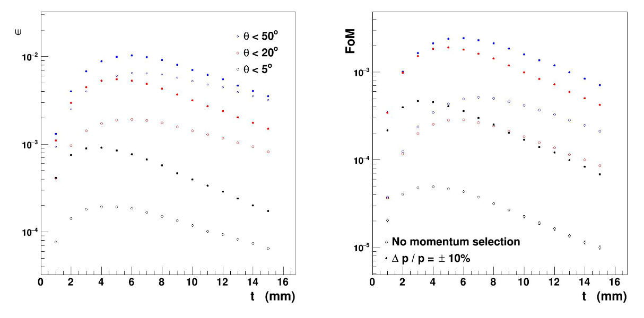
Source Target (Great work by Sami)
Efficiency FoM=${IP}^{2}$

Slide 6
Current “Best” Approach
X4
Polarized Beamline
Legend
Target
Conical Solenoid
Solenoid
Quadrupole
Dipole
Collimator/dump
RF Cavity
Unpolarized Beamline
(Additional bunching cavity)
X4

Slide 7
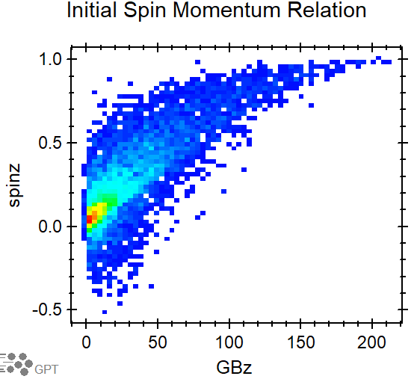
Pros and Cons (Polarized Beamline)
Solenoids vs Quads (efficiency)
Emittance controlled by collimation (energy, emit. effciency)
Initial dipole isolates particles species
Drift helps separate high from low polarization
Dipole energy selection which is good for polarization
Chicane provides bunch compression
Subsequent acceleration to 123 MeV

Slide 8
Pros and Cons (Unpolarized Beamline)
Solenoids vs Quads (efficiency)
Emittance controlled by collimation (energy, emit. effciency)
Initial dipole isolates particles species
Drift reduces efficiency, buncher helps to minimize effect
Chicane carried over form polarized concept
Subsequent acceleration to 123 MeV

Slide 9
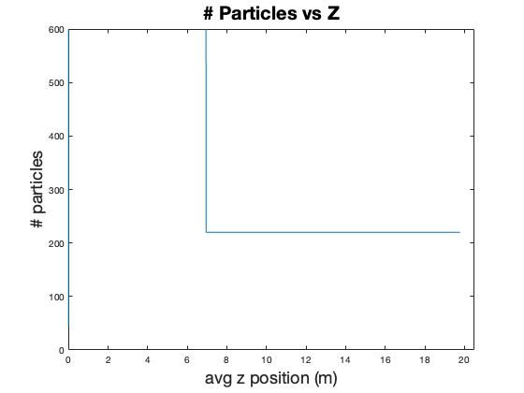
Polarized Simulation Results: Particles vs Z

Slide 10
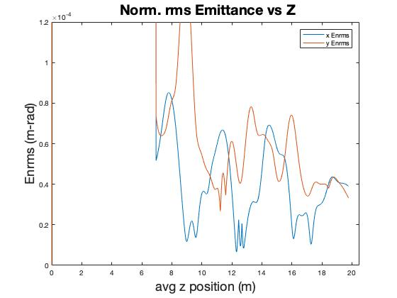
Polarized Simulation Results: Emittance vs Z

Slide 11
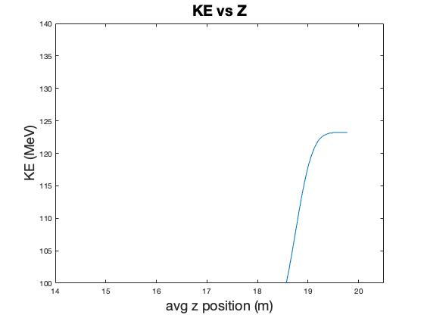
Polarized Simulation Results: Energy vs Z

Slide 12
Polarized Simulation Results: Energy Spread vs Z
Standard deviation in energy changes very little after chicane
Could reduce this with additional cavities
$\frac{∆P}{P}$ ~ 4%

Slide 13
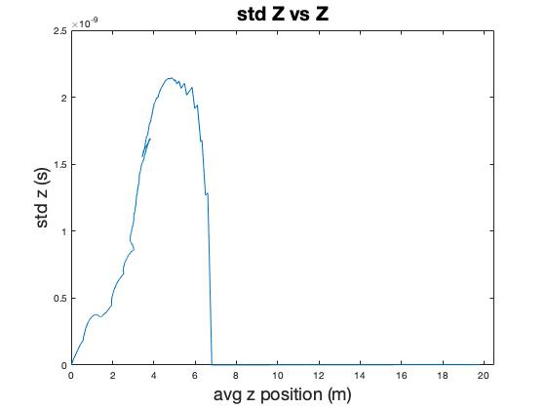
Polarized Simulation Results: Length vs Z

Slide 14
Polarized Simulation Results: Transverse Size vs Z
Primarily controlled by collimation
Following chicane, beam is no longer
Collimated (with current solenoid strength)

Slide 15
Polarized Simulation Results: Polarization vs Z
Polarization increases as low energy large emittance are collimated until final aperture that removes particles
With no further loss of particles and only acceleration from cavities, spin should remain stable

Slide 16
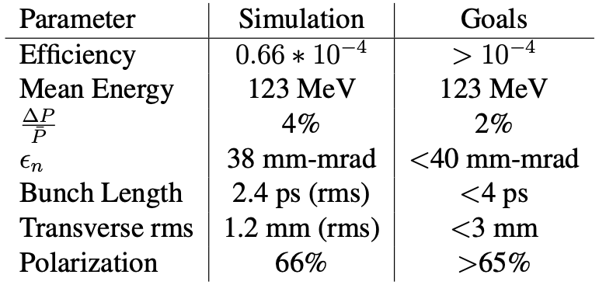
Polarized Simulation Summary
Efficiency needs to improve
Mean energy is achieved
Momentum spread needs to decrease
Emittance is acceptable
Bunch length is acceptable
Bema size is acceptable
Polarization is acceptable

Slide 17
Polarized Simulation Summary: Progress (?)
Previous:
Latest:

Slide 18
Different approach?
Maybe look at higher energy option (10-11 GeV)
Different challenges but maybe more attainable?

Slide 19
Open to questions and discussion

