Slide 1
UITF: T-cathode and Small shield
Experimental data @200 [kV]
07/07/2019
Gabriel Palacios

Slide 2
Details of experimental data
UITF gun
T-cathode and Small shield both @200 [kV]
Bulk GaAs activated with with Cs and NF₃
Data taken with BPM 201 (on top of corrector 101H&V)
Data taken with first solenoid lens

Slide 3
Comparing T-cathode to Small shield cathode
Includes fit without removing outliers
Also plots of fit slopes

Slide 4
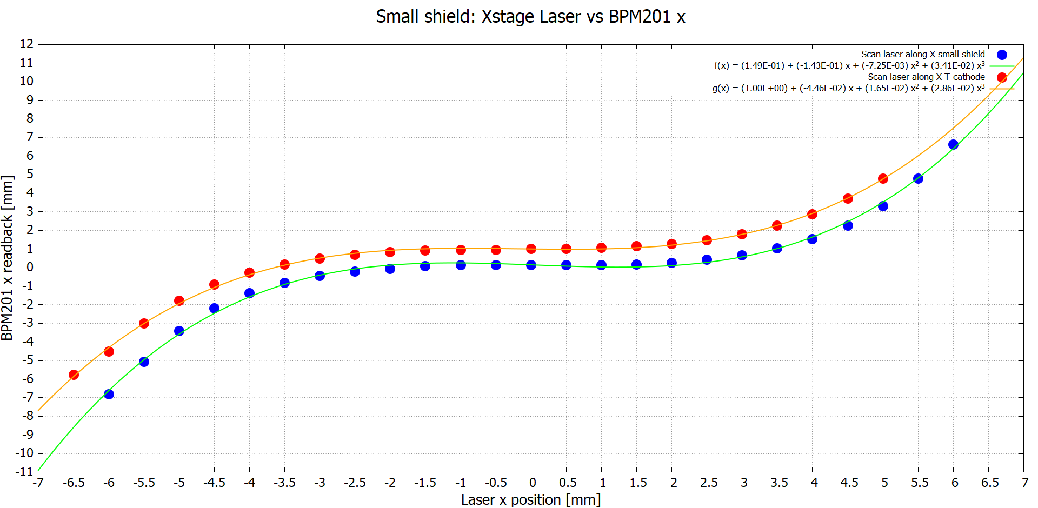
1.4 [mm] difference between: 4.7 and 3.3
0.87 [mm] difference between: 1.03 and 0.16
x-axis: If we shoot from
-3 [mm]<Photocathode< 3 [mm] we just need to correct for an extra ~1 [mm]
2 [mm] difference between: -3 and -5

Slide 5
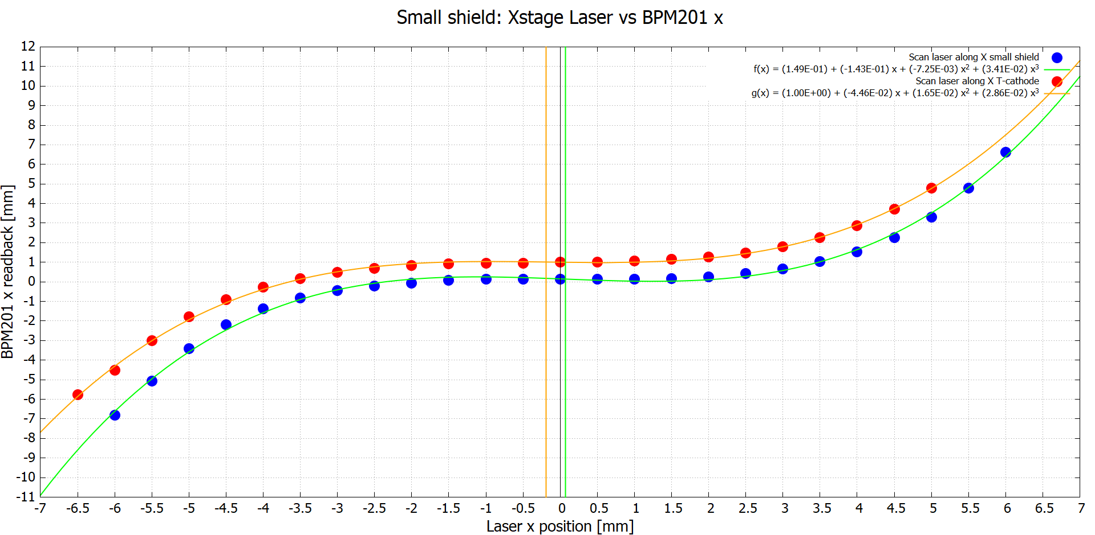
S-S inflexion point
Photocathode assumed center
T-cathode inflexion point

Slide 6
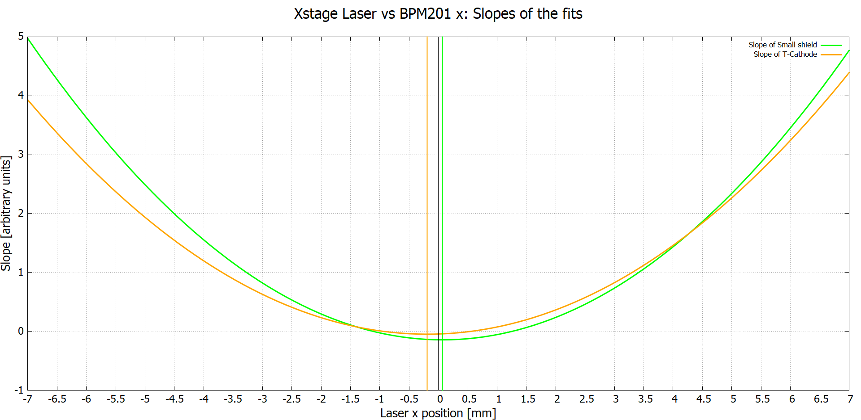

Slide 7
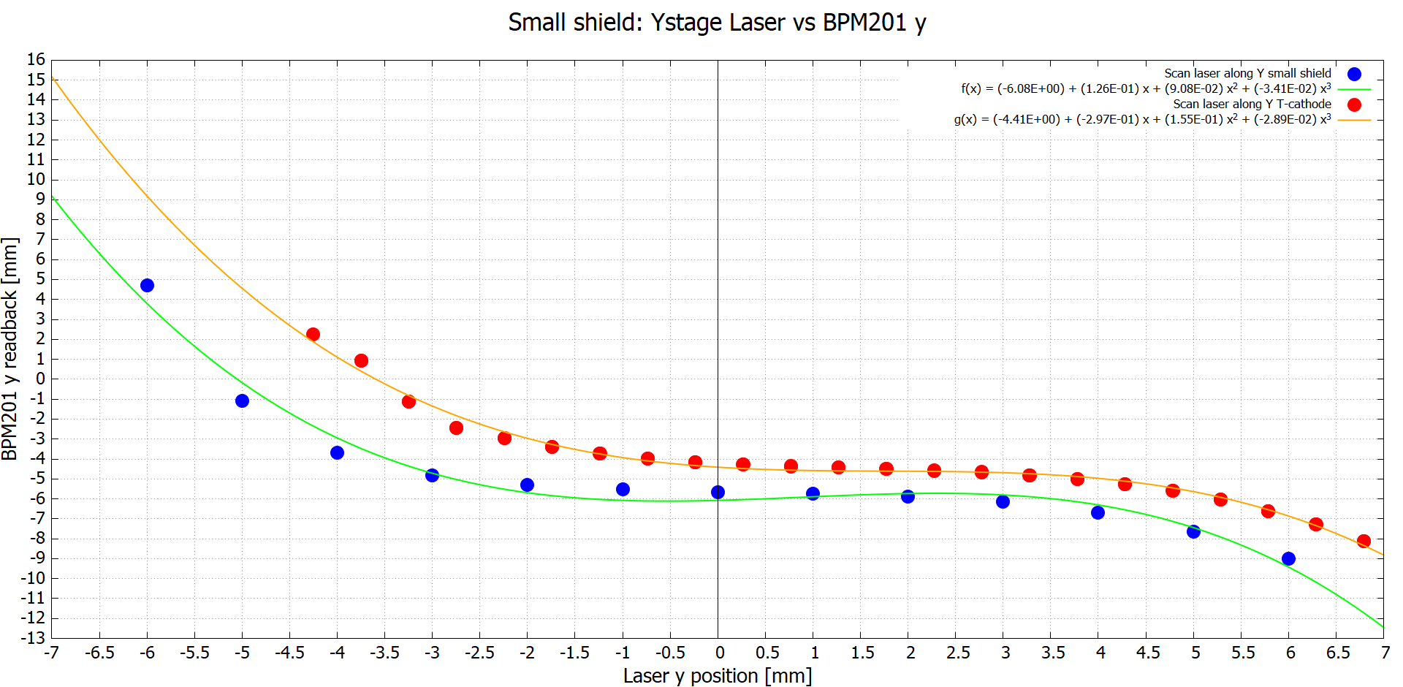
y-axis: If we shoot from
-3 [mm]<Photocathode< 3 [mm]
we just need to correct for an extra ~2.5 [mm]
NOTE: shoot from higher positions
4.6 [mm] difference between: 0.9 and -3.7
1.8 [mm] difference between: -6.7 and -4.9
1.6 [mm] difference between: -4.1 and -5.7

Slide 8
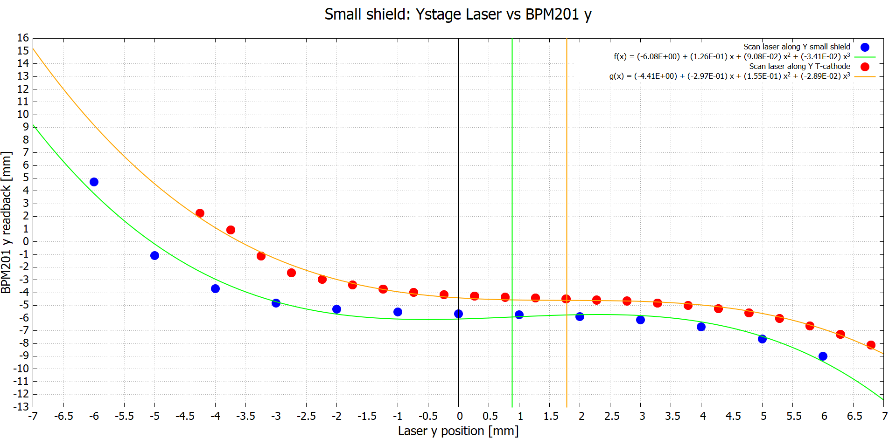
T-cathode inflexion point
Photocathode assumed center
S-S inflexion point

Slide 9
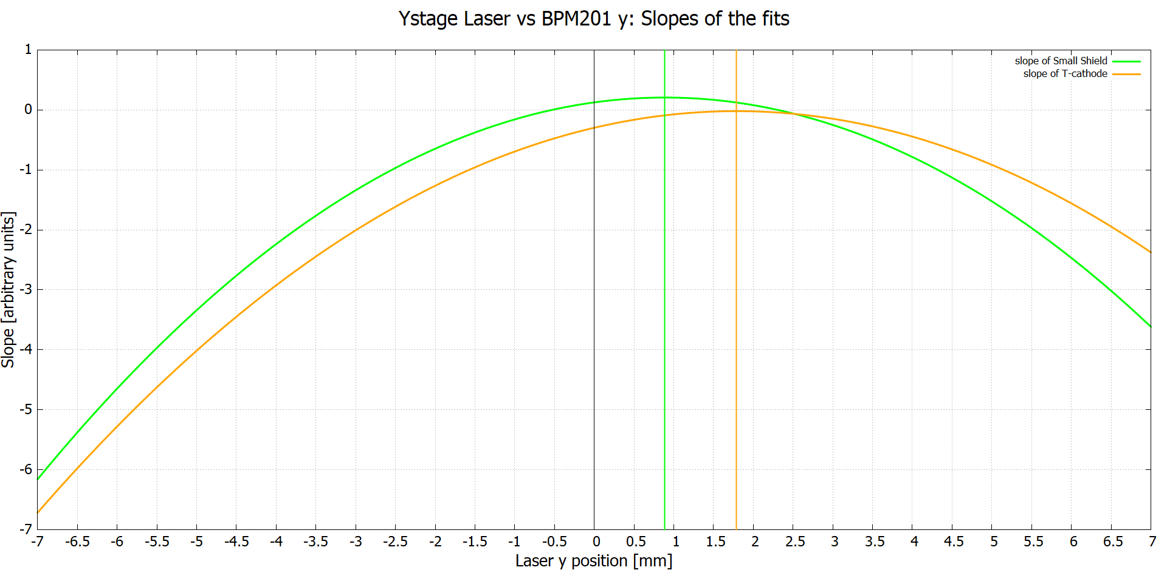
No zero!

Slide 10
Full cathode 3D BPM readbacks
*full screen to see animation*

Slide 11
Centered in solenoid lens
How much correction do we need (MBHK101H&V) to center the beam in the first solenoid lens, as we change the position of the beam along the x&y-axis of the photocathode?

Slide 12
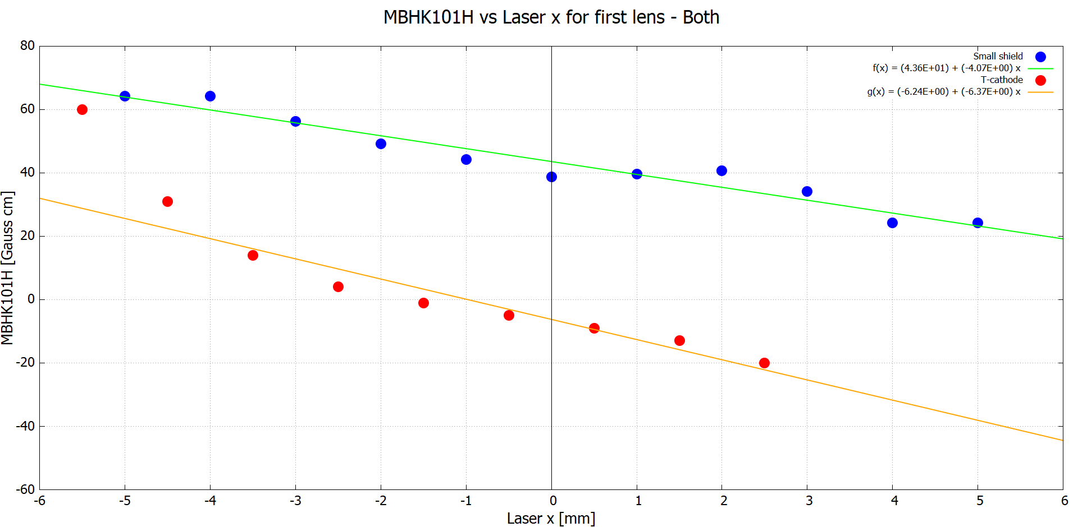
42.3 [Gauss cm] difference between: 56.2 and 13.9
43.6 [Gauss cm] difference between: 38.9 and -4.7
53.6 [Gauss cm] difference between: 33.8 and -19.8
Notice that for the T-cathode, y=1.5 [mm], not zero! :S

Slide 13
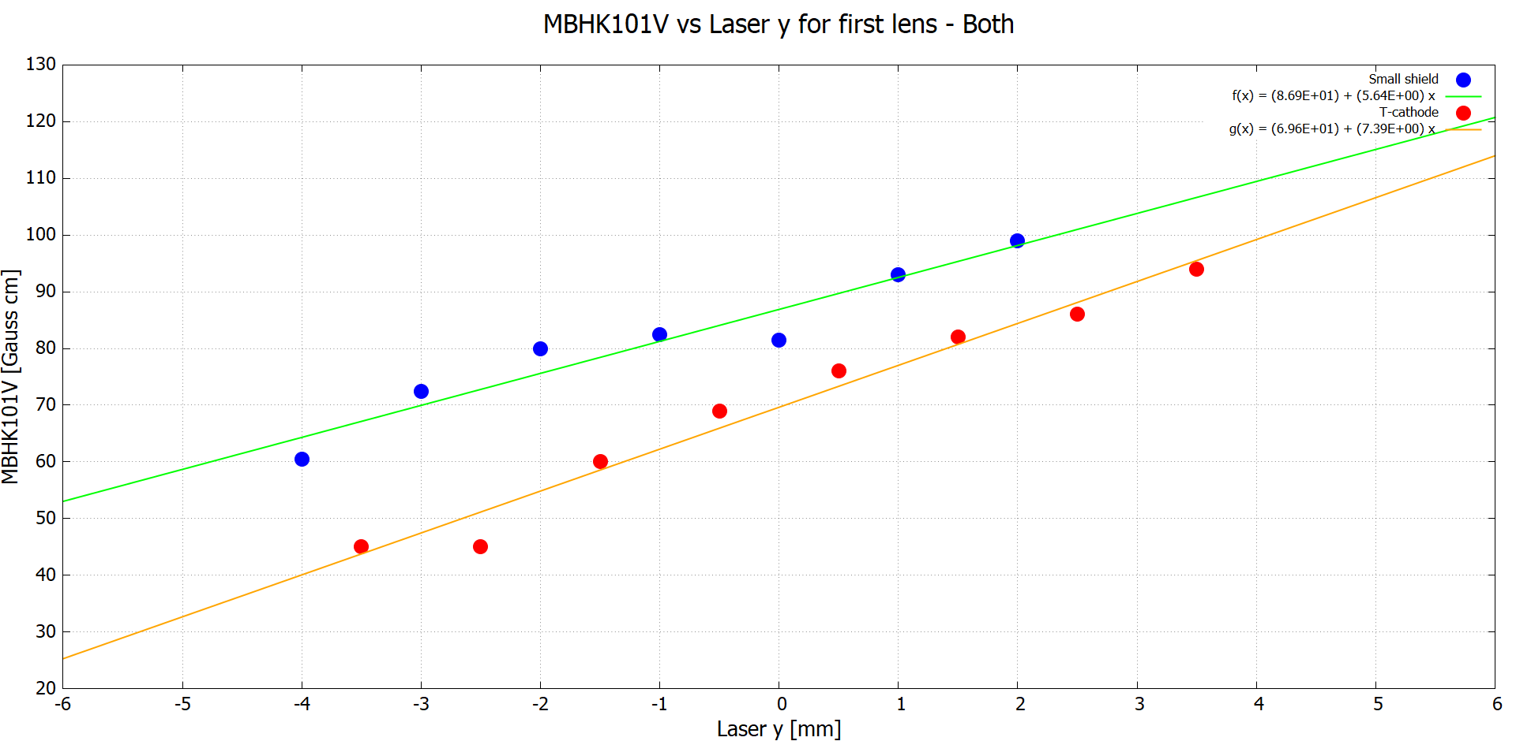
13 [Gauss cm] difference between: 69 and 82
12.6 [Gauss cm] difference between: 98.9 and 86.3
27 [Gauss cm] difference between: 72.6 and 45.0
Notice that for the T-cathode, x=-1.5 [mm], not zero! :S

Slide 14
Conclusions
Horizontal BPM
The SS has a slight left-kick. It would require correction for 1 mm extra.
The shield seems to bring electrostatic center closer to PC center and reduce asymmetry.
Vertical BPM
The SS has a worst down-kick. This was already present at the T-cathode. Requires correction for ~2.5 mm extra.
The shield seems to bring electrostatic center closer to PC center exacerbate asymmetry.
Solenoid centering method would need more testing.
Not apples-to-apples.
Small number of data points due to Dithering issues.
User errors.
RECALL: Electrostatic simulations show SS has better electric field around triple-point (due among other things to insulator shape, triple-point curvature) than T-cathode!
Better than bigger shield for sure!
Field emission / HV processing was better or worst?
I’ve heard better emittance for big shield (?) Simulations inconclusive yet.

Slide 15
Fin

Slide 16
Extras
XY-stage steps to mm
S&A

Slide 17
12 [mm] radius photocathode.
6000 [steps] in x-axis
6000 [steps] in y-axis
Then $\frac{12 [mm]}{6000 [steps]}=0.002\frac{[mm]}{[steps]}$

Slide 18
Corrected positions according to S&A

Slide 19
Corrected positions according to S&A
BPM201
Photocathode
12.6 mm
BPM203
x
7.5 mm
3.6 mm
z

Slide 20
Corrected positions according to S&A
BPM203
BPM201
1.2mm
y
0.3mm
z
0.6 mm
Photocathode

Slide 21
Corrected positions according to S&A

Slide 22
Corrected positions according to S&A
BPM201
Photocathode
12.62 mm
BPM203
x
7.52 mm
3.62 mm
z

Slide 23
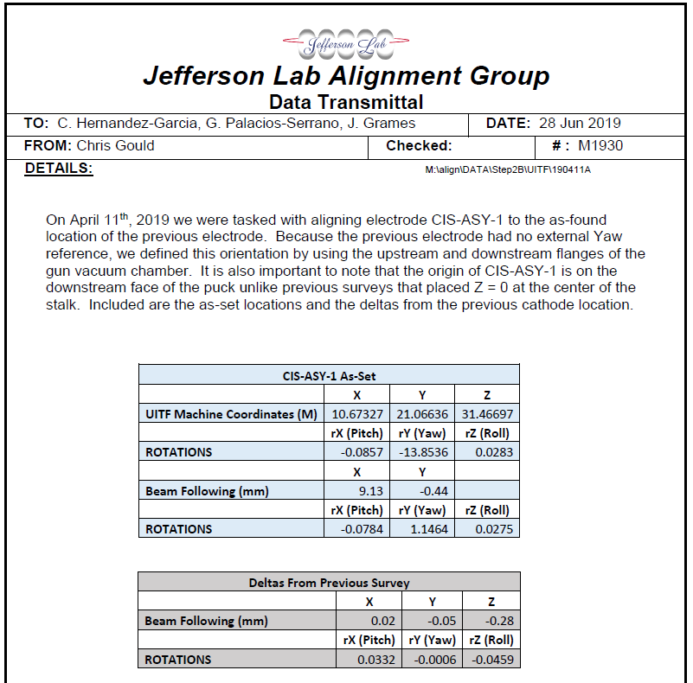
Corrected positions according to S&A
BPM203
BPM201
1.15 mm
y
0.25 mm
z
0.65 mm
Photocathode

Slide 24
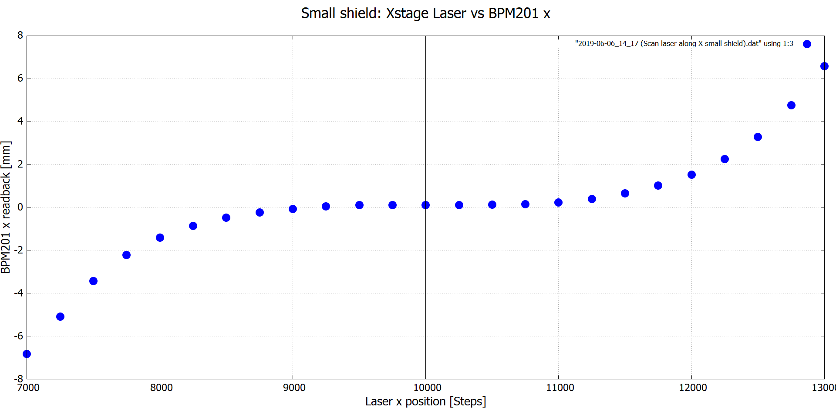
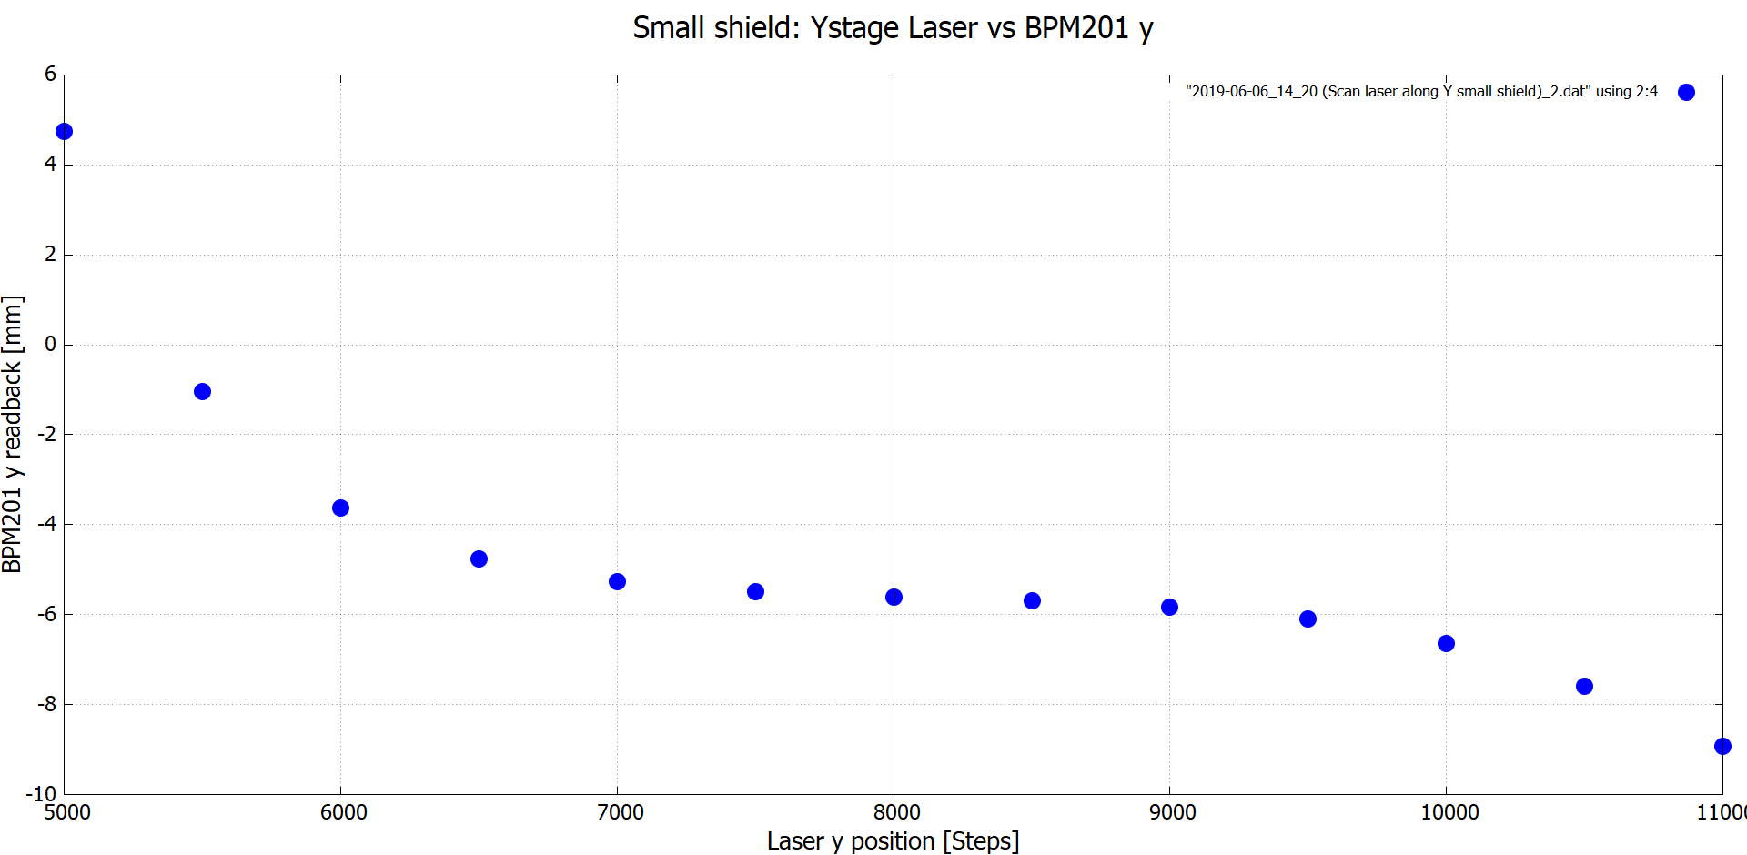
Remove the ones marked by red arrows for the fit?
Original
Bona fide results inside the saturation interval:
-6 [mm]<BPM201 x< 6[mm]
-6 [mm]< BPM201 y< 6[mm]

Slide 25
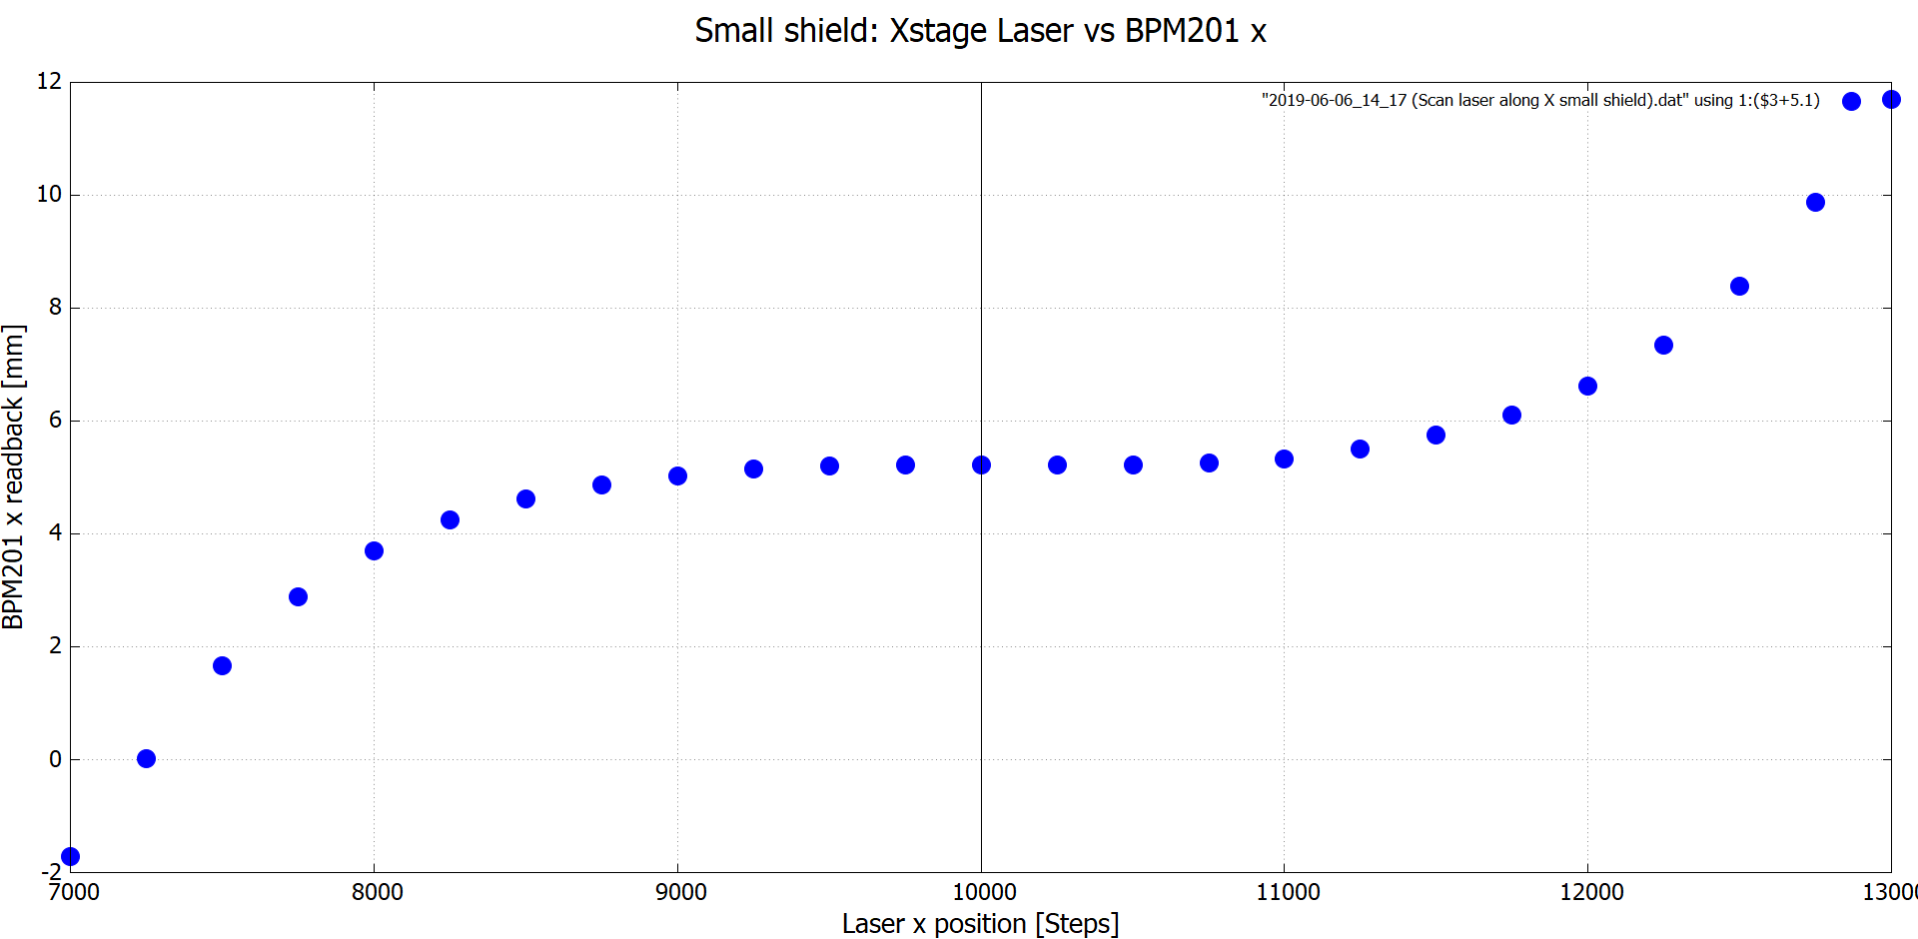
Relative to BFS*
Overcorrected!
Bona fide results inside the saturation interval:
-6 [mm]<BPM201 x< 6[mm]
-6 [mm]< BPM201 y< 6[mm]
* Click here for BFS

Slide 26
Recall
Just a recap of the simulations

Slide 27
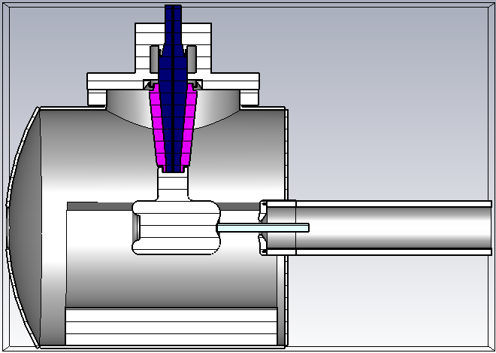
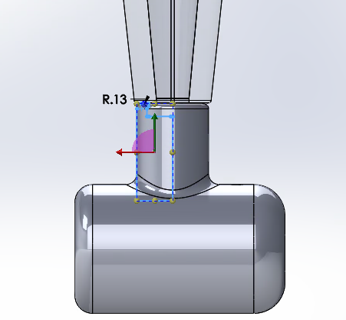
Models: T-cathode

Slide 28
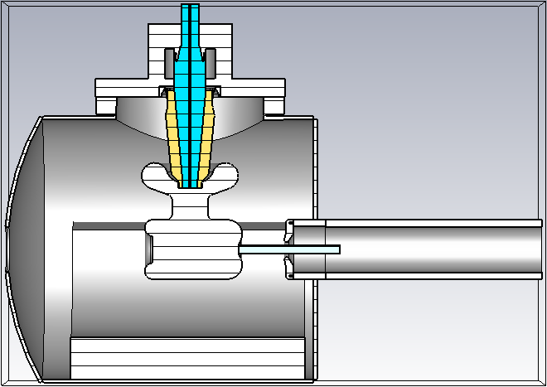
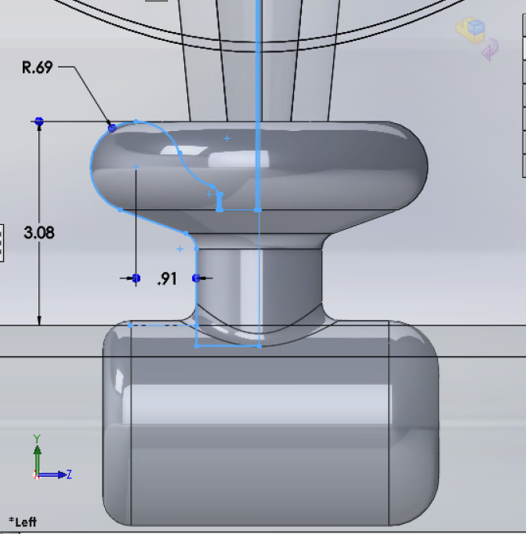
Models: Mushroom

Slide 29
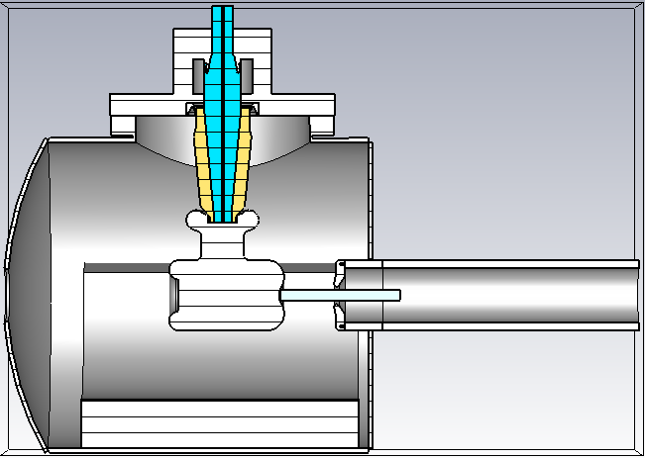
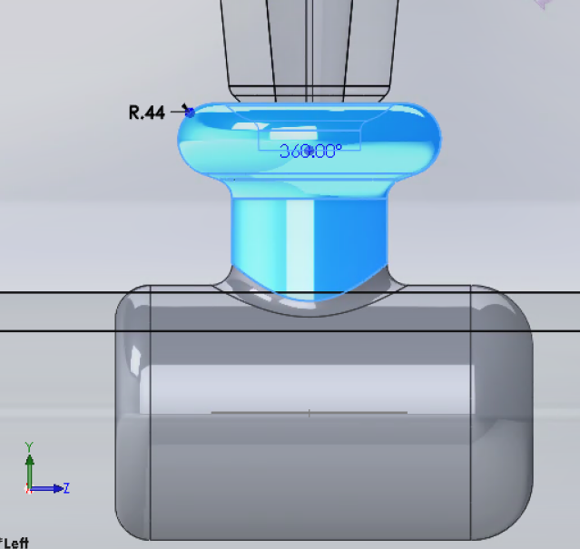
Models: Small mushroom

Slide 30
CST results: Transverse electric field at C-a gap axis
All the data sets correspond to the center line in the cathode-anode gap. Different colors represent different shields.
~12% difference between 0.17 and 0.15
~53% difference between 0.17 and 0.08

Slide 31
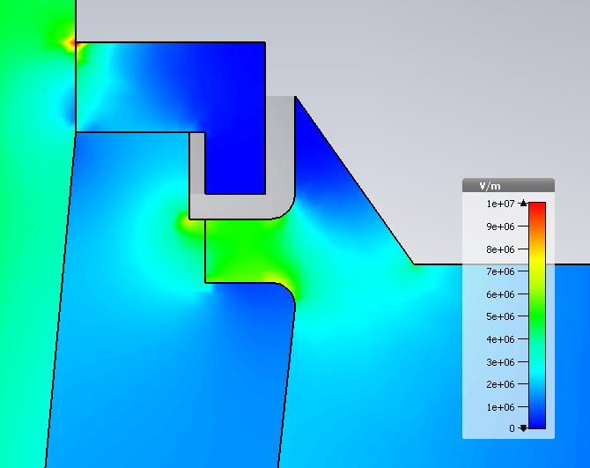
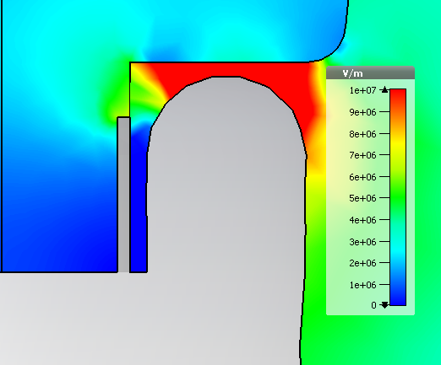
CST results: Electric field norm– No shield
Triple points:
Upper flange:5MV/m
29MV/m at cusp
Triple points:
Cathode: 3.6MV/m
6.5MV/m
7.9MV/m
4.87 MV/m

Slide 32
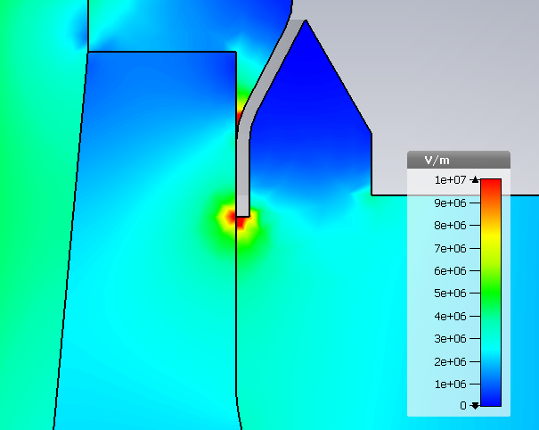
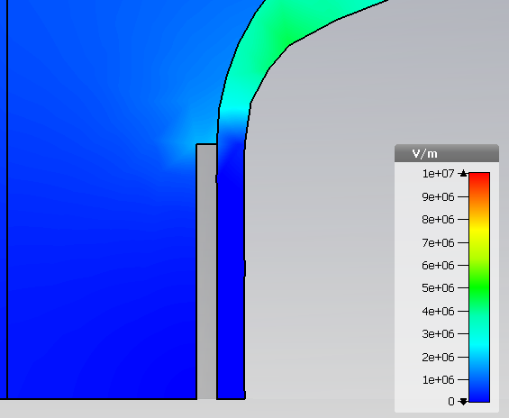
CST results: Electric field norm– original shield
Triple points:
Upper flange:10MV/m
7.2MV/m
5.6MV/m
Triple points:
Cathode: 0.6MV/m
7.9MV/m
4.85 MV/m

Slide 33
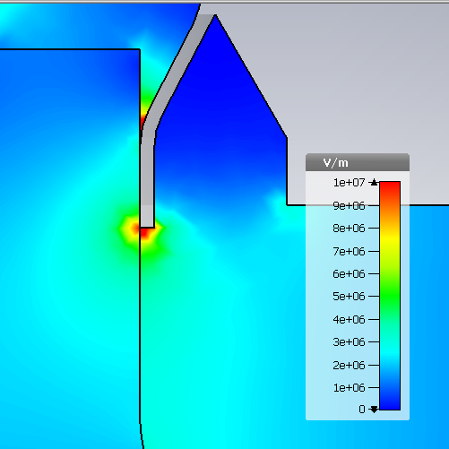
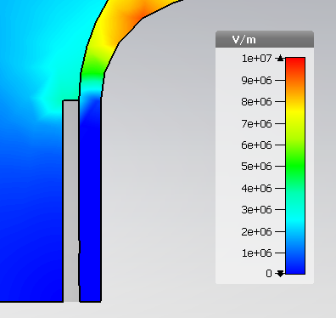
CST results: Electric field norm– Shield 8
Triple points:
Upper flange:11MV/m
7.9MV/m
6.5MV/m
Triple points:
Cathode: 1.2MV/m
8.08MV/m
4.86 MV/m

Slide 34
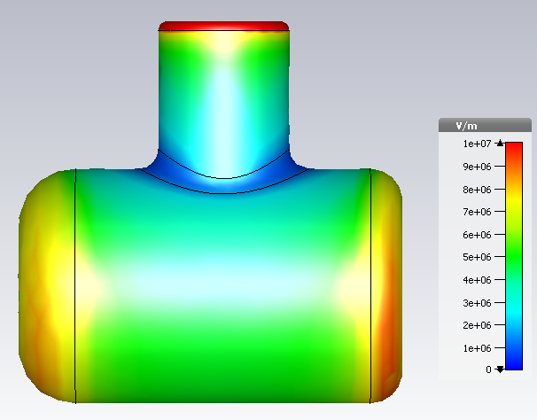
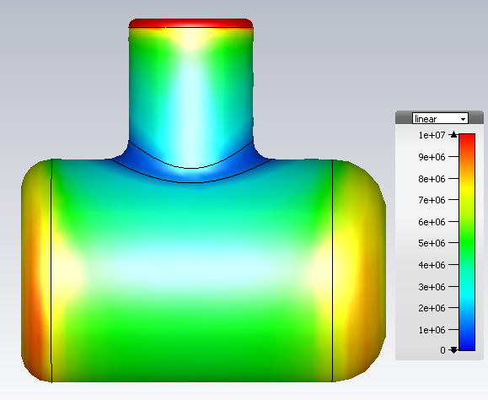
CST results: Electric field norm– T-shape

Slide 35
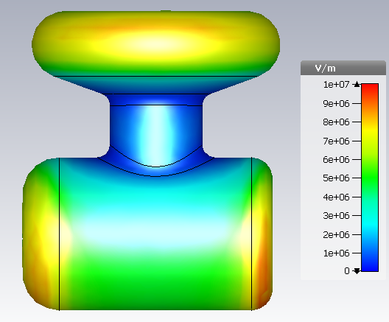
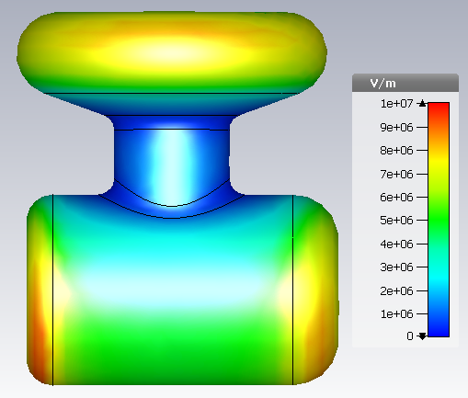
CST results: Electric field norm– Mushroom

Slide 36
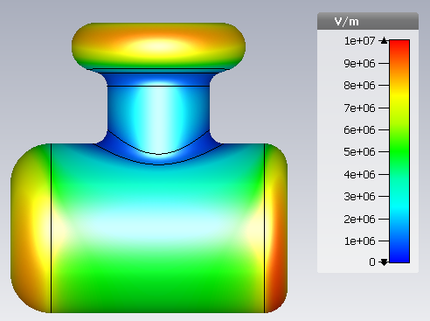
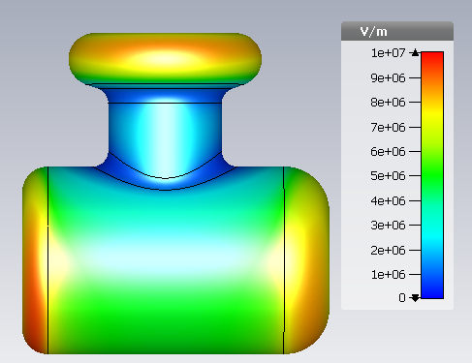
CST results: Electric field norm– Shield 8

