Slide 1
Agenda
Background/Objective
HDice Mode 2 (Normal Lab Operations) Helium Supply Decision
Hdice UITF Testing “Mode 1” Helium Supply for Operations
Options (Dewars or Transfer Line)
Cost Comparison & Assumptions
Pro & Cons of Each
Path Forward for “Mode 1” Operational Supply

Slide 2
Background/Objective
Helium supply to the Hdice target during UITF test runs needed resolution.
Filling dewars from our refrigerators ruled out as too costly which left two options:
Transfer line from CTF
Dewars from a helium supplier
Bulk Helium contract was up for renewal in Feb ‘16
Opportunity taken to ask for pricing on liquid helium delivered in 250/500L dewars for both Hdice lab operations (Mode 2) and UITF testing (Mode 1).
I have the numbers and would like to make decisions on the path forward for both lab operations and UITF testing so we can commit the necessary manpower and let our intentions be known with the vendor.

Slide 3
Mode 1&2 Costs
Item No. | Description | Estimated Quantity | Unit | Unit Price | Total Amount
1. | MODE #1: SEE TECHNICAL 2.7.3.1 SPECIFICATION FOR LIQUID HELIUM GAS DOCUMENT
 | YEAR #1 | 25,000 | Liters | $8.39 | $209,750.00
 | YEAR #2 | 25,000 | Liters | $8.56 | $214,000.00
 | YEAR #3 | 25,000 | Liters | $8.99 | $224,750.00
 | DEWAR RENTAL FEE (IF APPLICABLE) |  |  | $10.00/Day 28-Days/2-Free | $280.00/Month
2 | MODE #2: SEE TECHNICAL 2.7.3.1 SPECIFICATION FOR LIQUID HELIUM GAS DOCUMENT
 | YEAR #1 | 12,000 | Liters | $8.39 | $100,680.00
 | YEAR #2 | 12,000 | Liters | $8.56 | $102,720.00
 | YEAR #3 | 12,000 | Liters | $8.99 | $107,880.00
 | DEWAR RENTAL FEE (IF APPLICABLE) |  |  | $10.00/DAY 28-Days/2-Free | $280.00/Month

Slide 4
Hdice Lab Operations Helium Supply
If we change to this supplier I need to know:
When do we want to make the change (Not before ~April 1)
Cost code: ICEOPS PHALLB
Point of contact for the supplier: Andy
Notes:
Quantity for Mode 2 is ~4k liters/yr for second 2 yrs, first year is 12k liters

Slide 5
Supply to Hdice Testing at UTIF
Options (Currently being considered)
Vendor supplied 500L Dewars
Transfer line from CTF starting at ¼ CM to fill the 500L Hdice buffer dewar
Cost Comparison:
Labor dollars are loaded for TL work
Assumed 3 target runs per year
Tests are 5.3 wks (equivalent) in duration @ 256liters/day
2/3^{rds} of the gas is recovered for use as makeup gas at the Lab’s refrigerators
Spreadsheet Results

Slide 6
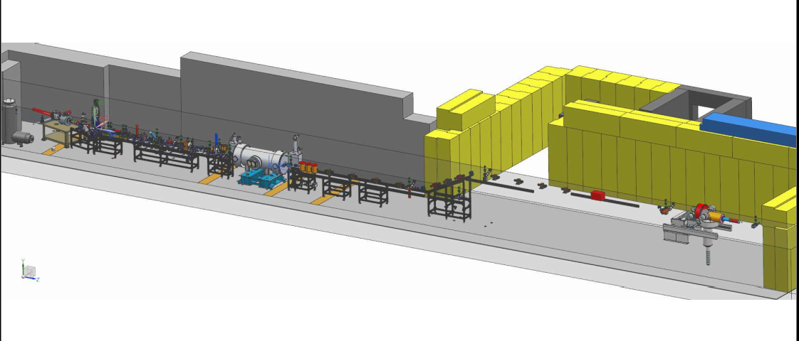
Design work was stopped…would like it to continue

Slide 7
Pros/Cons
Transfer Line:
Pros:
Don’t have to deal with dewar swaps
No filling efficiency loss
Lower manpower demands on Hdice staff
Cons:
Labor to engineer/design/fabricate is currently heavily taxed by other projects: (Operations, UITF, 12GeV, FRIB)
Added load to CTF operations on UITF
No clear long term use of TL after Hdice testing
Dewar Transfers:
Pros:
Minimizes impact on cryo manpower
No added load to CTF operations
Drops burden on CTF from 6 to 3 wks per run
Cons:
Dewar swap labor & dewar handling risks
Possibility of contamination from vendor
Costs?

Slide 8
Path Forward for Hdice UTIF Testing
??

