Slide 1
14” 200 kV gun
Exploring the anode location to cancel vertical kick
Gabriel Palacios
gabrielp@jlab.org 07/23/2021

Slide 2
Models
Started from the GTS model I’ve been using for all our simulations.

Slide 3
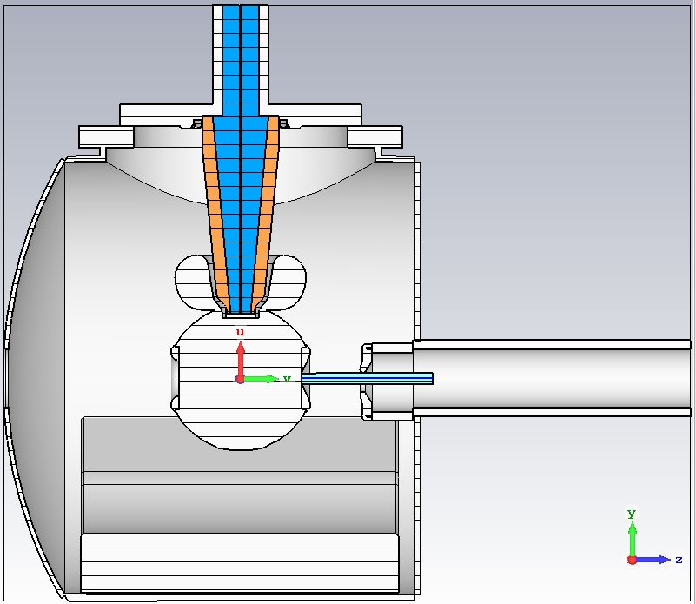
Model
This is the model with the so-called “CEBAF anode” and 6 cm cathode-anode gap.
I created a line between the photocathode surface and the anode, The line is on the x,y plane and runs from called “curve1”.
Material and settings are the same as before:
Closed boundaries everywhere except top and z >0
Alumina for insulator and rubber for cable.
Moveable anode
Curve1 along z-axis

Slide 4
Electrostatics
Imported the model to CST, then ran the CST EM studio with -200 kV at the cathode

Slide 5
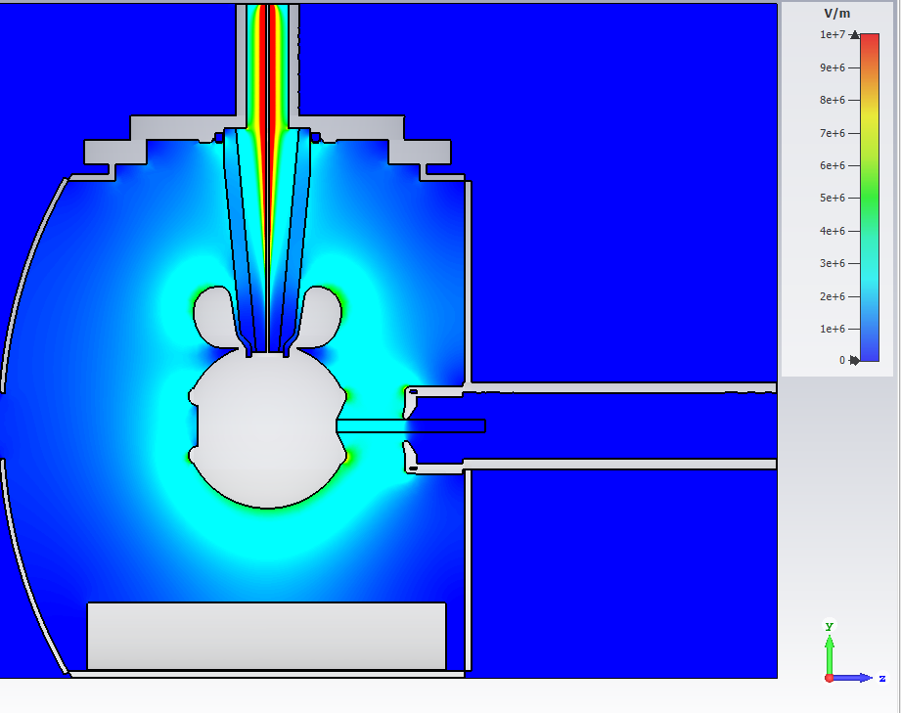
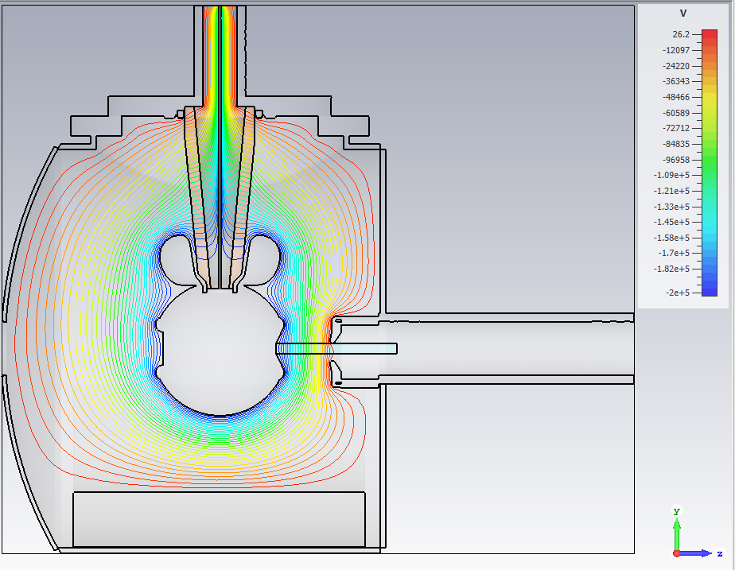
Electrostatics

Slide 6
GPT
Qbunch -1e-12 # C
XYrms 0.5e-3 # m
Space charge off?
I exported the field maps and use them as inputs in the GPT deck for the GTS gun with Dr. Sajini’s parameters, then obtained the dynamics and plotted the average position (of the particles) as a function of different positions of the anode along the y-axis

Slide 7
GPT: Average beam position

Slide 8
GPT: Average beam position

