Slide 1
GPT/IBSimu SEY Distribution Comparison
Josh Yoskowitz

Slide 2
Simulation Parameters
Using SEY initial distribution from Cristhian & Ricardo
Total charge: 0.5 nC
Total macro particles: 99450
Using E-field map for the photogun and B-Field maps for the correctors & solenoid with the usual strengths
No ionization, SEY routine, space charge, etc.
Purpose: To compare the screen and orbit data between GPT and IBSimu given that the SEY initial distribution leaves the photocathode all at once.

Slide 3
GPT Simulation

Slide 4
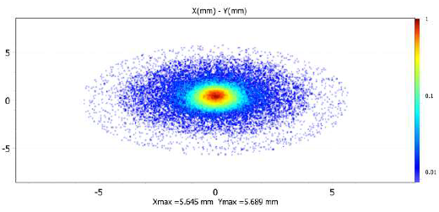
Screen data comparison at z=0.0001m (at PC): XY
GPT
IBSimu

Slide 5
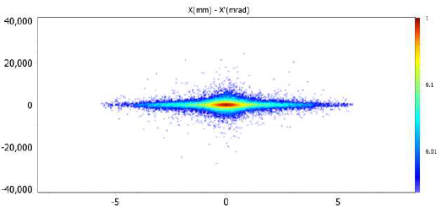
Screen data comparison at z=0.0001m (at PC): XX’
GPT
IBSimu

Slide 6
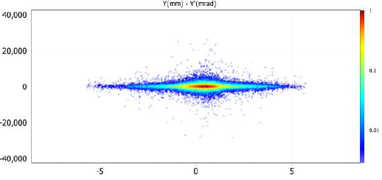
Screen data comparison at z=0.0001m (at PC): YY’
GPT
IBSimu

Slide 7
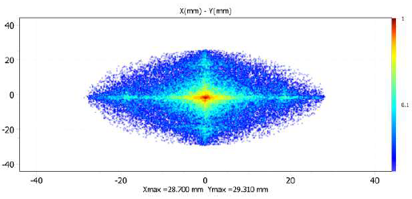
Screen data comparison at z=0.135m: XY
GPT
IBSimu

Slide 8
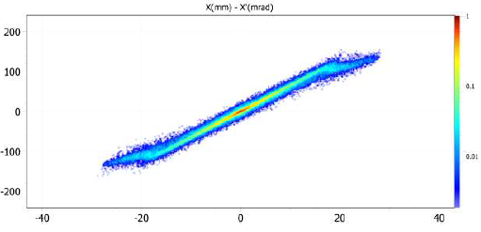
Screen data comparison at z=0.135m: XX’
GPT
IBSimu

Slide 9
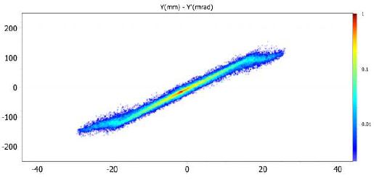
Screen data comparison at z=0.135m: YY’
GPT
IBSimu

Slide 10
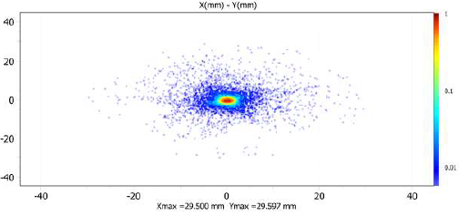
Screen data comparison at z=1.5m: XY
GPT
IBSimu

Slide 11
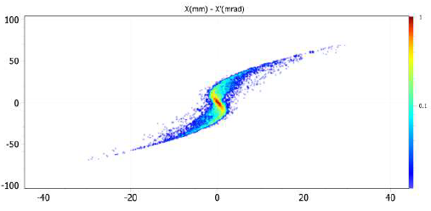
Screen data comparison at z=1.5m: XX’
GPT
IBSimu

Slide 12
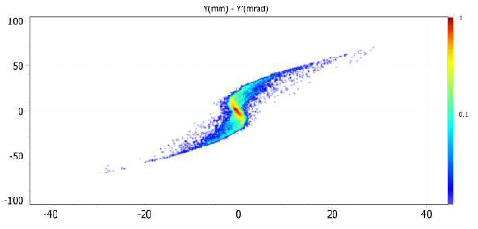
Screen data comparison at z=1.5m: YY’
GPT
IBSimu

Slide 13
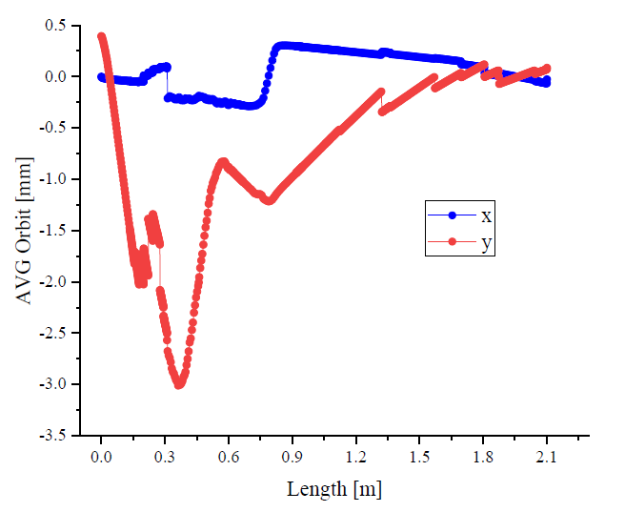
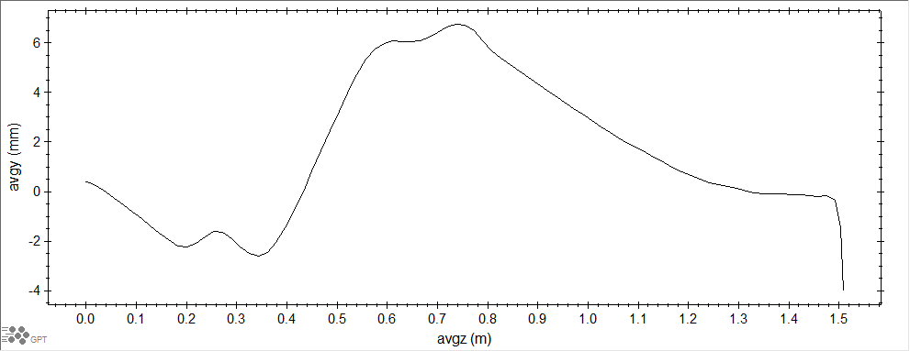
Orbit Data – Avg X&Y vs Avg Z
GPT
IBSimu

Slide 14
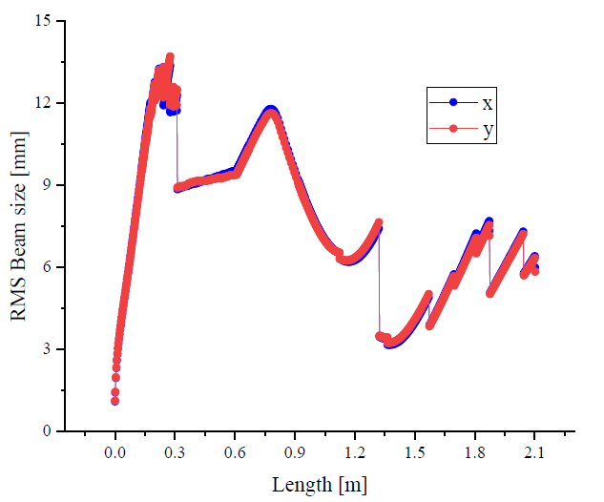
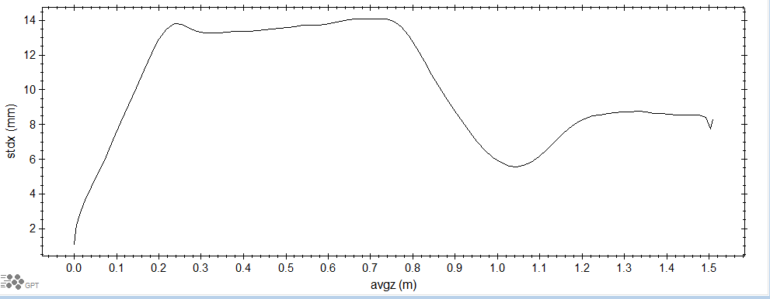
Orbit Data – RMS X&Y vs Avg Z
GPT
IBSimu

Slide 15
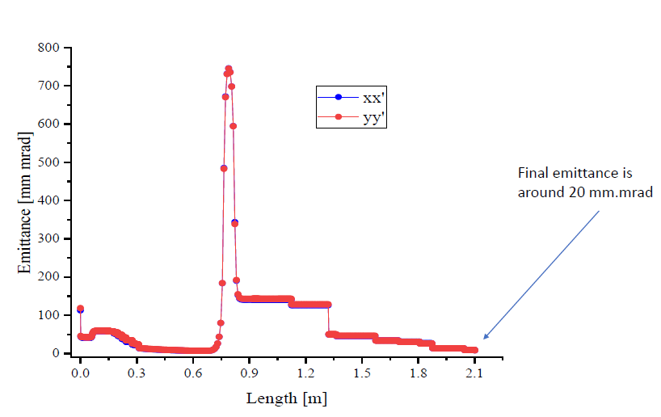
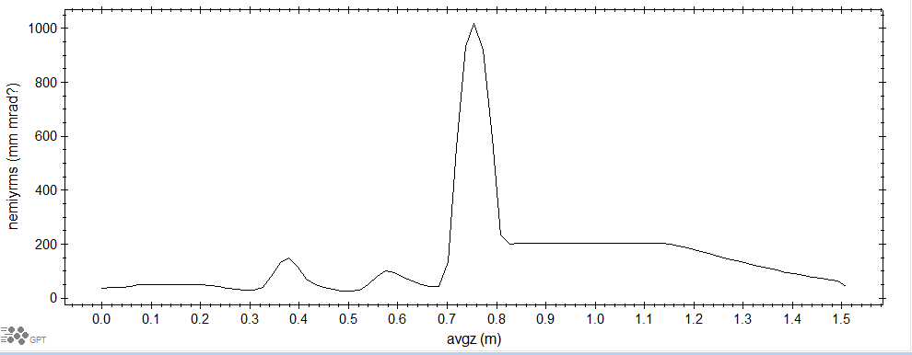
Orbit Data – Norm Emittance X&Y vs Avg Z
GPT
IBSimu

