Slide 1


Electron Sources at JLab
Future Trends for Photoelectron Guns at Accelerators
M. Poelker, P. Adderley, D. Bullard, J. Grames, J. Hansknecht,
C. Hernandez-Garcia, M. Stutzman, R. Suleiman, S. Zhang
Students: M. BastaniNejad, E. Forman, Md. Abdullah A. Mamun
VII Congreso Internacional de Ingeniería Física, November 24-28, 2014
Universidad Autónoma Metropolitana
Matt Poelker, Jefferson Lab
Notes:
Interior Page Design 2

Slide 2
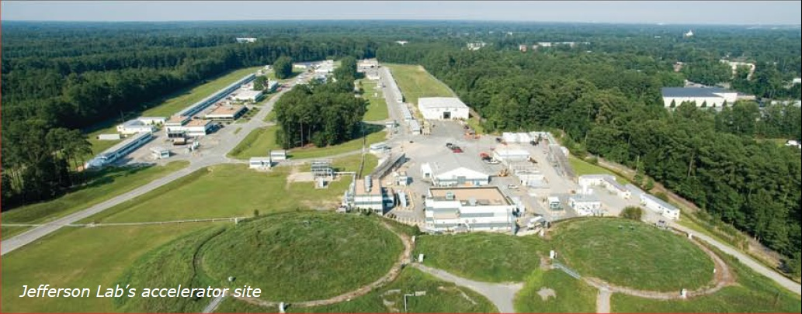
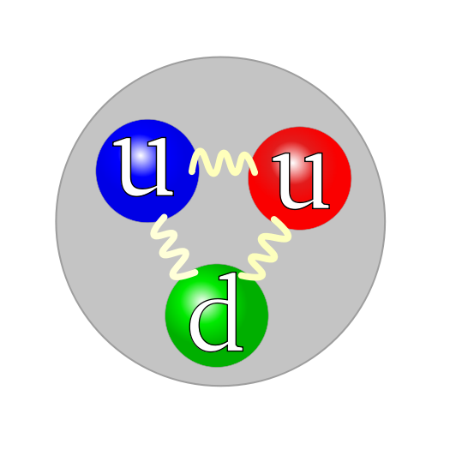
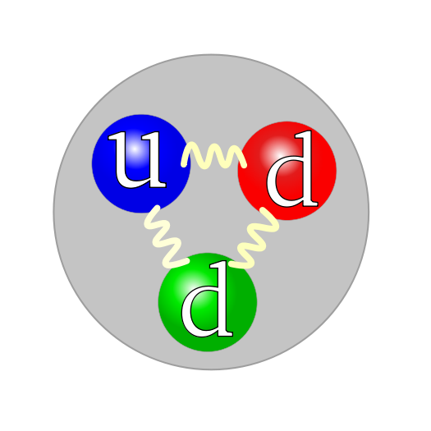
Things we’ve been Studying
Electron
Proton
Neutron
Matt Poelker, Jefferson Lab
Notes:
Interior Page Design 2

Slide 3
CEBAF – Just a big Microscope
Continuous Electron Beam Accelerator Facility
A B C A B C
two SRF Linacs
1497 MHz
111 ps
RF Synchronous
Lasers
499 MHz,
ΔФ = 120°
A
B
C
B
A
RF Separators
499 MHz
A
B
Pockels Cell
C
C
Gun
Photoemission from GaAs photocathode
Matt Poelker, Jefferson Lab
Notes:
Interior Page Design 2

Slide 4
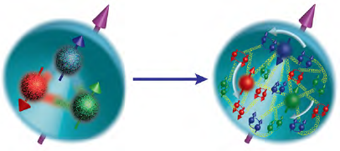
Energy Upgrade: 12 GeV CEBAF
deBroglie taught us that particles travel with a wavelength given by λ = h/p
To probe matter of size, A, the probe must have a
wavelength at least this size or smaller…
That’s why we want high energy accelerators: to give our probes large momentum, and therefore small wavelength, to resolve small things
YES, this works !
NO, this doesn’t work !
λ
A
A
λ
1.75 fm
Matt Poelker, Jefferson Lab
Notes:
Interior Page Design 2

Slide 5
What do we do with CEBAF?
Investigate the powerful force fields believed to be responsible for quark confinement: one of the major gaps in our understanding of nature
Understanding the quark and gluon structure of the proton, the neutron, and atomic nuclei at the most basic quantum level
Exploring the limits of our understanding of nuclear structure and the nucleon-nucleon force at short distances
Searching for new physics beyond the Standard Model of nuclear and particle physics
Advance technology that might benefit humankind
Matt Poelker, Jefferson Lab
Notes:
Interior Page Design 2

Slide 6
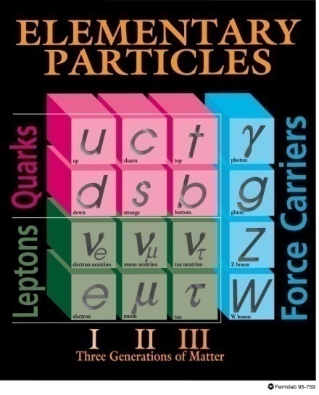

The Standard Model
Too many free parameters (masses, mixing angles, etc.)
No explanation for the 3 generations of leptons, etc.
Not enough CP violation to get from Big Bang to today’s world
No gravity (dominates dynamics at planetary scales)
No dark matter (essential for understanding galactic-scale dynamics)
No dark energy (essential for understanding expansion of the universe)
The Standard Model is only part of a larger model!
+ gravity
+ dark matter
+ dark energy
Matt Poelker, Jefferson Lab
Notes:
Interior Page Design 2

Slide 7
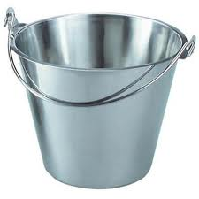
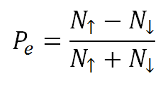
Spin Polarized Electrons
Probing with spin tells us something
Target
We measure an experimental asymmetry related to physics properties of target
Matt Poelker, Jefferson Lab
Notes:
Interior Page Design 2

Slide 8
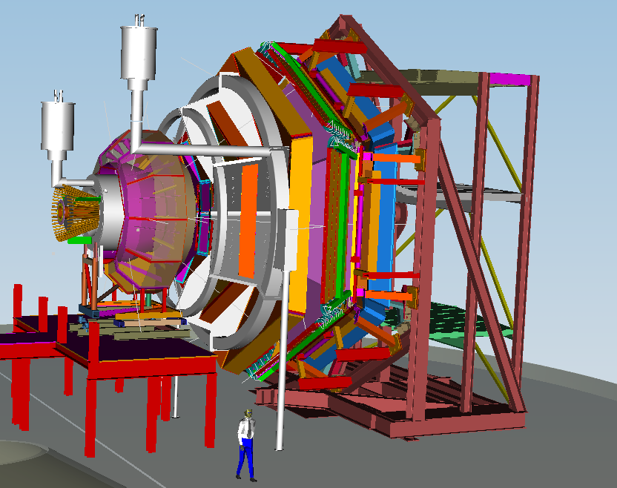
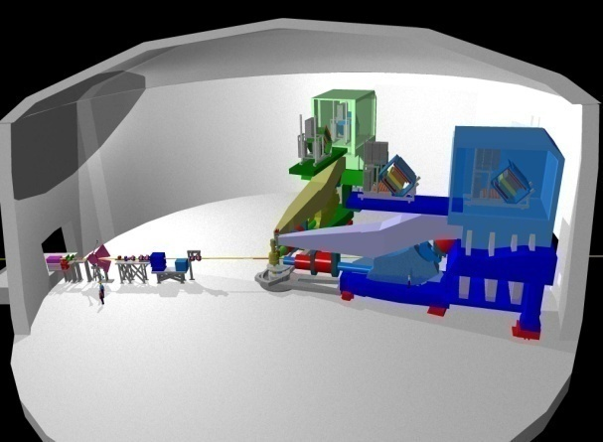
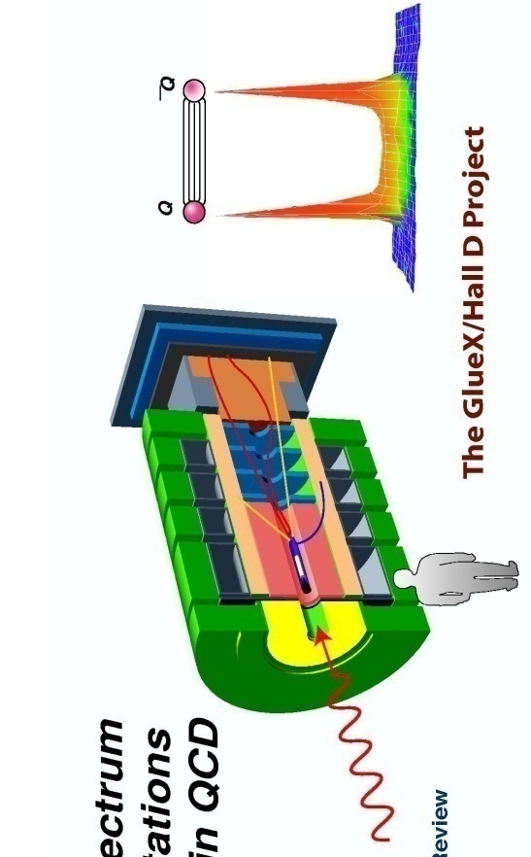
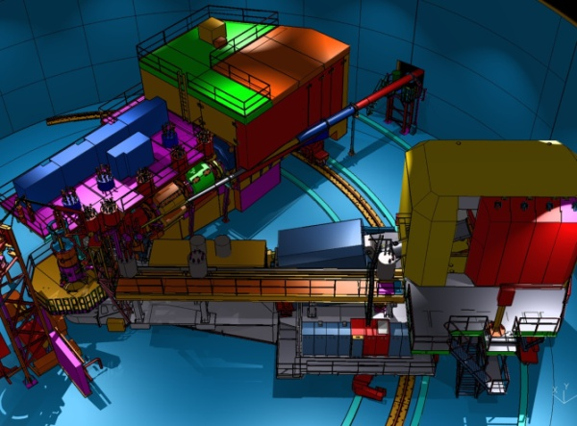
Scientific Capabilities by Hall
Three Halls Need Polarized Electron Beam!
Hall A – short range correlations, form factors, hyper-nuclear physics, parity violation experiments to test the Standard model
Hall B – understanding nucleon structure via generalized parton distributions
Hall C – precision determination of valence quark properties in nucleons and nuclei
Hall D – exploring origin of confinement by studying exotic mesons
Matt Poelker, Jefferson Lab
Notes:
Interior Page Design 2

Slide 9
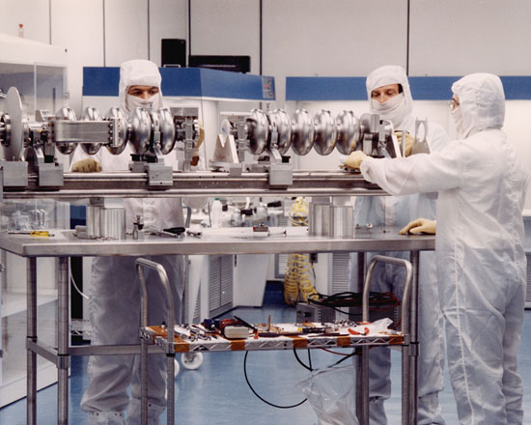
How to make the electrons “powerful” ?
Give them energy using radiofrequency waves !!!
Decelerating
Debunching
Bunching
Accelerating
So only a portion of the RF cycle is good for accelerating e-beam
Matt Poelker, Jefferson Lab
Notes:
Interior Page Design 2

Slide 10
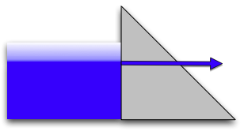

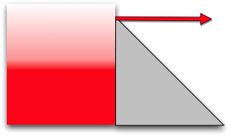

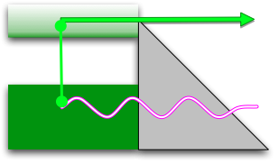

The Canonical Emission Equations
slide courtesy of Dr. K. Jensen, Naval Research Laboratory
Field Emission
Fowler Nordheim
E.L. Murphy, and R.H. Good,
Physical Review 102, 1464 (1956).
Thermal Emission
Richardson-Laue-Dushman
C. Herring, and M. Nichols,
Reviews of Modern Physics 21, 185 (1949).
Photoemission
Fowler-Dubridge
L.A. DuBridge
Physical Review 43, 0727 (1933).
Listed chronologically
Matt Poelker, Jefferson Lab
Notes:
Interior Page Design 2

Slide 11
No Perfect Electron Source
Which electron source you choose depends on your accelerator requirements
Sometimes you can choose between different sources (DC vs RF), sometimes your options are very limited (polarized = photoemission)
Each source has purported advantages and disadvantages
Electron source technology is mature, but fortunately many good problems still need be solved
Matt Poelker, Jefferson Lab
Notes:
Interior Page Design 2

Slide 12

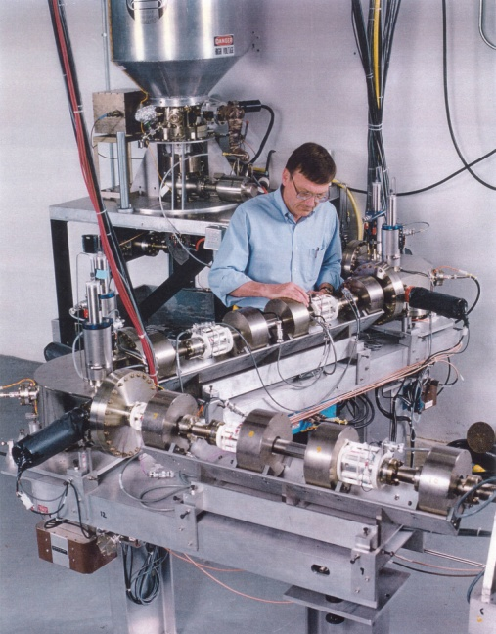
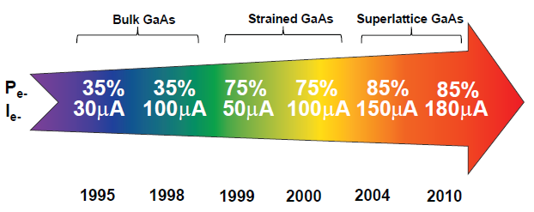
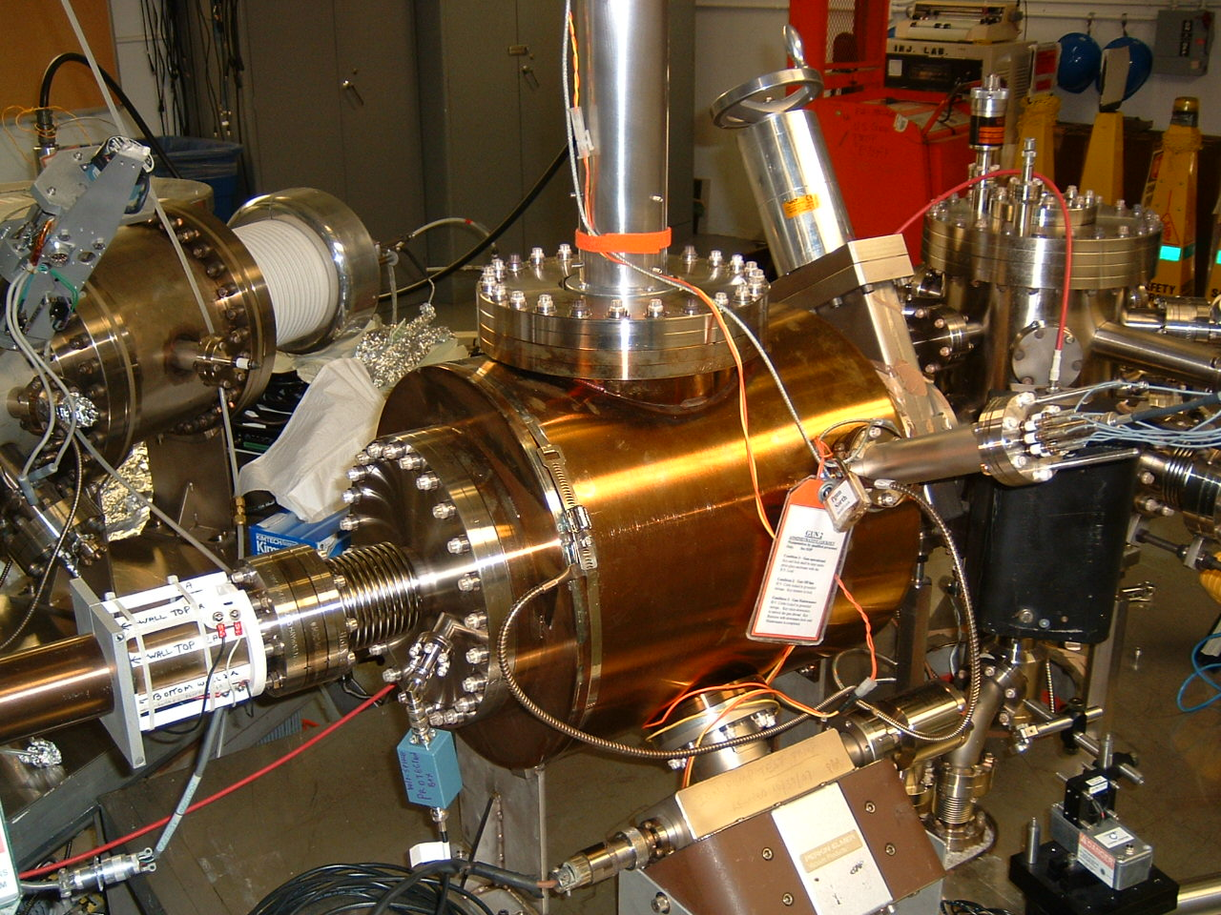
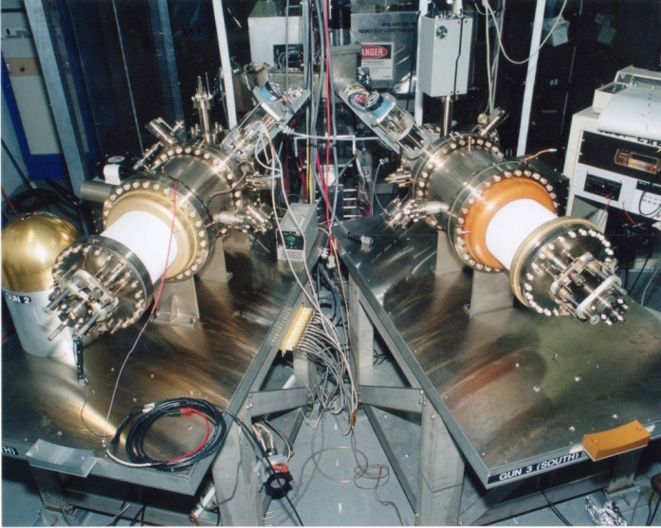
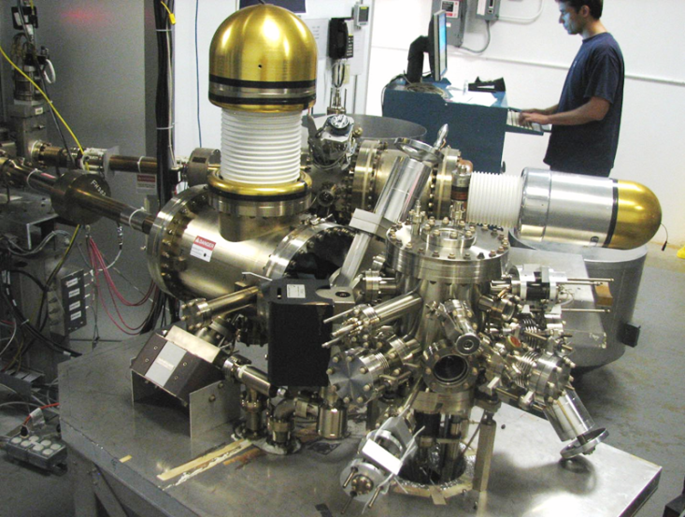
Always Tweaking the Design
1
Text goes here
4
Endless (?) quest for perfection
2
3
Matt Poelker, Jefferson Lab
Notes:
Interior Page Design 1

Slide 13
Key Features of a Polarized Photogun
Photocathode
  High Polarization
  High QE (photoemission yield)
  Long Lifetime
Vacuum
  Static Vacuum
  Dynamic Vacuum
High Voltage
  Must eliminate field emission
Drive Laser
  Reliable, phase locked to machine
  Adequate Power
  Wavelength Tunable
Matt Poelker, Jefferson Lab
Notes:
Interior Page Design 2

Slide 14
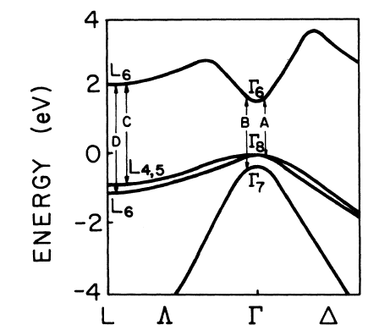
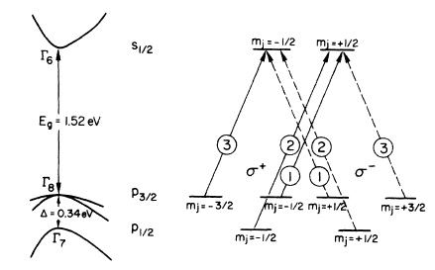
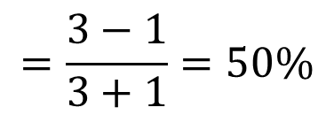
GaAs Energy Levels
$$=\frac{3−1}{3+1}=50\%$$
Use circularly polarized light to selectively populate the conduction band with electrons of a particular spin state
Matt Poelker, Jefferson Lab
Notes:
Interior Page Design 2

Slide 15
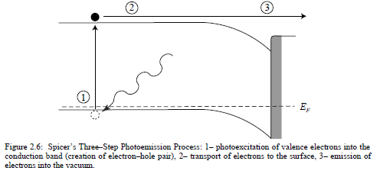
Photoemission: a three step process
old
new
-
-
χ^{NEA} ~ 0.2 eV
-
Light
GaAs
Vacuum
Step 0: Reduce the work function at surface
Step 1: Electrons are excited to conduction band by absorbing light
Step 2: (some) Electrons diffuse to the surface
Step 3: (some) Electrons leave material
Matt Poelker, Jefferson Lab
Notes:
Interior Page Design 2

Slide 16
Reducing the Work Function
Positive Electron Affinity
Negative Electron Affinity
PEA = 4.07 eV
-
NEA Surface
Activation
-
χ^{NEA} ~ 0.2 eV
Conduction
Band
E_{gap}
Valence
Band
+
Light
GaAs
Vacuum
GaAs
Vacuum
p-doped GaAs, lowers Fermi level and reduces work function at surface, creates band bending region
Add ~ one monolayer of Cs and Oxidant to reduce work function below that of conduction band
Matt Poelker, Jefferson Lab
Notes:
Interior Page Design 2

Slide 17
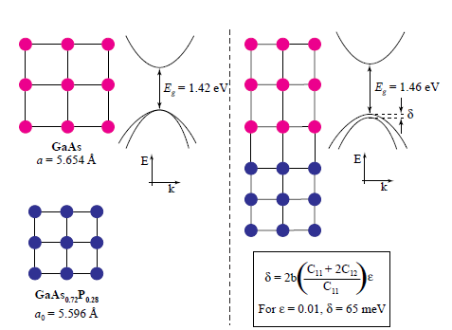
Breaking the 50% Barrier
Lattice mismatch provides stress
The band gap of the substrate layer must be larger than surface layer
Lattice constants must differ enough to introduce suitable strain
Adjust lattice constant of substrate by varying concentration of third element
Pablo Saez, PhD Thesis, SLAC Report 501, 1997
1% lattice mismatch provides equivalent force as hydraulic press!
Matt Poelker, Jefferson Lab
Notes:
Interior Page Design 2

Slide 18

Getting the Recipe Right
Strained-Superlattice GaAs/GaAsP
QE 1% and Polarization 85%
GaAsP
30 A
Strained GaAs
30 A
1000 A
Active Region
GaAs_{0.64}P_{0.36}
Buffer
GaAsP
2.5μm
Strained GaAs
GaAs_{(1-x)}P_{x} Graded Layer
2.5μm
GaAsP
Strained GaAs
GaAs Substrate
D. Luh et al, SLAC, PESP2002
From Aaron Moy, SVT Assoc and SLAC, PESP2002
Matt Poelker, Jefferson Lab
Notes:
Interior Page Design 2

Slide 19
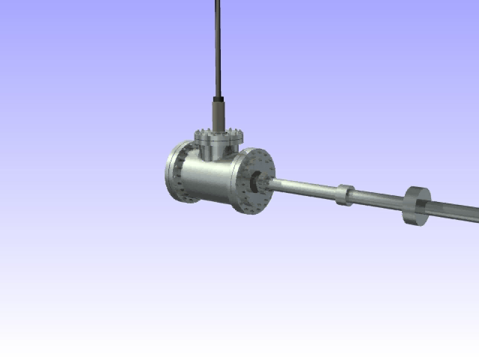
Ion Bombardment

Slide 20
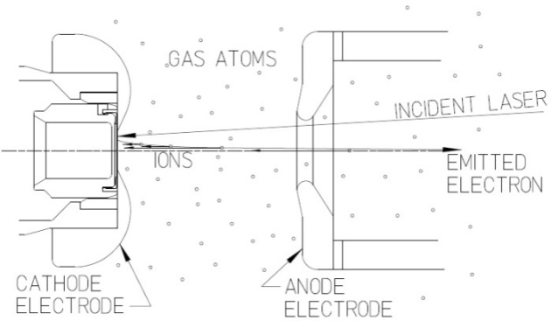
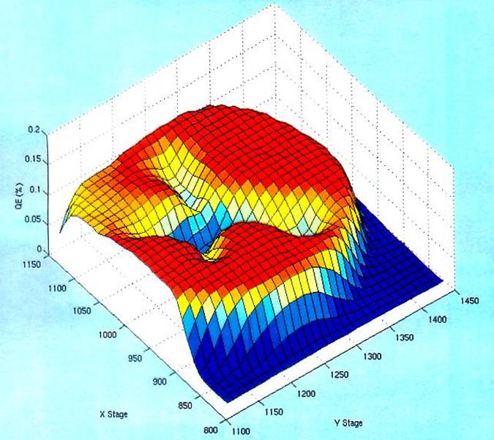
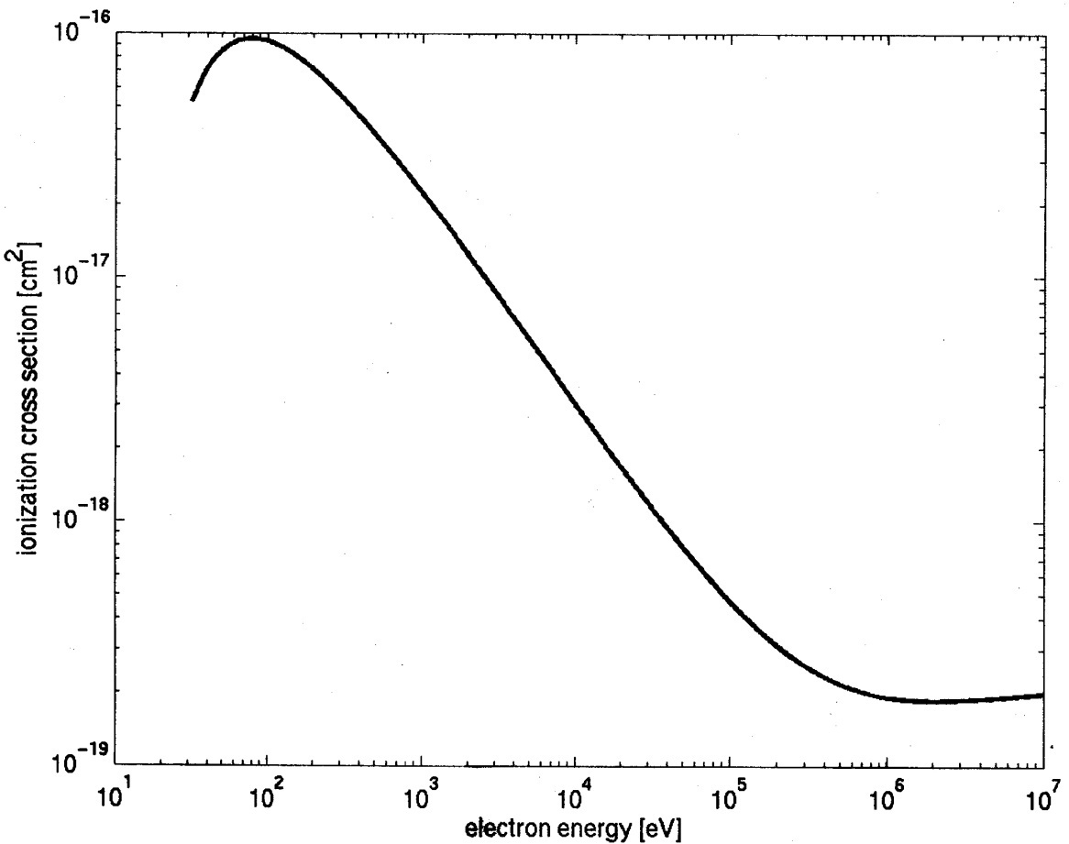
Imperfect Vacuum = Finite Lifetime
Ion bombardment – notice characteristic “trench” from laser spot to electrostatic center of photocathode
Active area = 5mm
Laser spot = 0.5mm dia.
Ionization cross section for H₂
Most ions created at low energy
100kV
Matt Poelker, Jefferson Lab
Notes:
Interior Page Design 2

Slide 21
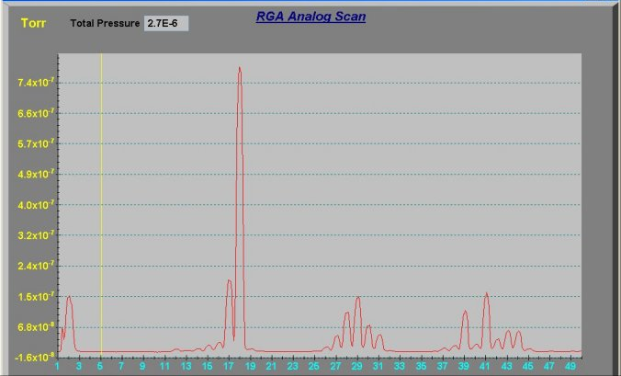
What Does “Bake” Mean?
Heat the vacuum chamber at 250ºC for 30 hours, to get rid of water and other chemically reactive gas species….
Post-Bake
H₂O
Residual Gas Analysis of
un-baked vacuum chamber
What’s left is chemically inert
although still problematic
H₂
CH4
CO
CO
H₂
CO₂
CO₂
Matt Poelker, Jefferson Lab
Notes:
Interior Page Design 2

Slide 22
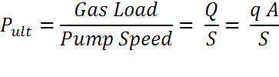
Improve Vacuum and Improve Lifetime
Q= gas load, q= outgassing rate, A = surface area, S = pump speed
Strategy: Reduce Gas Load, Increase the Pump Speed
Baked gun, baked beamline, no leaks
Perform vacuum “dirty work” inside the preparation chamber, i.e., heat and activate the photocathode
Degas all vacuum components at 400ºC to reduce outgassing rate
Minimize the surface area of your chamber
Lots of H₂ pumping - non-evaporable getter pumps. Plus a small ion pump for other gas (methane, argon, helium)
Matt Poelker, Jefferson Lab
Notes:
Interior Page Design 2

Slide 23
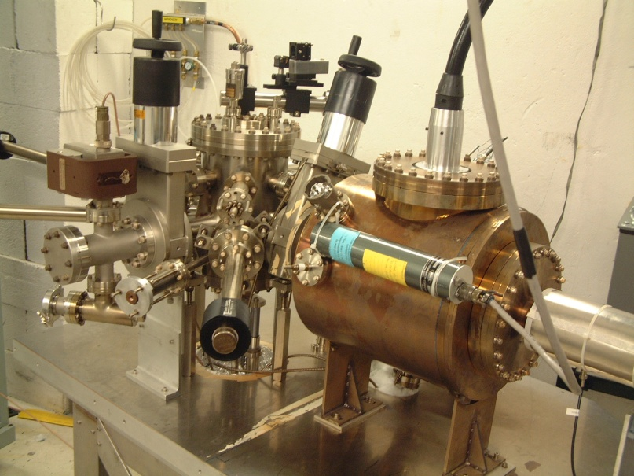
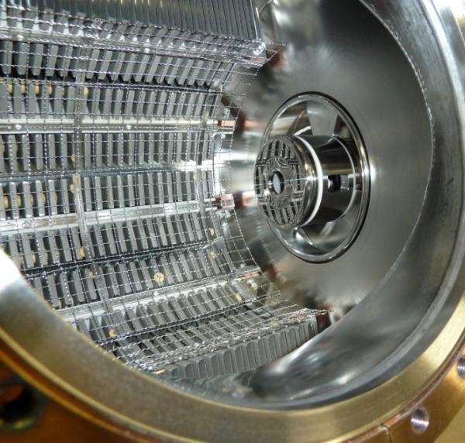
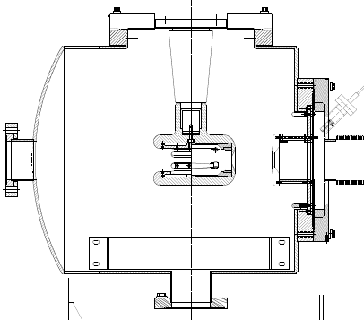
The CEBAF - ILC 200kV Inverted Gun
NEG pumps
New design
Our “Load-locked” GaAs photogun:
Gun Vacuum ~ 10⁻¹² Torr
Beamline vacuum could be improved…
Matt Poelker, Jefferson Lab
Notes:
Interior Page Design 2

Slide 24
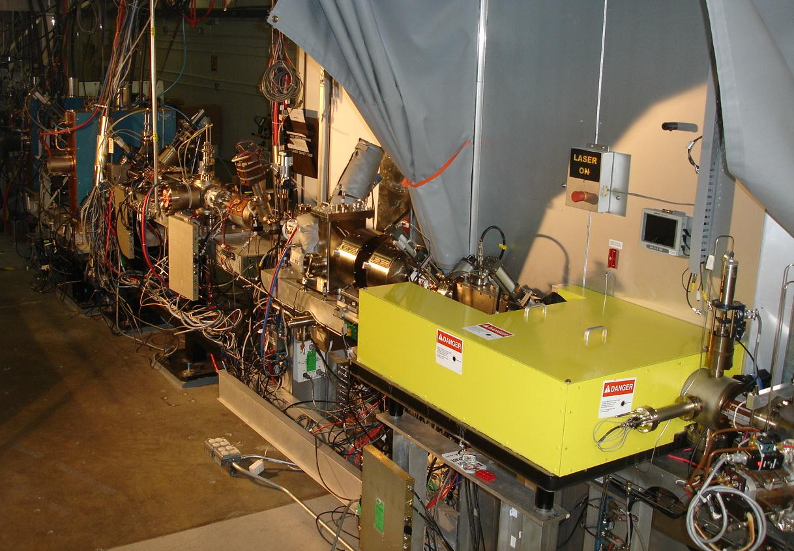
Complicated Beamline
Differential Pump Station
Magnets to focus and steer beam
Valves, Pumps, Viewers
Antenna beam position monitors
Spin Manipulators
Buncher cavity
Faraday cup
Window to introduce laser light
Emittance filter
Photogun nearby
Matt Poelker, Jefferson Lab
Notes:
Interior Page Design 2

Slide 25
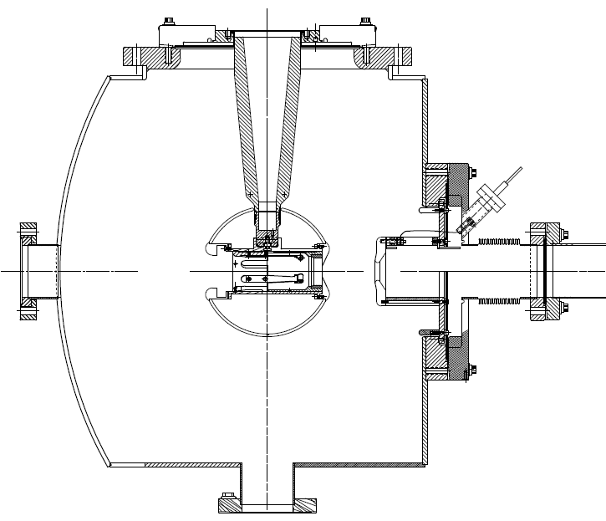
The 350 kV Photogun at Jlab FEL
Maximum Field strength ~ 10 MV/m
CEBAF 200kV Inverted Gun
Longer “R30” insulator
Spherical electrode
Thin NEG sheet to move ground plane further away
Matt Poelker, Jefferson Lab
Notes:
Interior Page Design 2

Slide 26
Benefits of Higher Gun Voltage
Reduce space-charge-induced emittance growth, maintain small transverse beam profile and short bunch-length. In other words, make a “stiff” beam right from the gun
Reduce problems associated with Surface Charge Limit (i.e., QE reduction at high laser power)
Prolong Charge Lifetime (?)
Compact, less-complicated and less-expensive injector
Biggest Obstacle: Field Emission and HV Breakdown… which lead to bad vacuum and photocathode death
Matt Poelker, Jefferson Lab
Notes:
Interior Page Design 2

Slide 27
Field Emission
Sources of Field Emission: micro-protrusions, contamination on surface, material defects and impurities, ionization of desorbed gas, etc.,
Material choices: hardness, work function, grain structures and grain boundaries, electrical conductivity, thermal conductivity
Surfaces: generally people assume smooth is better than coarse, although experiments indicate smooth does not guarantee “good”
Mostly, people assume 5 MV/m is “easy” - we want to operate at 10 MV/m or higher
Matt Poelker, Jefferson Lab
Notes:
Interior Page Design 2

Slide 28
Things we’ve been Studying
Fowler-Nordheim Theory: a good place to start, but it will disappoint you…
Diamond-paste polished stainless steel
  Is it necessary to have such a smooth surface?
Gas conditioning: an essential tool
Electropolished stainless steel: might be an option
Barrel-polished stainless steel: another option
BCP-d niobium: pricey
TiN-coated aluminum: promising…
900 ºC degas, CO₂ snow, high pressure rinsing…?
Small inverted insulators and breakdown
Matt Poelker, Jefferson Lab
Notes:
Interior Page Design 2

Slide 29
Things we’ve been Studying
Fowler-Nordheim Theory: a good place to start, but it will disappoint you…
Diamond-paste polished stainless steel
  Is it necessary to have such a smooth surface?
Gas conditioning: an essential tool
Electropolished stainless steel: might be an option
Barrel-polished stainless steel: another option
BCP-d niobium: pricey
TiN-coated aluminum: promising…
900 ºC degas, CO₂ snow, high pressure rinsing…?
Small inverted insulators and breakdown
Matt Poelker, Jefferson Lab
Notes:
Interior Page Design 2

Slide 30
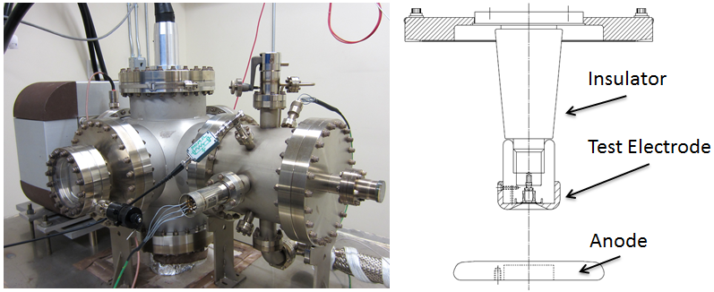
Field Emission Test Stand
Spellman -225kV supply, small “R28” inverted insulators, variable cathode/anode gap from to 10 to 50mm, field strength to ~ 20 MV/m
Build a test stand that resembles an actual gun (tests with small gaps and high field strength but low voltage, don’t appear to be very useful)
Matt Poelker, Jefferson Lab
Notes:
Interior Page Design 2

Slide 31
Diamond-Paste Polishing
Receive the electrode from the machine shop with “32” surface finish
Silicon carbide polishing with 300 grit paper to remove obvious visible scratches
Solvent cleaning in ultrasonic bath of alkali solution
Silicon carbide polishing with 600 grit paper
Solvent cleaning in ultrasonic bath of alkali solution
Polish with 6mm grit
Ultrasonic clean
Polish with 3mm grit
Ultrasonic clean
High pressure rinsing (1200 psi) for 20 minutes with ultrapure de-ionized water with resistivity > 18 MΩcm.
High temperature (900ºC) vacuum degas for one hour
Two months later and the electrode is ready for high voltage!
Maybe it will work!?
Matt Poelker, Jefferson Lab
Notes:
Interior Page Design 2

Slide 32
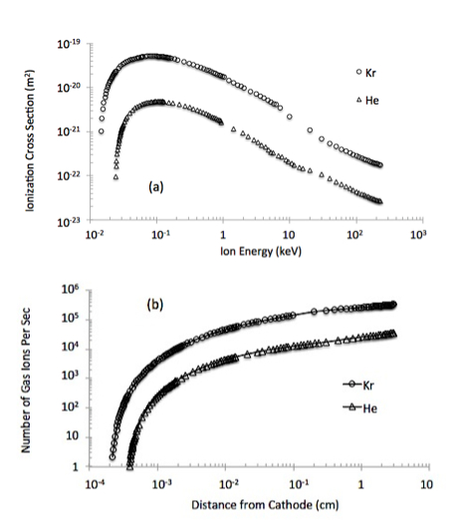
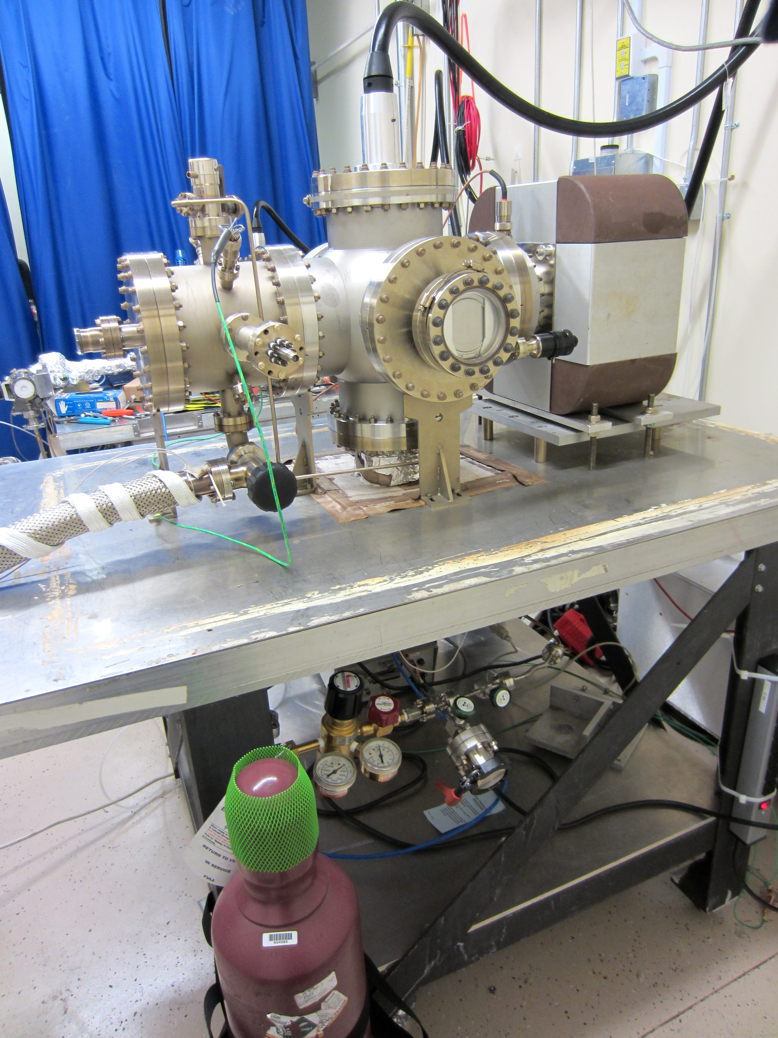
Gas Conditioning
Leak Valve
Field emission ionizes inert gas
Ions bombard electrode, hopefully near field emitter, which can be sputtered away
And ions get implanted, increasing work function
Gas Bottle
Matt Poelker, Jefferson Lab
Notes:
Interior Page Design 2

Slide 33
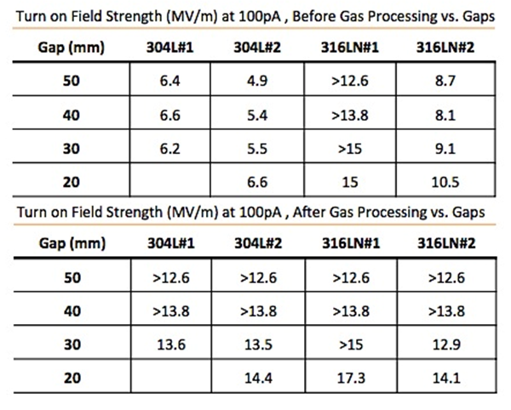
A Powerful Technique
Gas conditioning can turn a BAD electrode into a GOOD electrode
TURN OFF ion pump
NEG pumps don’t pump inert gas
Set voltage to excite field emitter
Add gas at 10⁻⁵ Torr, apply voltage and watch for sharp decrease in FE current
Perhaps 316L is better than 304L?
Matt Poelker, Jefferson Lab
Notes:
Interior Page Design 2

Slide 34
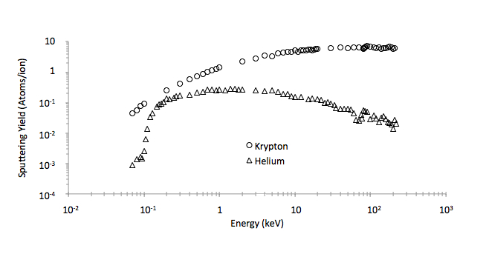
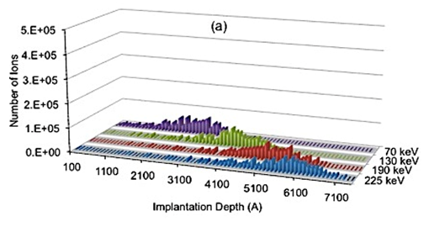
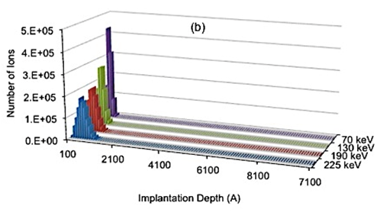
What Does Gas Conditioning Do?
Sputtering and Implantation
Helium: provides a shallow implantation depth, so it seems to work best when FE turns ON at lower voltages, and/or with small gaps (10 to 20mm), don’t expect much sputtering
Krypton: can work at any voltage, good for larger gaps (30 to 50mm), sometimes too much sputtering creates a new field emitters
Helium
Krypton
Implantation
Sputtering Yield
Matt Poelker, Jefferson Lab
Notes:
Interior Page Design 2

Slide 35
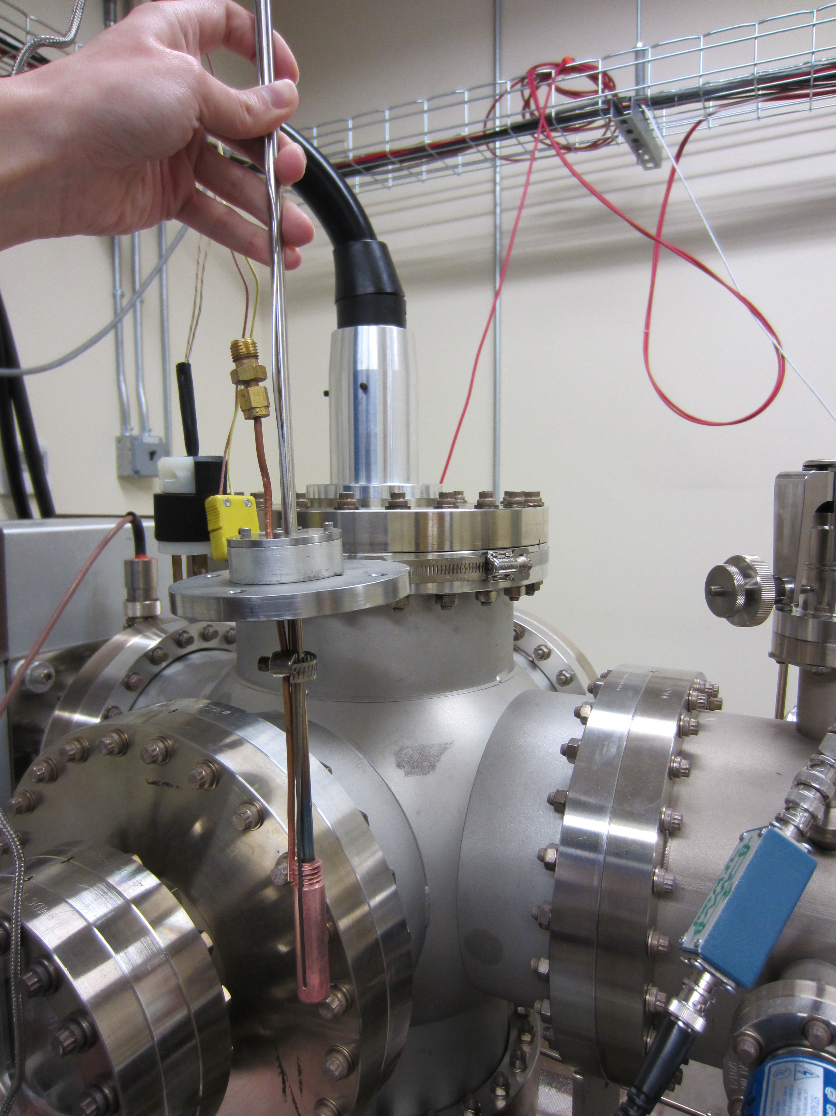
What Does Gas Conditioning Do?
Benefits of implantation are reversible
Work of M. BastaniNejad, E. Forman, C. H Garcia
Matt Poelker, Jefferson Lab
Notes:
Interior Page Design 2

Slide 36
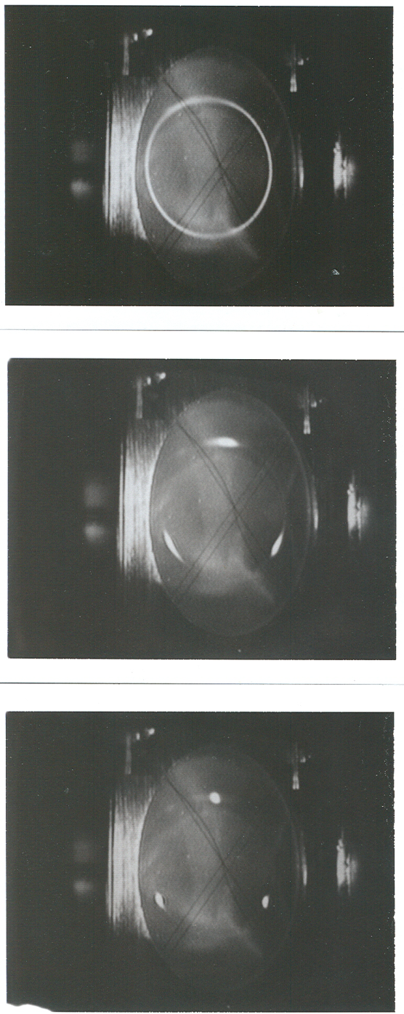
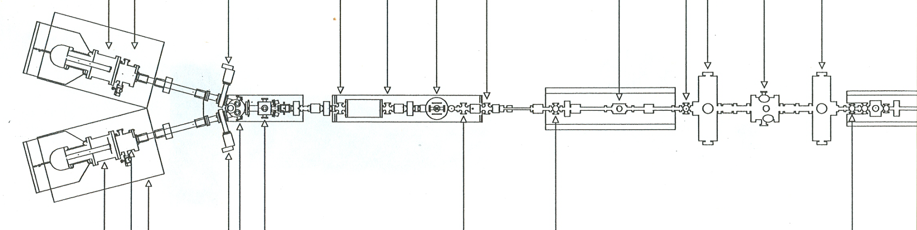
Beam at the chopper viewer
Synchronous Photoinjection
A B C A B C….
Beam Current
111ps
1497 MHz
Extracting DC beam, very wasteful, most of the beam dumped at chopper. Need ~ 2mA from gun to provide 100uA to one hall. Gun lifetime not good enough…..yet.
RF Chopper
Sets Bunchlength
Matt Poelker, Jefferson Lab
Notes:
Interior Page Design 2

Slide 37
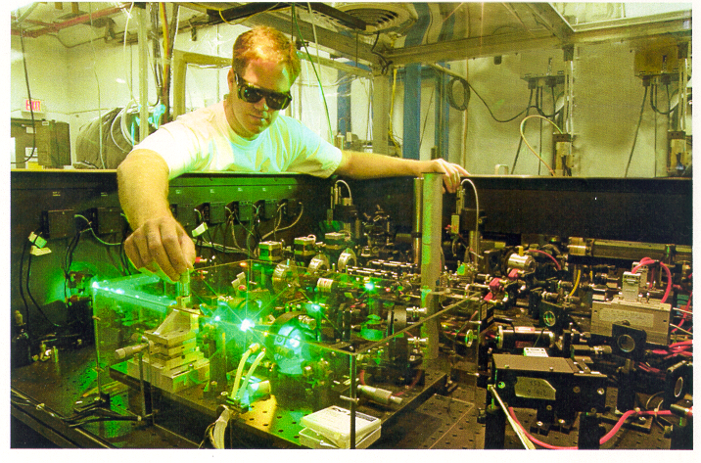
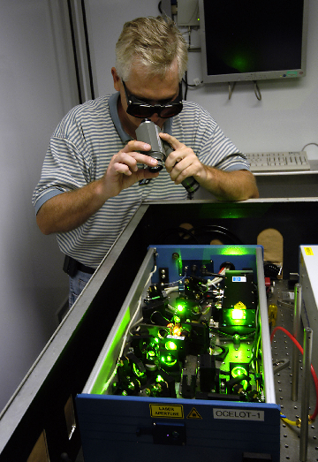
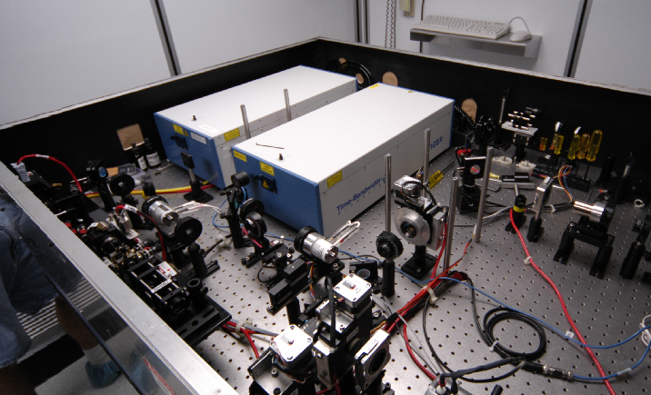
Ti-Sapphire Lasers at CEBAF
Needed more laser power for high current experiments
Replaced diode lasers with Ti-sapphire lasers
Re-align Ti-Sapphire lasers each week
Homemade harmonic modelocked Ti-Sapphire laser, seeded with light from gain switched diode. No active cavity length feedback. It was a bit noisy….
Matt Poelker, Jefferson Lab
Commercial laser with 499MHz rep rate from Time Bandwidth Products
Notes:
Interior Page Design 2

Slide 38
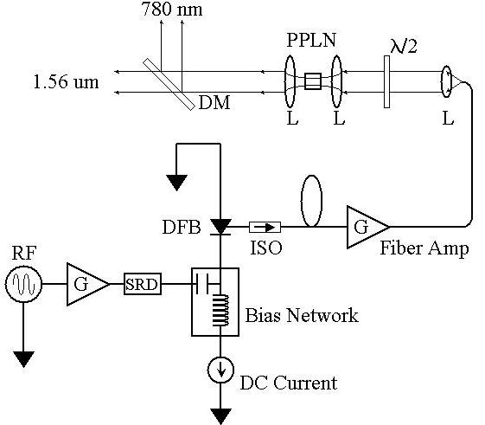



Fiber-Based Drive Laser
Gain-switched seed
780nm
Frequency-doubler
1560nm
ErYb-doped fiber amplifier
Matt Poelker, Jefferson Lab
Notes:
Interior Page Design 2

Slide 39


JLab Energy Recovery Linac
Beam accelerated from 5 to 100 MeV and then decelerated back to 5 MeV, to recover the energy
Powerful light source
IR and UV FEL
THz light
Search for Dark Matter
Fixed Target Options
Matt Poelker, Jefferson Lab
Notes:
Interior Page Design 2

Slide 40

DarkLight Experiment
Matt Poelker, Jefferson Lab
Notes:
Interior Page Design 2

Slide 41

DarkLight Experiment
10 mA at 100 MeV : 1 MW beam power!!
Energy Recovery Linac, with internal target, makes this experiment possible
But not with a GaAs photocathode…
Matt Poelker, Jefferson Lab
Notes:
Interior Page Design 2

Slide 42






(unpolarized) Alternative to GaAs?
CsK₂Sb photocathode made at BNL
Gatevalve
600 L/s (H₂) NEG
Magnetic Manipulator
25 L/s (N₂) ion pump
Packed in the Minivan
Transported to JLab
Matt Poelker, Jefferson Lab
Notes:
Interior Page Design 2

Slide 43

Injector Test Stand (South Cave)
Lead Lined Wall
High Voltage Gun Chamber/cylinder with HV Cable
Prep/Puck Manipulation Chamber
Laser Table #1
Laser Table #2
Matt Poelker, Jefferson Lab

Slide 44




CsK₂Sb Photocathode
At 10mA, the QE of photocathode was increasing!!
Record current at JLab
Things were “normal” at 10mA
Then we see a slight QE decline at 16mA
Sharp QE decline at 20mA
Work of R. Mammei, J. McCarter
Matt Poelker, Jefferson Lab
Notes:
Interior Page Design 2

Slide 45


Ion Bombardment a Problem?
Testing the CsK₂Sb photocathode
QE evolution similar, with or without beam
Evidence that QE evolution was mostly due to laser heating – not ion bombardment or Joule heating
Matt Poelker, Jefferson Lab
Notes:
Interior Page Design 2

Slide 46


How Hot Did the Surface Get?
Heat never really leaves the ~0.030” Stainless steel layer
Simulated Steady State Thermal
 | Maximum Temperature: stainless steel substrate and aluminum puck |  |  |  |  | Maximum Temperature: molybdenum puck
Absorbed Laser Power | 0.2 W | 1.0 W | 1.3 W | 2 W | 2.5 W | 1.3 W | 3 W | 5 W
Laser Spot Size 0.5 mm | 40 °C | 108 °C | 135 °C | 173 °C |  | 42 °C | 67 °C | 98 °C
Laser Spot Size 1 mm |  |  | 78 °C |  | 129 °C | 36 °C
Need to consider thermal conductivity of substrate
Matt Poelker, Jefferson Lab
Notes:
Interior Page Design 2

Slide 47



Making CsK₂Sb Photocathodes at JLab
Add layer of Sb to a substrate, then co-deposit Cs and K
Now we make our own photocathodes
Ref: CHESS seminar 2013 Smedley
Cheap lasers at 532 nm
Work of M. Mamun, C. H Garcia
Matt Poelker, Jefferson Lab
Notes:
Interior Page Design 2

Slide 48


QE: Baked vs. Unbaked System
Sb PP of 5.5×10⁻¹¹ Torr, T_{sub}= 200 °C, 32.7 A from power supply, 532 nm laser
30 min Sb deposition
100 min Sb deposition
Baked System: QE observed only on one substrate ⬄ Dissimilar Sb growth on GaAs and Ta
Unbaked System: QE observed on both substrates ⬄ Similar Sb growth on both substrates
Matt Poelker, Jefferson Lab
Notes:
Interior Page Design 2

Slide 49
Sb growth: Baked vs. Unbaked System
Sb PP of 5.5×10⁻¹¹ Torr , 100 min at T_{sub}= 200 °C, 32.7 A from power supply
Leak-free baked system
Sb on Ta
Sb on GaAs
Sb on GaAs
Sb on GaAs
Max. grain height ~ 100 nm
Post-leak unbaked system
Sb on Ta
Sb on GaAs
Sb on GaAs
Sb on GaAs
Max. grain height ~ 300 nm
Sb growth enhanced on GaAs in the unbaked system compared to baked system
Sb growth equally favored on both Ta and GaAs substrates in the unbaked system
Indicates:
Sticking coefficient of Sb on GaAs enhanced in the unbaked system and similar to that on Ta
Monolayers of Sb on both GaAs and Ta grew at the same pace
Matt Poelker, Jefferson Lab
Notes:
Interior Page Design 2

Slide 50
New Accelerators
New accelerators need new electron guns:
  Light sources
  Nuclear and particle physics machines
High current ERLs, like JLab’s FEL, for DarkLight
  DC high voltage gun, but with CsK2Sb photocathode
Electron Ion Collider (MEIC, eRHIC, LHeC)
  Very high average current polarized beams and un-polarized for cooling proton beams
  Three options: rf-pulsed thermionic gun, DC high voltage photogun, and SRF photogun (some consider “holy grail”)
ILC at Japan: polarized electron beam with a challenging time structure, and high current polarized positron source
Matt Poelker, Jefferson Lab
Notes:
Interior Page Design 2

Slide 51

Electron Ion Collider at JLab
e injection
Stage I MEIC
  CEBAF as full-energy
  e⁻/e⁺ injector
  3 to12 GeV e⁻/e⁺
  25 to100 GeV protons
  12 to40 GeV/u ions
Stage II EIC
  up to 20 GeV e⁻/e⁺
  up to 250 GeV protons
  up to 100 GeV/u ions
Two independent but complementary detectors
Hall D
MEIC
Ion linac
IP2
Pre-booster
IP1
C E B A F
High-Energy Arc (Stage II)
Halls A-C
Matt Poelker, Jefferson Lab
Notes:
Interior Page Design 2

Slide 52

MEIC Layout
Prebooster
Electron cooling
Ion
source
Warm large booster
(up to 25 GeV/c)
Three Figure-8 rings
stacked vertically
SRF linac
Cold 25-100 GeV/c
proton collider ring
Warm 3-12 GeV
electron collider ring
Medium-energy IPs with
horizontal beam crossing
Injector
12 GeV CEBAF
Cross sections of tunnels for MEIC
Matt Poelker, Jefferson Lab
Notes:
Interior Page Design 2

Slide 53

ERL Circulator Cooler Concept
Design Choices
Energy Recovery Linac (ERL)
Compact circulator ring
to meet design challenges
Large RF power (up to 81 MW)
Long gun lifetime (average 1.5 A)
Required technologies
High bunch charge (2 nC) magnetized gun
High current ERL (55 MeV, 15 to150 mA)
Ultra fast kicker
solenoid
ion bunch
electron bunch
Cooling section
Fast kicker
circulator ring
Fast kicker
energy recovery
dump
injector
SRF Linac
recirculating 10+ turns ➔ reduction of current from an ERL by a same factor
decompression
Previous proposals
RHIC luminosity upgrade
Using ERL technology
(Ben Zvi, et.al. 2000~2007)
HERA luminosity upgrade
Using circulator ring
(Brinkman, et.al. ~1997)
CCR
dump
beam exchange system
dechirper
cooling solenoids
ERL
SRF
rechirper
injector
D. Douglas C. Tennant
recompression
Matt Poelker, Jefferson Lab
Notes:
Interior Page Design 2

Slide 54
Backup Slides
Thank You
Matt Poelker, Jefferson Lab
Notes:
Interior Page Design 2

Slide 55
Ultra Fast Beam Kicker for ERL-CCR
solenoid
ion bunch
It requires an ultra fast kicker for switching bunches in/out of a CCR
The kicker must be able to operate at a high repetition rate (~26 MHz)
Rise/full time must be shorter than sub ns to avoid disturbing the neighboring bunches
Cooling section
Fast kicker
circulator ring
Fast kicker
energy recovery
E. Nissen
injector
SRF Linac
dump
RF kicker
Like an RF separator, driven by a waveform which is a superposition of multi harmonic waveforms
Very high duty factor
Low power requirements
Requires a multi-harmonic signal amplifier
Engineering design & proto-typing are underway
A. Hutton, A. Kimber, E. Nissen
Matt Poelker, Jefferson Lab
55

Slide 56
Electron Cooling in MEIC
Use conventional electron cooling mechanism
Multi-stage cooling scenario
  Prebooster: standard DC electron cooling for beam accumulation from positive source
  Collider ring: bunched high-energy electron cooling after injection (initial), after acceleration and re-bunching (final), and during collisions (continuous)
    Magnetized injector of high-charge short electron bunches
    (a similar injector operates at BINP)
    Energy recovery linac to reduce power
    consumption
    Ultra-fast (beam-beam or RF) kicker
    Compact circulator ring to reduce electron
    source current
Ion
source
SRF linac
Cooling
Cooling
to high-energy
collider ring
Prebooster
(accumulator ring)
Large booster
Medium-energy collider ring
solenoid
ion bunch
electron bunch
Cooling section
Fast kicker
circulator ring
Fast kicker
energy recovery
injector
SRF Linac
dump
Notes:
56

Slide 57





MEIC : Medium Energy EIC
Use CEBAF “as-is” after the 12-GeV Upgrade
medium-energy
IPs
polarimetry
low-energy IP
Three compact rings:
3 to 11 GeV electron
Up to 12 GeV/c proton (warm)
Up to 100 GeV/c proton (cold)
Ee=5 GeV
Luminosity (x10³²)
Ee=10 GeV
eRHIC-1, Ee=5 GeV
Proton Energy (GeV)

Slide 58


Diamond-Paste Polished Stainless Steel
Variable performance is common
Favorable response to gas conditioning
Matt Poelker, Jefferson Lab
Notes:
Interior Page Design 2

Slide 59

I to V curves for Niobium
Text goes here
304-SS
Fine Grain Nb
Large Grain Nb
Single Crystal Nb
Notes:
Interior Page Design 2

Slide 60
Buffered Chemical Polishing of Niobium
Receive the electrode from the machine shop with “32” surface finish
Silicon carbide polishing with 600 grit paper, if necessary, to remove obvious visible scratches
Solvent cleaning in ultrasonic bath of alkali solution
Buffered-chemical polishing to remove ~ 100 μm material
High pressure rinsing (1200 psi) for 20 minutes with ultrapure de-ionized water with resistivity > 18 MΩcm.
High temperature (900ºC) vacuum degas for one hour
Notes:
Interior Page Design 2

Slide 61

FE results of BCP-ed Niobium
Field strength at which the electrode exhibited 100pA of field emission, post krypton gas conditioning
“>” symbol….the electrode did not produce 100pA of field emission
Notes:
Interior Page Design 2

Slide 62

Niobium Electrodes
More evidence that there’s more to field emission than topography
SS Roughness: 10.9 nm
FGNb Roughness: 215.1 nm
LGNb Roughness: 141.01 nm
SCNb Roughness: 17.6 nm
This one performed best!
Notes:
Interior Page Design 2

Slide 63


Electropolished Stainless Steel
Can we avoid time-consuming diamond-paste polishing?
Start with three test electrodes having different surface finish, and send them to commercial electropolishing company
Matt Poelker, Jefferson Lab
Notes:
Interior Page Design 2

Slide 64



Electropolished Stainless Steel
EP-d electrodes exhibited less variability
EP-d electrodes did not respond favorably to gas conditioning
Best electrodes were DPP-d
Matt Poelker, Jefferson Lab
Notes:
Interior Page Design 2

Slide 65
TiN-coated aluminum
Aluminum is cheap and easy to machine
Takes just hours to polish to mirror-like finish with silicon-carbide paper
Good thermal conductor, compared to steel, a nice feature when gun provides high current
We used a “boutique” vendor to coat our small electrodes
Can an industrial TiN-coating provide the same benefit? Need to test
Matt Poelker, Jefferson Lab
Notes:
Interior Page Design 2

Slide 66





Surface Images Al and TiN-Al
Al: 400 grit
Al: 600 grit
Al: 800 grit
Al: 1200 grit
TiN coated: 1200 grit
Note, the black spots are voids and defects, not particulate contamination from sand paper polishing
Matt Poelker, Jefferson Lab
Notes:
Interior Page Design 2

Slide 67



TiN-coated aluminum
Bare aluminum:
easily damaged
TiN-coated
aluminum
Diamond-paste polished Ti-alloy:
a traditional “hard” electrode
Matt Poelker, Jefferson Lab
Notes:
Interior Page Design 2

Slide 68



Field strength between capacitor plates
~ 4.5 MV/m
3 cm gap, +/- 70 kV
~ 650 m x 2 = 1300 m of electrode!
AGS Ring at BNL
Matt Poelker, Jefferson Lab
Notes:
Interior Page Design 1

Slide 69




Fowler-Nordheim Line Plots
$$I= C_{1}{A_{e}β}^{2}E^{2}e^{{−C_{2}}/{βE}}$$
$C_{1}=\frac{1.54x{10}^{−6 }∙{10}^{4.52⋅φ^{−0.5}}}{φ}$
$C_{2}=6.53x{10}^{9}φ^{1.5}$
$slope= \frac{d(\log_{10}I/{E^{2})}}{d(1/E)}$= - $\frac{2.84×{10}^{9}φ^{1.5}}{β}$
intercept = ${{Log}_{10}({I_{F}}/{E^{2})}}_{E→∞}={Log}_{10}[\frac{1.54×{10}^{−6}A_{e}β^{2}{×10}^{4.52φ^{−0.5}}}{φ}]$
But it’s wrong to assume work function, Φ , is a constant
With three variables, there are an infinite number of solutions that provide a good fit
These plots tell you β, the field enhancement factor, and A_{e}, the field emitter area
Notes:
Interior Page Design 2

Slide 70


Fowler-Nordheim Line Plots
Text goes here
Notes:
Interior Page Design 2

Slide 71

Building the 350 kV Gun
Start with “dummy” electrodes and test different insulators and cathode screening electrode
Notes:
Interior Page Design 2

Slide 72




Plan B
Insulator sleeve
Plan A
No Improvement
Plan D
Plan C
In hand, but untested

Slide 73

Insulators and Screening electrode
Longer R30 insulators, conventional alumina
Short R28 insulator, bulk resistivity, mildly conductive
ZrO-coated R30 insulator, also mildly conductive
dummy electrode and with a screening electrode
Notes:
Interior Page Design 2

Slide 74

Breakdown
Matt Poelker, Jefferson Lab
Notes:
Interior Page Design 2

Slide 75

Breakdown
Problems at the cable junction, atmosphere side
Notes:
Interior Page Design 2

Slide 76

Summary of Tests
Two configurations reached our voltage goal
Notes:
Interior Page Design 2

Slide 77


Linear Potential Drop
Want a linear potential gradient along length of the insulator
Notes:
Interior Page Design 2

Slide 78


Barrel Polishing of Stainless Steel
On our to-do list for testing
Notes:
Interior Page Design 2

Slide 79


Second Inverted Gun @ Injector Test Cave
Large grain Niobium (Nb) cathode electrode
HV Power Supply: Spellman 225 kV, 30 mA
Why a Niobium electrode?
  Buffered-chemical polishing (BCP) for ~ 1 hour, no need for hand-polishing (takes weeks)
  No field emission at high field gradients (up to12 MV/m)

Slide 80


HV Conditioning and Field Emission
Inside the Gun Chamber
Floating Anode
connected to
Pico-ammeter
Macor glass-ceramic
spacer
100 MΩ
Conditioning
Resistor
We now have 200kV gun with no field emission:
Hand and Buffered Chemical Polished Large Grain Niobium material
Transformer
Oil Tank
A Short for Beam
Delivery

Slide 81



Polarized Source
monthly
reversal
960 Hz
reversal
8 hour
reversal

Slide 82



Stern-Gerlach Experiment
Electrons have total angular momentum J = L + S, orbital and spin angular momentum terms. Spin angular moment = +/- Hbar/2

