Slide 1
Status of UITF MeV Layout
August 17, 2015

Slide 2
Beam and Component Conditions
Parameter | Value | Unit | Comment
Energy | 10 | MeV | Assumed maximum
Energy spread | 0.5 | % | Assumed maximum
Betax | 8.7 | meter | Meas. 7.2 MeV/c
Alphax | -2.4 | radian | Meas. 7.2 MeV/c
Emitx_norm | 0.47 | meter-radian | Meas. 7.2 MeV/c
Betay | 35.1 | meter | Meas. 7.2 MeV/c
Alphay | -9.5 | radian | Meas. 7.2 MeV/c
Emity_norm | 0.33 | meter-radian | Meas. 7.2 MeV/c
Cave 1 height | 1.0668 | meter | 42”
HDIce height | 2.2098 | meter | 87”
Chicane angle | 25.0 | degree | Z=2.45m, S=2.70m
QCM valve | 9.3835 | meter | Z position ME layout

Slide 3
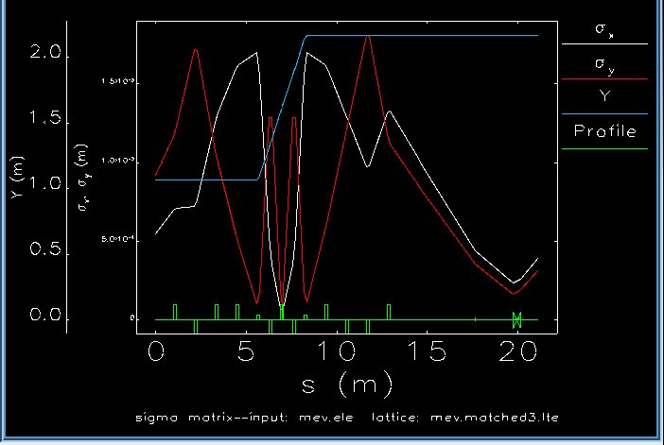
Elegant Layout (/grames/elegant/UITF/chicane/hd9/mev.ele)

Slide 4
Sizing 10 MeV Quadrupoles (QJ: 9, QD: 2)
 |  |  |  |  |  | QJ @ 10 A | QD @ 10A
 |  |  |  |  |  | 594.0000 | 3214.0000
Qty | ¼ | L [m] | K1 [1/m2] | B'L [Gauss]
1.0000 | Q1: | 0.1500 | 1.3727 | 68.6809 |  | 1.1562 | 0.2137
1.0000 | Q2: | 0.1500 | -4.3460 | -217.4473 |  | -3.6607 | -0.6766
1.0000 | Q3: | 0.1500 | 1.1214 | 56.1080 |  | 0.9446 | 0.1746
1.0000 | Q4: | 0.1500 | 0.8324 | 41.6472 |  | 0.7011 | 0.1296
 | Chicane
2.0000 | QA: | 0.1500 | -22.2295 | -1112.2161 |  | -18.7242 | -3.4605
1.0000 | QB: | 0.0750 | 5.5574 | 278.0540 |  | 4.6810 | 0.8651
 | HDIce
1.0000 | QW: | 0.1500 | 0.8659 | 43.3239 |  | 0.7294 | 0.1348
1.0000 | QX: | 0.1500 | -0.0029 | -0.1471 |  | -0.0025 | -0.0005
1.0000 | QY: | 0.1500 | -4.2807 | -214.1762 |  | -3.6057 | -0.6664
1.0000 | QZ: | 0.1500 | 2.6826 | 134.2174 |  | 2.2596 | 0.4176

Slide 5
Next steps…
Elegant
Incorporate and assess raster coils after final matching quad
Add interleaved beam line components (BPM, steering, DP, valves, etc)
Incorporate 10 MeV/c QCM beam conditions from Bubble measurement
Magnets
Test DS air-core dipole at 4.2A, likely need to build w/ AWG14
Fabricate FD chopper solenoid steel and spare coils
Test FH, FA, FQ solenoids at higher 350 keV
Assemble Wien magnet and test for higher 350 keV
Test 2 iron quads found at ISB for Wien filter
Test 2 dipoles for use in chicane
Test 3 dipoles for use in spectrometer

