Slide 1
Photos of Injector Solenoids
April 18 2019
4 in. is about 10 cm

Slide 2
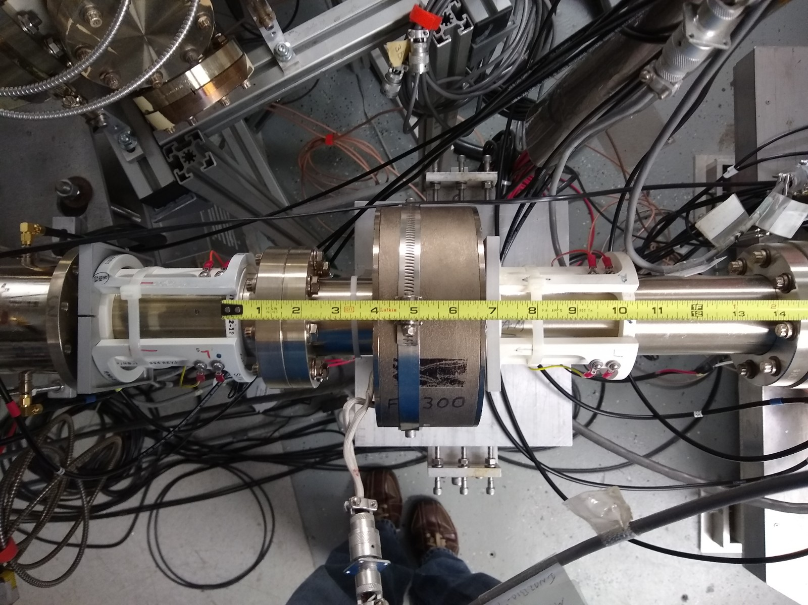
MFH2I01

Slide 3
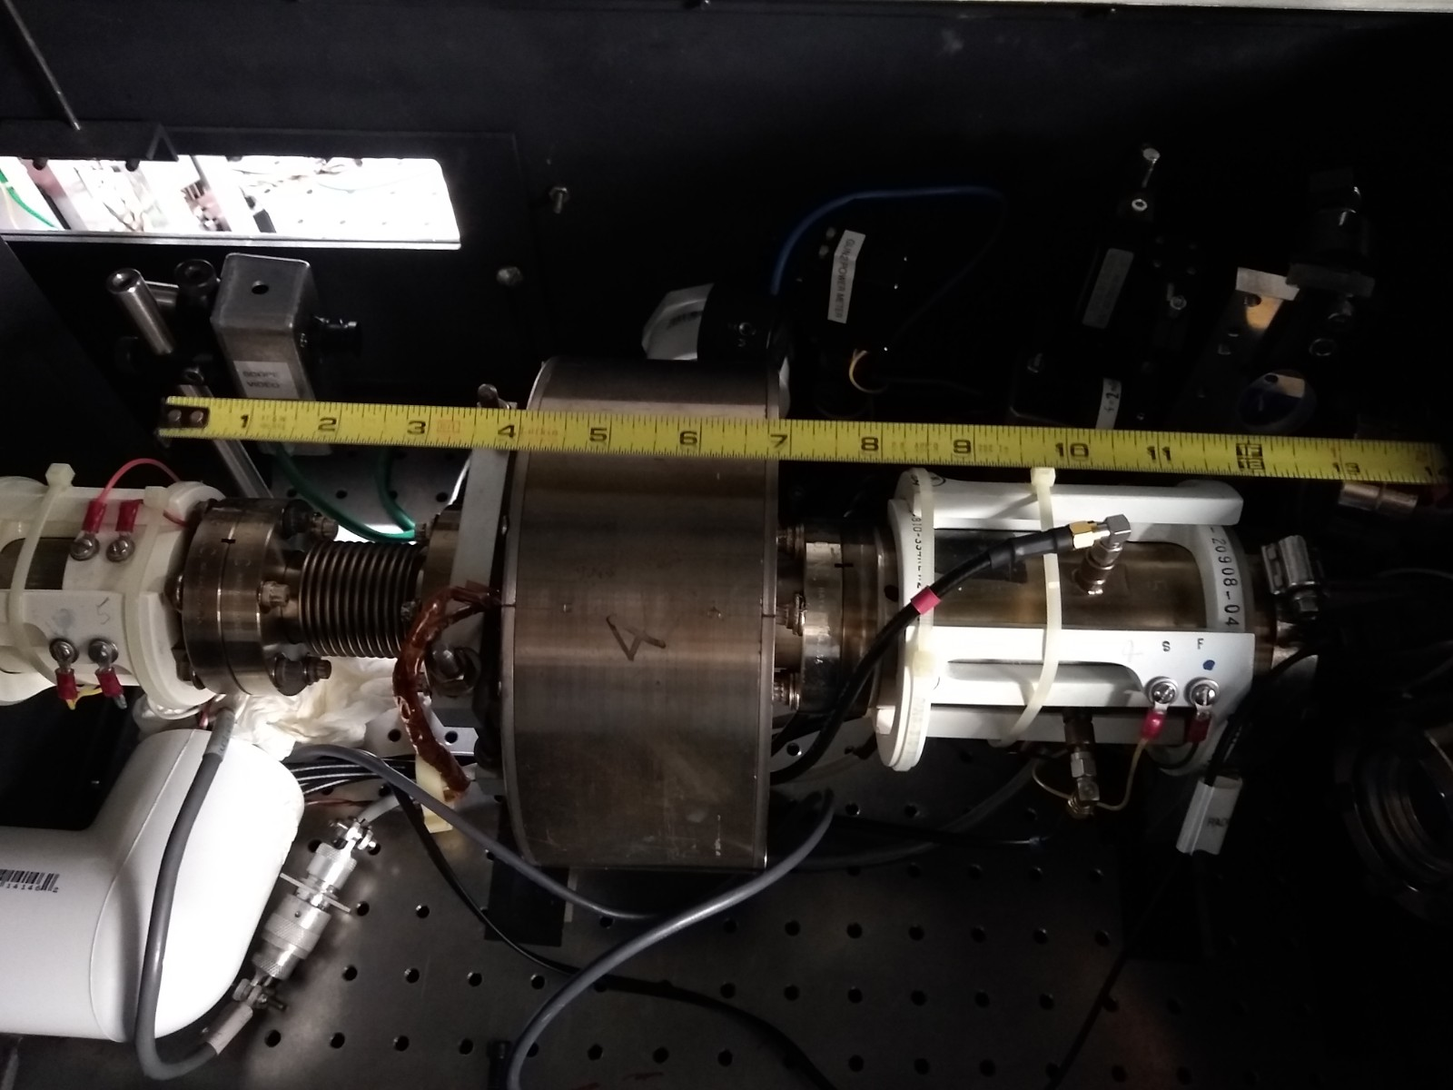
MFB1I02

Slide 4
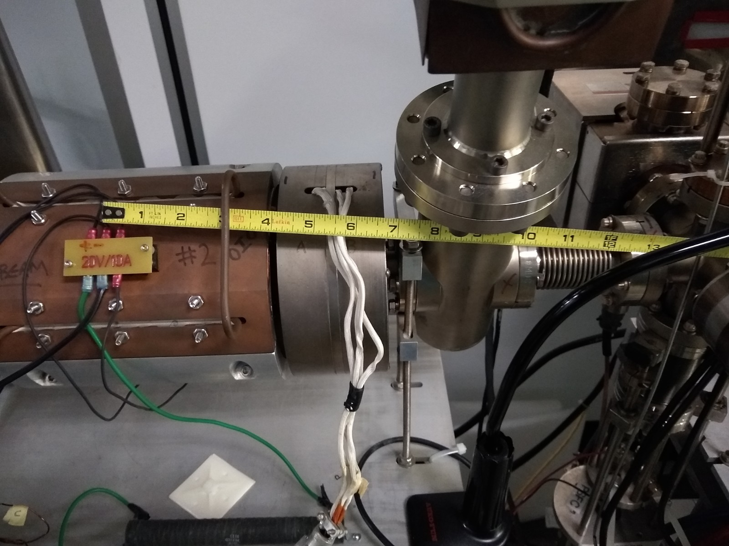
MFQ0I01

Slide 5
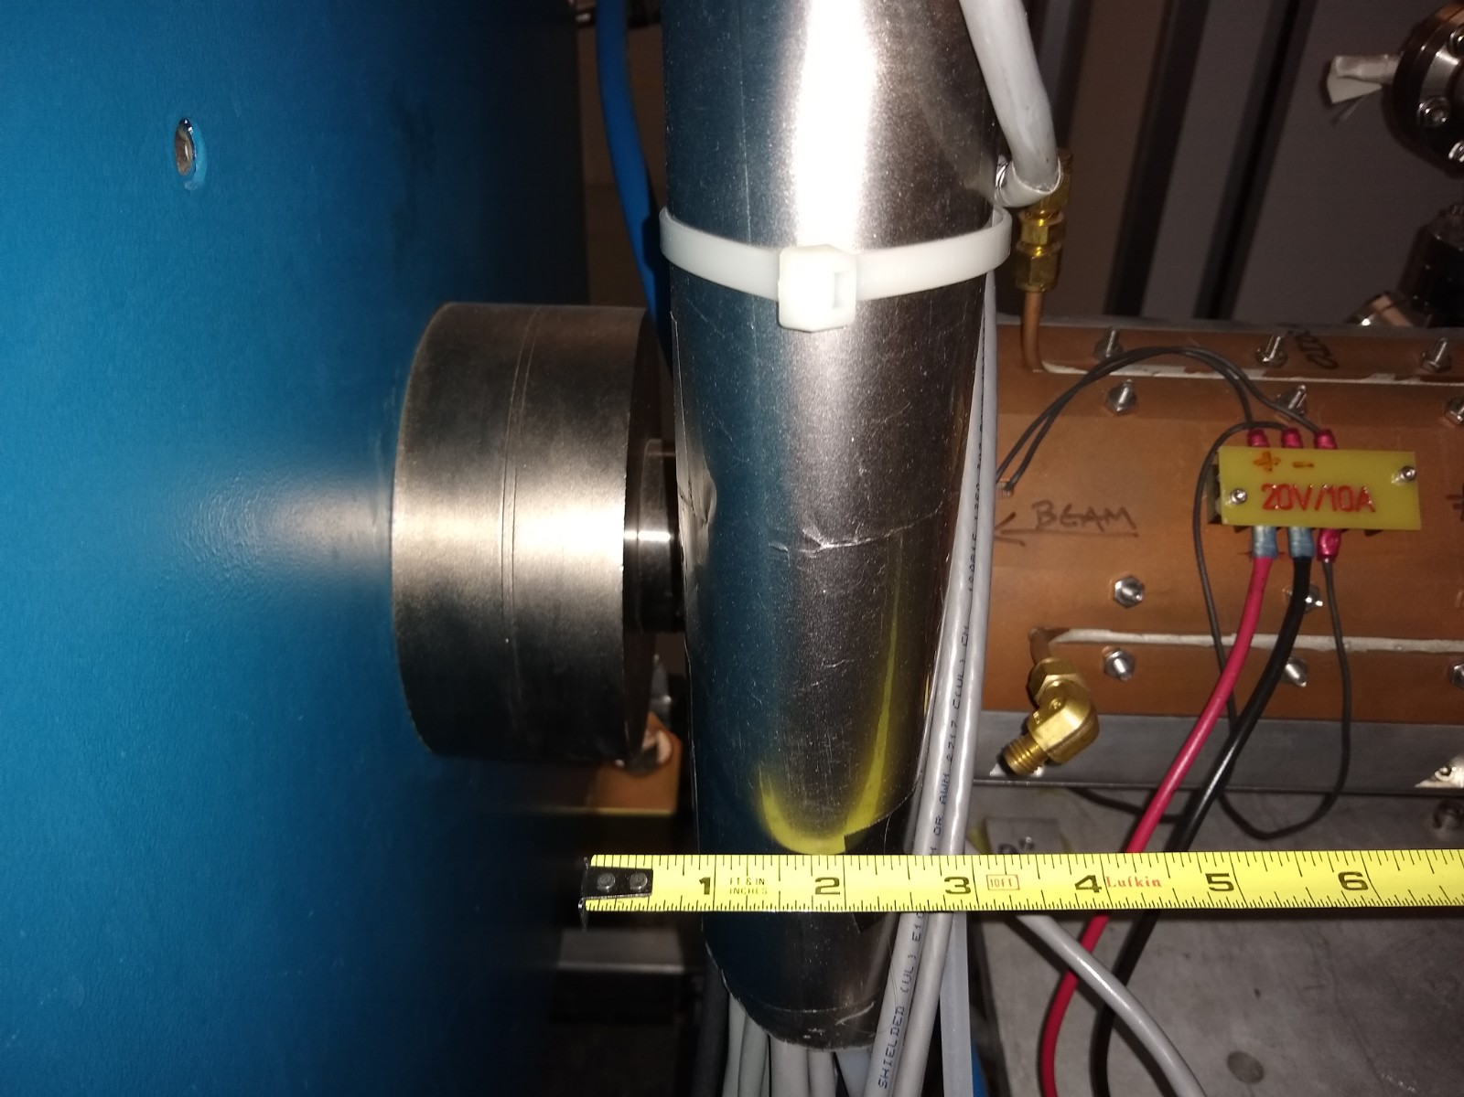
MFA0I03 OR MFA0I05

Slide 6
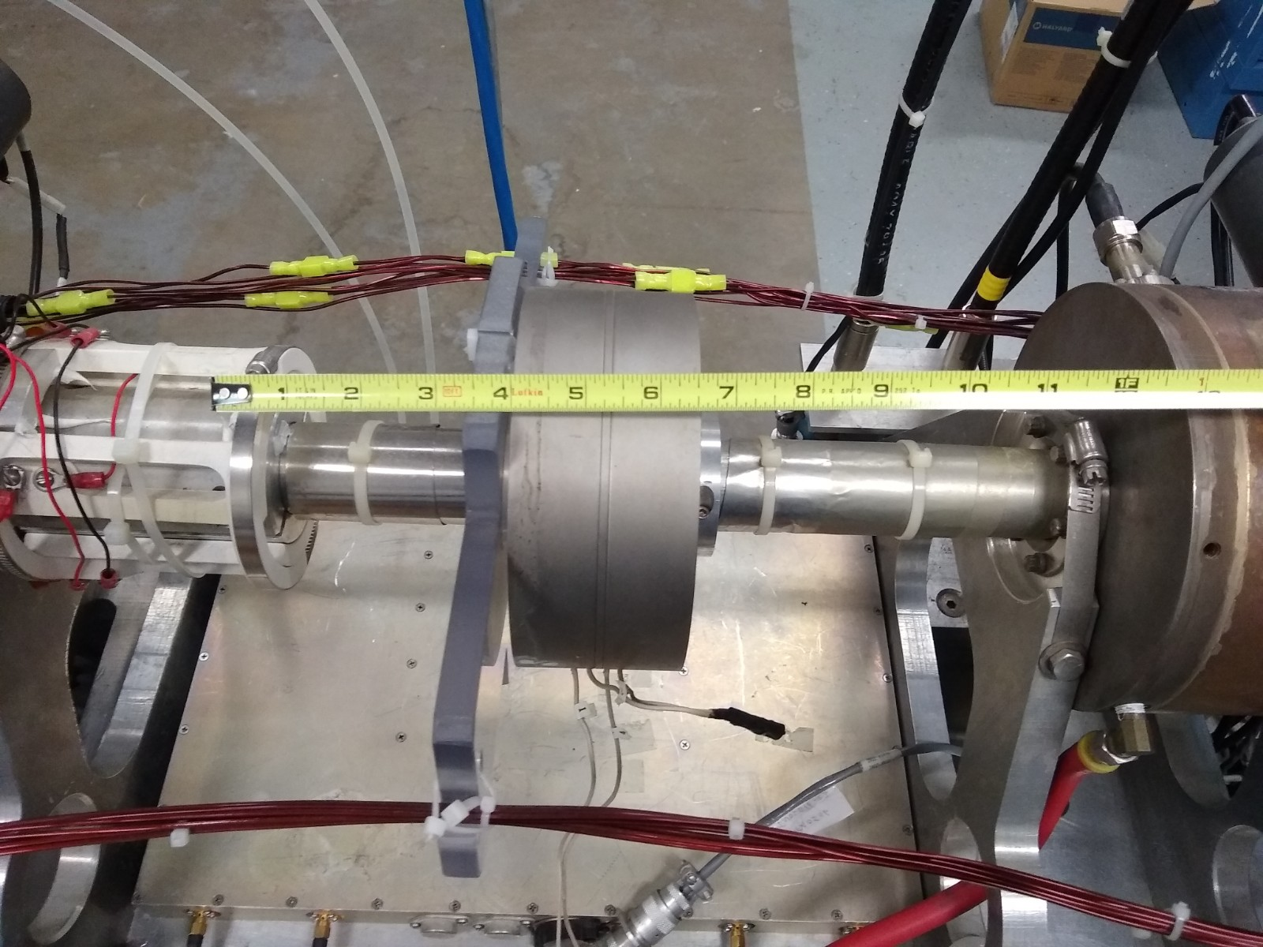
MFA0I06

Slide 7
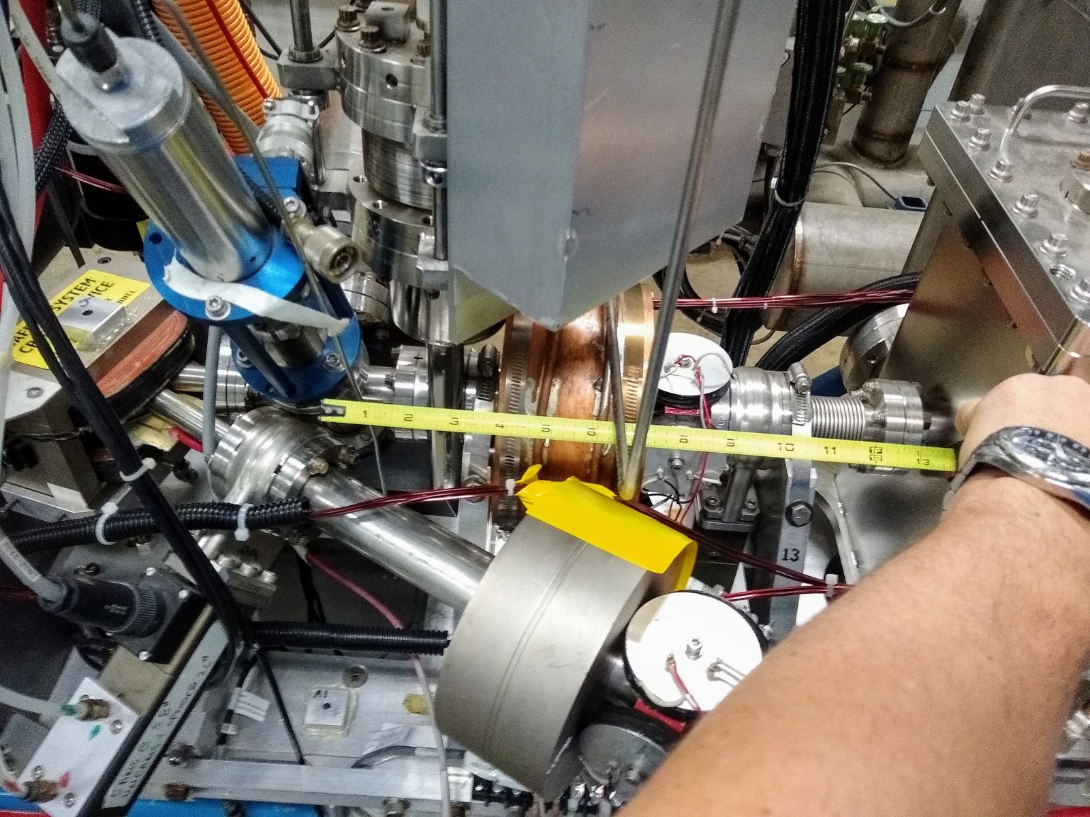
MFL0I07
MFA1Dxx

