Slide 1
200 kV guns particle tracking with CST Microwave studio
Gabriel Palacios
gabrielp@jlab.org 09/12/19

Slide 2
Cathode-anode gap:
The data for the following plots was probed on simulated BPM’s 201 and 203 as a function of vertical position on the photocathode surface (for y=-4, -2, 0, 2, 4 mm)
Photocathode
Front face
y=4 mm
y=2 mm
y=0 mm
y=-2 mm
y=-4 mm

Slide 3
Trajectories
Launching at y= 2 mm
Launching at y= 0 mm
Launching at y= -2 mm
Anode
Anode
Anode

Slide 4
Trajectories launching at y=4 mm
Anode

Slide 5
Trajectories launching at y=2 mm
Anode

Slide 6
Trajectories launching at y=2 mm
0, 2, and -2 close ups in one slide to compare to each other
Anode
Close up

Slide 7
Trajectories launching at y=0 mm
Anode

Slide 8
Trajectories launching at y=0 mm
Anode
Close up

Slide 9
Trajectories launching at y=-2 mm
Anode

Slide 10
Trajectories launching at y=-2 mm
Anode
Close up

Slide 11
Trajectories launching at y=-4 mm
Anode

Slide 12
T-cathode trajectories

Slide 13
Small shield trajectories

Slide 14
Big shield trajectories

Slide 15
T-cathode trajectories
y=4 mm
y=2 mm
y=0 mm
y=-2 mm
y=-4 mm
Close up

Slide 16
Small shield trajectories
y=4 mm
y=2 mm
y=0 mm
y=-2 mm
y=-4 mm
Close up

Slide 17
Big shield trajectories
y=4 mm
y=2 mm
y=0 mm
y=-2 mm
y=-4 mm
Close up

Slide 18
Simulated BPM201
Simulated BPM201: 39.54 [cm] from the electrode center
Simulated BPM203:
90.74 [cm] from the electrode center

Slide 19
Simulated BPM201
Simulated BPM201: 39.54 [cm] from the electrode center
Simulated BPM203:
90.74 [cm] from the electrode center

Slide 20
Simulated BPM201
Simulated BPM201: 39.54 [cm] from the electrode center
Simulated BPM203:
90.74 [cm] from the electrode center

Slide 21
Simulated BPM201

Slide 22
Simulated BPM203

Slide 23
Fin.

Slide 24
Extras
From previous presentations

Slide 25
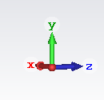
CST frame of reference:
y
x
z
X goes into the page.

Slide 26
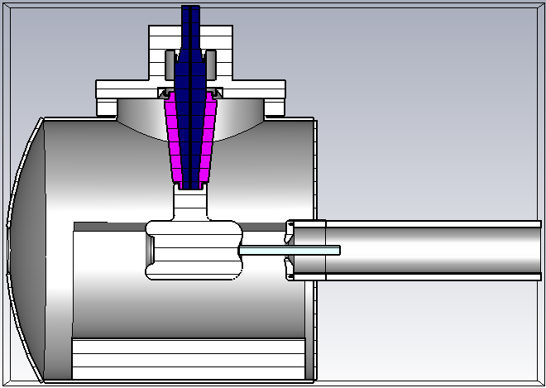
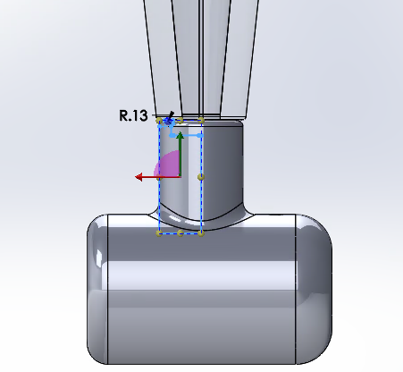
Models: T-cathode

Slide 27
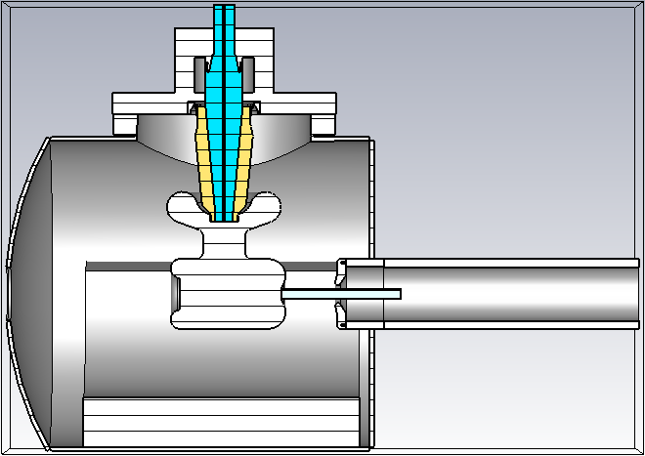
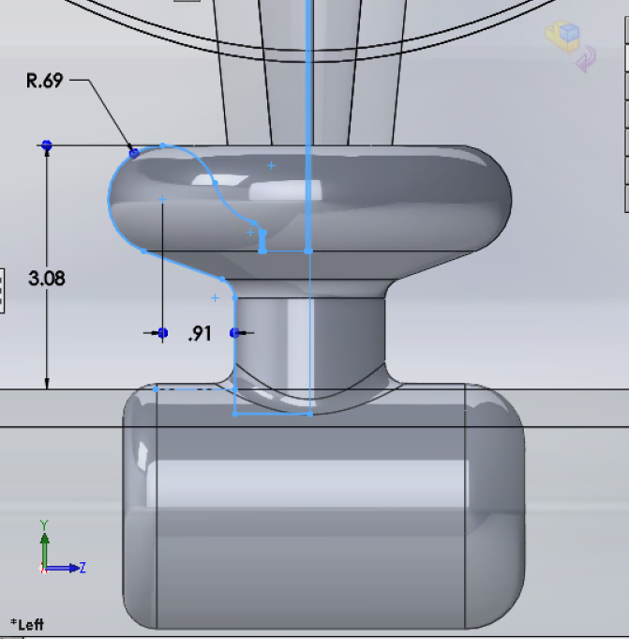
Models: Mushroom

Slide 28
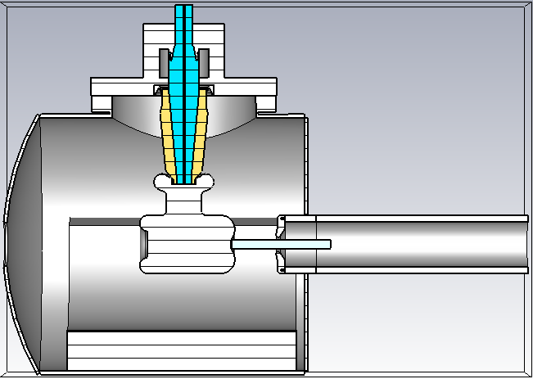
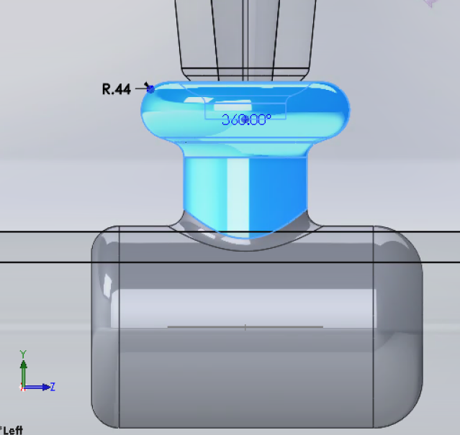
Models: Small mushroom

Slide 29
Cathode-anode gap:
The data for the following plots was probed along a horizontal line on the cathode-anode gap as a function of vertical position on the photocathode surface (varying from y=-6mm to 6mm.)

Slide 30
CST results: Transverse electric field – T-shape
The different colors show how the transverse electric field changes as a function of height on the photocathode in the interval -6mm<y<6mm along a horizontal line in the cathode-anode gap
0.252 gap between 0.21 and -0.042
Note: offset in z due to CST model photocathode not in 0,0 coordinates

Slide 31
CST results: Transverse electric field – Mushroom
The different colors show how the transverse electric field changes as a function of height on the photocathode in the interval -6mm<y<6mm along a horizontal line in the cathode-anode gap
0.191 gap between 0.27 and 0.079
Note: offset in z due to CST model photocathode not in 0,0 coordinates

Slide 32
CST results: Transverse electric field – Small mushroom
The different colors show how the transverse electric field changes as a function of height on the photocathode in the interval -6mm<y<6mm along a horizontal line in the cathode-anode gap
0.257 gap between 0.22 and -0.037
Note: offset in z due to CST model photocathode not in 0,0 coordinates

Slide 33
Comparing all models at the c-a gap only for the y=0 electric field line

Slide 34
CST results: Transverse electric field at C-a gap axis
All the data sets correspond to the center line in the cathode-anode gap. Different colors represent different shields.
~12% difference between 0.17 and 0.15
~53% difference between 0.17 and 0.08

Slide 35
False color

Slide 36
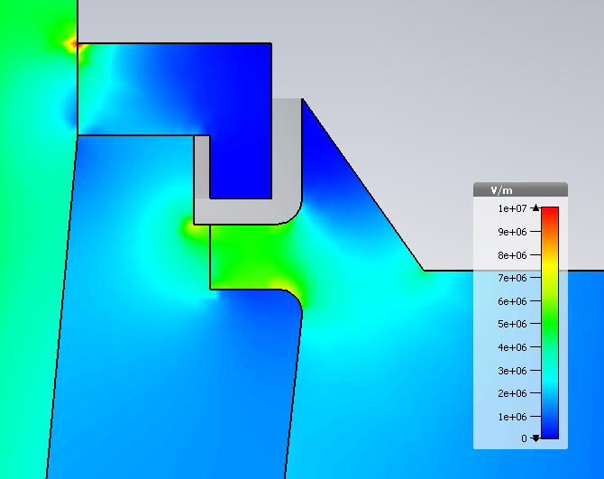
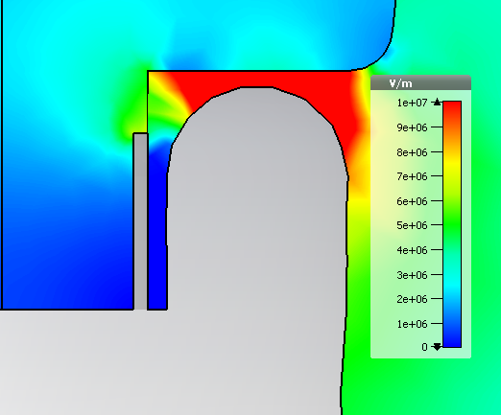
CST results: Electric field norm– No shield
Triple points:
Upper flange:5MV/m
29MV/m at cusp
Triple points:
Cathode: 3.6MV/m
6.5MV/m
7.9MV/m
4.87 MV/m

Slide 37
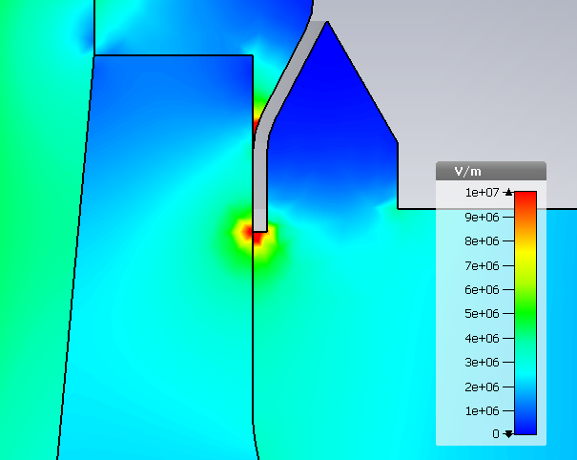
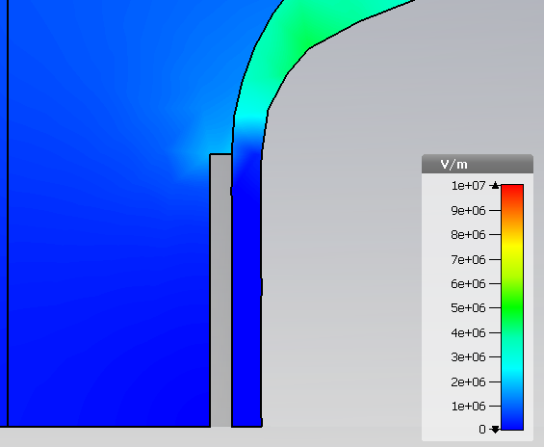
CST results: Electric field norm– original shield
Triple points:
Upper flange:10MV/m
7.2MV/m
5.6MV/m
Triple points:
Cathode: 0.6MV/m
7.9MV/m
4.85 MV/m

Slide 38
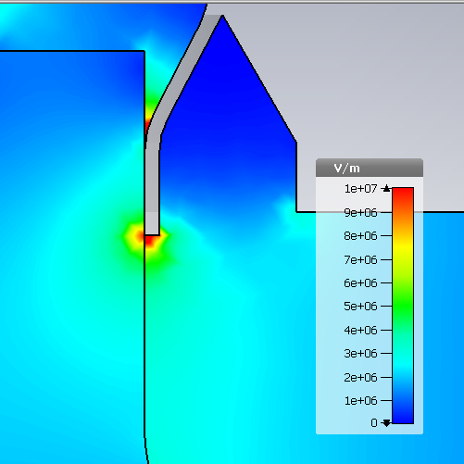
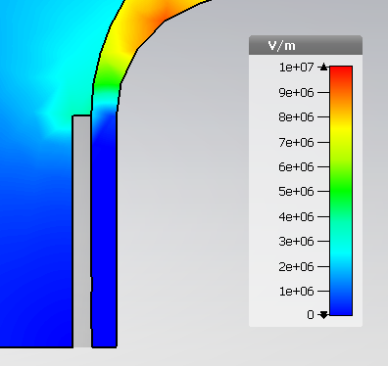
CST results: Electric field norm– Shield 8
Triple points:
Upper flange:11MV/m
7.9MV/m
6.5MV/m
Triple points:
Cathode: 1.2MV/m
8.08MV/m
4.86 MV/m

Slide 39
Electric field norm:
On the metallic surface
Pics are sadly not to scale, in all of them the cathode (horizontal cylinder) size is the same.

Slide 40
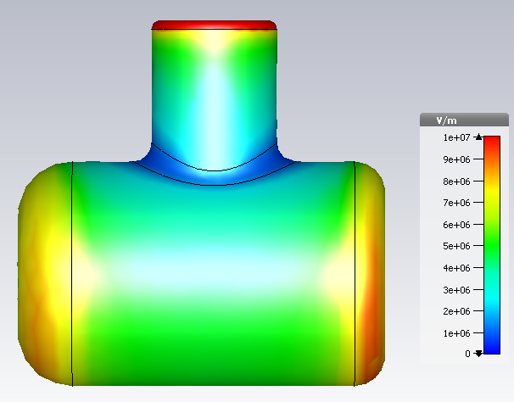
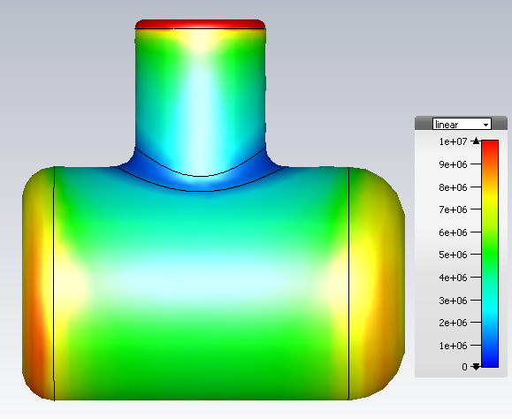
CST results: Electric field norm– T-shape

Slide 41
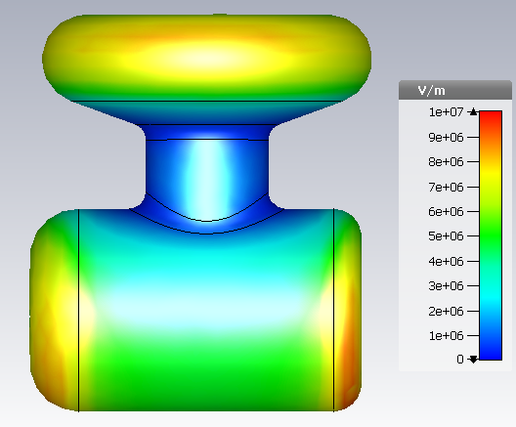
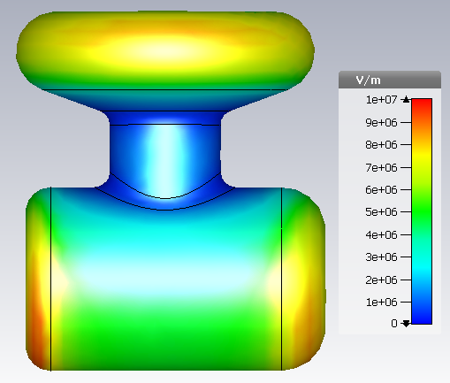
CST results: Electric field norm– Mushroom

Slide 42
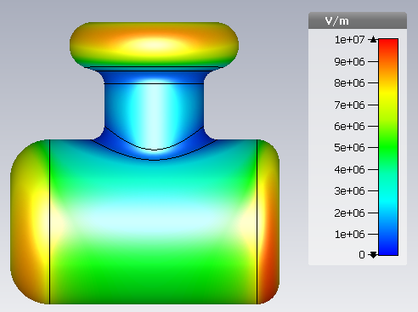
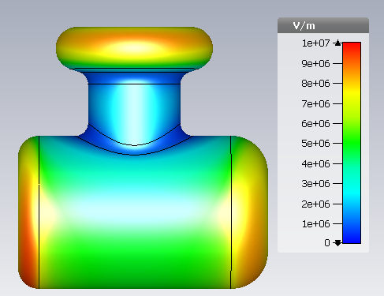
CST results: Electric field norm– Shield 8

