Slide 1
GaAs Polarized Electron Source:
A brief tour
Joe Grames
Center for Injectors and Sources
Thomas Jefferson National Accelerator Facility
June 17, 2021

Slide 2
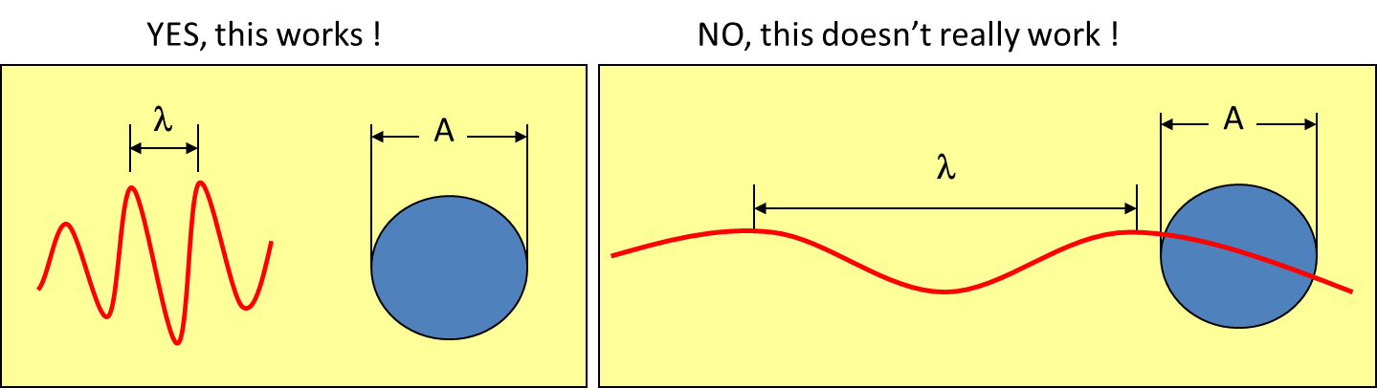
Our mission: to boldly see what no one has ever seen before!

Slide 3
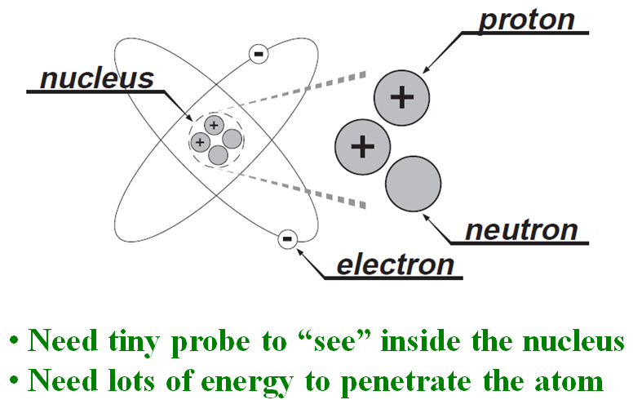
Energy scale to probe massive particles…
M ~ 938 MeV/c²
m ~ 0.511 MeV/c²
energy ~ 1/λ ~ mass
E = hc/λ = mc²

Slide 4
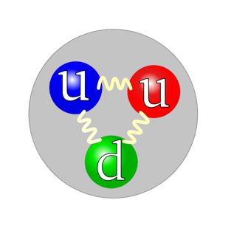
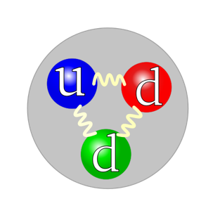
What to do?
Build a 5 mile long electron microscope!
Electron
Proton
Neutron
Make electrons energetic enough (E_{beam}) to peek inside proton or neutron (M_{nucleon}).

Slide 5
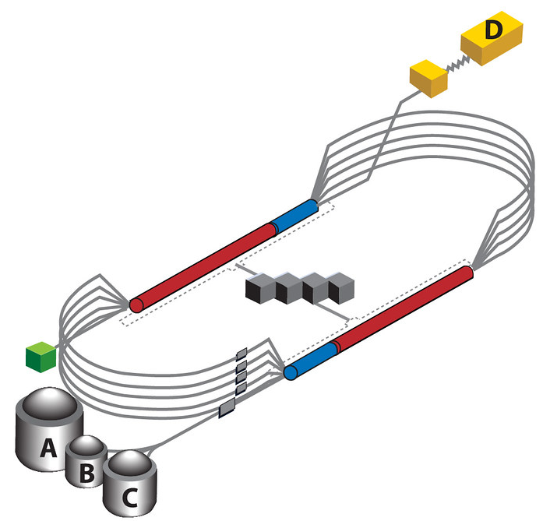
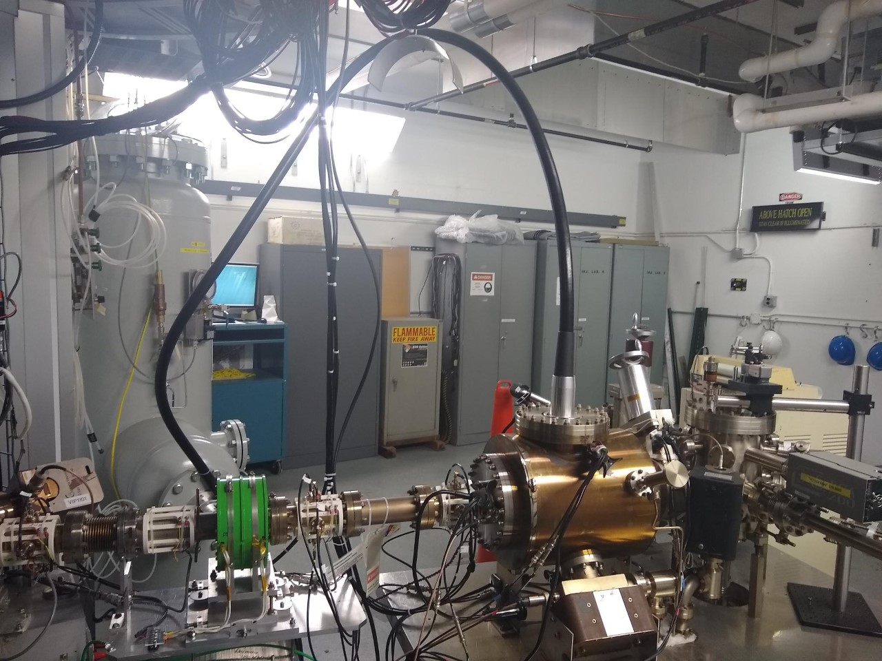
Continuous Electron Beam
Accelerator Facility (Jefferson Lab, USA)
1 GeV linac
1 GeV linac

Slide 6
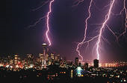
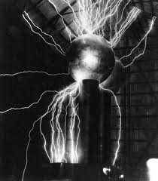
Accelerators need “free” electrons !
How might we acquire them?
Field Emission (electronic energy)
Thermionic Emission (thermal energy)
Photo Emission (optical energy)

Slide 7
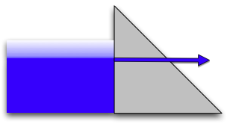

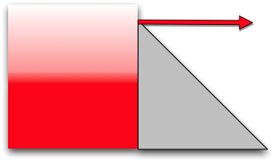

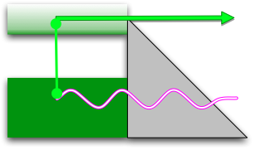

The Canonical Emission Equations
(slide courtesy of Dr. K. Jensen, Naval Research Laboratory)
Field Emission
Fowler Nordheim
E.L. Murphy, and R.H. Good,
Physical Review 102, 1464 (1956).
Thermal Emission
Richardson-Laue-Dushman
C. Herring, and M. Nichols,
Reviews of Modern Physics 21, 185 (1949).
Photoemission
Fowler-Dubridge
L.A. DuBridge
Physical Review 43, 0727 (1933).

Slide 8
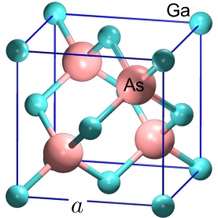
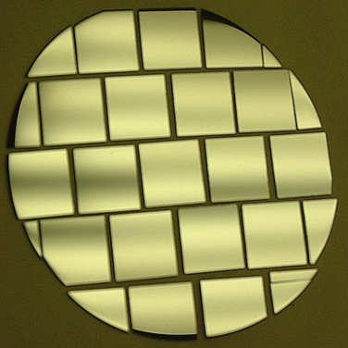
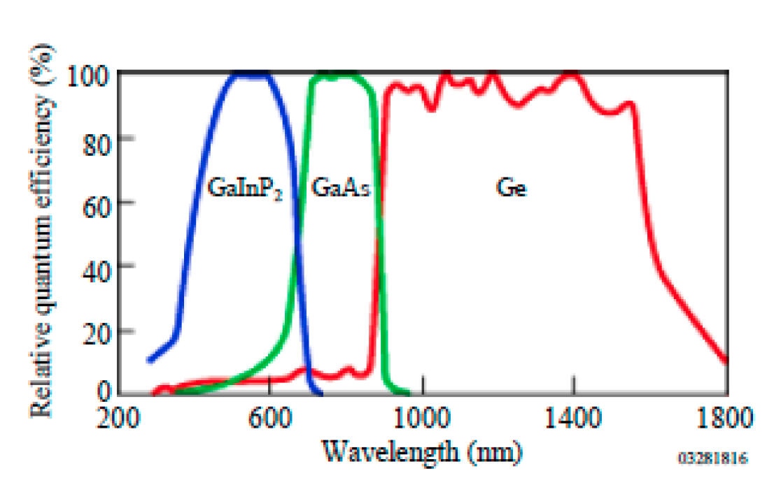
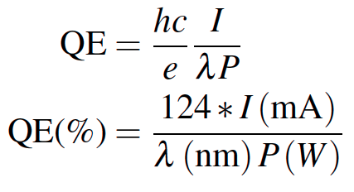
Photo-absorption
In practical terms, the quantum efficiency “QE” is the metric used to assess the number of electrons emitted per number of illuminating photons.
# Photons IN
# Electrons Out
GaAs
Al-Naser, Qusay & Hilou, Hassan & Abdulkader, Abbas. (2009). The last development in III-V multi-junction solar cells. 1. 10.1109/CCCM.2009.5268104.

Slide 9
Photo-Emission from GaAs
Dipole layers of
Cesium + NF₃
Reduces Work Function
Negative Electron Affinity (NEA)
Bare GaAs surface
Large Work Function
Positive Electron Affinity (PEA)
NEA Surface Activation
PEA=4.07 eV
-
Conduction
Band
-
χ^{NEA} ~ 0.2 eV
E_{gap}
Valence
Band
+
Light
GaAs
Vacuum
GaAs
Vacuum

Slide 10
NEA Activation of GaAs
QE
“Activate” GaAs photocathode by applying about one mono-layer of Cesium and NF₃ to very clean surface
NF₃
Cs
0
Time
R | GaAs Light Reflection Coefficient (~ 0.3)
d | GaAs layer thickness (~ 0.1 μm)
α(Һω) | Photo-absorption Coefficient (~ 5x10³ cm⁻¹)
B(χ) | Surface Tunneling Probability(~ 0.2)

Slide 11
Spin Polarized Photoemission from Bulk GaAs
E
E
J
S_{1/2}
-1/2
+1/2
S_{1/2}
σ+
σ-
E_{gap}=1.42 eV
3
1
1
3
P_{3/2}
E_{F}
P_{3/2}
Δ=0.34 eV
-3/2
-1/2
+1/2
+3/2
P_{1/2}
-1/2
+1/2
P_{1/2}
k
σ+: Right circularly polarized light
σ- : Left circularly polarized light
m_{j}
Laser excitation from P_{3/2} to S_{1/2} : E_{gap} < E_{γ} < E_{gap}+Δ
Electron Polarization:
Reverse electron polarization by reversing light polarization

Slide 12
Beam Polarization
P = (N⁺ - N⁻)/(N⁺ + N⁻)
The polarization is defined as the net fraction of spin states along a preferred direction; photoemission is oriented along the beam helicity.
(2 - 2) / (2 + 2) = 0%
(3 - 1) / (3 + 1) = 50%
Modern high polarization photocathodes provide spin alignment of about 19 out of 20 electrons

Slide 13
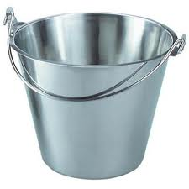
Who wants polarized beams?
Target
You measure
an experimental
asymmetry !

Slide 14
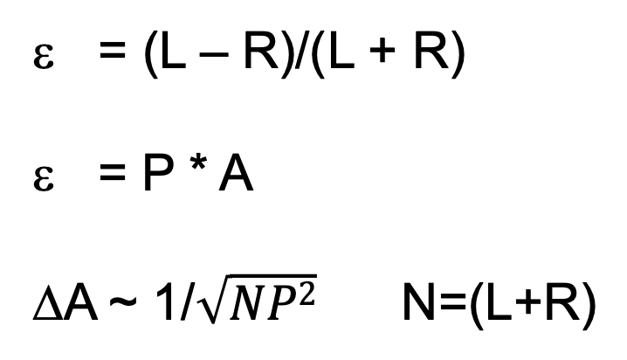
Polarized source figure of merit (FOM)
Measured asymmetry
Physics asymmetry
Error on analyzing power
= (L – R)/(L + R)
= P * A
ΔA ~ 1/$\sqrt{NP2}$ N=(L+R)
For example, increasing the beam polarization from 30% to 90% achieves the same uncertainty
in (30/90)² ~ 11% of the time.
Experiments might be completed in one month,
instead of one year.

Slide 15

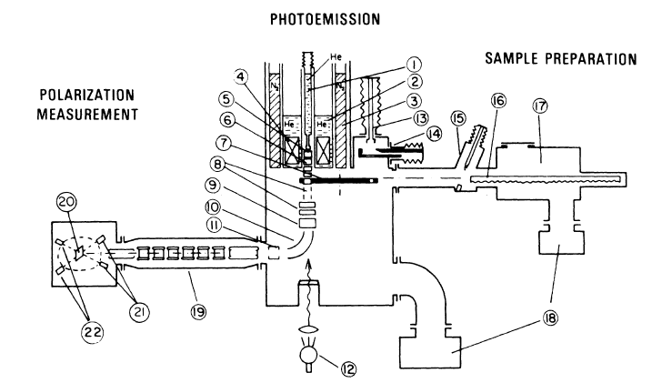
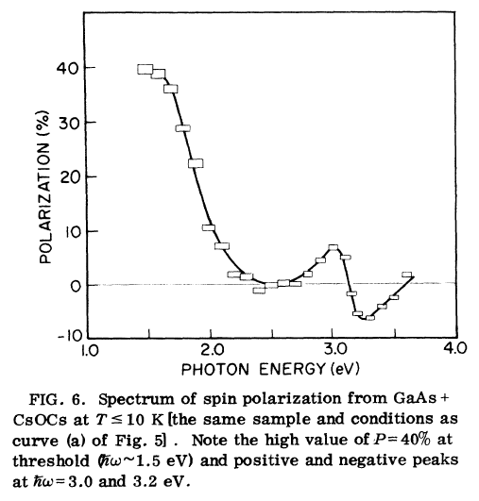
First Observation of Polarization from GaAs

Slide 16
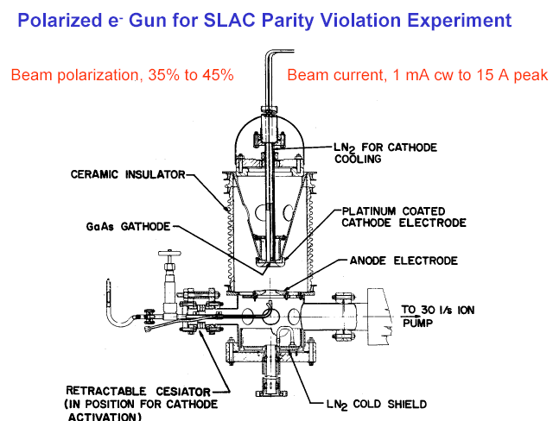
First HV GaAs photogun used on an accelerator
Built for SLAC parity-violation experiment E122
December 1977 - Polarized electrons accelerated at SLAC
June 1978 - E122 announces parity violation (Standard Model)

Slide 17
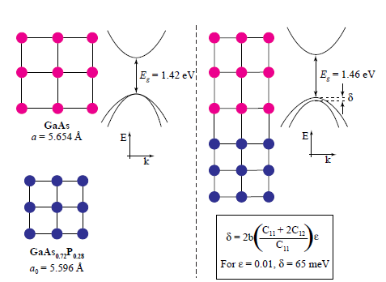
Breaking the P=50% barrier
Lattice mismatch provides stress
The band gap of the substrate layer must be larger than surface layer
Lattice constants must differ enough to introduce suitable strain
Adjust lattice constant of substrate by varying concentration of third element
Pablo Saez, PhD Thesis, SLAC Report 501, 1997
1% lattice mismatch provides equivalent force as hydraulic press!

Slide 18
Strained layer GaAs
S_{1/2}
m_{j} = -1/2
+1/2
0.1 μm
Strained GaAs
σ+
σ-
250 μm
GaAs_{1-x}P_{x} (x=0.29)
P_{3/2}
m_{j} = -3/2
+3/2
250 μm
GaAs_{1-x}P_{x} (0<x<0.29)
-1/2
+1/2
p-type GaAs
substrate
Polarization 75% >> 50% ☺
Strain relaxes in 0.1 μm layer
Not all electrons reach surface
QE 0.1% << 6% ☹
600 μm
MOCVD-grown epitaxial spin-polarizer wafer

Slide 19

Strained layer superlattice GaAs/GaAsP
GaAsP
30 A
Strained GaAs
30 A
1000 A
Active Region
GaAs_{0.64}P_{0.36}
Buffer
GaAsP
2.5μm
Strained GaAs
GaAs_{(1-x)}P_{x} Graded Layer
2.5μm
GaAsP
Strained GaAs
GaAs Substrate
D. Luh et al, SLAC, PESP2002
QE 1% and Polarization 85%
From Aaron Moy, SVT Assoc and SLAC, PESP2002

Slide 20
GaAs Photocathode Evolution

Slide 21
JLab polarization : since mid-90’s
my PhD

Slide 22
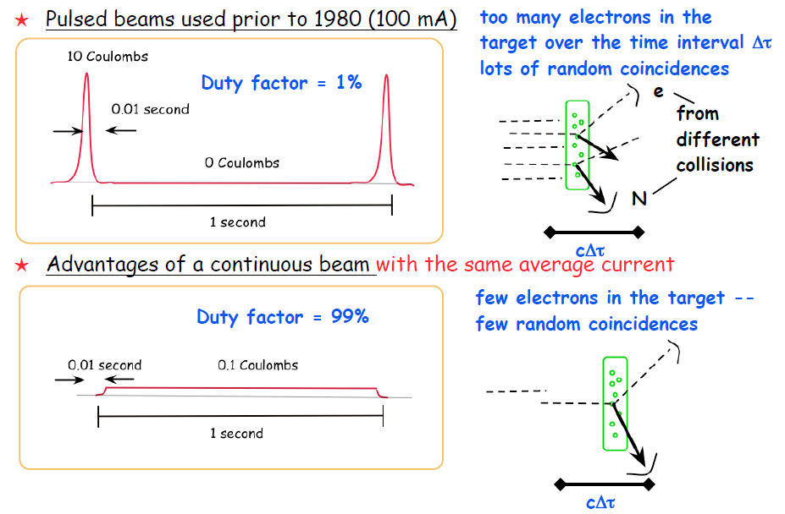
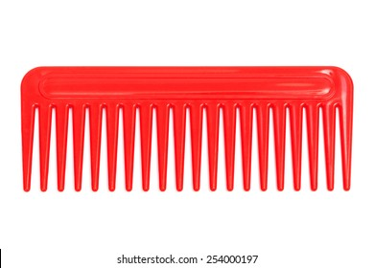
Continuous vs. Pulsed Beams
1 Coulomb
Duty factor = 100%
1 Coulomb
Duty factor = <100% w/ rf structure

Slide 23
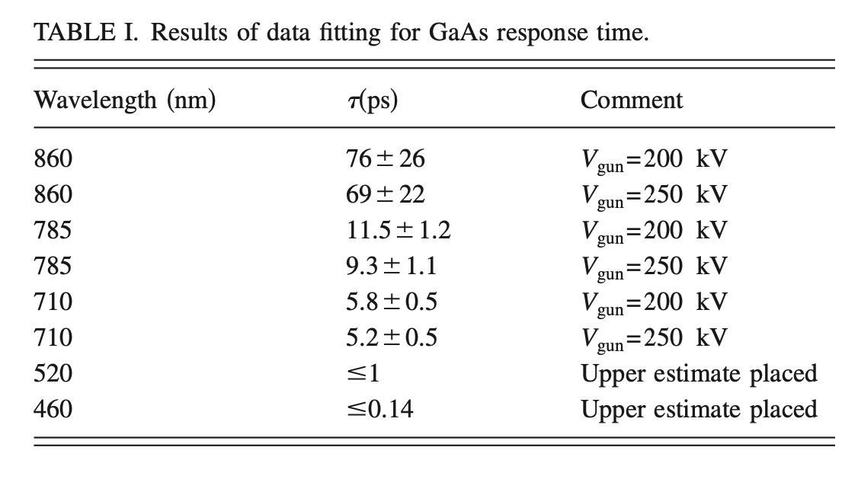
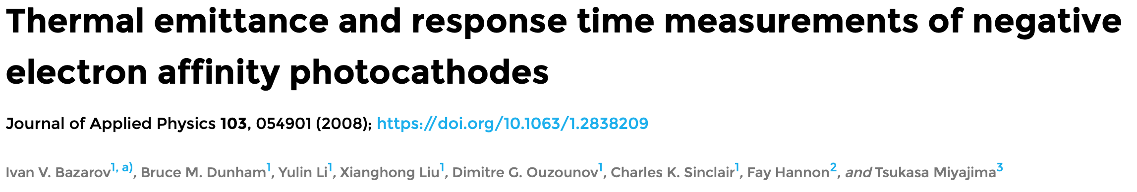
…but continuous does NOT mean DC
DC beams
Pros
  Laser simple
  No long. SC forces
Cons
  Incompatible w/ RF accel
  Lose 5/6th of the beam
RF beams
GaAs has a prompt reponse (1-10’s psec)
Depends on absorption length (λ) and diffusion to surface

Slide 24
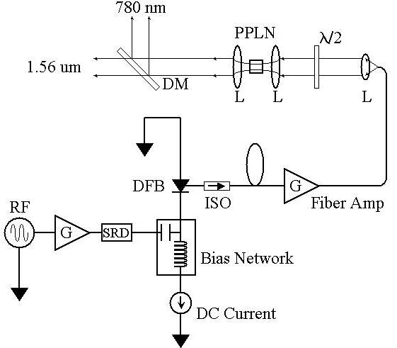
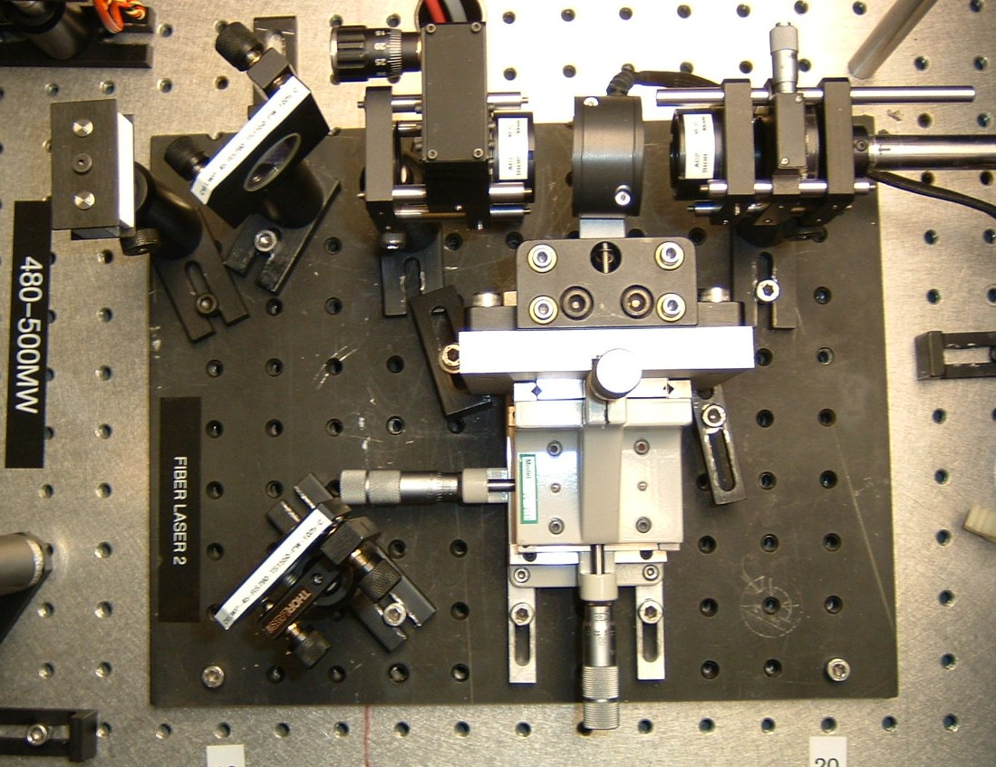
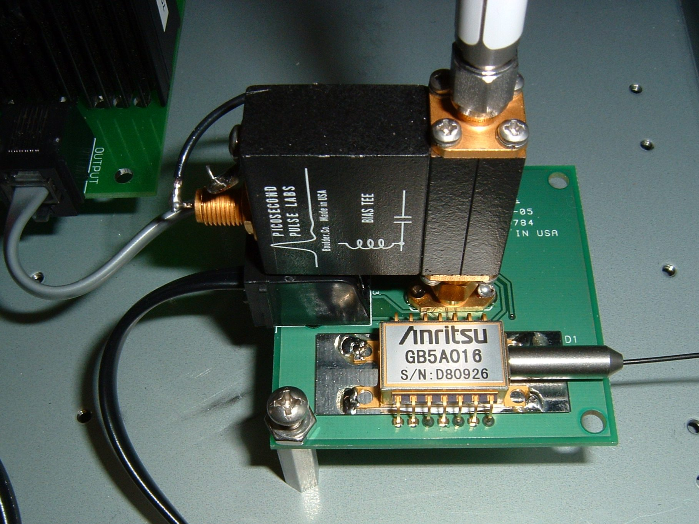
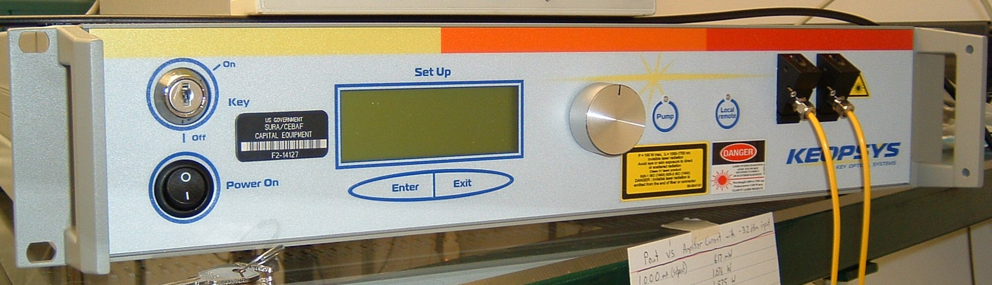
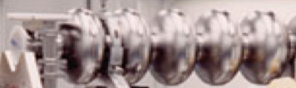
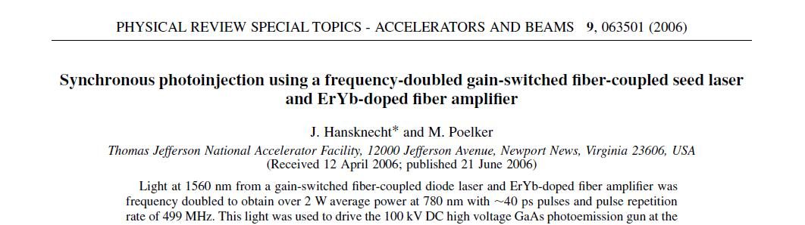
Fiber-based Drive Laser
780 nm
Frequency-doubler
1560 nm to 780 nm
30% Efficiency (2 W)
RF Locked Low-Power (1 mW)
1560 nm Fiber Diode
1560 nm
499 MHz
High Power (6 W) 1560 nm Fiber Amplifier

Slide 25
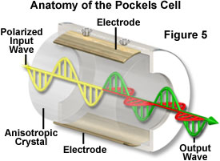
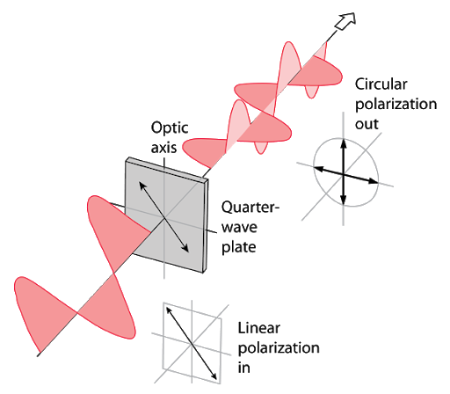
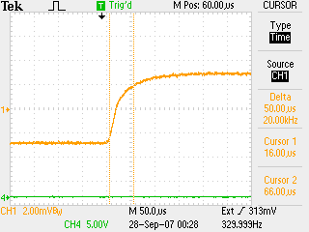
Fast helicity reversal
Potassium di-Hydrogen Phosphate (Long)
Rubidium Titanyl Phosphate (Trans)
Pockels cell λ/2 transition optical result. ~70us with no ringing.

Slide 26
Parity Violation Experiments at CEBAF

Slide 27
What does “A_{PV} = 36 ppb” even mean?
A
ε = (A - B)/(A + B)
Target
1,000,000,000
A - B
= 0.000000036
1,000,000,000
B
A = 500,000,018
B = 499,999,982

Slide 28
Part of the ”bigger picture”

Slide 29
How to make the electrons “energetic” ?
Air ~ 6 MV/m
Sulfur hexafluoride ~15 MV/m
Ceramic ~ 30 MV/m

Slide 30
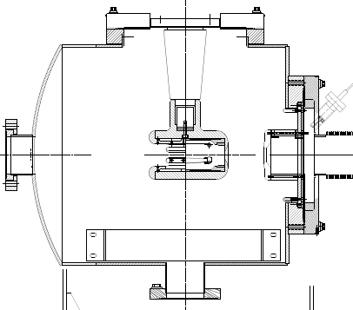
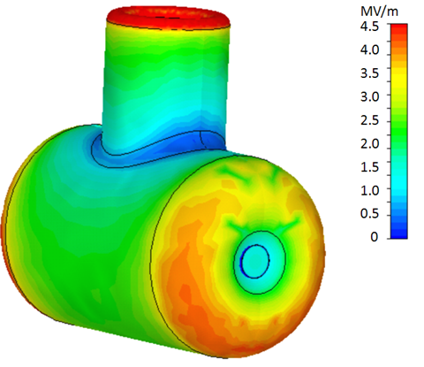
Anatomy of a high voltage gun chamber
Vacuum flange
Insulator
Cathode electrode
Load
photocathodes
Anode electrode
light in
electrons out
Photocathode
Getter pump
Ion pump

Slide 31
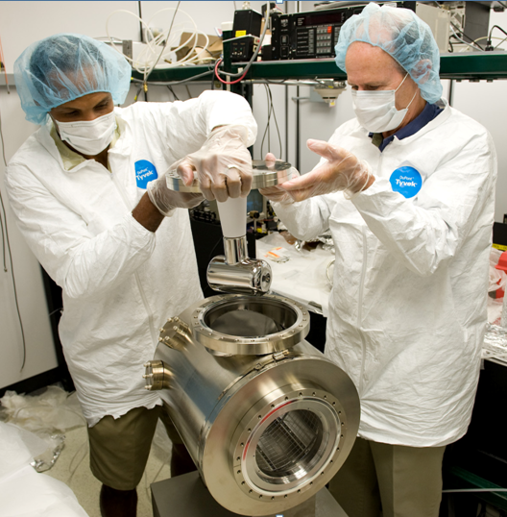
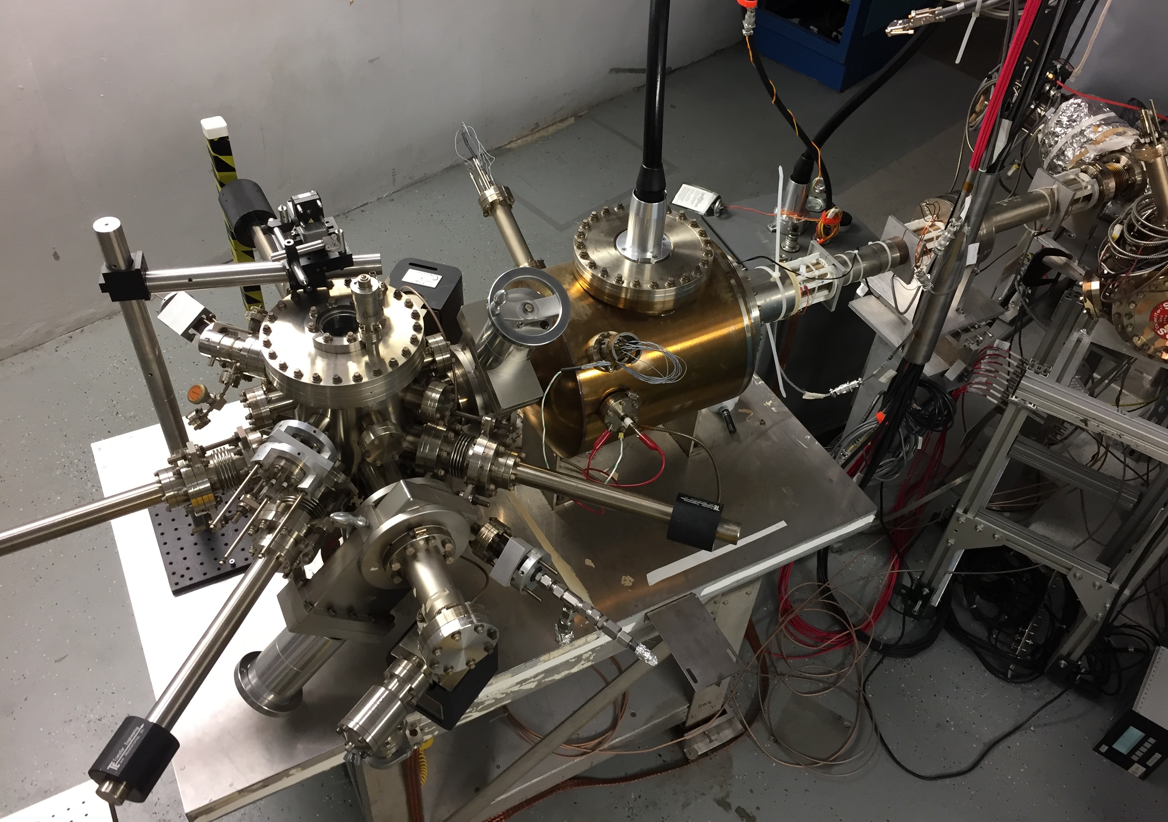
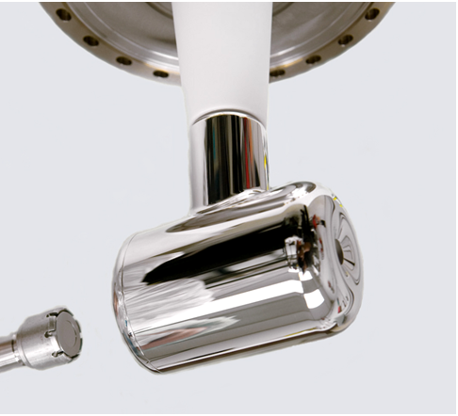
Polarized electron source
Activation
chamber
HV chamber
HV cable
Loading
chamber

Slide 32
Benefits of Higher Gun Voltage
Reduce space-charge-induced emittance growth, maintain small transverse beam profile and short bunch-length. In other words, make a “stiff” beam right from the gun
Address current density limitation due to Child’s Law (Space Charge Limit)
Reduce problems associated with Surface Charge Limit (i.e., QE reduction at high laser power)
Prolong Charge Lifetime

Slide 33
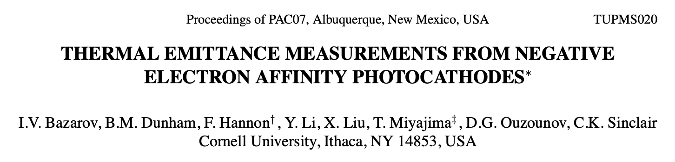
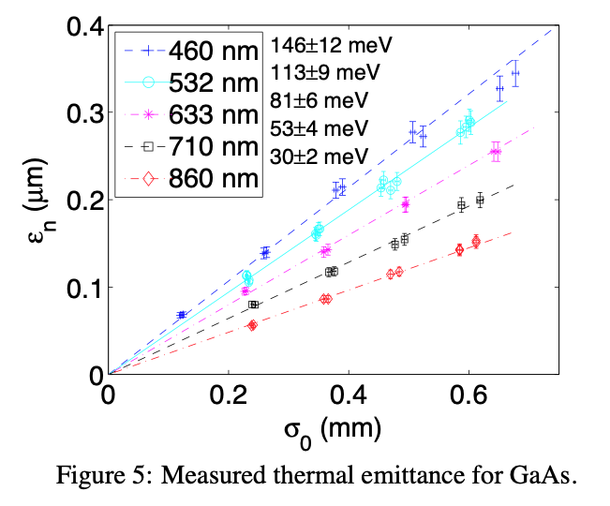
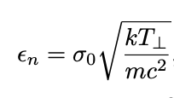
Thermal Emittance, Laser Size and Brightness
Normalized Emittance:
Normalized Brightness:

Slide 34
Bunchlength and Transmission
Bunch length at 5 meters
Transmission 110 psec temporal slit
Longer bunches complicates longitudinal rf acceleration
Reduced transmission requires high bunch charge !!!

Slide 35
Space Charge (Child’s Law) Limit
(1D) Maximum current density that can be transported across cathode-anode gap (for an infinite charge plane):
[A/cm²]
(2D) For electron emission from a finite circular spot on the cathode:
(PRL 87, 278301)
(3D) For short pulse 2D:
(PRL 98, 164802)

Slide 36
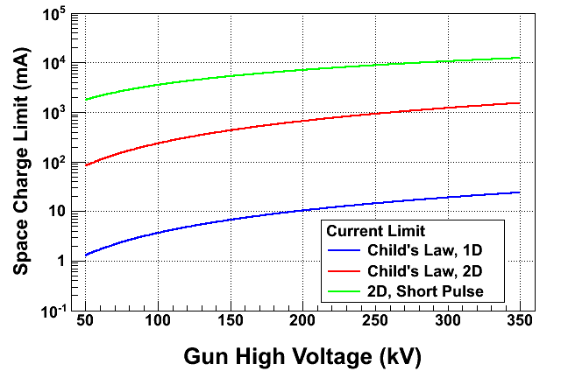
Space Charge Limit at CEBAF
1995
2010
2021

Slide 37
Schottky Effect
NEA of GaAs depends on Gun HV.
QE increases with external Electric Field at GaAs surface, E_{s},
Where χ (~200 meV) is the zero-field NEA value (Physics Letters A 282, 309) and potential barrier lowering due to Electric Field is
Where ε_{s} (= 13.1) is GaAs relative permittivity.

Slide 38
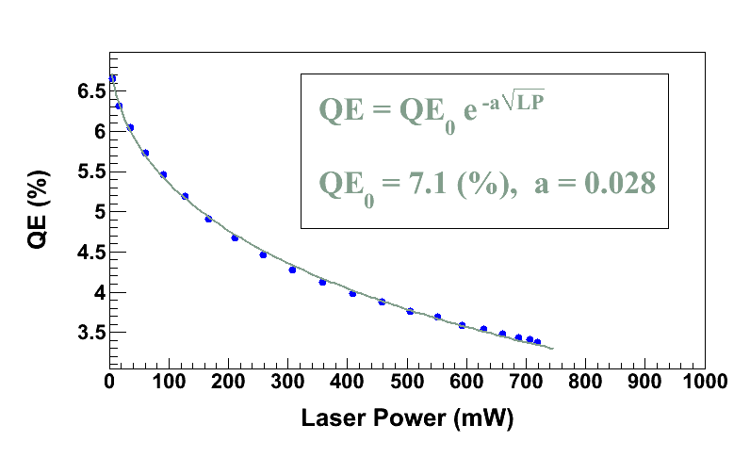
Surface Charge Limit (Surface Photovoltage Effect)
Surface Charge Limit reduces NEA of GaAs
Photoelectrons trapped near GaAs surface produce opposing field that reduces NEA resulting in QE reduction
U(LP)
χ
E_{gap}
δU(E_{s})
Where U(LaserPower) is up-shifting of potential barrier due to photovoltage.
For heavily Zn doped GaAs surface, U(LP) → 0
Higher Gun HV suppresses photovoltage

Slide 39
“Death” of a photocathode
Metrics for quantifying reduction of NEA condition:
Vacuum lifetime – generally a leak, or chemical “X” (hours)
Dark lifetime – “dark” means no light, so field emission (hours)
Charge lifetime – beam related, proportional to charge extracted (Coulombs)
Charge fluence lifetime – surface charge extract (Coulombs/Area)
Note, there are other ways to reduce lifetime…
Laser heating (NEA evaporation)
beam loss (vacuum, x-rays)
stray light (stray beam)
…and on

Slide 40
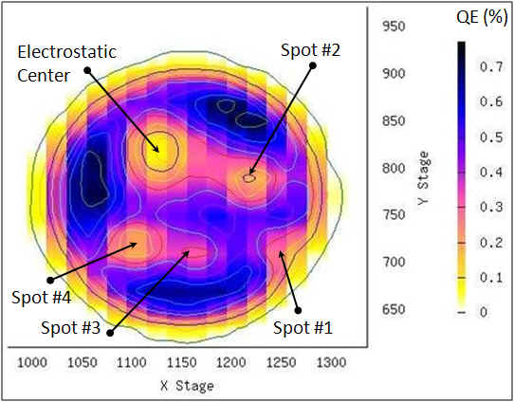
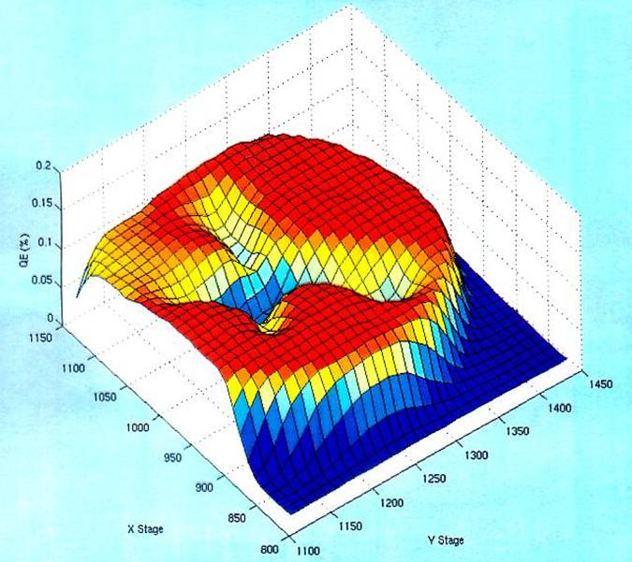
Ion back-bombardment leads to QE reduction
These ions may strike the photocathode, generate secondary electrons or x-rays, and desorb gas from surfaces; all leading to a reduction of the photocathode quantum efficiency (QE).

Slide 41
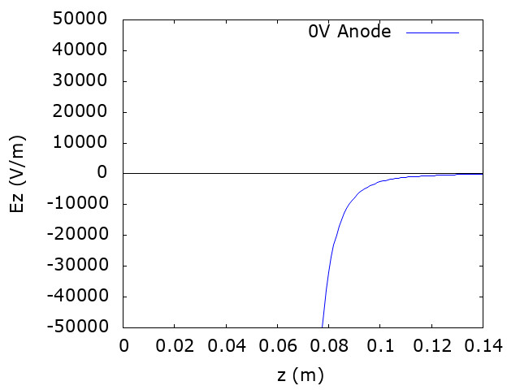

Mitigating ion back-bombardment
Work of J. Yoskowitz (Old Dominion University) IPAC’21

Slide 42
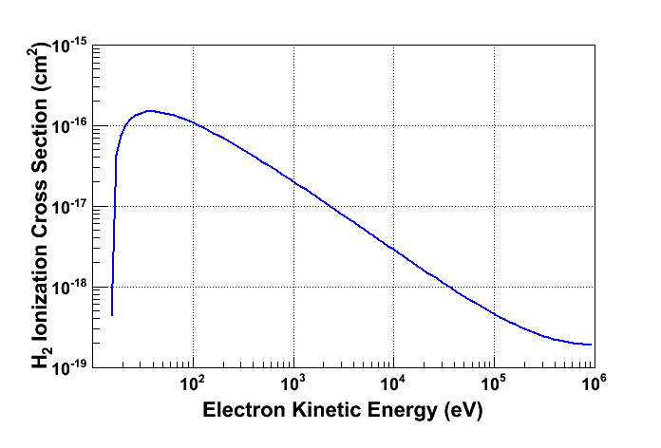
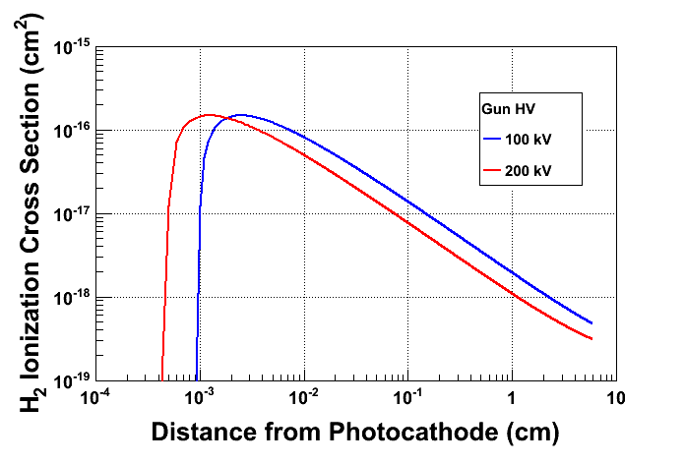
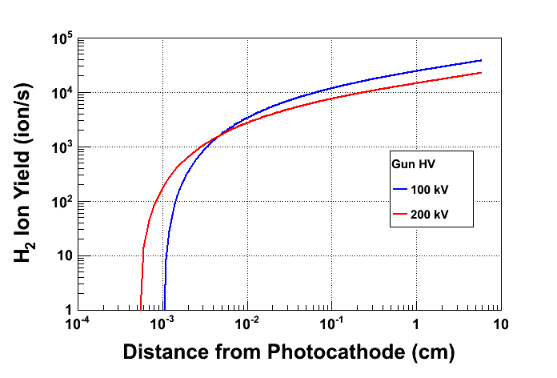
Prolong Photocathode Charge Lifetime
Most ions created at low energy
Most ions created close to GaAs surface
Beam Current: 2.0 mA
Vacuum: 8.0 × 10⁻¹² Torr

Slide 43

We understand Alice’s worry…
“The woods were dark and foreboding, and Alice sensed that sinister eyes were watching her every step. Worst of all, she knew that Nature abhorred a vacuum” – Gary Larson
Air ~ 10¹⁶ / Torr-cm³
  ^{(molecules ~2 nm apart)}
Gun ~ 10⁻¹² Torr
  ^{(molecules ~1 mm apart)}

Slide 44
Vacuum conditions in an accelerator
Application | Pressure Range | Location | Vacuum Regime
Beamline to dumps | 10⁻⁵ Torr | Target to dump line | Medium
Insulating vacuum for cryogens | 10⁻⁴ Torr to 10⁻⁷ Torr | Cryomodules, transfer lines | Medium to high
Targets, Scattering Chambers | 10⁻⁶ to 10⁻⁷ Torr | Experimental Halls | High to very high
RF waveguide warm to cold windows | 10⁻⁷ to 10⁻⁹ Torr | Between warm and cold RF windows | High to very high
Warm beamline | 10⁻⁷ to 10⁻⁸ Torr | Arcs, Hall beamline, BSY, some injector | High to very high
Warm region girders | 10⁻⁹ Torr or better | Girders adjacent to cryomodules | Very high to ultrahigh
Differential pumps | Below 10⁻¹⁰ Torr | Ends of linacs, isolate cryomodules | Ultrahigh vacuum
Baked beamline | 10⁻¹⁰ to 10⁻¹¹Torr | Y chamber, Wien filter, Pcup | Ultra high vacuum
Polarized guns | 10⁻¹¹ to 10⁻¹² Torr | Photoguns | Ultra to Extreme high vacuum
SRF cavity vacuum | < 10⁻¹² Torr | Inside SRF cavities with walls at 2K | Extreme high vacuum

Slide 45


Achieving Extreme High Vacuum
Avoid contamination by oils due to roughing pumps, fingerprints, machining.
Baking used to get pressures below 10⁻¹⁰ Torr
  250°C for 30 hours removes water vapor bonded to surface that otherwise limits pressure
Getter Pumps
  Chemically active surface
    Titanium sublimed from hot filament
    Non-Evaporative Getters
  Molecules stick when they hit
    Does not work well for inert gasses such as Argon, Helium or for methane
Ion Pumps
  Electric field to ionize gasses
  Magnetic field to direct gasses into cathodes where they are trapped
    Has some pumping capability for noble gasses
NEG pump array
Ion Pump

Slide 46





Polarized Electron Sources : Quest for Perfection!
1
~1995
~2015
5
The endless quest for perfection
~2010
4
2
~2000
3
~2005

Slide 47
I would like to acknowledge the many folks who have contributed in one way or another their time or materials to this presentation.
Carlos Hernandez-Garcia, Matt Poelker,
Marcy Stutzman, Riad Suleiman
And errors, mistakes, etc. are my own.
Thank you !

Slide 48
Outline
Part I – Photocathodes
  Electron emission
  PEA & NEA & QE
  Polarization
  Time response
Part II – Polarized Source & Operation
  Drive lasers
  Helicity reversal
  High voltage
  Space and surface charge limits
  Photocathode lifetime
  Vacuum
Part III – Polarized Injectors
  Low energy spin rotators
  Low energy Mott polarimetry
  PES @ Accelerator Facilities

Slide 49
Polarized source (100’s keV) beam lines & spin
Need to be mindful of the magnetic & electric fields used affect both the electron’s trajectory and it’s spin!

Slide 50





Typical polarized source beam line at low energy
Dipoles (fortunately largely benign to spin)
Solenoids (be careful!)
  Are more effective lenses than quads at low energy
  But are great spin rotators (precession is about the momentum vector)
$${\vec{Ω}}_{spin}=\frac{e}{m}\left[\left(a+\frac{1}{γ}\right){\vec{B}}_{⊥}\right]$$
$${\vec{Ω}}_{p}=\frac{e}{m}\left[\left(\frac{1}{γ}\right){\vec{B}}_{⊥}\right]$$
$$Δ\vec{Ω}spin =\frac{e}{m}\left[\frac{1}{γ}(a+1){\vec{B}}_{∥}\right]$$
$${\vec{Ω}}_{p}=0$$
$$θ=\frac{180}{π}\frac{e}{m}\frac{L_{eff}}{βc}\left[\frac{1}{γ}(a+1)B_{∥}\right]$$
10’s deg/G-cm @ 100’s keV

Slide 51



Typical polarized source beam line at low energy
Wien filters (dedicate spin rotators)
  crossed electric and magnetic fields
  E/B ratio fixed for net zero force, but together provide non-zero spin rotation
$$Δ\vec{Ω}=\frac{e}{m}\left[a{\vec{B}}_{⊥}+(\frac{1}{γ^{2}−1}−a)\frac{\vec{β}×\vec{E}}{c}\right]$$
$$θ=\frac{180}{π}\frac{e}{m}\frac{L_{E}}{βc}\left[a\frac{E}{βc}+(\frac{1}{γ^{2}−1}−a)\frac{βE}{c}\right]$$

Slide 52



Wien filter effects
Wien filters
  Fringe fields
  Optical effects
V. Tioukine and K. Aulenbacher, NIM A 568 (2006) 537–542
B.Steiner et al., Proc. PAC07, Albuquerque (MOPAN013)

Slide 53

Injector spin rotators
Taken together can provide 4π spin rotation

Slide 54
Mott scattering

Slide 55
Mott cross-section and Sherman function

Slide 56
Sherman function (Mott analyzing power)
Analyzing power (Sherman function) is very large >40% (>100 keV)
Scales with Z of target material
Detection of elastics at backward angle becomes tough at MeV beam energies, but the advantage is that targets can be thicker (1 micron) and scattering rate is suitable for accelerator intensities (>100’s nA)

Slide 57




100 keV Mott polarimeter
LEFT Si detector (120 deg)
Collimator (defines ΔΩ)
Faraday cup
k’
k
k’
RIGHT Si detector (120 deg)
Target ladder
Polarized beam normal to (k x k’)

Slide 58


Target thickness extrapolation
Single elastic scattering … asymmetry would be constant, independent of thickness
Double elastic scatting … electron spin is rotated and analyzed (lesser asymmetry)
What we measure … weighted contribution of Single + Double scattering
Theory (from single atom)
Measurement (many targets))
5 MeV

Slide 59

Continuous Electron Beam
Accelerator Facility (Jefferson Lab, USA)
4 independent end stations means using 4 lasers at once, synchronously:
  Merged with beam-combiners and polarizing cubes
  Phase synchronous (499 or 249.5 MHz)
  All lasers focused to same area on photocathode

Slide 60


S-DALINAC (Darmstadt, Germany)
(courtesy J. Enders, Darmstadt Univ.)

Slide 61

Mainz Energy-Recovery
Superconducting Accelerator (Mainz, Germany)
(courtesy K. Aulenbacher, Mainz U.)

Slide 62


Electron Ion Collider (BNL, USA)
LINAC to RCS
Transfer Line
RCS to ESR Transfer Line
12 o’clock
(courtesy E. Wang, BNL)

Slide 63
Electron Ion Collider (BNL, USA)
(courtesy P. Inacker-Mix, BNL)

Slide 64

International Linear Collider (Japan)
50% of polarized e- beam creates polarized e+
50% of polarized e- beam collides with e+

