Slide 1
Fall 2017 QE Scan Analysis
Josh Yoskowitz

Slide 2
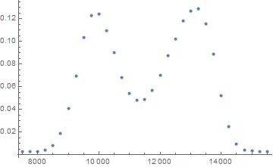
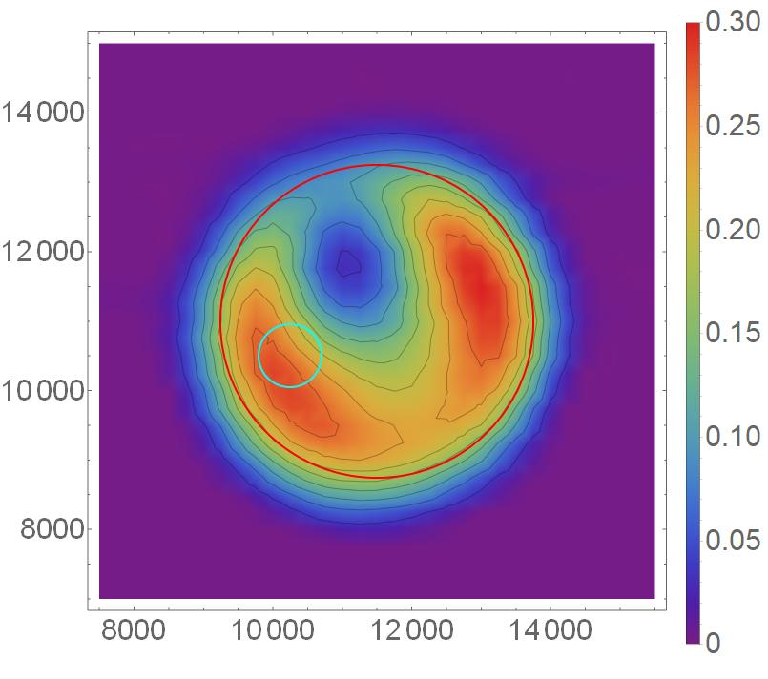
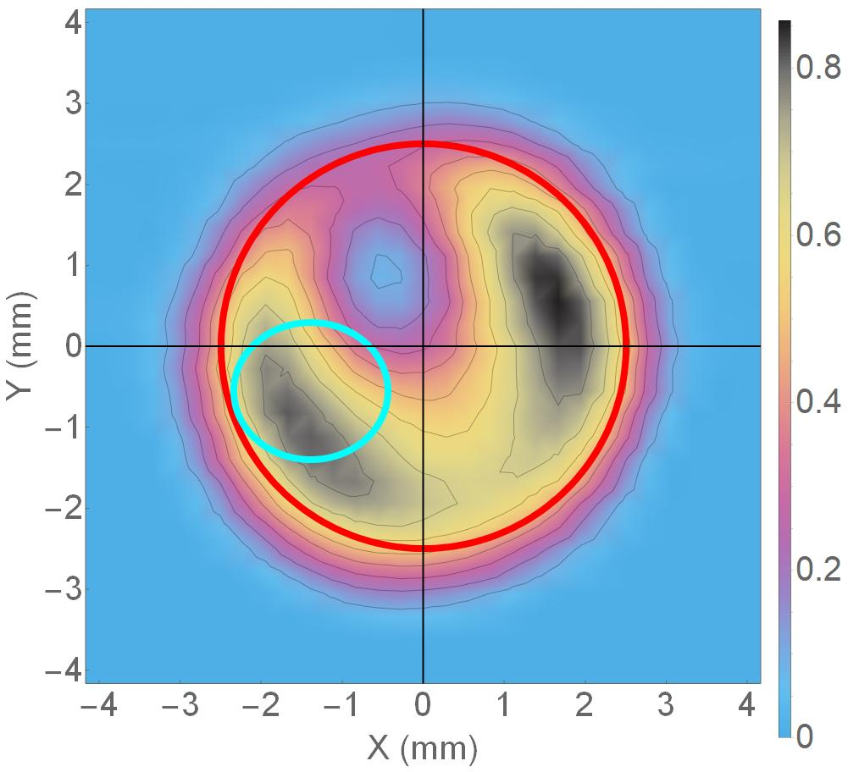
Calibration of QE Scan Data
Steps to calibrate data:
Convert ADC values to QE values using beam current, laser power, laser wavelength, etc.
Plot QE scan data by row.
For each row that crosses the active area (i.e. has significant, non-zero QE values): While approaching from the left and right sides of the plot, find the positions that correspond to the highest slope (i.e. highest absolute value of the derivative).
Find the difference in x-values between these two points – this corresponds to the distance across the active area at this row.
Plot all distances and then pick the largest distance – this corresponds to the diameter of the active area.
Set this distance (in steps) equal to 5mm – the diameter (FWHM) of the active area -- then use this to calibrate the data from steps to mm. This row is also the center of the active area, thus the QE scan can also be centered about the active area.
Using the steps to mm conversion factor, the laser spot (cyan circle) can be plotted.
QE
X (steps)
Y (steps)
QE
X (steps)
QE

Slide 3
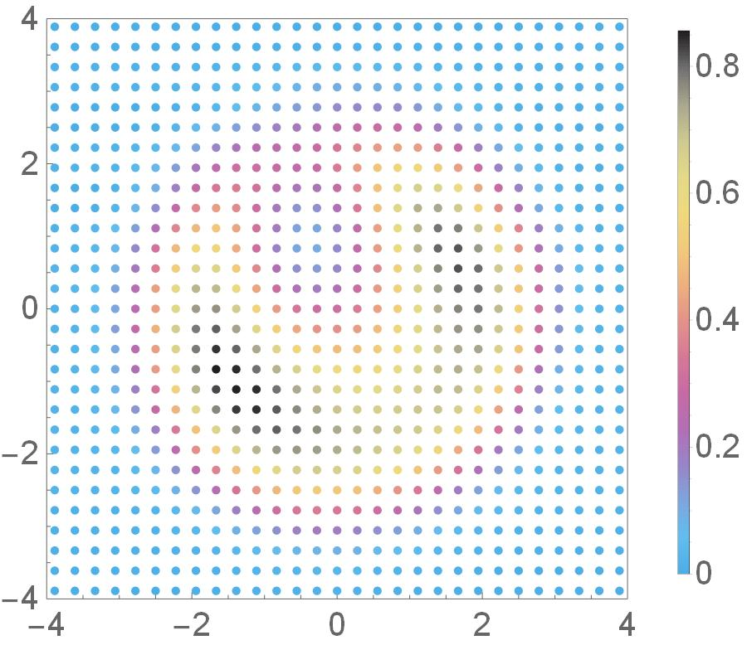
QE Scans and Parameters: 1st Scan
Date & Time: 9/25/2017 at 8:41am
Photocathode Active Area (Red Circle): 5mm Diameter
Activation: A4
Laser spot size/position: 2.54 mm² RMS at (0.56,0.28) mm
Laser Configuration: C4, Lens OUT
Logbook Entry: https://logbooks.jlab.org/entry/3485607
QE
QE
Y (mm)
X (mm)

Slide 4
QE Scans and Parameters: 2nd Scan
Date & Time: 9/25/2017 at 3:49pm
Photocathode Active Area (Red Circle): 5mm Diameter
Activation: A4
Laser spot size/position: 2.54 mm² RMS at (0.56,0.28) mm
Laser Configuration: C4, Lens OUT
Logbook Entry: https://logbooks.jlab.org/entry/3485686
QE
QE
Y (mm)
X (mm)

Slide 5
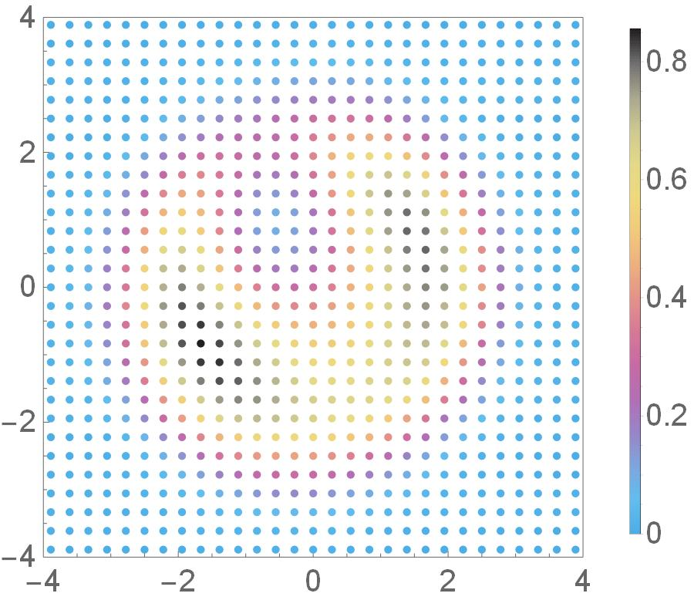
QE Scans and Parameters: 3rd Scan
Date & Time: 9/26/2017 at 9:10am
Photocathode Active Area (Red Circle): 5mm Diameter
Activation: A4
Laser spot size/position: 2.54 mm² RMS at (0.28,-1.39) mm
Laser Configuration: C4, Lens OUT
Logbook Entry: https://logbooks.jlab.org/entry/3485741
QE
QE
Y (mm)
X (mm)

Slide 6
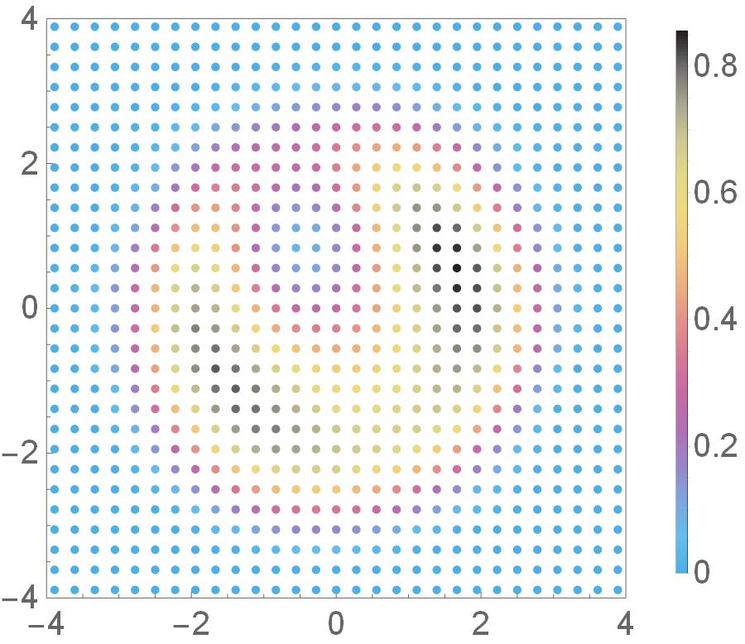
QE Scans and Parameters: 4th Scan
Date & Time: 9/26/2017 at 4:16pm
Photocathode Active Area (Red Circle): 5mm Diameter
Activation: A4
Laser spot size/position: 2.54 mm² RMS at (-1.39,-0.56) mm
Laser Configuration: C4, Lens OUT
Logbook Entry: https://logbooks.jlab.org/entry/3485811
QE
QE
Y (mm)
X (mm)

Slide 7
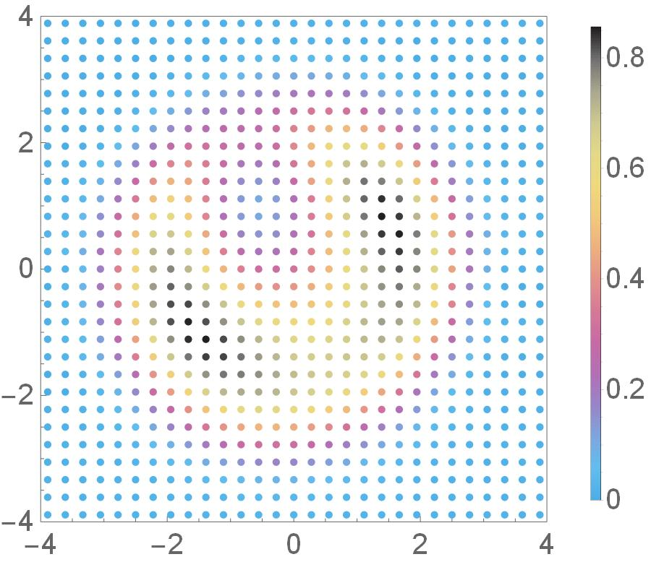
QE Scans and Parameters: 5th Scan
Date & Time: 9/27/2017 at 7:44am
Photocathode Active Area (Red Circle): 5mm Diameter
Activation: A4
Laser spot size/position: 2.54 mm² RMS at (-0.28,0.83) mm
Laser Configuration: C4, Lens OUT
Logbook Entry: https://logbooks.jlab.org/entry/3485869
QE
QE
Y (mm)
X (mm)

Slide 8
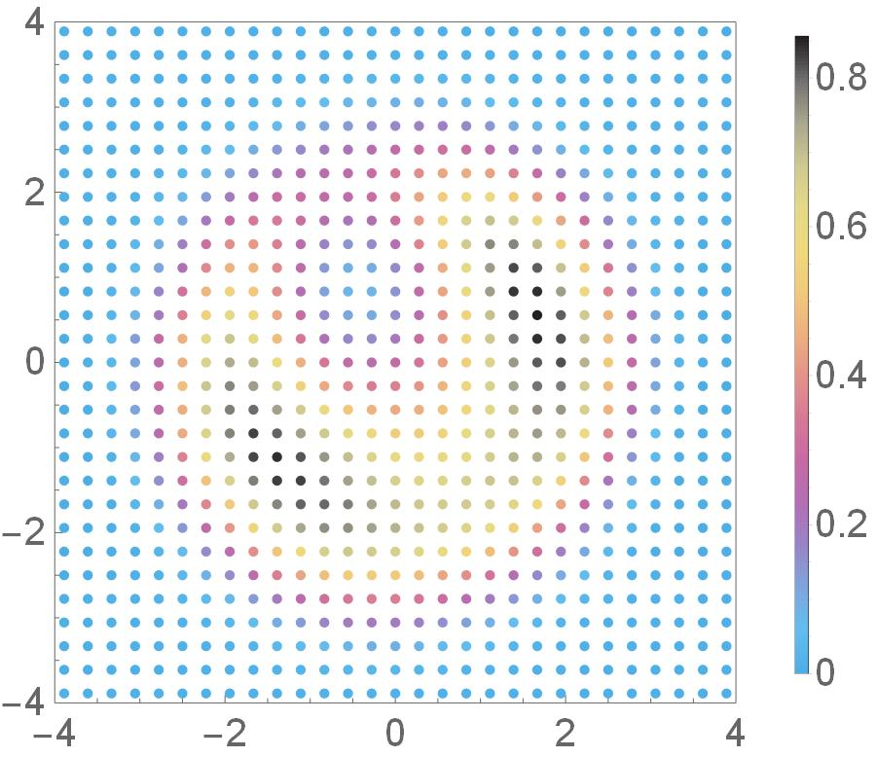
QE Scans and Parameters: 6th Scan
Date & Time: 9/27/2017 at 3:26pm
Photocathode Active Area (Red Circle): 5mm Diameter
Activation: A4
Laser spot size/position: 2.54 mm² RMS at (0,0.56) mm
Laser Configuration: C4, Lens OUT
Logbook Entry: https://logbooks.jlab.org/entry/3486105
QE
QE
Y (mm)
X (mm)

Slide 9
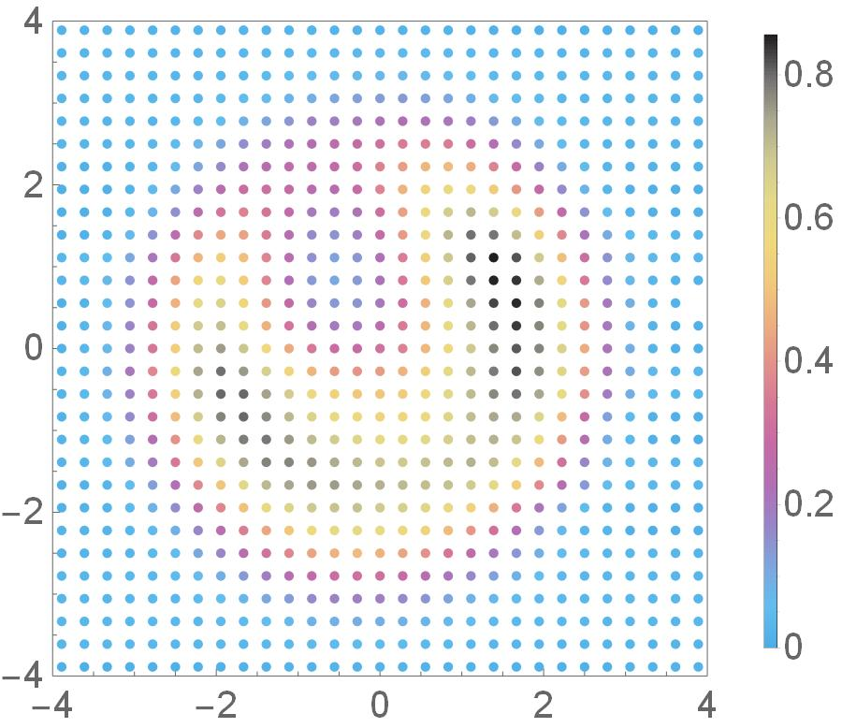
QE Scans and Parameters: 7th Scan
Date & Time: 9/28/2017 at 6:15am
Photocathode Active Area (Red Circle): 5mm Diameter
Activation: A4
Laser spot size/position: 2.54 mm² RMS at (-1.11,-1.67) mm
Laser Configuration: C4, Lens OUT
Logbook Entry: https://logbooks.jlab.org/entry/3486147
QE
QE
Y (mm)
X (mm)

Slide 10
QE Scans and Parameters: All Lasers on 1st Scan
Date & Time: 9/25/2017 at 8:41am
Photocathode Active Area (Red Circle): 5mm Diameter
Activation: A4
Laser spot size/positions: 2.54 mm² RMS at
(0.56,0.28) mm (2x)
(0.28,-1.39) mm
(-1.39,-0.56) mm
(-0.28,0.83) mm
0,0.56) mm
(-1.11,-1.67) mm
Laser Configuration: C4, Lens OUT
QE

Slide 11
Unshifted Difference Scans: 2nd-1st QE Scans
Dates: 9/25/2017 at 8:41am and 9/25/2017 at 3:49pm
Total Time Elapsed: 7 hours 8 minutes (428 minutes)
Total Charge Extracted: 7.12 C
Charge Lifetime: (178.105 ± 28.963) C
ΔQE
Y (mm)
X (mm)

Slide 12
Unshifted Difference Scans: 3rd-2nd QE Scans
Dates: 9/25/2017 at 3:49pm and 9/26/2017 at 9:10am
Total Time Elapsed: 17 hours 21 minutes (1041 minutes)
Total Charge Extracted: 10.623 C
Charge Lifetime: (292.543 ± 61.491) C
ΔQE
Y (mm)
X (mm)

Slide 13
Unshifted Difference Scans: 4th-3rd QE Scans
Dates: 9/26/2017 at 9:10am and 9/26/2017 at 4:16pm
Total Time Elapsed: 7 hours 6 minutes (426 minutes)
Total Charge Exracted: 5.796 C
Charge Lifetime: (123.321 ± 23.364) C
ΔQE
Y (mm)
X (mm)

Slide 14
Unshifted Difference Scans: 5th-4th QE Scans
Dates: 9/26/2017 at 4:16pm and 9/27/2017 at 7:44am
Total Time Elapsed: 15 hours 28 minutes (928 minutes)
Total Charge Extracted: 5.924C
Charge Lifetime: (111.859 ± 22.161) C
ΔQE
Y (mm)
X (mm)

Slide 15
Unshifted Difference Scans: 6th-5th QE Scans
Dates: 9/27/2017 at 7:44am and 9/27/2017 at 3:26pm
Total Time Elapsed: 7 hours 42 minutes (462 minutes)
Total Charge Extracted: 11.1 C
Charge Lifetime: ?
ΔQE
Y (mm)
X (mm)

Slide 16
Unshifted Difference Scans: 7th-6th QE Scans
Dates: 9/27/2017 at 3:26pm and 9/28/2017 at 6:15am
Total Time Elapsed: 14 hours 49 minutes (889 minutes)
Total Charge Extracted: 12.806 C
Charge Lifetime: (153.212 ± ?) C
ΔQE
Y (mm)
X (mm)

Slide 17
Difference Scans: 7th-1st QE Scans
Dates: 9/25/2017 at 8:41am and 9/28/2017 at 6:15am
Total Time Elapsed: 2 days 21 hours 24 minutes (4174 minutes)
Total Charge Extracted (All Runs): 53.369
Average Charge Lifetime: (171.808 ± 18.803) C
ΔQE
Y (mm)
X (mm)

Slide 18
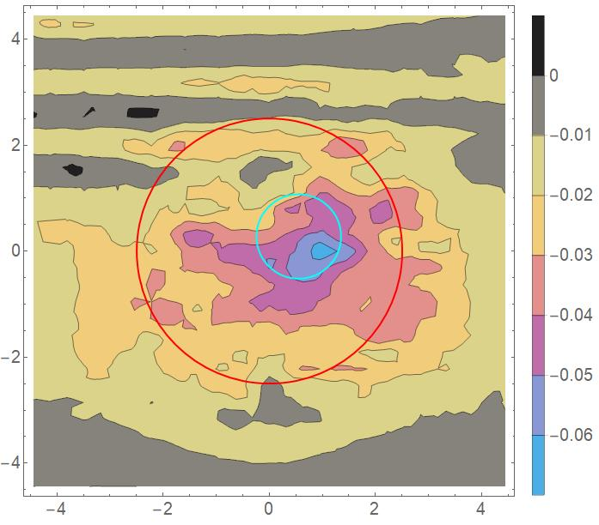
Shifted Difference Scans: 2nd-1st QE Scans
QE
QE
Y (mm)
Y (mm)
$$X_{f}=X_{i}−0.04mm$$
$$Y_{f}=Y_{i}$$
X (mm)
X (mm)
Original
Shifted

Slide 19
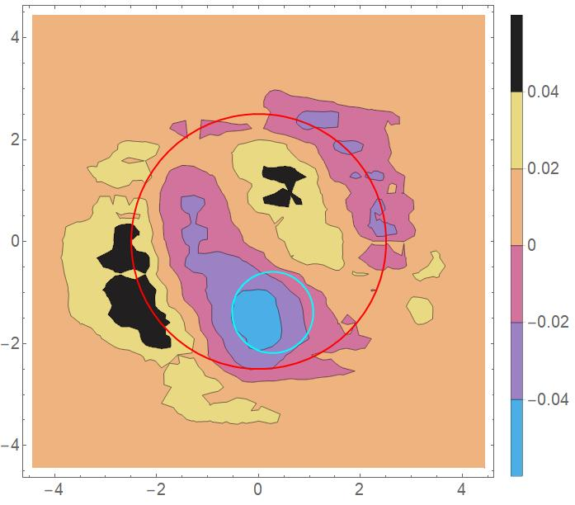
Shifted Difference Scans: 3rd-2nd QE Scans
QE
QE
Y (mm)
Y (mm)
$$X_{f}=X_{i}+0.15mm$$
$$Y_{f}=Y_{i}−0.1mm$$
X (mm)
X (mm)
Original
Shifted

Slide 20
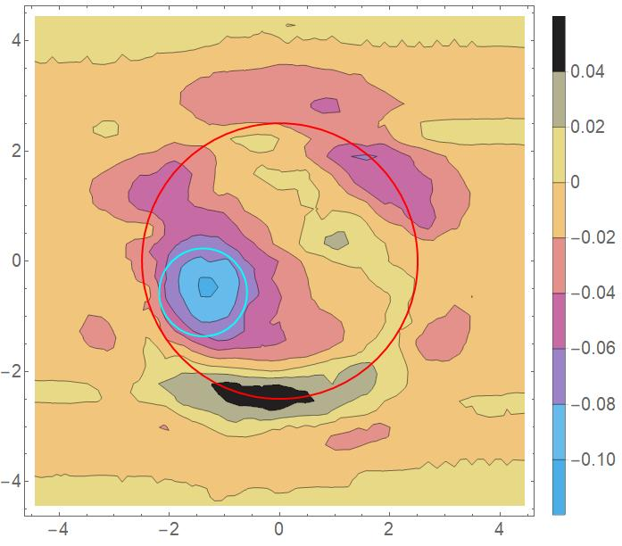
Shifted Difference Scans: 4th-3rd QE Scans
QE
QE
Y (mm)
Y (mm)
$$X_{f}=X_{i}−0.1mm$$
$$Y_{f}=Y_{i}$$
X (mm)
X (mm)
Original
Shifted

Slide 21
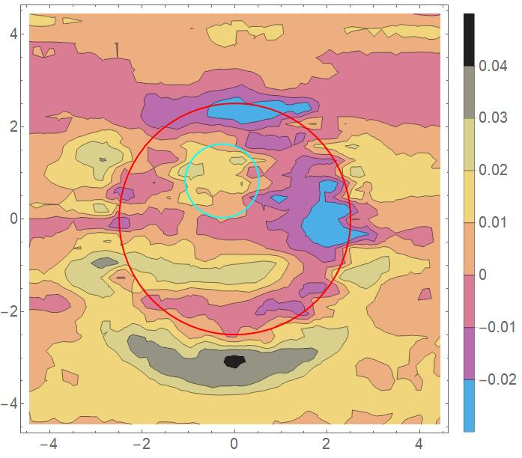
Shifted Difference Scans: 5th-4th QE Scans
QE
QE
Y (mm)
Y (mm)
$$X_{f}=X_{i}+0.1mm$$
$$Y_{f}=Y_{i}−0.1mm$$
X (mm)
X (mm)
Original
Shifted

Slide 22
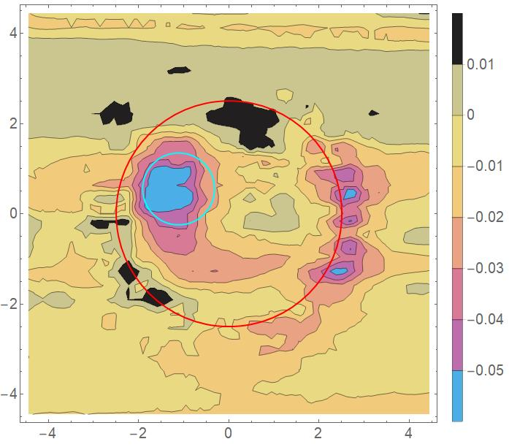
Shifted Difference Scans: 6th-5th QE Scans
QE
QE
Y (mm)
Y (mm)
$$X_{f}=X_{i}−0.15mm$$
$$Y_{f}=Y_{i}+0.1mm$$
X (mm)
X (mm)
Original
Shifted

Slide 23
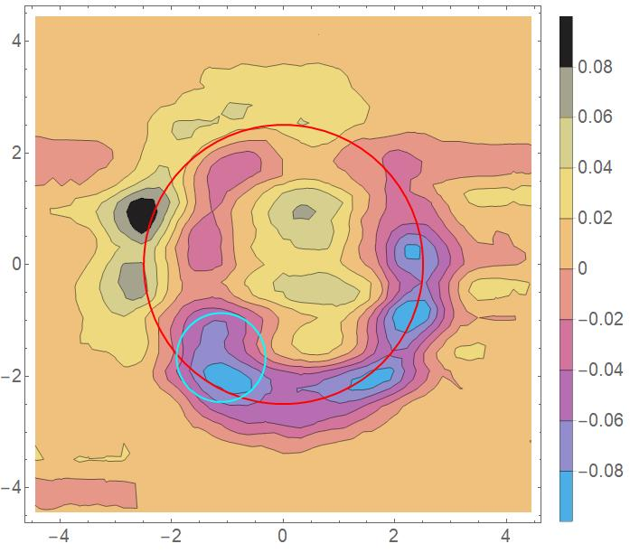
Shifted Difference Scans: 7th-6th QE Scans
QE
QE
Y (mm)
Y (mm)
$$X_{f}=X_{i}$$
$$Y_{f}=Y_{i}$$
X (mm)
X (mm)
Original
Shifted

Slide 24
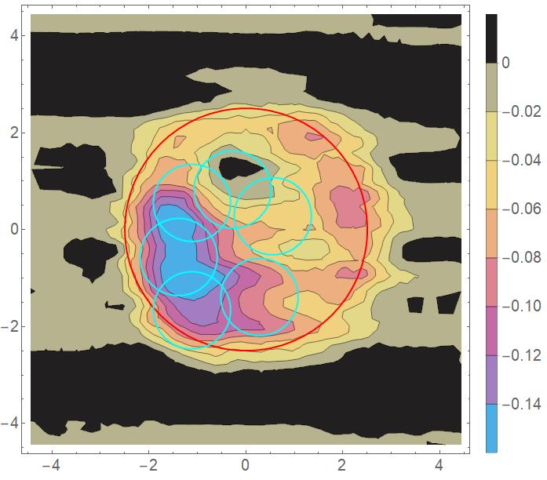
Shifted Difference Scans: 7th-1st QE Scans
QE
QE
Y (mm)
Y (mm)
$$X_{f}=X_{i}+0.1mm$$
$$Y_{f}=Y_{i}−0.1mm$$
X (mm)
X (mm)
Original
Shifted

Slide 25
QE Scan Summary
Scan # | Date | Time | Laser Spot Before Cal (x, y) (steps) | Laser Spot After Cal (x, y) (mm)
1 | 9/25/2017 | 8:41 AM | (12000, 11250) | (0.56, 0.28)
2 | 9/25/2017 | 3:49 PM | (12000, 11250) | (0.56, 0.28)
3 | 9/26/2017 | 9:10 AM | (11750, 9750) | (0.28, -1.39)
4 | 9/26/2017 | 4:16 PM | (10250, 10500) | (-1.39, -0.56)
5 | 9/27/2017 | 7:44 AM | (11250, 11750) | (-0.28, 0.83)
6 | 9/27/2017 | 3:26 PM | (10500, 11500) | (0, 0.56)
7 | 9/28/2017 | 6:15 AM | (10500, 9500) | (-1.11, -1.67)
Global Parameters
Center of active area: (11500, 11000) steps (or (0,0) mm after calibration and centering).
Calibration Factor: 900 steps/mm
Laser 4σ Size: 2.54 mm²
Laser 4σ Diameters: σ_{x} = 1.9 mm, σ_{y} = 1.7 mm, Avg = 1.8 mm
Laser Config: C4
Activation: A4
Active Area Diameter: 5 mm FWHM

Slide 26
QE Scan Stats Within Laser Spot (From Raw Data)
Scan | Min QE (%) | Max QE (%) | Average QE (%) | Standard Deviation (%)
1 | 0.10 | 0.82 | 0.52 | 0.21
2 | 0.083 | 0.78 | 0.49 | 0.20
3 | 0.11 | 0.83 | 0.52 | 0.17
4 | 0.065 | 0.76 | 0.46 | 0.20
5 | 0.095 | 0.78 | 0.40 | 0.18
6 | 0.070 | 0.76 | 0.35 | 0.18
7 | 0.039 | 0.71 | 0.43 | 0.21

Slide 27
Run Summary and Charge-Lifetime Data
Run | QE Difference Scans | Duration (min) | Total Charge Extracted [C] | Charge Lifetime [C]
1 | 1->2 | 241 | 7.12 | 178.105 ± 28.963
2 | 2->3 | 354 | 10.623 | 292.543 ± 61.491
3 | 3->4 | 330 | 5.796 | 123.321 ± 23.364
4 | 4->5 | 395 | 5.924 | 111.859 ± 22.161
5 | 5->6 | 370 | 11.1 | ? (Laser drifted?)
6 | 6->7 | 427 | 12.806 | 153.212 (uncertainty?)
Average Current: 0.5 mA
Total Charge Extracted: 53.369 C
Total Duration: 2117 minutes

Slide 28
Integrating QE Difference Scans Within Laser Spot
Run | QE Difference Scans | GWI Within Laser Spot (Unshifted*) | GWI Within Laser Spot (Shifted*) | Unweighted Integral within Laser Spot (Unshifted*) | Unweighted Integral within Laser Spot (Shifted*)
1 | 1->2 | -0.0226 | -0.0175 | -0.144 | -0.112
2 | 2->3 | -0.0133(6)** | -0.0133(7)** | -0.0856 | -0.0833
3 | 3->4 | -0.0260 | -0.0304 | -0.166 | -0.191
4 | 4->5 | 0.0095 | 0.0042 | 0.0592 | 0.0258
5 | 5->6 | -0.0079 | -0.0180 | -0.0533 | -0.113
6 | 6->7 | 0.0227 | 0.0227*** | -0.143 | -0.143***
Gaussian Weighted Integral (GWI):
Gaussian Weighted Integral: $GWI=\iint_{S}{G\left(x,y\right)f\left(x,y\right)dxdy}$
Unweighted Integral: $\iint_{S}{f\left(x,y\right)dxdy}$
2D Gaussian Function: $G\left(x,y\right)=\frac{1}{2πσ_{x}σ_{y}}\exp\left[−\left(\frac{{\left(x−x_{o}\right)}^{2}}{2σ_{x}^{2}}+\frac{{\left(y−x_{o}\right)}^{2}}{2σ_{y}^{2}}\right)\right]$
$f(x,y)$ denotes the QE scan interpolation function (from Mathematica)
S is the (elliptical) area of the laser spot at $\left(x_{0},y_{0}\right)$ with radii $σ_{x}$ = 1.9 mm and $σ_{y}$ = 1.7 mm
*Refers to the second QE scan being shifted before subtraction
**Number in parentheses is the next decimal place (to show these numbers are not the same)
***Run 6 did not need to be shifted

Slide 29
Comparing Integrals and Charge Lifetime Data
Run | QE Difference Scans | Charge Extracted / Duration (C/min) | Relative C/min | Relative Charge | Relative Lifetime | Relative GWI (Unshifted) | Relative GWI (Shifted) | Relative Unweighted Integral (Unshifted) | Relative Unweighted Integral (Shifted)
1 | 1->2 | 0.0295 | 0.983 | 0.560 | 0.609 | 0.869 | 0.576 | 0.867 | 0.586
2 | 2->3 | 0.0300 | 1 | 0.830 | 1 | 0.512 | 0.438 | 0.516 | 0.436
3 | 3->4 | 0.0176 | 0.587 | 0.453 | 0.423 | 1 | 1 | 1 | 1
4 | 4->5 | 0.0150 | 0.5 | 0.463 | 0.382 | -0.365 | -0.138 | -0.357 | -0.135
5 | 5->6 | 0.0300 | 1 | 0.867 | ? | 0.304 | 0.592 | 0.321 | 0.592
6 | 6->7 | 0.0300 | 1 | 1 | 0.524 | -0.873 | -0.747 | 0.861 | 0.749
Relative comparisons made with respect to largest value in each column

