Slide 1
Run I (15 shifts) : Commission Mott, Target Thickness and Systematics
Tested 62 MHz
Calibrated BCM0L02
Set timing
Calibrated E/dE
Find correct target ladder offset
Calibrate PITA in/out
Mott disk full
Set spin angle
Dump fraction study
Threshold measurement
Momentum measurement
Asymmetry vs.
target thickness
time/stability
deadtime/rate
position (change corrector)
spot size (change quadrupole)
energy spread (change RF phase)

Slide 2
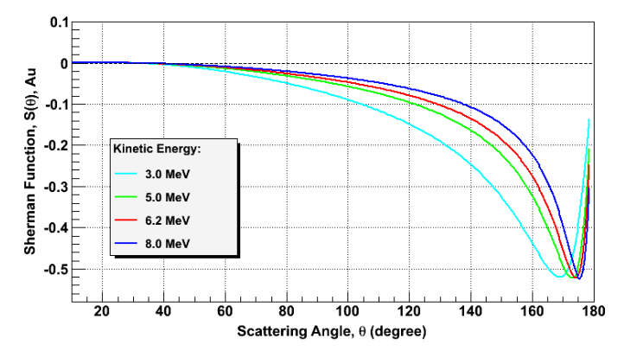
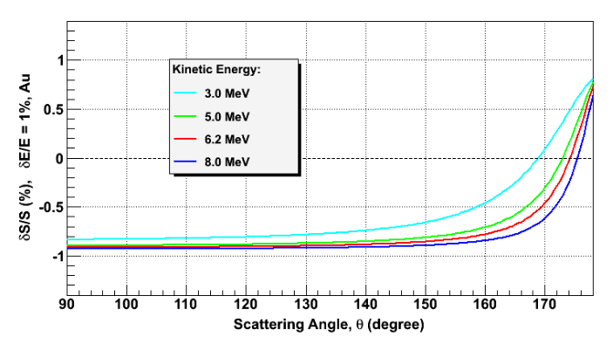
Sensitivity to beam energy

Slide 3
Run II (7 shifts) : Focus on beam energy, quantifiable systematics and plots for paper
Setup (1 shift)
Use 31 MHz, HI threshold
Set Spin Angle
Set PMT E/DE, TIMING
Calibrated BCM, PITA
Set / measure momentum
Asymmetry vs.
repeat target thickness KE=5.0 MeV, get same result twice (2 shifts)
energy dependence (2 shifts)
spot size – measure with OTR + beaminizer, may need camera (1 shift)
energy spread – change w/o E shift and measure (1 shift)

