Slide 1
Upgraded Injector Test Facility (UITF) Update
Matt Poelker
Jefferson Lab Accelerator Advisory Committee Review
October 22 – 24, 2019

Slide 2
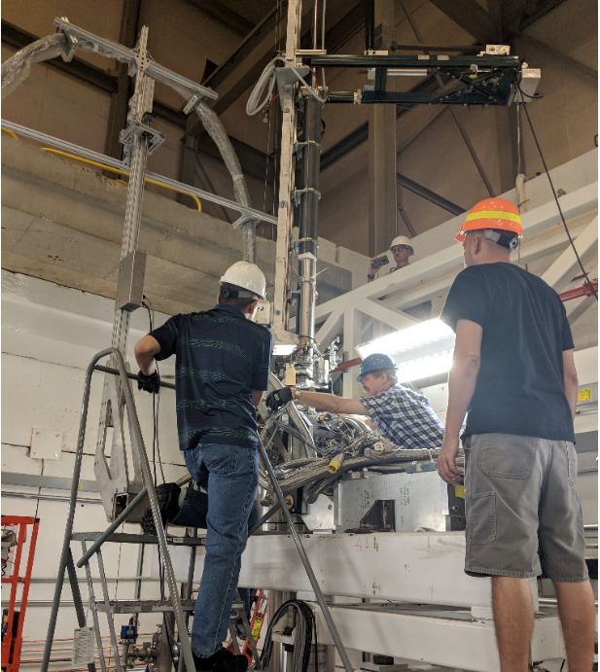
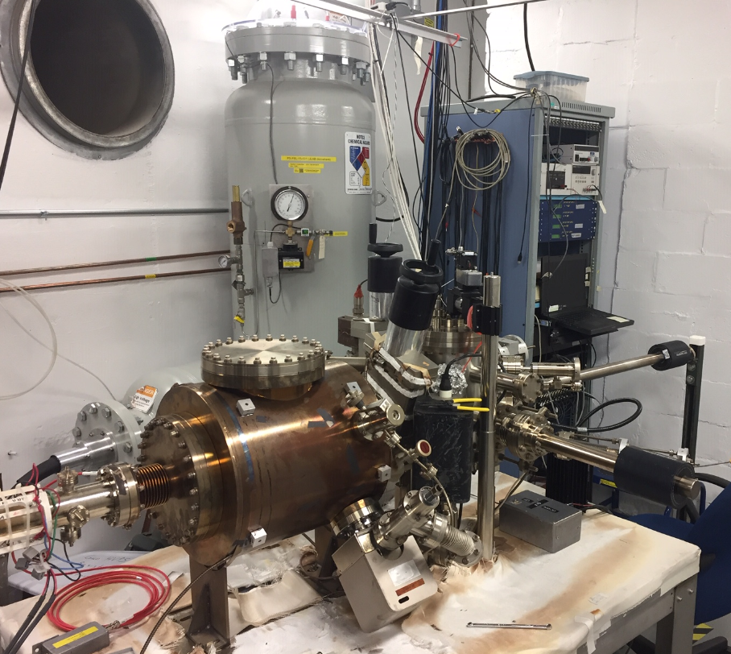
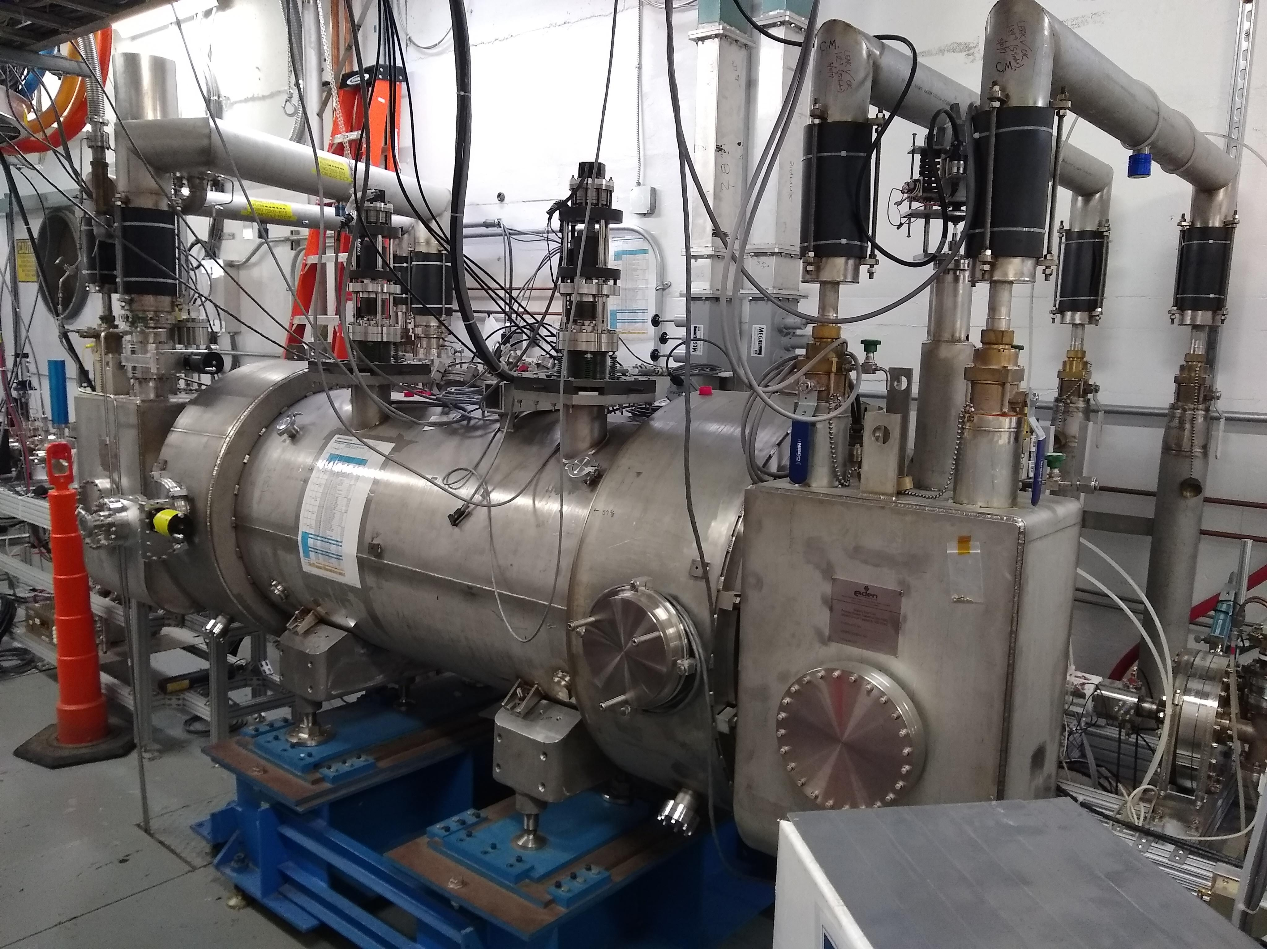
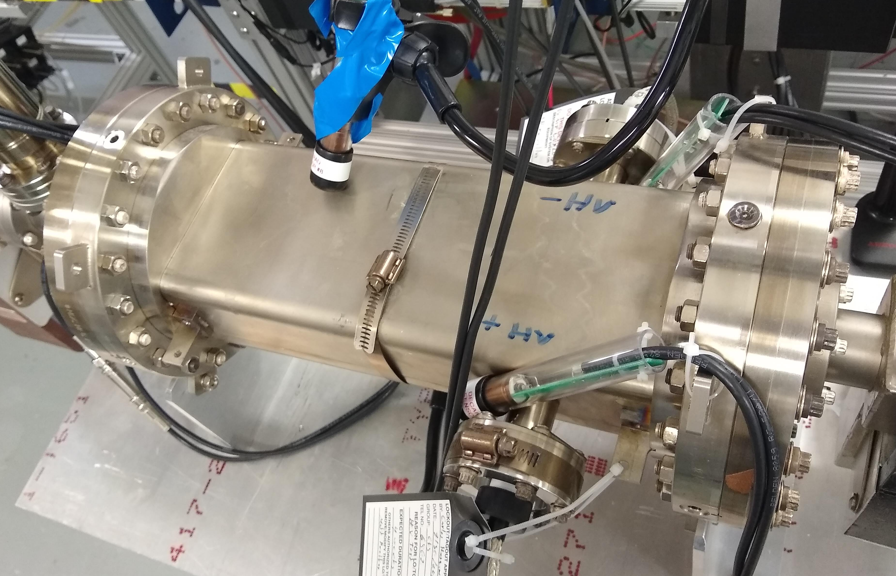
UITF is a 10 MeV spin-polarized electron accelerator

Slide 3
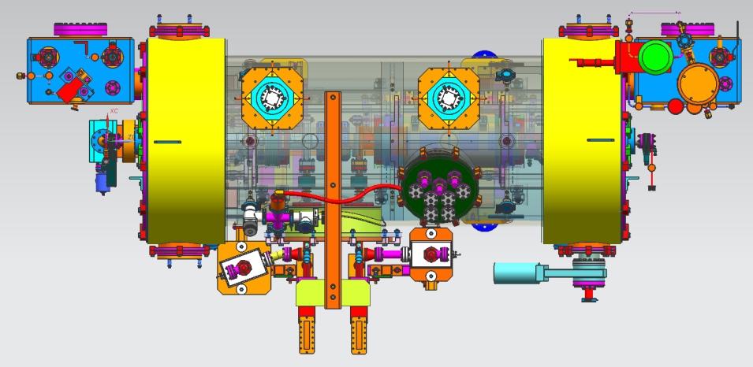
Test the Booster before installing at CEBAF in 2020
Increase gun voltage and Wien filters for 200 kV operation to suppress space-charge effects and improve parity quality beam
Locate Wien filters (energy filters) upstream of pre-buncher cavity and install quadrupoles to better compensate astigmatism
Increase aperture of chopper and beam line solenoids to suppress existing astigmatism and improve parity quality beam
Install new SRF booster that eliminates warm-rf capture cavity, RF deflection and x/y coupling
Our new “booster”:
2 cell capture section + 7 cell cavity,
should provide 10 MeV beam and introduce no x/y coupling, allow better matching, more adiabatic damping

Slide 4
Testing the spin-polarized target “HDIce”
ERR tentatively scheduled for week of November 19th

Slide 5
Past Reviews of UITF
Review #1: UITF Operations Review, aka “will it work?” March 18, 2016
https://wiki.jlab.org/ciswiki/index.php/UITF_Meeting_-_March_18,_2016
Review #2: UITF Safety Review, May 10, 2016
https://wiki.jlab.org/ciswiki/index.php/UITF_Meeting_-_May_10,_2016
Review #2.5: PSS BCM review, October 21, 2016*
https://wiki.jlab.org/ciswiki/index.php/UITF_Meeting_-_October_21,_2016
Review #3: Conduct of Operations Review, April 24, 2019
https://wiki.jlab.org/ciswiki/index.php/UITF_Meeting_-_April_24,_2019
Shielding Design Package, June 2019, JLAB-TN-18-020
Accelerator Readiness Review: June 26-28, 2019
https://www.jlab.org/indico/event/322/timetable/#20190626
* the PSS BCM, once deemed necessary now deemed optional, following detailed shielding assessment

Slide 6
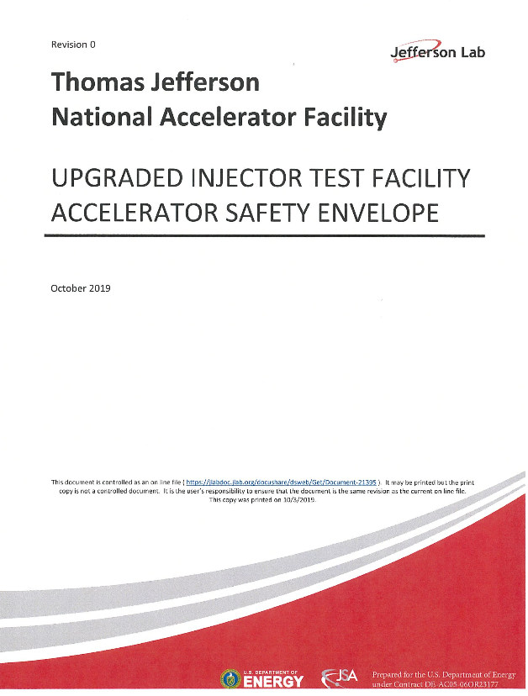
Official Documentation
https://wiki.jlab.org/ciswiki/index.php/UITF_Official_Documents
https://www.jlab.org/eshq/ProgramDocs

Slide 7
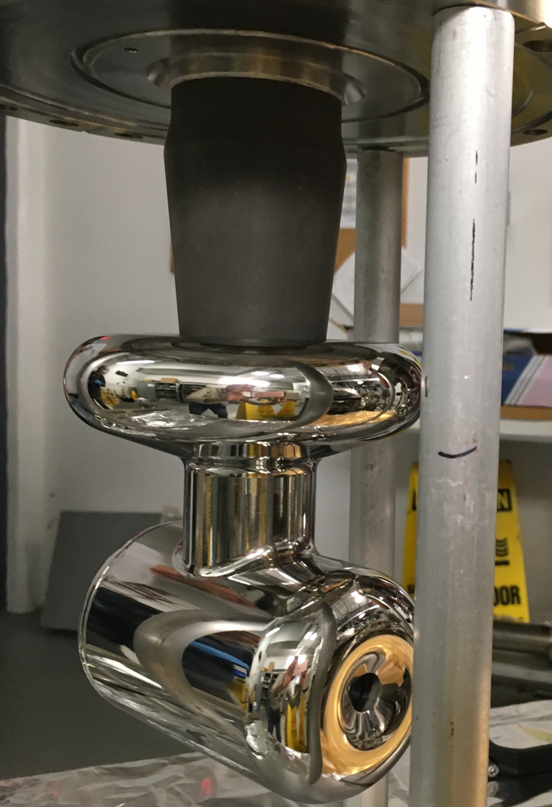
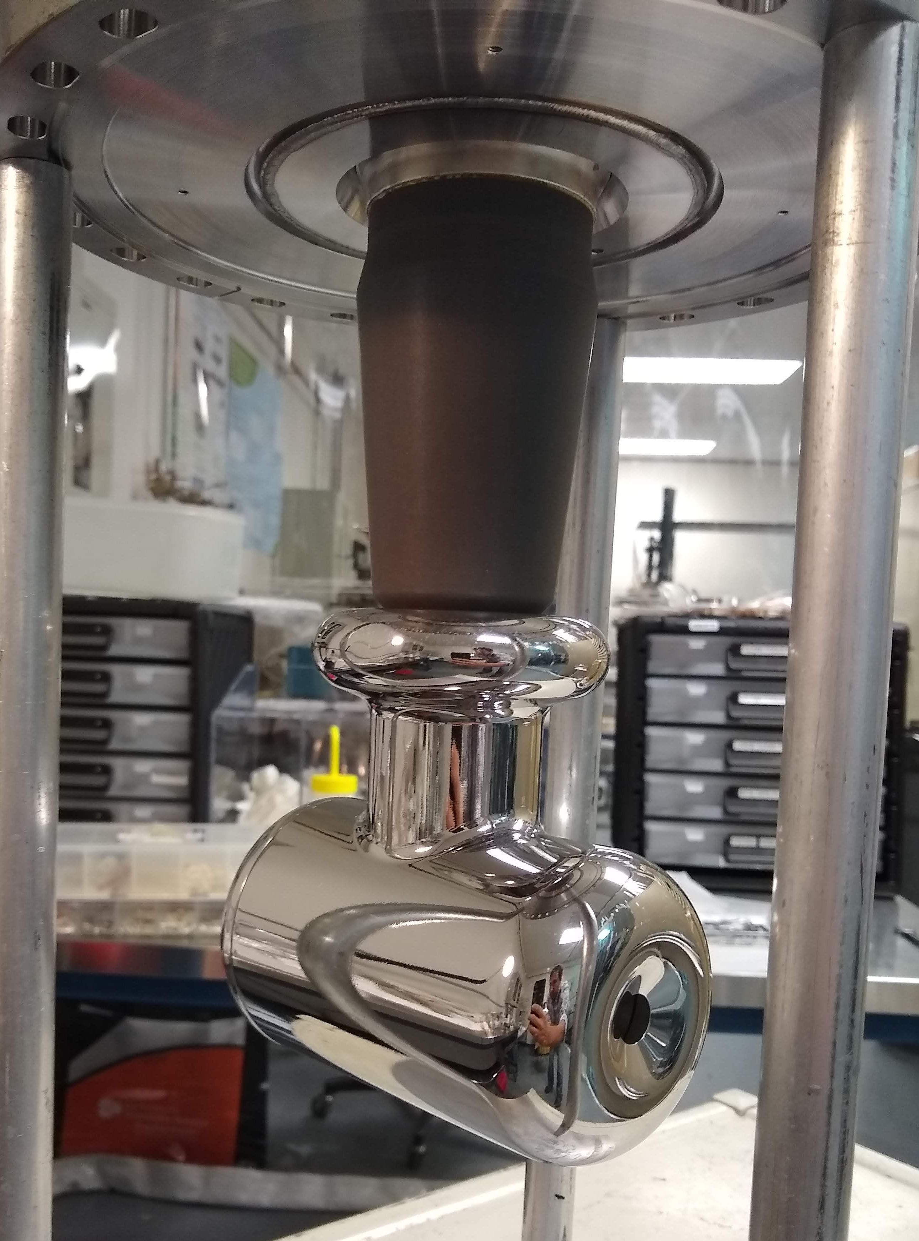
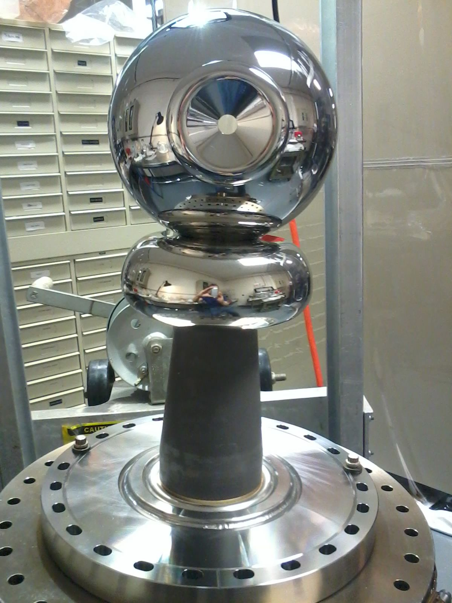
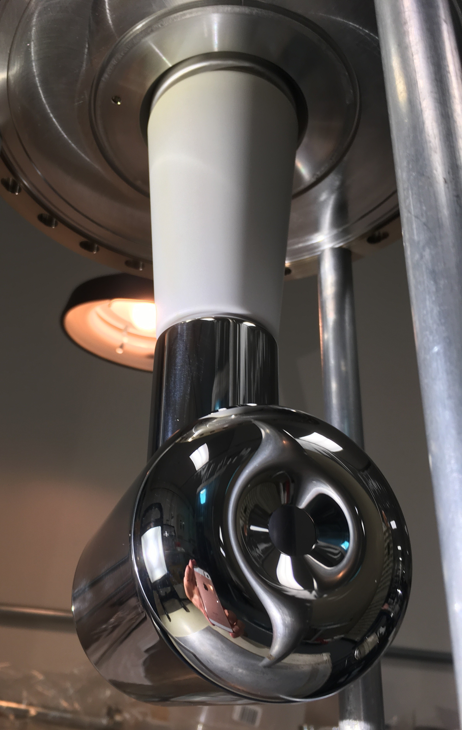
UITF as Gun Test Stand
keV beamline, fully functional
Used to test electrodes before installation at CEBAF

Slide 8
Uses of UITF: workshop on December 12, 2018
Application | Beam Energy | Beam Current | Experiment Duration | Notes | Presenter
Commission QCM for CEBAF | 6 MeV, but prefer up to 10 MeV | up to 100 uA | three or four 1-week long tests | tests complete before long shutdown of 2020, when QCM to be installed at CEBAF | R. Kazimi
Commission HDIce for CEBAF | ~ 8 MeV | up to 100 nA for tuning, 0.25 to 5 nA for production | four or five run periods, one-month long each | target provides transverse polarization required for 3 A-rated Hall B experiments | A. Sandorfi
Manufacturing polarized targets for CEBAF via DNP | 10 to 18 MeV | 1 to 10 uA | hours, days | likely some R&D to determine optimum polarizing conditions | C. Keith
Bubble Chamber astrophysics | 4 - 10 MeV | 0.01 to 100 uA | 3 weeks, ~ 3 runs/year | UITF better location than CEBAF injector, when CEBAF shutdowns are short | R. Suleiman
MeV parity violation experiment | 10 MeV | milliamps preferred, will reduce experiment duration | months to years | requires polarized electron beam, transmission geometry offers advantages | R. Carlini
Testing Nb₃Sn-coated cavities | determining the beam energy of test cavity is point of test | up to 100 uA | as many tests as possible | Nb3Sn cavities require only 4K Helium | G. Eremeev
Wastewater treatment | 2- 10 MeV | 100 uA | imagine week-long test durations over three years | together with local partners | G. Ciovati
Polarized positron source | 5 - 10 MeV | up to 100 uA | staged tests, likely many required, 1-week long duration | requires polarized electron beam | J. Grames
EIC: fast kicker tests | 5 - 10 MeV | up to 100 uA | two 1-week long tests | together with sbir-partner | H. Wang
EIC: testing high bunch charge | 5 - 10 MeV | up to 100 uA | two 1-week long tests | requires polarized electron beam | J. Grames and J. Guo
https://wiki.jlab.org/ciswiki/index.php/UITF_Meeting_-_December_12,_2018

Slide 9
UITF - Summary
Testing the “booster” and HDIce target remain high priority tasks, now with “deadline” May 2020
Since 2017…..Accelerator is built with three MeV beam destinations, waiting for permission to commission
Conduct of Operations Review, Shielding Design Package, and Accelerator Readiness Review
UOD, ASE and updated FSAD
Commissioning Plan and a number of OSPs
While working towards MeV operations, we have been using UITF as a Gun Test Stand:
Tested a number of cathode electrodes, and two gun designs
Modified Wien filter to operate at +/-20kV per plate, for 200 keV beam
Assisted visiting scholar Max Herbert, testing LiCsNF3:GaAs, does lithium prolong operating lifetime?
Installed the non-invasive resonant polarimeter from sbir-partner Electrodynamic, beam tests soon
When booster leaves UITF for CEBAF May 2020, we will install a traditional ¼ CM, and then we need 350 kV photogun (this is an R&D project for us)
Held Workshop on Uses of UITF
Nb₃Sn coated cavities inside ¼ CM, waste water treatment, fast kicking, bubble chamber astrophysics experiment, PEPPo….all these represent potential R&D for UITF

Slide 10
UITF - Summary
Future challenges:
The Gun and Injector Groups (nominally, the people we originally imagined operating UITF) need to focus on the CEBAF injector upgrade
Formality of DOE requirements….fulltime Facility Manager and Operations staffing required
Liquid helium: the CTF refrigerator at building 58 cannot provide sufficient LHe to operate Vertical Test Area, Cryomodule Test Facility and UITF simultaneously

Slide 11
Back Up Slides

