Slide 1
Magneto-Optic Kerr Effect in a Magnetized Electron Gun
A Jefferson Lab summer project by Benjamin Hardy, mentored by Joseph Grames
* This work is supported by the the National Science Foundation, Research Experience for Undergraduates award 1359026 and the Department of Energy, Laboratory Directed Research and Development contract DE-AC05-06OR23177.

Slide 2
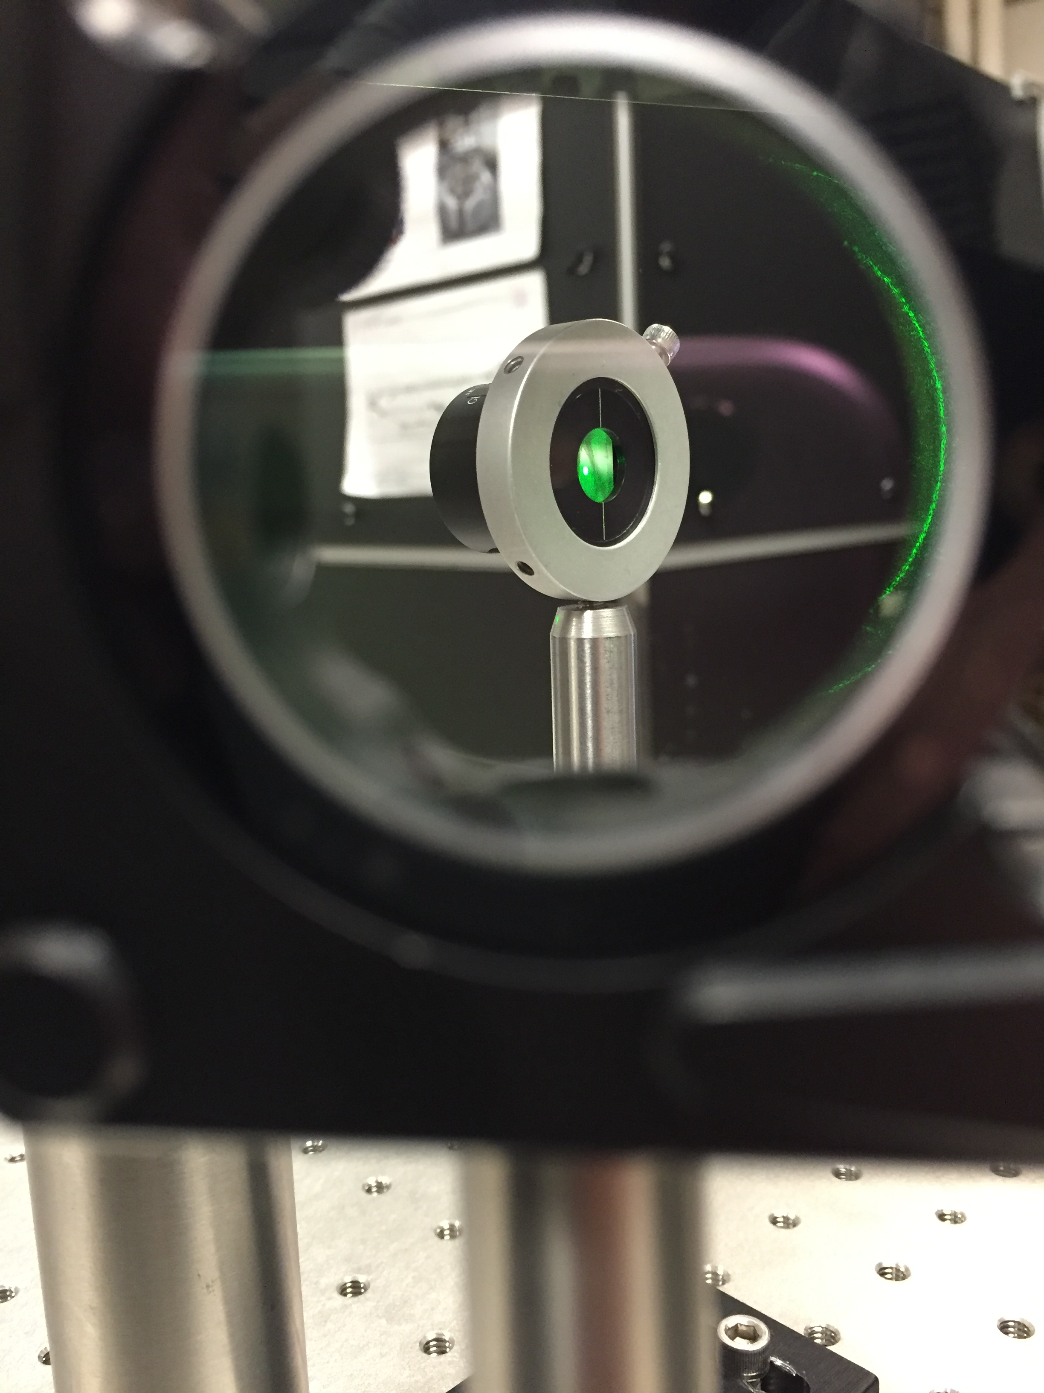
Outline
Motivation – Measure magnetic field in vacuum
Method – Magneto-Optic Kerr Effect diagnostic
Results – Fixed and modulated polarization
Next Steps – Calibration with solenoid magnet
Summary – project accomplishments

Slide 3
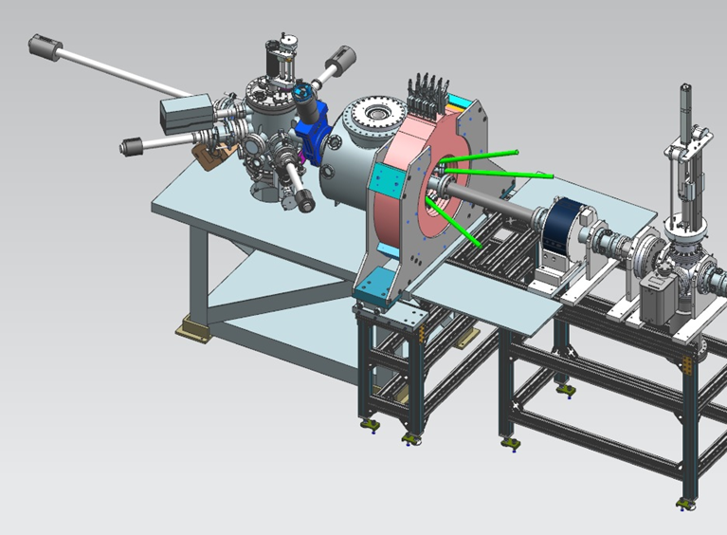
Motivation – Solenoid Magnetic Field
A magnetized electron beam will “cool” and improve the ion beam in an electron-ion collider.
An electron source in a solenoid field produces a magnetized electron beam.
Conventional methods of measuring magnetization would require breaking vacuum
An in-situ diagnostic of the magnetic field strength/uniformity would be valuable and practical
Beamline
Photocathode/ Vacuum Chamber
Solenoid Magnet
Figure 1 – Identifies electron beam source (in vacuum chamber) in relation to solenoid magnet.

Slide 4
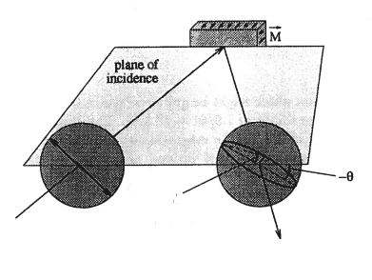
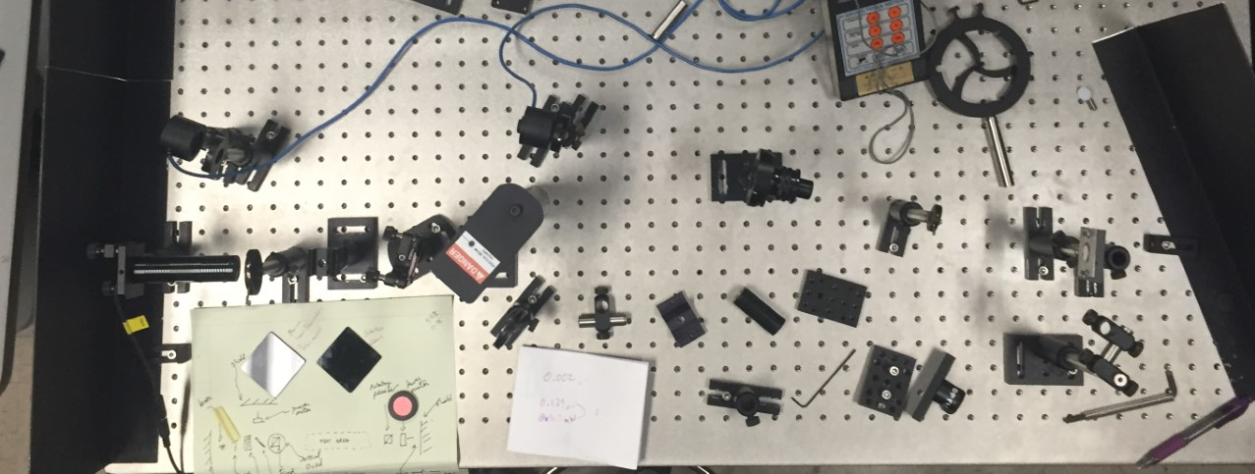
Method- The Magneto-Optic Kerr Effect
Figure 2. Principle of the MOKE measurement
Magneto-Optic Kerr Effect (MOKE)
Polarized laser light is reflected from a magnetized surface (e.g. iron foil)
Induced circular birefringence results in rotation of the plane (Ө) and change in degree of ellipticity (ε)
Kerr effect is linearly related to the magnetization of the sample
Ө
ε
Figure 3. Optics table layout for initial tests

Slide 5
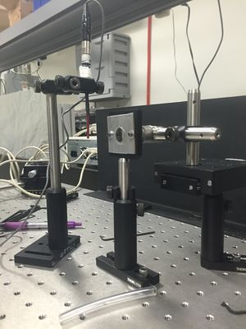
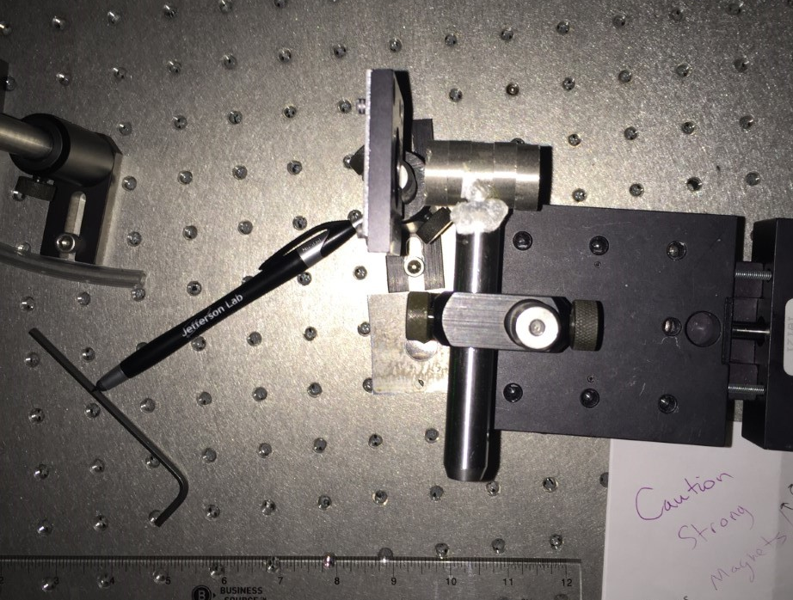
Method- reflection and initial bench tests
Polished iron foil reflects polarized laser light (0 deg) to analyzer (90 deg)
Rare earth magnets mounted to linear stage vary magnetic field at foil surface
Polarization of light reflected from magnetized iron foil is now changed
Foil: 99.9% Iron (polished)
Rare earth Magnets
Figures 4,5 – further demonstrating bench test. Pure polished Iron foil, and permanent magnets.

Slide 6
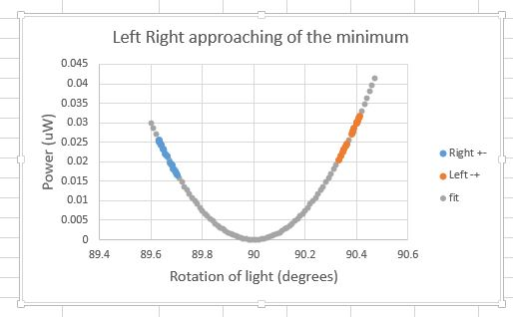
Results- First measurement of Kerr Ө
Simple test of circular birefringence
Analyzer is rotated (<0.5 deg) “Right” or “Left” of null point
Varying the magnetic field rotates linear polarization and passes more/less light through analyzer
Reversing magnetic field reverses rotation.
Rotation is small; prefer a more sensitive absolute approach
Transmitted Power vs. Applied B-Field
(slopes indicated non-zero birefringence)
Perfectly crossed polarizers

Slide 7
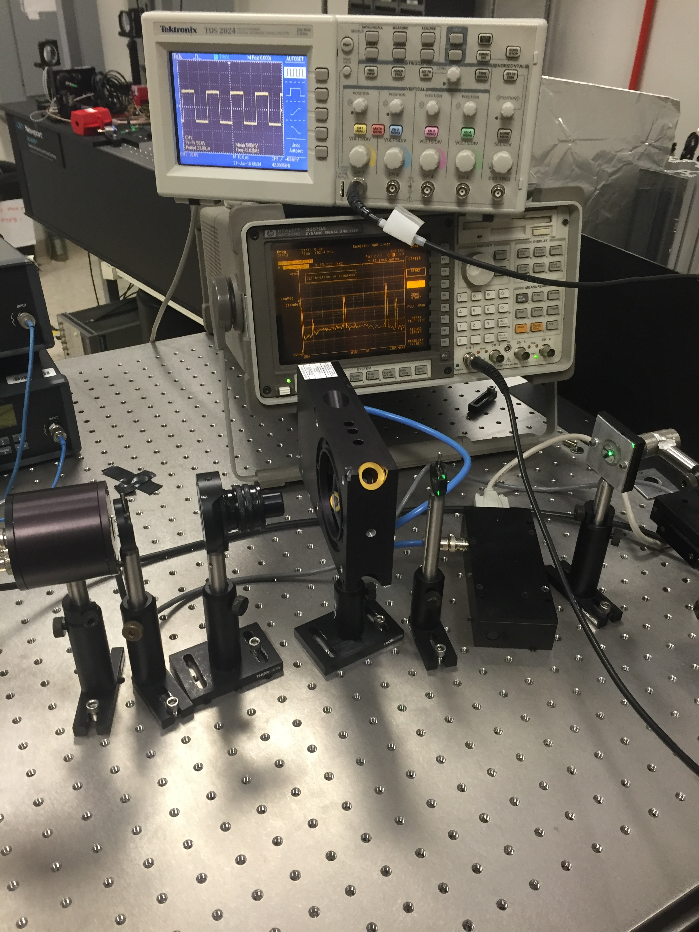
Method- Implementing the Photo-elastic modulator
Figure 6 – PEM arrangement
The photo-elastic effect is the birefringence of a material (silica crystal) due to applied stress
A Photo-Elastic Modulator (PEM) modulates the polarization of light at a resonant frequency of applied stress (e.g ≈42. kHz)
A PEM analyzing arrangement propagates the Kerr effect (ε and Ө) at harmonics of the PEM frequency
Lock-In Amplifiers detect the 1f and 2f amplitudes of the analyzer light to extract the Kerr signal
PEM
Laser (0⁰)
Analyzer (45⁰)
Photodiode

Slide 8
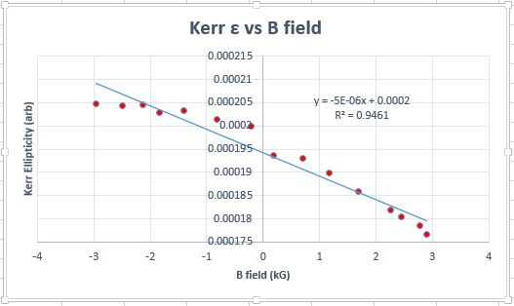
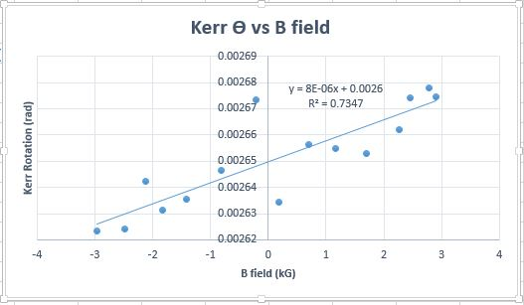
Initial Results – Lock-in Amplifier method
Figure 7. Equations for (ε, Ө)
Figure 8 – Ellipticity vs. B-field
Figure 9 – Rotation vs. B-field

Slide 9
Mirror test

Slide 10
Green Light test

Slide 11
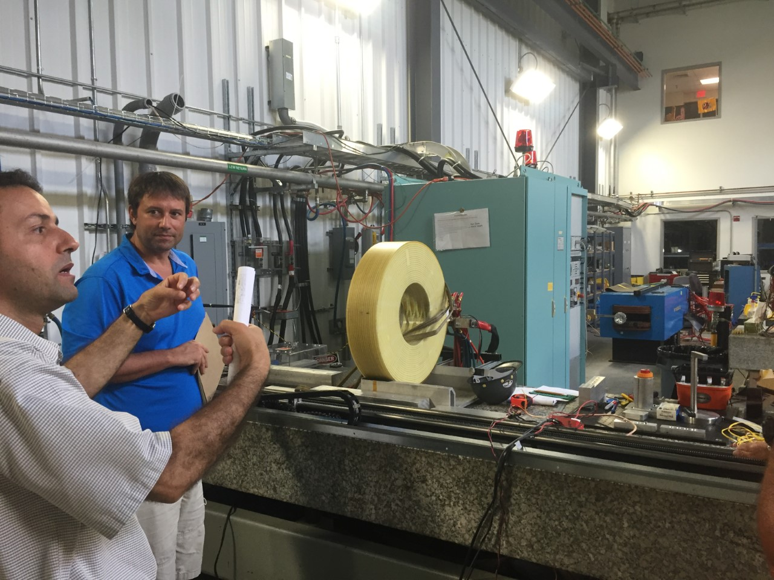
What’s next? – Calibration of bench tests with Solenoid
Further optimization of Lock-In technique
Transport “Kerr-mometer” to Magnet Measurement Facility
Calibrate Kerr signal to solenoid magnetic field (foil at determined photocathode position)
Measure Kerr signal vs. position on photocathode (surface uniformity)
Solenoid Magnet in MMF
Joe Grames
Riad Suleiman
Figure 10 – Riad Suleiman and Joe Grames discuss mapping of solenoid magnetic field

Slide 12
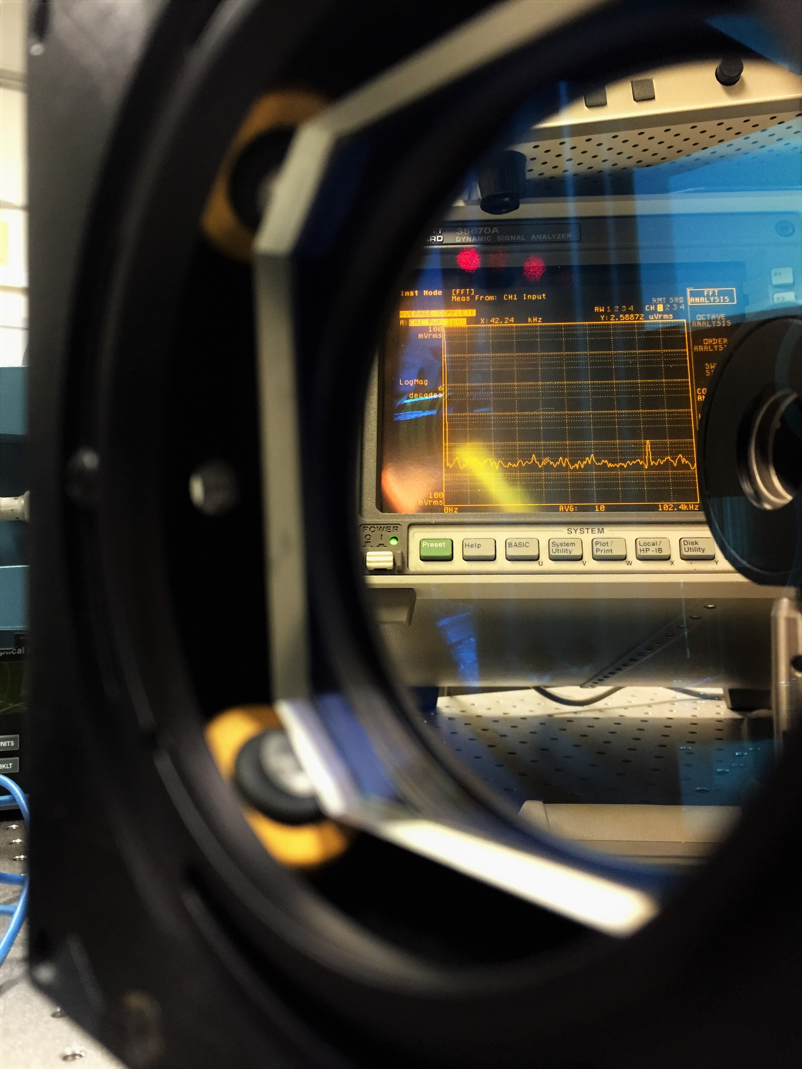
Highlights - Accomplishments
Demonstrated change in reflected laser polarization with iron foil magnetization
Applied PEM and Lock-In amplifiers to improve sensitivity to Kerr effect
Calibrated Kerr-mometer to solenoid magnetic field at photocathode
Developed basis for in-situ monitor of Magnetized Gun magnetic field

Slide 13
References- figures
1 – Courtesy of Riad Suleiman; LDRD proposal “Generation and Characterization of Magnetized Bunched Electron Beam from DC Photogun for JLEIC Cooler”
2 – Robinson, Stephan. "Kerr Measurements of Electron Polarization." Inaugural-Dissertation (1994): 14.
3 – Captured by myself
4 - Captured by myself
5 - Captured by myself
6 - Captured by myself
7 - Oakberg, Theodore C. “Photo-Elastic Modulators – Magneto-Optic Kerr Effect.” Hinds Instruments (2000): 2.
8 – Compiled by myself
9 – Compiled by myself
10 – Captured by myself
11 - Burov, A., S. Nagaitsev, A. Shemyakin, and Ya. Derbenev. "Optical Principles of Beam Transport for Relativistic Electron Cooling." Phys. Rev. ST Accel. Beams Physical Review Special Topics - Accelerators and Beams 3.9 (2000): 1

Slide 14
ThAnk YӨU!!

Slide 15
Back up slides

Slide 16
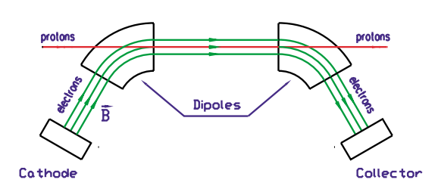
Motivation- Magnetized cooling
Magnetized electron Ion cooling (MEIC) techniques are used in Colliders
Helps extend Luminosity lifetime and ion beam emittance
MEIC requires a bunched magnetized electron beam
Electron beam produced by K₂CsSb Photocathode
Figure 11 – Electron Ion cooling explained in a picture of the NAP-M cooler at Fermi National Accelerator Lab. A Bunched Electron beam helps prevent intra-beam scattering of the ions in our case.

