Slide 1
Gun Test Stand Inverted insulator gun update September 25 2015
A full set of electrodes including a puck with dummy cathode and a new anode are being polished.
A new cathode preparation chamber has been fabricated and has been attached to the gun vacuum chamber.
The new set of electrodes will be high voltage tested with the insulator configuration that demonstrated 350 kV operation, but this time with improved electrode polishing to minimize previously observed field emission.

Slide 2
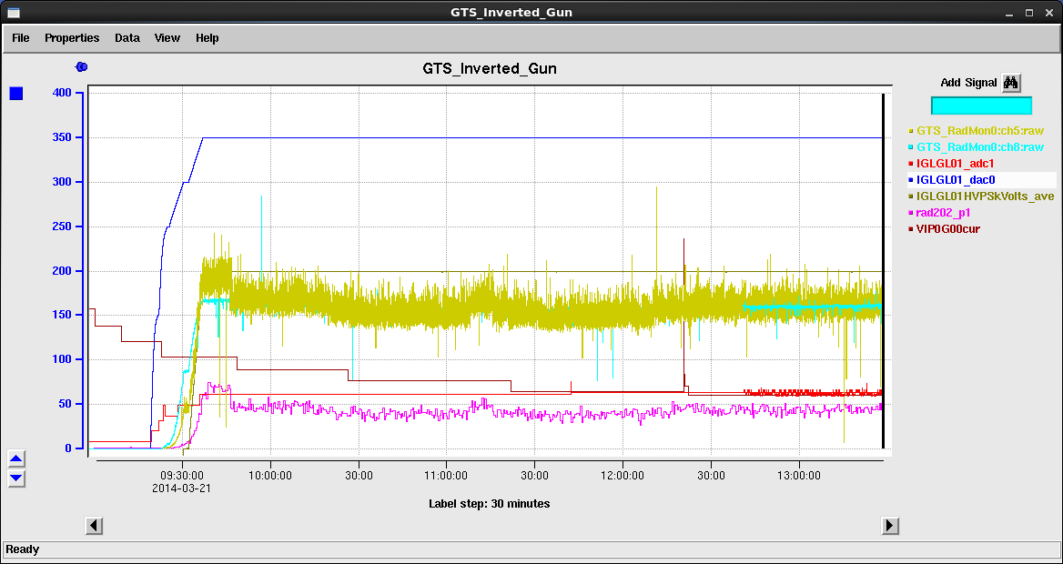
This is the configuration tested successfully to 350kV, albeit field emission higher than desired

Slide 3
The cathode prep chamber is now attached to the gun vacuum chamber

Slide 4
Planned tasks for the next few weeks
Electrodes polished and UHV clean
Cathode prep chamber ready for vacuum
Electrodes degassed in Big Blue
Electrodes and insulator installed
Gun assembly under vacuum
Vacuum bake starts
High Voltage conditioning starts
Vacuum bake ends

