Slide 1
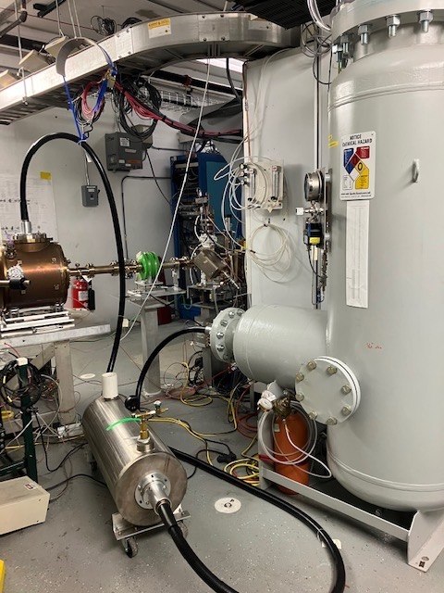
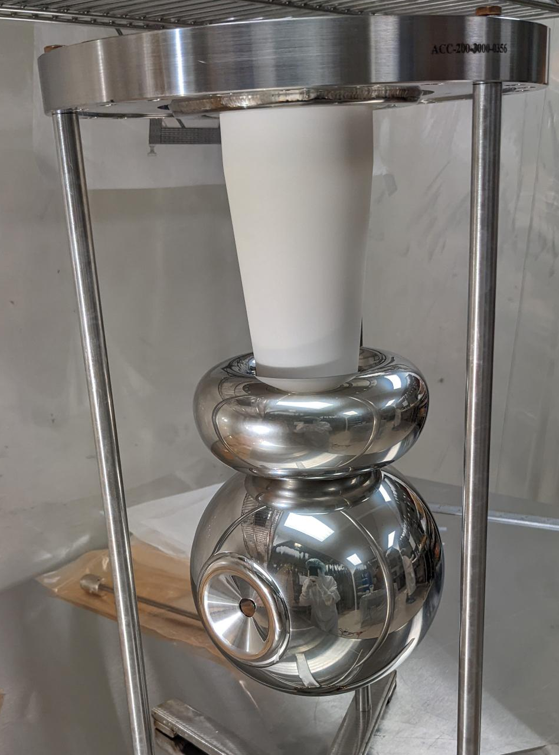
Gun High Voltage Conditioning is necessary to operate at 200 kV without detectable field emission.
This takes about 6-8 shifts
Ceramic
insulator
Gun
Electrode
450 kV HVPS
SF6 insulated
100 M-Ohm
resistor SF6 tank

Slide 2
Gun High Voltage Conditioning planned during SWING shifts starting April 26
Configuration:
Gun HVPS PSS permissive signals to be bypassed by SSG per OSP
Injector open for daily tasks:
Gun HVPS panel IB-PP3, ganged circuit breakers 13, 15, 17 LOTO-ed with Ops and CIS admin locks.
Injector swept and locked on swing shifts:
Injector sweep by Ops
Injector Access Room Door #2 locked by Ops
Injector gate locked by Ops with break-away lock
Gun HVPS panel IB-PP3, ganged circuit breakers 13, 15, 17 engaged
High Radiation Area postings
Lock up 3 pm!
Gun HV hot checkout a few kV
ISB breaker checks
Lock up 3 pm! HV start
HV End ?

Slide 3
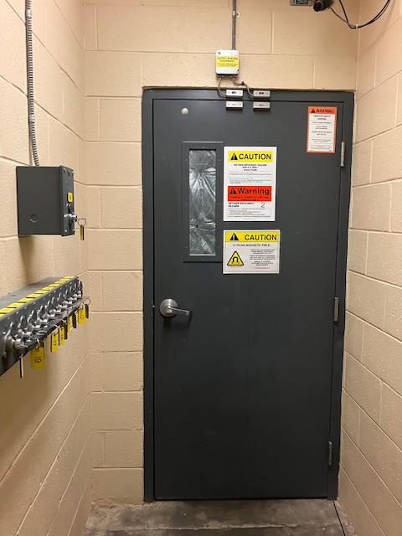
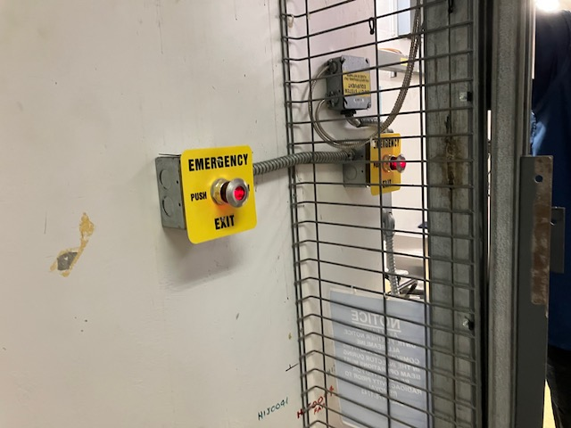
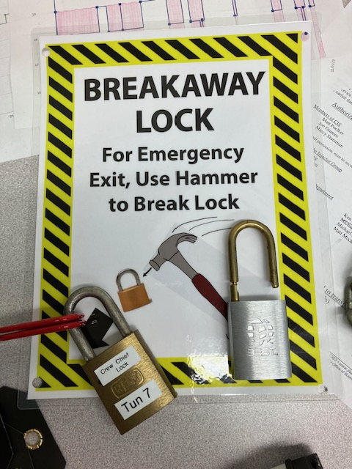
Door #2 will be the locked door for going down into the Injector. Door #1 remains as is
EXIT
NO EXIT
The North Linac side will be a "No Exit" side. Escape will need to be down the West Arc, out the North Access or down the North Linac
A break away hammer will be on the Injector side of the gate, only for use in escaping out of the Injector.
EXIT
EXIT

