Slide 1
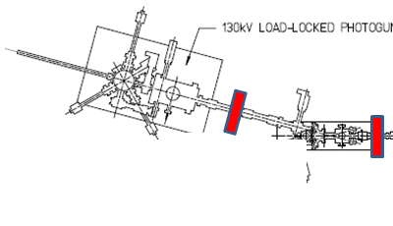
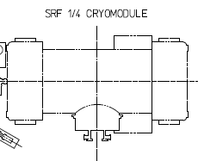
CEBAF injector
FEL-style injector
Both injectors “work”. What style injector do we need for HDIce testing? and afterwards, we need it to work for other applications

Slide 2
Polarized beam, normal incidence laser light, no spin manipulation
Add a Wien filter, install this at FEL….

Slide 3
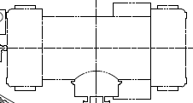
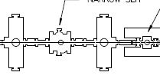
W
What I proposed initially, with buncher upstream of chopper
Normal incidence illumination, Wien filter, apertures, buncher, chopper
Joe suggested buncher should be AFTER chopper, this makes sense
Lens in front of 1/4CM? Apertures A1 and A2 can be installed in place of Wien initially?

Slide 4
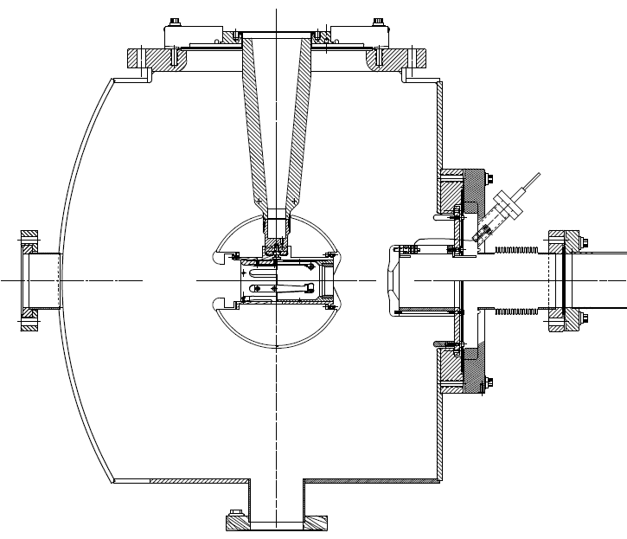
spectrometer
1497 MHz choppers
Wien
Buncher
Bend
1/4CM
2
3
4
5
6
7
A3
A4
1
A1
A2
Gun
What quantities can we measure with this beamline?

Slide 5
Things to consider
Can our design accommodate higher current after HDIce? 100uA at least. What bunch charge?
Appropriate diagnostic and tools to steer up beam?
Vacuum quality, yes we can make good vacuum
350kV beam = stiff beam, how hard do we imagine running the buncher?
Will the UofI solenoids really work for 350kV beam
What is the lowest gun voltage we need to achieve? And still accelerate beam through the quarter?
Don’t want to “eat up” all floor space with long CEBAF injector….
On the bright side, a long complicated front end will let us make interesting measurements
Need to pull the trigger on our front end design
How many components do we have, and need to manufacture/buy?

