Slide 1
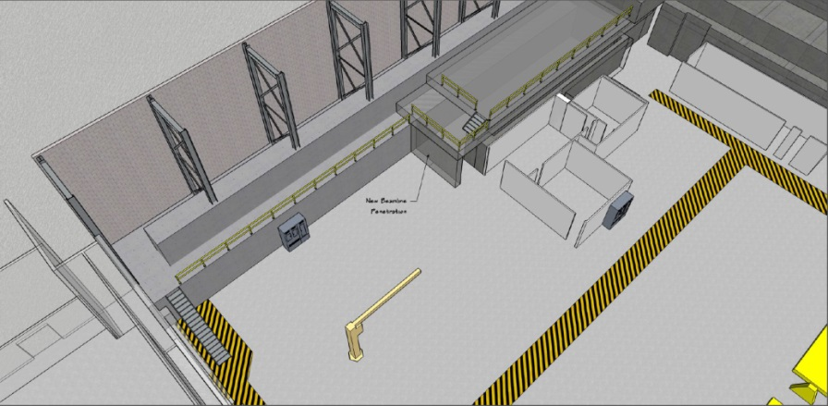
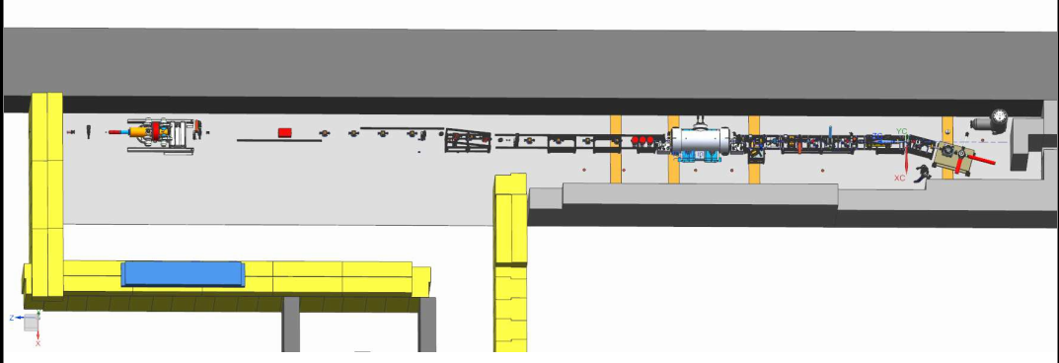
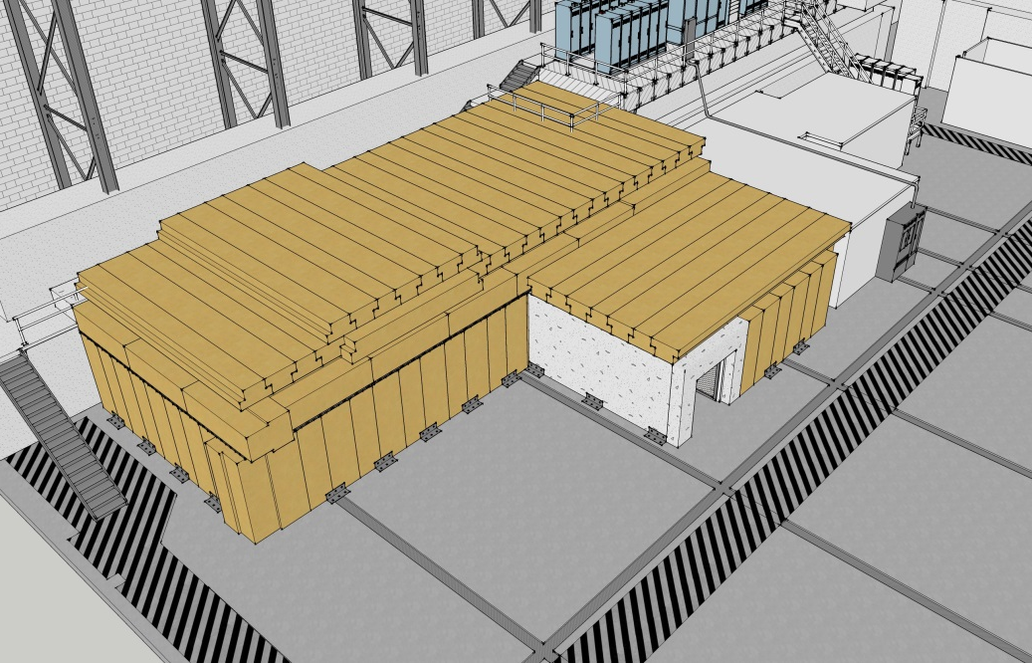
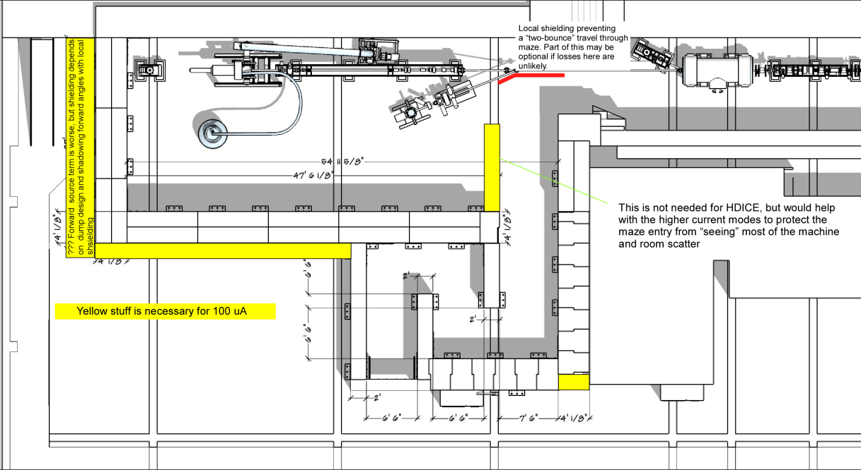
Upgraded Injector Test Facility - UITF
What we started with…
UITF as imagined

Slide 2
Purpose of this Ops Review
Please assess the viability of this facility. Will it work?
Ops Review is a precursor to an Internal Safety Review planned for April/May
More reviews to follow, including:
Conduct of Operations Review in May, with SCMB,
Accelerator Readiness review July+
Experiment Readiness Review prior to HDIce installation
Everyone is saturated with work, thank you for your time

Slide 3
UITF Ops Review - Outline
Overview: What is it for? What will it do?
Schedule, funding, who is working on this project?
Official User HDIce (+ testing the new ¼ cryomodule)
Present status
Beamline design
Operational perspective
Optics modeling
Gun HV supply and Drive Laser
MPS
What are the key concerns that could jeopardize functionality?

Slide 4
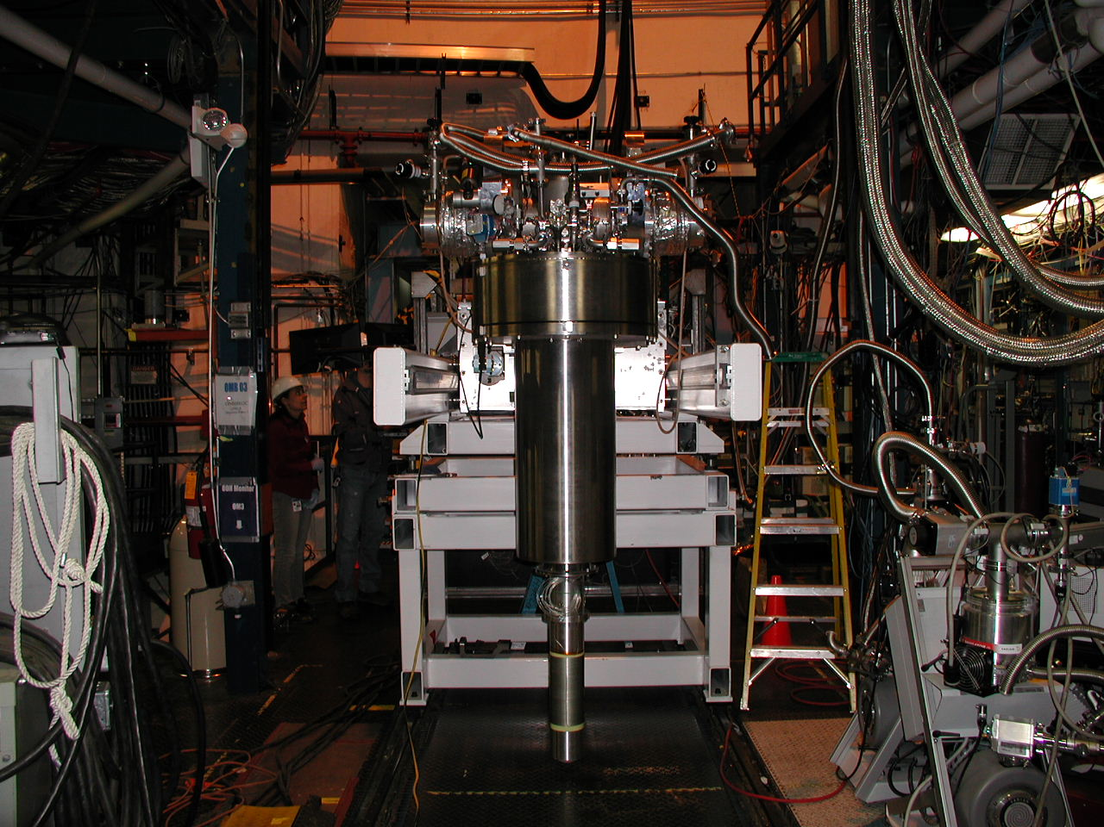
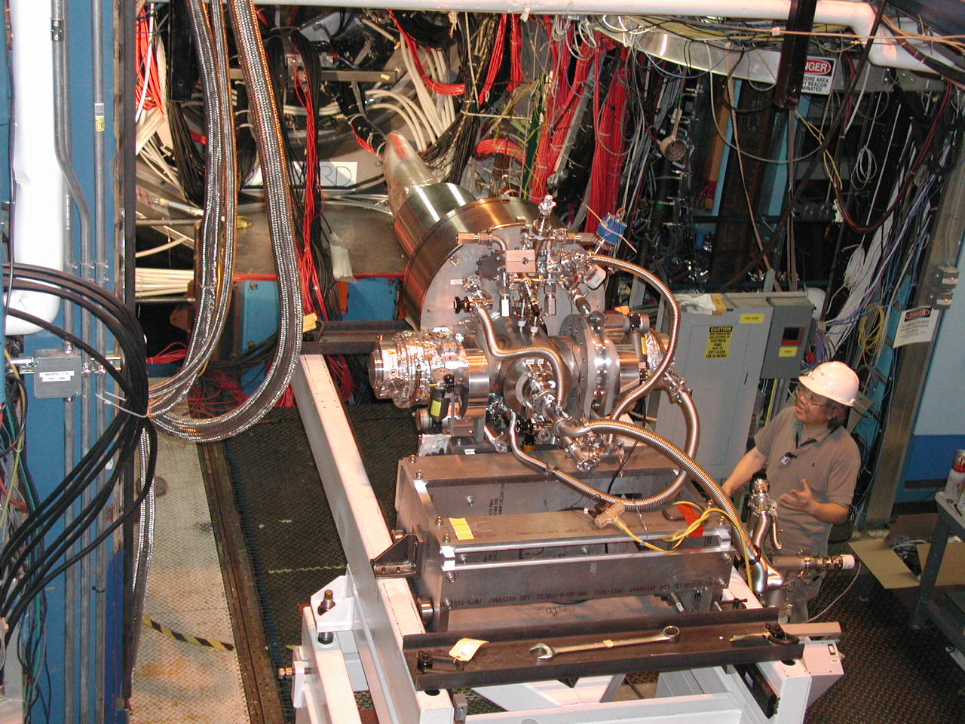
UITF is for Commissioning HDIce

Slide 5
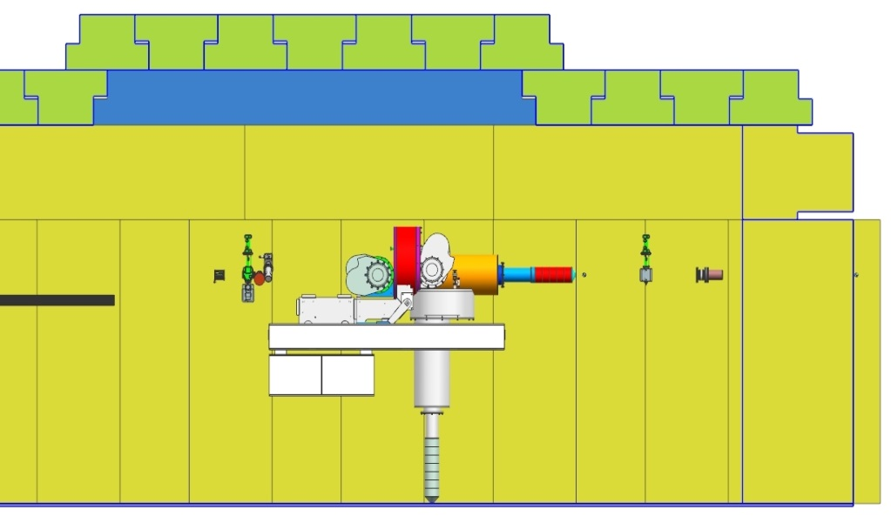
HDIce
Cryogenic target, polarized by “brute force” B-field
Takes months to fabricate a polarized target. Target can be depolarized by heat produced by beam
UITF beam tests will help us define proper operating conditions at 11 GeV CEBAF
3 run periods per year, each run 3 weeks duration, for 3 years
Target here
e-beam

Slide 6
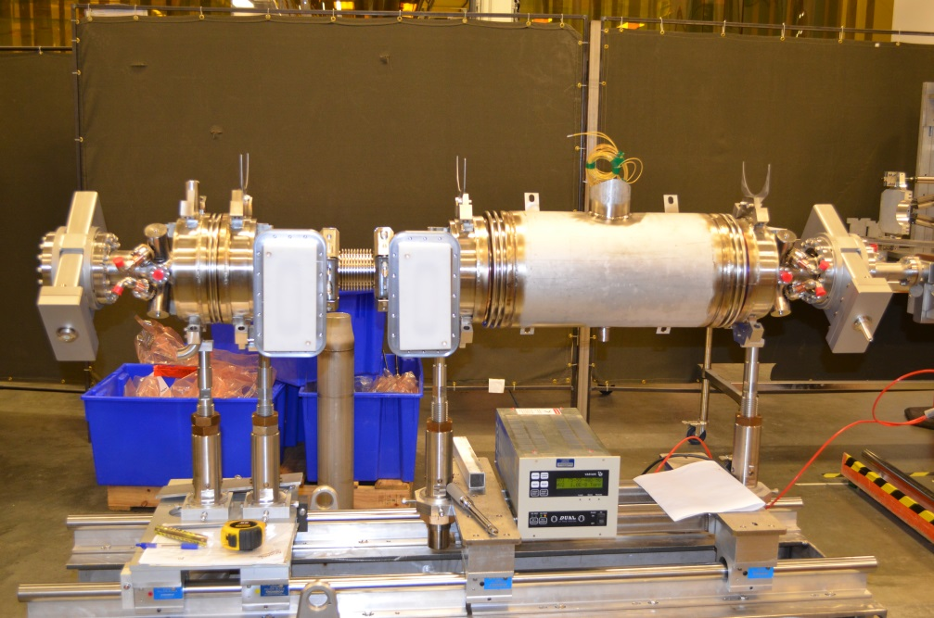
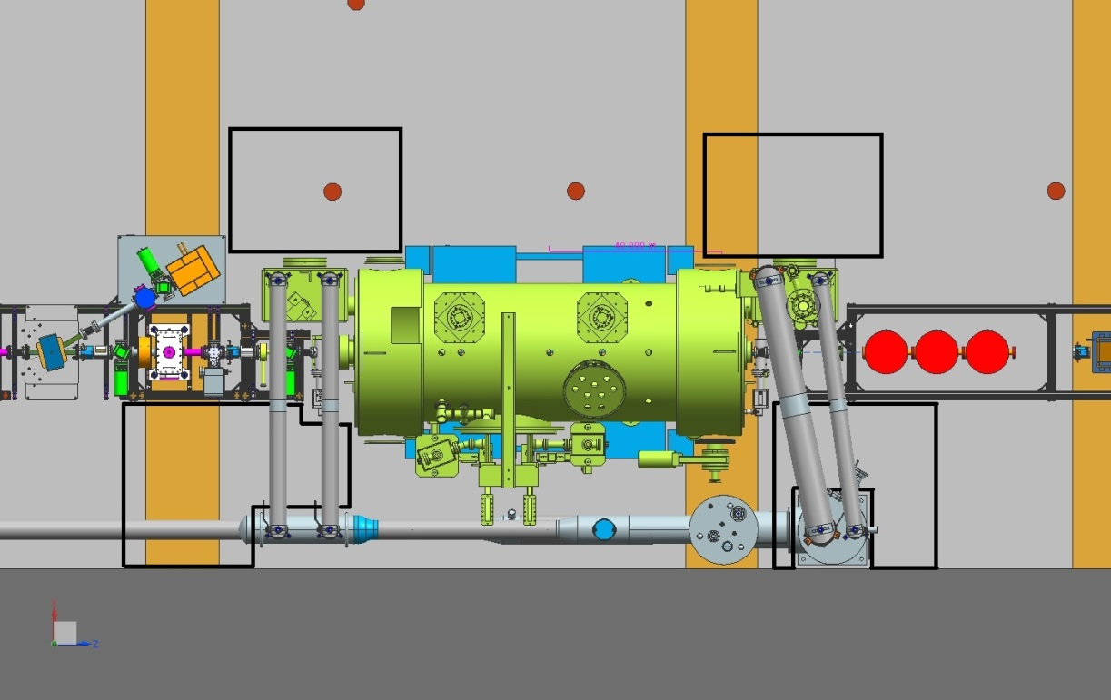
UITF and the new ¼ Cryomodule
An opportunity to test the new ¼ CM, which will be ready for commissioning at CMTF in June
Space at UITF is tight, but layout shares many features in common with CEBAF “injector–upgrade” layout
UITF will use old ¼ CM after we install new ¼ CM

Slide 7
UITF Schedule
April: Cryogenic work complete, ¼ CM connection to CTF
May: klystrons and controls complete, waveguide getting installed
June: new ¼ CM complete + tested at CMTF
July: new ¼ CM installed at UITF, keV beamline complete, the gun ready for high voltage, ODH and PSS complete, CARMs installed, U-tubes installed
August: all Facilities work complete, we can make radiation in our locked enclosure. Ops software and EES work nearly complete
September-December: CIS making keV beam, building MeV beamline, poised for MeV beam when CTF available
HDIce tests with beam, January 2017

Slide 8
Monthly Meetings with Mont
Purpose: to inform Lab Leadership of the UITF status
Action Items (from previous meetings)
Project Update
Progress Update
Milestones Update
Budget Update
Highlights & Concerns
Next meeting agenda
Notes:
RW=Roy Whitney

Slide 9
UITF “Players”
Major components
Facilities
Engineering
Mech Design
Installation
Cryo
Safety Systems
I&C
DC Power
Low Level RF systems
High Power RF
Survey & Alignment
SRF
Build new ¼ CM
Commission with RF
Ops and CASA
Network and communications
Software
Beamline design
Green means we can see progress

Slide 10
Progress Update
Major components
Source Group
Reliable 350kV ops
Beam to cup in front of ¼ CM
Beam to cup in front of HDIce
EHSQ
Shielding approval, ODH assessment
Global hazard review
FSAD
Accel Readiness Review
Commissioning Plan
HDIce
Installation at Cave
Beam on HDIce
Green means we can see progress

Slide 11
Charge Codes!
ITFCRY
ITFPTB
UITFBL
Facilities
Cryo Infrastructure including some RF
Polarized Target Beamline
UITF
Facilities

Slide 12
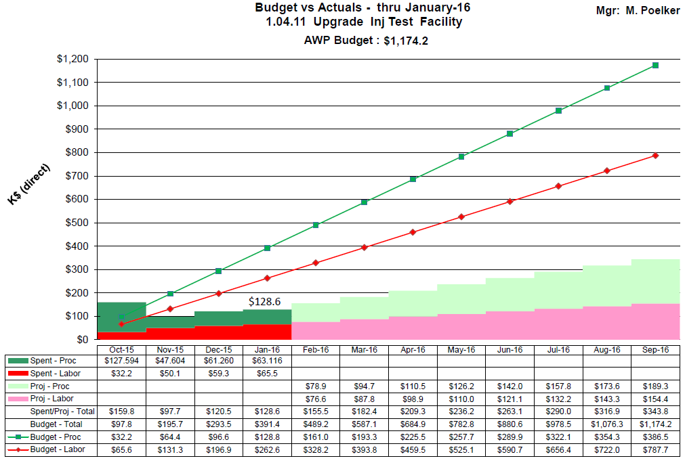
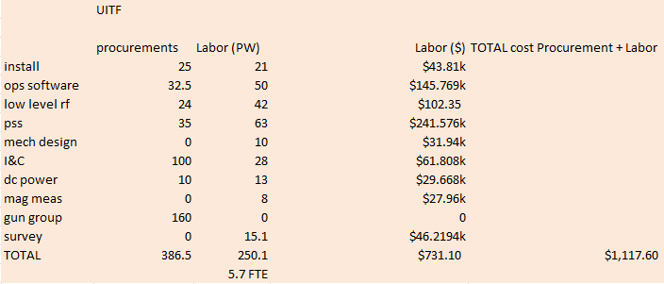
Budget UITFBL

Slide 13
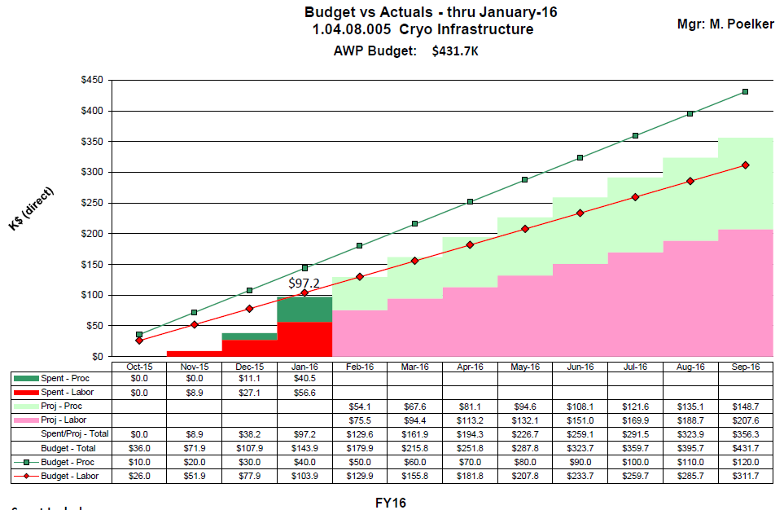
Budget ITFCRY

Slide 14
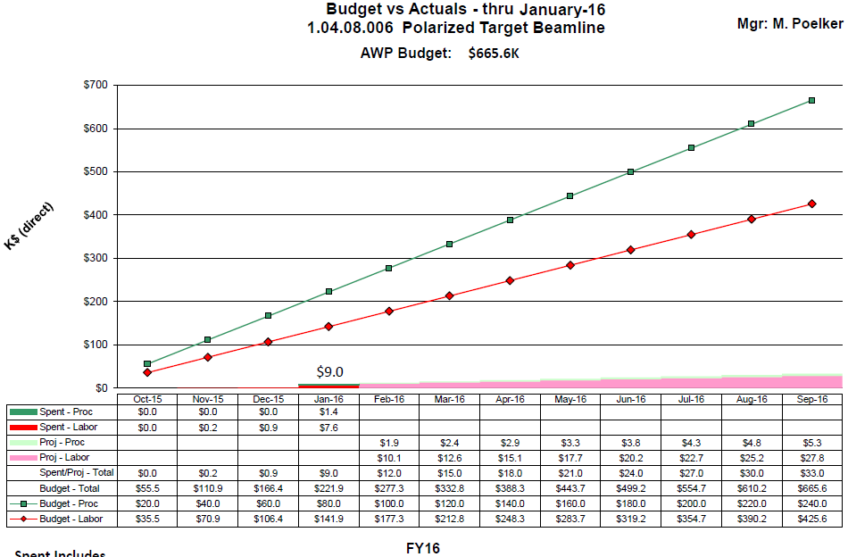
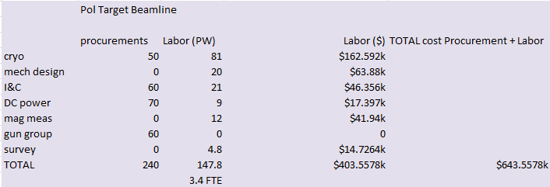
Budget ITFPTB

Slide 15
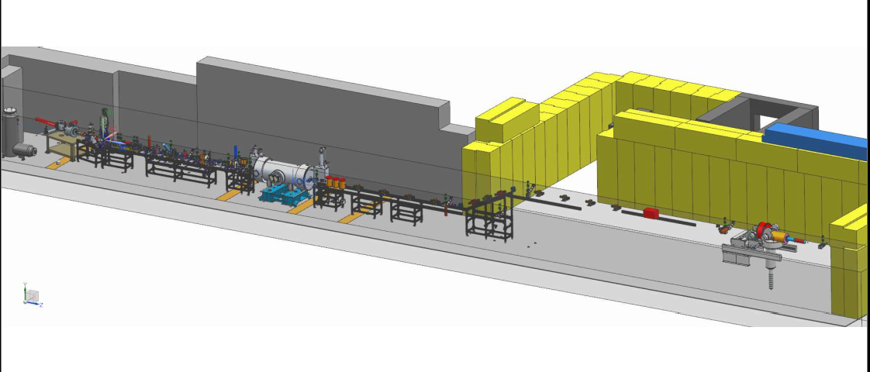

Slide 16
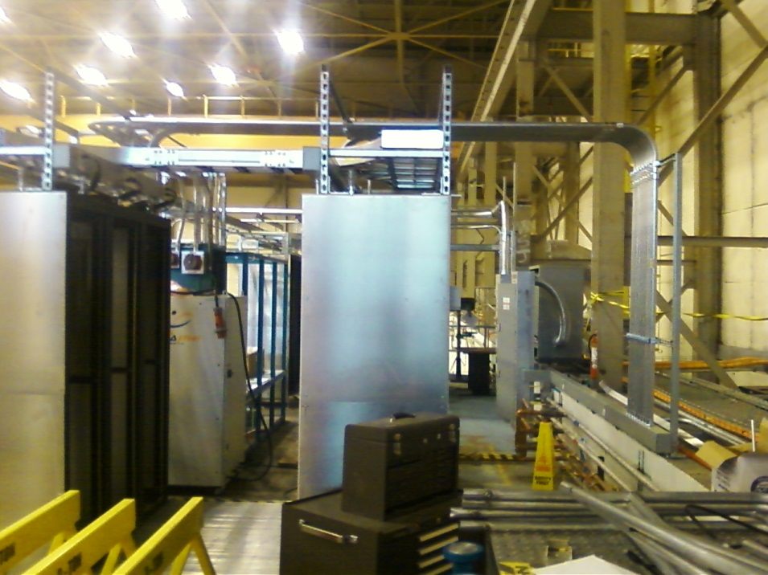
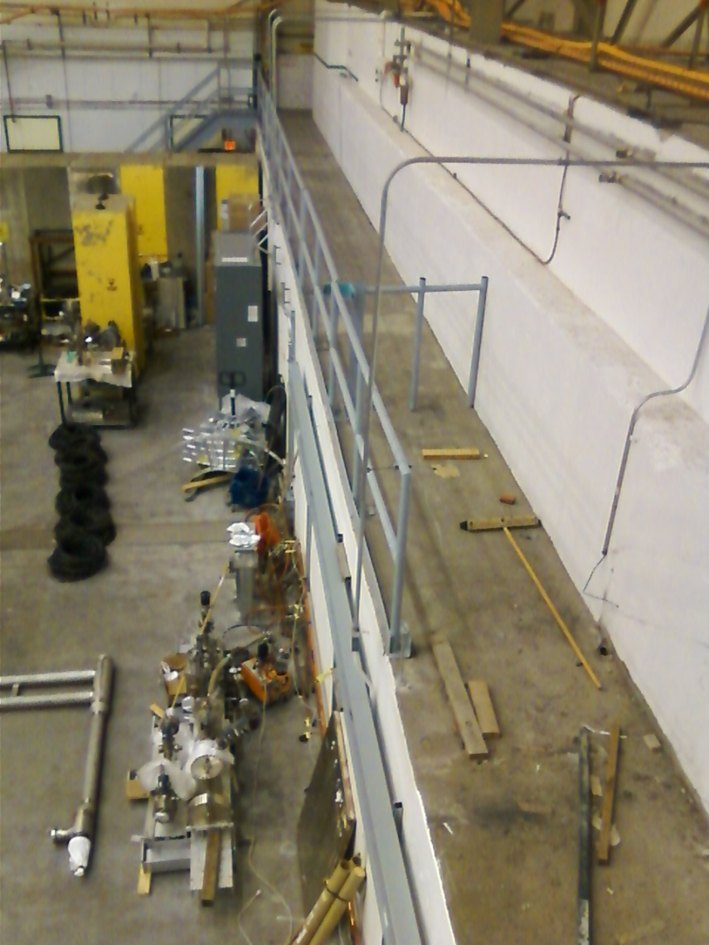
Status Facilities
Cave 1 electric and network complete
NEXT: Clean off ledge and move IPC

Slide 17
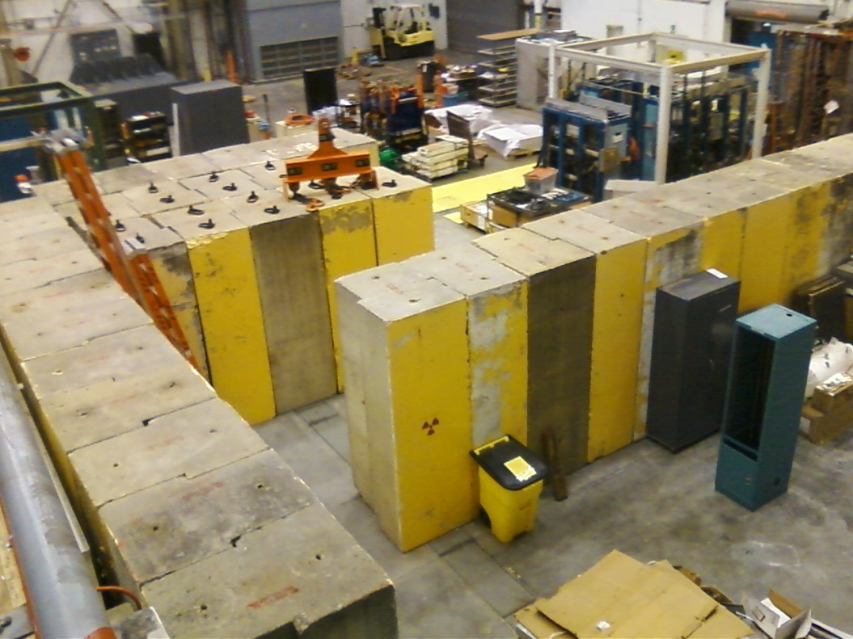
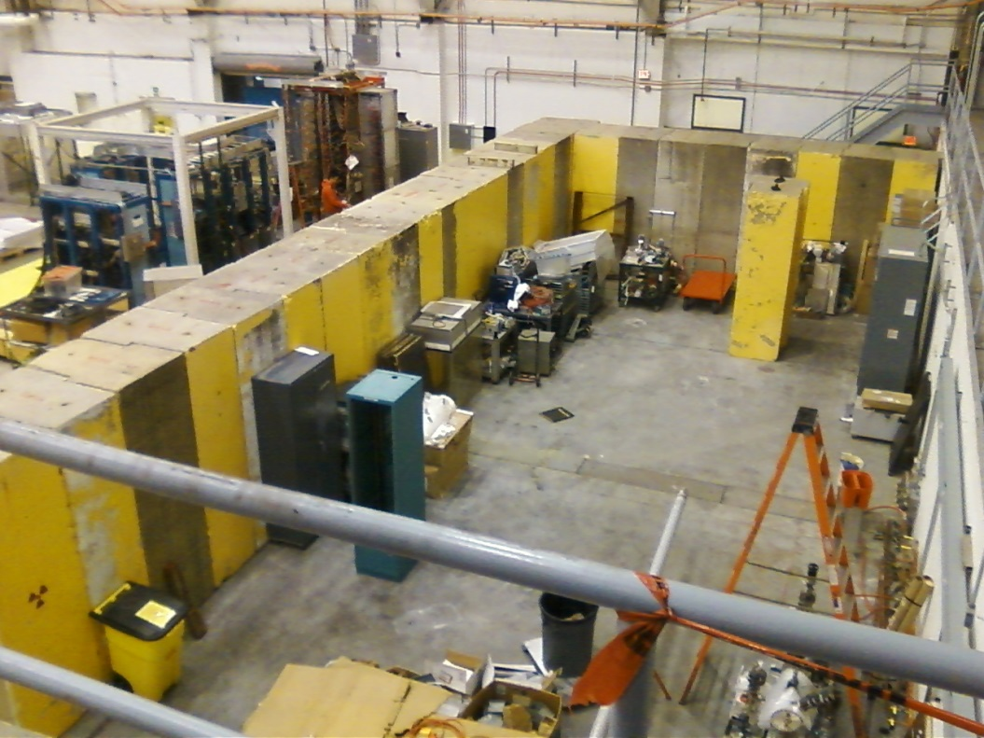
Status Facilities
Interior walls to be painted soon, bracing added for seismic support. Second layer craned into place. Precast blocks to arrive in May, labyrinth and ceiling in place July

Slide 18
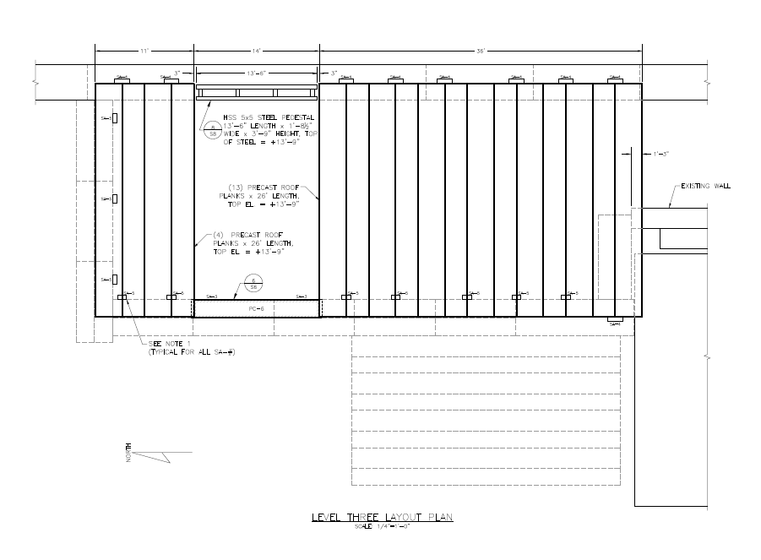
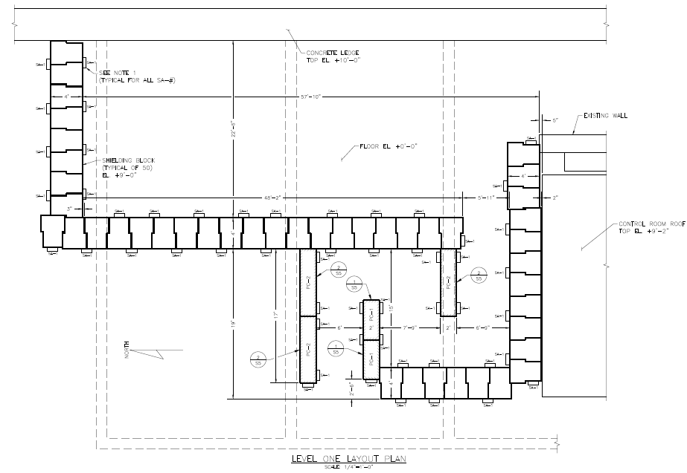
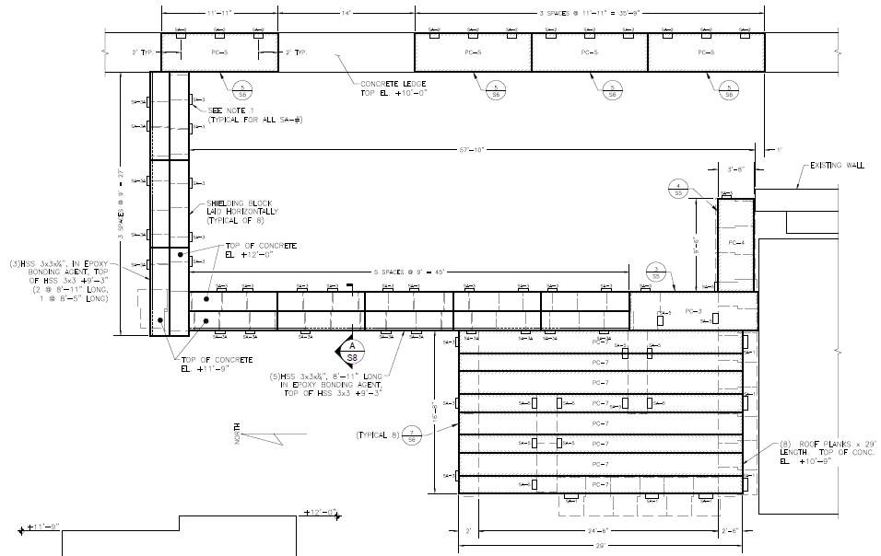
Facilities (T. Renzo)

Slide 19
Facilities Tasks and Timeline
February 2016
Cave1 electrical work complete
Facilities has issued PR for Cave2 concrete and bracing, out for bids
March
Installation Group willing to secure Cave2 structure, install other utilities
April
Facilities moves IPC outside Cave2
Concrete for Cave2 arriving on site, installing it
Physics installs 2nd layer of concrete, adds bracing
May
Cave2 including labyrinth complete, roof not yet installed
June
Facilities focus shifts to utilities inside Cave2: electricity, lights, fire suppression, gate
July
Facilities continues to work on utilities inside Cave2: electricity, lights, fire suppression, gate
August
Facilities completes utilities inside Cave2: electricity, lights, fire suppression, gate, entire Cave2 roof installed. All bracing complete
Facilities provides power to big Bertha from diesel generator (this could happen later, since no Beam to HDIce until Jan 2017)

Slide 20
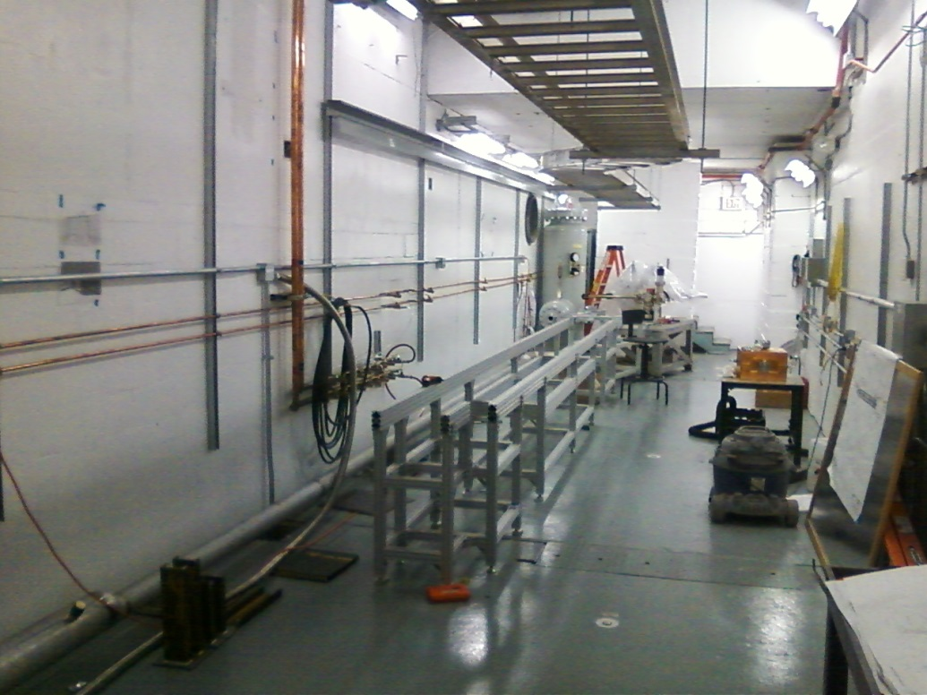
Status Cryo Group
Installed transfer line, leak checked OK
Purchased a turbo pump for leaky shield line
Building the heat exchanger
Controls getting worked

Slide 21
Status New ¼ CM
Test at CMTF June
Install at UITF July
Met with Cryo, SRF, RF, and Kazimi of Ops
Discussing relief valves from ODH point of view
Who does what? e.g. Cryo makes u-tubes and SRF stabs them, Cryo pulls cables, SRF provides connectors
Expect 8 MeV beam with available klystrons

Slide 22
Cryo, SRF, RF and new 1/4 CM
We agreed on means to “park” the ¼ CM when not accelerating beam: circulate 80K LN2 through 35K shield line. UITF should not be a burden on CTF 34 wks per year
LN2 temp could fluctuate 80 to 100 K, no problem for parking but….
How to cool HDIce? We will purchase dewars to get started, and capture boil off via warm return
Draft ODH assessment complete: ODH0 except when swapping dewars or stabbing u-tubes (ODH1)
New ¼ CM requires waveguide tuners
Chad Seaton building the high power rf control board
Next biggest issue: designing the waveguide layout

Slide 23
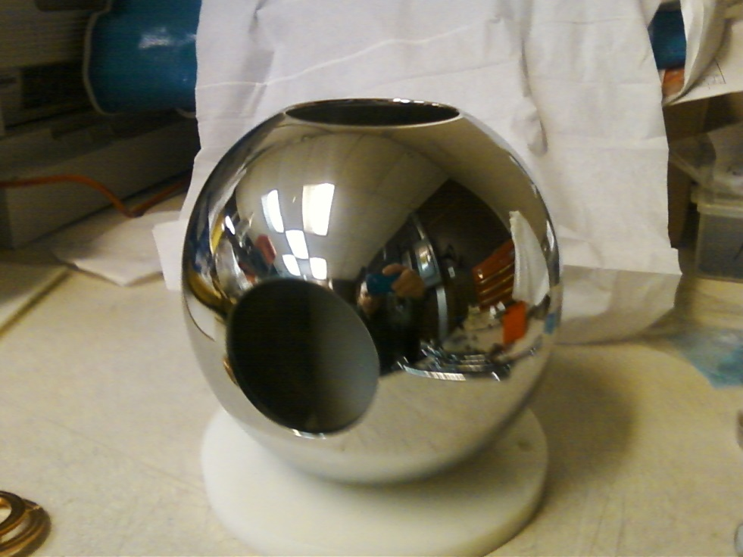
Status Gun Group
Barrel polished in 2 days
HV power supply
buncher
Gun HV power supply installed inside SF6 tank, very little corona at 60 psi
Gun table and 80/20 keV beamline structure moved into place
NEXT: add gun HV chamber, install big beamline elements, buy stuff….

Slide 24
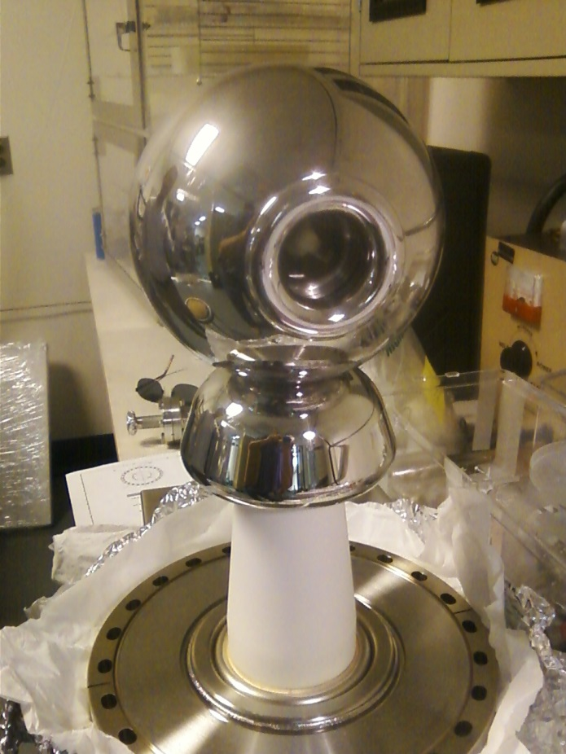
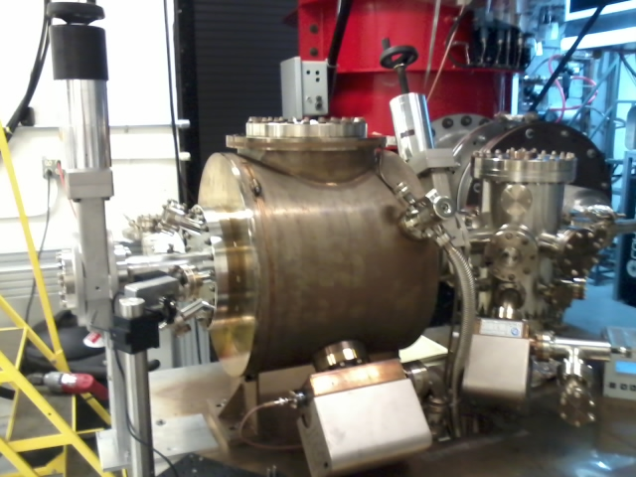
Building the electron gun at LERF GTS
The new gun happy at 325 kV, stopping at this voltage for now. Shifting focus to building the beamline and photocathode deposition chamber (LDRD magnetized beam tests)
Only need 200 kV gun when using the new ¼ CM

Slide 25
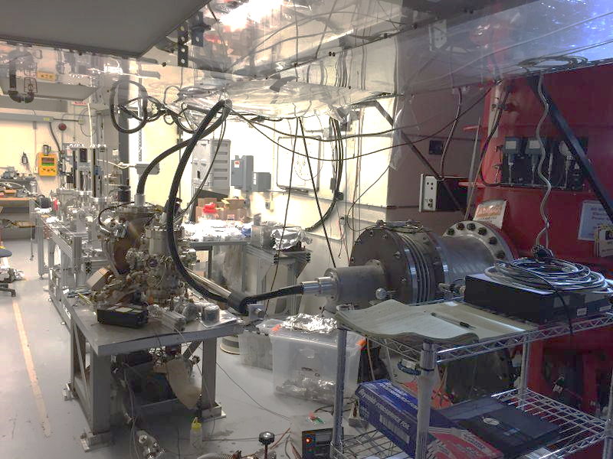
Gun and Beamline at GTS

Slide 26
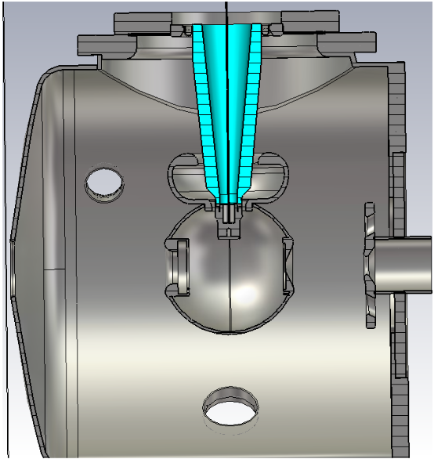
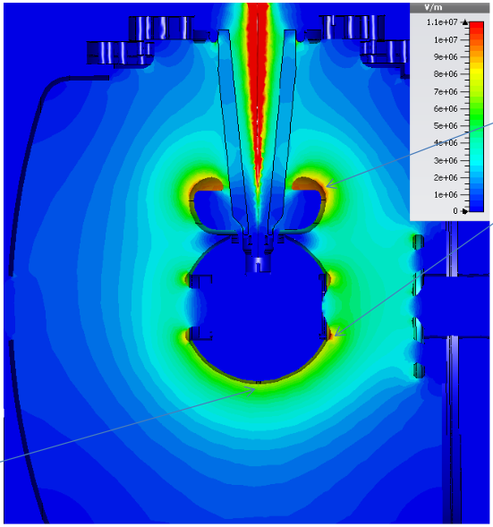
Status Gun Group
11 MV/m
8 MV/m
Yan Wang’s POISSON simulations validated by Fay Hannon using CST 3D field mapper

Slide 27
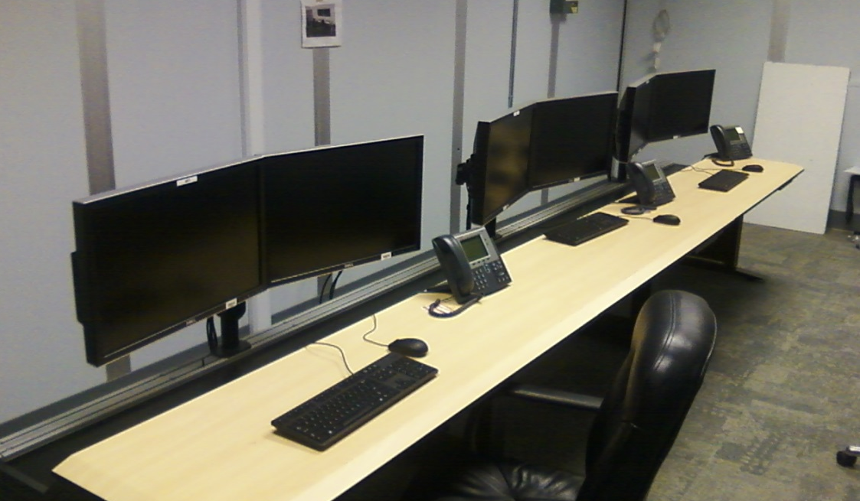
Status Operations
Network switcher hardware installed
Computer terminals installed in control room
6100 IOCs ordered, but we can use older IOCs if needed sooner
Groups are installing hardware in racks, and conversations have started with Software (Scott Higgins our POC)

Slide 28
Status Engineering
I&C building stripline bpm electronics
DC power prep-ing magnet racks, pulling cables
RF control boards complete
RF group building second water skid
RF group building the klystron control panel
Safety System Group on track, ODH and PSS
Installation Group done with Cave1, can help with Cave2 when it makes sense

Slide 29
Status Reviews
UITF Accelerator Review: where beamline design is reviewed by Ops/CASA/SRF, March 18, 2016
Geoff Krafft, Mike Spata, Reza Kazimi, Arne Freyberger, Todd Satogata, Fay Hannon
Need to send out pre-review material soon: beamline design, optics envelope, machine protection
Safety Systems Review, May 2016
Machine and Personnel, including radiation protection
SCMB?
UITF Readiness Review, August 2016
Commissioning and Operations plans
Experimental Readiness Review, December 2016
Focused on HDIce
Documents: FSAD, mini-AOD, ESAD

Slide 30
UITF – Issues and Concerns
Modest shielding limits beam current to 100 nA CW. How to ensure we do not exceed maximum beam current?
Finding a shielding solution for 100 uA operations
CTF upgrade, CTF is oversubscribed (LCLSII), 80 K shield line approach, “parking” the new ¼ CM
Very low current operation, how to see beam < 1nA ?
Available klystrons, will we make 8 MeV?
MeV beam blows up when interacting with radiation baffles inside HDIce
Resources are tight…UITF is a stretch goal
3 run periods per year, 3 weeks each. CIS to operate the facility. Is this realistic?

Slide 31
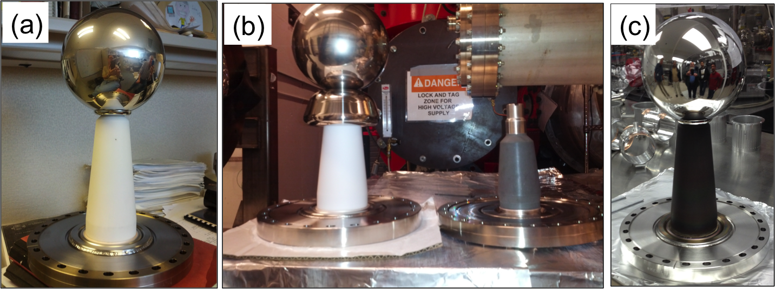
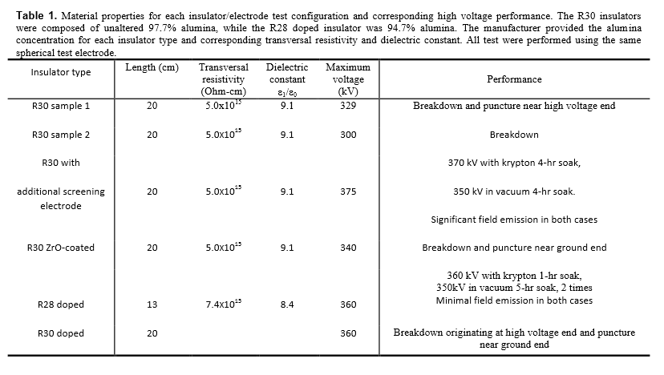
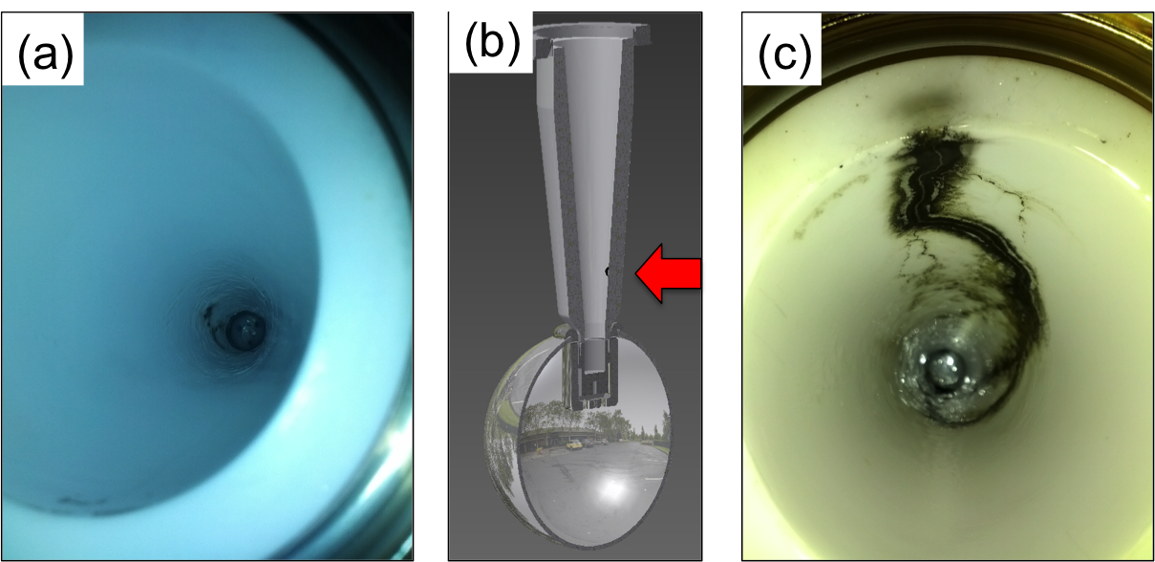
Notes:
Interior Page Design 2

