Slide 1
Existing Wien capabilities for 60º and for 90º spin rotation
Carlos Hernandez-Garcia
Positrons meeting Aug 31 2022

Slide 2
Existing Wien capabilities for 60º spin rotation
Totally doable for all three electrode gap options
Gabriel has conditioned the 13 mm gap Wien up to 26 kV /electrode, and the CEBAF 15 mm gap Wien to 22 kV / electrode

Slide 3
UITF Wien filter (13 mm gap) comparing measured Bx with CTS modeled Ey
B measurements by J. Meyers and M. Beck
E CST simulations by Gabriel Palacios

Slide 4
UITF Wien filter (13 mm gap) comparing measured Bx with CTS modeled Ey zoomed in fringe fields
B measurements by J. Meyers and M. Beck
E CST simulations by Gabriel Palacios

Slide 5
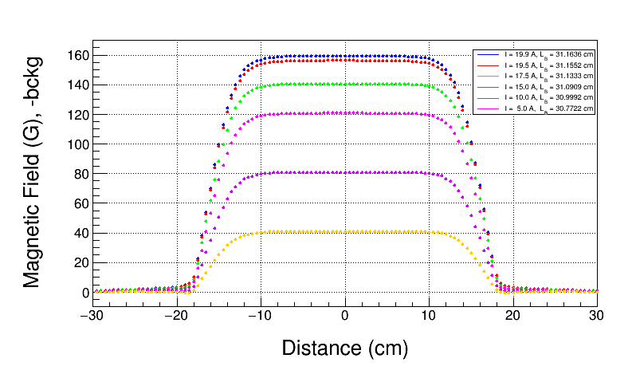
UITF Wien Field Map, with Background Subtraction

Slide 6
UITF Field Map, 19.9 A, Repeat Measurements

Slide 7
UITF WienCore (Center) Magnetic Field vs Current
With Background Subtraction

Slide 8
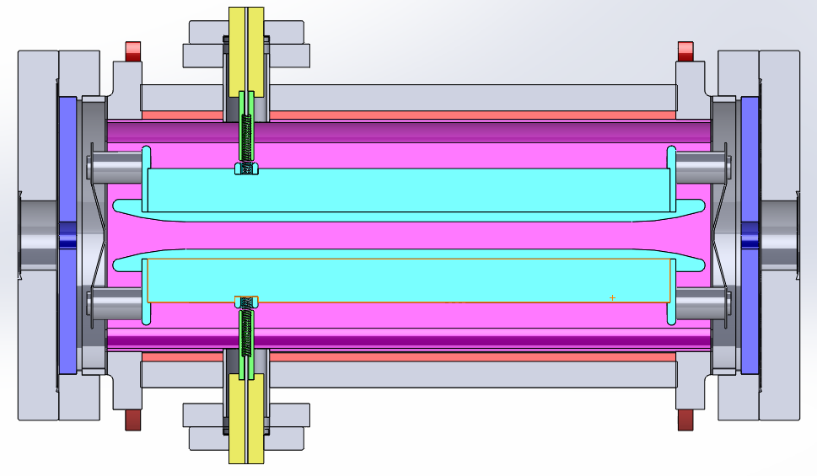
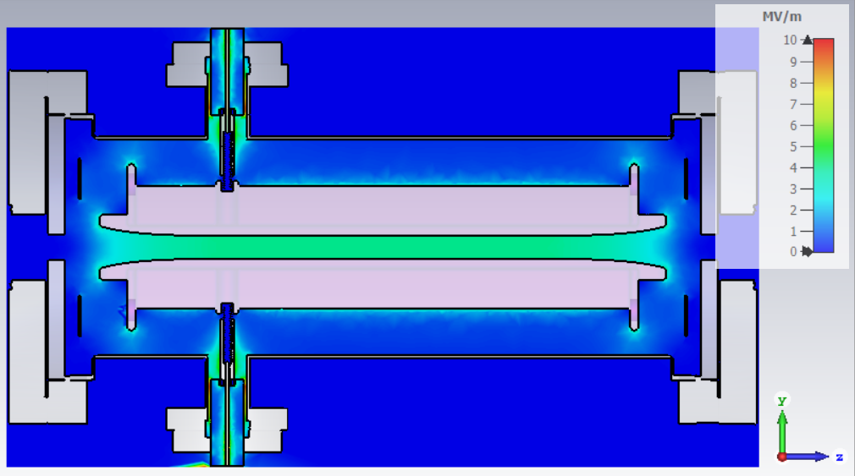
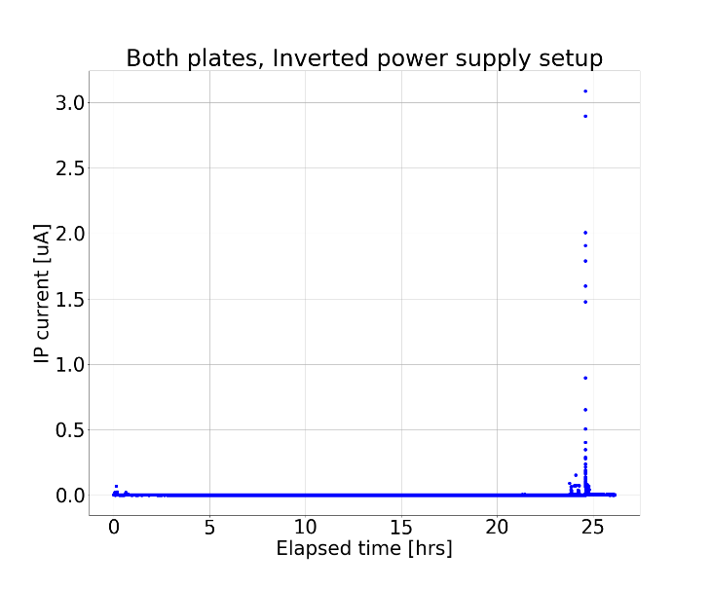
The process of modifying the original design from SLAC involved 3D modeling, CST-EM simulations, working with designers and engineers for construction, and high voltage testing
Vacuum chamber
5.7 MV/m
3.9 MV/m with 13 mm gap
13, 15 o r17 mm
40 kV rated feedthroughs
3.4 MV/m
42 cm
We tested off-line two high-gradient Wien filter spin rotators:
15 mm gap with 22 kV applied voltage capable of 100 deg spin angle rotation with 200 keV beam
13mm gap, with 26 kV applied voltage capable of 90 deg spin angle rotation with a 300 keV beam
Work by Gabriel Palacios

Slide 9
Existing Wien capabilities for 90º spin rotation. We have an 13 mm electrode gap Wien currently operating in UITF with 180 keV beam
Tested with beam
Applied voltage in testbed
From J. Benesch JLab-TN-15-032:

Slide 10
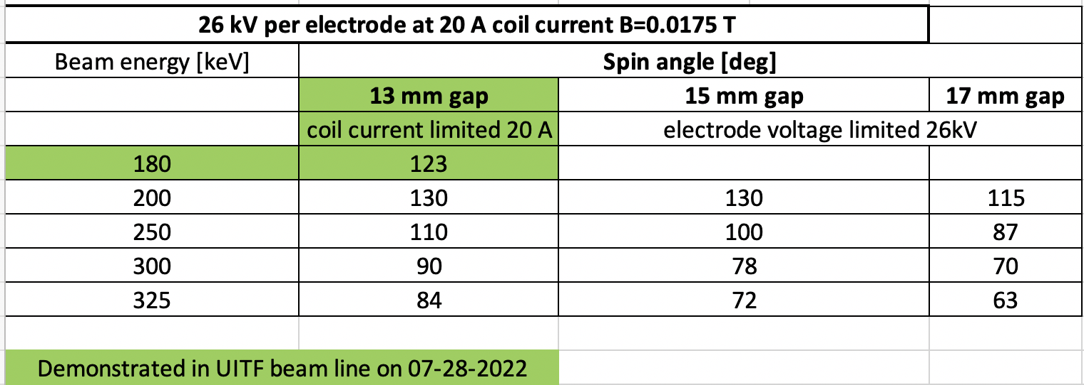
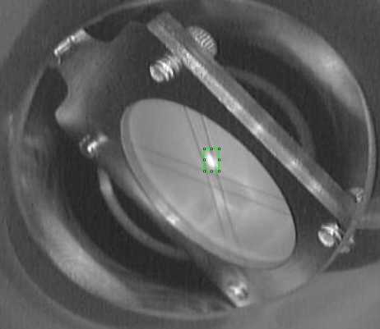
Limiting magnet current to 20 A, and electrode voltage to 26 kV (demonstrated), these are the existing Wien capabilities:

Slide 11
