Slide 1
Magneto-Optic Kerr Effect in a Magnetized Electron Gun*
A Jefferson Lab summer project by Benjamin Hardy, mentored by Joseph Grames
* This work is supported by the the National Science Foundation, Research Experience for Undergraduates award 1359026 and the Department of Energy, Laboratory Directed Research and Development contract DE-AC05-06OR23177.

Slide 2
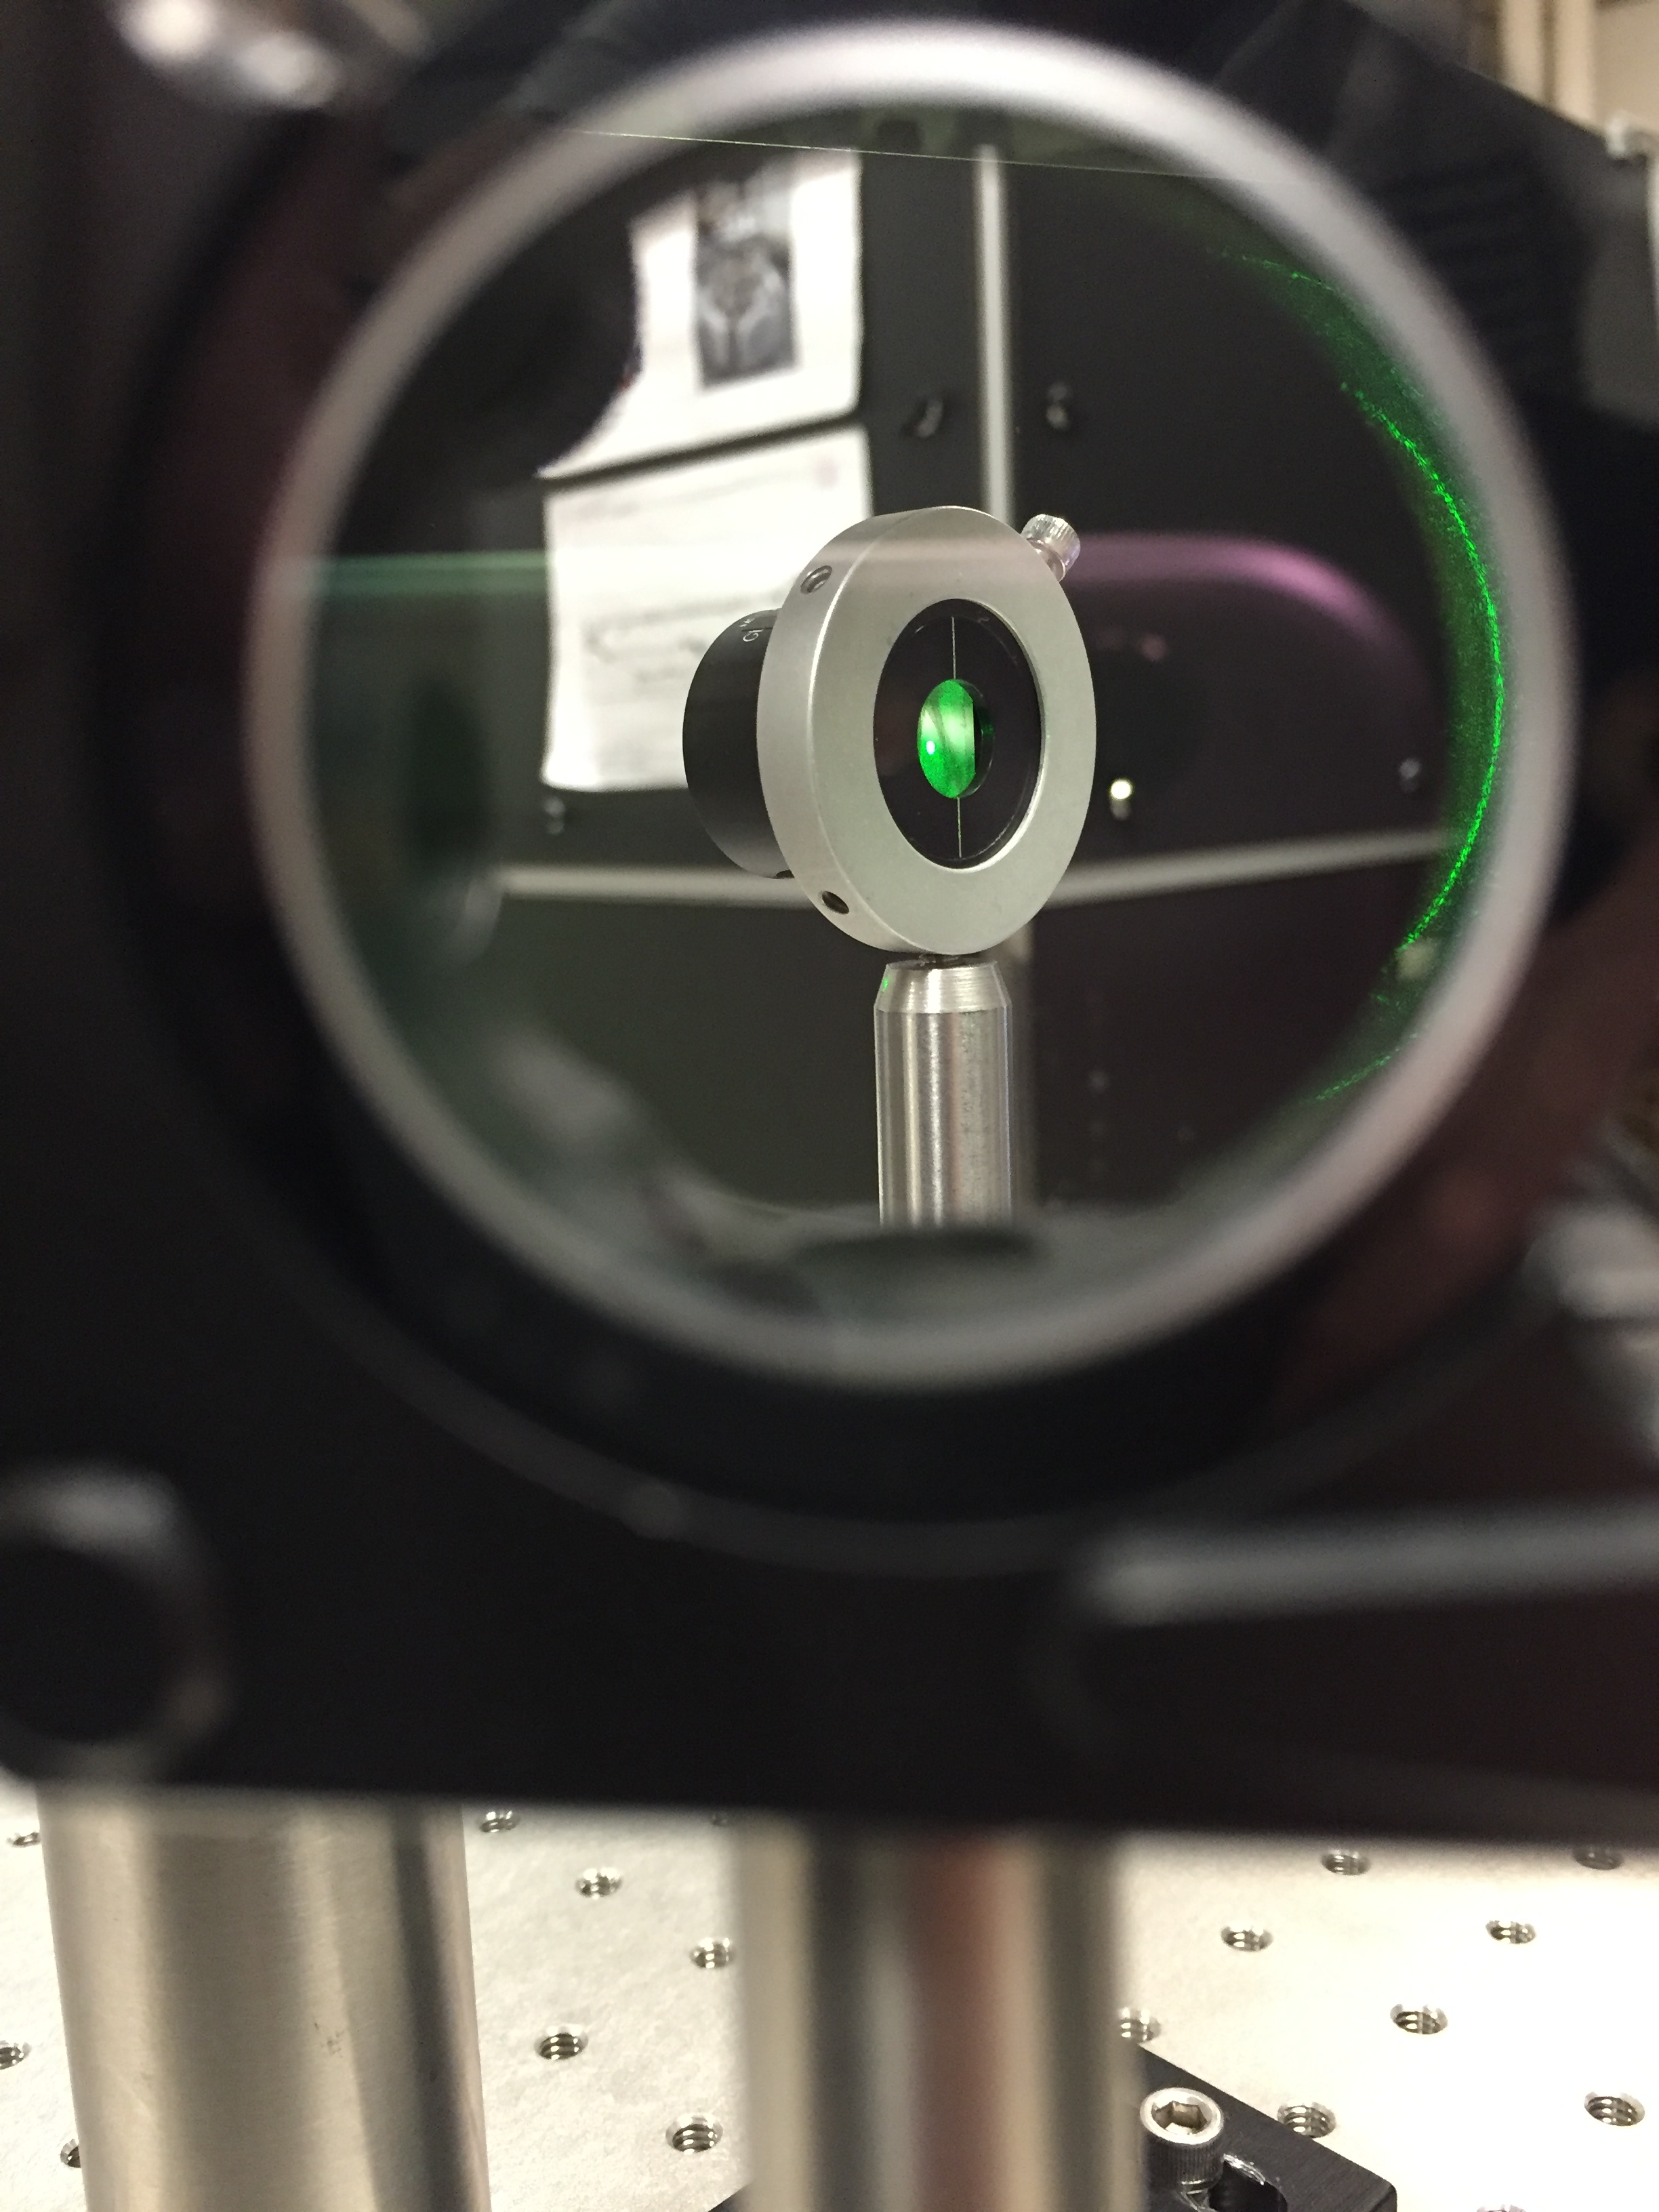
Outline
Motivation – Measure magnetic field in vacuum
Method – Magneto-Optic Kerr Effect diagnostic
Results – Fixed and modulated laser polarization
Next Steps – Calibration with solenoid magnet
Summary – Project highlights

Slide 3
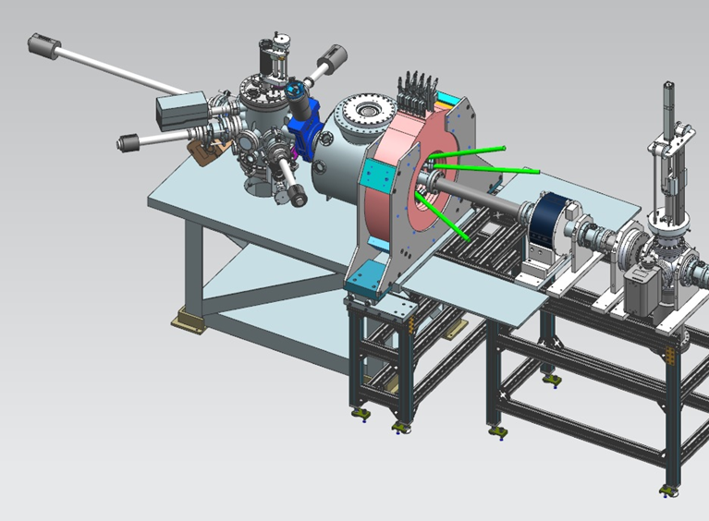
Motivation – Solenoid Magnetic Field
A magnetized electron beam will “cool” and improve the ion beam in an electron-ion collider.
An electron source in a solenoid field produces a magnetized electron beam.
The solenoid is in air, but the electron source (photocathode) is in vacuum – not easily reached.
An in-situ diagnostic of the magnetic field inside the vacuum chamber would be valuable and practical
Beamline
Photocathode/
Vacuum Chamber
Solenoid Magnet
Figure 1 – Identifies electron beam source (in vacuum chamber) in relation to solenoid magnet.

Slide 4
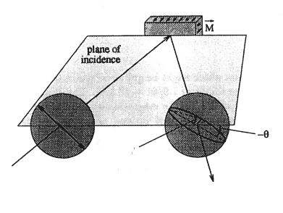
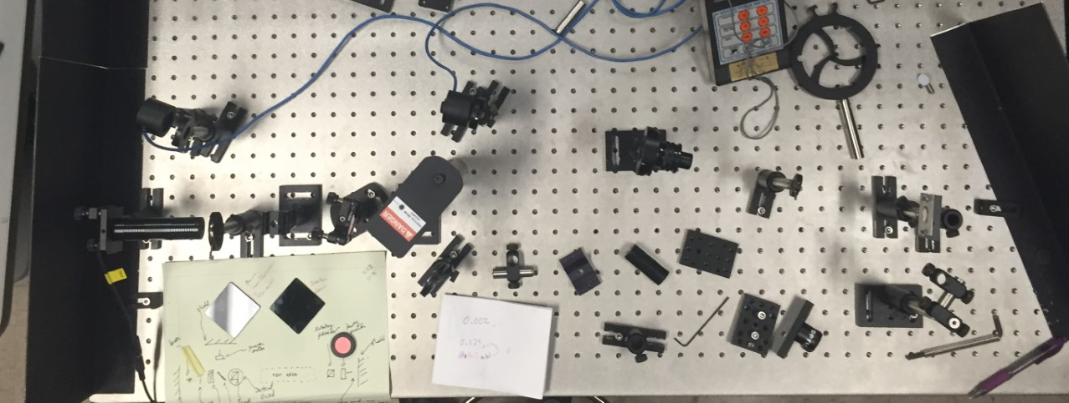
Method- The Magneto-Optic Kerr Effect
Figure 2. Principle of the MOKE measurement
Magneto-Optic Kerr Effect (MOKE)
Polarized laser light is reflected from a magnetized surface (e.g. iron foil)
Induced circular birefringence results : rotation of the plane (Ө) and degree of ellipticity (ε) are changed
Kerr effect is linearly related to the magnetization of the sample
ε
Ө
Figure 3. Optics table layout for initial tests

Slide 5
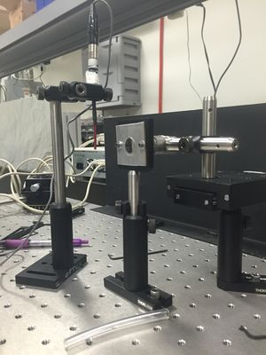
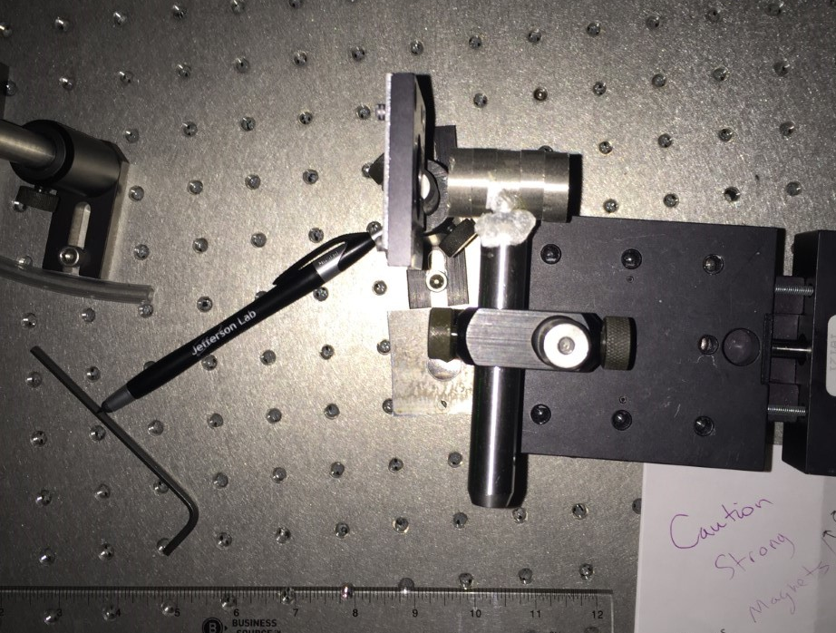
Method- reflection and initial bench tests
Polished iron foil reflects polarized laser light (0 deg) to analyzer (90 deg)
Rare earth magnets mounted to linear stage vary magnetic field at foil surface
Polarization of light reflected from magnetized iron foil is now changed
Foil: 99.9% Iron (polished)
Rare earth Magnets
Figures 4,5 – further demonstrating bench test. Pure polished Iron foil, and permanent magnets.

Slide 6
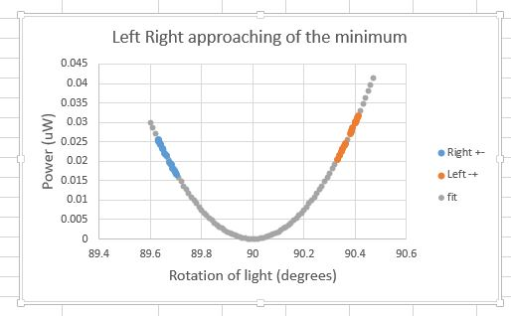
Results- First measurement of Kerr Ө
Simple test of circular birefringence
Analyzer is rotated (<0.5 deg) “Right” or “Left” of null point
Varying the magnetic field rotates linear polarization and passes more/less light through analyzer
Reversing magnetic field reverses rotation.
Rotation is small; prefer a more sensitive absolute approach
Transmitted Power vs. Applied B-Field
(slopes indicated non-zero birefringence)
Perfectly crossed polarizers

Slide 7
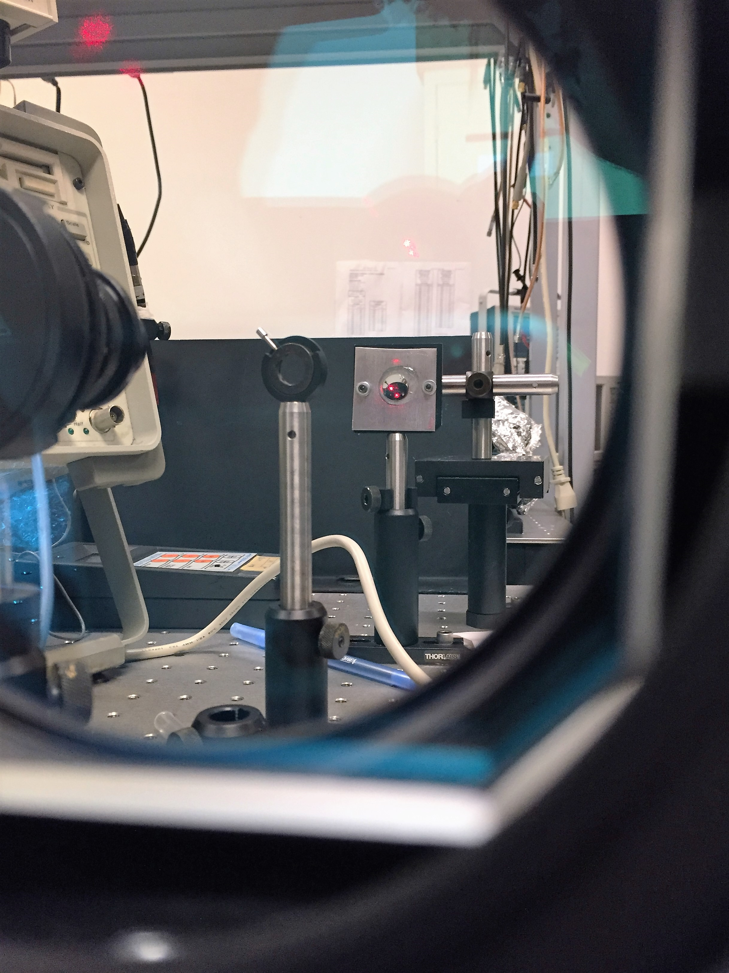
Method- Implementing the Photo-elastic modulator
Figure 6 – PEM arrangement
Analyzer
The photo-elastic effect is the birefringence of a material (silica crystal) due to applied stress
A Photo-Elastic Modulator (PEM) modulates the polarization of light at a resonant frequency of applied stress (e.g ≈42. kHz)
A PEM analyzing arrangement propagates the Kerr effect (ε and Ө) at harmonics of the PEM frequency
Lock-In Amplifiers detect the 1f and 2f amplitudes of the analyzer light to extract the Kerr signal
Laser
Fused Silica Bar

Slide 8
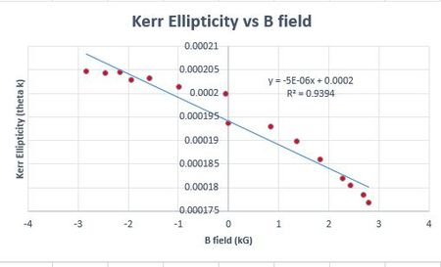
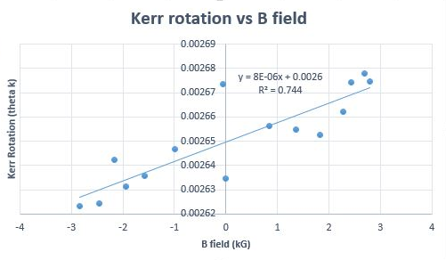
Initial Results – Lock-in Amplifier method
Figure 7. Equations for (ε, Ө)
Figure 8 – Ellipticity vs. B-field
Figure 9 – Rotation vs. B-field

Slide 9
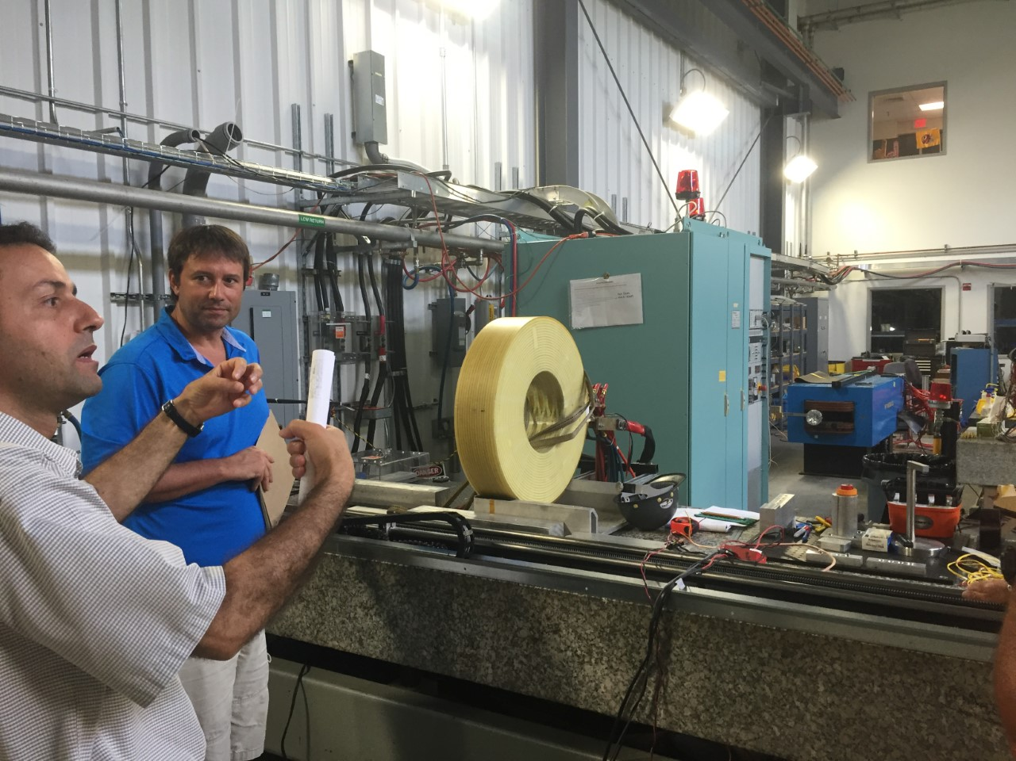
What’s next? – Calibration of bench tests with Solenoid
Solenoid Magnet in MMF
Joe Grames
Further optimization of Lock-In technique
Transport “Kerr-mometer” to Magnet Measurement Facility
Calibrate Kerr signal to solenoid magnetic field (foil at nominal photocathode position)
Measure Kerr signal vs. position on photocathode (spatial uniformity)
Riad Suleiman
Figure 10 – Riad Suleiman and Joe Grames discuss mapping the solenoid magnetic field

Slide 10
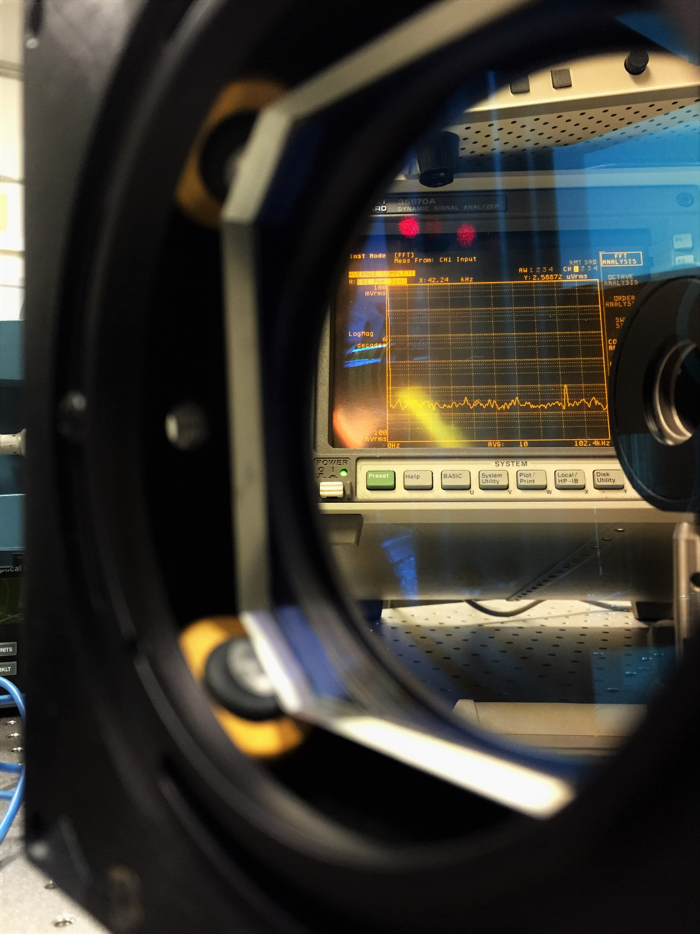
Highlights
Demonstrated change in reflected laser polarization with iron foil magnetization
Applied PEM and Lock-In amplifiers to improve sensitivity to Kerr effect
Calibrated Kerr-mometer to solenoid magnetic field at photocathode
Developed basis for in-situ monitor of Magnetized Gun magnetic field

Slide 11
References- figures
1 – Courtesy of Riad Suleiman; LDRD proposal “Generation and Characterization of Magnetized Bunched Electron Beam from DC Photogun for JLEIC Cooler”
2 – Captured by myself
3 – Robinson, Stephan. "Kerr Measurements of Electron Polarization." Inaugural-Dissertation (1994): 14.
4 - Captured by myself
5 - Captured by myself
6 - Captured by myself
7(a,b) - Kliger, Lewis and Randall, Polarized Light in Optics and Spectroscopy, Academic Press, 1990.
8 – Compiled by myself
9 – Compiled by myself
10 – Captured by myself
11 - Burov, A., S. Nagaitsev, A. Shemyakin, and Ya. Derbenev. "Optical Principles of Beam Transport for Relativistic Electron Cooling." Phys. Rev. ST Accel. Beams Physical Review Special Topics - Accelerators and Beams 3.9 (2000): 1

Slide 12
ThAnk YӨU!!

