Slide 1
Comparison of Sheds
Yan
2/2/16

Slide 2
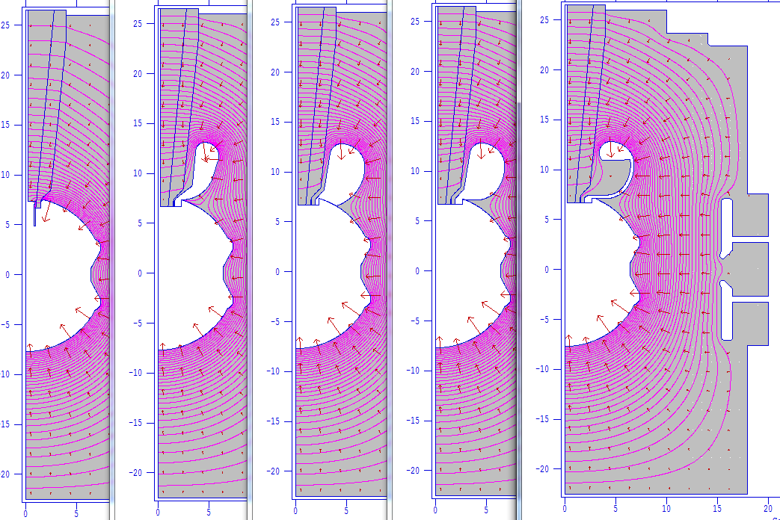
Evolution of Shed

Slide 3
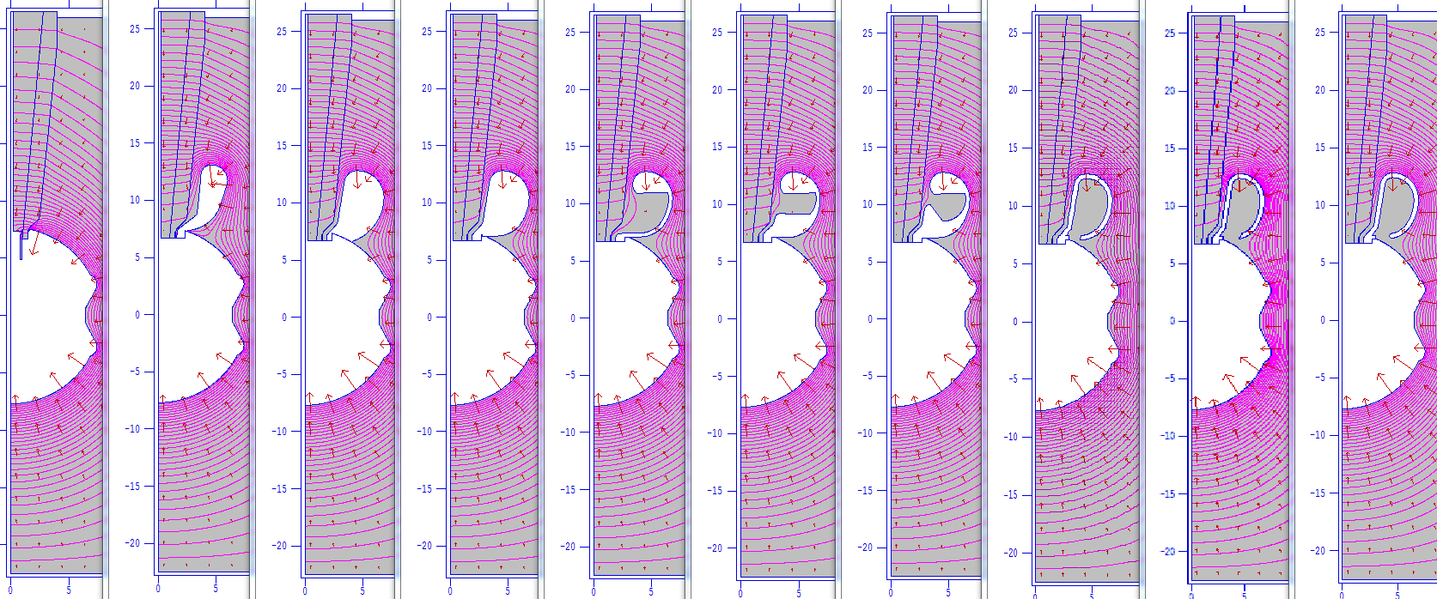
Evolution of Shed

Slide 4
Comparison of E Field (MV/m)
7.8
8.2
8.7
8.0
3.3
2.8
4.4
3.7
5.4
12
6.6
5.2
0.05
0.1
0.05
0.05
0.3
0.03
0.4
0.14
9mm opening
15mm opening
12 mm opening

Slide 5
Er (v/cm) along insulator (plug side) at 350KV

Slide 6
Ez (v/cm) along insulator (plug side) at 350kV

Slide 7
E (v/cm) along insulator (plug side) at 350kV

Slide 8
V (v) along insulator (plug side) at 350 kV

