Slide 1
Round-to-Flat Beam Transformation and Applications
Yine Sun
Accelerator System Division
Advanced Photon Source
Argonne Nation Lab.
International Workshop on Beam Cooling and Related Topics
Jefferson Lab, Newport News, Virginia, USA.
Sept. 28 – Oct. 2, 2015

Slide 2
Outline
Introduction;
Generation of magnetized electron bunches from a high-brightness RF photo-injector;
Parameterization and measurements of the magnetized beam;
Experimental demonstration of the removal of the angular momentum and the generation of a flat beam:
  theory;
  measurement method;
  data analysis and results;
  comparison with simulations.

Slide 3
Beam dynamics: three different regimes
Magnetized
(canonical angular momentum)
emittance
space charge
envelope equation in a drift:
where
is the generalized perveance.
Yine Sun, http://lss.fnal.gov/archive/thesis/2000/fermilab-thesis-2005-17.pdf

Slide 4

Applications of magnetized beam and flat beam
Electron cooling for heavy ion: cooling interaction Time
Flat beam for linear e⁺e⁻ collider:
reduce beamstrahlung

Slide 5
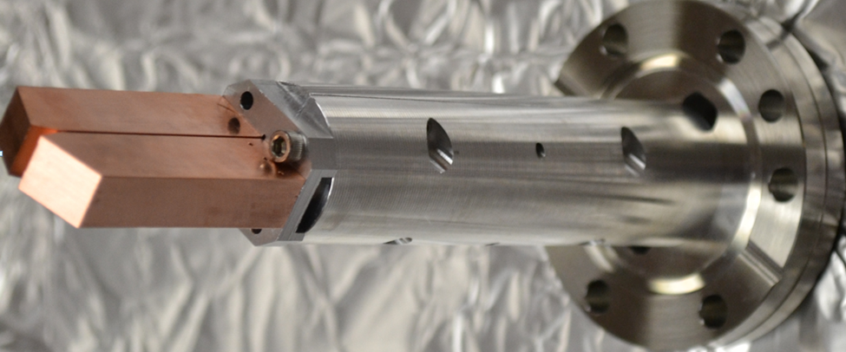
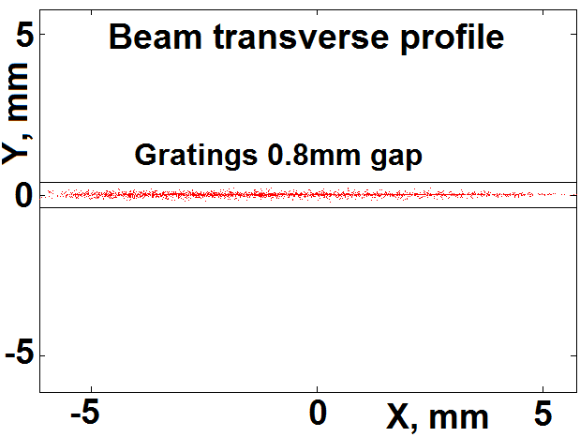
Applications of magnetized beam and flat beam
Flat beam for light sources
  Radiators of planar geometry such in the Radiabeam-APS THz generation experiment carried out at the Injector Test Stand in APS/ANL.

Slide 6
Generation of magnetized electron beam
From a high-brightness RF photo-injector
On the cathode:
Solenoidal end field applies a torque to the beam. When B_{z}=0, canonical equals to the mechanical angular momentum.
FNPL 1.625-cell RF gun, 1.3 GHz

Slide 7
Measurement of canonical angular momentum on the photocathode
B₀: B-field on cathode
σ_{c} :RMS beam size on cathode

Slide 8
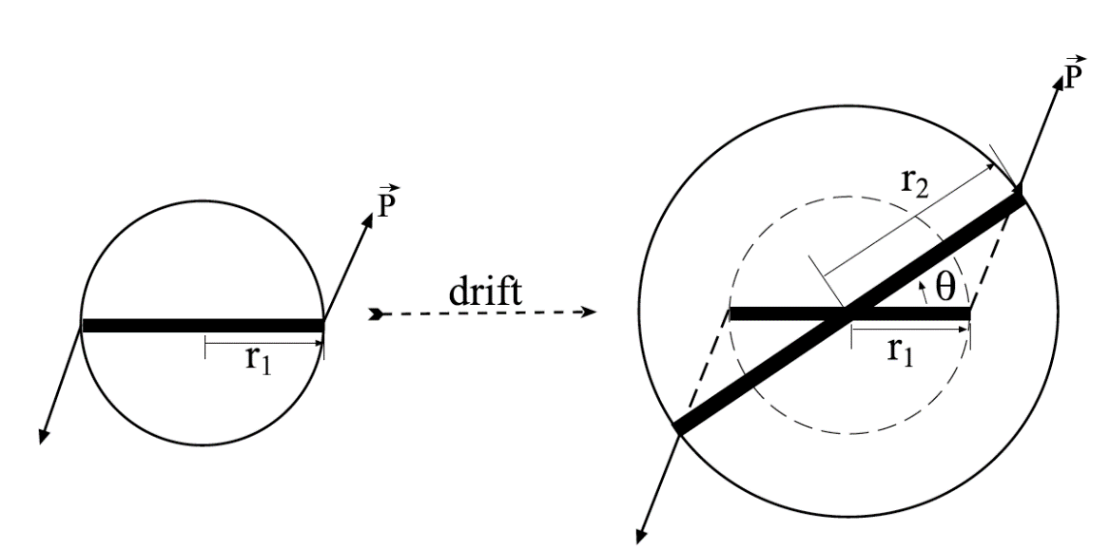
Measurement of mechanical angular momentum in a drift space
D
Y.-E Sun et al. Phys. Rev. ST Accel. Beams 7, 123501 (2004).

Slide 9
Measurement of rotation angle
rotation of the slit image
slit image

Slide 10
Measurement of mechanical angular momentum vs B-field

Slide 11
Demonstration of conservation of canonical angular momentum
as a function of magnetic field on cathode
weighted least-squares linear fit: y=(0.98±0.03)x

Slide 12
Parametric dependencies of angular momentum
Angular momentum versus
  beam longitudinal position z
  bunch charge
  beam size on the cathode

Slide 13
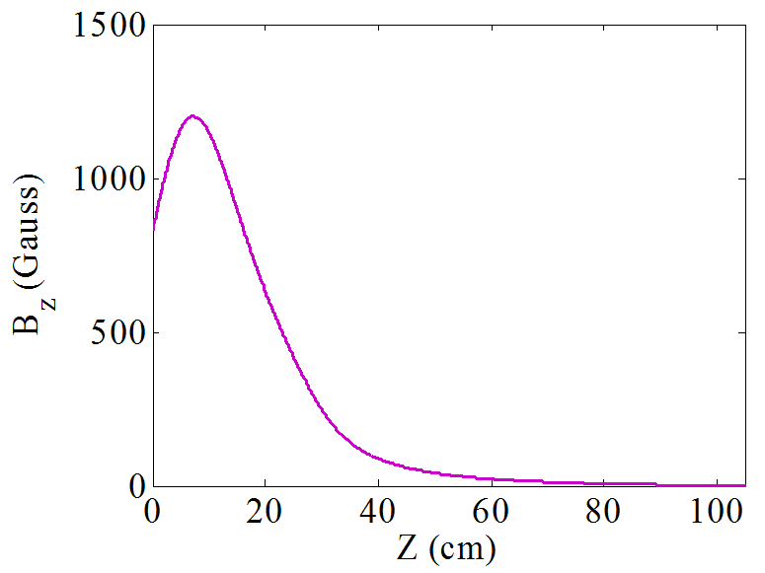
From magnetized beam to flat beam
Ya. Derbenev, “Adapting Optics for High Energy Electron Cooling”, University of Michigan, UM-HE-98-04, Feb. 1998.
Ya. Derbenev, “Matched Electron Cooling”, WEWAUD02, COOL’15.
skew-quads
flat beam
Round photocathode
immersed in solenoid field
See also: A. Burov, S. Nagaitsev and Ya. Derbenev, Phys. Rev. E 66, 016503 (2002).

Slide 14
Fermilab/NICADD Photoinjector Lab. (FNPL)
4 MeV
16 MeV
rf gun
TESLA superconducting cavity
round-to-flat transformer
(skew quadrupoles)

Slide 15
Round-to-flat beam transformation using skew quadrupoles
Flat beam: large transverse emittance ratio, zero average angular momentum.
q₁
q₂
q₃
d₂
d₃
Two sets of solutions:
(D. Edwards)

Slide 16
Round-to-flat beam transformation
General form of a round beam at beam waist location
(K.-J. Kim)
uncorrelated
emittance
“normalized” canonical
angular momentum
Transfer matrix
of the round-to-flat
beam transformer (skew quadrupoles)
Flat beam emittances given by:
e.g. L=20 mm mrad, ε_{u}=1 mm mrad
ε₊=47 mm mrad; ε₋=0.02 mm mrad

Slide 17
Position and velocity snap shots at the entrance/exit of the transformer
(ASTRA simulations)
y
x
  Round beam
  flat beam

Slide 18
Beam evolution through the transformer for the first solution
10 mm
Right before 1st quad
Right after 1st quad
Right before 2nd Quad
Right after 2nd Quad
Right before 3rd quad
Right after 3rd quad

Slide 19
Removal of angular momentum and generating a flat beam
experiment
simulation

Slide 20
Flat beam measurements: beam images
Solenoid setting: main=195A, buck=0A, secondary=75A
σ = 0.97 mm, σ_{t} = 3 ps
E = 15.86 MeV Q = 0.51 ± 0.17 nC
X3
X4
X5
X6
X7
X8

Slide 21
Flat beam experiment: emittance measurements
Solenoid setting: main=190A, buck=0A, secondary=75A
Laser σ = 0.76 mm
σ_{t} = 3 ps
E = 15.8 MeV
Q = 0.50 ± 0.05 nC
X7
X8 Hslit
X8 Vslit
X7
X8 Hslit
X8 Vslit

Slide 22
ASTRA Simulation with experimental conditions

Slide 23
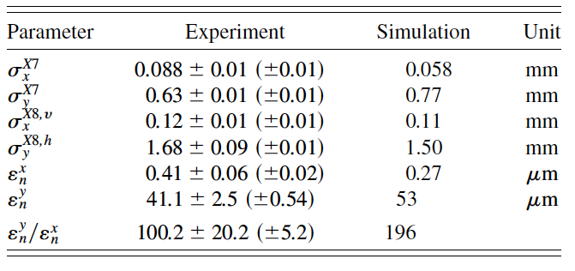
Experimental results compared with numerical simulations
(0.5 nC)
P. Piot, Y.-E Sun, K.-J. Kim, Phys. Rev. ST Accel. Beams 9, 031001 (2006).

Slide 24
Summary
Magnetized photo-injector electron beams are generated and dependences on various parameters are studied. The angular-momentum-dominated electron beams are characterized;
The magnetized electron beam is converted into a flat electron beam using a skew-quadrupole channel;
The emittances of the flat beam are measured and at 0.5 nC, normalized emittance of 0.4 mm mrad was measured; emittance ratio of 100 was achieved.

