Slide 1
Mott Experiment Paper
Joe Grames
November 9, 2017
Measurements were made. Studies were done. Reports have been written. Three studies are especially important in writing the paper: theory, analysis and simulation.
I reviewed these three reports, and summarize my notes in the following slides. I believe we have a good story to tell, however, it would be helpful to discuss our interpretations and the arguments that support them. Like me, you needn’t have the strongest point of view on each topic, however, I believe this exercise will be valuable in coming to consensus on the paper.
Theory – X. Roca Maza, https://arxiv.org/abs/1710.08683 (10/25/17)
Analysis – D. Moser, Mott Experiment Run I/II Data Analysis, JLAB-TN-17-025 (7/6/17)
Simulation – M. McHugh, GEANT4 Simulation of the Jlab MeV Mott Polarimeter (4/28/16)

Slide 2
THEORY

Slide 3
My comments are based upon https://arxiv.org/abs/1710.08683 and refer to references therein.
Xavier‘s numerical calculations are performed using the code ELSEPA [16], and later modifications [7].
The elastic Differential Cross Section (DCS) and spin-polarization functions (S,T,U) are computed in terms of the direct (f) and spin-flip (g) scattering amplitudes solved in a Dirac framework.
From Xavier : The radial wave equations [see Eq.8 in PhysRevC.78.044332] are solved by using the exact power-series expansions of the radial functions. The integration is started at r=0 and extended outwards up to a point r_m. For r>r_m, the field is purely Coulombian, and the normalized upper-component radial Dirac function can be expressed as Eq.11 of the same reference. As usual, the phase shift is determined by matching this outer analytical (Eq.11) form to the inner numerical solution at r_m, requiring continuity of the radial function and its derivative.

Slide 4
There are four contributions considered to the interaction potential:
Electrostatic Potential - Nuclear Charge Distribution
For energies <50 MeV a two parameter Fermi model or Helm model is a good approximation [6,7]
For JLab conditions finite nuclear size corrections using Fermi model are (S ~ 3-4% and DCS ~ 15-20%)
Fermi model tested against self-consistent nuclear field model [19] agrees to <0.1%
Electrostatic Potential - Atomic Charge Distribution
Most accurate electron densities from self-consistent relativistic Dirac-Fock calculations [10] are used
For JLab conditions atomic charge (screening) corrections are <0.3% (may be few % at small angle)
Electron Exchange Potential(interchange projectile and atomic electrons)
Furness-McCarthy exchange potential is used [20]
For JLab conditions the correction is <0.2%
Exchange Potential Absorption Potential (inelastic loss to atomic electrons)
Local Density Approximation proposed by Salvat [21] for projective moving in electron cloud is used
For JLab conditions the the correction is <0.05% at 1 MeV and smaller at higher energies

Slide 5
Two lowest order fine structure internal radiative corrections are considered:
vacuum polarization – easily estimated by means of the Uehling approximation [15]
self energy – theoretically very complicated to reliably evaluate with high accuracy
Vacuum Polarization
Use the Uehling approximation and solved in ELSEPA by including in the Dirac equation potential [17]
For JLab conditions size of effect for our experiment energy and gold target is <0.4% (Xavier says <0.5%)
Self energy
Not calculated
From Xavier : First of all I will only stress Steigerwald experiments [14] together with my calculations of the vacuum polarization to justify that self-energy corrections should be of opposite sign and similar magnitude as vacuum polarization. Having said that, Ref.[13] provides a very indirect (and might be wrong) support to the issue of the sign. In Ref.[13] instead of correcting the nuclear electromagnetic potential including VP and SE, they took into account this corrections to the electronic atom potential (such a correction will be negligible in our case since the full contribution of atomic electrons is already small). Nevertheless, they found that SE and VP have different signs and are of the same order. So this is not a real smoking gun, but it is what we have so far from theory… May be the best is not to stress Ref.[13] but just Steigerwald work.

Slide 6
Other Effects
Bremsstrahlung
Kurt Aulenbacher cites W. Johnson, C. Carroll and C. Mullin, Physical Review 126,4 (1962) 352 case where effect at 600 keV the correction is about 0.8%
Not considered [22], but Xavier can give this some consideration
Recoil effects
Not considered [23] by Xavier
Summary Table of Effects that are addressed
Effect | Size of effect for JLab conditions | Corresponding uncertainty on effect
Finite nuclear size (Fermi) | <4.0% (included) | Xavier : <0.1% if a reasonable nuclear model for the charge density is used
Atomic electrons (Dirac Fock) | <0.3% (included) | Xavier can look into these or we can assume 100% uncertainty
Electron exchange potential | <0.2% (included)
Inelastic channel | <0.05% (included)
Vacuum polarization | <0.5% (not included) | From Xavier: Has proposed 0.5%, See previous slide, he would use Steigerwald’s work. It looks to me the most solid proof.
Self-energy | None (not included)

Slide 7
ANALYSIS : CUTS
(& EXTRAPOLATION)

Slide 8
The final analysis is summarized in JLAB-TN-17-025.
The time and energy cuts are defined in terms of the mean and sigma of a Gaussian function, fit to events limited to the region near the peak value (X in time and Y in energy).
The asymmetry is calculated by integrating the number of events which lay within both a time and energy cut, each of which is defined by units of sigma about the mean.
In the early analyses we tested the sensitivity of the asymmetry to various slices of time and energy, and with representative foils like “thin, middle, thick”.
In the final analysis we teste the sensitivity of extrapolation parameters to varying cuts of time and energy, but collectively applying the same time and energy cuts to all foils in a run.
Examples of the results are shown in the next two slides…

Slide 9
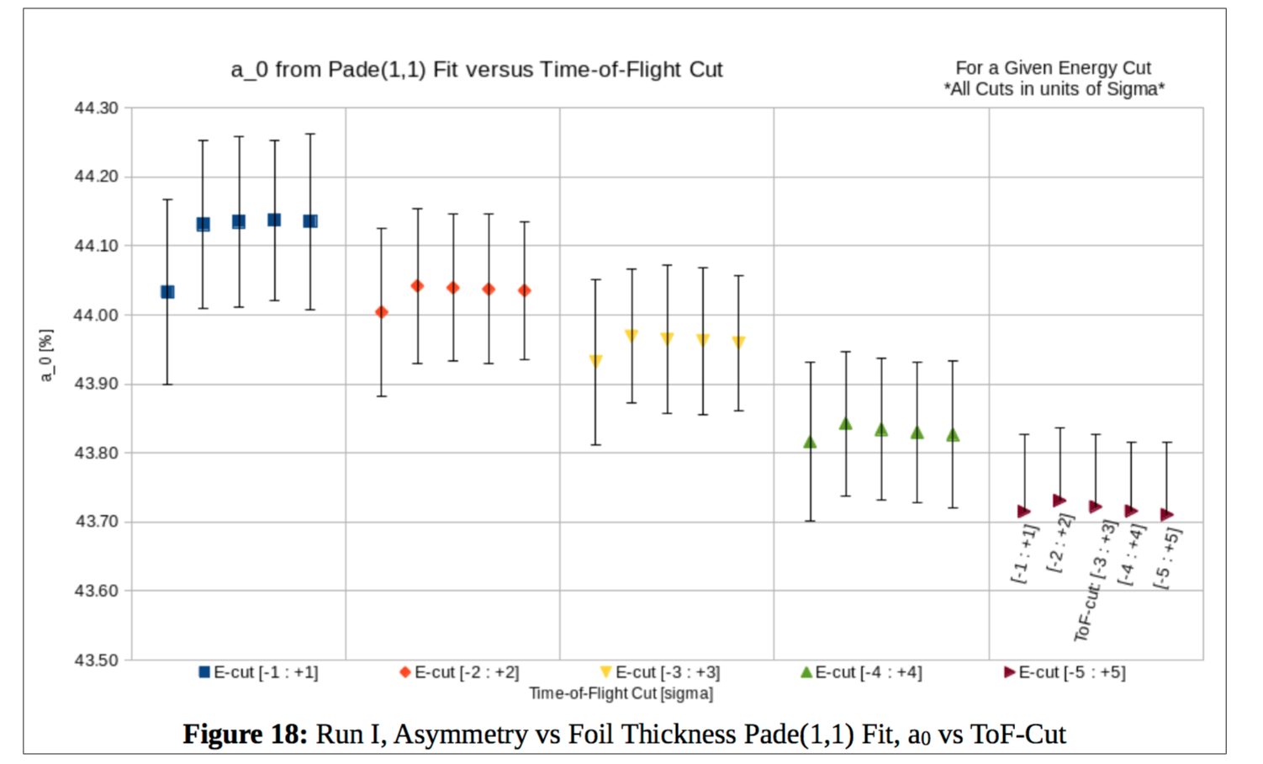
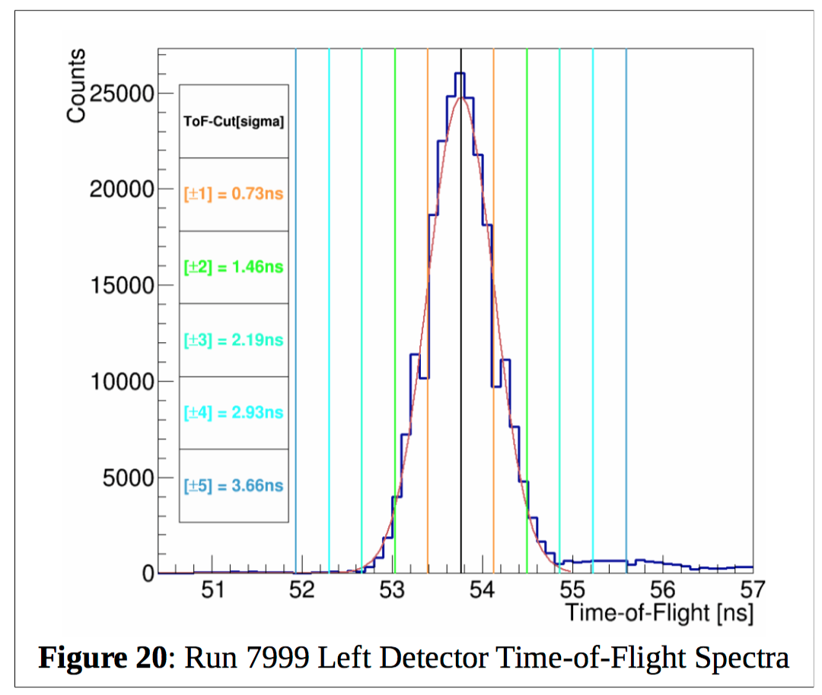
The optimal timing cut was determined by testing the sensitivity of A0 against large variations in the energy cut.
Example of selecting the timing cut by using A0 of Pade(1,1) from Run 1.

Slide 10
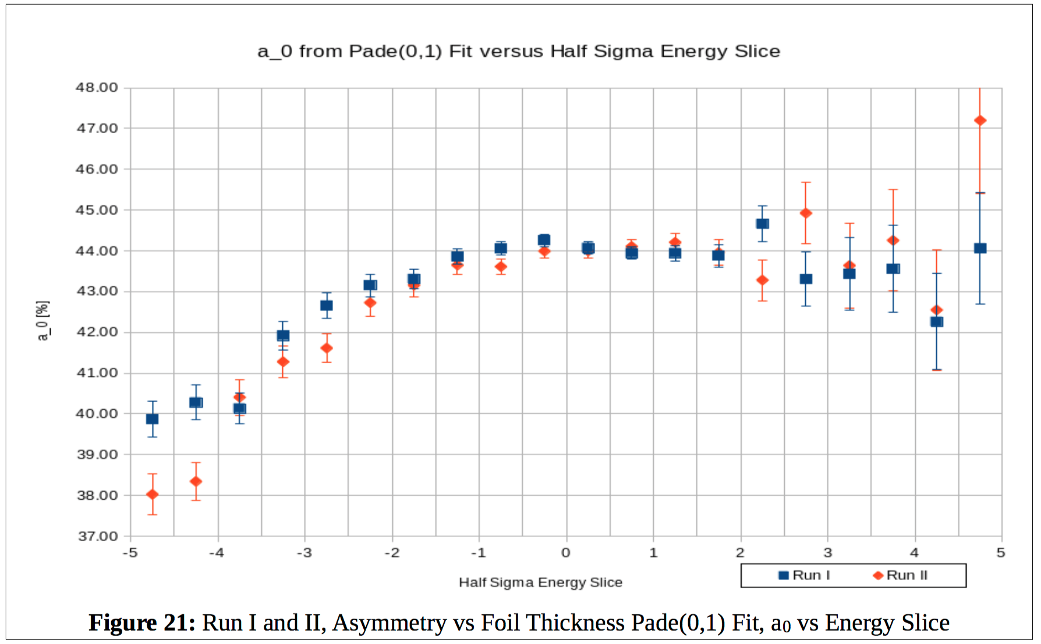
The optimal energy cut was determined by testing stability of A0 against 0.5σ slices energy for fixed T[-2:2].
Example of selecting the energy cut by using A0 of Pade(0,1) from Run 1 and 2.

Slide 11
We tested the sensitivity of to a variation of the time and energy cuts about the nominal value by [10%,20%,30%].
We chosen the standard deviation of the ratio of the asymmetries for each foil in a Run : Asym(varied-cut) / Asym(nominal-cut).
Table 5 shows example for Asymmetry in Run 1, and Table 8 shows results for Asym and Rates for both Runs 1 and 2.
The purpose of the exercise is to evaluate a systematic uncertainty to the asymmetry associated with applying one set of time and energy cuts to all the foils.

Slide 12
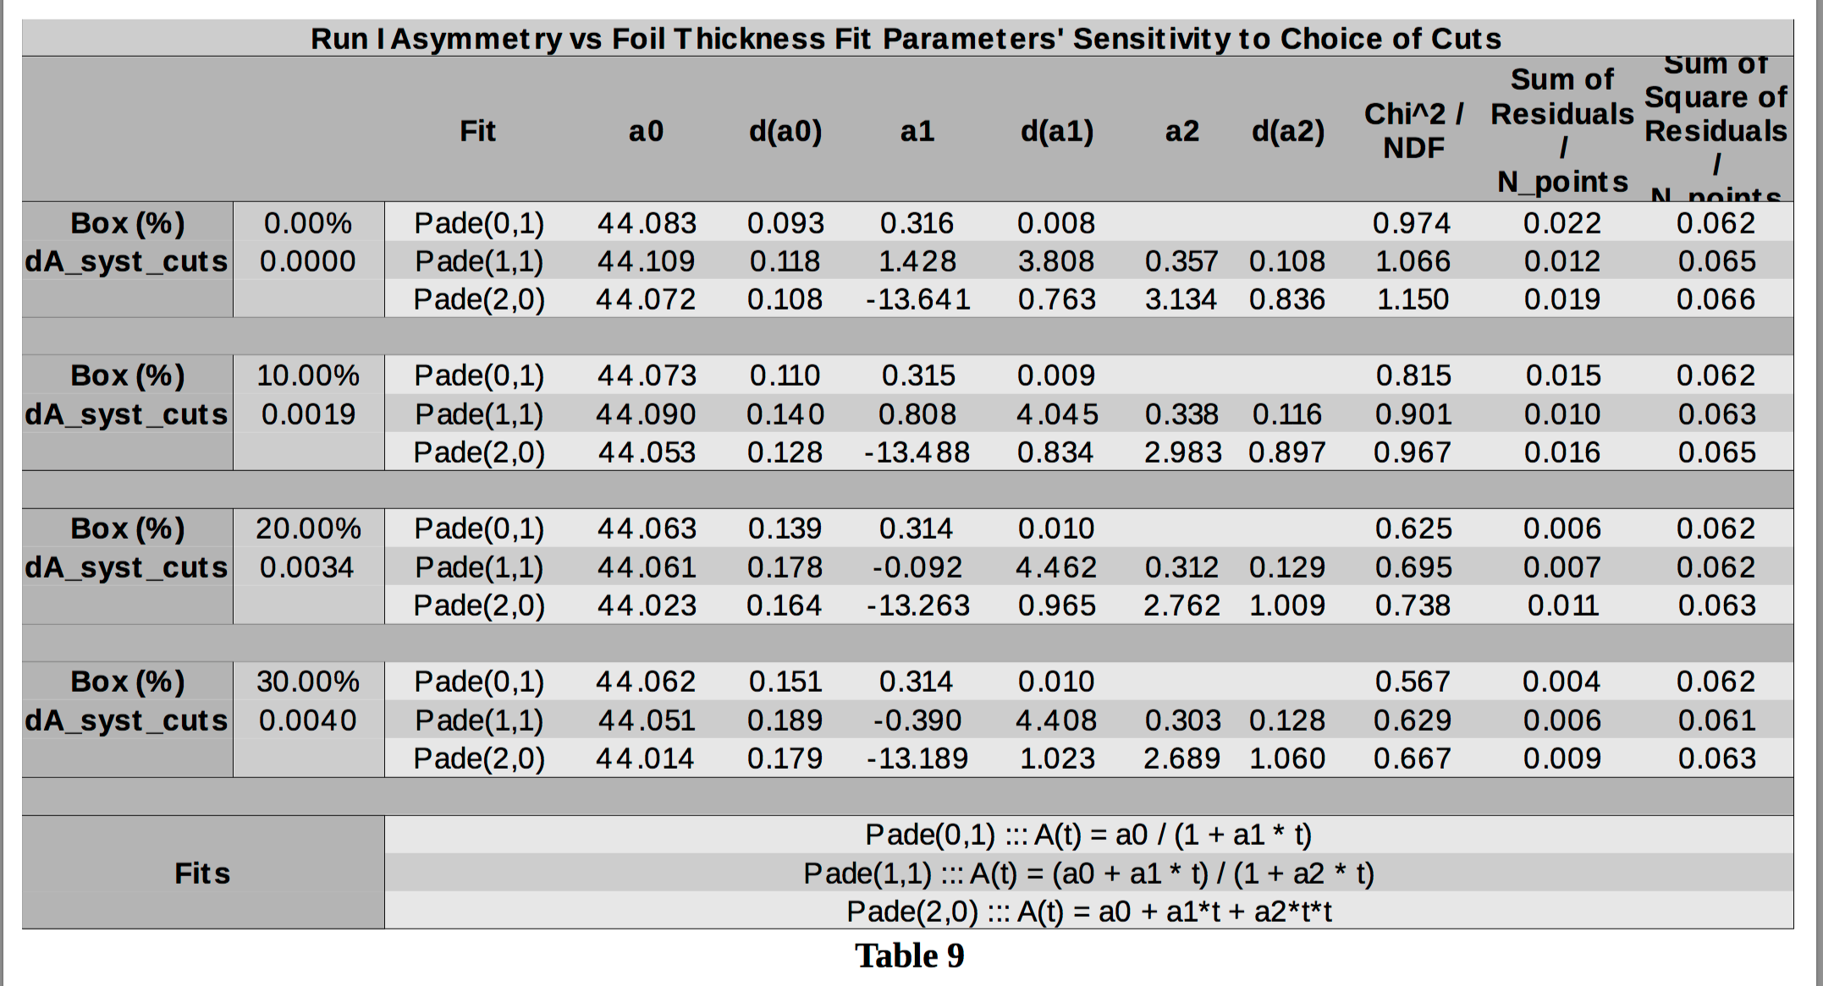
Example for Run 1 : The sensitivity of the A0 parameter in A vs. R extrapolation is then calculated including the systematic uncertainty of the asymmetry resulting from applying the same cuts to all the foils in a run.

Slide 13
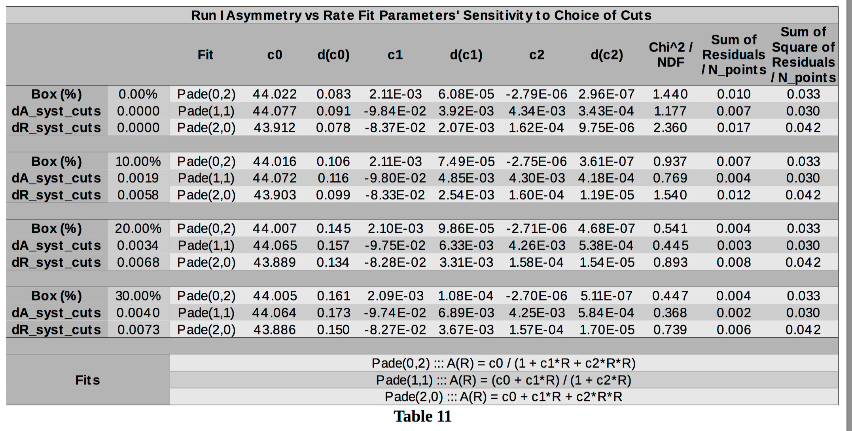
Example for Run 1 : The sensitivity of the A0 parameter in A vs. R extrapolation is then calculated including the systematic uncertainty of the asymmetry resulting from applying the same cuts to all the foils in a run.

Slide 14
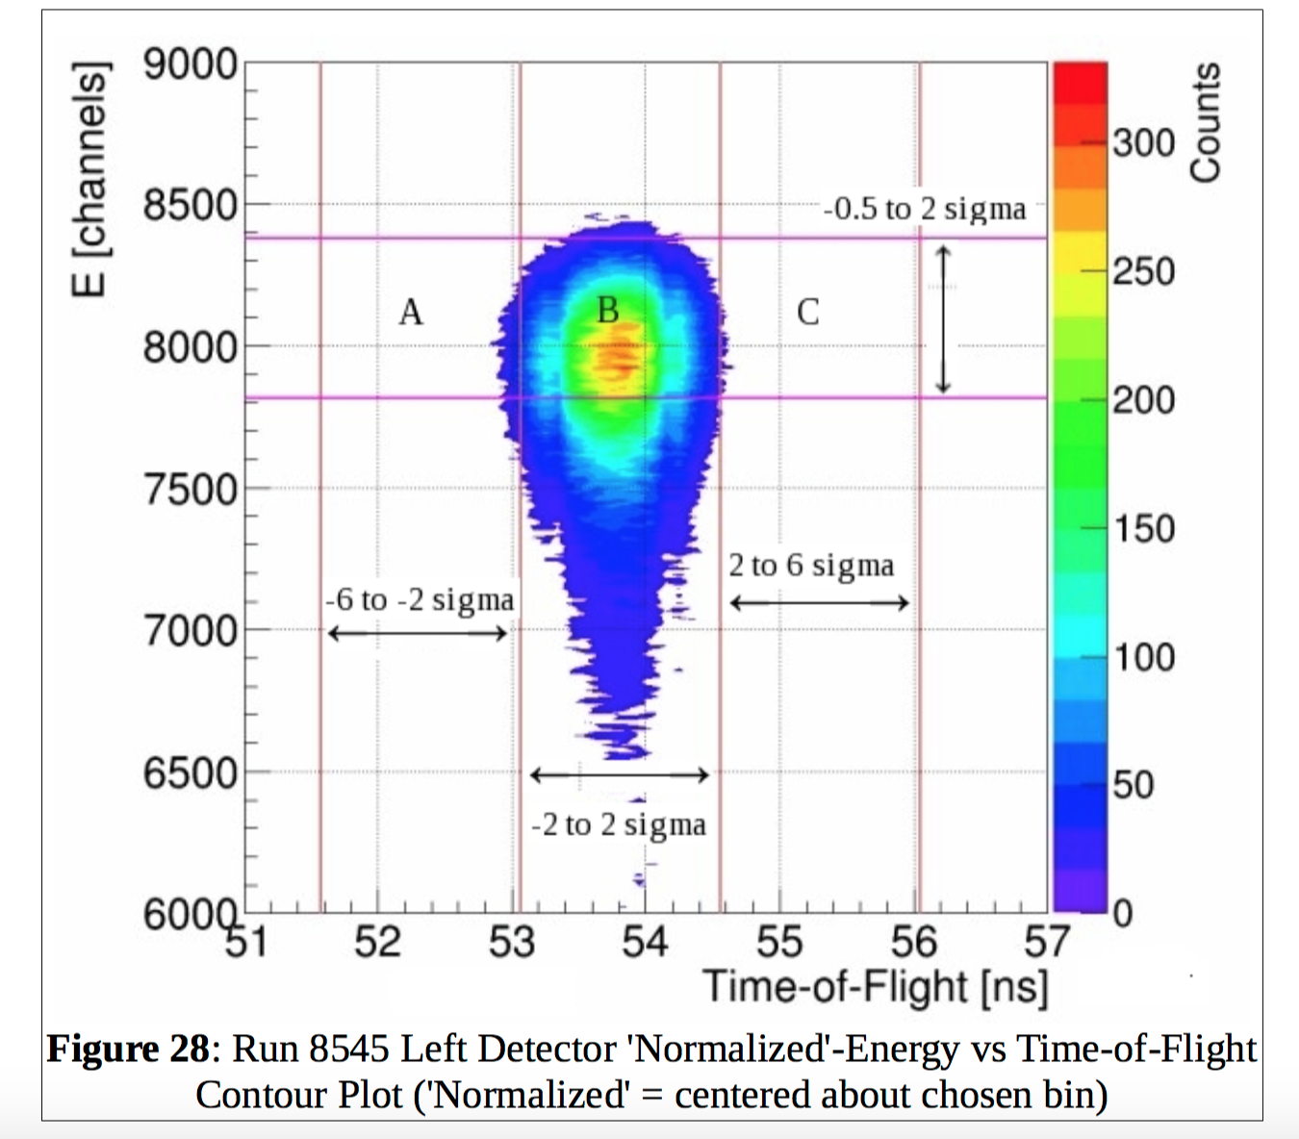
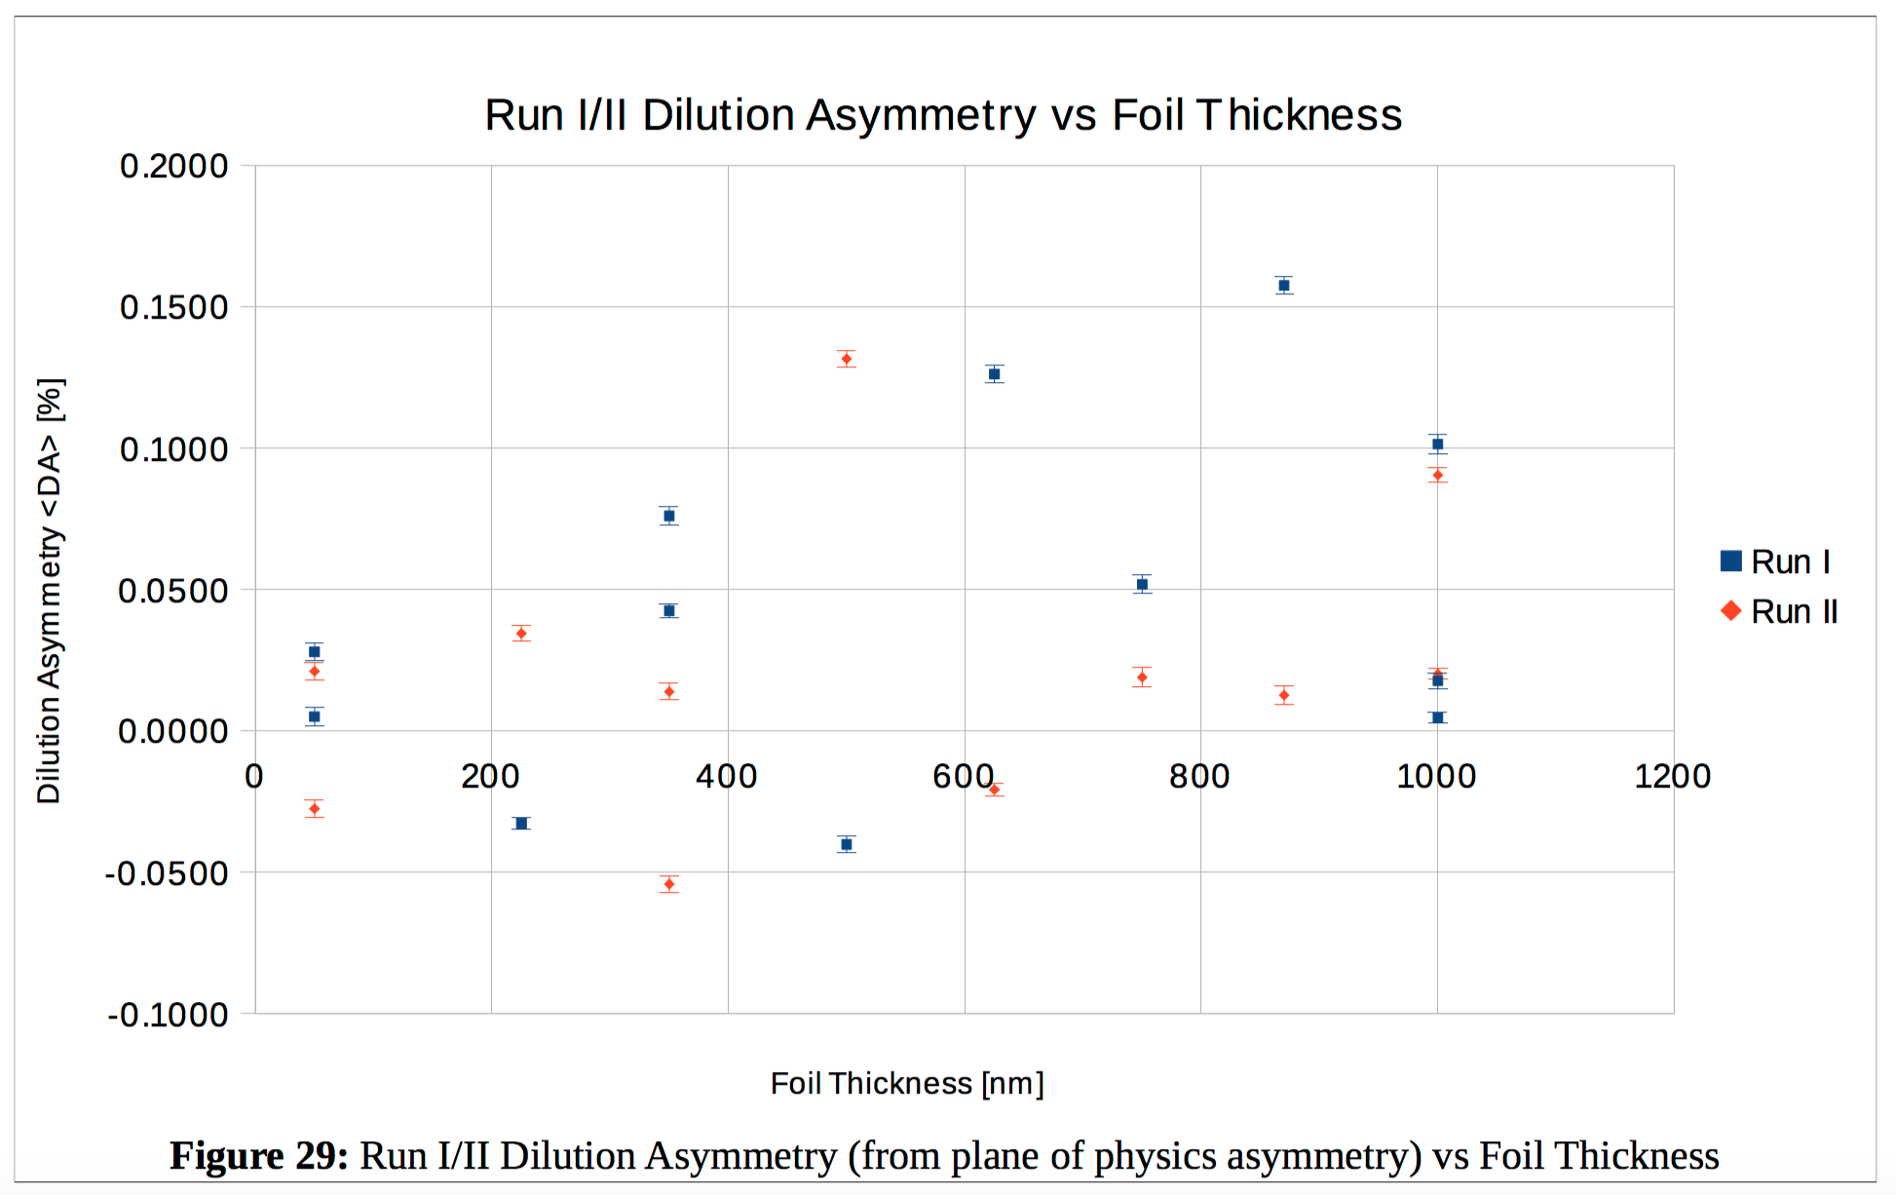
Background contribution (which we also called Dilution) is defined as those events arriving too early or too late within the same duration as the nominal time cut and within the same energy slice as the nominal energy cut.
The dilution of the asymmetry including assumed background events within the nominal time and energy cuts is calculated for each foil and for both Runs.
The size of the dilution asymmetry is <0.16% over all cases, and is neglected.
I propose these be included as a systematic uncertainty.

Slide 15
In telling the analysis story I think it could read like this…
Computing an asymmetry of selected events
Describe a Mott run
Describe events recorded by DAQ
Describe decoding of events to time and energy histograms
Describe any corrections or translations of time and energy histograms
Describe the time and energy spectra (2D and 1D projections)
Describe the time and energy fits
Describe how time and energy cuts are generated and applied
Describe asymmetry computed from cuts
Analysis
Demonstrate running asymmetry as a function of time and energy for specific foils
Describe extrapolation method
Describe process for identifying the nominal cuts
Describe results calculating systematic uncertainties about the nominal cuts
Describe results calculating systematic uncertainty associated with background

Slide 16
SIMULATION

Slide 17
The Geant4 simulation is documented in GEANT4 Simulation of the Jlab MeV Mott Polarimeter (4/28/16).
Physical model is a very close approximation to reality and uses numerical values of (DCS,S,T,U) provided by Xavier.
All simulations were run with 5.0 MeV energy, 150 keV energy spread, and 1 mm FWHM Gaussian transverse profile.
Because the cross section is low the simulation does not throw projectiles at the target, but instead employs rejection method.
Single scattering (independent of thickness):
Double scattering ( independent of thickness):

Slide 18
Marty came to the conclusion that the prediction of single + double scattering required also calculating the corresponding rate for each of the processes individually.
Single scattering rate computed by Reimann integration and agree well with experiment and theory:

Slide 19
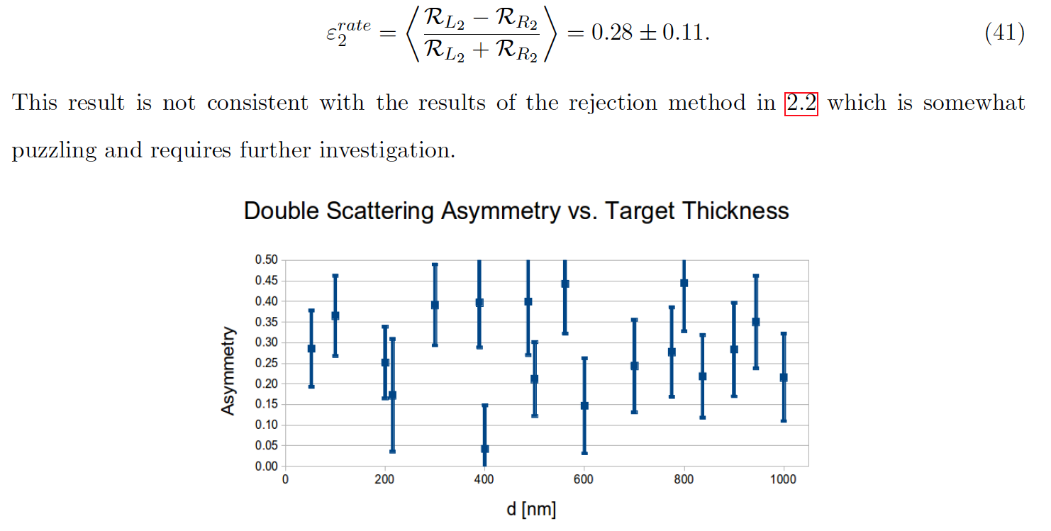
Double scattering rate cannot be easily computed by Reimann integration so Marty returned to a brute-force Monte Carlo throwing projectile electrons in a target foil.
Marty computes a double-scattering rate that agrees with measurement...
...but does NOT agree with the rejection method:

Slide 20
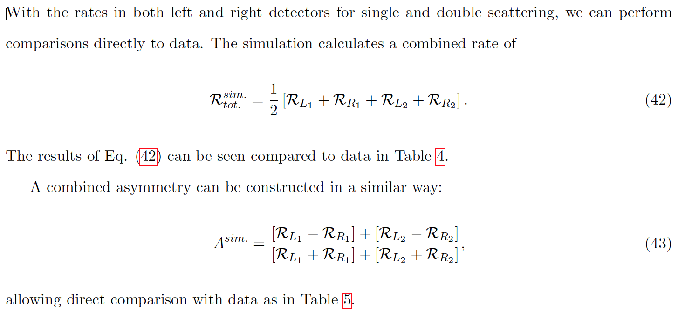
Conclusion #1 – Finally, Marty proposes to compute COMBINED values of average rate and analyzing power as a function of target thickness using the two methods (single=Reimann, double=Monte Carlo), and compare with data.
Good agreement for the rate, but NOT the analyzing power.

Slide 21
Conclusion #2 – Based upon the constant single- and double- scattering analyzing power vs. target thickness Marty makes the connection that the individual rates should may be written as…
…so when combined with [42-43] lead to the relationships which are of the Pade(1,1) form:

Slide 22
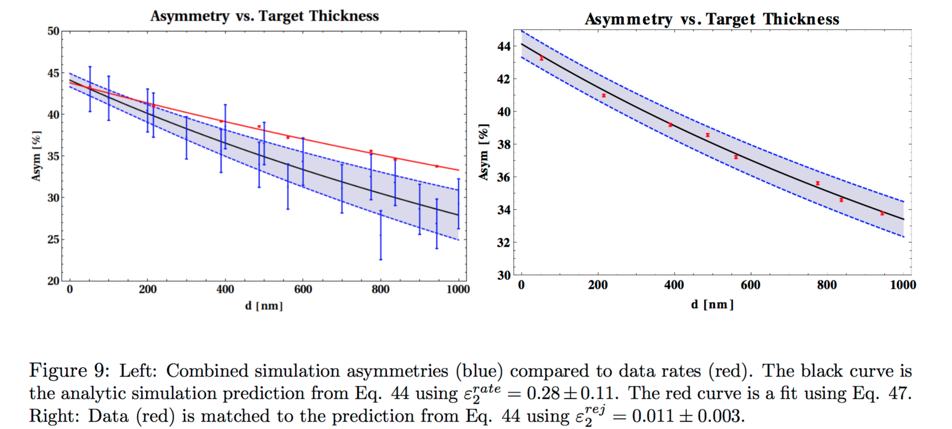
In the plots below the data is shown in red. On the left Marty uses is ε₂^{rate} = 0.28 +/- 0.11 (Monte Carlo), and on the right Marty uses the ε₂^{rej} = -0.011 +/- 0.003 (rejection)
I believe this conclusion is finally that the single- and double- scattering analyzing powers (independent of thickness) determined by the rejection method + the single- (Reimann) and double- (Monte Carlo) rates (which agree with experimental data) predict the data very well.
In summary, it appears that Marty‘s calculation of the single- and double- scattering analyzing power by rejection method combined with the functional form indicated by simulation predicts the effective Sherman function.

