Slide 1
Generation and Characterization of Magnetized Bunched Electron Beam from DC Photogun for JLEIC Cooler
PIs: Riad Suleiman and Matt Poelker
JLEIC bunched magnetized electron cooler is part of Collider Ring and aims to maintain ion beam emittance and extend luminosity lifetime
LDRD Scientific Goals:
Generate magnetized electron beam and measure its properties
Explore impact of cathode magnet on photogun operation
LDRD Benefits:
Simulations and measurements will provide insights on ways to optimize JLEIC electron cooler and help design appropriate electron source
JLab will have direct experience magnetizing high current electron beam

Slide 2
Milestones and Costs
Year 1: Generate non-magnetized beam. Design, procure and install cathode magnet, pucks and slits.
Year 2: Generate magnetized beam. Measure mechanical angular momentum and benchmark simulation.
Year 3: Measure photocathode lifetime vs magnetization up to 32 mA.
Materials and Supplies:
Cathode solenoid magnet and pucks
Three skew quadrupoles
Beamline hardware
Laser components
Labor:
Cathode magnet design, procurement, mapping and installation
Mechanical designer for cathode magnet support, pucks, slits and beamline
ASTRA and GPT modeling (Fay Hannon)
Postdoc – years 2 and 3
FY16 | $339,211
FY17 | $265,850
FY18 | $212,025
Total | $817,086

Slide 3
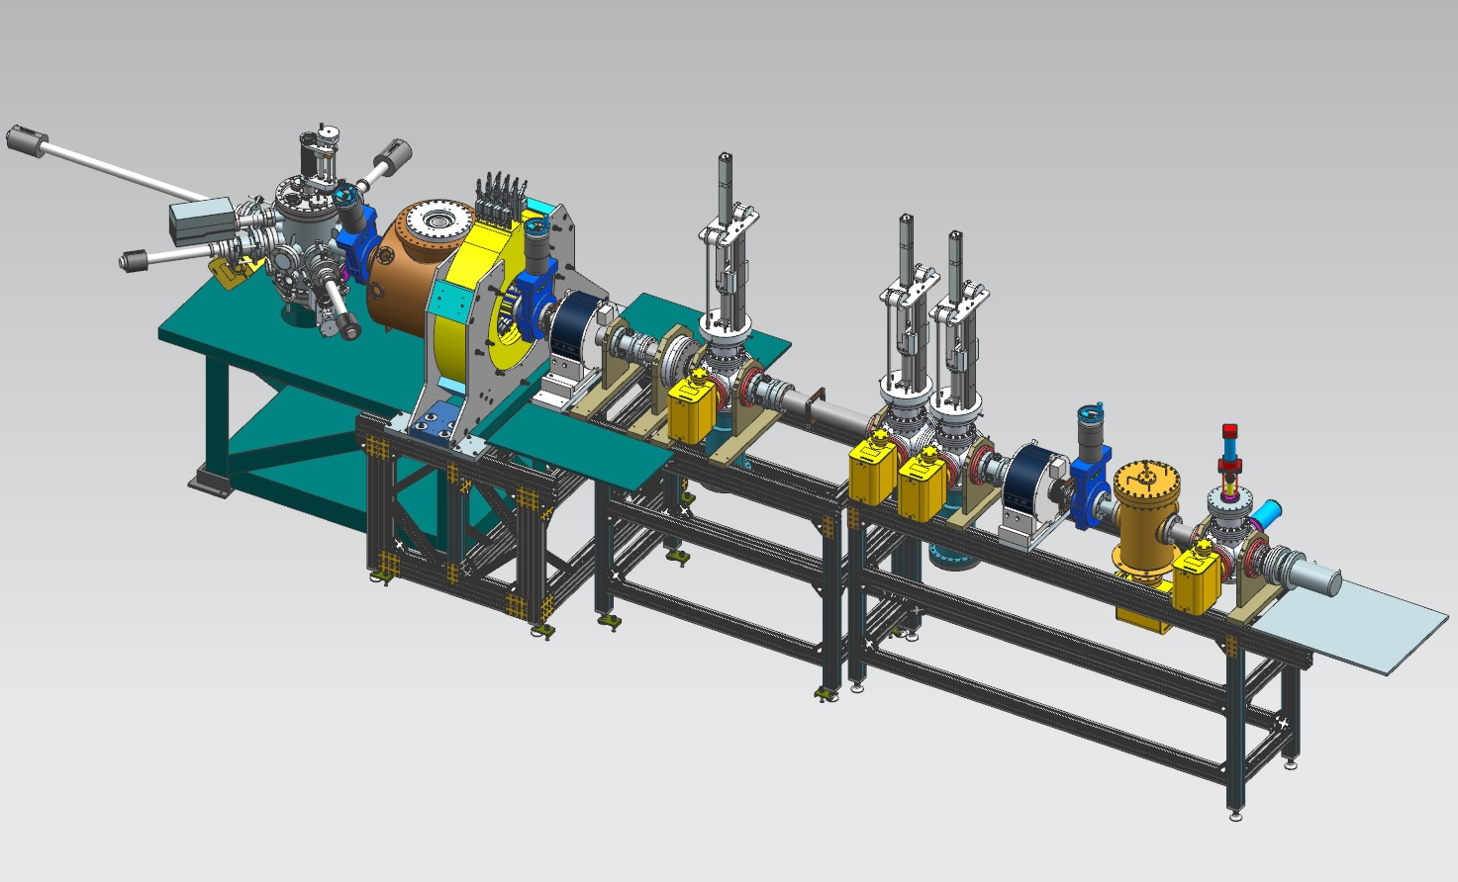
Experimental Overview: Gun Test Stand
Cathode
Solenoid
(B_{z}=2kG)
Beamline
Focusing
Solenoid
Diagnostic Cross 1
(Slit + YAG Screen)
Diagnostic Cross 3
(YAG Screen)
Cathode
Anode
Green
Laser
K₂CsSb
Photocathode
Three Skew Quads
(Round-to-Flat Beam Transformer)
Diagnostic Cross 2
(Slit + YAG Screen)
Generate magnetized beam:
Laser size:1 – 5 mm, B_{z} = 0 – 2 kG
Bunch charge: 1 – 500 pC
Frequency: 15 Hz – 476.3 MHz
Bunch length: 10 – 100 ps
Average beam currents up to 32 mA
Gun high voltage: 200 – 350 kV

Slide 4
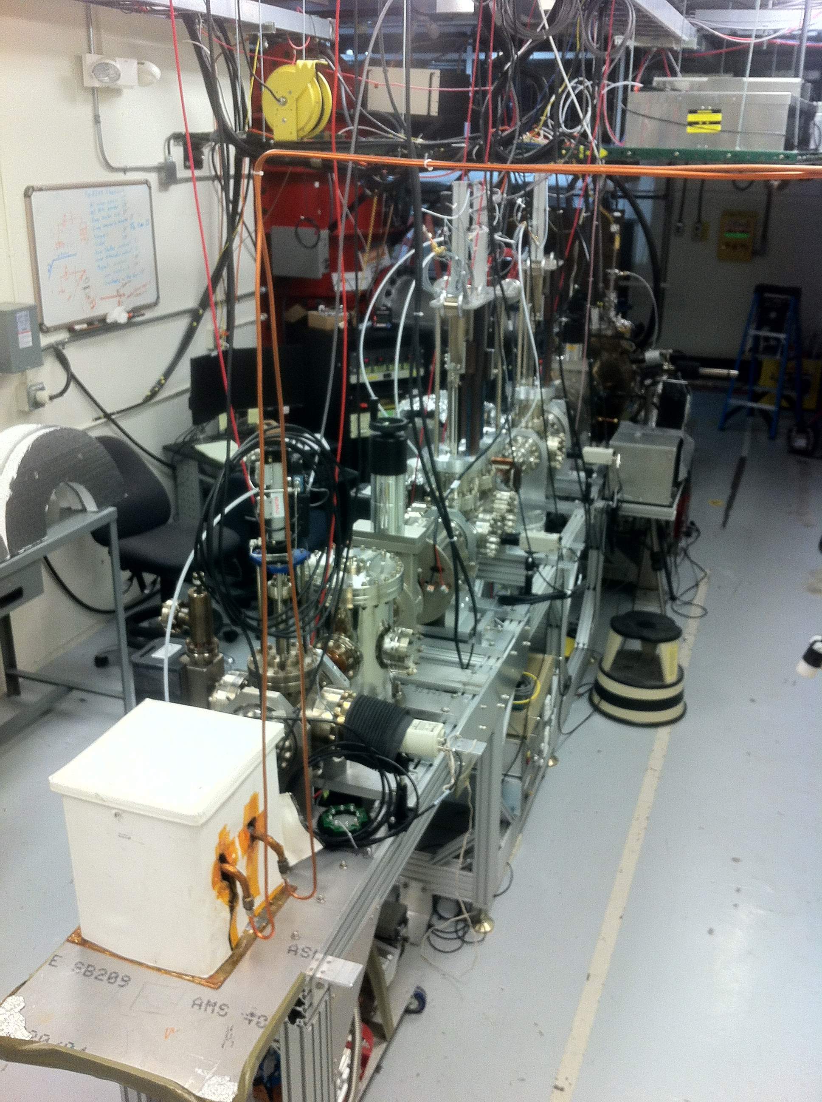
FY16 Accomplishments
K₂CsSb Photocathode Preparation Chamber, Gun and Beamline: delivered 1 mA to dump (non-magnetized)
Simulation (Fay Hannon):
Used ASTRA and GPT simulation to design beamline and to locate magnets and diagnostics at optimum positions
Simulated magnetized electron beam properties along beamline for various starting conditions
Simulated a round to flat transformer

Slide 5
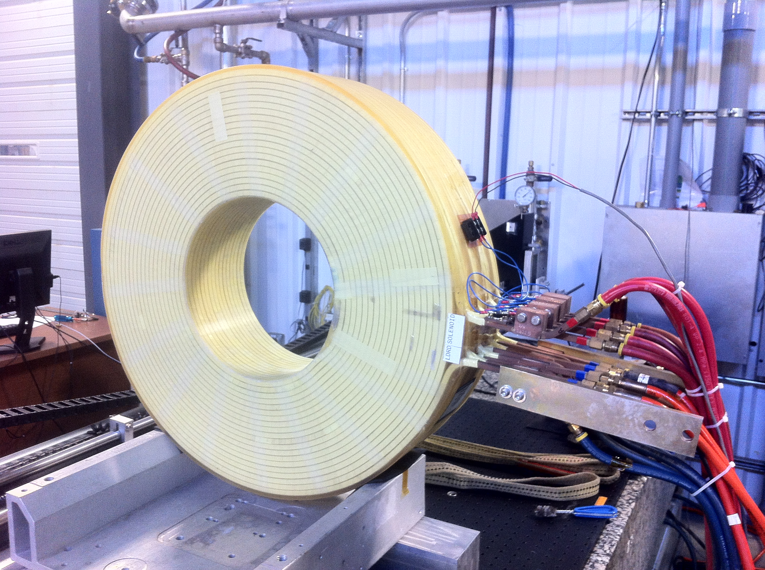
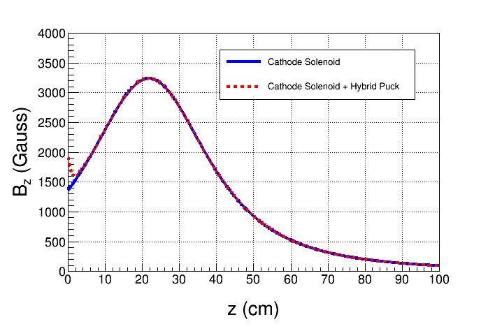
Cathode Solenoid Magnet
Magnet is now at Magnet Measurement Facility to be mapped
Magnet Power Supply: Use new spare CEBAF Dogleg magnet power supply (500A, 80V)
Molybdenum
Steel
New Pucks
Designed to enhance magnetic field at cathode to 2.0 kG

