Slide 1
After last meeting Matt, Riad and I discussed January energy choice…
Focus on Physics paper measurements
Focus on 5 MeV systematics
Pick “final” summer energies later
Defer 499 MHz until physics measurement done
Mott will never end

Slide 2
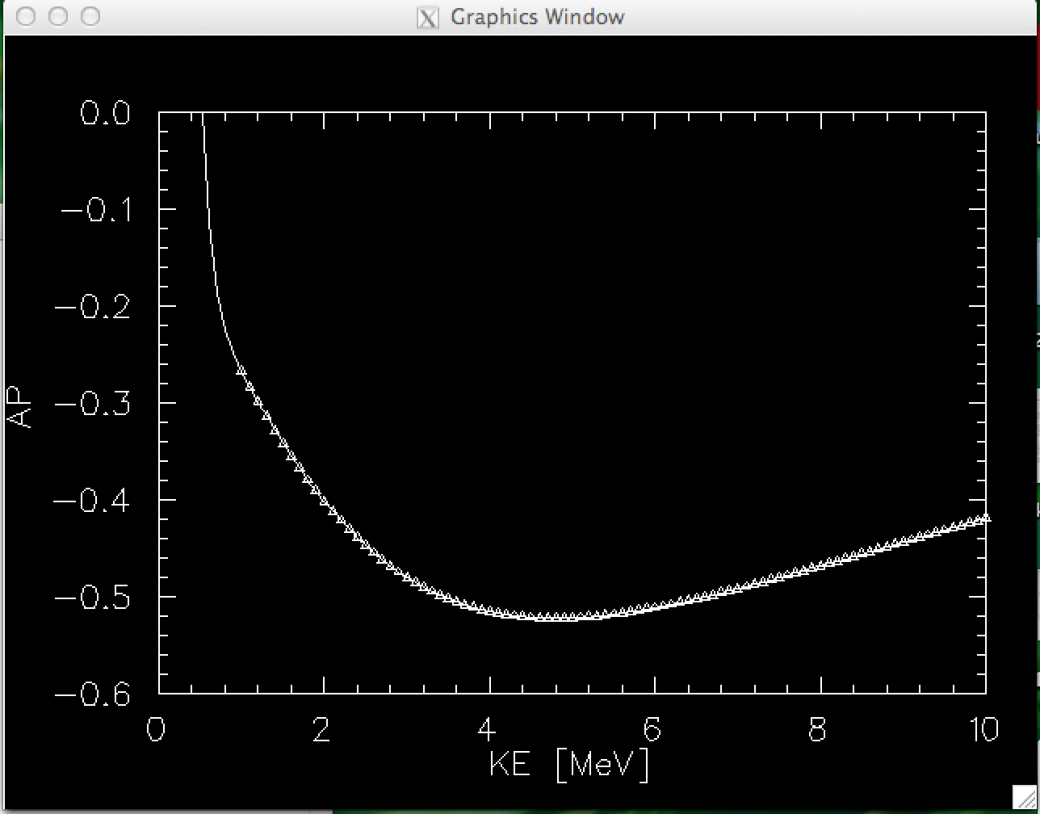
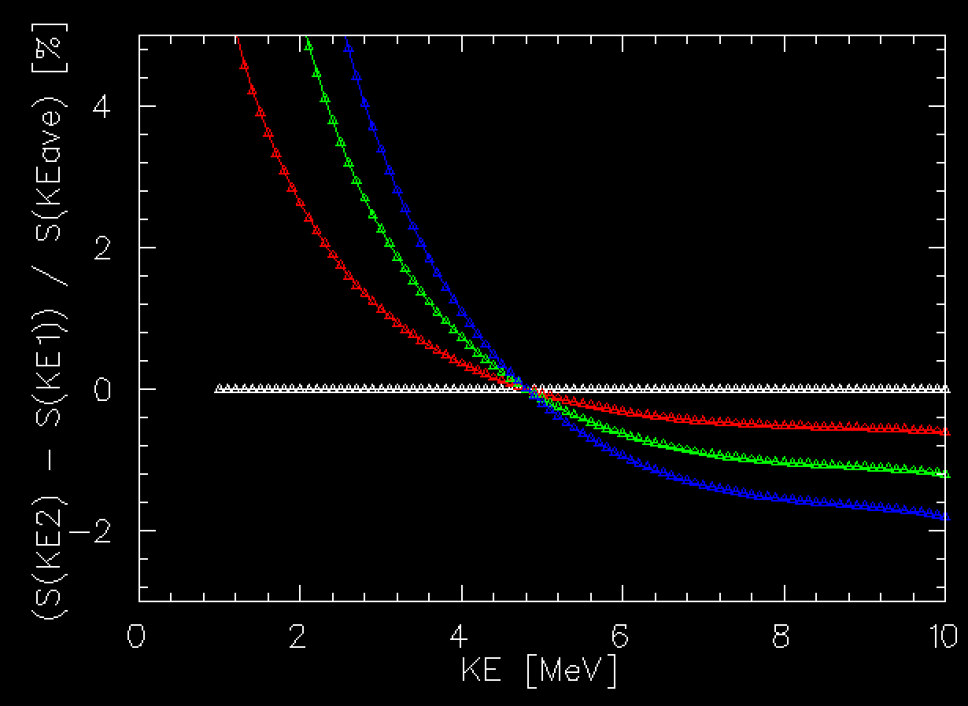
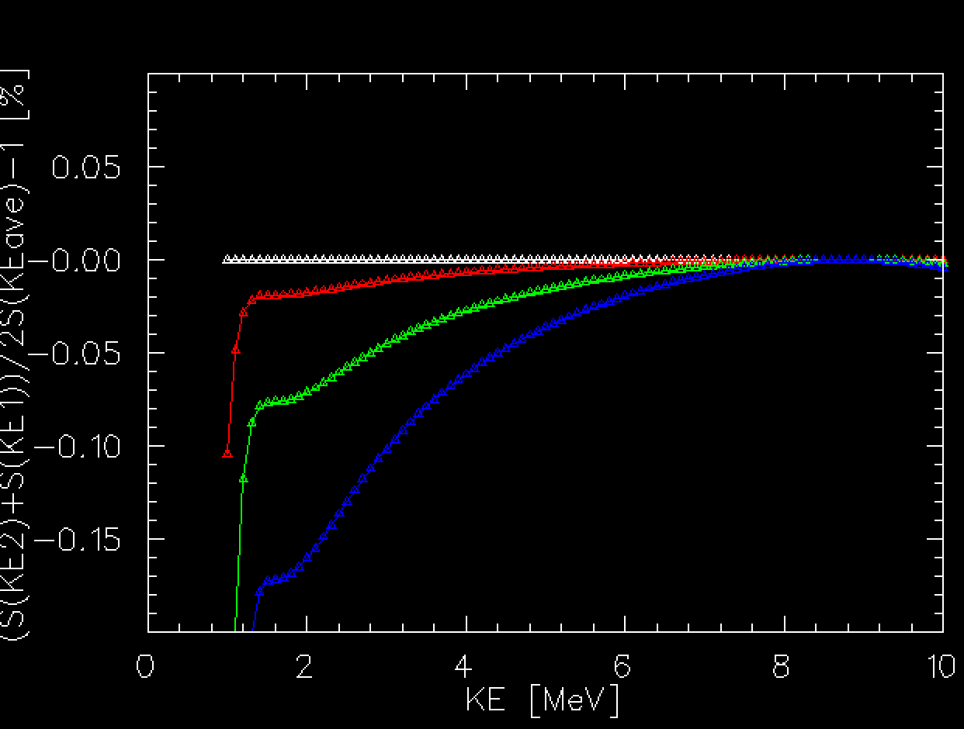
How important is energy spread on the beam …
S(172.6 deg) for Au
Polynomial Fit
Numerical Calculation of Sherman Function
(ours, not Xavier’s)
Polynomial fit is sufficiently good approximate to discrete simulation
Difference over range
Variation with energy is large
Important to collect the full energy spread
Average over range
Fully integrated energy spread largely cancels
Still non-zero even at 5 MeV
dKE = 0 keV
dKE = 50 keV
dKE = 100 keV
dKE = 150 keV
dKE = 0 keV
dKE = 50 keV
dKE = 100 keV
dKE = 150 keV

Slide 3
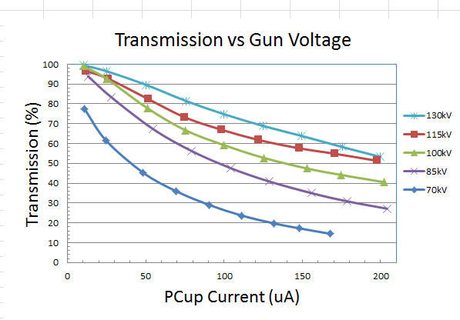
My initial 31MHz beam time estimate using 10uA was unrealistic…
10 uA @ 499MHz ⬄ 80uA @ 62 MHz ⬄ 160 uA @ 31 MHz
Faraday Cup #1 (uA)

Slide 4
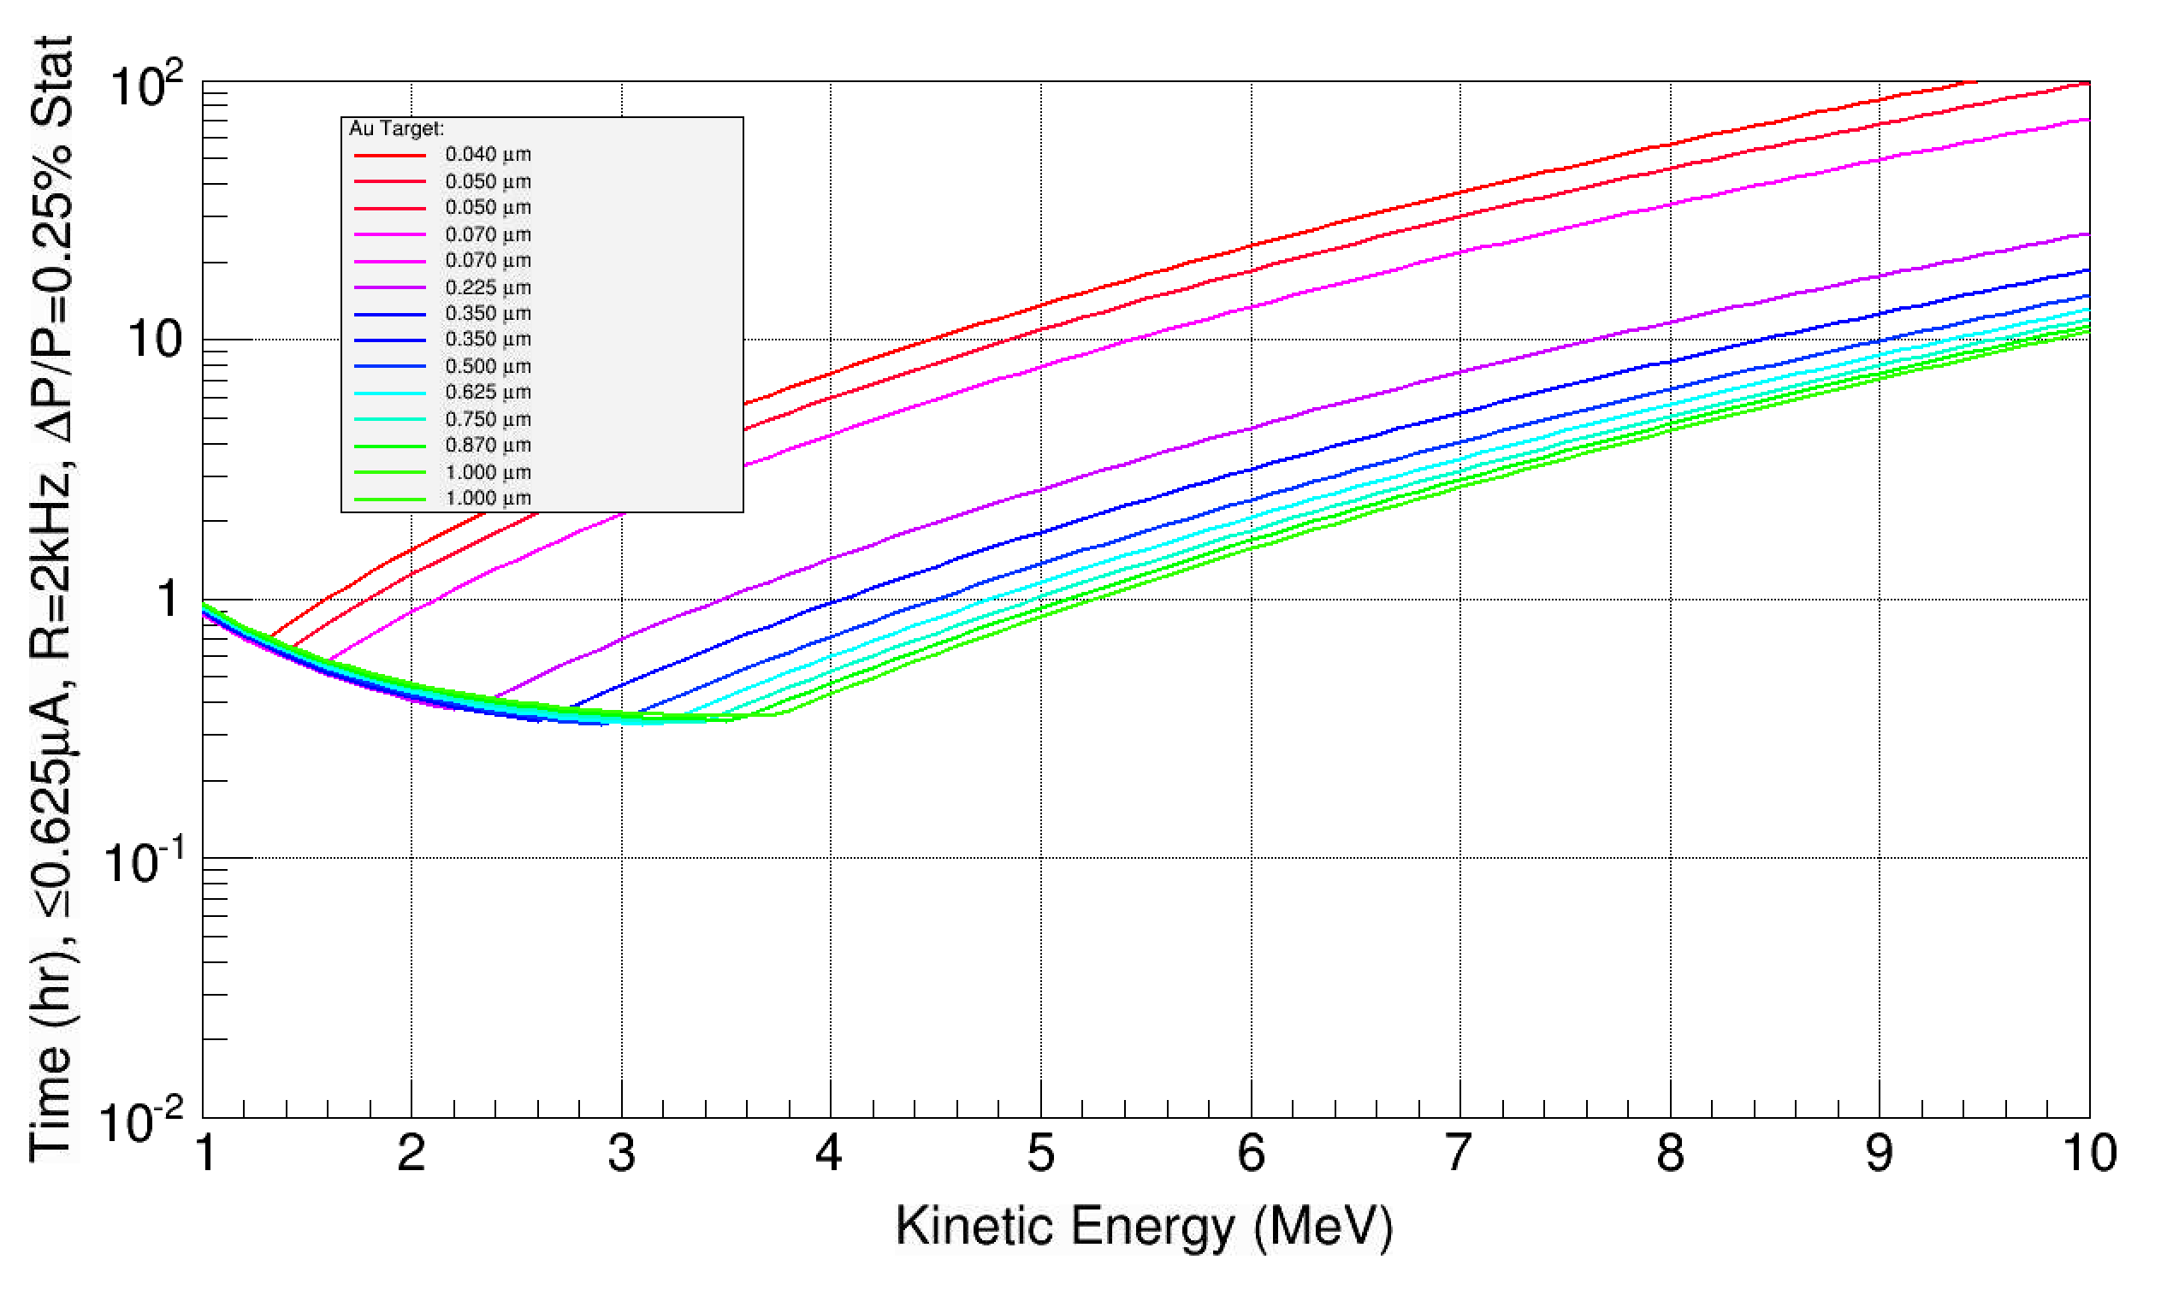
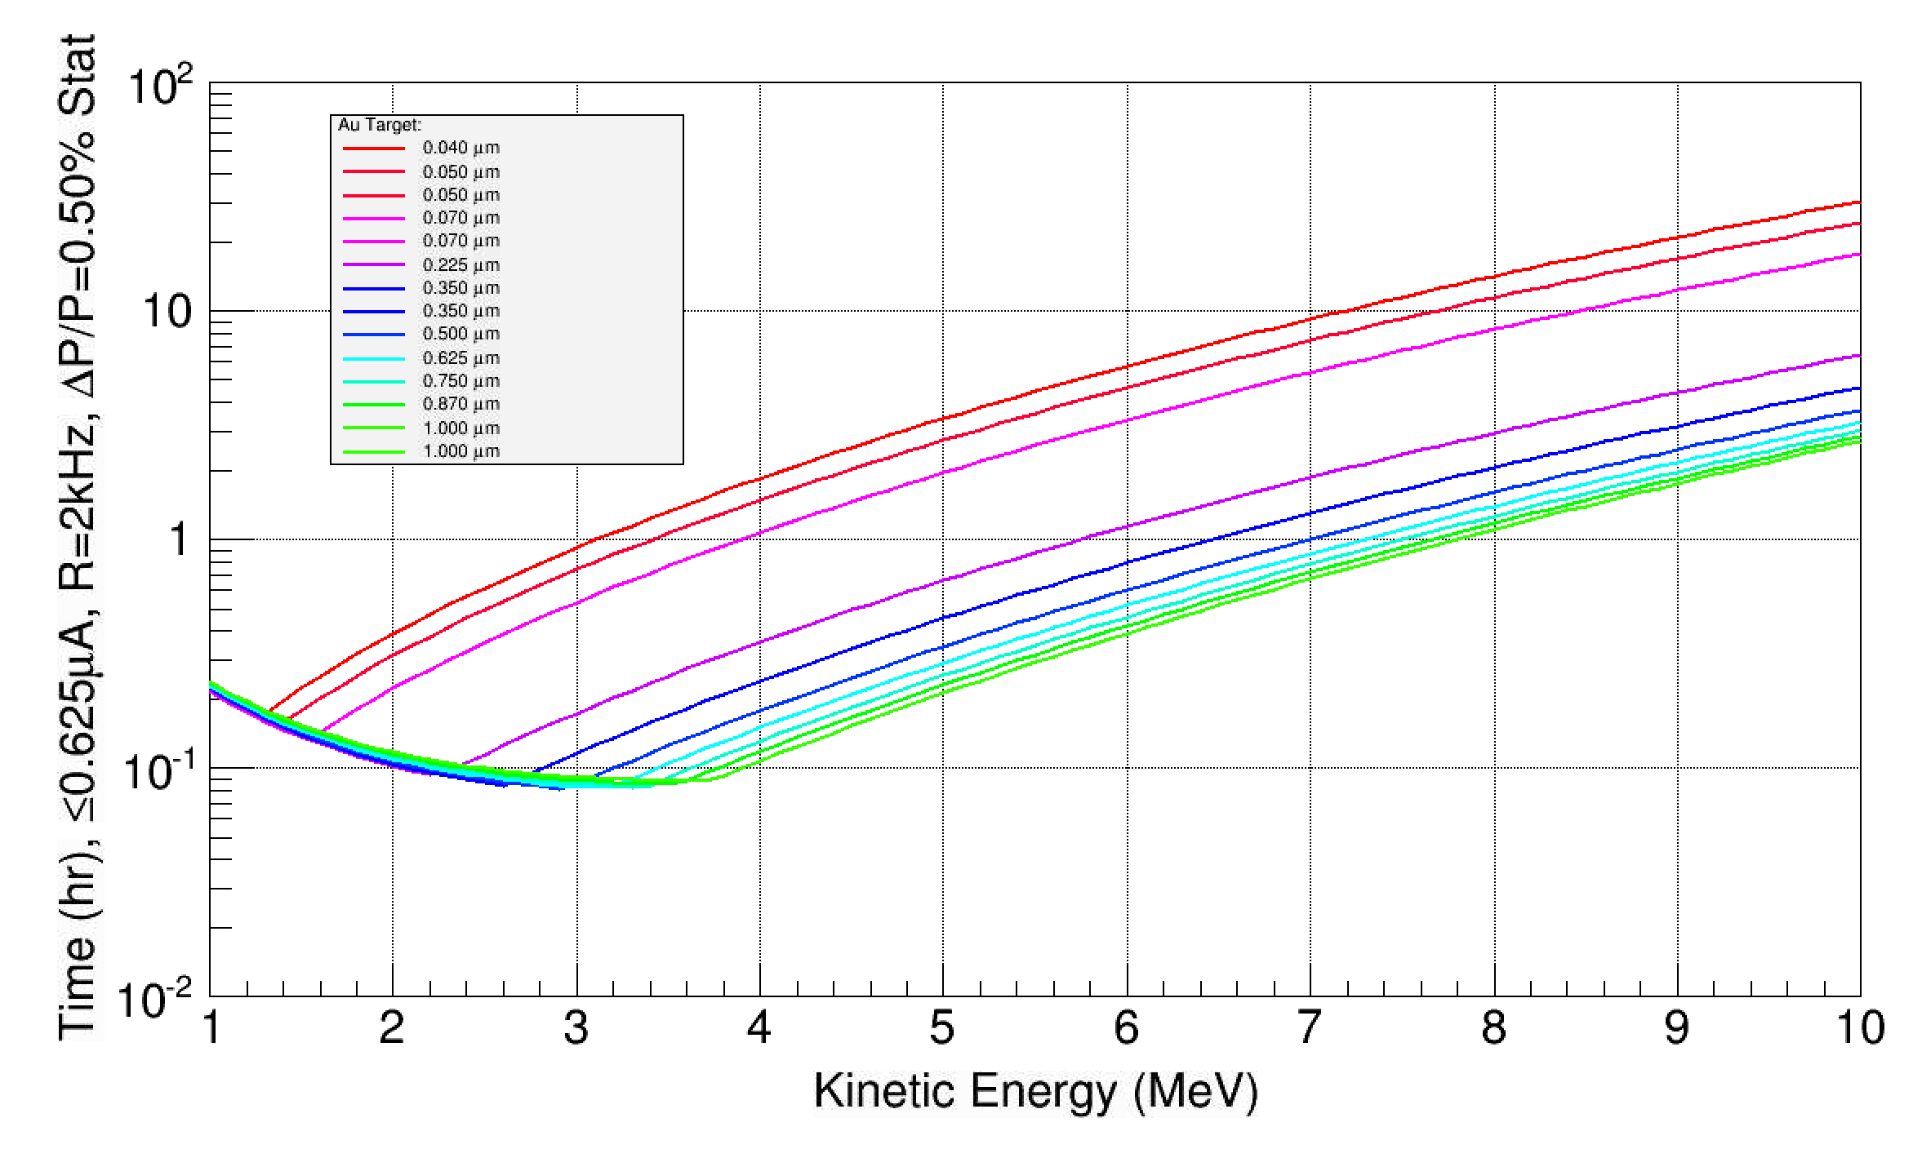
What is our worst case scenario for January … ?
12 hours of Mott beam tests end of year (starts Sunday @ 8pm)
Test new Mott mode for higher rate
Test if if 62 MHz (16ns) is sufficiently good
Characterize transmission vs. bunch charge at 31 and 62 MHz
Induce and measure energy spread in spectrometer and Mott
Target foil positions
Long run stability
Worst Case : I=0.625 uA @ 31 MHz
dP/P=0.25% needs = 8 + 3 shifts
dP/P=0.50% needs = 3 + 3 shifts

Slide 5
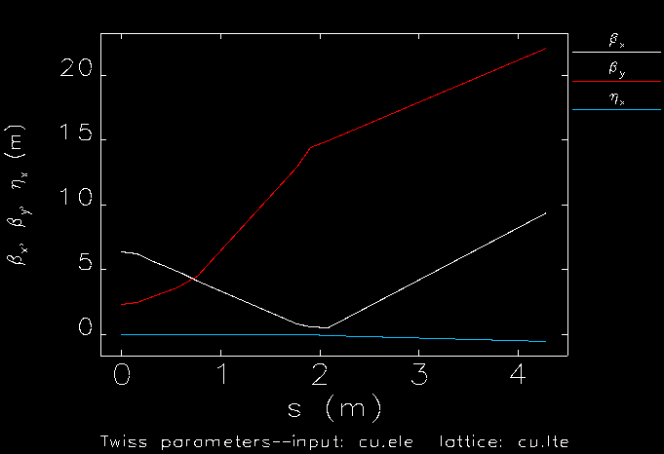
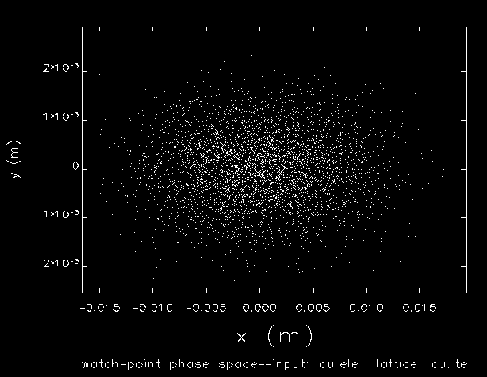
Started building optics deck for Mott and Spectrometer…
Measured (Spring 2014) beam emittance at 5.3 MeV/c
beta_x = 6.38, alpha_x =-1.02, emit_nx=0.39e-6
beta_y = 2.34, alpha_y =-0.02, emit_ny=0.26e-6
Two tuning quads (MQJ0L02/MQJ0L02A) at nominal value and dp/p assumed 1%
Finally for experiment we will plan to
Measure beam emittance
Measure (and vary) energy spread
Calculate tuning quads for desired beam spot size and for simulation

