Slide 1
The GaAs Polarized Electron Source:
A brief tour
Joe Grames
Center for Injectors and Sources
July 25, 2023

Slide 2
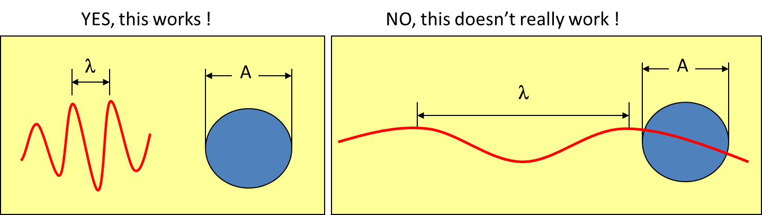
Our mission: to boldly “see” what no one has seen before!

Slide 3
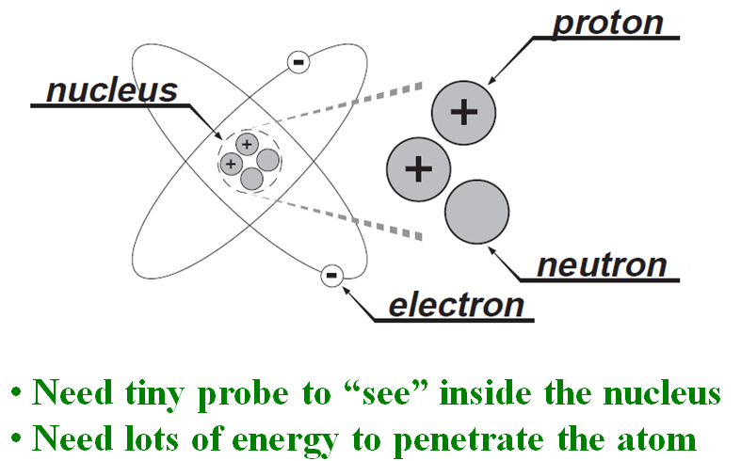
Energy scale to probe massive particles…
M ~ 938 MeV/c²
m ~ 0.511 MeV/c²
energy ~ 1/λ ~ mass
E = hc/λ = mc²

Slide 4
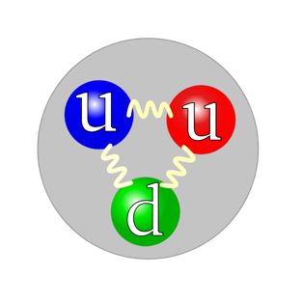
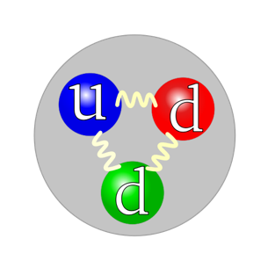
What can we do?
Build a 5 mile long electron microscope!
Electron
Proton
Neutron
Make electrons energetic enough (E_{beam}) to see the mass of the proton or neutron (M_{nucleon}) and its constituents.

Slide 5
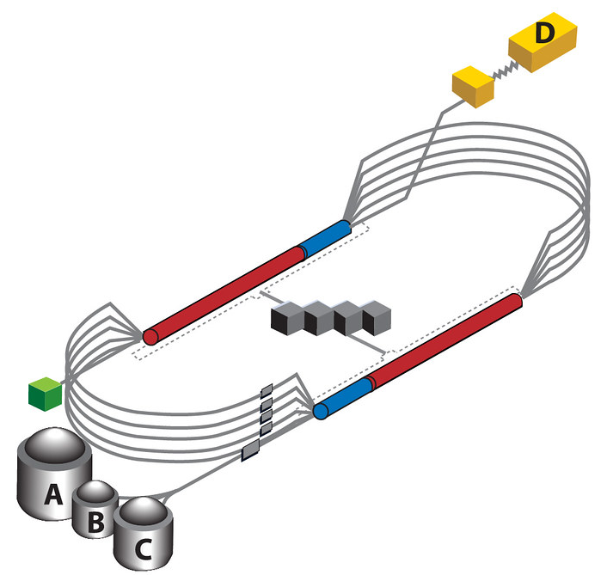
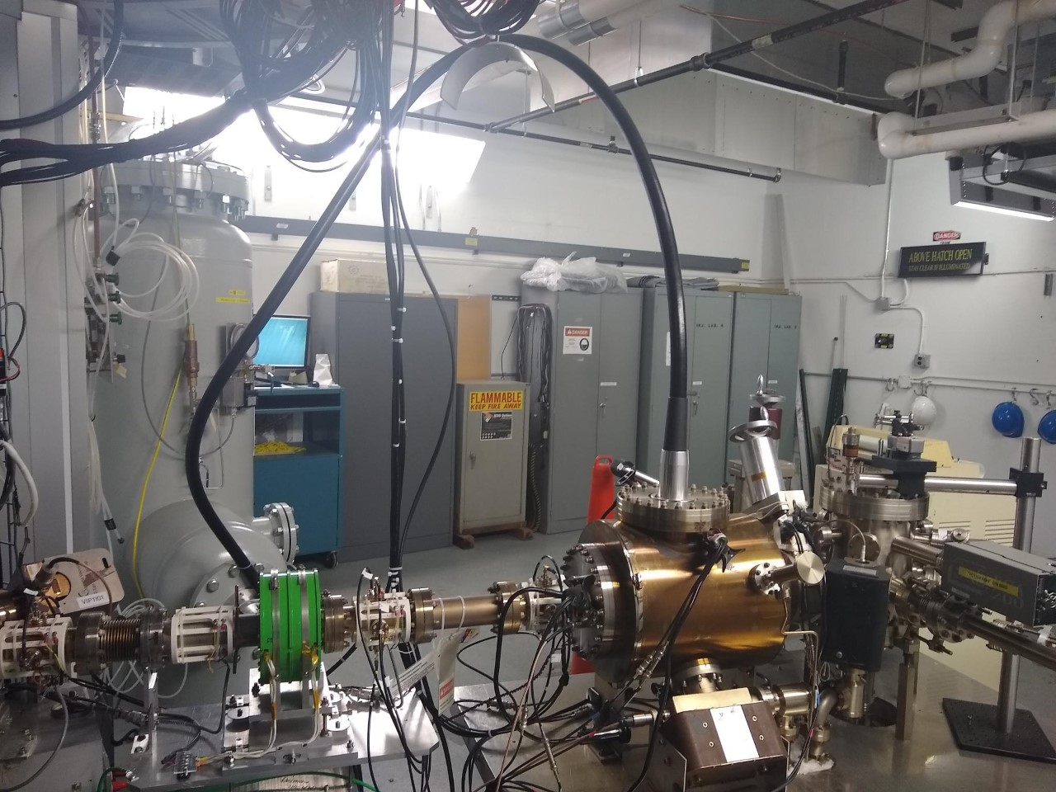
Continuous Electron Beam
Accelerator Facility (Jefferson Lab, USA)
1 GeV linac
1 GeV linac

Slide 6
Spin (Beam) Polarization
Spin Polarization is defined as the net fraction of spin states along a preferred direction; helicity refers to spin parallel/anti-parallel to beam momentum (velocity).
P = (N⁺ - N⁻)/(N⁺ + N⁻)
(2 - 2) / (2 + 2) = 0%
(3 - 1) / (3 + 1) = 50%

Slide 7
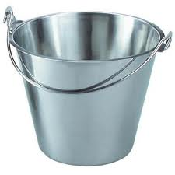
Why polarized beams?
Target
You measure
an experimental
asymmetry !

Slide 8
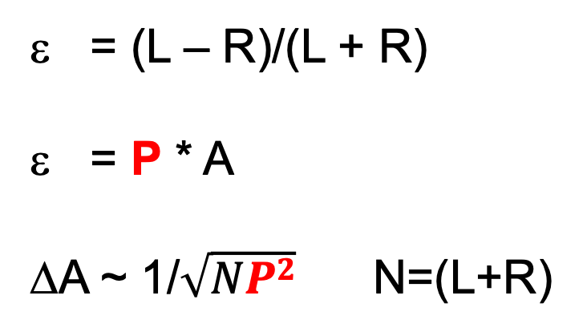
Why should “P” be large?
Measured asymmetry
Physics asymmetry
Error on analyzing power
= (L – R)/(L + R)
= P * A
ΔA ~ 1/$\sqrt{NP2}$ N=(L+R)
For example, increasing the beam polarization from 30% to 90% achieves the same uncertainty
in (30/90)² ~ 11% of the time.
Experiments might be completed in one month,
instead of one year.

Slide 9
Parity Violation Experiments at CEBAF
1990’s
2020’s

Slide 10
Example: what does “A_{PV} = 36 ppb” even mean?
A
ε = (A - B)/(A + B)
Target
1,000,000,000
A - B
= 0.000000036
1,000,000,000
B
A = 500,000,018
B = 499,999,982

Slide 11
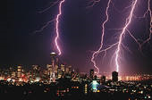
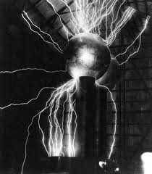
Accelerators need “free” electrons !
So, how might we acquire them?
Field Emission (electronic energy)
Thermionic Emission (thermal energy)
Photo Emission (optical energy)

Slide 12
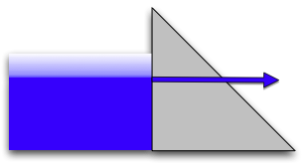

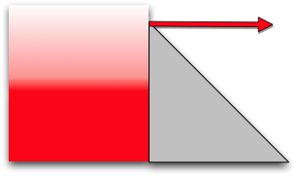

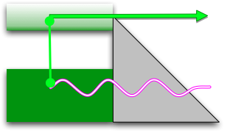

Canonical Electron Emission Equations
Φ is the energy required to “free” the electron
(slide courtesy of Dr. K. Jensen, Naval Research Laboratory)
Field Emission
Fowler Nordheim
E.L. Murphy, and R.H. Good,
Physical Review 102, 1464 (1956).
Thermal Emission
Richardson-Laue-Dushman
C. Herring, and M. Nichols,
Reviews of Modern Physics 21, 185 (1949).
Photoemission
Fowler-Dubridge
L.A. DuBridge
Physical Review 43, 0727 (1933).

Slide 13
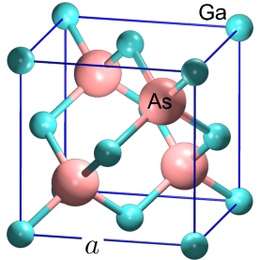
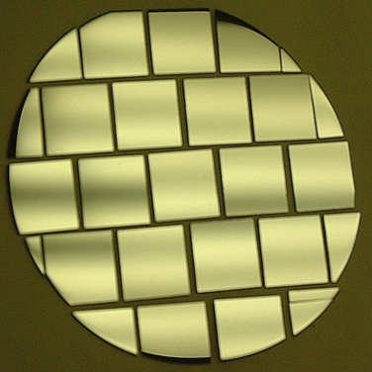
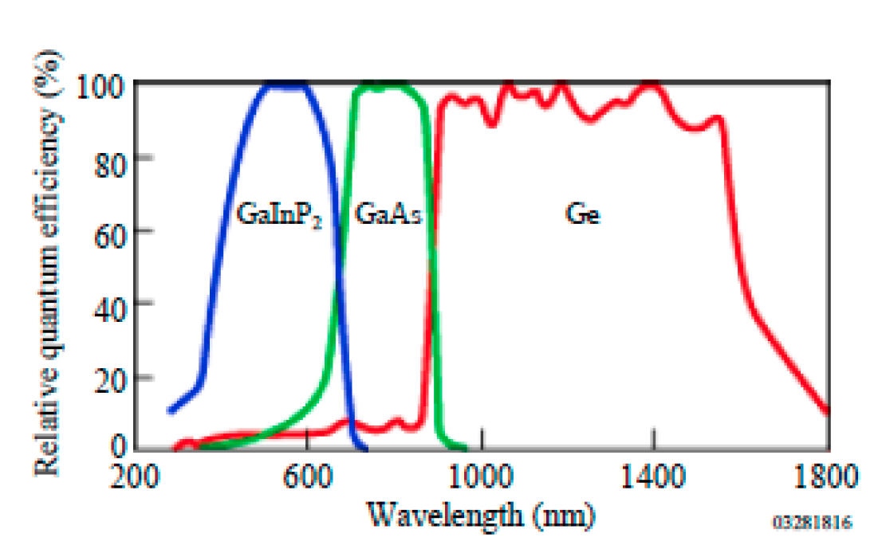
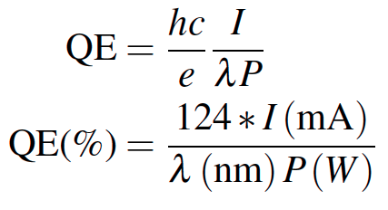
Photoabsorption
In practical terms, the quantum efficiency “QE” is the metric used to assess the number of electrons emitted per number of illuminating photons.
# Photons IN
# Electrons Out
GaAs
Al-Naser, Qusay & Hilou, Hassan & Abdulkader, Abbas. (2009). The last development in III-V multi-junction solar cells. 1. 10.1109/CCCM.2009.5268104.

Slide 14
How to describe photoemission?
QE
“Activate” GaAs photocathode by applying about one mono-layer of Cesium and NF₃ to very clean surface
NF₃
Cs
0
Time
R | GaAs Light Reflection Coefficient (~ 0.3)
d | GaAs layer thickness (~ 0.1 μm)
α(Һω) | Photo-absorption Coefficient (~ 5x10³ cm⁻¹)
B(χ) | Surface Tunneling Probability(~ 0.2)

Slide 15
Photo-Emission from GaAs
Dipole layers of
Cesium + NF₃
Reduces Work Function
Negative Electron Affinity (NEA)
Bare GaAs surface
Large Work Function
Positive Electron Affinity (PEA)
NEA Surface Activation
PEA=4.07 eV
-
Conduction
Band
-
χ^{NEA} ~ 0.2 eV
E_{gap}
Valence
Band
+
Light
GaAs
Vacuum
GaAs
Vacuum

Slide 16
Spin Polarized Photoemission from Bulk GaAs
E
E
J
S_{1/2}
-1/2
+1/2
S_{1/2}
σ+
σ-
E_{gap}=1.42 eV
3
1
1
3
P_{3/2}
E_{F}
P_{3/2}
Δ=0.34 eV
-3/2
-1/2
+1/2
+3/2
P_{1/2}
-1/2
+1/2
P_{1/2}
k
σ+: Right circularly polarized light
σ- : Left circularly polarized light
m_{j}
Laser excitation from P_{3/2} to S_{1/2} : E_{gap} < E_{γ} < E_{gap}+Δ
Electron Polarization:
Reverse electron polarization by reversing light polarization

Slide 17
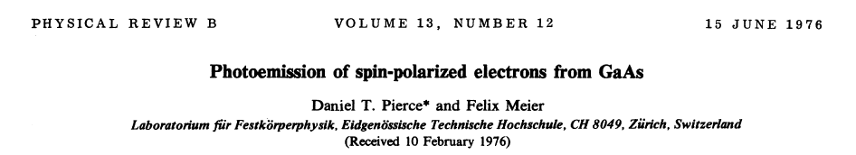
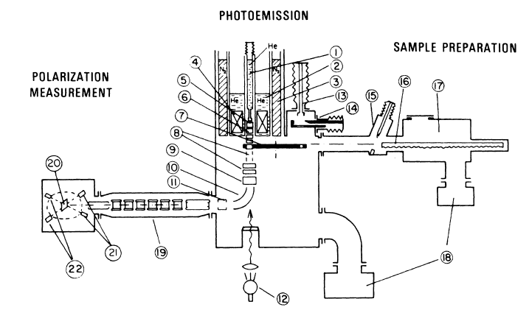
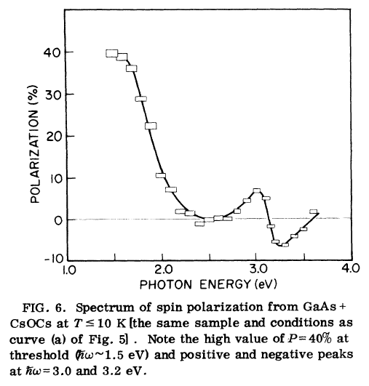
First Observation of Polarization from GaAs

Slide 18
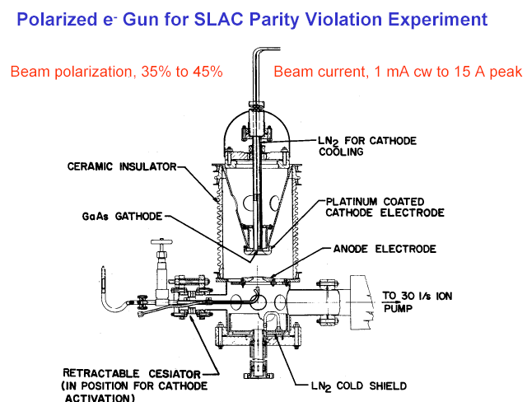
First HV GaAs photogun used on an accelerator
Built for SLAC parity-violation experiment E122
December 1977 - Polarized electrons accelerated at SLAC
June 1978 - E122 announces parity violation (Standard Model)

Slide 19
JLab polarization : since mid-90’s
”High” spin polarization photocathodes align 9 out of 10 electrons ~85%
Remember, GaAs aligned 3 out of 4 electrons ~50%

Slide 20
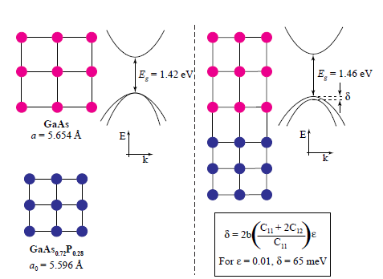
Breaking the P=50% barrier
Lattice mismatch provides stress
The band gap of the substrate layer must be larger than surface layer
Lattice constants must differ enough to introduce suitable strain
Adjust lattice constant of substrate by varying concentration of third element
Pablo Saez, PhD Thesis, SLAC Report 501, 1997
1% lattice mismatch provides equivalent force as hydraulic press!

Slide 21
Strained layer GaAs
S_{1/2}
m_{j} = -1/2
+1/2
0.1 μm
Strained GaAs
σ+
σ-
250 μm
GaAs_{1-x}P_{x} (x=0.29)
P_{3/2}
m_{j} = -3/2
+3/2
250 μm
GaAs_{1-x}P_{x} (0<x<0.29)
-1/2
+1/2
p-type GaAs
substrate
Polarization 75% >> 50% ☺
Strain relaxes in 0.1 μm layer
Not all electrons reach surface
QE 0.1% << 6% ☹
600 μm
MOCVD-grown epitaxial spin-polarizer wafer

Slide 22

Strained layer superlattice GaAs/GaAsP
GaAsP
30 A
Strained GaAs
30 A
1000 A
Active Region
GaAs_{0.64}P_{0.36}
Buffer
GaAsP
2.5μm
Strained GaAs
GaAs_{(1-x)}P_{x} Graded Layer
2.5μm
GaAsP
Strained GaAs
GaAs Substrate
D. Luh et al, SLAC, PESP2002
QE 1% and Polarization 85%
From Aaron Moy, SVT Assoc and SLAC, PESP2002

Slide 23
GaAs Photocathode Evolution

Slide 24
How to make the electrons “energetic” ?
Air ~ 6 MV/m
Sulfur hexafluoride ~15 MV/m
Ceramic ~ 30 MV/m

Slide 25
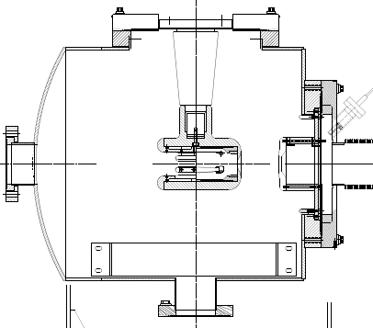
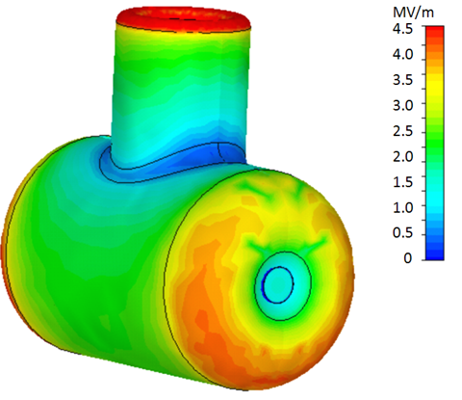
Anatomy of a high voltage gun chamber
Vacuum flange
Insulator
Cathode electrode
Load
photocathodes
Anode electrode
light in
electrons out
Photocathode
Getter pump
Ion pump

Slide 26
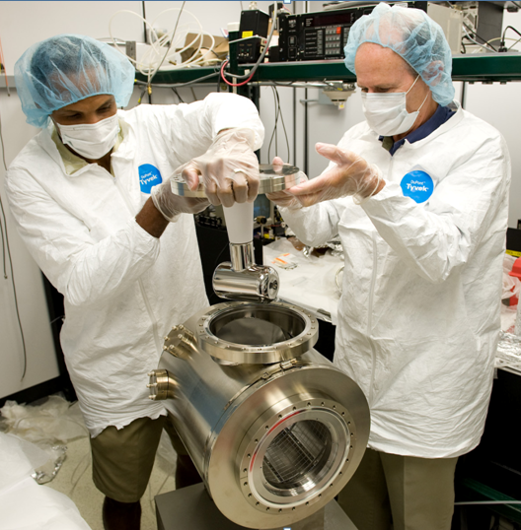
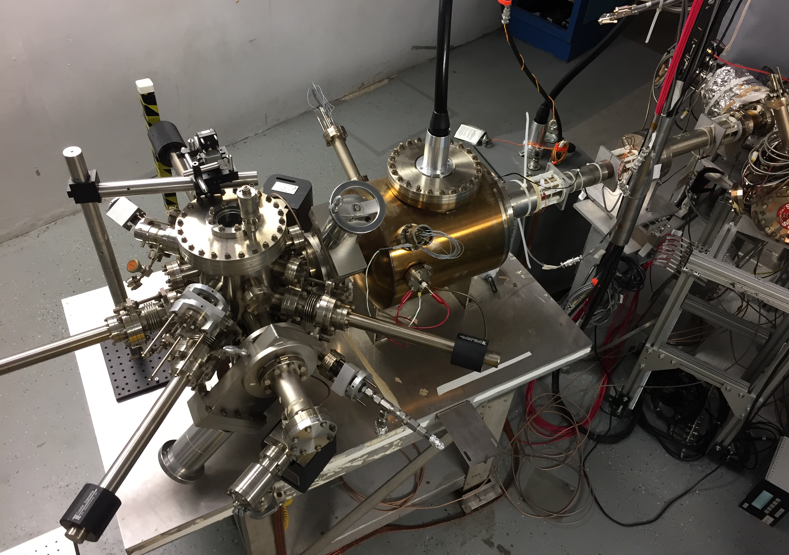
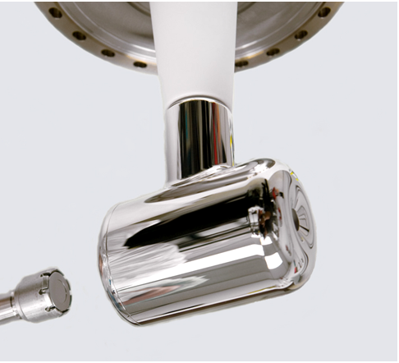
Polarized electron source
Activation
chamber
HV chamber
HV cable
Loading
chamber

Slide 27
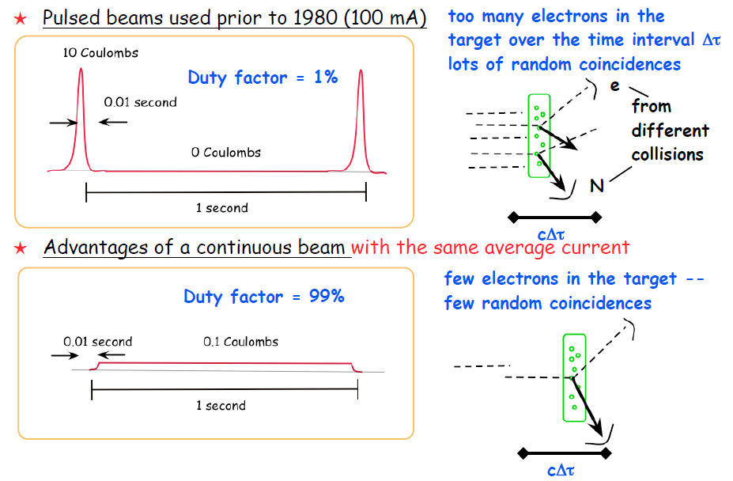
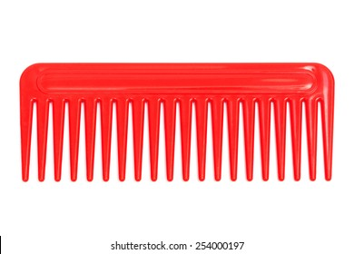
Continuous vs. Pulsed Beams
1 Coulomb
Duty factor = 100%
1 Coulomb
Duty factor = <100% w/ rf structure

Slide 28
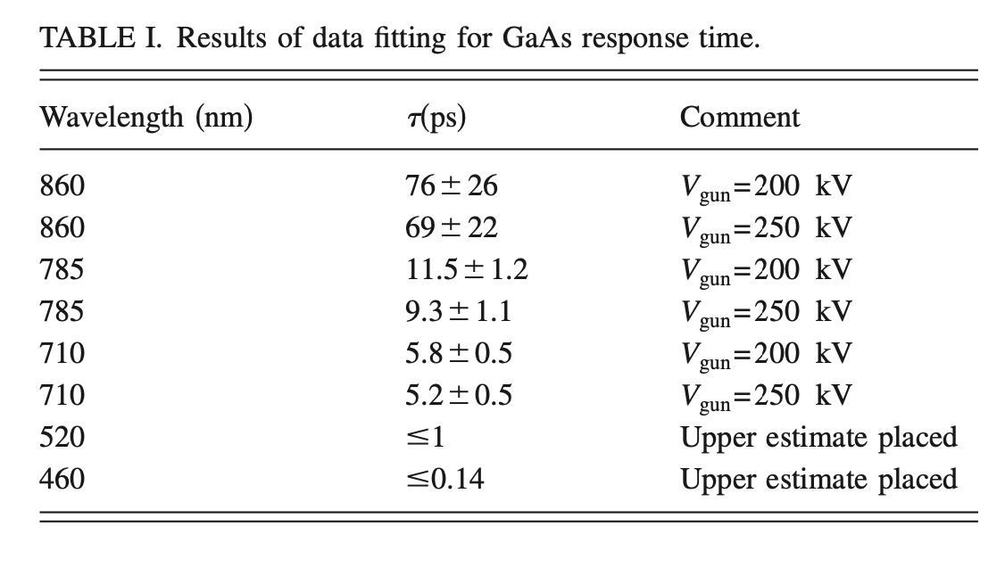
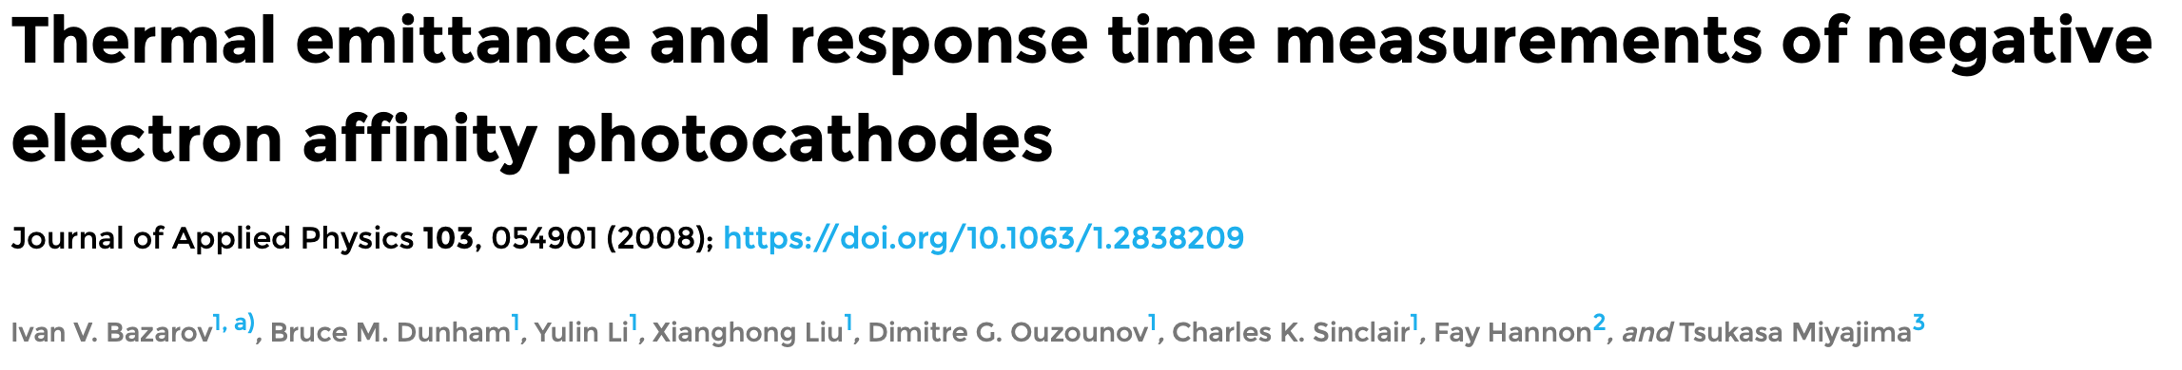
…but continuous does NOT mean DC
DC beams
Pros
  Laser simple
  No long. SC forces
Cons
  Incompatible w/ RF accel
  Lose 5/6th of the beam
RF beams
GaAs has a prompt reponse (1-10’s psec)
Depends on absorption length (λ) and diffusion to surface

Slide 29
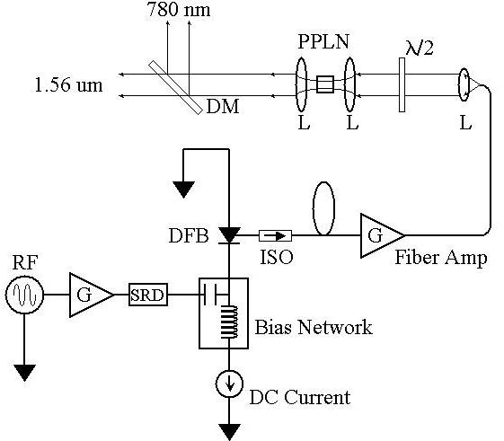
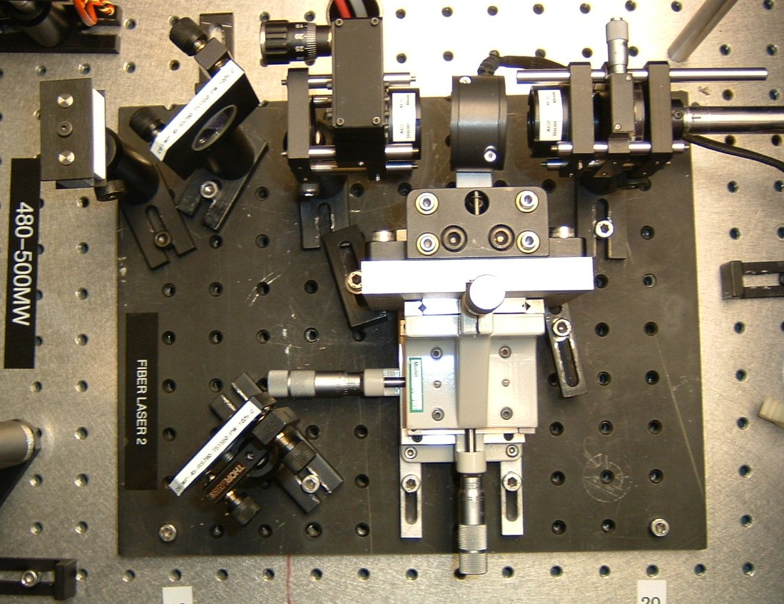
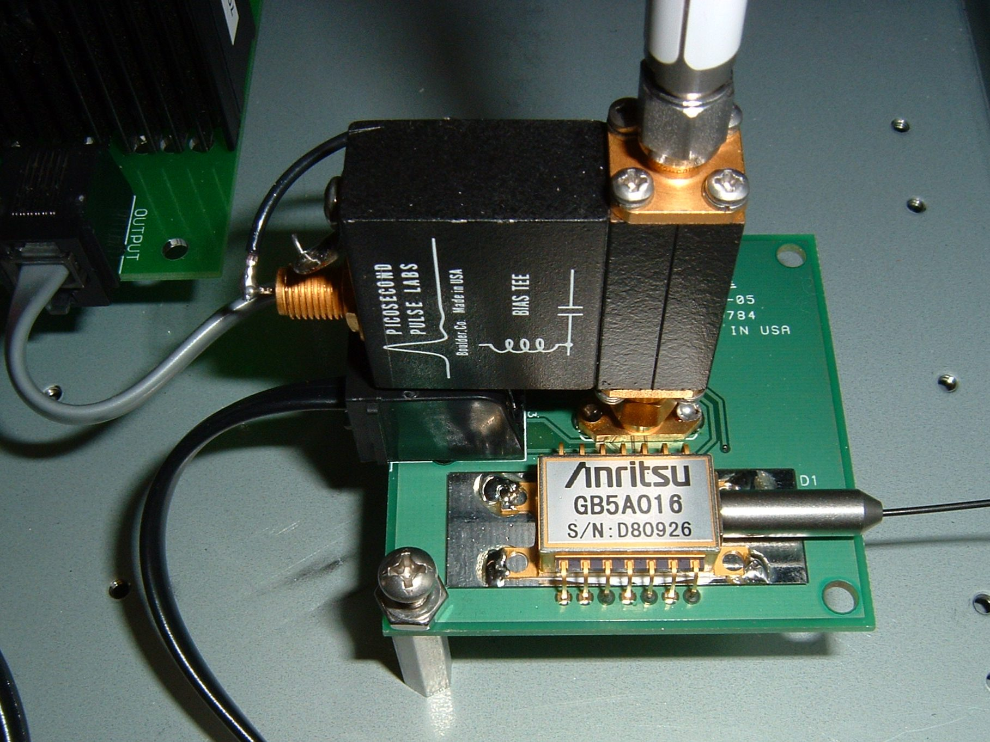
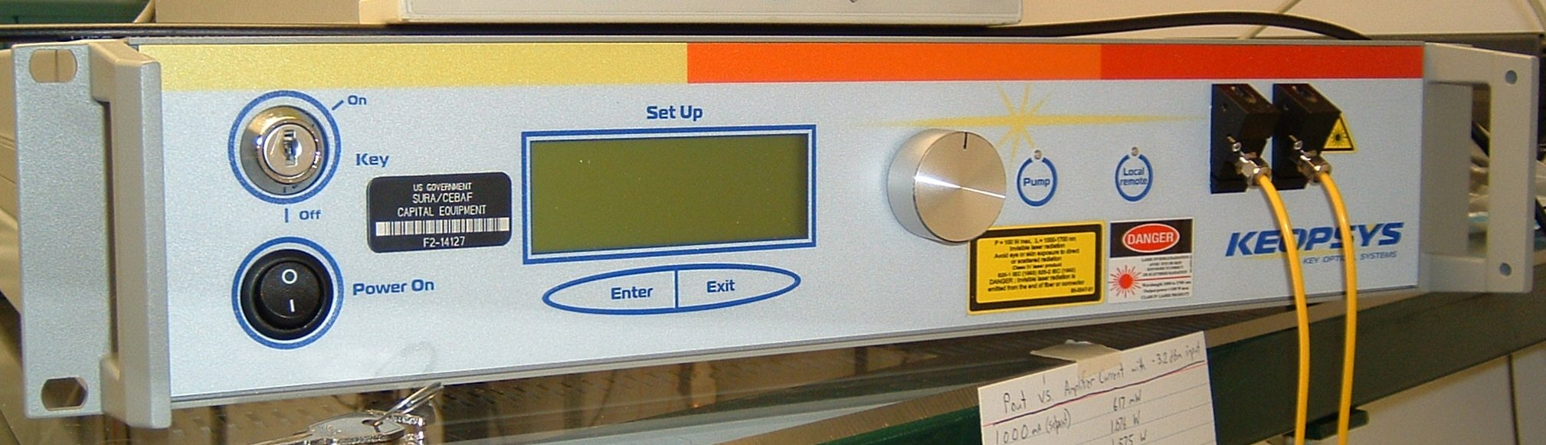
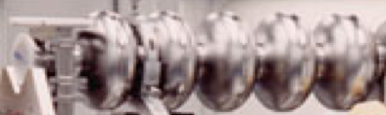
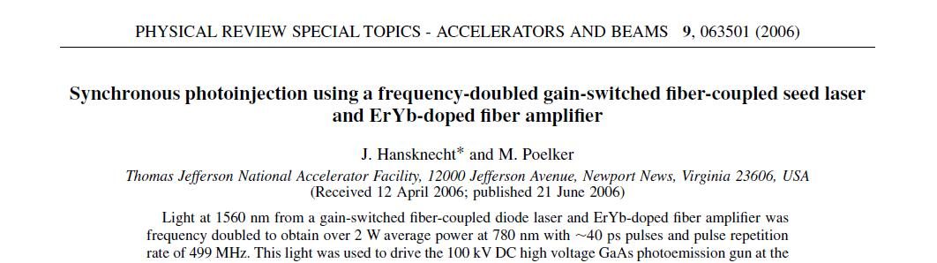
Radiofrequency gain-switched frequency doubled fiber amplified laser
780 nm
Frequency-doubler
1560 nm to 780 nm
30% Efficiency (2 W)
RF Locked Low-Power (1 mW)
1560 nm Fiber Diode
1560 nm
499 MHz
High Power (6 W) 1560 nm Fiber Amplifier

Slide 30
Laser is just one part of the ”big picture”

Slide 31
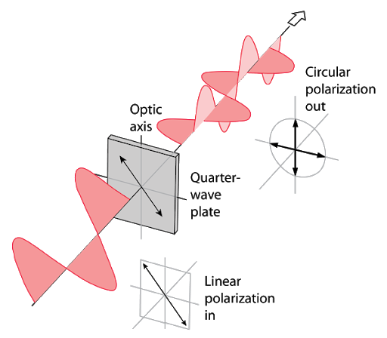
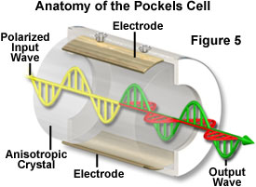
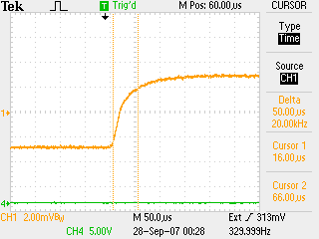
Making circularly polarized laser light
Potassium di-Hydrogen Phosphate (Long)
Rubidium Titanyl Phosphate (Trans)
Pockels cell λ/2 transition optical result. ~70us with no ringing.

Slide 32
Vacuum conditions in an accelerator
Application | Pressure Range | Location | Vacuum Regime
Beamline to dumps | 10⁻⁵ Torr | Target to dump line | Medium
Insulating vacuum for cryogens | 10⁻⁴ Torr to 10⁻⁷ Torr | Cryomodules, transfer lines | Medium to high
Targets, Scattering Chambers | 10⁻⁶ to 10⁻⁷ Torr | Experimental Halls | High to very high
RF waveguide warm to cold windows | 10⁻⁷ to 10⁻⁹ Torr | Between warm and cold RF windows | High to very high
Warm beamline | 10⁻⁷ to 10⁻⁸ Torr | Arcs, Hall beamline, BSY, some injector | High to very high
Warm region girders | 10⁻⁹ Torr or better | Girders adjacent to cryomodules | Very high to ultrahigh
Differential pumps | Below 10⁻¹⁰ Torr | Ends of linacs, isolate cryomodules | Ultrahigh vacuum
Baked beamline | 10⁻¹⁰ to 10⁻¹¹Torr | Y chamber, Wien filter, Pcup | Ultra high vacuum
Polarized guns | 10⁻¹¹ to 10⁻¹² Torr | Photoguns | Ultra to Extreme high vacuum
SRF cavity vacuum | < 10⁻¹² Torr | Inside SRF cavities with walls at 2K | Extreme high vacuum

Slide 33

We understand Alice’s worry…
“The woods were dark and foreboding, and Alice sensed that sinister eyes were watching her every step. Worst of all, she knew that Nature abhorred a vacuum” – Gary Larson
Air ~ 10¹⁶ / Torr-cm³
  ^{(molecules ~2 nm apart)}
Gun ~ 10⁻¹² Torr
  ^{(molecules ~1 mm apart)}

Slide 34
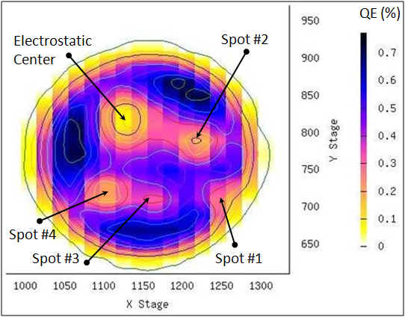
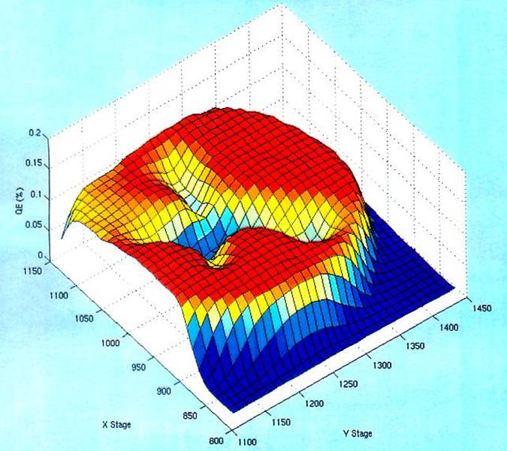
Ion back-bombardment leads to QE reduction
These ions may strike the photocathode, generate secondary electrons or x-rays, and desorb gas from surfaces; all leading to a reduction of the photocathode quantum efficiency (QE).

Slide 35
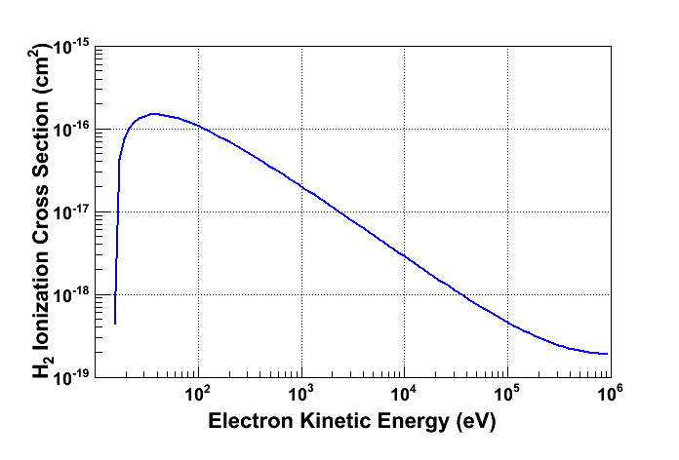
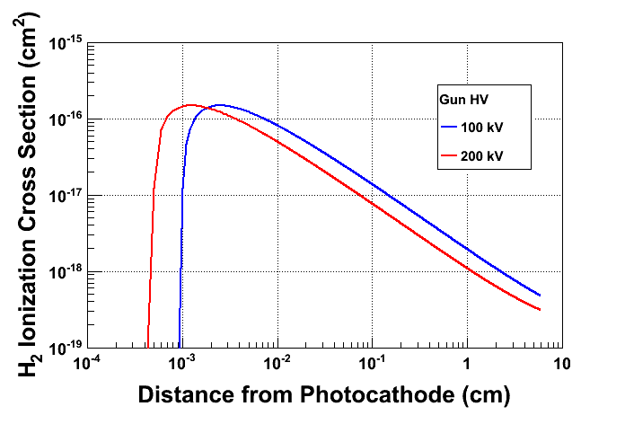
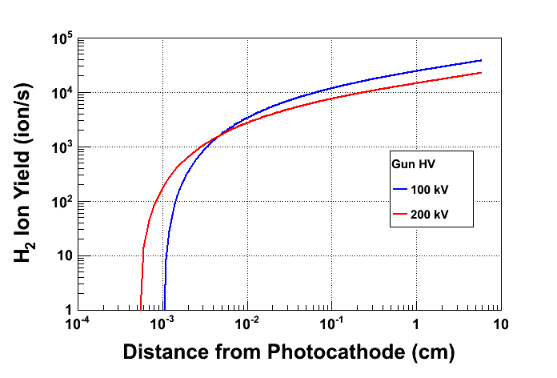
Prolong Photocathode Charge Lifetime
Most ions created at low energy
Most ions created close to GaAs surface
Beam Current: 2.0 mA
Vacuum: 8.0 × 10⁻¹² Torr

Slide 36
“Death” of a photocathode
Metrics for quantifying reduction of NEA condition:
Vacuum lifetime – generally a leak, or chemical “X” (hours)
Dark lifetime – “dark” means no light, so field emission (hours)
Charge lifetime – beam related, proportional to charge extracted (Coulombs)
Charge fluence lifetime – surface charge extract (Coulombs/Area)
Note, there are other ways to reduce lifetime…
Laser heating (NEA evaporation)
beam loss (vacuum, x-rays)
stray light (stray beam)
…and on

Slide 37
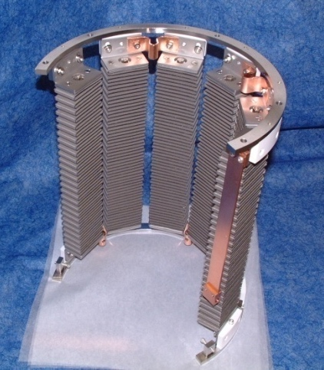
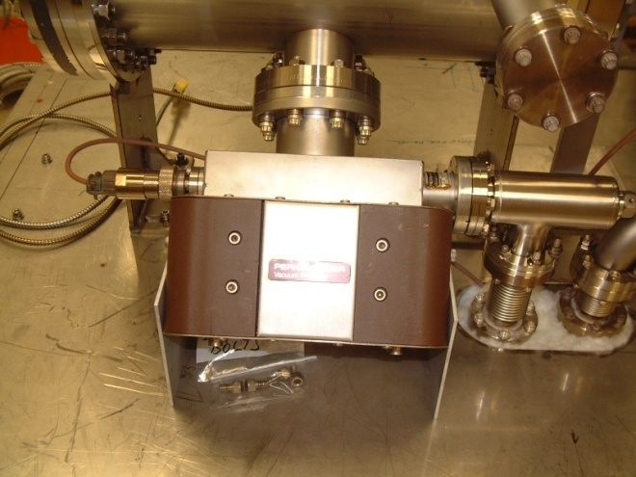
Achieving Extreme High Vacuum
Avoid contamination by oils due to roughing pumps, fingerprints, machining.
Baking used to get pressures below 10⁻¹⁰ Torr
  250°C for 30 hours removes water vapor bonded to surface that otherwise limits pressure
Getter Pumps
  Chemically active surface
    Titanium sublimed from hot filament
    Non-Evaporative Getters
  Molecules stick when they hit
    Does not work well for inert gasses such as Argon, Helium or for methane
Ion Pumps
  Electric field to ionize gasses
  Magnetic field to direct gasses into cathodes where they are trapped
    Has some pumping capability for noble gasses
NEG pump array
Ion Pump

Slide 38
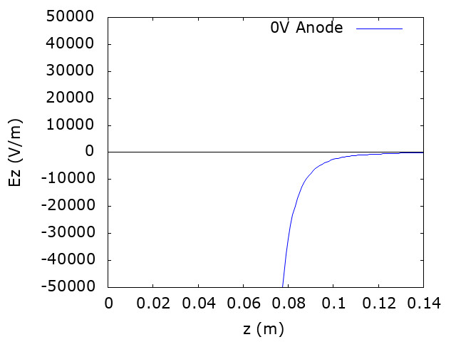

Mitigating ion back-bombardment
Work of J. Yoskowitz (Old Dominion University) IPAC’21

Slide 39
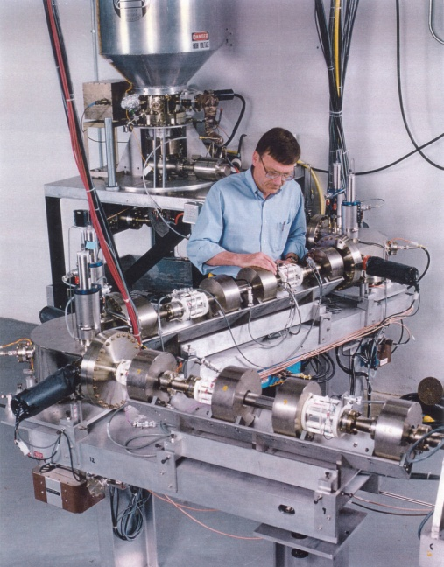
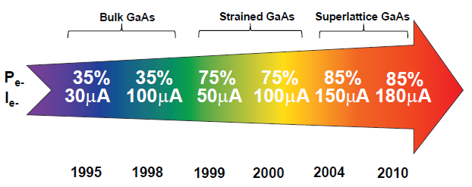



Polarized Electron Sources : Quest for Perfection!
1
~1995
~2015
5
The endless quest for perfection
~2010
4
2
~2000
3
~2005

Slide 40
I would like to acknowledge the many folks who have contributed in one way or another their time or materials to this presentation.
Carlos Hernandez-Garcia, Matt Poelker,
Marcy Stutzman, Riad Suleiman
And errors, mistakes, etc. are my own.
Thank you !

