Slide 1
North Access Building Acid Flushing and Power Failure Events 2 interacting events in which the insufficiently planned/coordinated actions to restart from the first event caused the second event Lessons Learned/Toolbox Discussion (Adapted from W. Oren’s ENG presentation, February 2017)
See Notable Event report: https://www.jlab.org/div_dept/dir_off/oa/notable/secure/NE%20Final%20ENG-17-0103.pdf

Slide 2
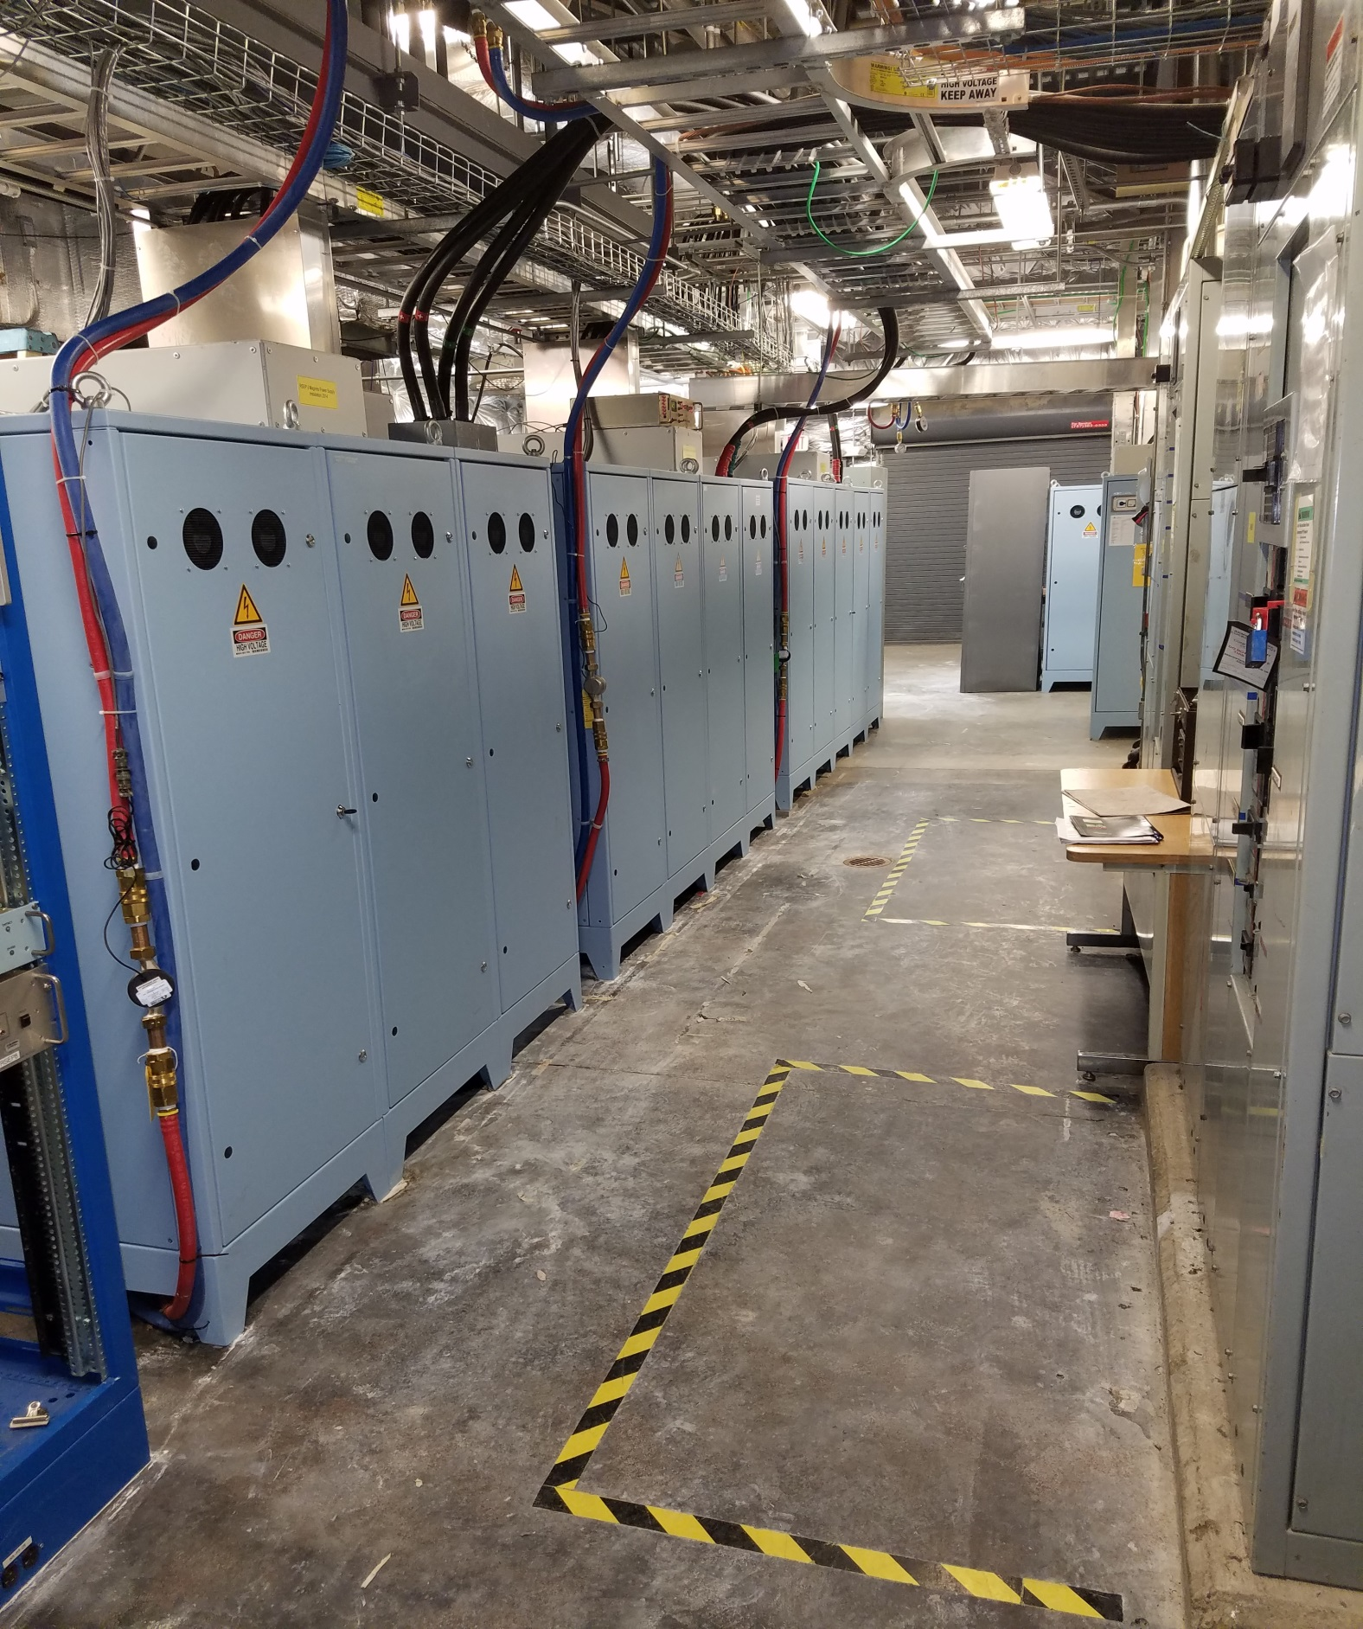
Event 1 Summary
During power supply maintenance in the North Access Building, spray from a leaking acid flushing line fitting caused a power outage and a visible flash
The line was about 5’ from a 480V switchboard
It was 6:45 a.m. on the first day back from the Holiday break
LCW lines used during acid flushing
Power supplies
Switchboard

Slide 3
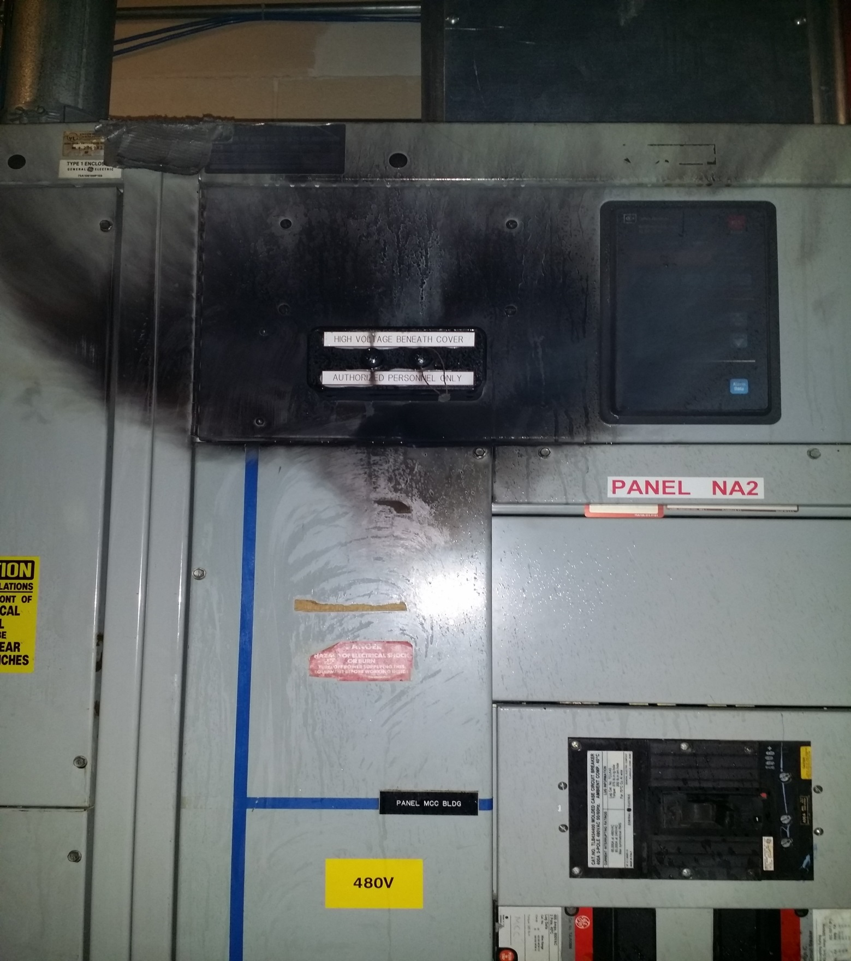
Causal Factors- Event 1
Lack of sufficient supervision enforcement/oversight and proper review
THA did not recognize the potential for a hose leak or recognize what could happen if one occurred. This in spite of multiple reviews by SME’s, supervision and location specific staff – safety warden
There was no clear evidence that the OSP was being followed with regard to checking for leaks in the system
Further observations suggested that other facets of the OSP were not being followed (lack of PPE, roping off area)
OSP had been signed but was not available on site as required by ESH Manual
There was no evidence that supervision was providing oversight or enforcing the use of the OSP
Remember – this work involved a pre-mitigated risk code of 3, and work started at 4 am after 10 days off from work

Slide 4
Event 1 “Take Aways”
THA’s must be appropriate & thorough (both formal and informal ones)
Checklists to formulate THA’s are great, but should be used as a “crutch” to remember what to look for; not as a substitute for a thorough “what could happen if” analysis
OSPs are required for tasks with pre-mitigated Risk Code 3 or 4 and must undergo a thorough review
It is the reviewers responsibility to do a thorough evaluation and work with author to address issues before signoff
It is the supervisors responsibility to assure workers have read, signed, and are using the OSP
Work Control Documents are not “suggestions”
Further, supervisors should carefully consider time of day and work week when scheduling/conducting OSP driven activities
Consider: worker attention/fatigue, skills sets, availability of incident response resources, etc.

Slide 5
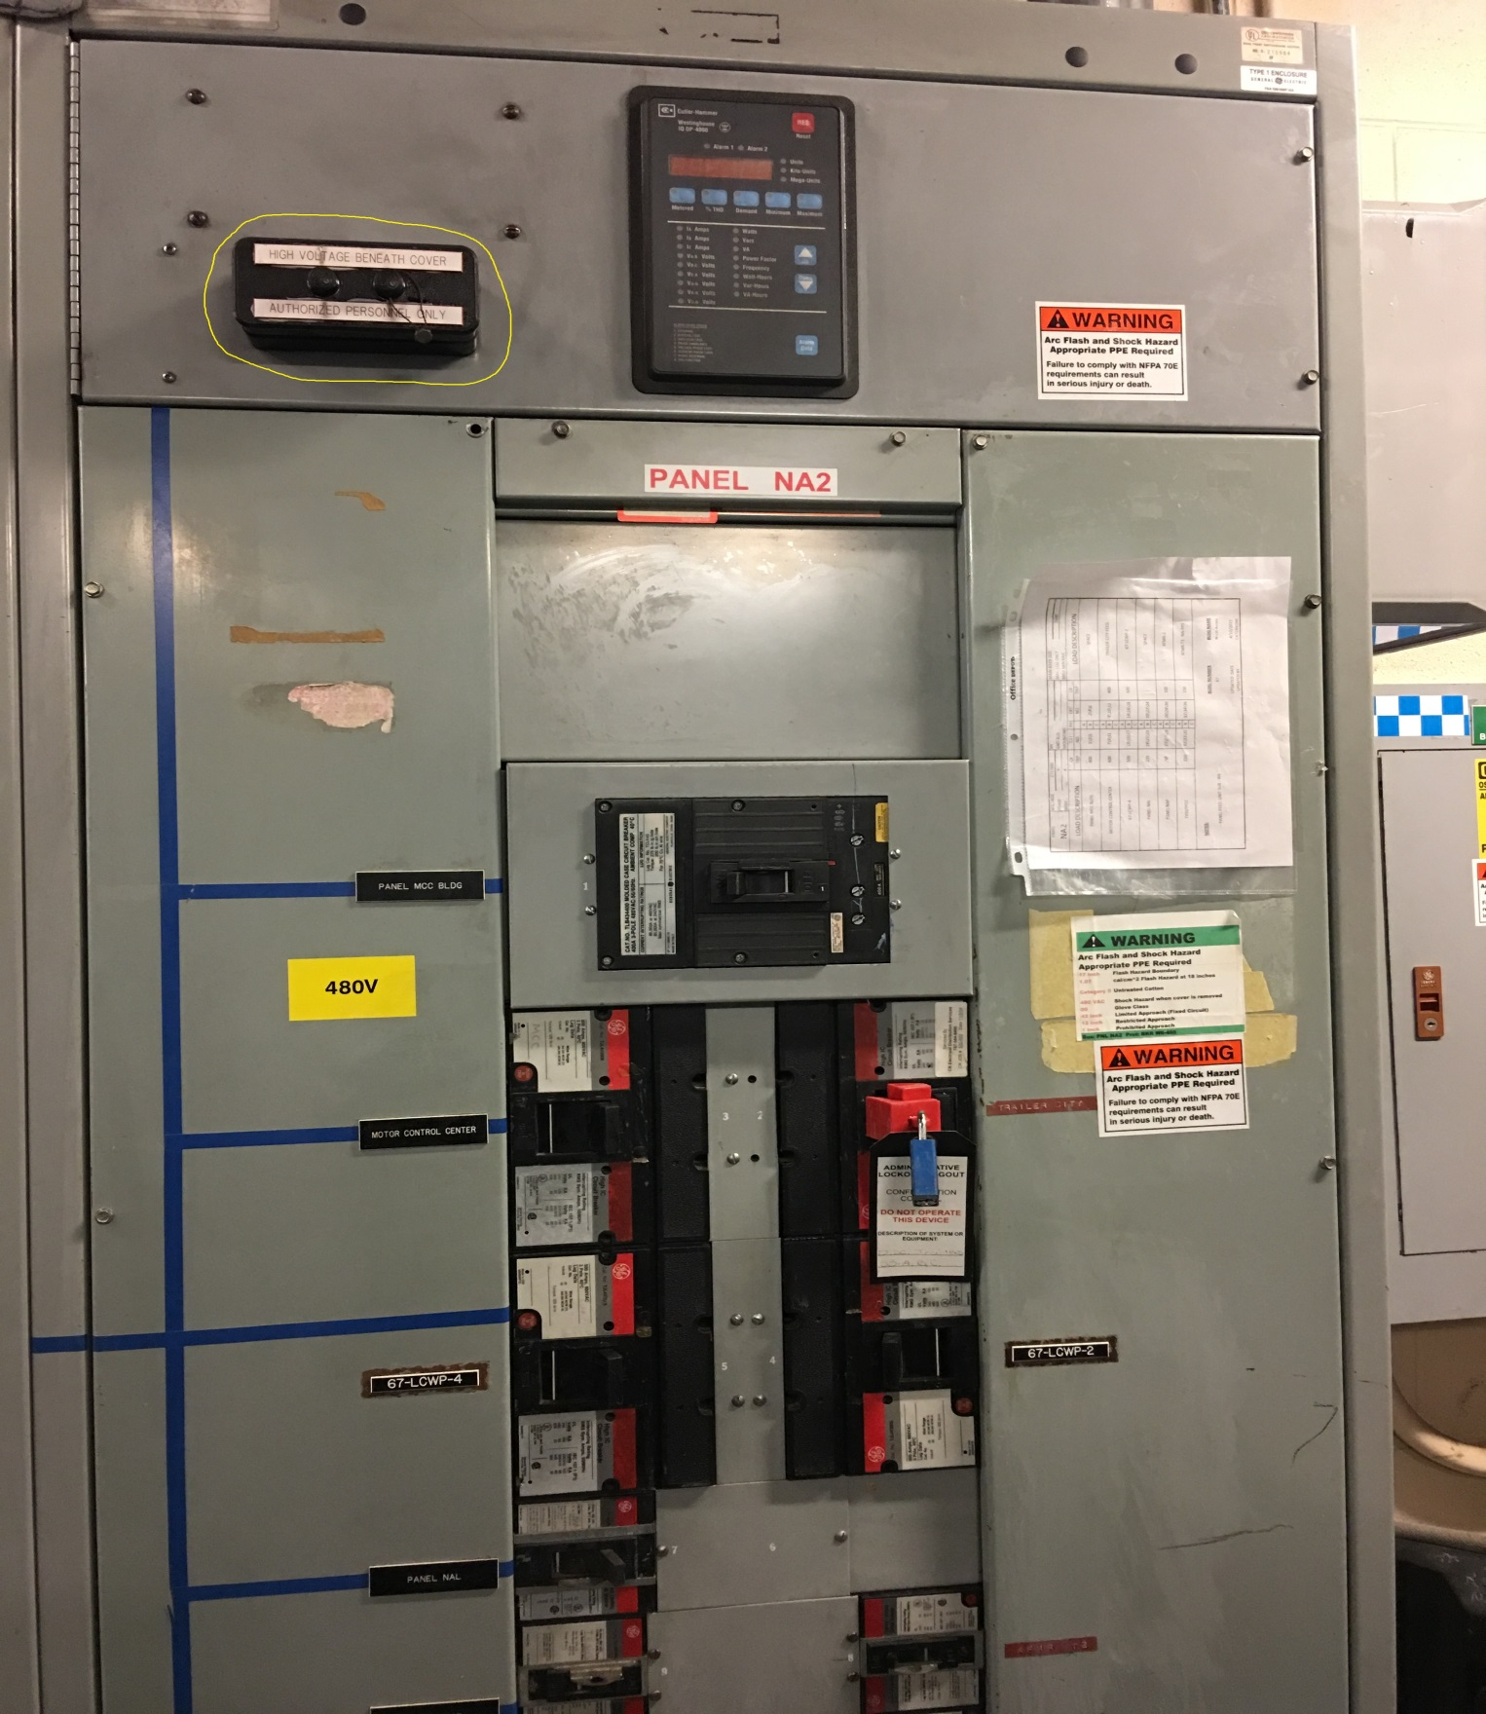
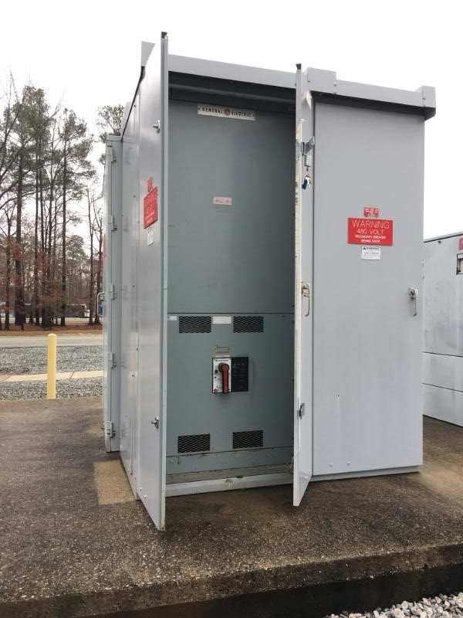
Event 2 Summary
An FM&L Engineer responded to scene to investigate
The engineer decided that electricians were needed to effect repairs
After being informed that the ESR was down, and inferring that helium would be rapidly lost, the engineer changed the plan.
New plan was to re-energize main breaker and then re-energize breakers on affected panel one at a time
Decision not communicated to affected staff and access to the site of the original failure was not controlled / secured
Dressed out and turned off the breakers on the affected panel; then checked the main breaker, which was in a remote location
Another unexpected “flash” occurred with other staff in the vicinity of the panel

Slide 6
Causal Factors – Event 2
Shifting of priorities allowed schedule to take precedence over initial decision not to reenergize panel as initially planned
Once the decision was made, planning for emergent work was insufficient
Building was left unsecured
New plan was not communicated to those affected
Effect of new hazard (acid spray) was not appreciated
Processes for breaker reset was ambiguous

Slide 7
Event 2 “Take Aways”
Planning for “emergent” work in some ways is more important than the highly anticipated job
A thorough “what could happen if” evaluation must be done before proceeding
Use colleagues to check plans and associated hazards whenever possible
Talk and Walk it through!
Communications are key between: responders, bystanders, those involve in incident, etc.
Preservation of an incident scene is important
If startup is needed to prevent additional hazards from occurring, document the scene before proceeding
Only clean up what will cause additional hazards upon restart and thoroughly evaluate the startup with all stakeholders ensuring all mitigations are in place before commencement

