Slide 1
500kV inverted insulators for polarized photogun NP FOA FY20
Objective: Develop an inverted insulator feedthrough + high voltage cable connector that can be used to reliably apply 500 kV bias voltage to a test electrode, with no high voltage breakdown inside or outside the vacuum chamber.
Such a feedthrough does not exist to date.
Motivation: A photogun based on the resultant 500 kV feedthrough design could then be used in a 400 kV photogun with margin for high voltage conditioning to generate high bunch charge spin-polarized electron beams for positron production
Carlos Hernandez-Garcia
Center for Injectors and Sources

Slide 2
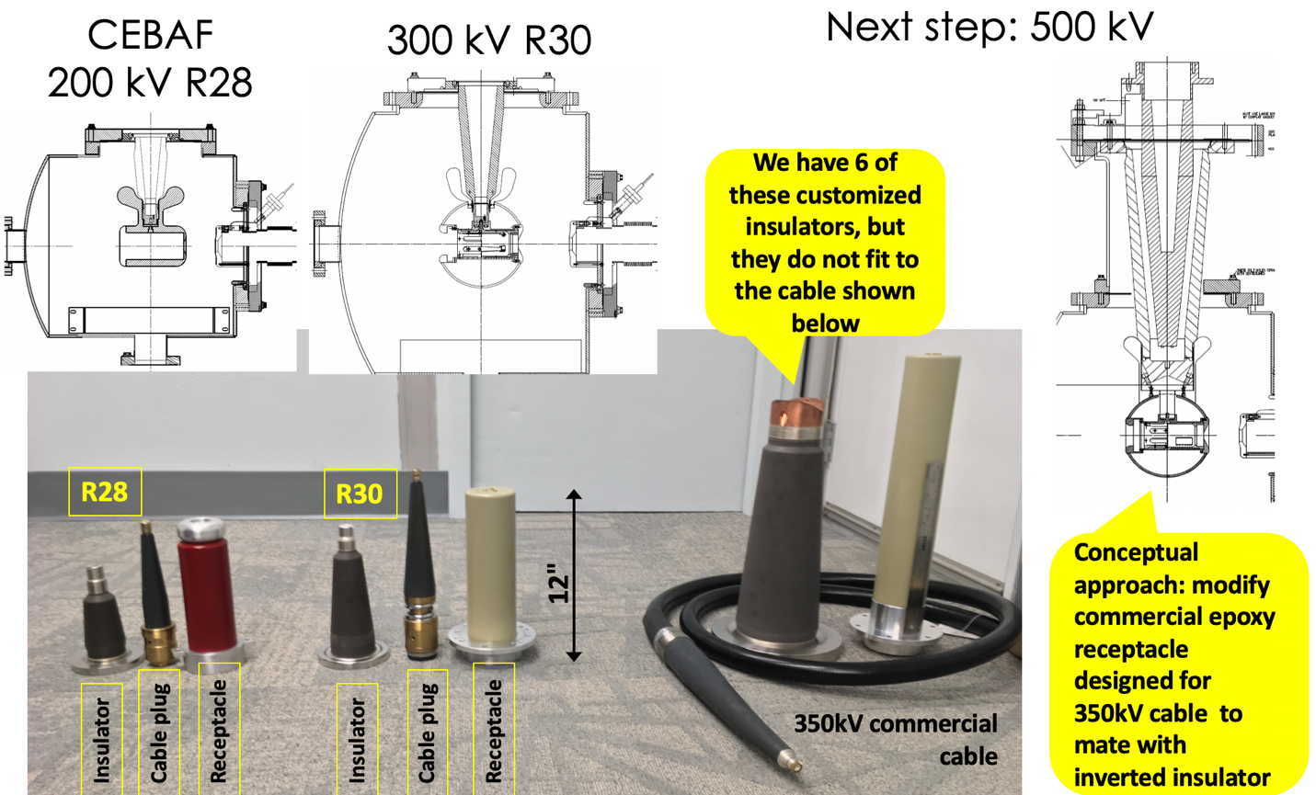
Approach
The proposed plan is an evolution from our experience developing and operating high voltage inverted insulator photo-guns connected to power supplies using commercial components.
The inverted insulator concept allows for small volume and surface area for ~10⁻¹² Torr conditions required by delicate SSL photocathodes for production of spin-polarized electron beams
High voltage conditioning margin is needed to reach operating voltage without field emission

Slide 3
Project overview
Description: This work relies heavily on:
A postdoctoral appointee for developing the electrostatic design and for conducting high voltage test of various feedthrough approaches
Engagement with industry for manufacturing custom high voltage cable connectors
Deliverables:
Robust HV connector approach for 500 kV without breakdown
Prototype 500 kV feedthrough design that fits commercial cable for potential SBIR with US manufacturer

Slide 4
Project overview
FY2020: $269.4k awarded
Staffing: Postdoc+Sci+Tech: 1 FTE | ME: 0.2 FTE 1.20 FTE
Hire postdoc & procure software Q1
Concept 1: Long insulator + SF₆ intervening layer design Q2
~Fabrication & assembly (in progress) Q3
High voltage testing in SF₆ chamber Q4
FY2021: $269.4k awarded
Staffing: Postdoc+Sci+Tech: 1.25 FTE | ME 0.20 FTE 1.45 FTE
Concept 2: Custom HV plug design & procurement Q1
High voltage testing in SF₆ chamber Q2
“Ultimate” concept: custom insulator + commercial plug Q3
Custom insulator plastic prototype + commercial plug fab & HV testing in SF₆ Q4

Slide 5
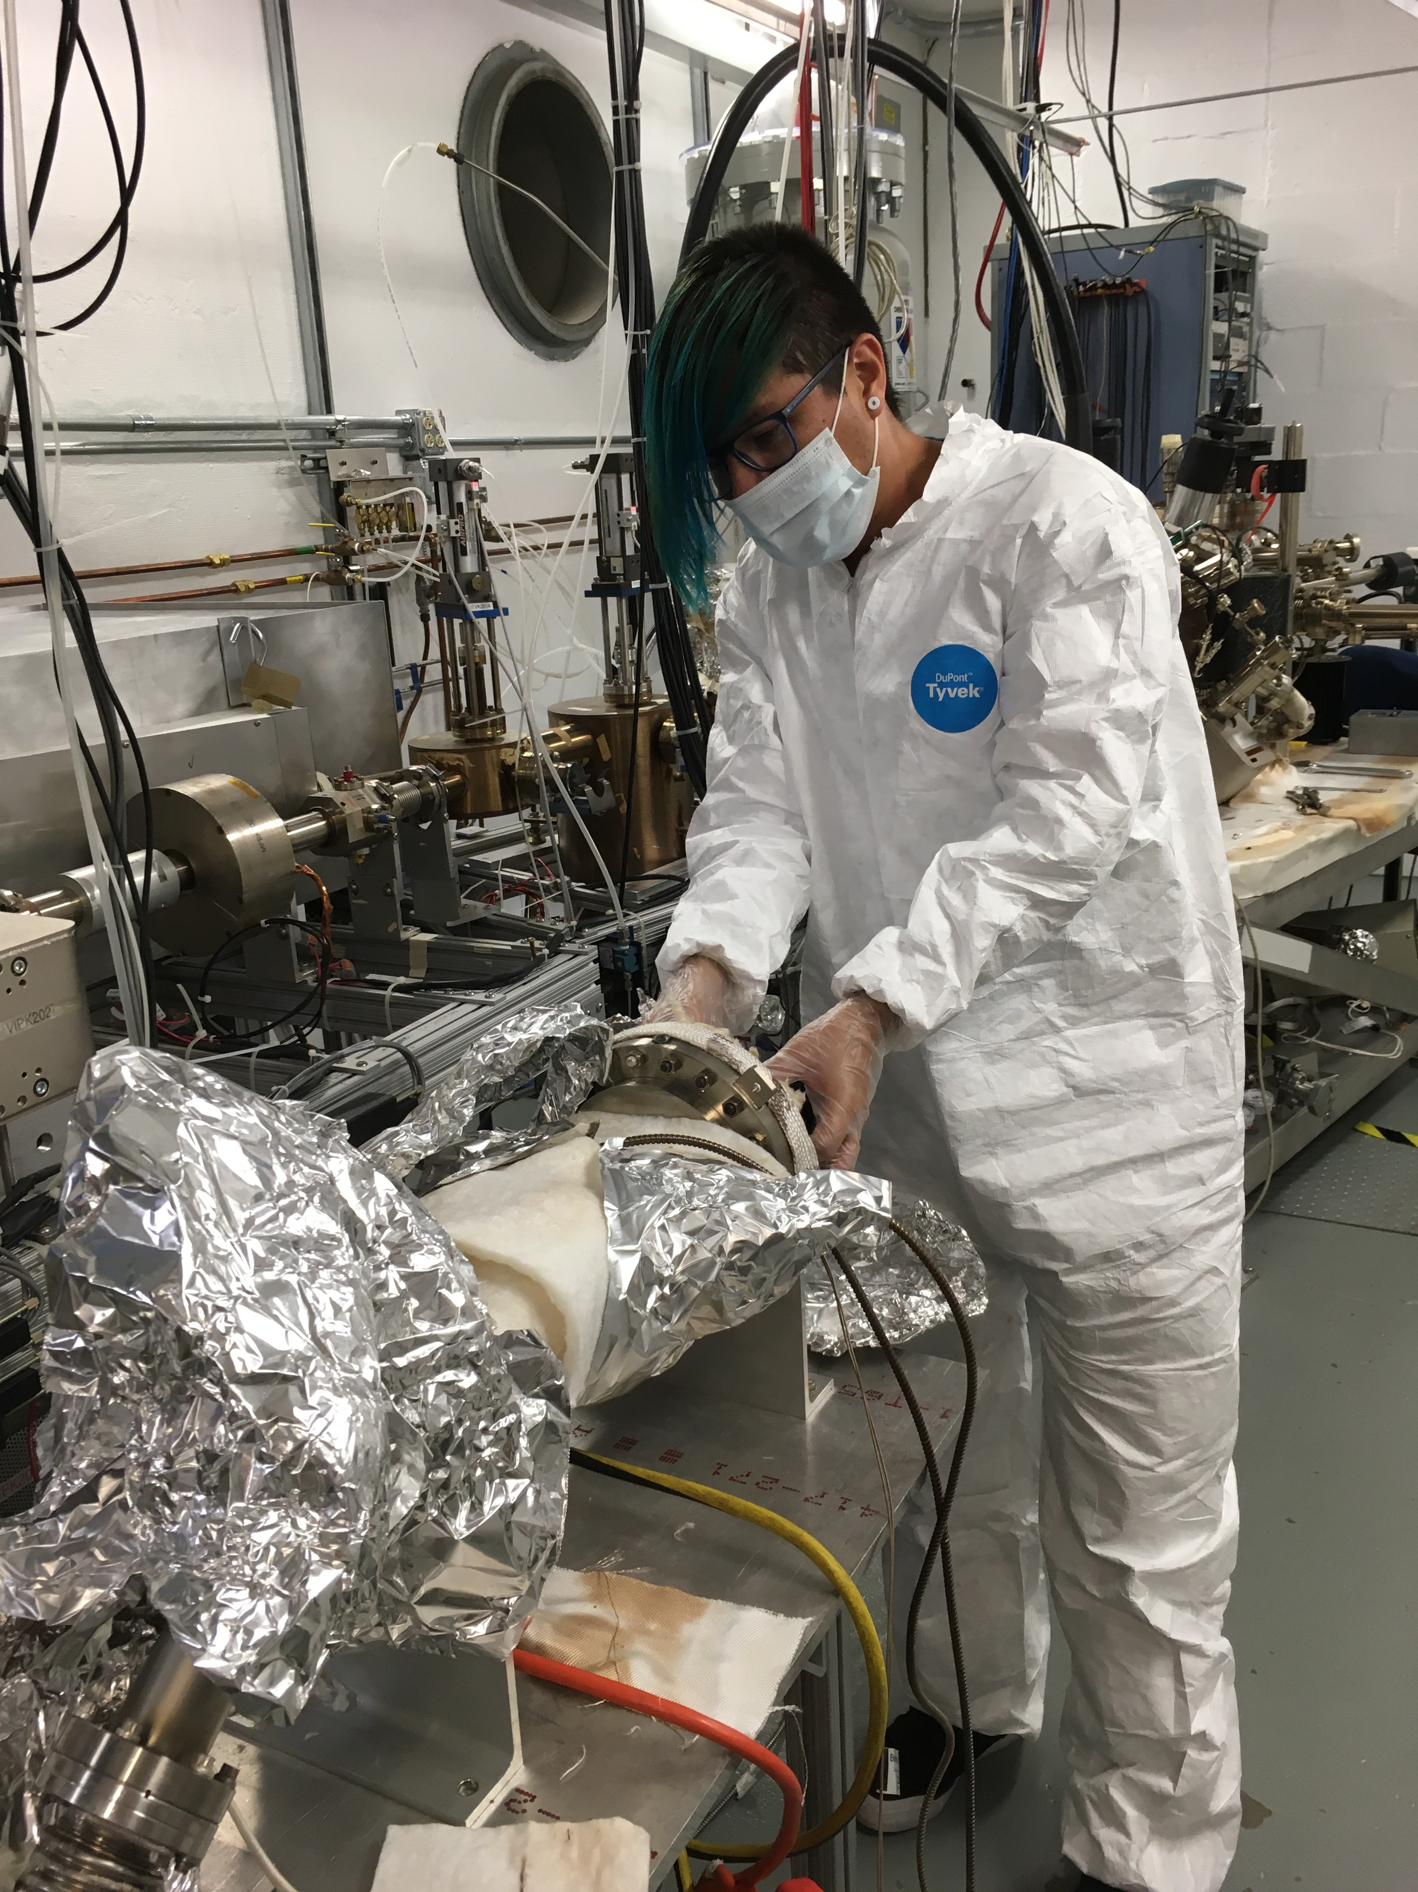
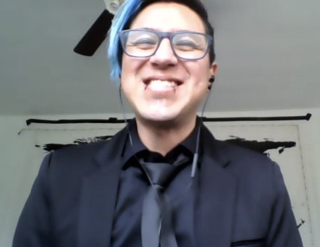
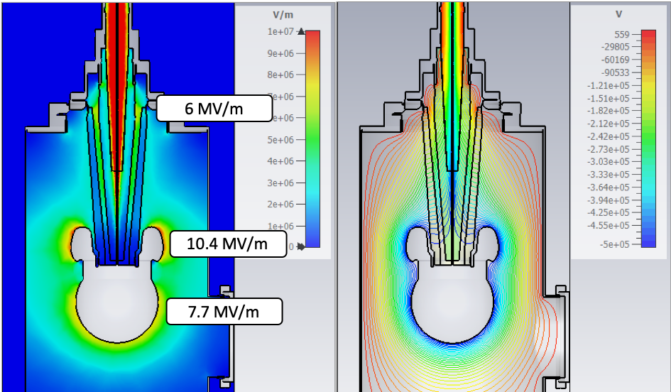
Progress: program
Gabriel Palacios-Serrano was hired as a postdoctoral fellow on 06/16/21
CST EM studio + Solidworks procured on 04/15/21
Electrostatic model with modified HV receptacle and intervening SF₆ layer completed
Electrostatic design of electrode + triple point junction shield (to prevent arcing) completed
SF₆ intervening layer
Model and simulations by Gabriel for 500 kV

Slide 6
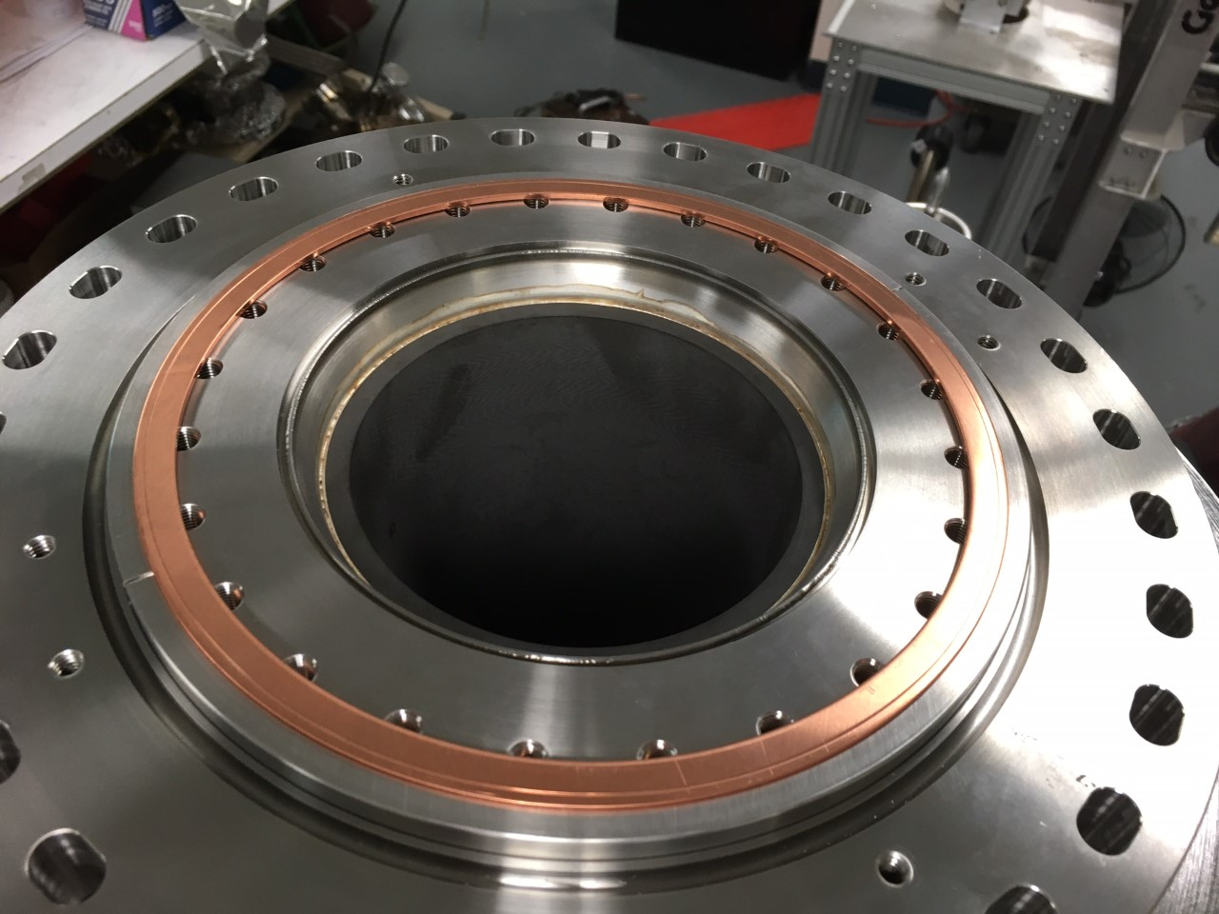
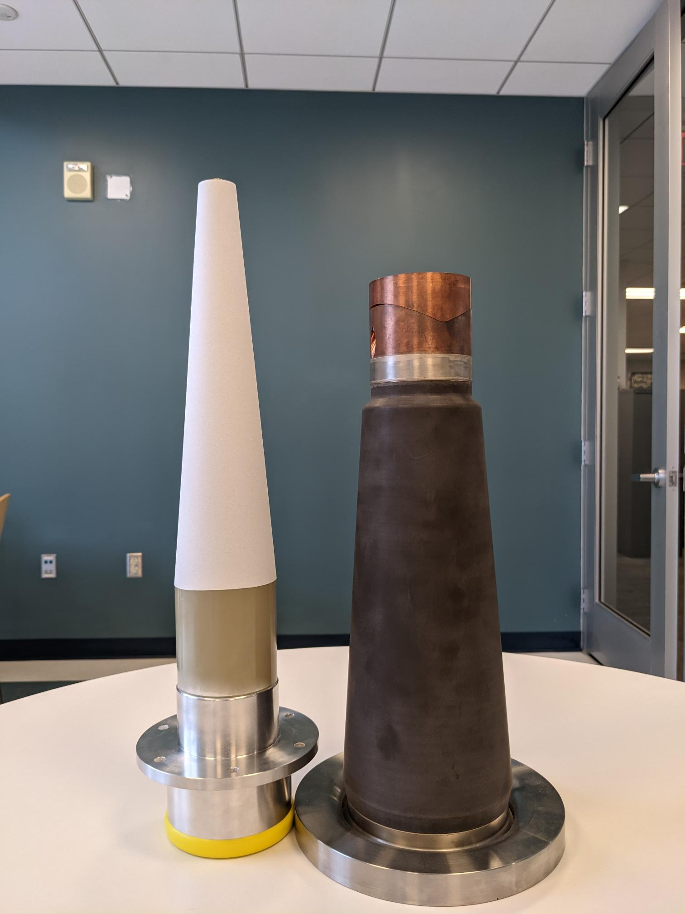
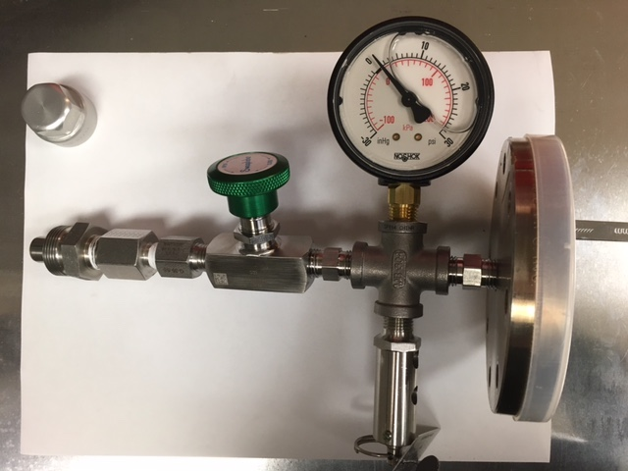
Progress: equipment and components
(6 insulators made in 2010*)
Insulator has been welded to its flange
Insulator assembly has been bolted to the HV test chamber
HV receptacle has been machined to fit into the ceramic insulator
HV test chamber has been pressure tested for 10 PSIG operations (Casey Heck at Cryo)
Relief valves (D. Meekins) have been verified to open at 12 PSIG (Casey Heck)
Pumpdown/SF₆ backfilling manifold has been designed and built
Top hat SF₆ reservoir has been designed and is being manufactured
HV assembly test chamber pressure test + components have been documented in the pressure systems folder as an alteration to DILO SF₆ gas handling system (Chase Dubbe)
* F. Hannon et al., Int’l. Particle Accelerator Conf., Kyoto, Japan, pp. 383-385, 2010.

Slide 7
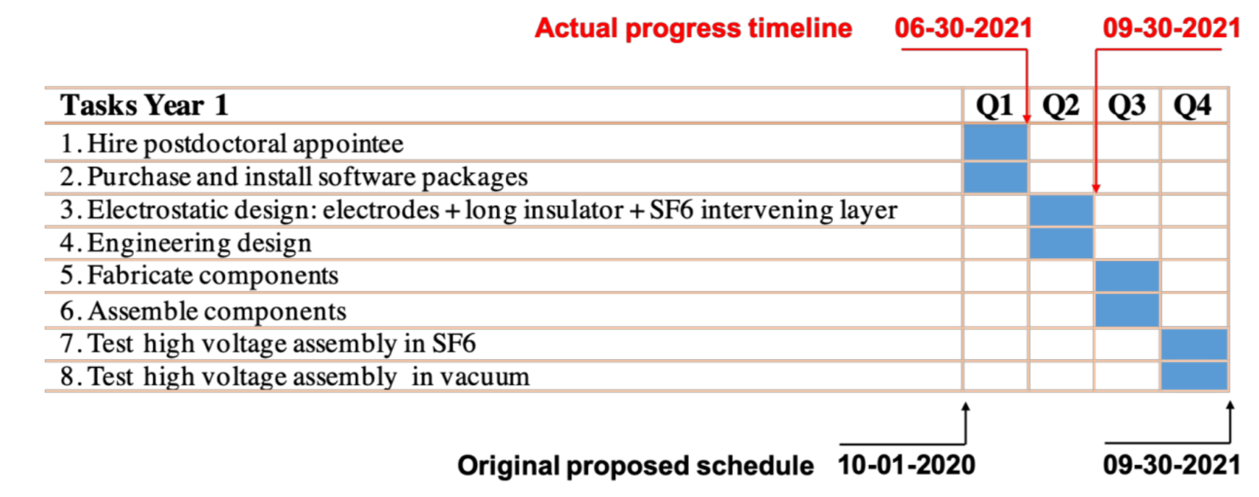
Concerns
Difficulty in filling the postdoctoral position effectively delayed the start of the project by 6 months
We are experiencing supply chain issues with custom HV components. Dielectric Sciences is keen to work with us on this project, but they are overwhelmed with back orders. This might become a serious delay in starting high voltage tests if not resolved
Some delay in components design experienced due to limited available time by ME matrixed labor
Complete
In progress
To complete

Slide 8
Budget
 | FY 2020 (k$) | FY 2021 (k$) | FY 2022 (k$) | FY 2023 Carryover (k$) | Total (k$)
Funds allocated | 269.4 | 269.4 | 0 | 0 | 538.8
Actual cost to 11/29/21 | 135.9 | 0
Estimate to complete |  |  | 309.5 | 93.4 | 402.9
FY 2022 schedule: optimistic, highly dependent on vendor custom HV components
In progress
To complete

Slide 9
Summary / Questions?
Carlos Hernandez-Garcia
chgarcia@jlab.org
Project objective: Design & test 500 kV insulator/cable connector approach to provide HV conditioning margin for implementation in a 400 kV DC photogun
Motivation: Design and build 400 kV photogun to generate high bunch charge 10 mA CW spin-polarized electron beams for positron production.
This photogun design could satisfy the ILC and EIC high bunch charge spin-polarized beam requirements.
Project concerns:
Difficulty in filling the postdoctoral position effectively delayed the start of the project by 6 months
Supply chain issues with sole custom HV components US vendor are starting to impact project schedule
Project deliverables:
Robust HV connector approach for 500 kV without breakdown
Prototype 500 kV feedthrough design that fits commercial cable for potential SBIR with US insulator manufacturer

Slide 10
Backup slides

Slide 11
Challenge
An envisioned 400 kV DC photogun design requires reliable 500 kV feedthrough to provide margin for high voltage conditioning
There is no inverted insulator feedthrough capable of 500 kV that fits commercial cable connectors
Commercial cable connectors are rated to ~ 400 kV max in SF₆, and have never been tested > 350 kV connected to inverted insulators in vacuum*
Vendor recommends using Mega-volt cable, but there are no connectors for this type of cable

Slide 12
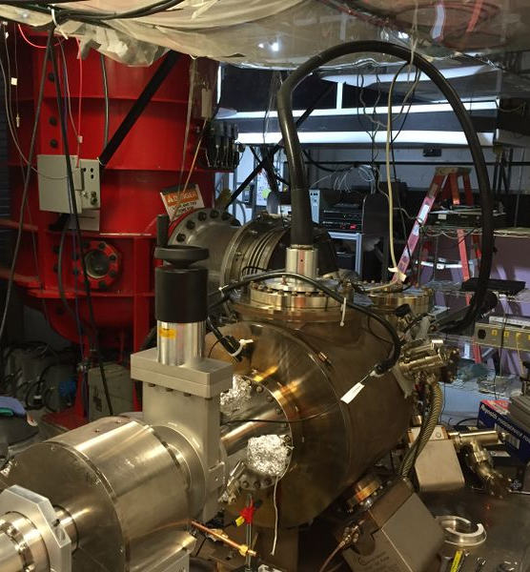
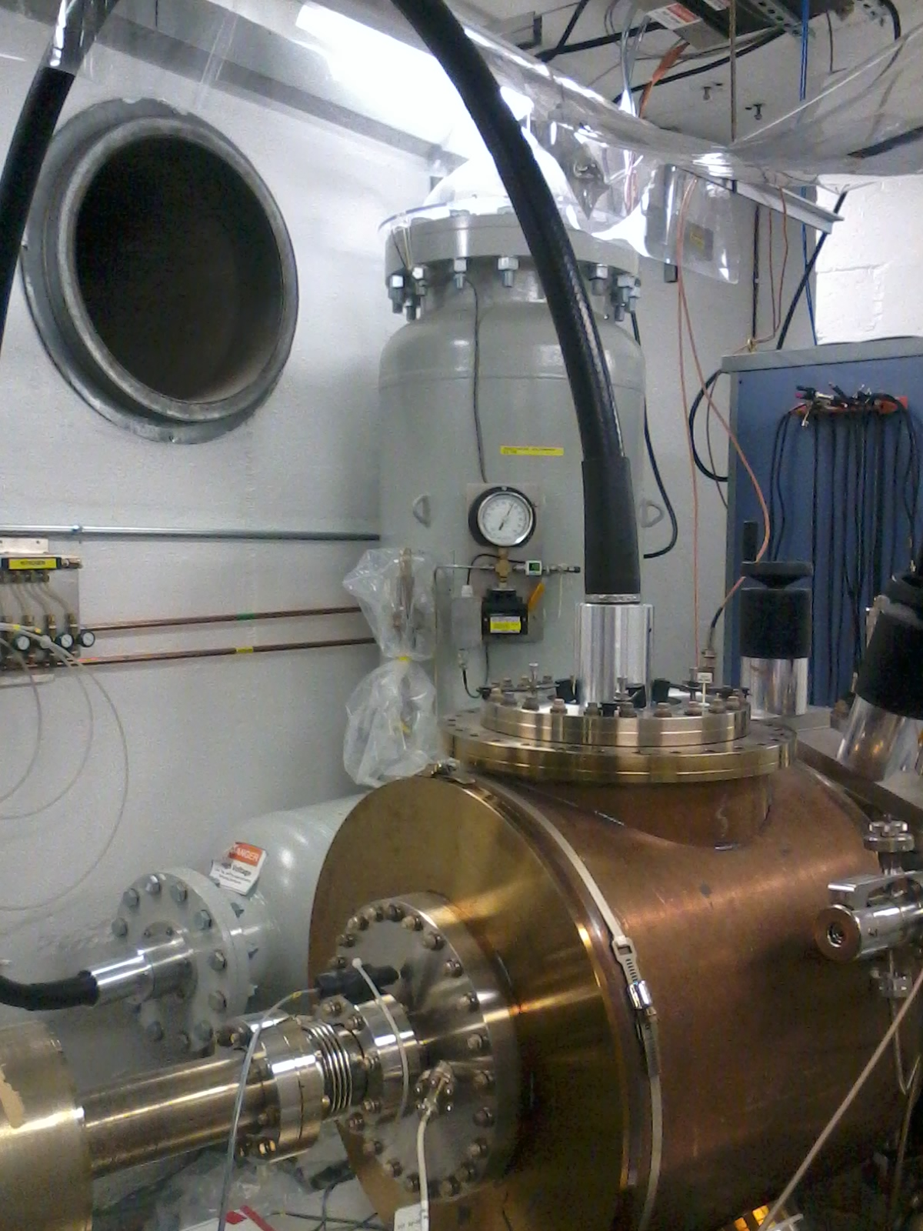
JLab inverted insulator photoguns use commercial HV cables
UITF 200 kV
CEBAF 200 kV
GTS 300 kV
400kV power supply
500kV power supply
HV cable
HV cable
HV cable
photogun
450kV power supply
photogun
photogun

Slide 13
The large inverted insulators were made for a 500 kV gun connected directly to the HVPS

Slide 14
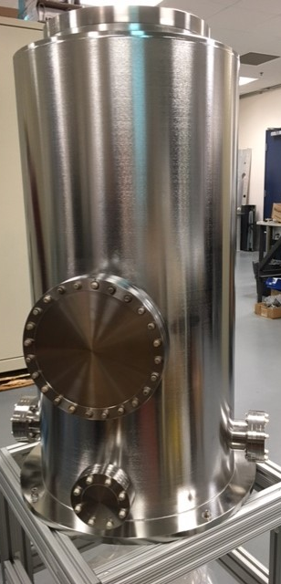
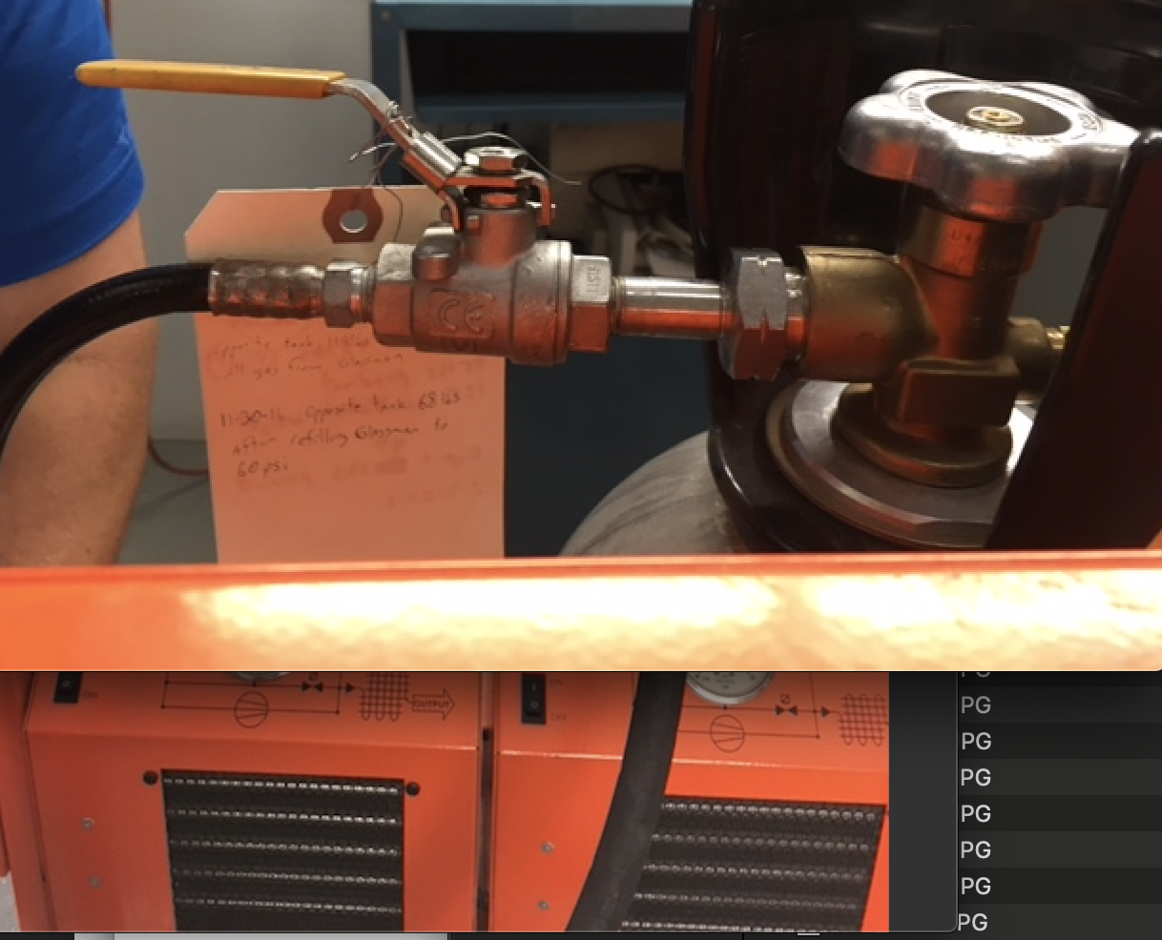
SF6 gas recovery / backfill system to prevent SF₆ losses
We use a commercial SF₆ gas recovery / backfill system to transfer SF₆ from the high voltage apparatus (power supply, resistor tank, test chamber) into storage bottles.
The gas is pushed into the bottles via two compressors
The high voltage apparatus is vented to atmosphere when the compressor inlet pressure reads 30 in-Hg vacuum
Once work is complete, we use a vacuum pump to evacuate the high voltage apparatus to 30 in-Hg
Then the SF₆ is transferred back from the storage bottles to the high voltage apparatus using a regulator integrated to the transfer system

Slide 15
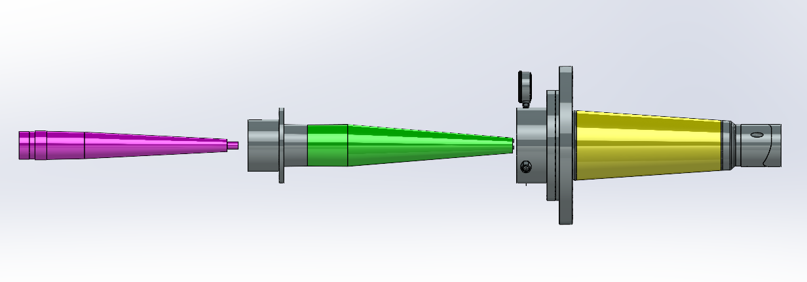
Progress: electrostatic simulations
The simulations show how the shielding electrode is critical in minimizing the electric field at the triple junction (metal-insulator-vacuum)
Insulator electrical breakdown is thought to originate at the triple junction by high electric field parallel to the surface of the insulator
The shape and size of the shielding electrode was optimized to minimize electric field at the cusp, thus reducing risk of field emission
Inverted ceramic insulator
Modified epoxy receptacle
HV cable
Model and simulations by Gabriel for 500 kV

Slide 16
Electrostatic simulations: Potential and radial electric field along insulator
The potential along the insulator is more linear with
the triple point junction shield
The radial electric field is lower overall with
the triple point junction shield
Simulations by Gabriel for 500 kV

Slide 17
Progress: electrostatic simulations
Varying dielectric constants in each material component induce discontinuities in the radial electric field
The implications of this effect will be studied in upcoming high voltage tests with the two planned connector configurations
Simulations by Gabriel for 500 kV

