Slide 1
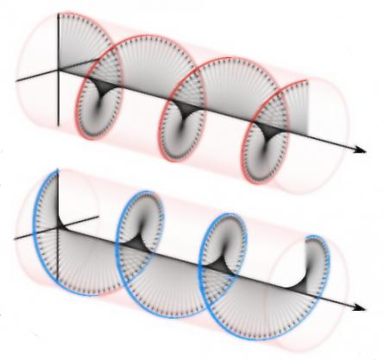
High Level Description of HV Driver and RTP Electro-Optic Cell at CEBAF
HV (x4) toggles laser between two helicity states (+,-)
+
-
-
+
RTP
Helicity
Pattern
DAC
16-bit
10V
Analog
Isolation
HVPS
(x8)
HV
Opto Switches
(x4)
Electro-Optic
RTP
Cell
x8
x8
x8
x4

Slide 2
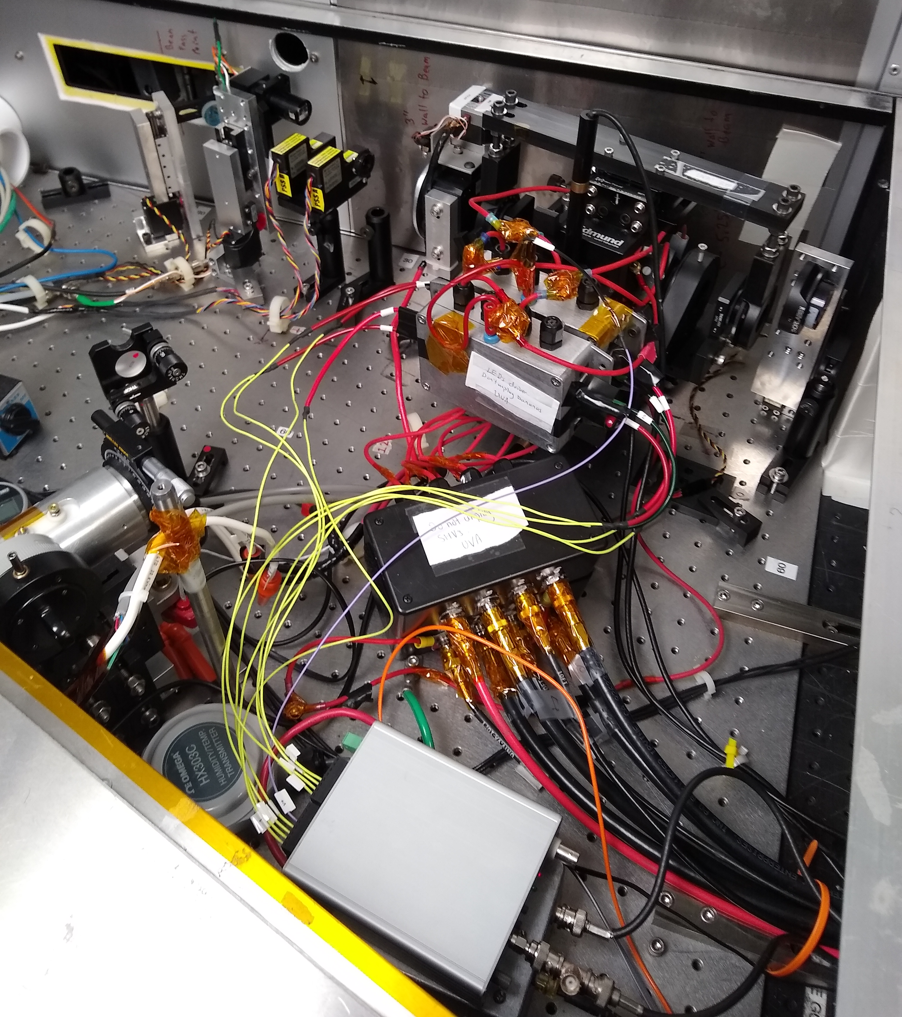
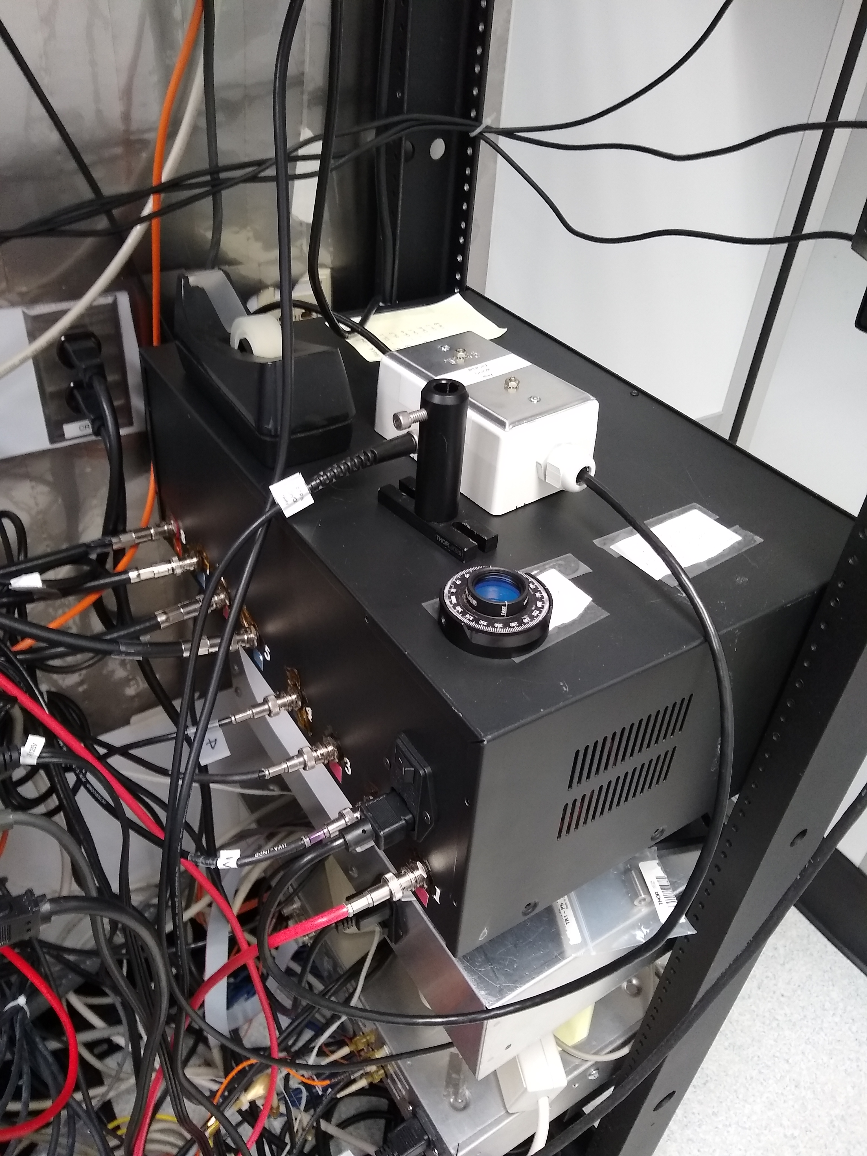
January 2019 Installation at CEBAF

Slide 3
Scope of Work
Helicity
Pattern
DAC
16-bit
10V
Analog
Isolation
HVPS
(x8)
HV
Opto Switches
(x4)
Electro-Optic
RTP
Cell
x8
x8
x8
x4
Configure 0-5V; April SAD
Design new rack mounted chassis for grounded rack, but w/ internal isolation.
Re-use same DACs, but move analog isolation from ISB to chassis.
Re-use same HV blocks in design.
Need HV cables dressed from rack to laser table.
Design new HV switch board, sits beside RTP inside laser box.
Include x4 dragon drivers + controller (receives helicity).
Each dragon gets 2 LED’s w/ voltage POT adjust.
Window or photodiode to monitor LED’s
Incorporate RC circuit to control HV rise time.
Quick connects from between driver and cell (x4) + ground; (HV banana plugs?)
1. Adapt to receive quick connects.

