Slide 1
Simulation of Emittance
Yan
April 2, 2018

Slide 2
GPT Simulation
Use GPT to simulate the gun and beamline.
Scan the laser across the photocathode up and down, and left and right.
Get the emittance at the location where the lens is.
y
x

Slide 3
GPT Simulation
Gun HV: 200kV
Gun field map: 3D map generated by Gabriel
Emittance calculated at the first lens: 50cm from the photocathode

Slide 4
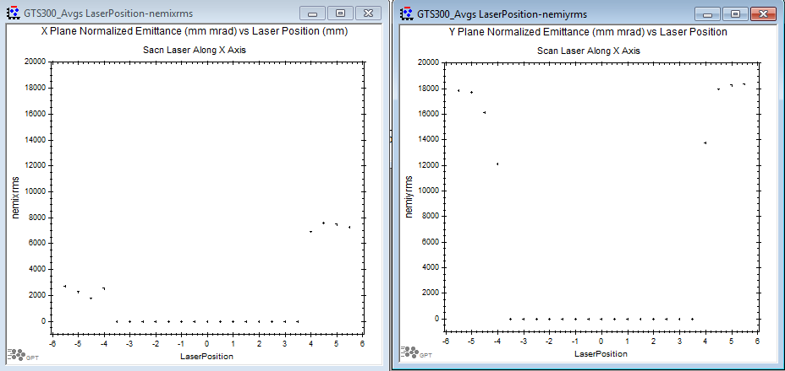
Scan Laser Along X Axis

Slide 5
Scan Laser Along X Axis - Zoom in

Slide 6
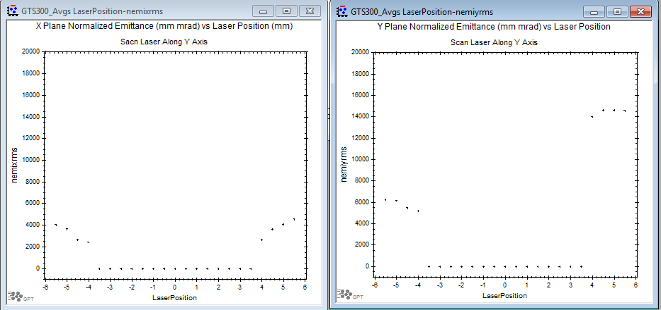
Scan laser Along Y Axis

Slide 7
Scan Laser Along Y Axis - Zoom in

Slide 8
Comparison of X and Y Scans

Slide 9
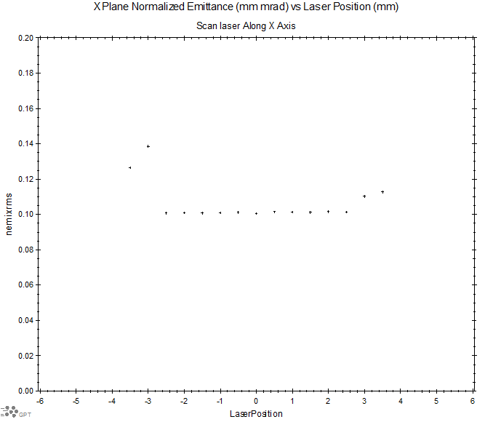
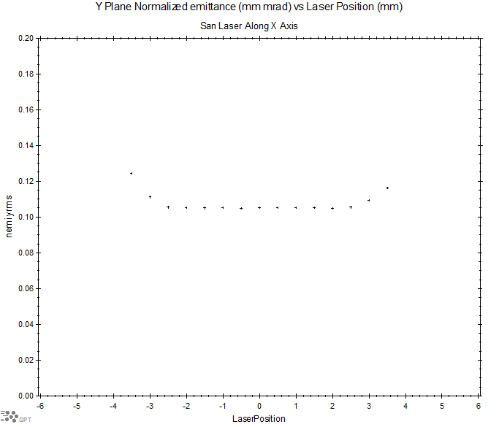


Comparison of X and Y Scans – Zoom in

Slide 10
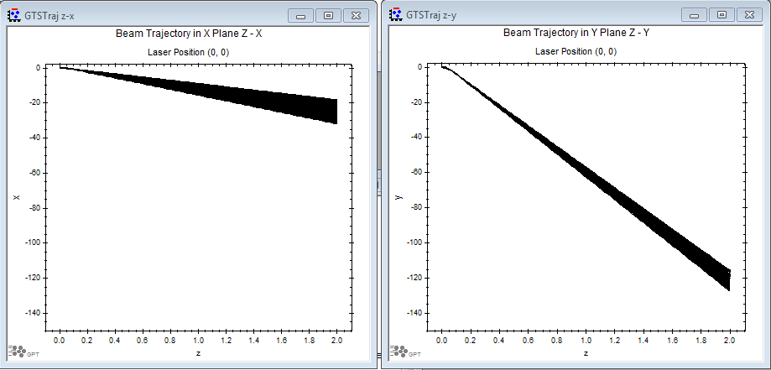
Beam Trajectory with Laser at (0, 0) mm

Slide 11
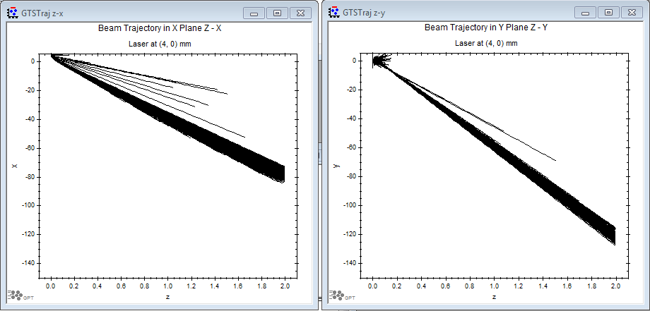
Beam Trajectory with Laser at (4, 0) mm

Slide 12
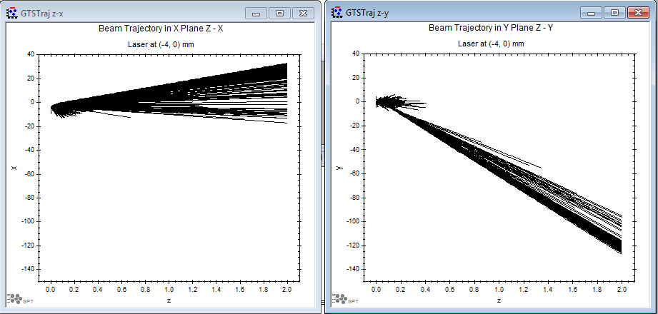
Beam Trajectory with Laser at (-4, 0) mm

Slide 13
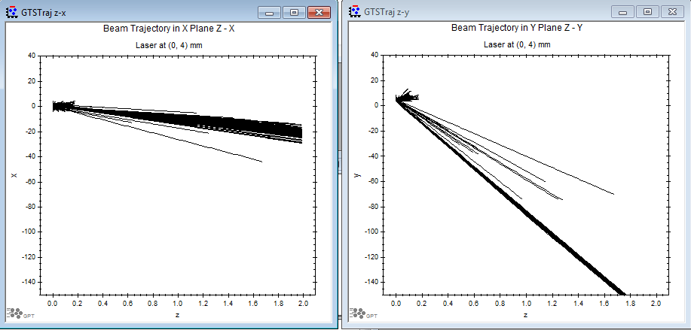
Beam Trajectory with Laser at (0, 4) mm

Slide 14
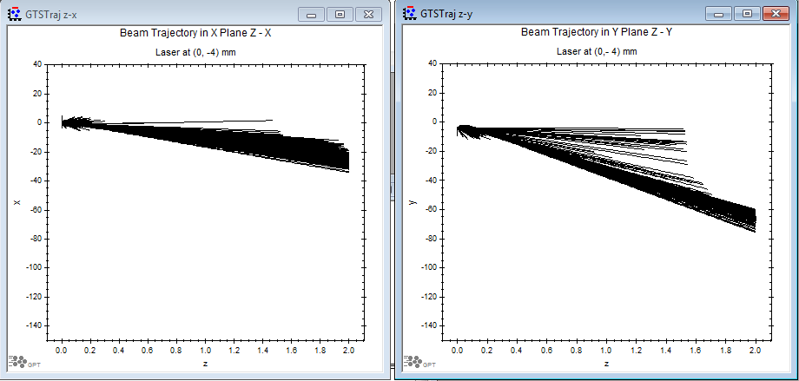
Beam Trajectory with Laser at (0, -4) mm

Slide 15
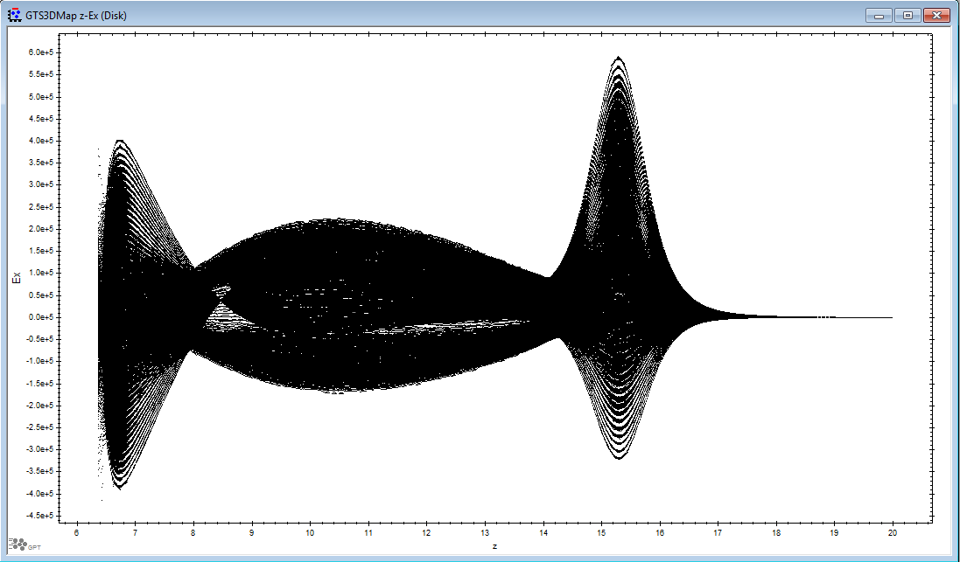
Field Map Z - Ex

Slide 16
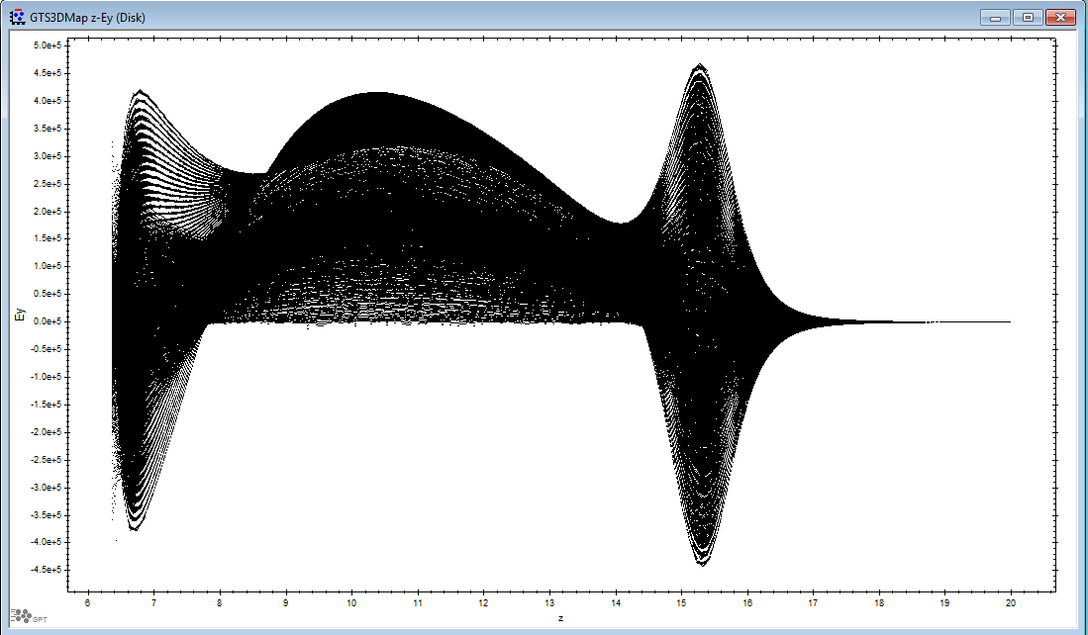
Field Map Z - Ey

Slide 17
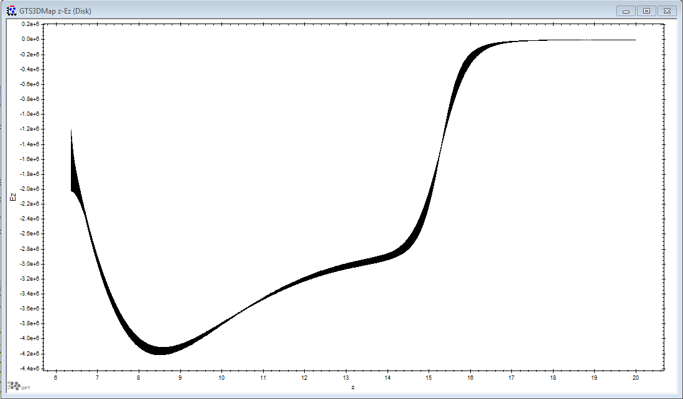
Field Map Z - Ez

