Slide 1

LD #2104 - A polarized positron source for our future
This LDRD proposal addresses the most critical aspect of positron beams at CEBAF, the positron source.
Joe Grames

Slide 2
Motivation and benefit to Jefferson Lab
Our Users have made a strong case for positron beams at CEBAF 12 GeV
A complementary charge and spin of e+ would provide a new and unique probes for Jefferson Lab
The Jefferson Lab Users Positron Working Group (now 250 members from 75 institutions) is asking Jefferson Lab to consider experiments with both polarized and unpolarized positrons beams:
2018 – 7 letters of intent to PAC
2020 – 2 conditionally approved proposals Halls B & C
2021 – community has described many years of floor-time experiments, summarized in soon to appear “e+ @ JLab” White Paper in EPJ A

Slide 3
A pivotal experiment – PEPPo
Generating polarized positrons is very challenging
  The presently accepted best method in the world imagines building a 150 GeV beam and passing it through nearly a mile of soda-straw helical undulators
  We recognized we can “squeeze” the polarization out of CEBAF polarized e- beam, not unlike selecting light from a prism

Slide 4
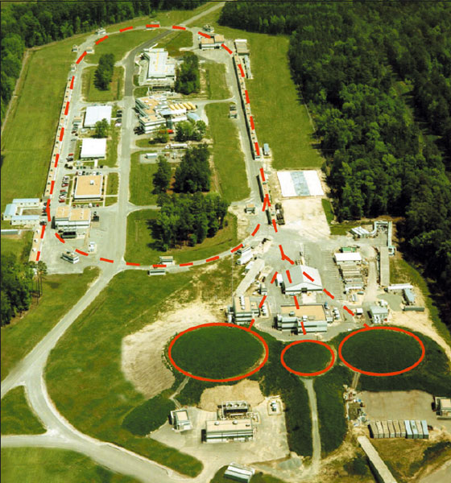
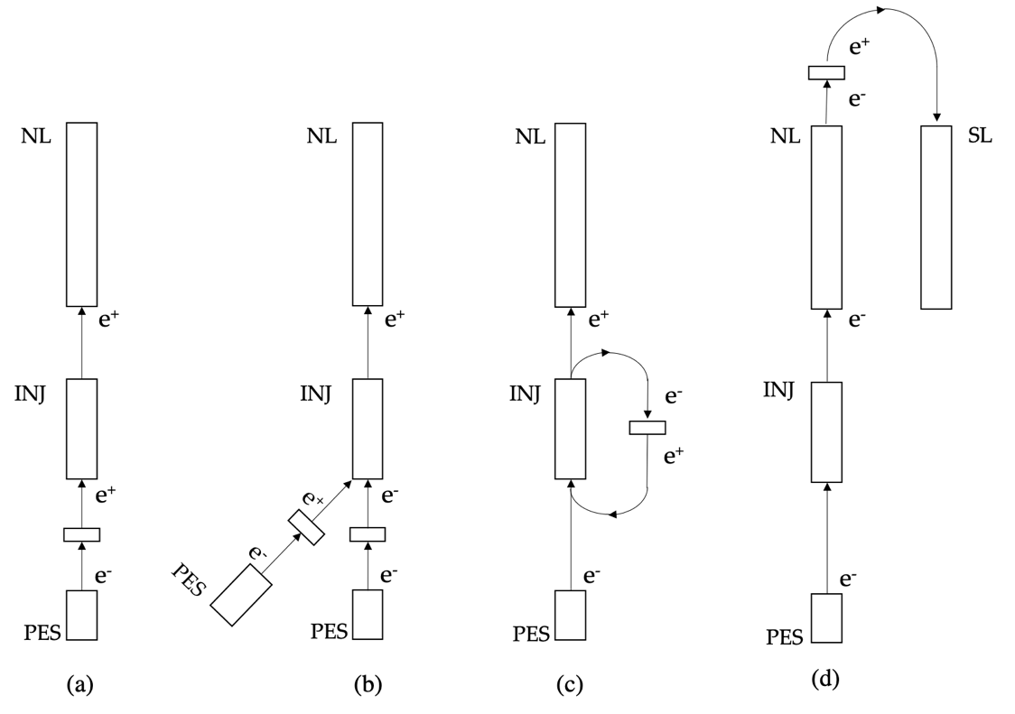
Mother Nature is on our side
PEPPo works with any electron beam energy (>1 MeV)
  Flexibility allows us to be imaginative, and to exploit the best integration at CEBAF
  The Yield (e+/e-) depends on beam power, a compromise in Beam Current x Beam Energy

Slide 5



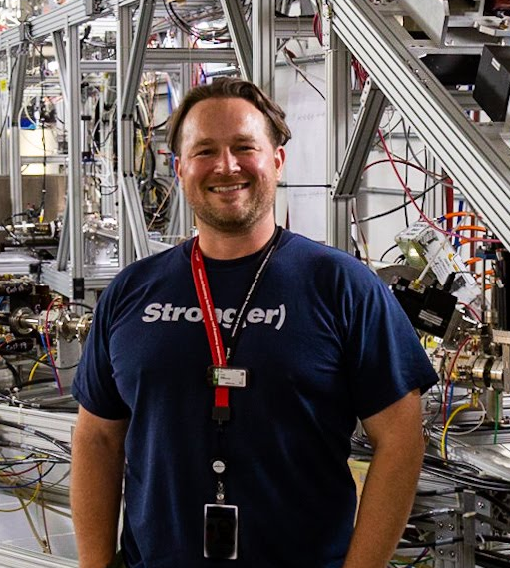
LDRD #2104 deliverables (2 year)
Our Year 1 objectives
Build a team!
Evaluate PEPPo production for CEBAF
Develop sophisticated spin-optimization software
Prove a conceptual layout “holds water”
Alicia Hofler
Ops Scientist
Sami Habet
IJCLab PhD Student
Mark Stefani
CIS Post-doc
Riad Suleiman
CIS Scientist
Ryan Bodenstein
CASA Scientist

Slide 6
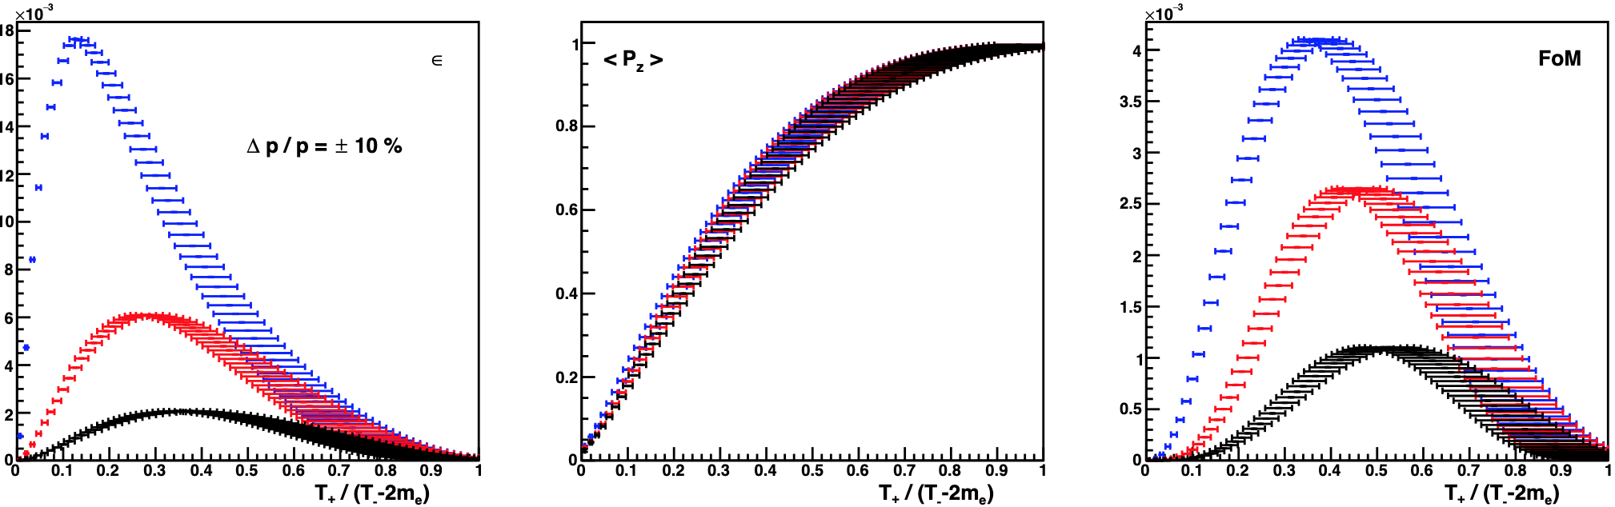
Geant4 optimization of positron production – work of Sami Habet
The positron flux produced by an electron beam was evaluated extensively with CEBAF range of energies within various thicknesses of a prototype tungsten target with focus on 123 MeV scheme
Unpolarized positron beams (like all previous accelerators) optimize on efficiency (e+/e-)
At JLab we also optimize on polarized Figure of Merit (efficiency X polarization²)
Yield
Polarization
Figure of Merit
E = 120 MeV
t = 4 mm
Δp/p = ±10%

Slide 7
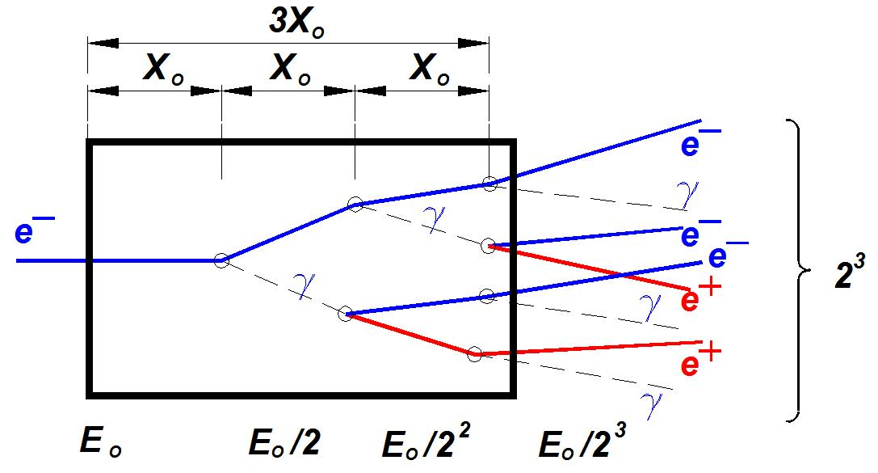
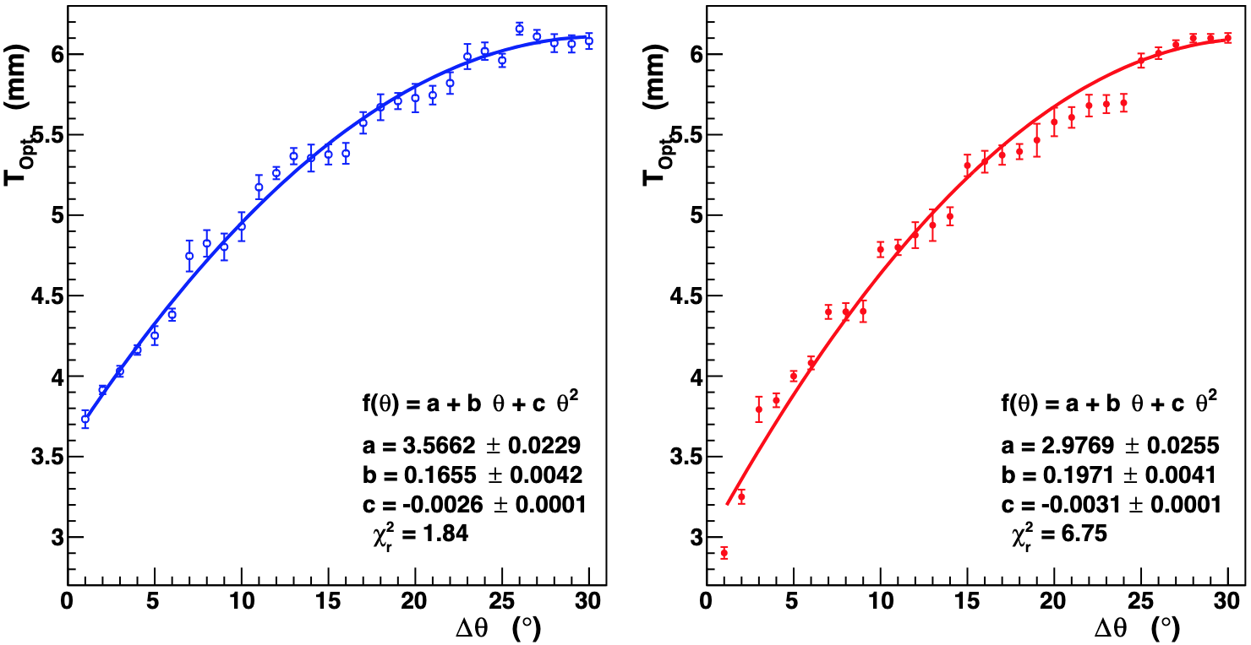
Geant 4 optimization of positron production – work of Sami Habet
The optimum target thickness and beam spot size is critical
Too thin and the electron energy is not well spent
Too thick and positrons are absorbed
For the PEPPo demo experiment we focused on polarization transfer of a single target.
In this LDRD we learned to appreciate how closely our target parameters are tied to the optimum target thickness.

Slide 8
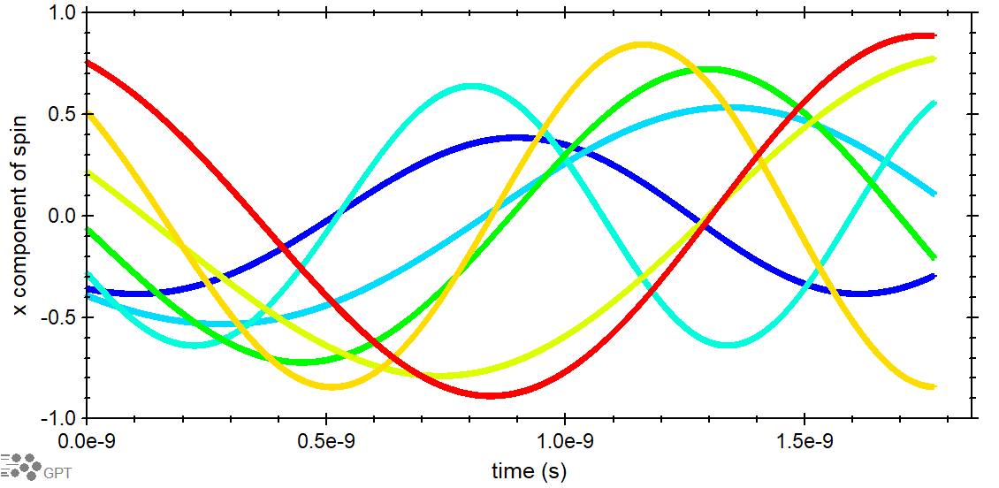
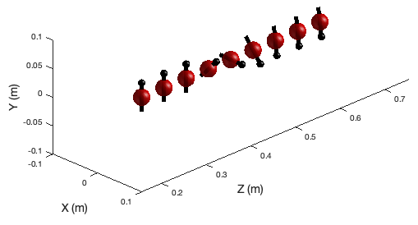
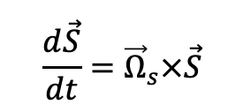
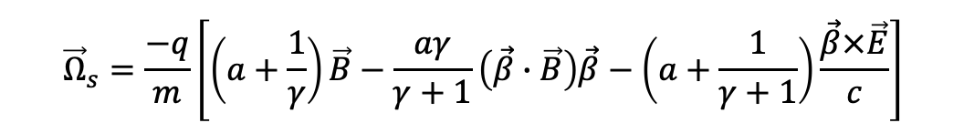
“GPT –s” – work of Mark Stefani and Riad Suleiman
Sophisticated commercial software GPT is used to track the swarm of positrons
a genetic algorithm negotiates the non-linear parameters to optimize collecting particle orbits
to “follow the spin” trajectories the Thomas-BMT equation was implemented to the code and tested
$$\frac{d\vec{S}}{dt}={\vec{Ω}}_{s}×\vec{S}$$
$${\vec{Ω}}_{s}=\frac{−q}{m}\left[\left(a+\frac{1}{γ}\right)\vec{B}−\frac{aγ}{γ+1}\left(\vec{β}∙\vec{B}\right)\vec{β}−\left(a+\frac{1}{γ+1}\right)\frac{\vec{β}×\vec{E}}{c}\right]$$
“GPT –s” fully developed for Windows and will be launched very soon on the lab’s Scientific Computing platform

Slide 9
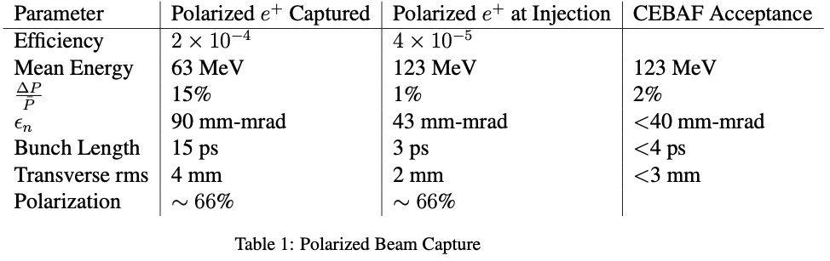
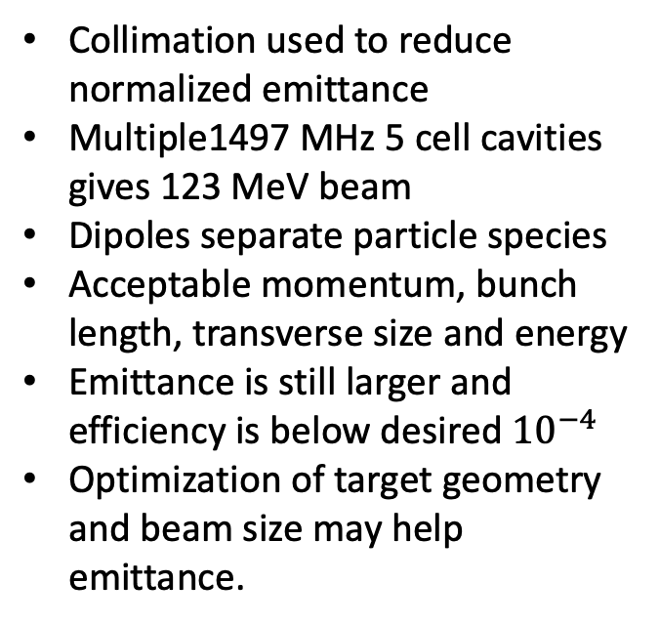
Polarized Positron Capture for CEBAF – work of Mark Stefani
Collimation used to reduce normalized emittance
Multiple1497 MHz 5 cell cavities gives 123 MeV beam
Dipoles separate particle species
Acceptable momentum, bunch length, transverse size and energy
Emittance is still larger and efficiency is below desired ${10}^{−4}$
Optimization of target geometry and beam size may help emittance.
Legend
Target
Conical Solenoid
Solenoid
Quadrupole
Dipole
Collimator/dump
RF Cavity

Slide 10
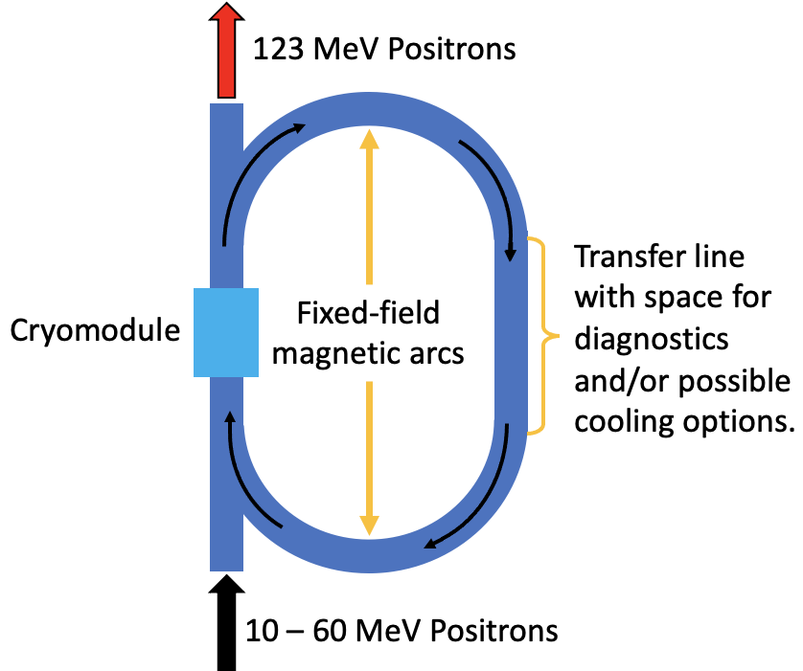
Alternative e+ acceleration scheme – work of Ryan Bodenstein
Traditional e+ acceleration requires protecting many SRF cavities from unintentional beam losses
  Can be expensive and limits collection.
An alternative recirculates e+ through a single protected SRF cavity several times.
  Fixed Field Alternating Gradient (FFA) technology uses fixed-field, multipurpose magnets to transport a wide range of energies through the same transport line.
    Can also use permanent magnets.
In Year 2 we will evaluate FFA against traditional single-pass injection.
Currently looking into the ability to cool the positron beam during recirculation.

Slide 11
Positron R&D – Year 2
The first year of the LDRD proved so successful we’re wrapping up early!
  Starting Oct 1 2021 the projected transitioned to a full research and development project in the lab’s accelerator division
  This will open up the project to more collaborators, both at the lab and internationally
Growing our Jefferson Lab e+ collaboration
  Team up with CASA and BNL colleagues to explore FFA and e+ w/ CEBAF energy upgrade
  Evaluate with SRF Institute options for compact 10 mA + 100 MeV SRF electron booster
  Strengthen collaboration with IJCLab (France) scientists to evaluate high power radiator targets
  Foster SBIR proposals to build and test fundamental concepts for CW positron converter target
  Invite new e+ accelerator physics collaboration with Mexican Universities
  Grow JLab’s potential partnership with the ILC Positron working group

Slide 12

Bird’s eye view of a cw polarized positron accelerator at JLab – thank you!
Beam Energy: 11 GeV (ABC) + D
Unpolarized e+ Beams: > 1 uA
Polarized e+ Beams: > 50 nA (>60%)
Duty Factor: 100% (cw)
Fast/Slow Helicity Reversal: Yes
6d emittance: Optimized vs. Yield
4-Halls: Yes (ABCD)
Radiological: Minimized footprint
Operations: “Drives like CEBAF”
Beams: e+ or e- (primary or secondary)
Magnets: Switched power supplies
Reliability: Similar to e- beam

