Slide 1
Welcome + Thoughts on Past and Future Workshops
M. Poelker
International Workshop on Polarized Sources, Targets & Polarimetry, Oct 16-20, 2017
Korea Advanced Institute of Science and Technology (KAIST), Daejeon, Republic of Korea

Slide 2
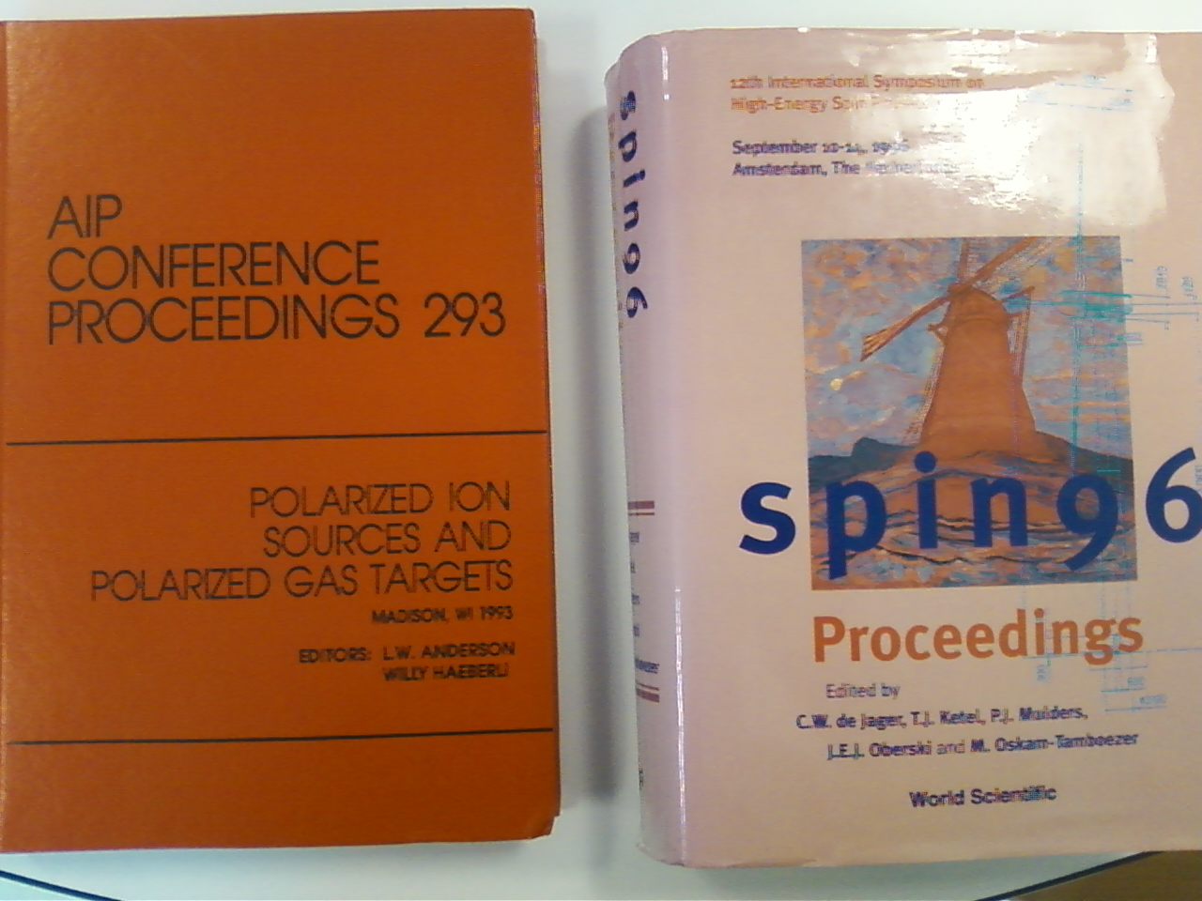
PSTP and PESP– the best workshops ever!

Slide 3
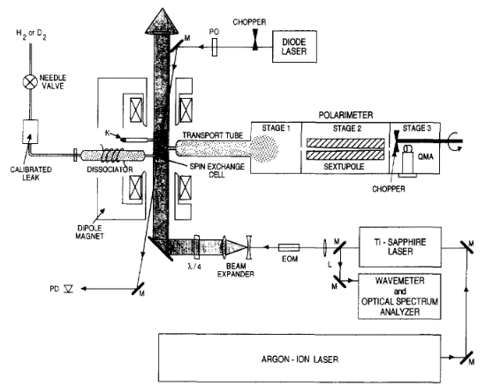
1993
Wilmer Anderson and Thad Walker explained our results as being related to “spin temperature populations”, direct polarization of H and D nuclei…

Slide 4
an opportunity to…
Broaden our horizons, learn about exciting new challenges
Meet others who like working with hardware, get advice and give advice, solve problems
Enable new physics with our breakthroughs

Slide 5
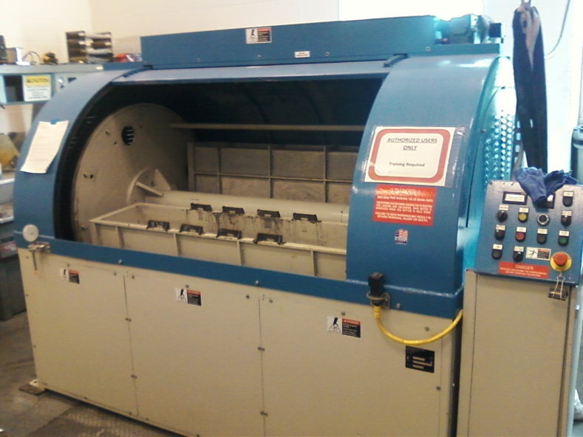
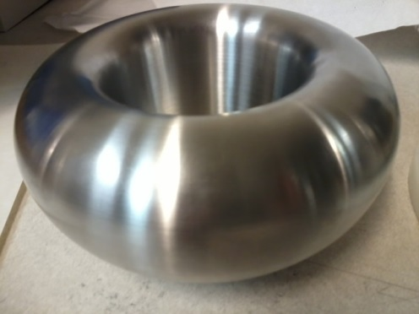
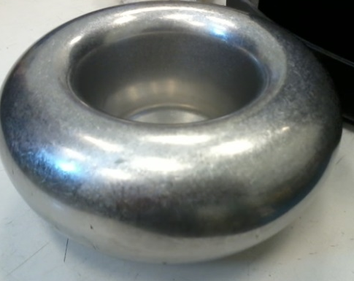
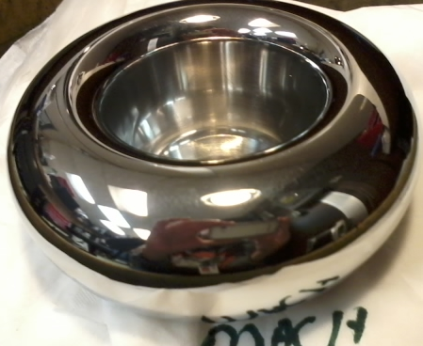
Barrel polished electrodes…
Gun electrodes traditionally polished using sand paper and diamond paste
Tedious process, takes about 30 days to complete
Now performed in 1 day using SRF barrel polishing machine
From machine shop
30 minutes in plastic cones
30 minutes with corncob
C. Hernandez-Garcia, D. Bullard, F. Hannon, Y. Wang, and M. Poelker, “High voltage performance of a dc photoemission electron gun with centrifugal barrel-polished electrodes,” accepted Rev. Sci. Instrum, 22 August 2017

Slide 6
Looking through Proceedings of past workshops, there has been remarkable progress in sources, targets and polarimeters
Let’s keep this going! These workshops have an impact
Science Matters

