Slide 1
Re-scoping UITF
Matt Poelker
November 14, 2015

Slide 2
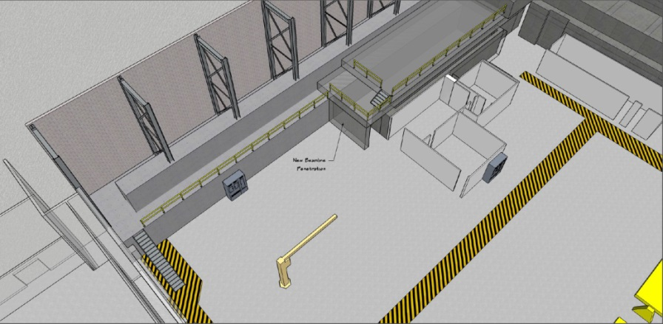
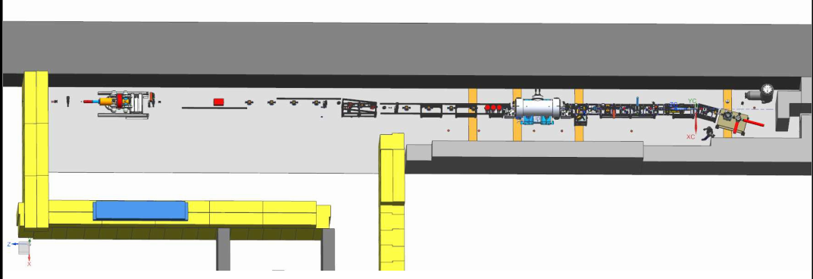
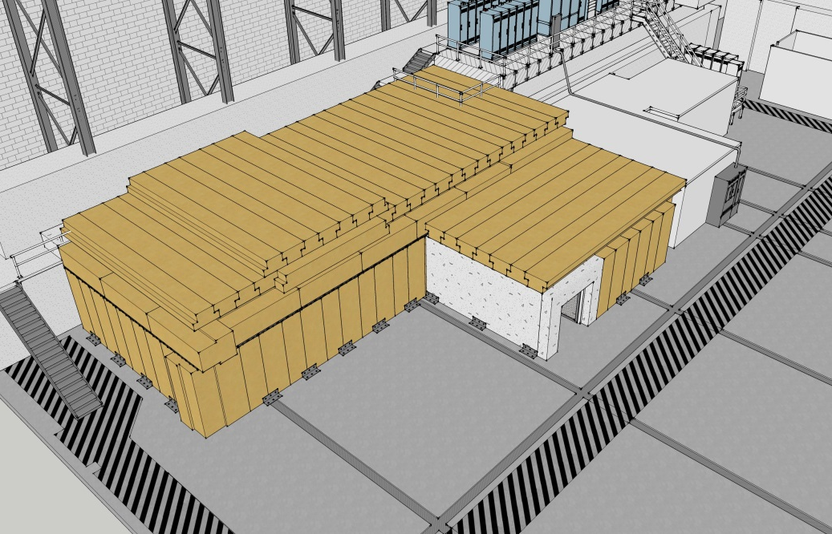
Proposed UITF re-scoped
Cryo Infrastructure
What we started with…
HDice
New UITF
Facilities
Cryo Infrastructure including some RF
HDIce (polarized target beamline)
New UITF
Facilities

Slide 3
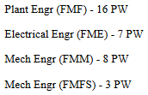
Facilities
Demolition
Stairs
Electric Cave1, top of Cave1, Cave2 and control room
Cave2 structure
Gate
Fire protection
Assorted (LCW, railings, etc.,)
Procurement Total: $269,000
Labor: $109,085 (34 PW)

Slide 4
Facilities
FY16 UITF Facilities Cost Estimate for Procurements (direct costs) – 13 Nov 2015
Structural:
Seismic Anchoring $ 30,000
Steel Pedestal (ODH vents) $ 8,000
Precast Concrete $ 56,000
Structural Total: $ 94,000
Architectural:
Entry Gate $ 5,000
Painting $ 5,000
Architectural Total: $ 10,000
Mechanical:
Compressed Air $ 4,000
Control Room HVAC $ 5,000
Mechanical Total: $ 9,000
Electrical:
Cave 1 Elec $ 78,000
Communications $18,000
Cave 2 Elec $ 50,000
Electrical Total: $ 146,000
Fire Protection:
Cave 2 $ 10,000
Fire Protection Total: $ 10,000
Project Total: $269,000

Slide 5
Cryo Infrastructure
Plumbing and controls to connect 1/4CM to CTF
Includes “spigots” near 1/4CM for supply and return to support other users, including HDIce or anything else needed in future.
Controls Procurement: $18 to 44
Controls Labor: $30.8 (14 PW)
Design and plumbing procurement $50 to 95
Design and plumbing labor $185.8 (97 PW)
Totals $68 to 139 and $216.6 (111 PW)
Some of this could move to “HDIce”

Slide 6
RF part of Cryo Infrastructure
Include within Cryo Infrastructure all RF (since the ¼ CM is no good without RF)
RF Procurement Total: $41k
RF Labor: $74.3 (34 PW)
This rf only for 1/4CM, more rf needed for new UITF (lasers, chopper, buncher, MO)

Slide 7
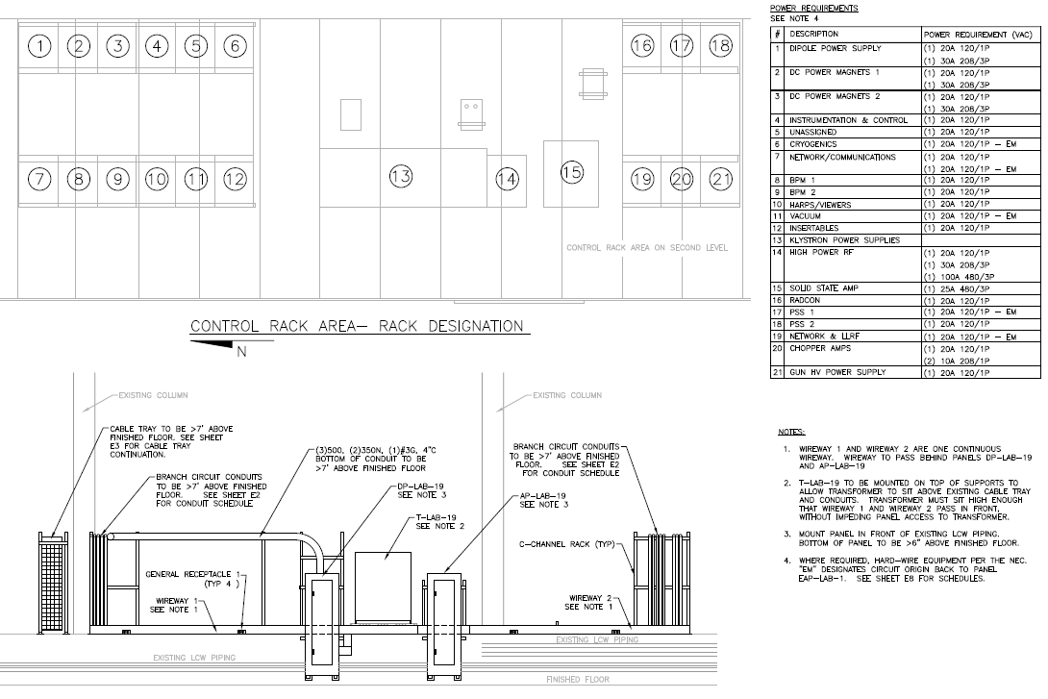
Cryo Infrastructure
To CTF
Cryo controls racks
RF

Slide 8
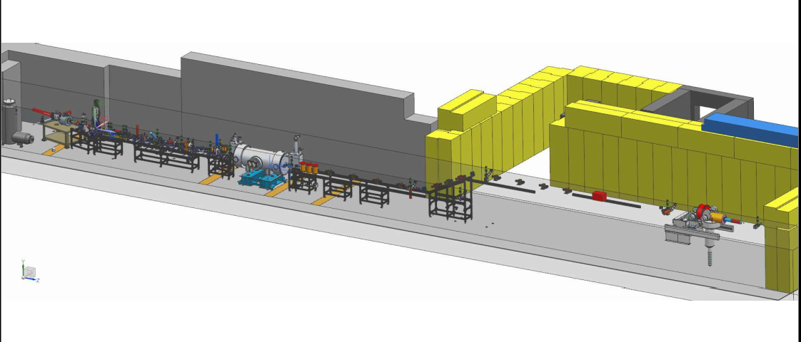
HDIce (polarized target beamline)
Designer for this part of beamline
Move some of the Cryo costs to here…
The hardware to build this part of beamline

Slide 9
HDIce (polarized target beamline)
 | To purchase in FY16
viewers | 15
MPS |  | Not defined yet
girder | 20
DC power | 60 | Trim cards…
Magnets |  | Three dipole magnets, two quads, steering magnets
Pneumatic valves
harp |  | Trying to find harp, magnets and valves….
Machine shop | 35
Total
3 months design time
Labor to put beamline together

Slide 10
New UITF re-scoped
Gun
Magnets
Viewers
Valves
BPMs
ODH and PSS
Network communications
Software
Rad Con

Slide 11
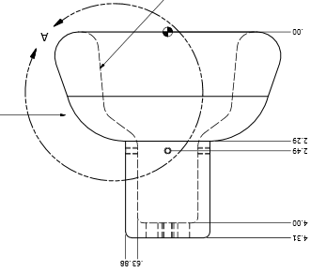
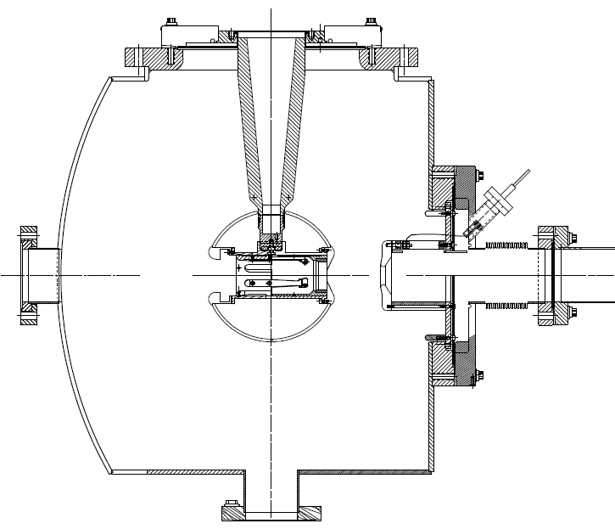
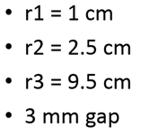
Getting the gun to work can incur costs
Combine the two features that provided incremental success: shed and doped insulator

Slide 12
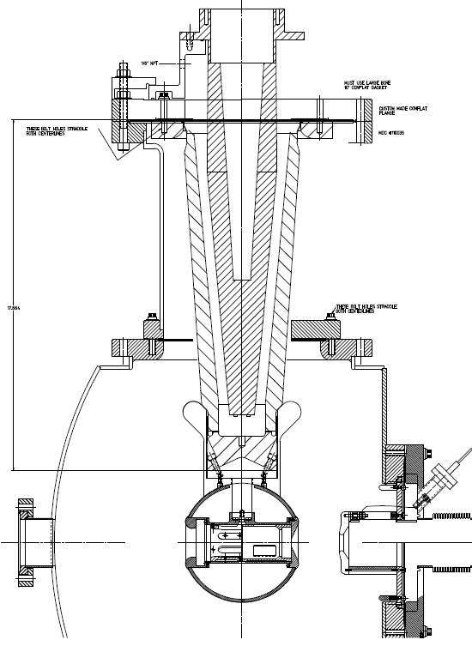
R350 epoxy receptacle
…then in October
Combination of doped insulator and shed, SF6 and epoxy receptacle, plus added length
Yan Wang has modeled the shed, a good design…
SF6
Doped insulator
“Shed” triple-point protection

Slide 13
New UITF Procurements
 | To purchase in FY16
Gun | 130 | includes beamline components
I&C | 211.9 | Some could get moved to HDIce portion
SSG | 44.7
DC power | 8 | cable
Magnets | 0 | Spectrometer dipole, trying to find one
Network | 32.5 | IOCs and network switcher
Machine shop | 40 | Always underestimated….
Total | 467.1

Slide 14
Four “Fences”
Facilities (fairly well defined)
$269k and $109.1 (34 PW)
Cryo Infrastructure (some confusion over procurements, lots of labor)
$68 to $139 and $216.6 (111 PW) for cryo portion
$41k and $74.3 (34 PW) for klystron portion
HDIce (polarized target beamline)
$130k
New UITF
$467k (I’ve double counted procurements…number too large)

Slide 15
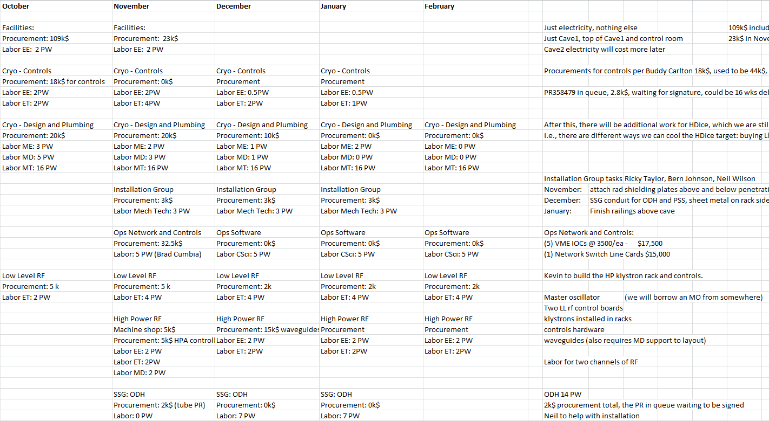
Month by Month Spending Profile
This schedule and cost estimate for “rf applied to cold ¼ CM” seems accurate
I will do the same for the entire project by UITF meeting next week…

