Slide 1

Polarized Positron Beams at Jefferson Lab
  Physics Motivation for CEBAF 12 GeV
  CEBAF Injector PEPPo Experiment
  Polarized Positron Source R&D
  Roadmap and Outlook
Joseph Grames
Center for Injectors and Sources
Jefferson Lab Accelerator Advisory Committee Review
October 9 – 11, 2018

Slide 2
Why Polarized Positrons at Jefferson Lab?
Parameter | CEBAF Electron Beam | Proposed Positron Beam
Typical Intensity | 1 nA - 100 μA | >100 nA (5 x 10¹¹ e+/s)
Spin Polarization | >85% | >50%
Helicity Reversal | 30 – 2000 Hz (Pockels cell) | 30 – 2000 Hz (Pockels cell)
Duty Factor | 100% (cw) | 100% (cw)
Bunch Frequency | 249.5/499 MHz | 249.5/499 MHz
Polarized electron beams have supported some of the highest impact results from the JLab program:
  The strangeness distribution in the nucleon (HAPPEX and G0)
  Precision Tests of the Standard Model (Q_{Weak})
  Measurement of the neutron skin in ²⁰⁸Pb
  Polarization transfer measurement of G_{E}/G_{M} for the proton
Unpolarized positron beams offer greater precision
  Comparison of e⁻ with e⁺ tests our understanding of two photon effects
Polarized positron beams provide a key tool
  Unraveling nucleon structure through the measurement of charge-sensitive General Parton Distributions
  Expand the nature of these tests (e.g. for G_{E}/G_{M} via polarization transfer)

Slide 3
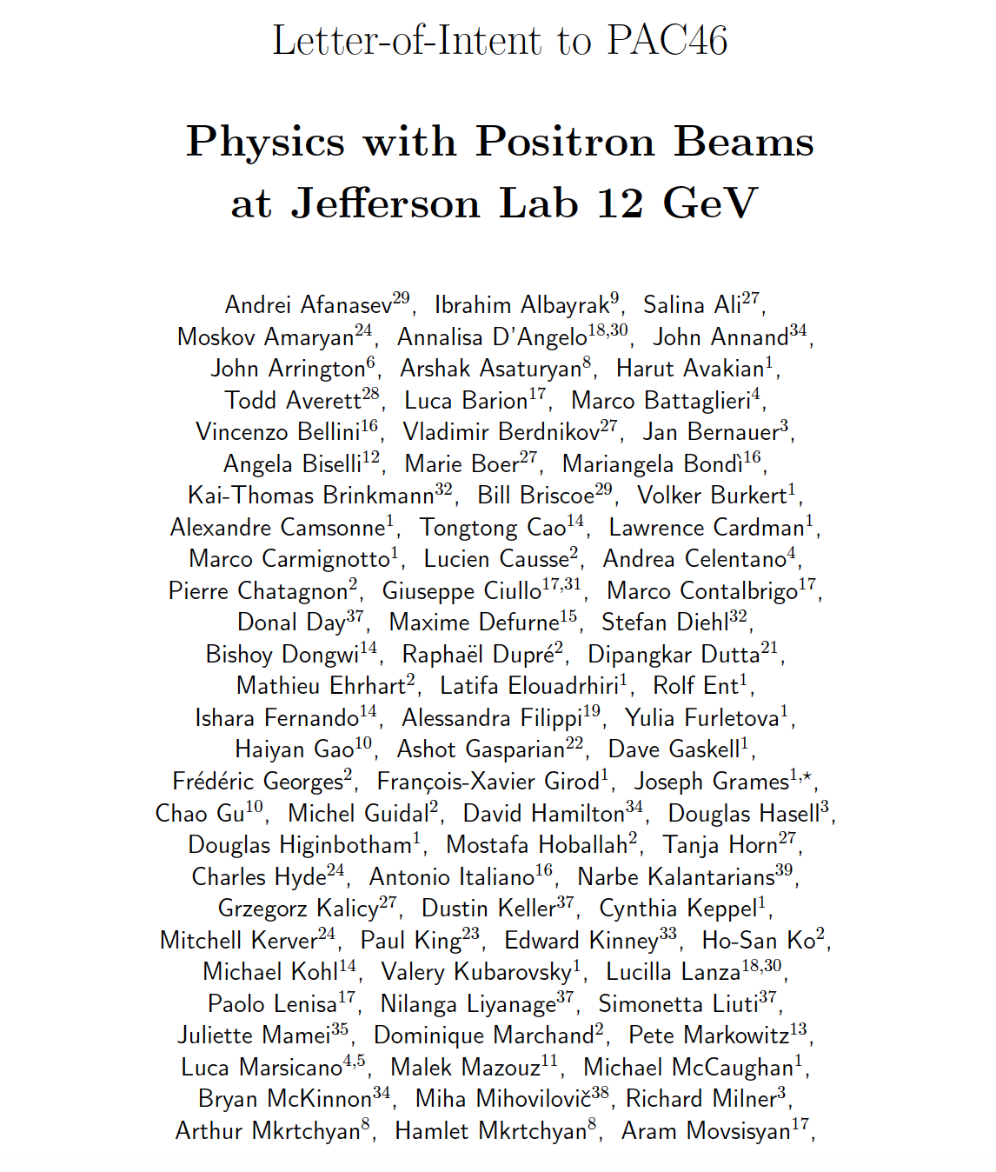



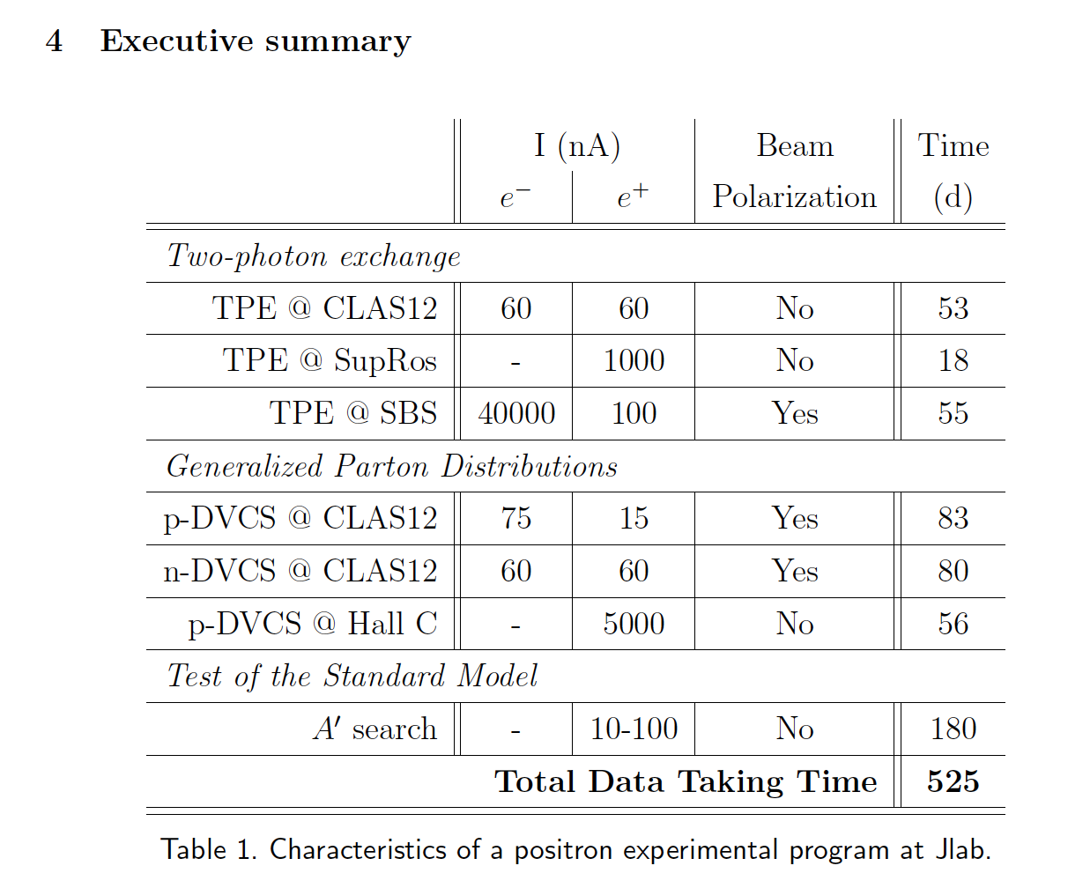
Letter of Intent to PAC46 (LOI-12-18-004)
Jefferson Lab Positron Working Group (JLAB-PWG) formed in 2016
  120 members (>90% are JLab Users), and growing
  39 institutions
Letter of Intent “Physics Program with Positron Beams at CEBAF 12 GeV” submitted to PAC46 (July 2018), highlighting 7 mini-LOI’s
Summary: “These measurements all have significant physics interest. The proposers should carefully evaluate feasibility and present the best case possible in a future proposal.”

Slide 4

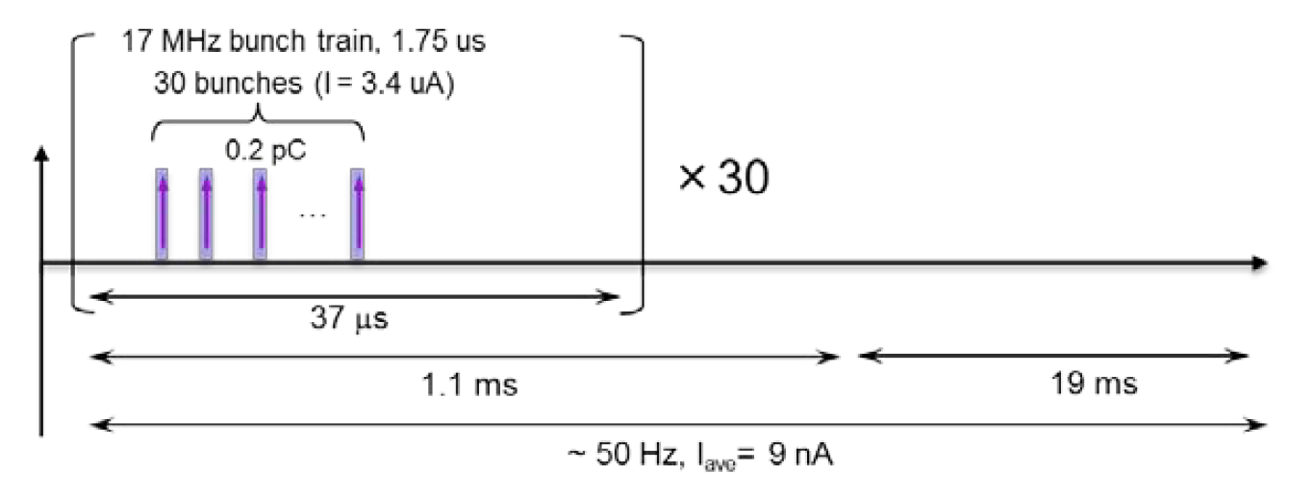
Polarized Positrons at an Electron Ion Collider
A polarized positron injector suitable for the Jefferson Lab Electron Ion Collider (JLEIC) has also been considered.
L ≥10³³cm⁻²s⁻¹ P_{e+}≥40%
I_{ave} > 10 nA (~10¹⁰ e+/s)
I_{peak} > 4 μA (~10¹³ e+/s)
e⁺
Challenge is accumulating high positron bunch charge with high rep rate.

Slide 5
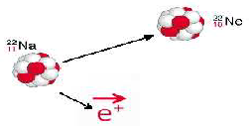




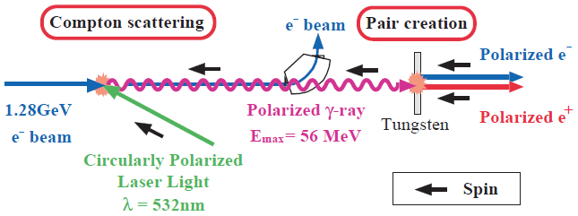
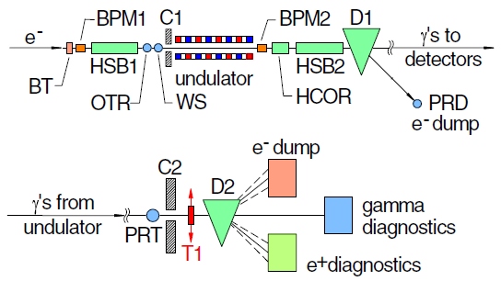
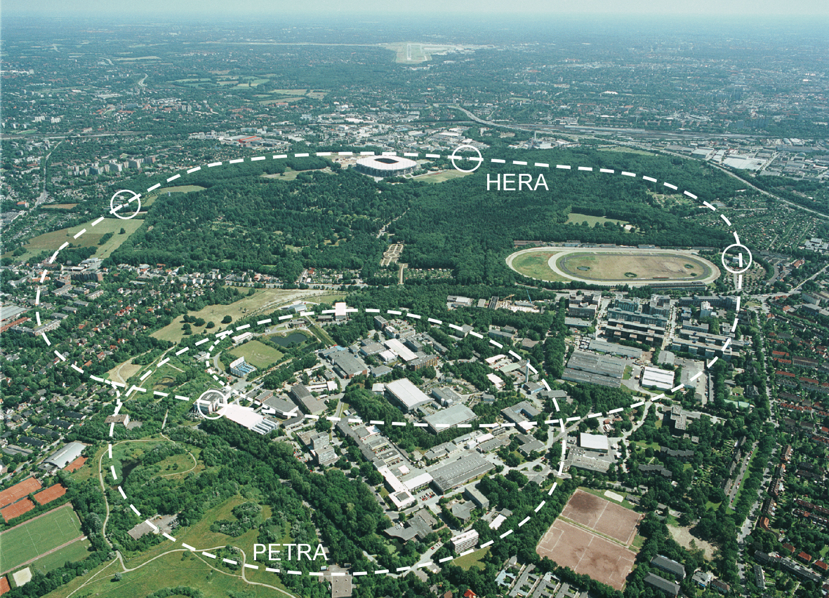
Methods for Generating Polarized Positrons
Polarized β⁺ Decay
L.A. Page & M. Heinberg. Phys. Rev.
106(6):1220-1224 (1957)
Sokolov-Ternov Effect
D. Barber , AIP Conf. Proc. 588, 338 (2001)
Polarized due to parity non-conservation in the weak interaction
HERA 27.5 GeV e+/e-
P(e⁺) ~ 40 %
P(e⁺) ~ 70 %
Compton Backscattering (KEK)
T. Omori et al, PRL 96 (2006) 114801
Helical Undulator (SLAC E166)
G. Alexander et al, PRL 100 (2008) 210801
KEK 1.28 GeV
SLAC 47.7GeV
P(e⁺) = 73 ± 15_{(stat)} ± 19_{(syst)} %
P(e⁺) = 80 ± 7_{(stat)} ± 9_{(syst)} %

Slide 6




New Method : Exploit Electron Beam Spin Polarization
Polarized Bremsstrahlung
Polarized Pair Creation
P_{circ}(γ) / P_{z} (e⁻)
P_{z} (e⁺) / P_{circ} (γ)
E_{γ} / T_{e-}
T_{e+} / (E_{γ} – 2m_{e+})
E.A. Kuraev, Y.M. Bystritskiy, M. Shatnev, E.Tomasi-Gustafsson, PRC 81 (2010) 055208

Slide 7
Polarized Electrons for Polarized Positrons (PEPPo) Collaboration
P. Adderley¹, A. Adeyemi⁴, P. Aguilera¹, M. Ali¹, H. Areti¹, M. Baylac², J. Benesch¹, G. Bosson²,
B. Cade¹, A. Camsonne¹, L. Cardman¹, J. Clark¹, P. Cole⁵, S. Covert¹, C. Cuevas¹, O. Dadoun³,
D. Dale⁵, J. Dumas^{1,2}, E. Fanchini², T. Forest⁵, E. Forman¹, A. Freyberger¹, E. Froidefond²,
S. Golge⁶, J. Grames¹, P. Guèye⁴, J. Hansknecht¹, P. Harrell¹, J. Hoskins⁸, C. Hyde⁷, R. Kazimi¹,
Y. Kim^{1,5}, D. Machie¹, K. Mahoney¹, R. Mammei¹, M. Marton², J. McCarter⁹, M. McCaughan¹,
M. McHugh¹⁰, D. McNulty⁵, T. Michaelides¹, R. Michaels¹, C. Muñoz Camacho¹¹, J.-F. Muraz²,
K. Myers¹², A. Opper¹⁰, M. Poelker¹, J.-S. Réal², L. Richardson¹, S. Setiniyazi⁵, M. Stutzman¹,
R. Suleiman¹, C. Tennant¹, C.-Y. Tsai¹³, D. Turner¹, A. Variola³, E. Voutier^{2,11}, Y. Wang¹, Y. Zhang¹²
¹Jefferson Lab, Newport News, VA, US, ² LPSC, Grenoble, France, ³LAL, Orsay, France
⁴ Hampton University, Hampton, VA, USA ⁵ Idaho State University & IAC, Pocatello, ID, USA
⁶ North Carolina University, Durham, NC, USA ⁷ Old Dominion University, Norfolk, VA, US
⁸ The College of William & Mary, Williamsburg, VA, USA ⁹ University of Virginia, Charlottesville, VA, USA ¹⁰ George Washington University, Washington, DC, USA ¹¹ IPN, Orsay, France
¹² Rutgers University, Piscataway, NJ, USA ¹³ Virginia Tech, Blacksburg, VA, USA
PEPPo possible due to support from SLAC E166, DESY, Princeton, Cornell, International Linear Collider Project and the Jefferson Science Associates

Slide 8

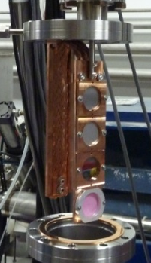
PEPPo Experiment : Feasability Demonstration at the CEBAF Injector
The purpose of the PEPPo (Polarized Electrons for Polarized Positrons) experiment at the CEBAF Injector was to demonstrate the feasibility of using bremsstrahlung radiation of MeV energy Polarized Electrons for the efficient production of Polarized Positrons.
8 MeV, 1μA, 85% polarization
Tungsten (1mm)
J. Grames, E. Voutier et al., JLab Experiment E12-11-105 (2011)

Slide 9
PEPPo : Principle of Operation
Polarized Electrons
(< 10 MeV/c) strike production target
Polarized Electrons
(< 10 MeV/c) strike production target
Positron Transverse and Longitudinal Phase Space Selection
S₁
e⁺
D
e⁻
e⁻
e⁻
T₁
T₁
1. BREMSSTRAHLUNG
Longitudinal e⁻ (P_{e-}) produce elliptical γ whose circular (P_{γ}) component is proportional to P_{e-}
2. PAIR PRODUCTION
In the same target, γ produce e⁺e⁻ pairs and transfer Pγ into longitudinal (P_{e+}) and transverse polarization averages to zero
S₂
P_{T}
D
Calorimeter
e⁺
T₂
3. Phase Space Definition
The emittance of the positron beam is defined by slits and magnetic fields
Compton Transmission Polarimeter
4. COMPTON TRANSMISSION POLARIMETER
Polarized e⁺ convert into polarized γ (P_{γ}) whose transmission through a polarized iron target (P_{T}) depends on P_{γ}.P_{T}

Slide 10
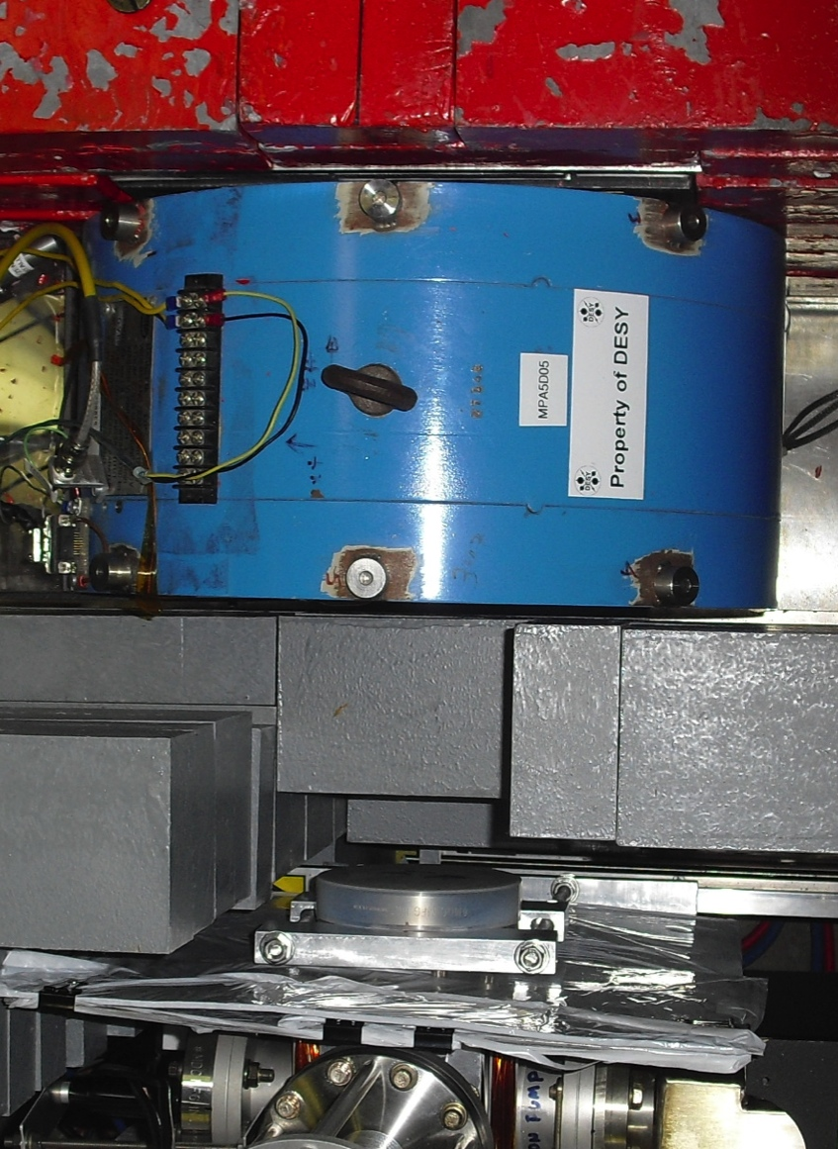
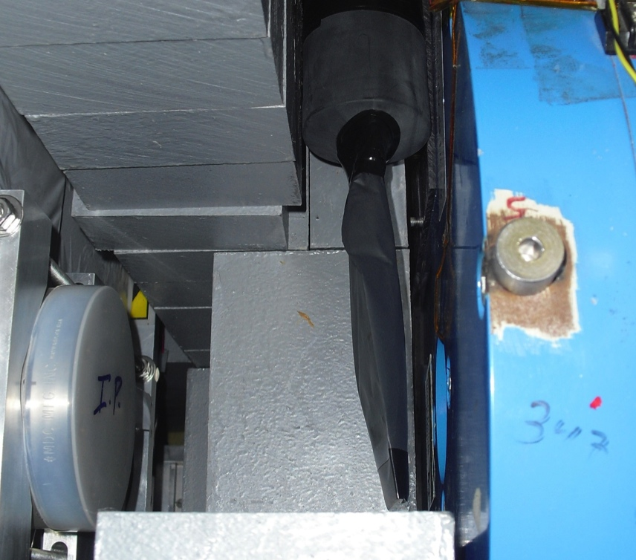
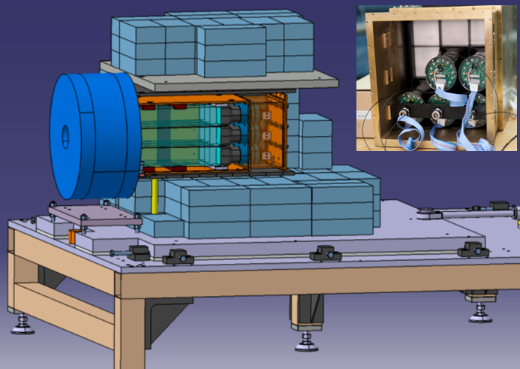
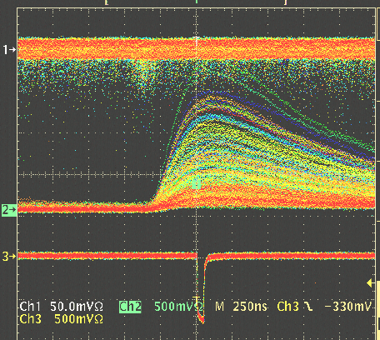
Positron Polarimeter by Compton Scattering
Polarized positrons incident on a tungsten foil produce polarized bremsstrahlung, which is then analyzed via the Compton scattering transmission asymmetry through a magnetized target.
C
A
L
O
R
I
M
E
T
E
R
γ
e+
Reconversion
Target
10mil Al window
Trigger Scintillator
P_{T} = 7.06% ± 0.05% _{(sys1)} ± 0.07% _{(sys2)}
Trigger Scintillator
P_{e+} = ε_{e+} /(A_{e+} ⋅ P_{T} )
P_{e+} - positron polarization
ε_{e+} - measured asymmetry
A_{e+} - analyzing power
P_{T} - target polarization
Calorimeter
Coincidence

Slide 11

PEPPo : Polarized Positron Production
(PEPPo Collaboration) D. Abbott et al. , Phys. Rev. Lett. 116 (2016) 214801
PEPPo demonstrated efficient polarization transfer of 8.2 MeV/c polarized electrons to positrons, expanding polarized positron production using MeV electron beam energies.
electron beam polarization
85.2 ± 0.6 ± 0.7 %
Whenever producing e⁺ from e⁻, polarization is coming for free, if initial electrons are polarized.

Slide 12
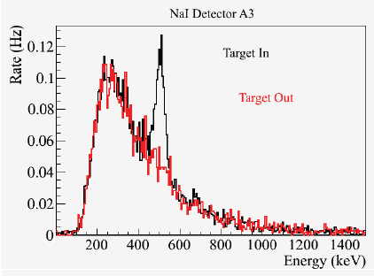
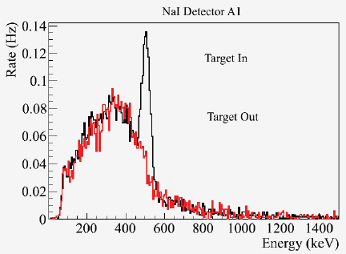
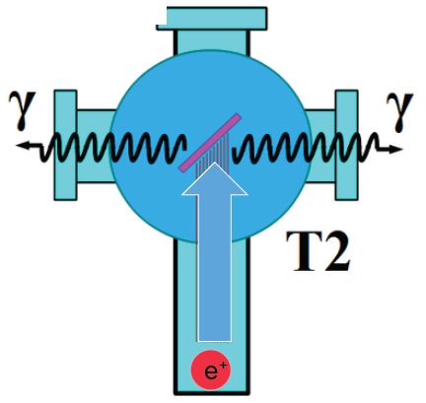
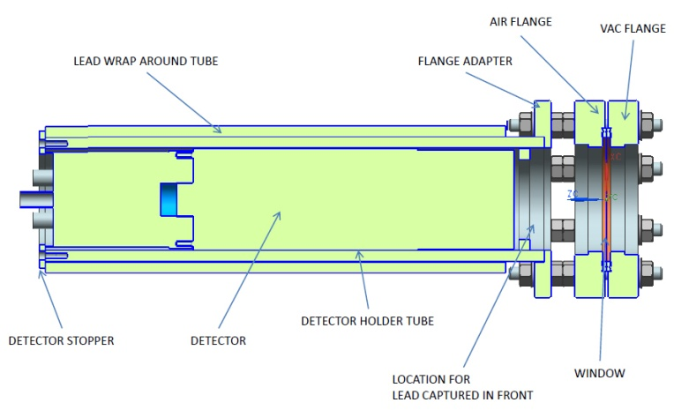
PEPPo : Positron Yield at MeV Beam Energy
Two NaI detectors measured coincidence of back-to-back photons emitted by annihilation of positrons in a viewscreen.
S₁
e⁻
e⁺
D
T₁
p_{e-}= 8.2 MeV/c
A3
A1
A3
D
e⁺
T₂
S₂
p_{e+}= 4 MeV/c
A1
For these data we had a yield of ~10⁻⁵ e⁺/e⁻
Viewscreen 0.011 thick @ 45 deg to beam line
99.5% aluminum oxide Al₂O₃
0.5% chromium doped Al₂O₃/Al₂O₃Cr₂O₃

Slide 13



Figure of Merit (Electron Energy 60 MeV)
R. Dollan, K. Laihem, A. Schälicke, NIM A 559 (2006) 185,
J. Dumas, J. Grames, E. Voutier, JPos09, AIP 1160 (2009) 120
J. Dumas, Doctorate Thesis (2011)
The polarization distribution of generated positrons is dominated by low-energy events.
The positron energy at the optimum FoM (P²I) is about half of the electron beam energy.
Producing highly polarized positron beams with intensities > 100 nA with typical injector energies (10-100 MeV) requires polarized electron beam intensities of >1-10 milliAmps
Optimum
FoM
Optimum energy

Slide 14
Enabling Technology : Advances in Polarized Electron Sources
Strained GaAs:
GaAs on GaAsP
Strained Superlattice GaAs:
Layers of GaAs on GaAsP
Bulk GaAs
100 nm
100 nm
625 μm
2 μm
14 Layers
350 μm
QE ~ 5%, 30 mA/W
Pol ~ 35% @ 780 nm
QE ~ 0.2%, 1 mA/W
Pol ~ 75% @ 850 nm
QE ~ 1%, 6 mA/W
Pol ~ 89% @ 780 nm
P_{e-} 35% 35% 75% 75% 85% 89%
I_{e-} 30μA 100μA 50μA 100μA 150μA 200μA
1995 1998 1999 2000 2004 2012 2018
Figure-of-Merit (P²I) has improved by a factor of 43
over the span of the CEBAF “6 GeV era”

Slide 15
High Current and High Polarization Photocathode Performance
W. Liu et al., Appl. Phys. Lett. 109, 252104 (2016)
SLAC: First GaAs photogun
JLAB: Low-P Bulk GaAs
JLAB: High-P GaAs/GaAsP
?
Intensity (mA)
Year

Slide 16

CEBAF Polarized Source Lifetime : GaAs/GaAsP > 1 mA
  An electron source operating at 1 mA for one week produces 605 C.
  Increasing laser size at CEBAF source at resulted in photocathode lifetimes 300-450 C at milliampere beam intensity.
  Measured ppm level beam loss suggests improved gun design extends scaling.

Slide 17

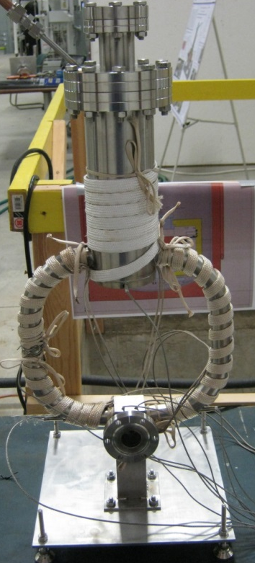
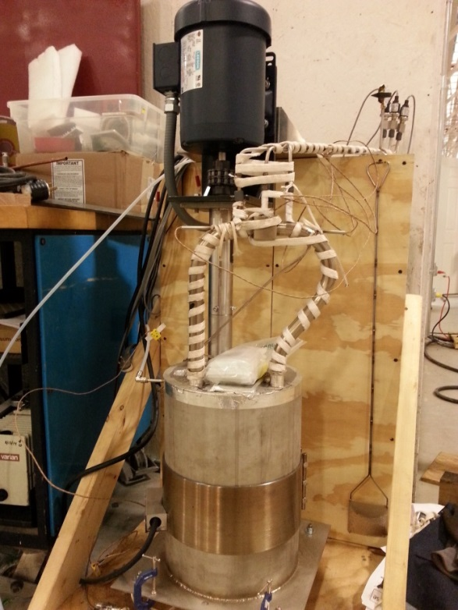
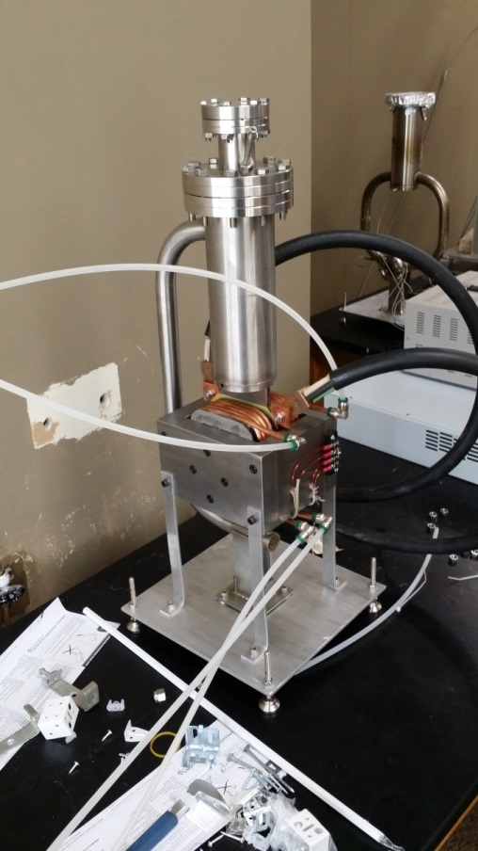
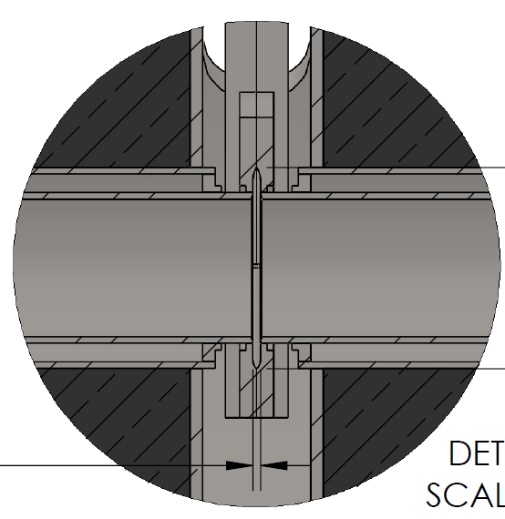
High Power Pair-Production Conversion Target R&D
Liquid Metal Target – lead-bismuth eutectic (LBE)
  High Z = 82, 83
  Low melting point: 124°C
  High boiling point: 1670°C
Multiple LBE targets tested on various accelerators
  Natural Circulation
  Mechanical Pumping
  Electromagnetic Pumping
Approaching 10 kW power level, CW
Stainless Steel Windows (0.25mm)
LBE (2mm)
Output (e⁻,e⁺,γ)
Input (e⁻)

Slide 18
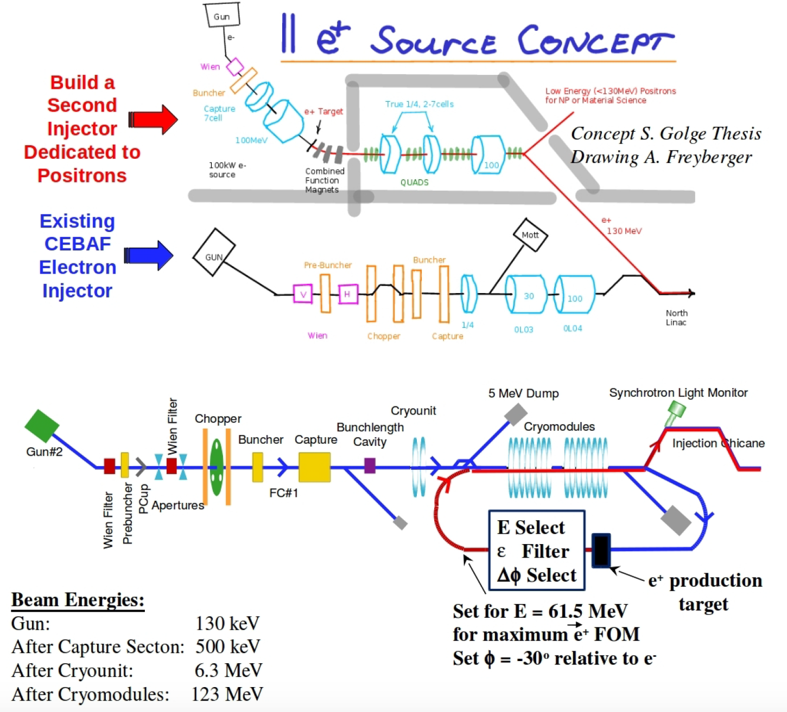
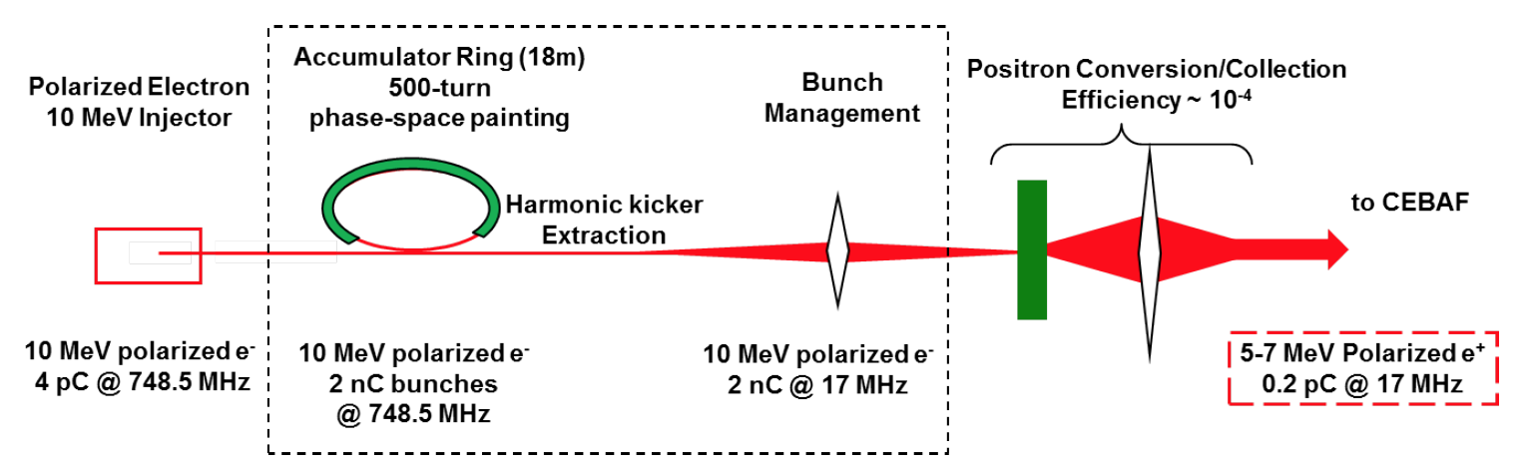
Polarized Positron Injector Concepts
We have explored concepts with varying level of detail (theses, workshops, and yes…napkins).
The common denominator is leveraging a Polarized Electrons Source and 10-100 MeV Injector to produce a positron beam.
A polarized e+ injector at Jlab would be novel in various ways:
  mA polarized e- source
  fast helicity reversal
  cw/short pulse bunches
  high power target > 10 kW
  srf acceleration

Slide 19
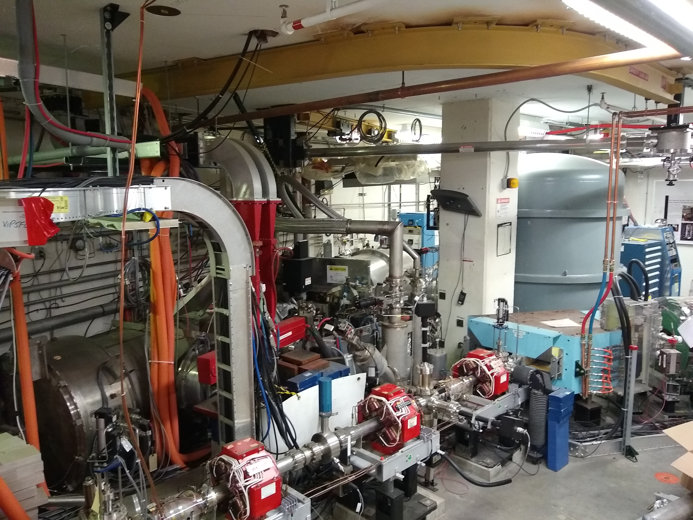
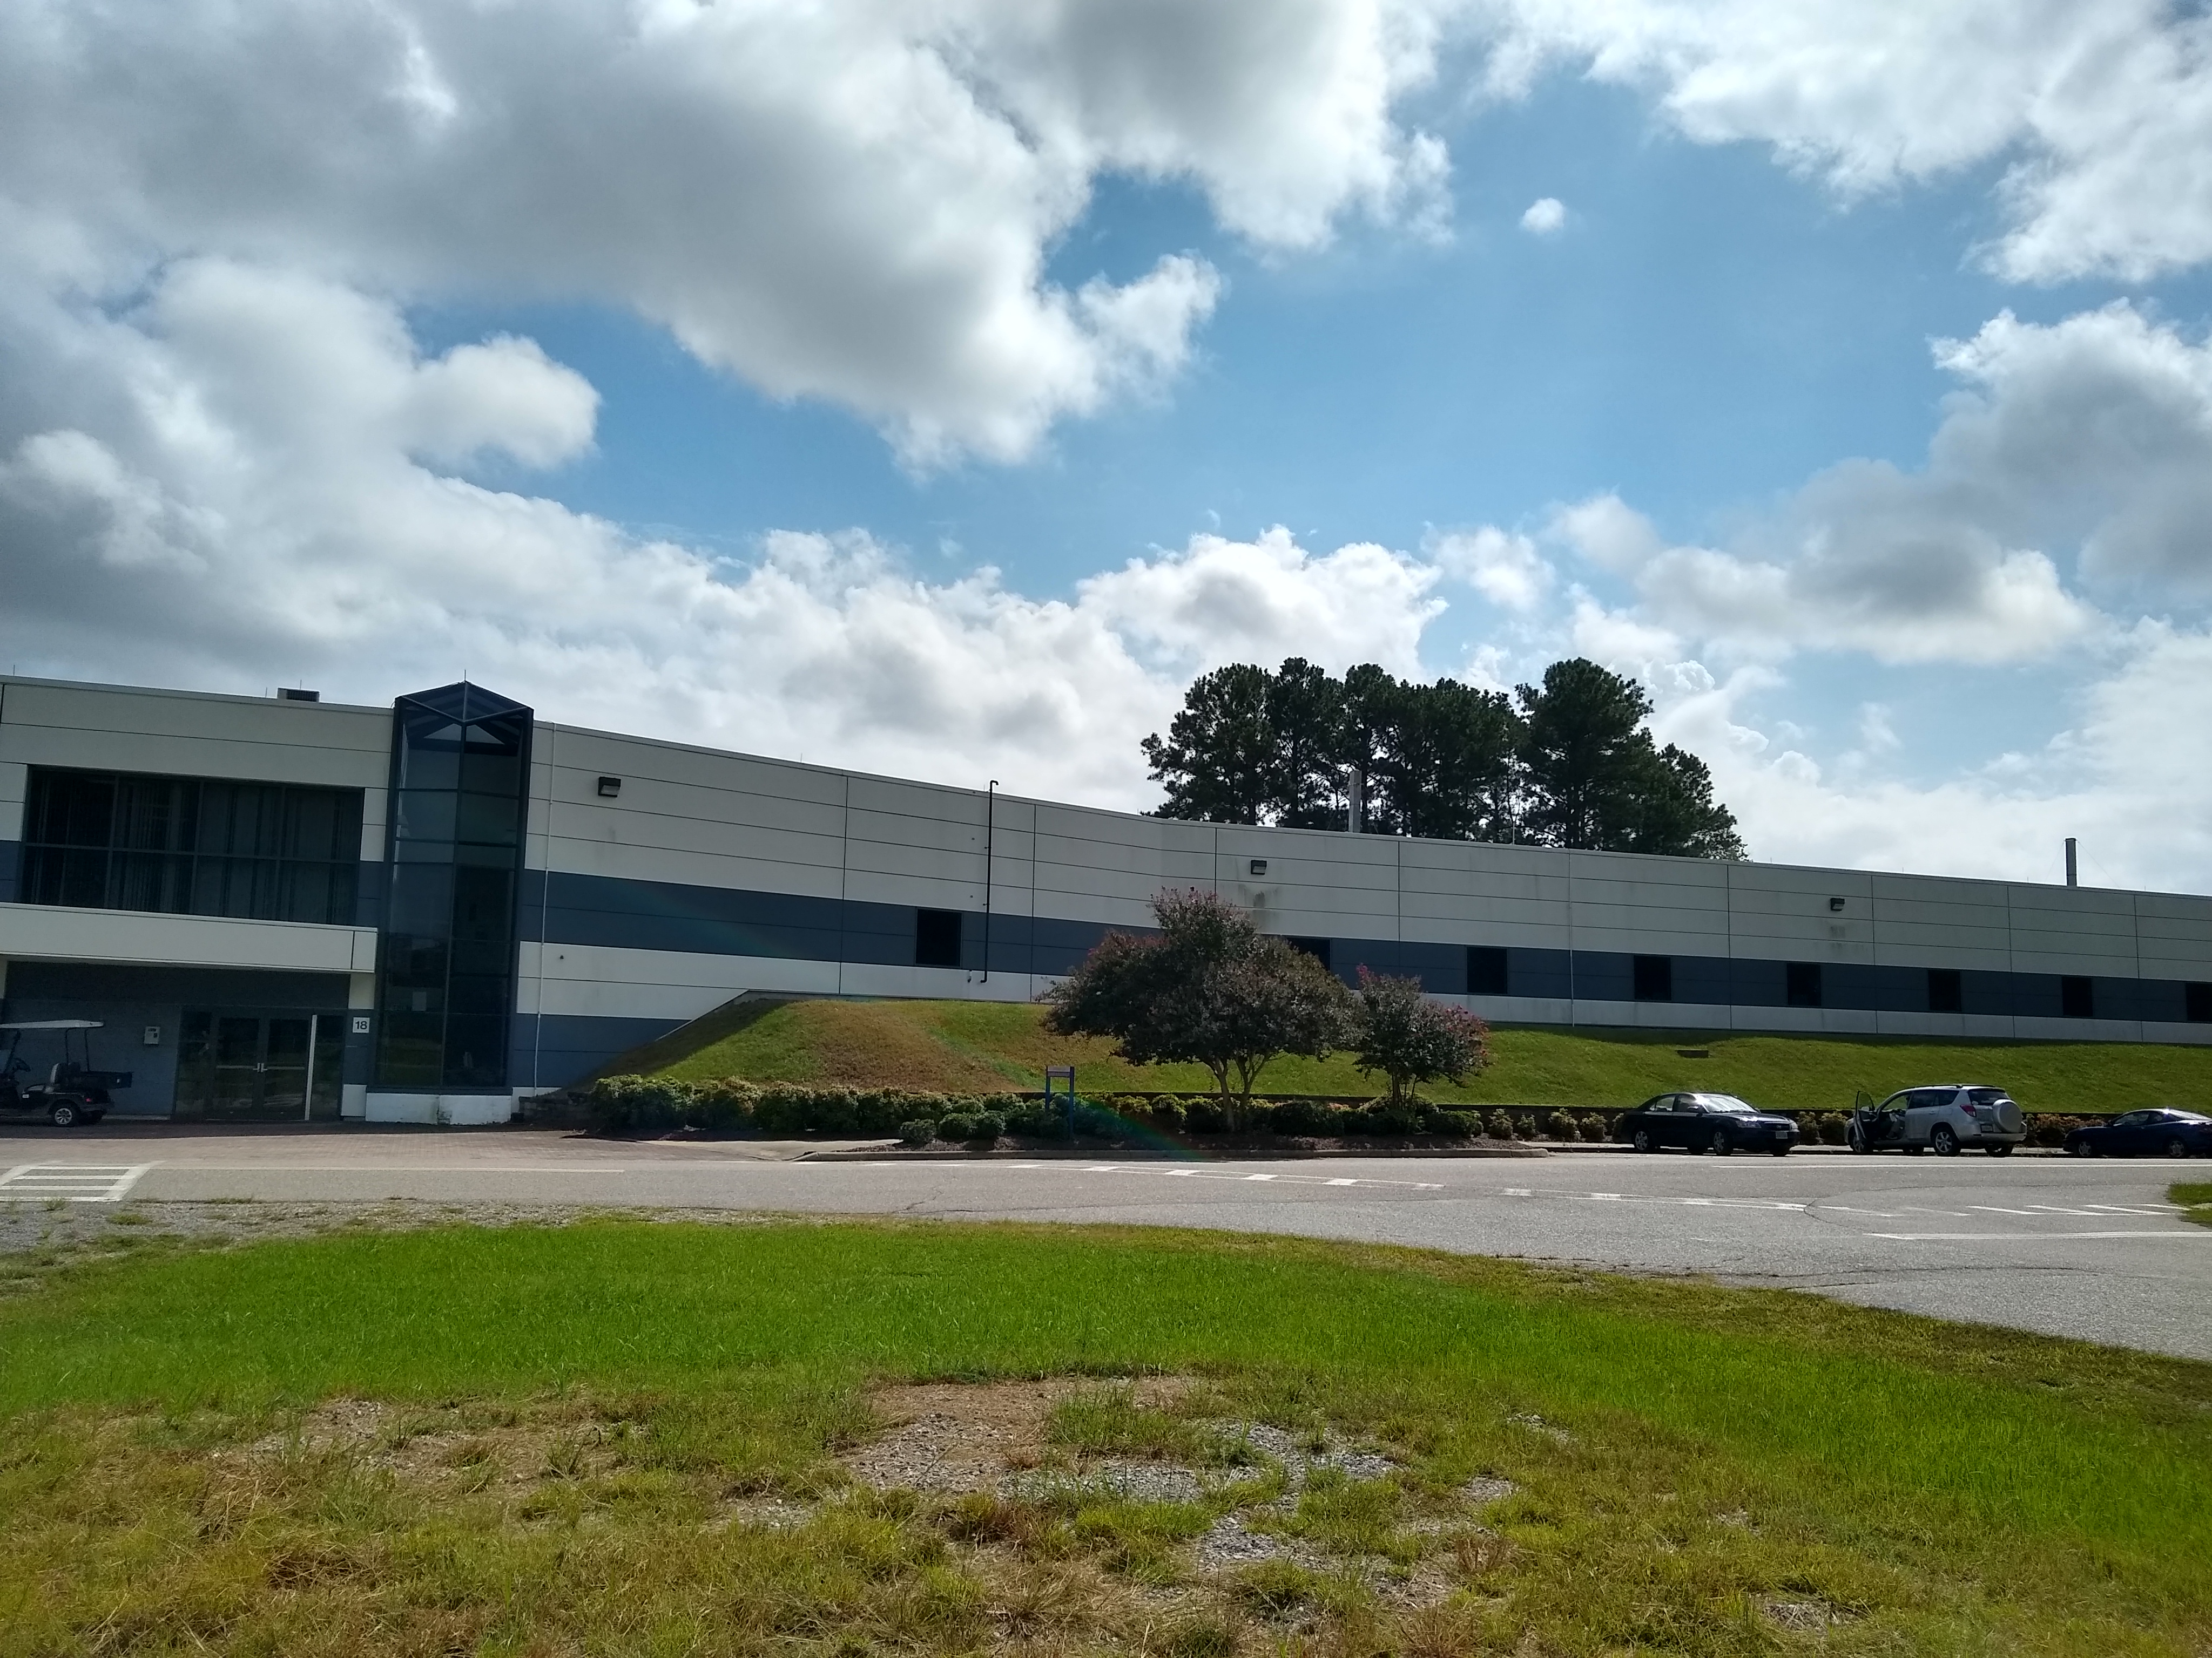
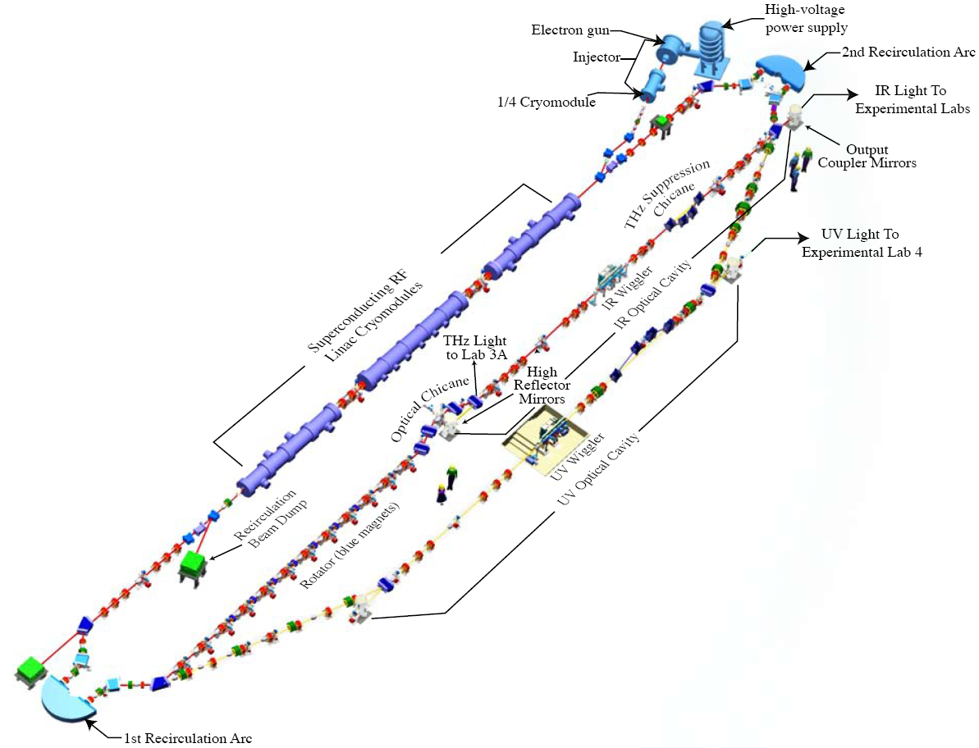
Jefferson Lab Resource : Low Energy Research Facility (LERF)
350kV Vent Bake Gun
GaAs (500C @ 5mA)
500kV, 10mA HVPS
Powerful light source
IR and UV FEL
THz light
Search for Dark Matter
Fixed Target Options
SRF Booster 10 MeV
HPC for mA current, nC bunch charge

Slide 20
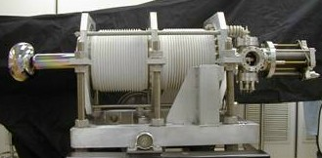
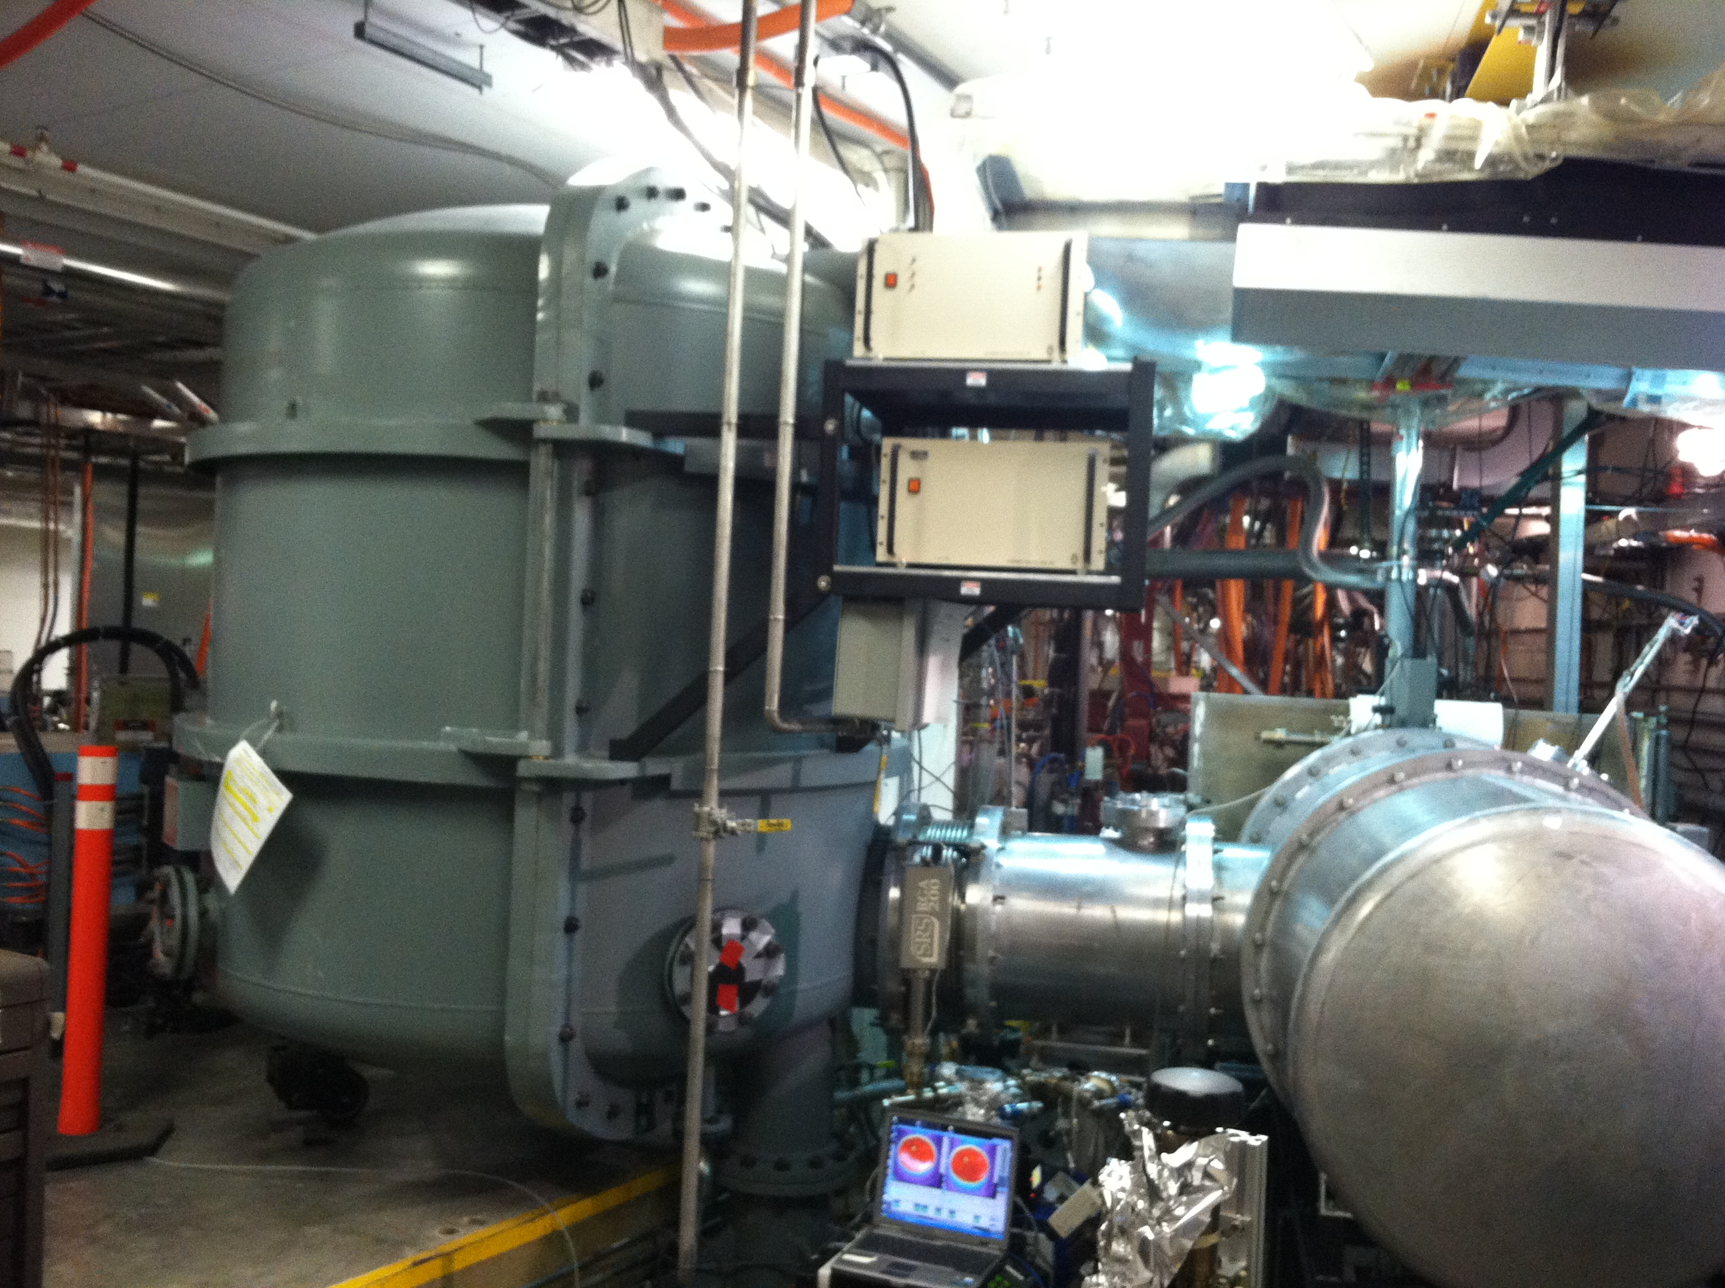
LERF Vent Bake Photogun
350kV Vent Bake Gun
Single photocathode material
4 weeks to replace photocathode
Repeated vacuum/HV conditioning
500kV, 10mA HVPS
Mated to gun via SF6 chamber
2 days for each gun access
Repeated HV conditioning
Slide Courtesy: C. Hernandez-Garcia

Slide 21
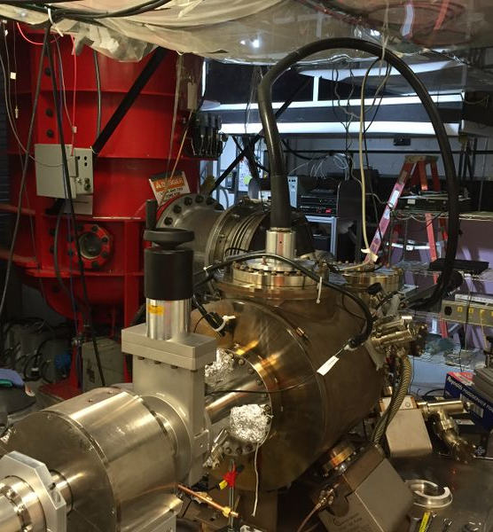
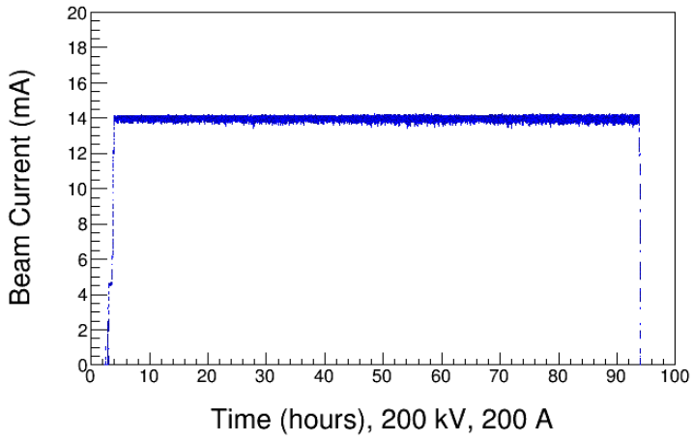
Magnetized Beam Photogun at the Gun Test Stand
Magnetized Beam LDRD, PI's: R. Suleiman and M. Poelker
Load-lock inverted insulator photogun (multiple photocathodes) like CEBAF
Cable connection from HVPS to gun
Over 1000 hours operating >300kV; HV conditioning about 1 week
Operating with CsKSb photocathodes at >10 mA average current

Slide 22
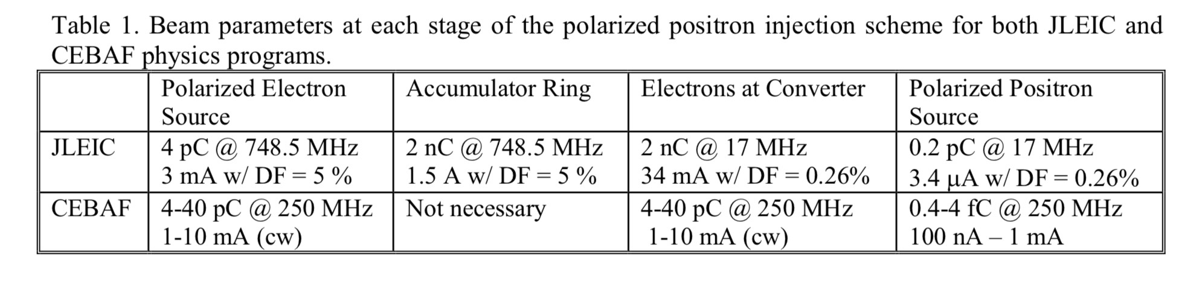
Roadmap : Polarized Positron Beam Demo (PEPPo-II)
Next priority should be designing, building and testing a positron beam collection system to define and optimize the transverse & longitudinal phase space and spin polarization for RF acceleration.
Upgrading the LERF injector with a >350kV inverted photogun and dual photocathode (GaAs and multi-alkali) photo-gun provides capability to:
  achieve predicted lifetime scaling of spin polarized photocathodes
  demonstrate reliable operation of high power conversion targets
  supports on-going unpolarized beam operations at LERF
  opens door to new polarized beam operations

Slide 23

Roadmap: Integrated Approach
Only scratching the surface…there are still many issues to consider related to the injection, transport and management of a positron beam in CEBAF (magnet reversal and reproducibility, managing beam loss, diagnostics of low current beams, etc).
A conceptual design study report is now essential, and simulations of various concepts to date suggest that a CW polarized positron source can be built to meet the CEBAF requirements.
JPos’09
(2009)
PEPPo
(2012-2015)
JPos’17
(2017)
LOI-12-18-004
(2018)

Slide 24
Outlook
Jefferson Lab Users are making the physics case for a high energy polarized and unpolarized positron beam physics program at CEBAF.
PEPPo demonstrated high positron polarization from moderate energy polarized electrons with a small footprint (cost, energy, radioactivity)
Progress of mA-polarized electron sources is promising for the development of polarized positron beams with CW intensity >100 nA (5 x 10¹¹ e+/sec).
Next priority is building and testing a collection system to define and optimize the transverse/longitudinal phase space for RF acceleration.
A comprehensive plan, supported by JLab Management, that can be successfully executed is essential for future success.

