Slide 1
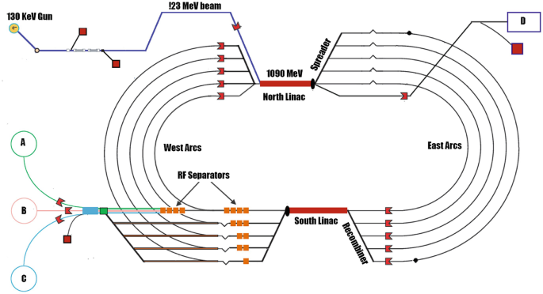
PEPPo-II LDRD (as of 3/29/2023) – PI is Max Bruker
Stages | e+ goal
1 | e+ production + well formed bunches accelerated to the 123 MeV spectrometer
2 | e+ bunches compressed + accelerated to 1 GeV + damped to end of NL viewer
3 | e+ beam recirculated through “Arc1” i.e. Spreader, Arc and Recombiner to viewer
4 | e+ beam accelerated to 2 GeV through SL + RF extracted to viewer (dumplet?)
5 | e+ beam at 2 GeV transported through the ramp into Hall B dump
Minimum deliverables
Driven by cost and schedule
2
1
3
5
4

Slide 2
CEBAF e- injector and e+ homework…
e - Parameter | Value | Comment
Beam energy | 7 MeV | Nominal injector energy, should stay below neutron threshold (~7.1 MeV)
Beam current | 0.50 - 0.75 mA | Depends on gun lifetime and injector setup
Beam power | 3.5 – 5.25 kW | Depends mainly on available RF power
Gun charge | 45 – 65 C/day | Demonstrated gun lifetime at milliamp current >300 C (won’t run 100% of time)
Bunch charge | 1 – 1.5 pC | Assumes 499 MHz (no modification), but can divide by 3 to fill 1497 MHz buckets
Homework…
Confirm e- parameters with INJ and SRF groups
Compute 7 MeV dist from (0.1,0.5,1 mm) W
Iterate with Silviu/Andriy on target param (Power, Size)
Discuss with Amy’s grp. if planning “straight” or “chicane”
Identify nominal 0L03-NL admittance (measure later)
Design chicane (e- beam, LDRD?, space, components)
Fold-in e+ (insertable target, magnet, collimators, cavity?)
Predict e+ beam target to destinations
Discuss upgrading ”7 MeV region” (shown) from 1 kW to 5 kW
S
C?

