Slide 1
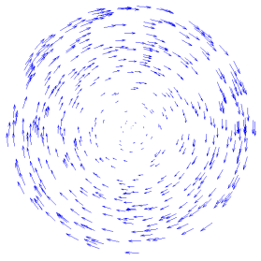
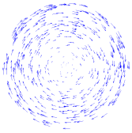
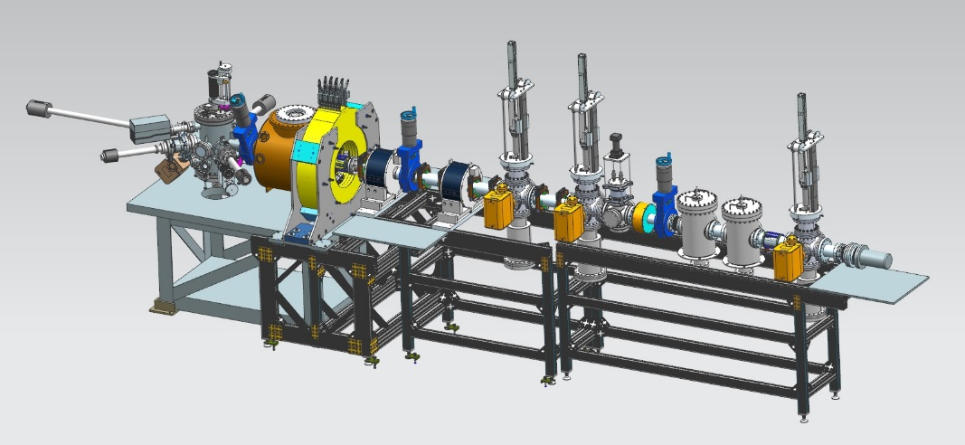
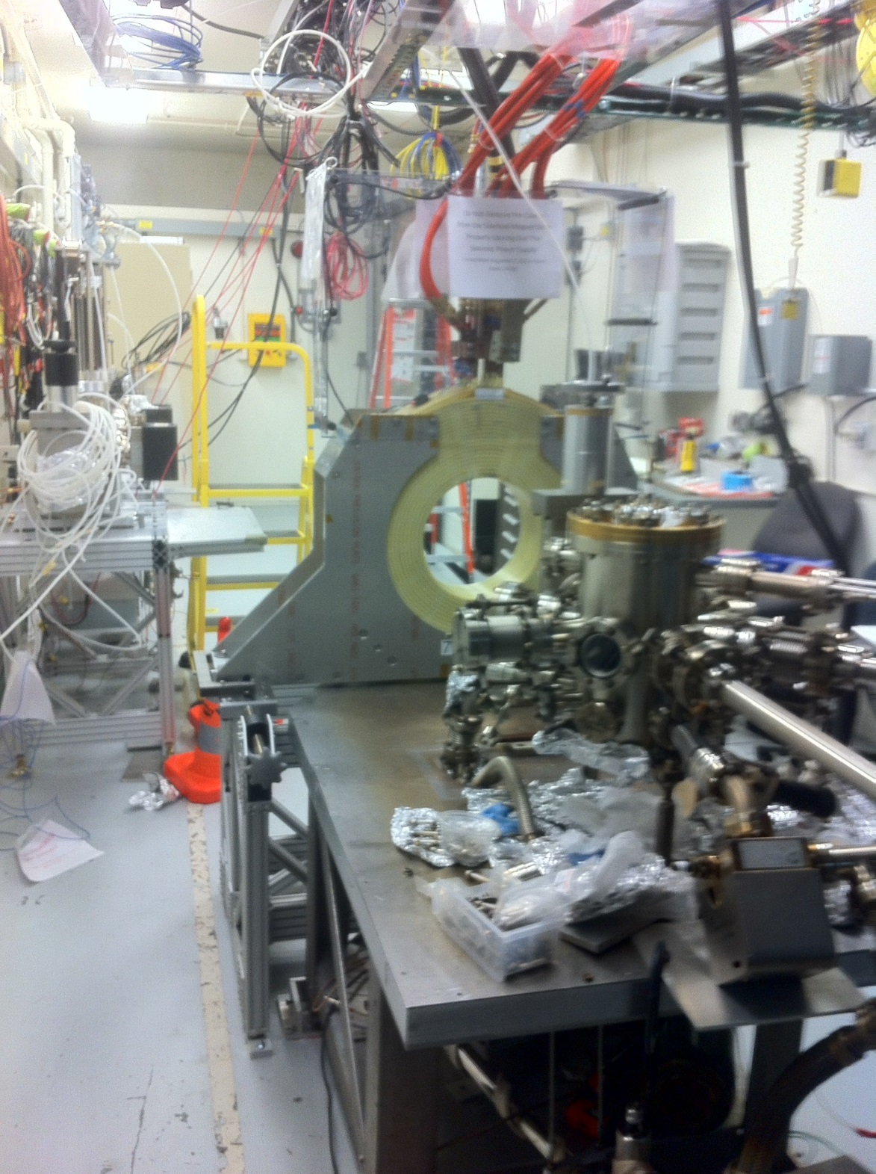
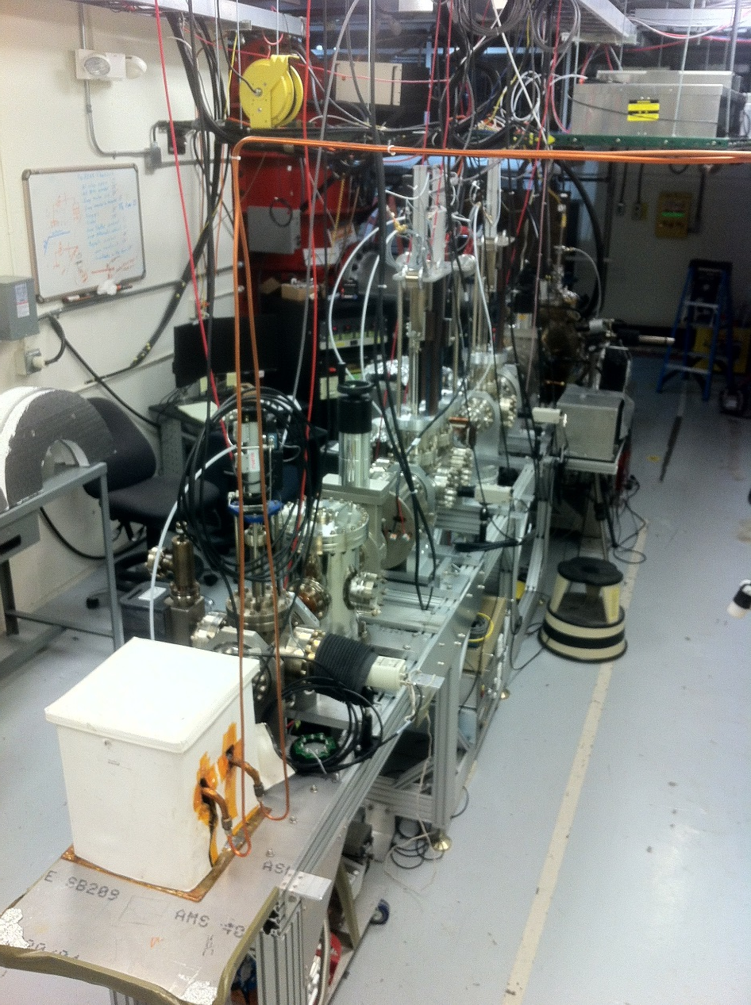
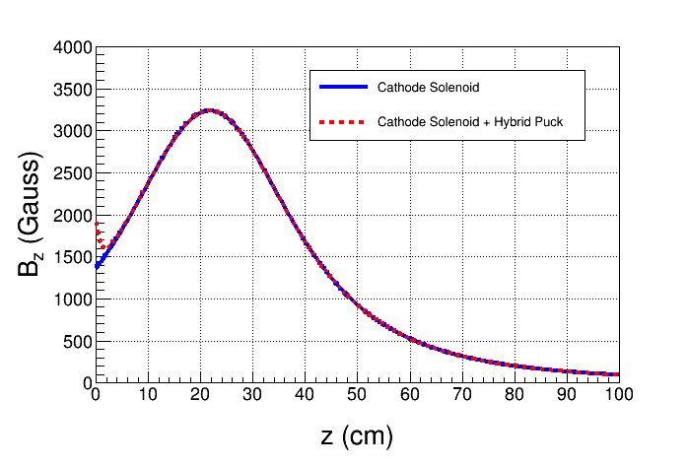
Magnetized Bunched Electron Beam from DC High Voltage Photogun
R. Suleiman, M. Poelker, J. Benesch, F. Hannon, C. Hernandez-Garcia, M. A. Mamun, Y. Wang, S. Zhang
Physics of Photocathodes for Photoinjectors (P3) Workshop October 17, 2016
Motivation
Electron beam is being used inside cooling solenoid where it suffers an azimuthal kick when it enters. This kick is cancelled by an earlier kick at exit of cathode solenoid
Experimental Overview
Jefferson Lab Electron Ion Collider (JLEIC) bunched magnetized electron cooler is part of Collider Ring and aims to counteract emittance degradation induced by intra-beam scattering, to maintain ion beam emittance during collisions and extend luminosity lifetime
Cathode Solenoid
Cooling Solenoid
Cathode
Solenoid
Injector
Focusing
Solenoid
Diagnostic Cross 1
(Slit + YAG Screen)
Diagnostic Cross 3
(YAG Screen)
SRF LINAC
Cathode
Green
Laser
electron
ion
Anode
K₂CsSb
Photocathode
Three Skew Quads
(Round-to-Flat Beam Transformer)
Diagnostic Cross 2
(Slit + YAG Screen)
Magnetized Cooling
Electrons born in strong uniform B_{z}
Upon exit of Cathode Solenoid
Upon entering Cooling Solenoid
Electrons helical motion in strong magnetic field increases electron-ion interaction time, thereby significantly improving cooling efficiency. Electron-ion collisions that occur over many cyclotron oscillations and at distances larger than cyclotron radius are insensitive to electrons transverse velocity.
Cooling rates are determined by electron longitudinal energy spread rather than electron beam transverse emittance as transverse motion of electrons is quenched by magnetic field.
This cyclotron motion also provides suppression of electron-ion recombination.
r_{e}= 0.7 mm
B_{cool} = 1 T
Generate magnetized beam:
$a_{0}$ = 1 – 5 mm, B_{z} = 0 – 2 kG
Bunch charge: 1 – 500 pC
Frequency: 15 Hz – 476.3 MHz
Bunch length: 10 – 100 ps
Average currents up to 32 mA
Gun high voltage: 200 – 350 kV
$a_{0}$= R_{laser} = 1.56 mm
B_{z} = 2 kG
= 36 µm
Bunch length | 60 ps (2 cm)
Repetition rate | 476.3 MHz
Bunch charge | 420 pC
Peak current | 7.0 A
Average current | 200 mA
Transverse normalized emittance | 10s mm mrad
Cathode spot radius – Flat-top ($a_{0}$) | 1.56 mm
Solenoid field at cathode (B_{z}) | 2 kG
Measure mechanical angular momentum
Measure photocathode lifetime versus solenoid field at high currents (up to 32 mA) and high voltages (200 – 350 kV) limited by in-house HV supplies
Study beam halo and beam loss versus magnetization
Use skew quads – Round-to-Flat Beam (RTFB) Transformer – to generate flat beam and measure horizontal and vertical emittances using slit method
Generate very high currents magnetized beam and study beam transport and RTFB versus electron bunch charge
Beamline
Cathode Solenoid
Generate magnetized electron beam and measure its properties starting fall 2016
Explore impact of cathode solenoid on photogun operation
Simulations and measurements will provide insights on ways to optimize JLEIC electron cooler and help design appropriate source
Jefferson Lab will have direct experience magnetizing high current electron beam
Plans and Summary
K₂CsSb Photocathode Preparation Chamber, Gun and Beamline: delivered 1 mA to dump (non-magnetized)
Simulation:
Used ASTRA and GPT simulation to design beamline and to locate magnets and diagnostics at optimum positions
Simulated magnetized electron beam properties along beamline for various starting conditions
Simulated a round to flat transformer
Cathode Solenoid Magnet
Mapped and installed at GTS
New Pucks
Enhance magnetic field at cathode to 2.0 kG
Molybdenum
Steel
Acknowledgement: This work is supported by the Department of Energy, Laboratory Directed Research and Development funding, under contract DE-AC05-06OR23177

