Slide 1
UITF Project Status Meeting
Matt Poelker
May 16, 2016

Slide 2
Outline
Purpose: to inform Lab Leadership of the UITF status
Action Items (from previous meetings)
Project Update
Progress Update
Milestones Update
Budget Update
Highlights & Concerns
Next meeting agenda
Notes:
RW=Roy Whitney

Slide 3
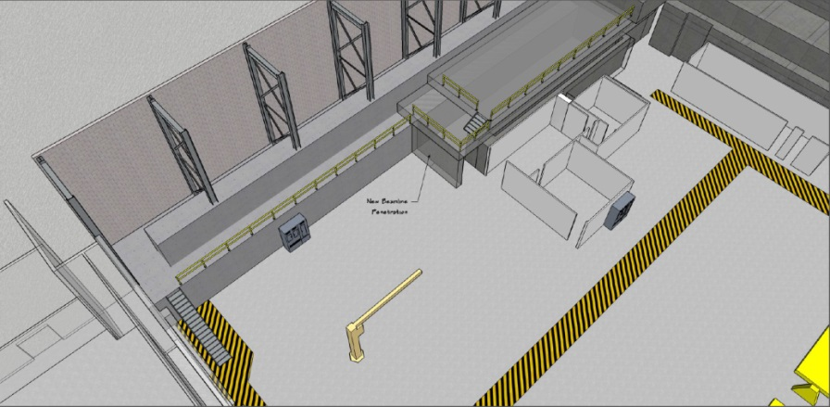
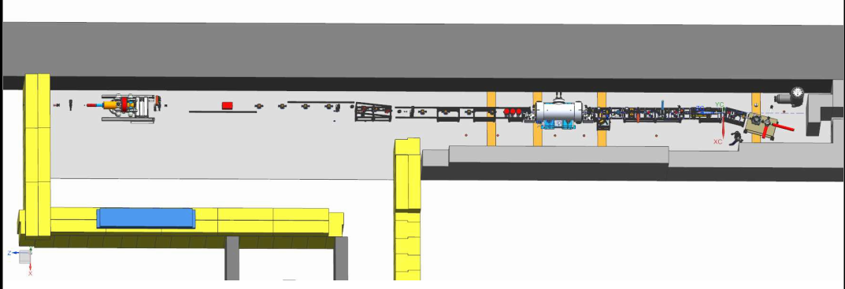
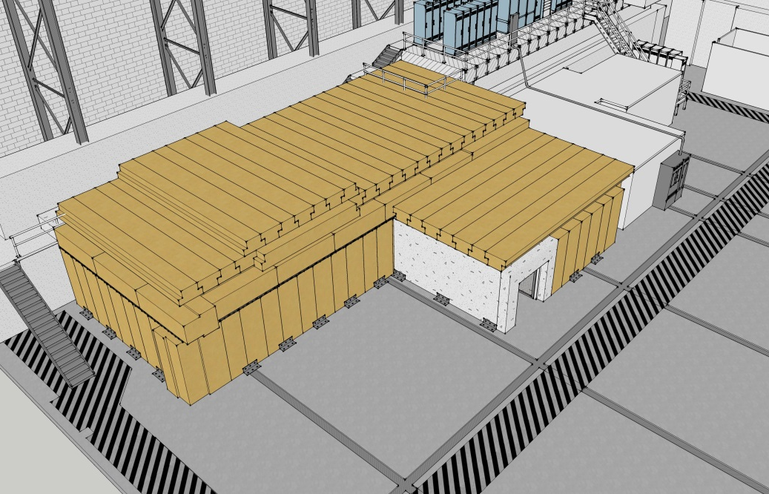
Proposed re-scoping
ITFCRY
ITFPTB
UITFBL
Facilities
Cryo Infrastructure including some RF
Polarized Target Beamline
UITF
Facilities

Slide 4
Action Items – April 12, 2015 Minutes
New Action Items:
Wrap up UITFBL by October 1, 2016
Notes:
RW=Roy Whitney

Slide 5
Progress Update
Major components
Facilities
Engineering
Mech Design
Installation
Cryo
Safety Systems
I&C
DC Power
Low Level RF systems
High Power RF
Survey & Alignment
SRF
Build new ¼ CM
Commission with RF
Ops and CASA
Network and communications
Software
Beamline design
Green means we can see progress

Slide 6
Progress Update
Major components
Source Group
Reliable 200kV ops
Beam to cup in front of ¼ CM
Beam to cup in front of HDIce
EHSQ
Shielding approval, ODH assessment, Ops Review
Global hazard review
FSAD
Accel Readiness Review
Commissioning Plan
HDIce
Installation at Cave
Beam on HDIce
Green means we can see progress

Slide 7
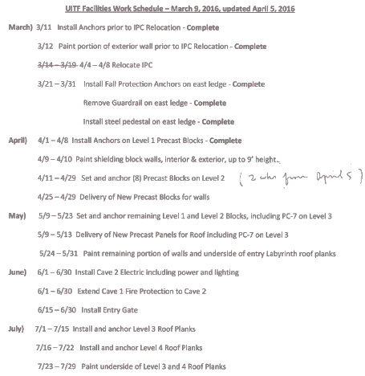
Facilities Tasks and Timeline
Waiting for labyrinth ceiling
Level 3 block
Electrical contractor site visit Wednesday

Slide 8
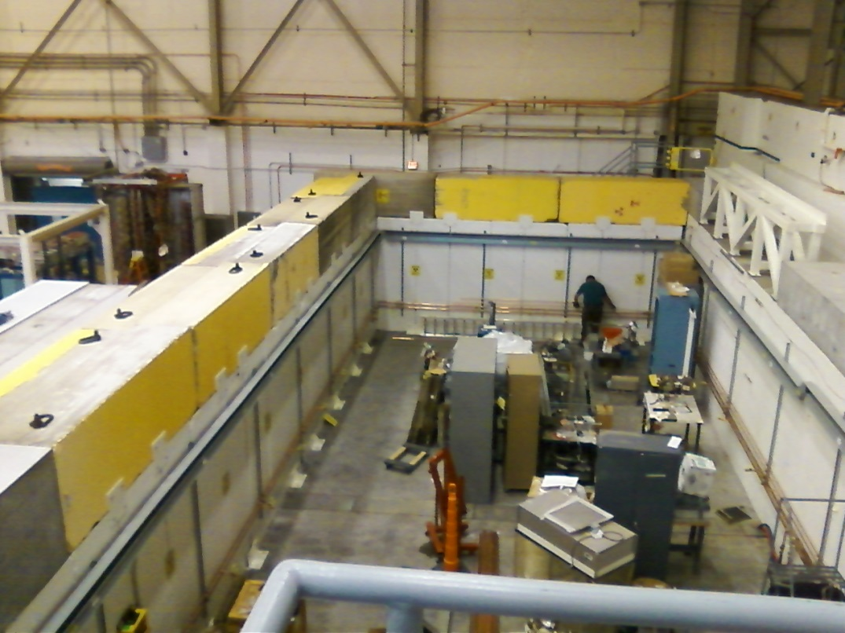
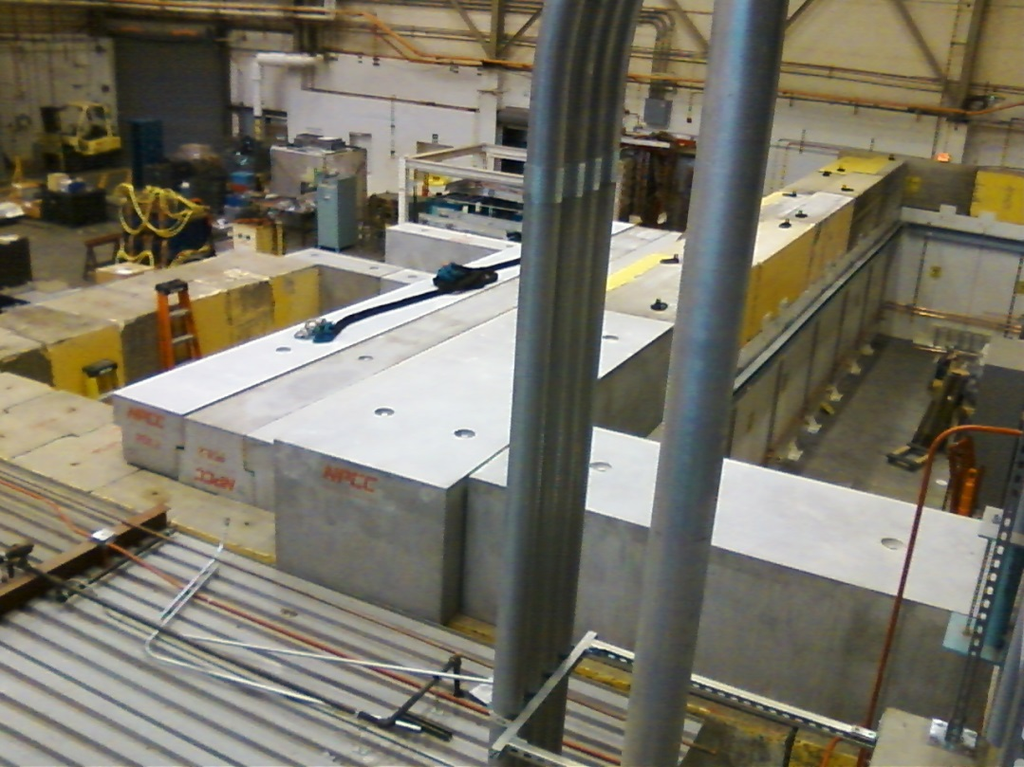
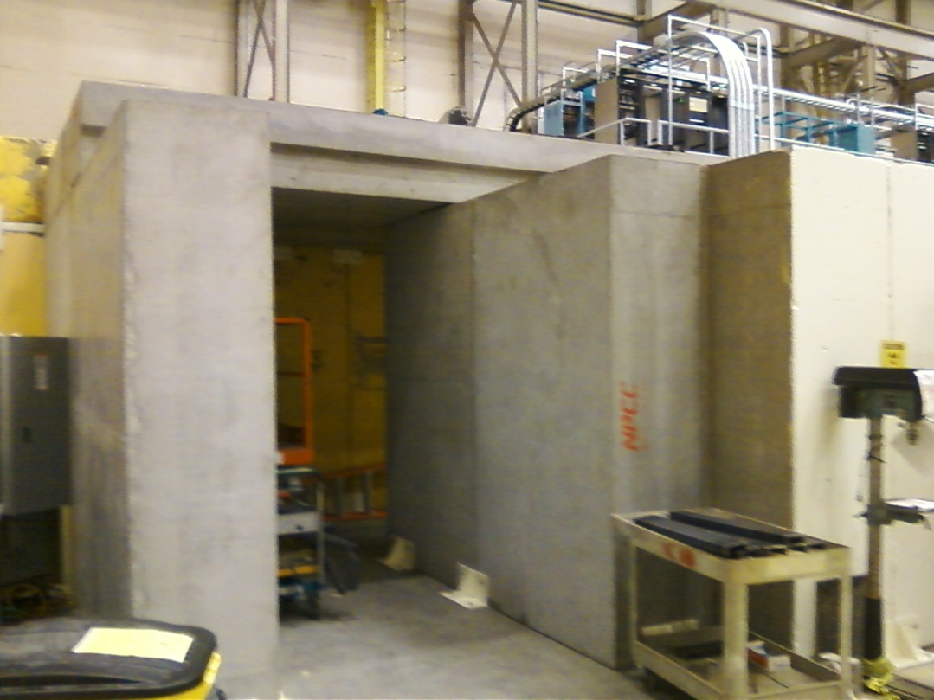
Status Facilities
Concrete layer#2 complete, bracing added for seismic support
Labyrinth walls complete, labyrinth ceiling tiles getting installed now

Slide 9
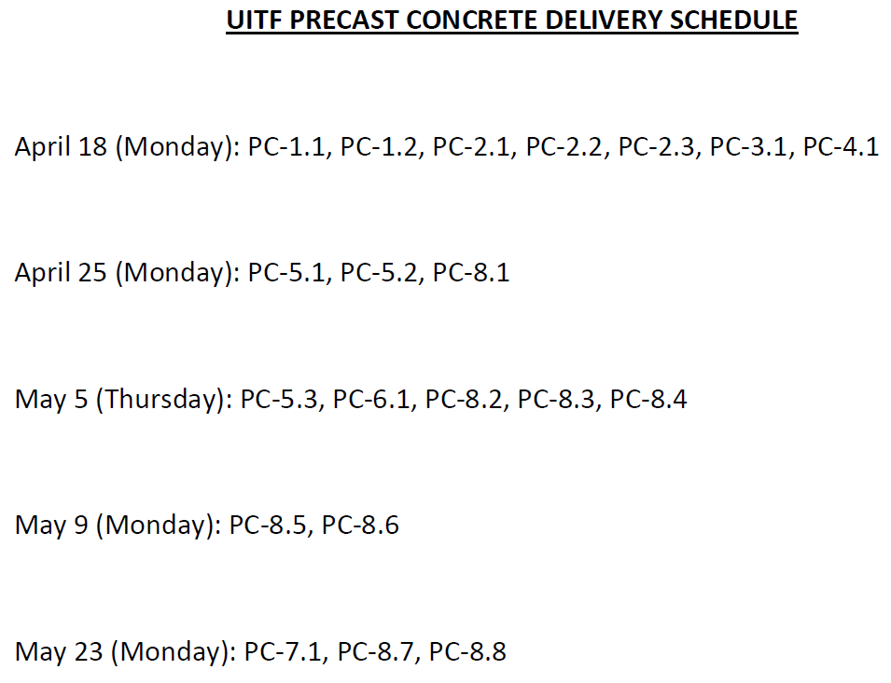
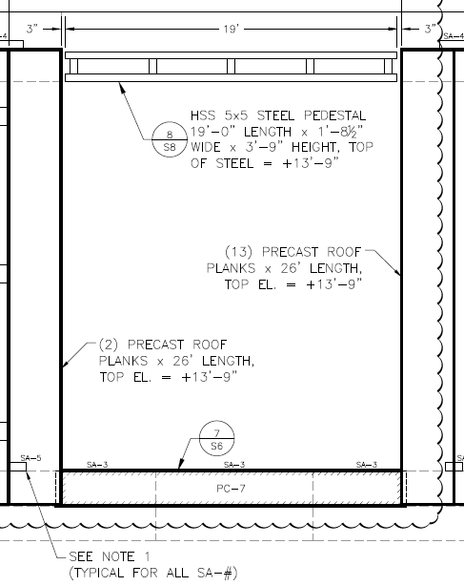
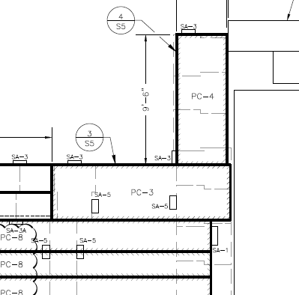
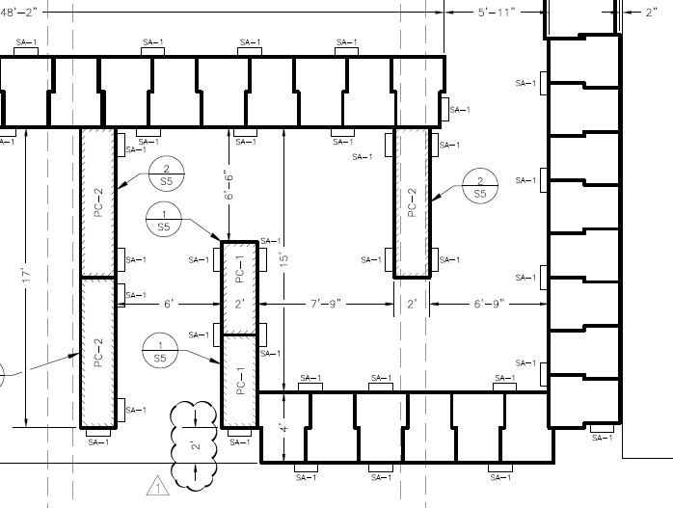
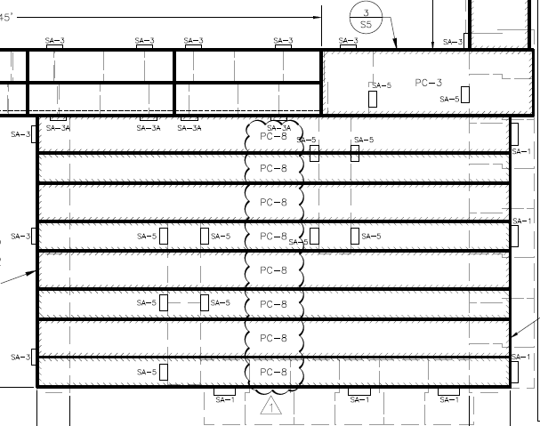
Facilities Tasks and Timeline

Slide 10
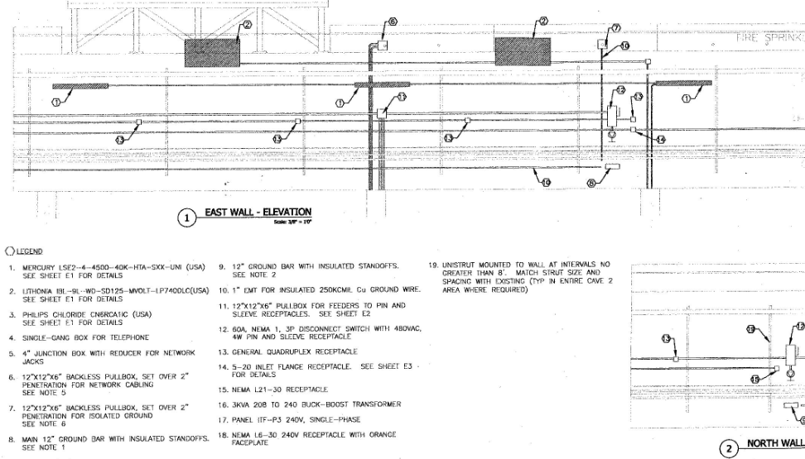
Facilities Tasks – Cave 2 electric

Slide 11
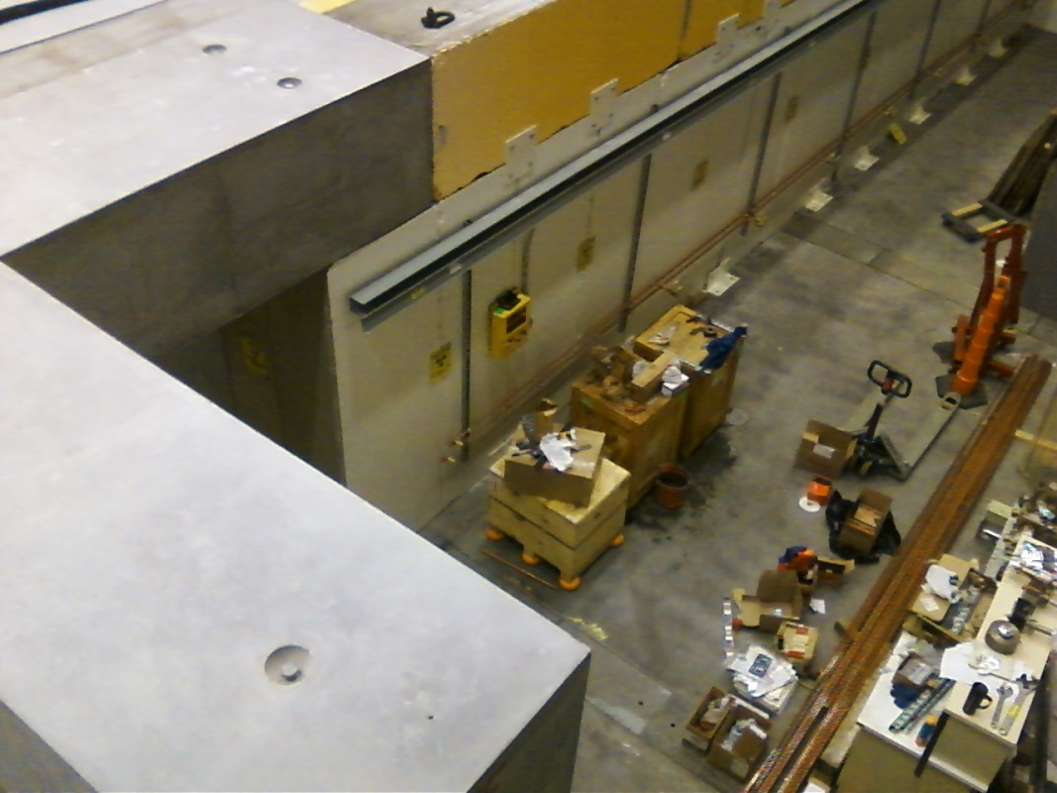
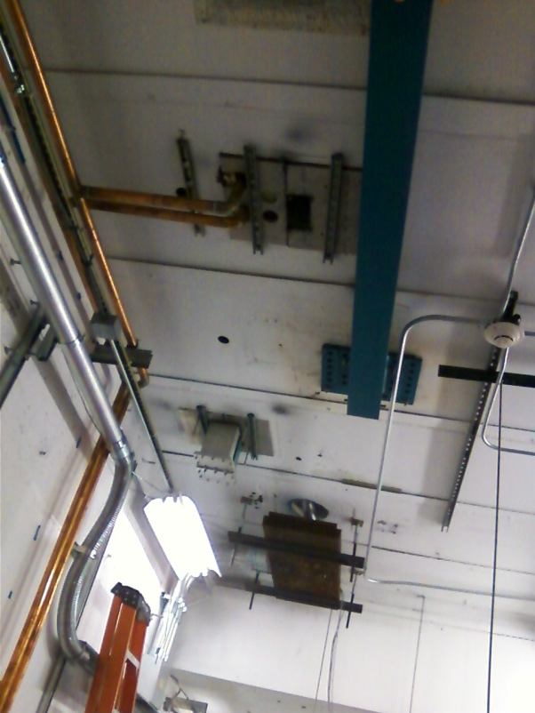
Status EES Installation Group
Completed installation of PSS box conduit
Completed the LCW piping
Working on compressed air and GN2 pipe
Working on shielding below ODH penetrations

Slide 12
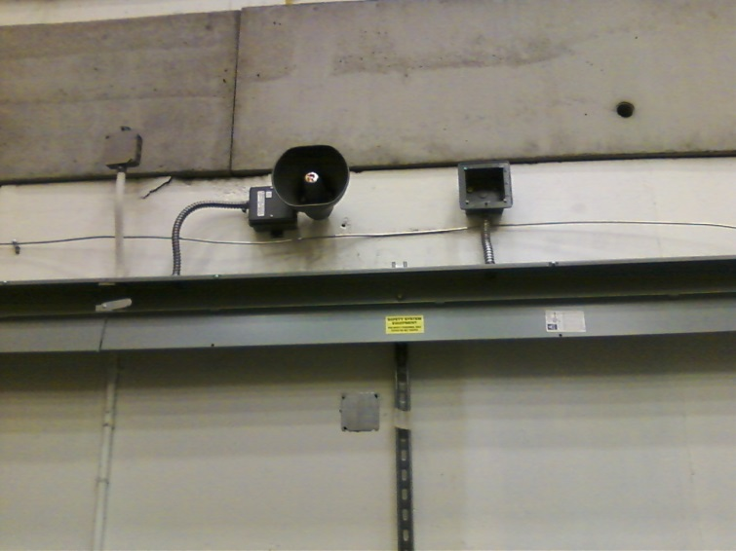
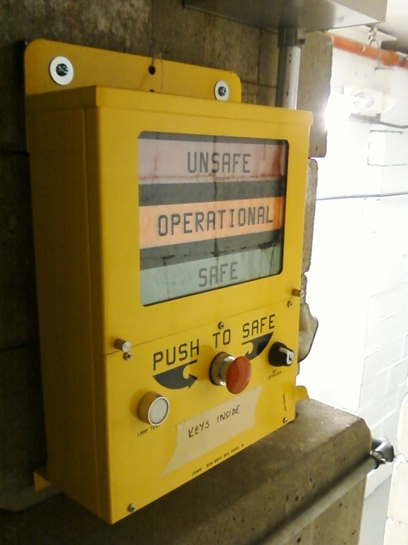
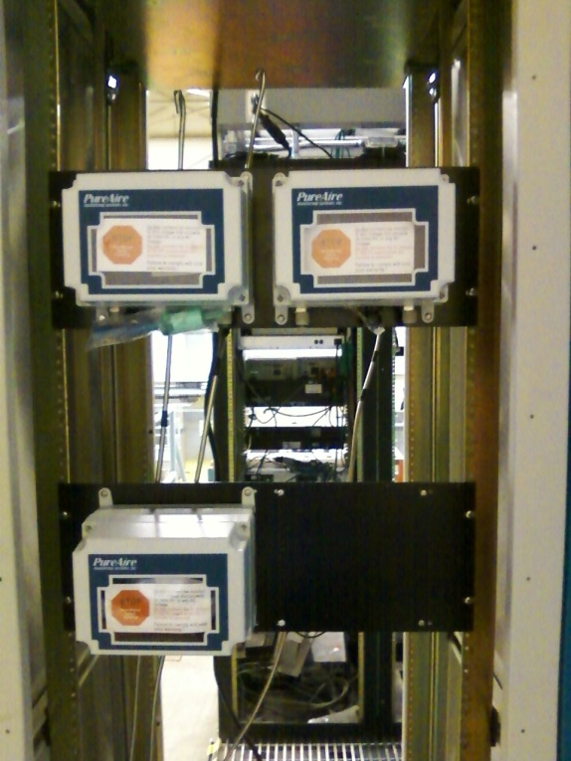
Status Safety System Group
Run/safe boxes attached to walls, annunciators
ODH sensor controls and tubing
Control panel inside Control Room
Building BLM system, set BLM locations

Slide 13
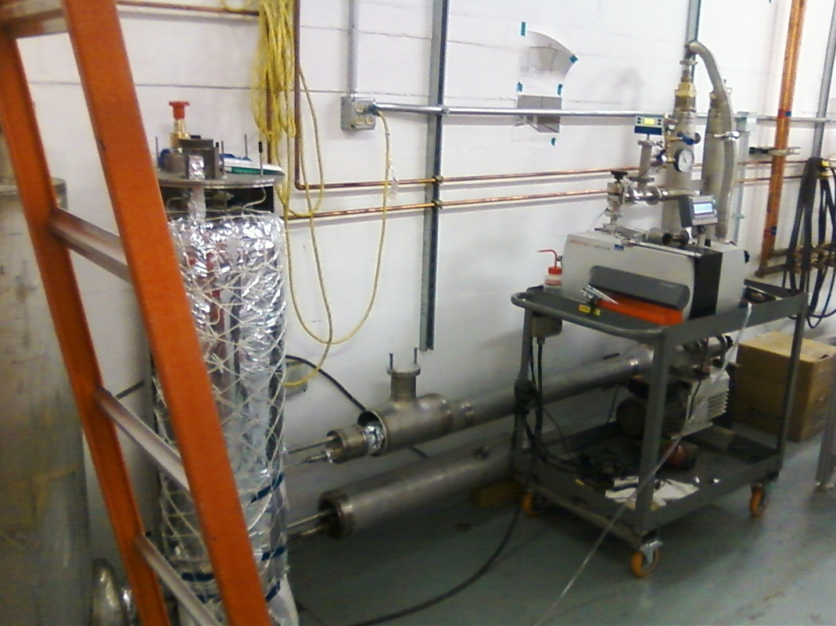
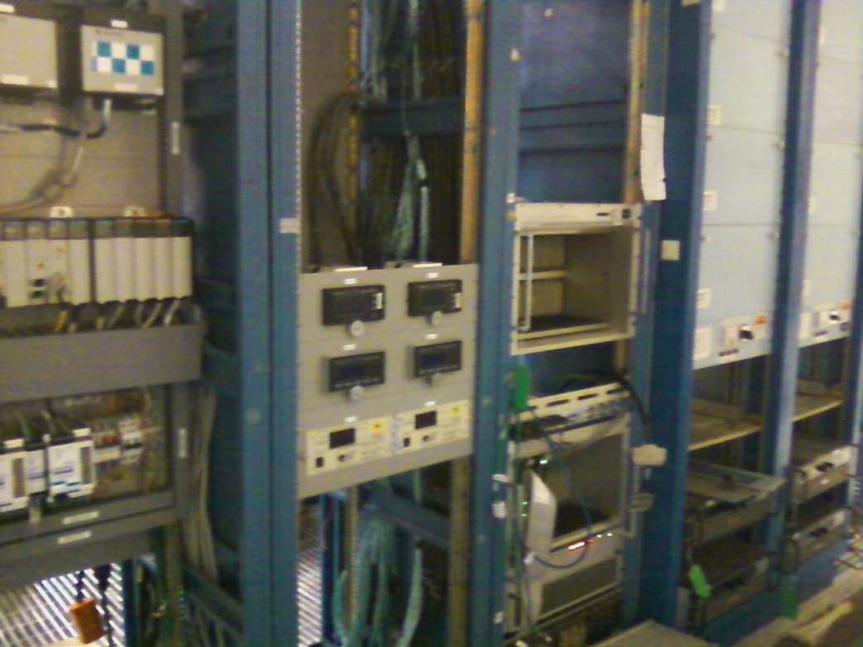
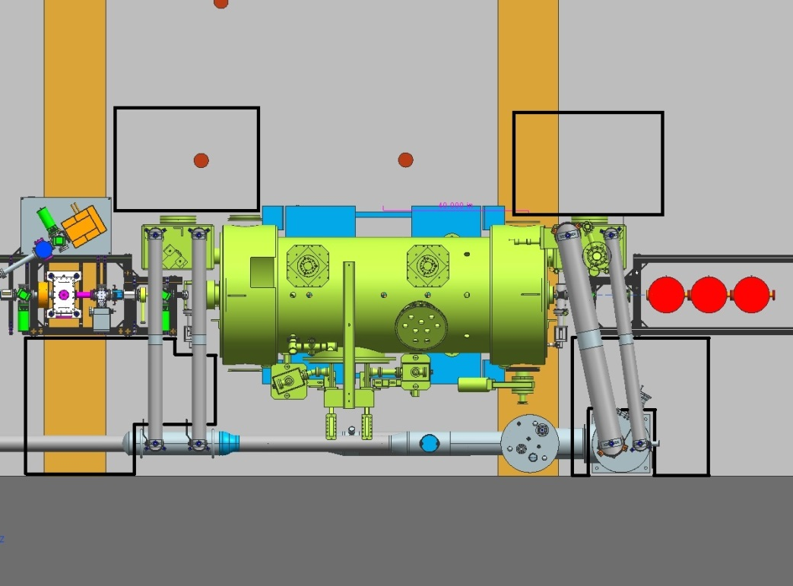
Status Cryo Group
Heat exchanger and controls delayed due to CEBAF work
Afterwards: U-tubes, turbo pump installation for shield line, HDIce warm return

Slide 14
Status Engineering
One magnet rack (of two) ready to power up, current limiting resistors added to cable tray
Preparing beamline viewer hardware, harps, current monitoring, ion pumps, vacuum valves, stripline BPMs, BCM
Safety System Group on track, ODH and PSS
Installation Group: LCW, GN2, compressed air, iron plate below chimney vents

Slide 15
Status RF
Machine shop working on waveguides
Klystrons identified and delivered to UITF
Buncher power calculated, don’t need 7kW solid state amplifier
Hovater spec-ing out the buncher and chopper amplifiers, installing master oscillator inside Laser Room

Slide 16
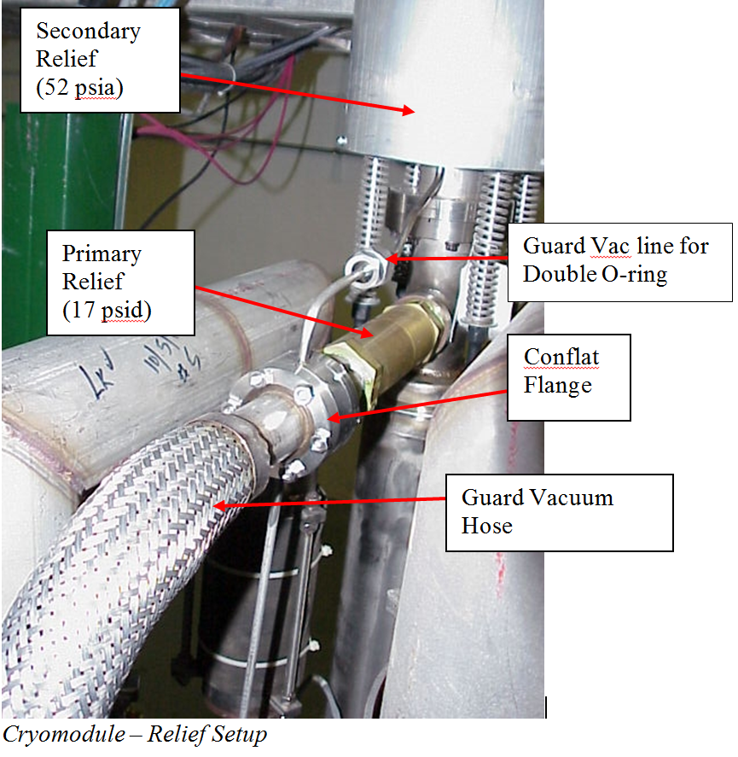
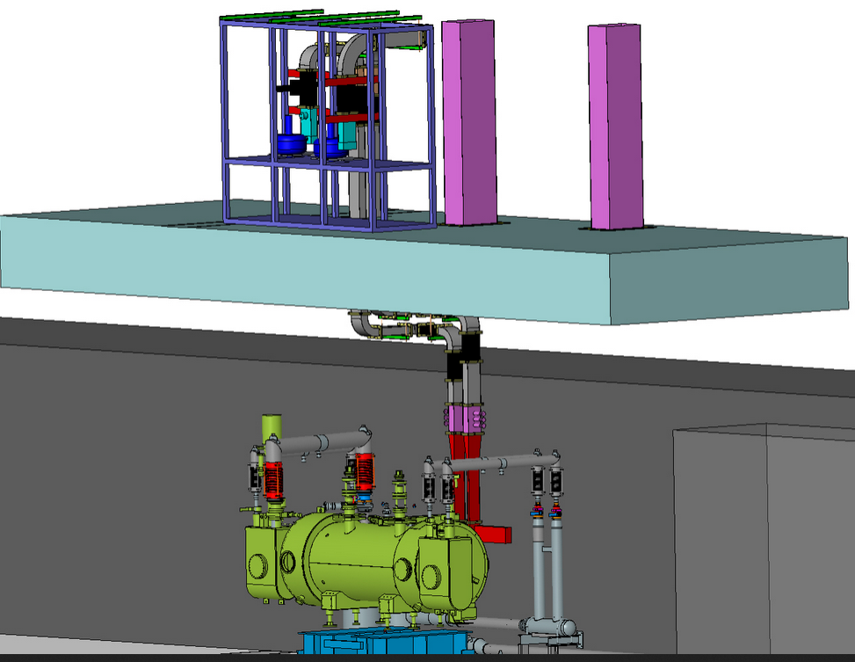
ODH Concern Mitigation – Cave 1
Machine chop fabricating Vent stacks, 7’ high located over two rectangular penetrations
¼ Cryomodule in Cave 1

Slide 17
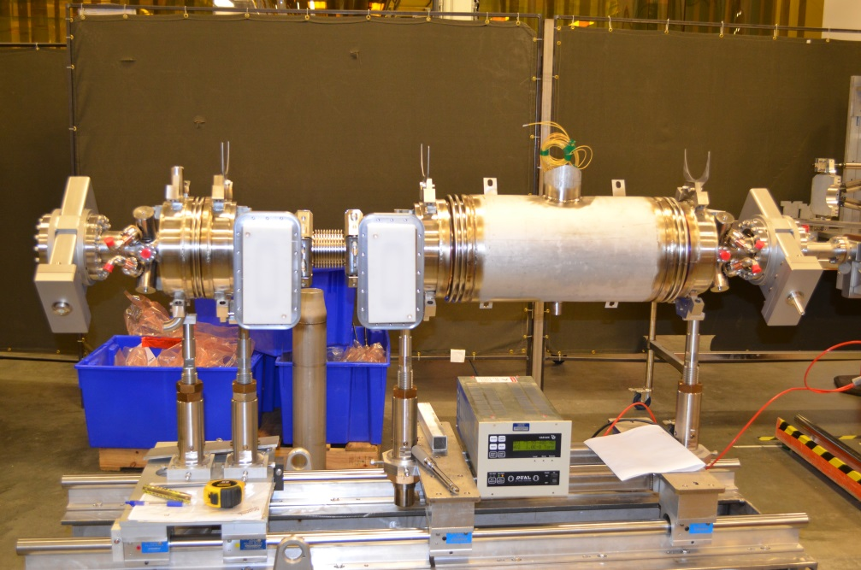
Status New ¼ CM
Test at CMTF June
Install at UITF July
Still on track ….
Need to design, install the vent pipe

Slide 18
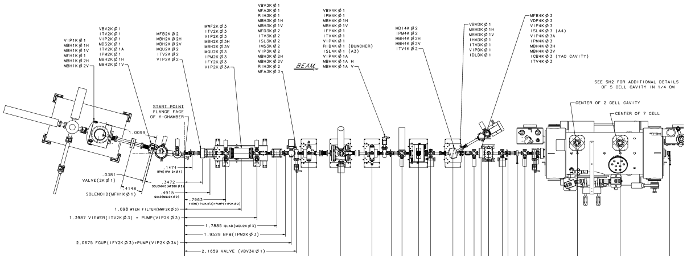
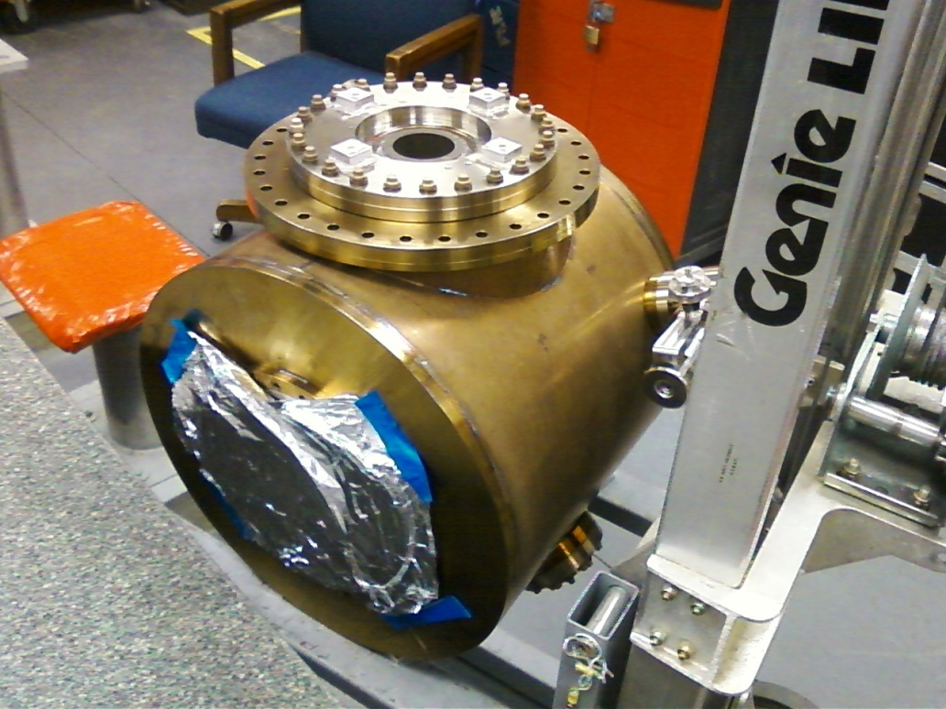
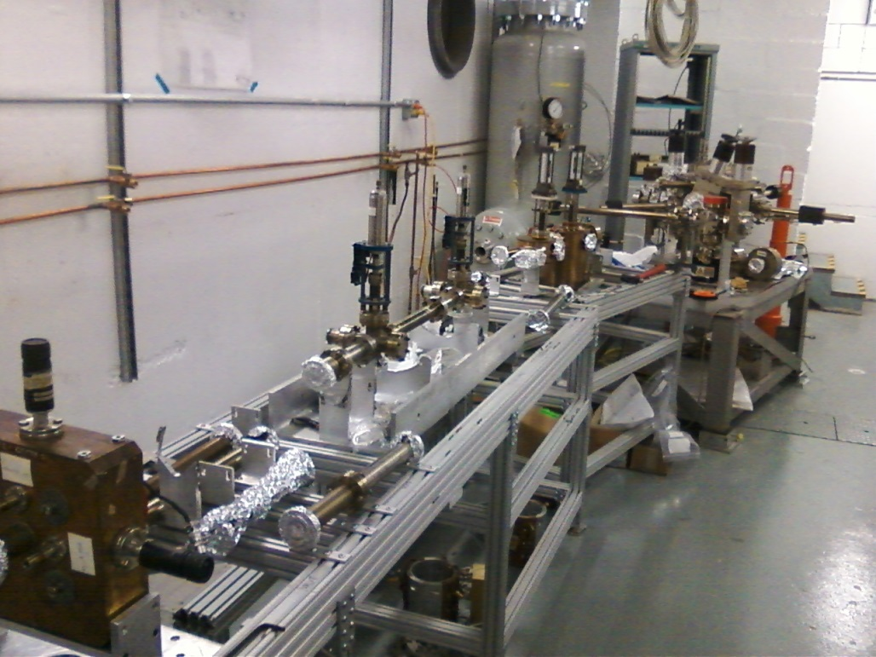
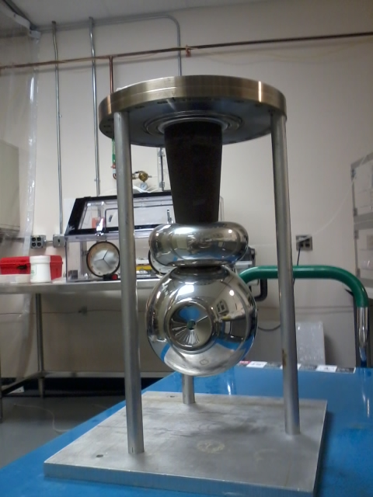
Status Gun Group
Adderley and Bullard have put the gun together, with electrode
Gun delivered to S&A, align anode + cathode, then move to Cave
New manipulators for prep chamber, align manipulators, bake the gun, the prep chamber, and the NEG-coated beamline (complete early June)
Adding components to keV beamline, complete by August
Machine shop busy with jobs…..

Slide 19
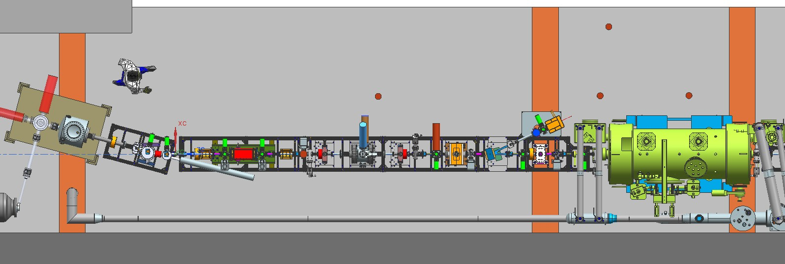
keV beamline
Working through a short list of Mechanical Design issues

Slide 20
MeV beamline
Insertable Faraday Cup
Fixed Dump
BLM locations
PSS BCM
Insertable Faraday Cup
Working to get 80/20 ordered for “ground level” beam

Slide 21
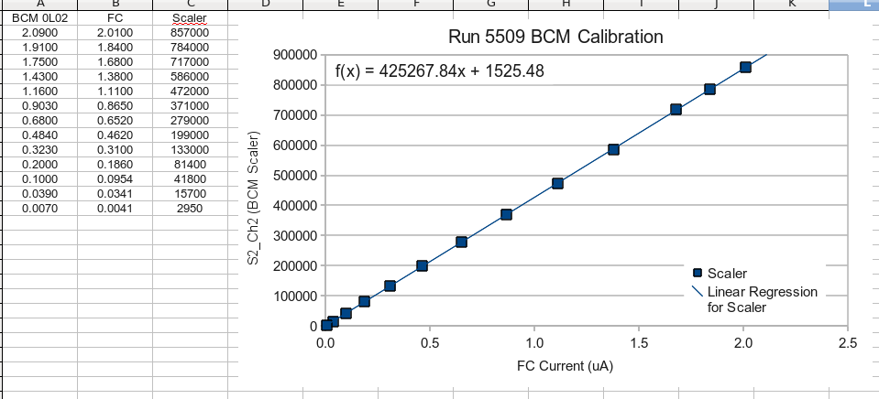
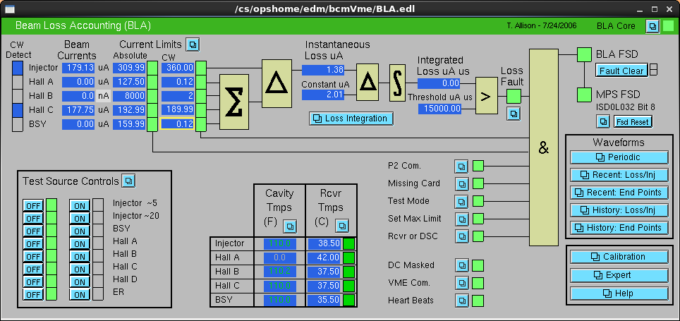
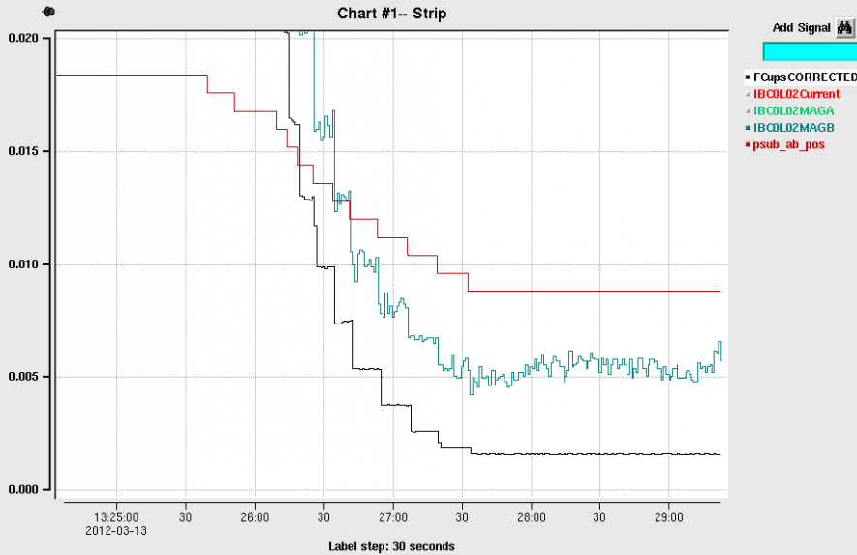
PSS BCM
PSS BCM
Insertable Faraday Cup
Can resolve ~ 1nA

Slide 22
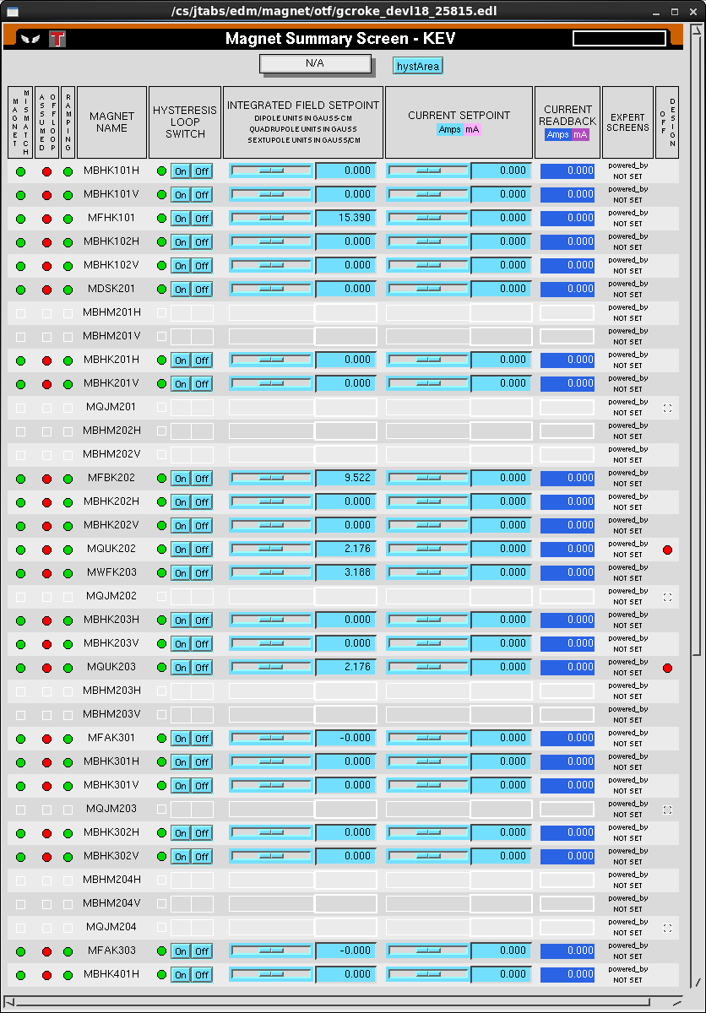
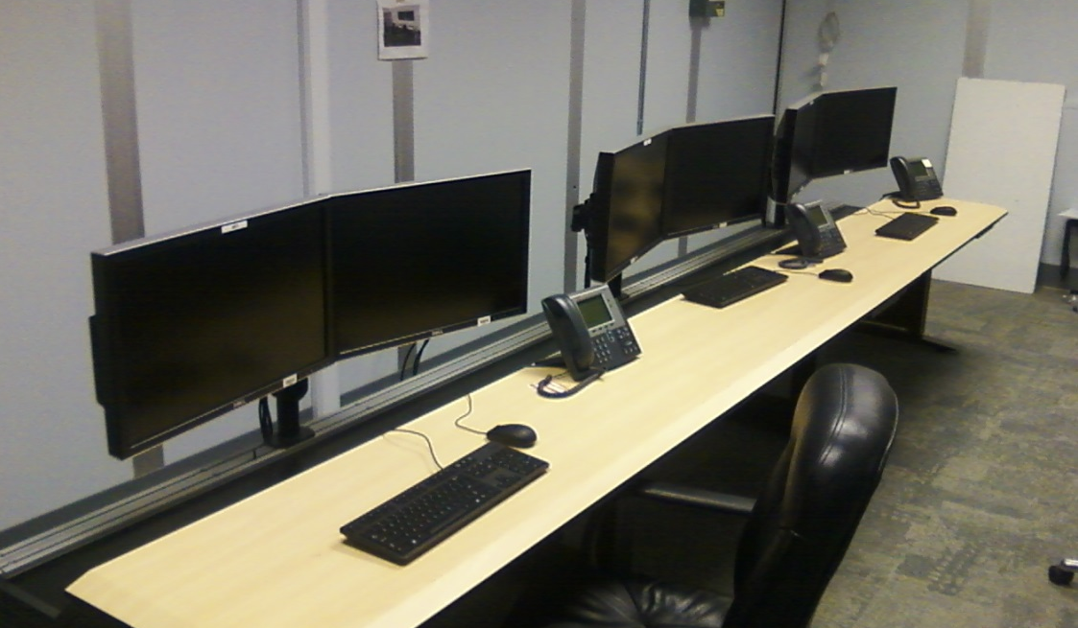
Status Operations
Software requests are coming in: Magnets, Gun HV power supply
But many more required: RF, viewers, video, valves, current monitoring, laser controls, etc.,

Slide 23
Status Reviews
UITF Accelerator Review: beamline design reviewed by Ops/CASA/SRF, March 18, 2016, “Will it work?” review
Geoff Krafft, Mike Spata, Reza Kazimi, Arne Freyberger, Todd Satogata, Fay Hannon
Yes, it will work. Summary distributed, Bruce Lenzer helping to make the review “official”
Internal Safety Review, May 10, 2016
Personnel safety, including radiation protection, and machine protection, assessment will be sent to SCMB
Conduct of Operations Review, June 2016
Commissioning and Operations plans (the SCMB review)
Accelerator Readiness Review, August 2016
Documentation in place, systems ready and checked out, staff trained
Experimental Readiness Review, Nov/Dec 2016

Slide 24
Status Reviews
Internal Safety Review, May 10, 2016
Poelker: UITF overview, from safety perspective
Areti: ODH Assessment
Hansknecht: gun HV, SF6, lasers
Vashek: Radiation
Henry Robertson: ODH and PSS
PSS BCM most pressing concern: setup design review, Use as much CEBAF-tested equipment as possible, limit the amount of new hardware that must be reviewed for reliability (this is good timing, CEBAF PSS will be pursuing something similar in future)
Assessment will be sent to SCMB - H. Fanning tallying up the recommendations

Slide 25
Status HDIce
HDIce Issues
What does beamline downstream of HDIce look like?
Raster (we seem ok with what is available)
Seeing < 1nA beam (want to get RF guys working on this now)
Build a “beam good” FSD node (one of our BLMs)
Another BCM, like PSS BCM, near the target
Where to put HDIce electronics? (Cave2 with network connection)
Energy spread, slits in chicane to reduce energy spread?
Accuracy of GEANT model
500 L dewar, ordering it with manifold to capture boil off

Slide 26
Milestones Update
WBS | Item | Milestone Description | Start Date | Projected Finish | % Complete | Days Float? | Change (%) | Change (Days)
1.04.xxx | Facilities | Civil work complete | 6-4-15 | August 2016 | 70% |  | 60 to 70%
 | Gun | Demonstrate gun ok at 200 kW at FEL GTS |  | December 2015 | 100% |  | done
 | CM | Commission cold ¼ CM, no beam |  | July 2016 | 50% |  | 40 to 50%
 |  | Beam from Gun to Cup in front of ¼ CM |  | September 2016 | 30% |  | 20 to 30%
 |  | Beam thru ¼ @ MeV energy delivered to cup in front of HDIce |  | October 2016 | 0
 |  | Beam to HDIce |  | April 2017 | 0
Facilities work complete by August
RF applied to new ¼ CM July
Beam at MeV during Fall 2016
Physics preparing for installation of HDIce November, 2016

Slide 27
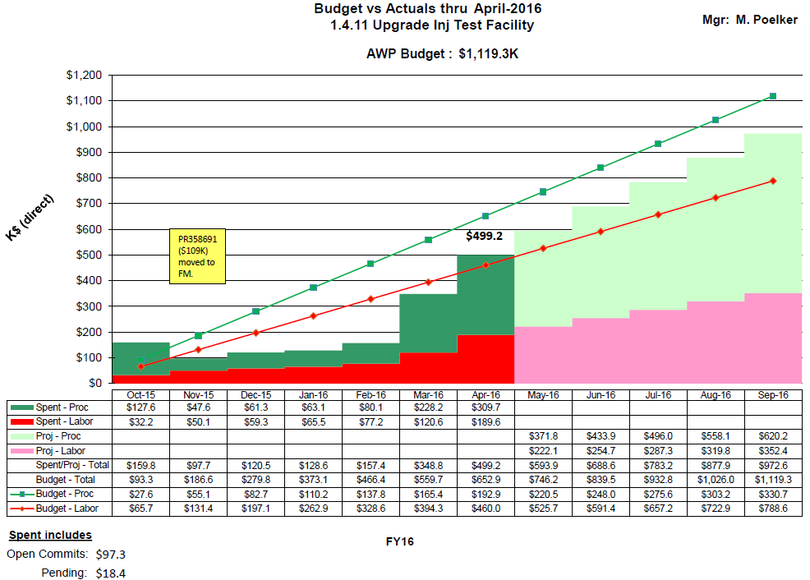
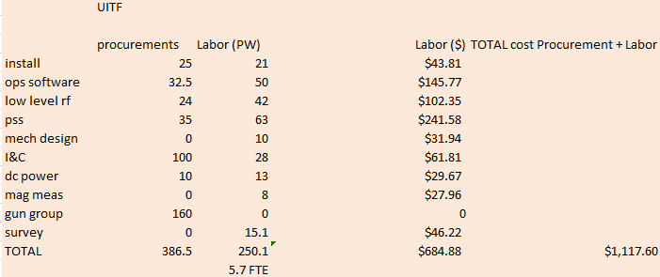
Budget UITFBL

Slide 28
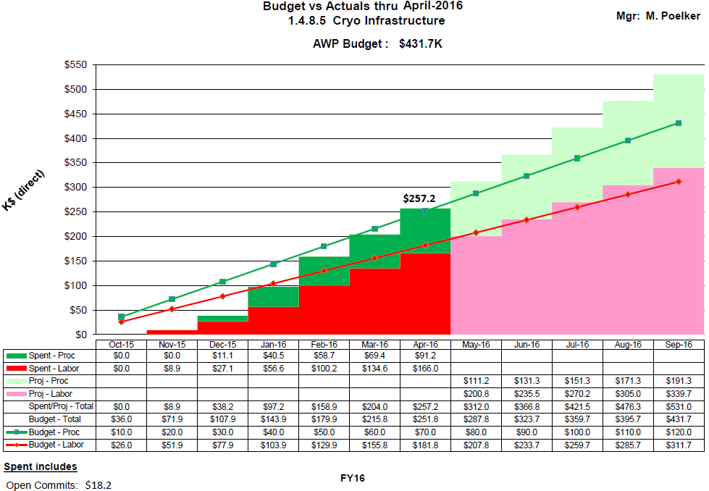
Budget ITFCRY
Don’t expect Cryo and RF to charge past July

Slide 29
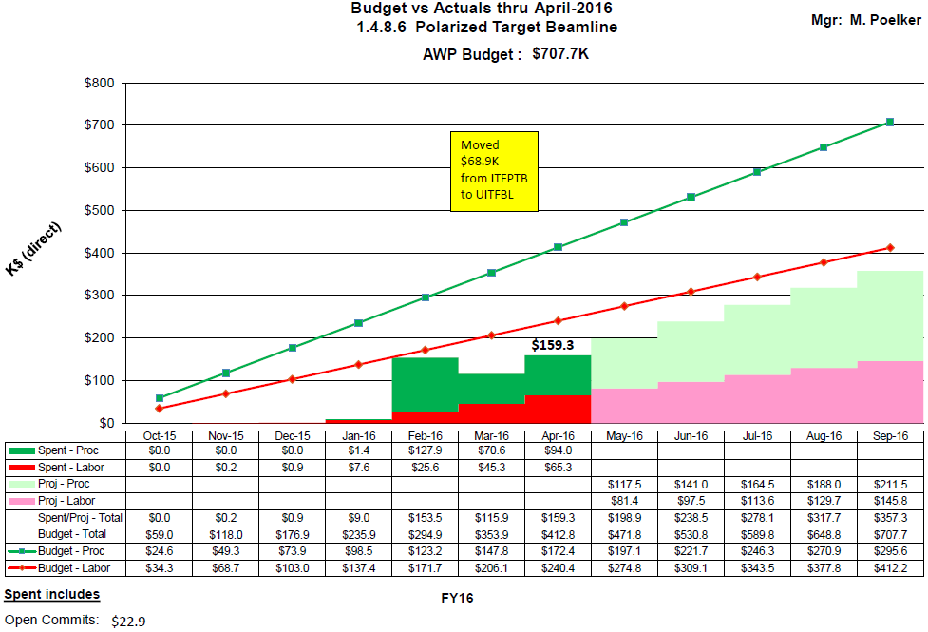
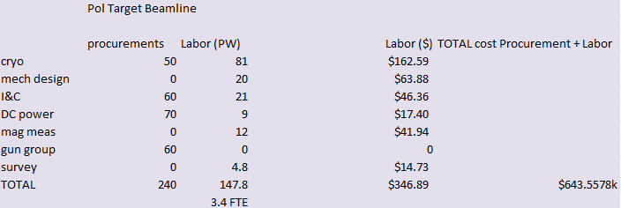
Budget ITFPTB

Slide 30
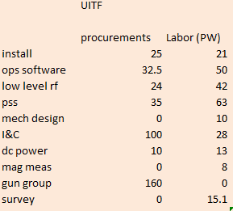
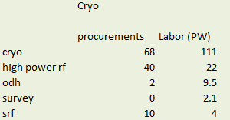
Today’s Focus
Current status:
Success will depend on groups working opportunistically on UITF
Cryo Group, EES I&C, Survey and Alignment, RF, Ops Software
Filling the racks, need to start loading software
CIS/gun group, need to grow the beamline
Need to order 80/20 beamline support for MeV region
Groups completing work “just in time”: SSG, SRF, RF, I&C and CIS
4.5 months left in FY….

Slide 31
Summary
There’s continued progress….
Fewer puzzles, now just lots of work to do

Slide 32
Backup Slides
Backup slides from past meetings, P&C meetings

Slide 33
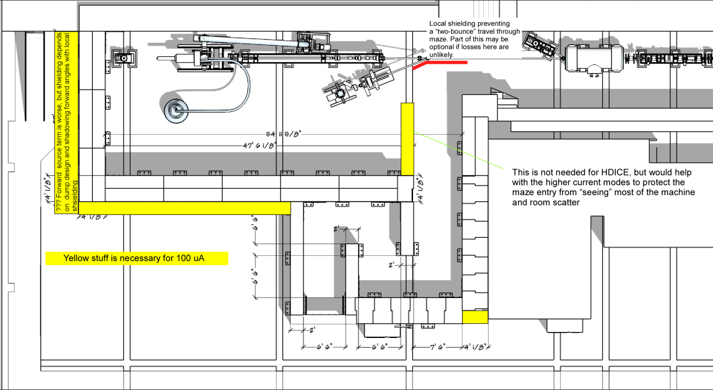
To refresh your memory…
What we started with…
UITF as imagined

Slide 34
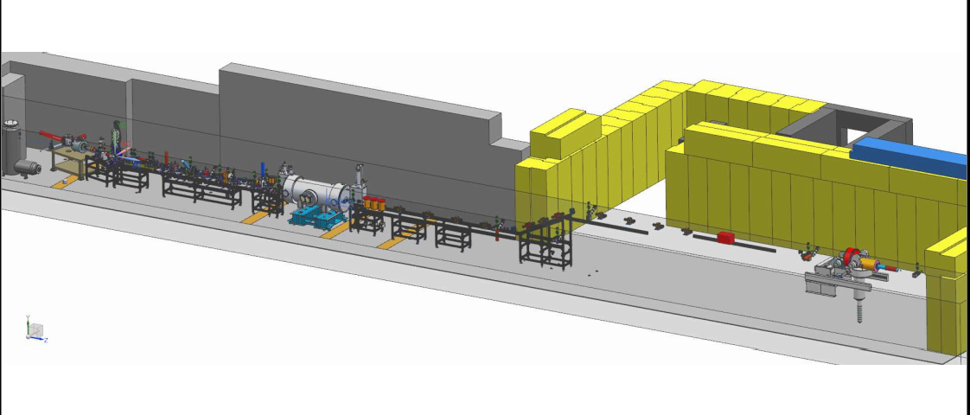
Design work was stopped…would like it to continue

Slide 35
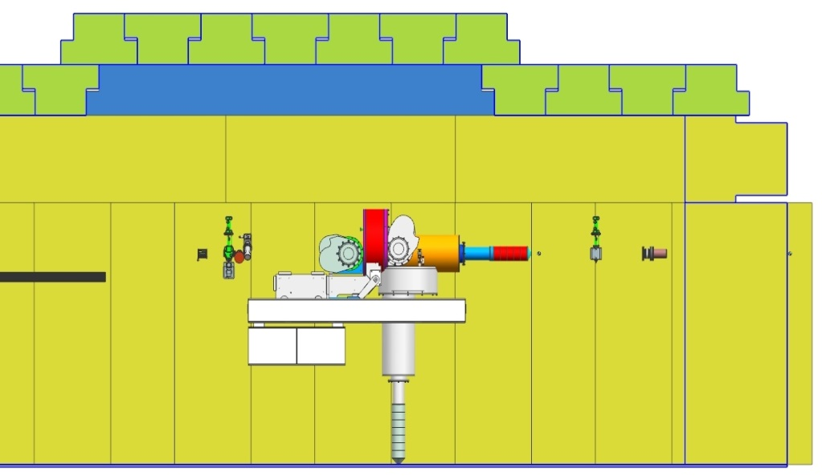
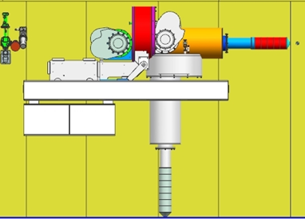
Status HDIce
Lots of scattering at MeV energy. Beam size very large at target. Decided to flip the orientation of the target
Cave2 design seems fine either way, need a Physics designer to be responsible for installation at UITF
Target here
Target here, better
e-beam
e-beam
Upstream radiation baffle blows up beam
In this configuration, we can achieve desired small beam size at target

Slide 36
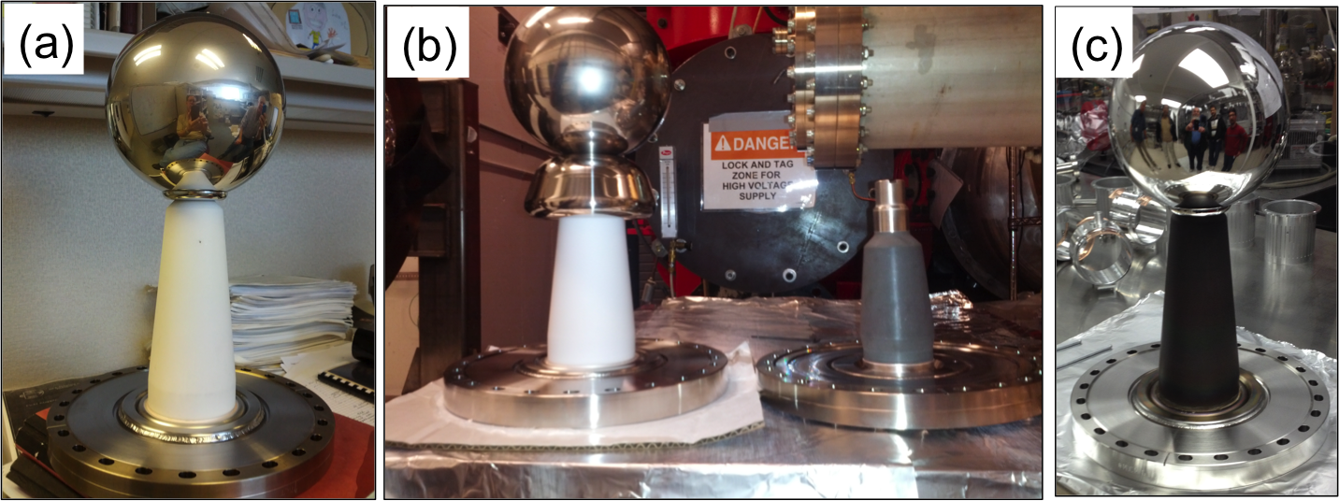
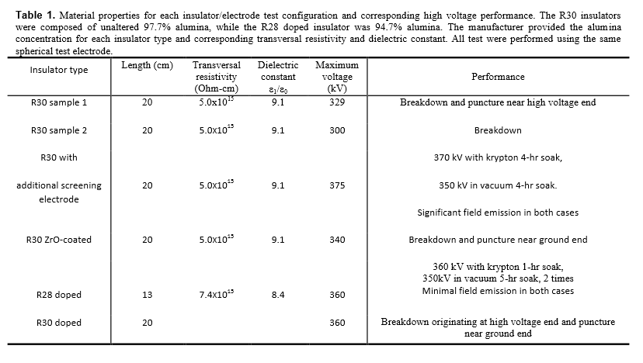
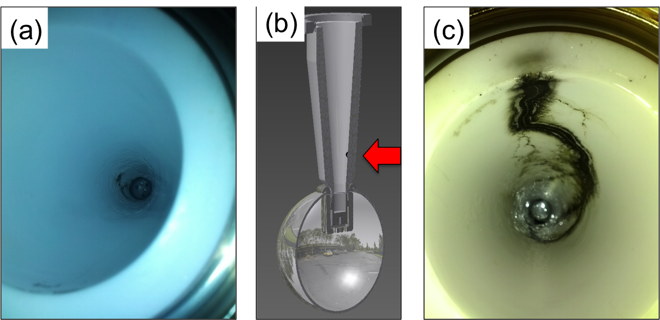
Notes:
Interior Page Design 2

Slide 37
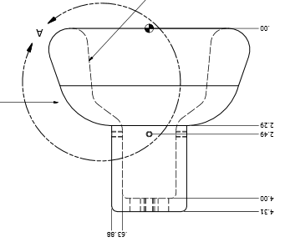
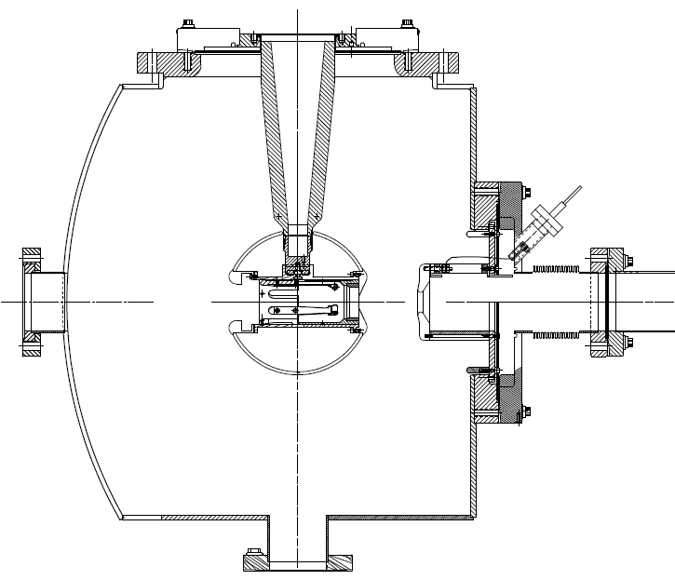
Next test late September
Combine the two features that provided incremental success: shed and doped insulator

Slide 38
Building the electron gun at LERF GTS
The new gun happy at 325 kV, stopping at this voltage for now. Shifting focus to building the beamline and photocathode deposition chamber (LDRD magnetized beam tests)

Slide 39
Gun and Beamline at GTS

Slide 40
Status HDIce
Stripline BPMs see 7nA beam with 1 Hz integration time. But we want to see 1nA beam, or even less at UITF. Don’t want to fly blind

Slide 41
Status HDIce
$$1nA=DutyFactor Ipeak+Ibaseline$$
$\frac{0.1msec}{16.7msec}$ x 10 nA = 0.06 nA ; I_{baseline} = 0.94nA
I_{peak}
Acceptable duration of high peak current: long enough to see but not long enough to depolarize
I_{baseline}
Need to work out details with HDIce and T. Allison, J. Musson

Slide 42
Schedule Ramifications
Commission ¼ CM (no beam), scheduled for Feb 2016
Electric/FM – ($78k + $23k for com. conduit) 101 k$
Control room – -
SRF checkout of ¼ CM present condition – -
Low Level RF – 16 k$
High Power RF – 25 k$
Network controls – 33 k$
Software control of RF – -
adequate shielding (Cave2 with a roof) – -
Cryo – (controls and pipe) 68 +/- k$
Installation group 9 k$
ODH - SSG 2 k$
EHS&Q approvals… -
Total 254 k$

Slide 43
Klystrons and Max UITF Beam Energy
Curt,
With 40uA beam current only, you can run at 8MV/m with less than 3kW from klystron. But you need a stub tuner to tune the FPC coupling Qext from the design value of 9e6 to 2e7.
Haipeng
Haipeng,
So the take away is that with 40uA and a 5 kW klystron, we can expect the 7 cell cavity to operate at 8 MV/m. Assuming microphonic detuning is in the 15 Hz range.
Curt
Matt, For the new ¼ CM, we will get a 5 kW tube for the 7 cell cavity. For the two cell maybe one that does 3-4 kW which should be ok. Then expect 200 kV from the gun, the two cell gives 1-2 MV, add the 5.6 MV from 7-cell and voila, we are close to 8 MeV ... Curt

Slide 44
Cryo, SRF, RF, Software and new 1/4 CM
Continuing to appreciate the interface between groups: cryo controls, SRF design features, the relief system, RF and I&C groups re: MPS, software
Software, getting started…
How to cool HDIce? Will use dewars for first tests
ODH assessment complete, sent to Dave Kashy for review, will need SRF to add pipe to vent relief valves, will need chimney stacks at two Cave1 penetrations

Slide 45
UITF MPS – what will it protect?
Protect the ¼ CM
Protect against beam loss and burn-through, maintain UHV
Protect viewers (this is a software interlock – Not FSD)
Protect magnets, ensure proper field for beam transport: comparator interlock, water flow or klixon interlocks
Protect RF beamline components: vacuum and water flow interlocks
Protect cups, apertures and dumps: water flow interlocks
Protect HDIce (mostly, this means putting the beam where it is supposed to go, protect against mis-steered beam)

Slide 46
Hardware configuration
Valves OPEN only when vacuum good
Current limiting resistors in series with magnets
Water flow interlocks at cups, dumps and apertures
Window comparators on dipoles and gun HV
Viewers inserted only when laser in pulsed-mode
Water flow interlocks at buncher and chopper cavities, RF can be applied to chopper and buncher only when vacuum reads “good”
Helium liquid level interlocked to klystron high power RF

Slide 47
FSD Input Signals
An FSD trip will shutter laser and sometimes close all valves
BLMs will shutter laser: CEBAF-style BLM modules (x2)
LLRF control boards with CEBAF-style FSD signals
Vacuum FSD signals from ¼ CM. Helium liquid level interlocked to klystron control panel
All beamline ion pumps ganged together, close laser shutter and close all pneumatic valves when pressure exceeds a setpoint
Window comparators using 16 bit ADC cards designed by EES
HDice “off target” detector (qty 1, suspect it will look like a BLM)

Slide 48
Similar to CEBAF
SSG BLM chassis, x2 units
New LLRF control boards
Cryo and SRF signals from ¼ CM
Window comparators using 16 bit ADC cards designed by EES
FSD signals summed using VME boards with 12 input channels each
FSD signals transmitted via fiber at 5 MHz
SCAM to create low duty factor modes
CEBAF style pockel cell tune mode generator: RTP cell with <250ns response time, backed by shutter that closes 5-10ms later

