Slide 1

Polarized Electrons for Polarized Positron Beams
  Polarized Electrons for Polarized Positrons
  CEBAF Physics Motivation and Status
    Low Energy Concept
    High Energy Concept
  JLEIC Approach
  Why not PEPPo for the ILC ?
  Polarized Electron Source R&D
Joseph Grames, Jefferson Laboratory, USA
Malek Mazouz, University of Monastir, Tunisia
Eric Voutier, IPN-Orsay, France
International Workshop on Future Linear Colliders (LCWS 2018)
October 22-26, 2018

Slide 2




New Method : Exploit Electron Beam Spin Polarization
Polarized Bremsstrahlung
Polarized Pair Creation
P_{circ}(γ) / P_{z} (e⁻)
P_{z} (e⁺) / P_{circ} (γ)
E_{γ} / T_{e-}
T_{e+} / (E_{γ} – 2m_{e+})
E.A. Kuraev, Y.M. Bystritskiy, M. Shatnev, E.Tomasi-Gustafsson, PRC 81 (2010) 055208

Slide 3
Enabling Technology : Advances in Polarized Electron Sources
Strained GaAs:
GaAs on GaAsP
Strained Superlattice GaAs:
Layers of GaAs on GaAsP
Bulk GaAs
100 nm
100 nm
625 μm
2 μm
14 Layers
350 μm
QE ~ 5%, 30 mA/W
Pol ~ 35% @ 780 nm
QE ~ 0.2%, 1 mA/W
Pol ~ 75% @ 850 nm
QE ~ 1%, 6 mA/W
Pol ~ 89% @ 780 nm
P_{e-} 35% 35% 75% 75% 85% 89%
I_{e-} 30μA 100μA 50μA 100μA 150μA 200μA
1995 1998 1999 2000 2004 2012 2018
Figure-of-Merit (P²I) has improved by a factor of 43
over the span of the CEBAF “6 GeV era”

Slide 4

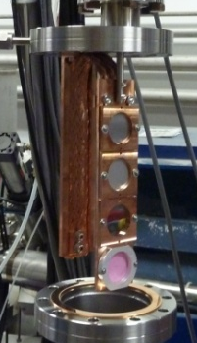
PEPPo Experiment : Feasibility Demonstration at the CEBAF Injector
PEPPo (Polarized Electrons for Polarized Positrons) => demonstrate feasibility of using bremsstrahlung radiation of MeV energy Polarized Electrons for production of Polarized Positrons.
J. Grames, E. Voutier et al., JLab Experiment E12-11-105 (2011)
8 MeV, 1μA, 85% polarization
Tungsten (1mm)
PEPPo possible due to support from SLAC E166, DESY, Princeton, Cornell, International Linear Collider Project and the Jefferson Science Associates

Slide 5

PEPPo : Polarized Positron Production
(PEPPo Collaboration) D. Abbott et al. , Phys. Rev. Lett. 116 (2016) 214801
PEPPo demonstrated efficient polarization transfer of 8.2 MeV/c polarized electrons to positrons, expanding polarized positron production using MeV electron beam energies.
electron beam polarization
85.2 ± 0.6 ± 0.7 %
Whenever producing e⁺ from e⁻, polarization is coming for free, if initial electrons are polarized.

Slide 6
Why Polarized Positrons at Jefferson Lab?
Parameter | CEBAF Electron Beam | Proposed Positron Beam
Typical Intensity | 1 nA - 100 μA | >100 nA (pol) >1 uA (unpol)
Spin Polarization | >85% | >50%
Helicity Reversal | 30 – 2000 Hz (Pockels cell) | 30 – 2000 Hz (Pockels cell)
Duty Factor | 100% (cw) | 100% (cw)
Bunch Frequency | 249.5/499 MHz | 249.5/499 MHz
Polarized electron beams have supported some of the highest impact results from the JLab program:
  The strangeness distribution in the nucleon (HAPPEX and G0)
  Precision Tests of the Standard Model (Q_{Weak})
  Measurement of the neutron skin in ²⁰⁸Pb
  Polarization transfer measurement of G_{E}/G_{M} for the proton
Unpolarized positron beams offer greater precision
  Comparison of e⁻ with e⁺ tests our understanding of two photon effects
Polarized positron beams provide a key tool
  Unraveling nucleon structure through the measurement of charge-sensitive General Parton Distributions
  Expand the nature of these tests (e.g. for G_{E}/G_{M} via polarization transfer)

Slide 7
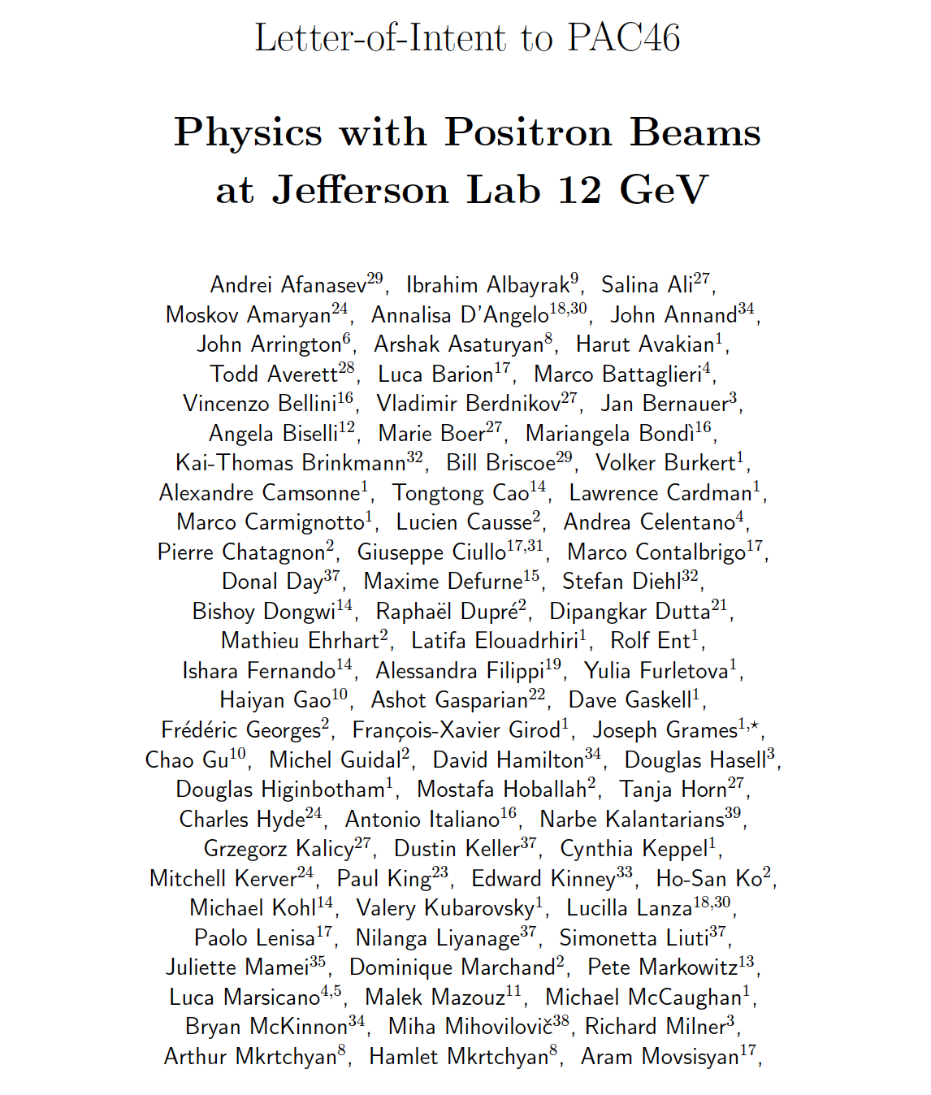


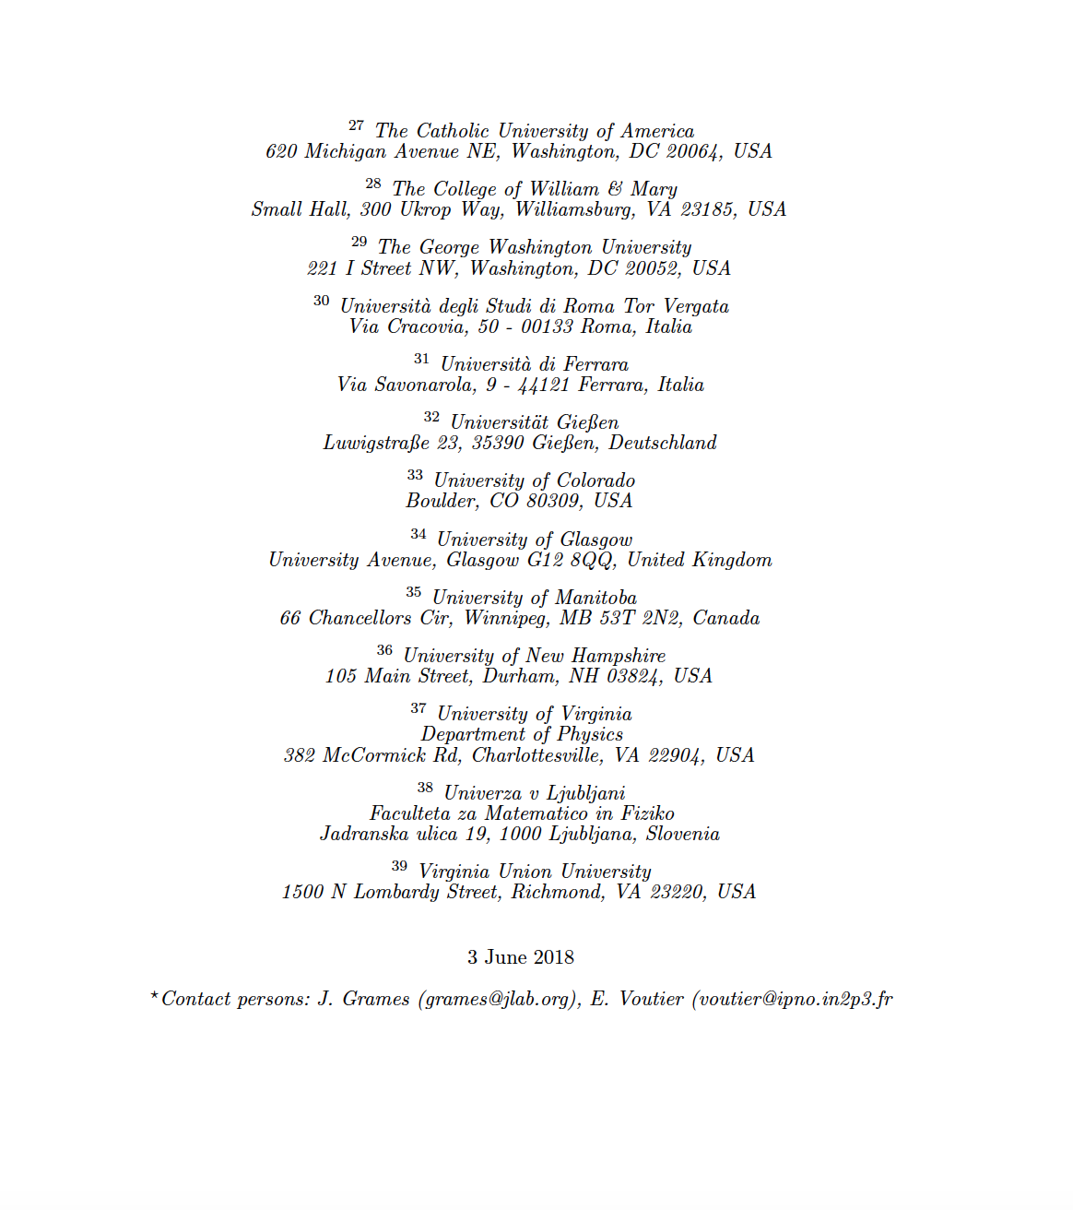
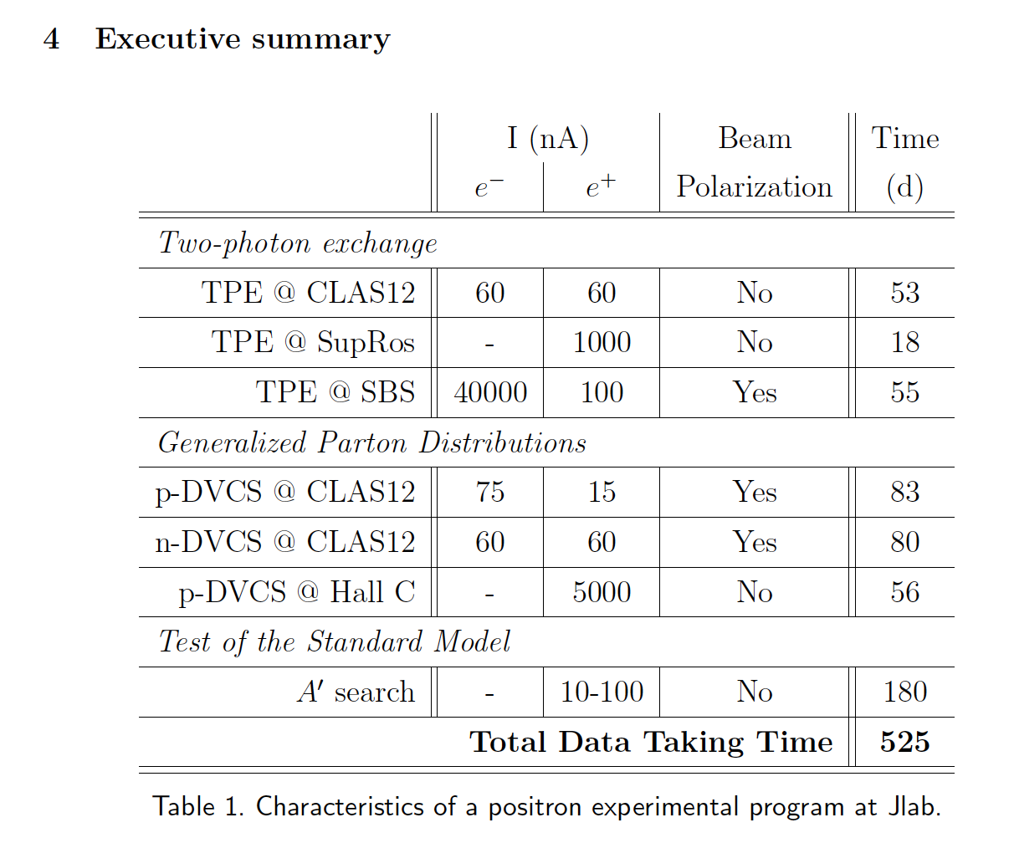
Letter of Intent to PAC46 (LOI-12-18-004)
Jefferson Lab Positron Working Group (JLAB-PWG) formed in 2016
  120 members (>90% are JLab Users), and growing
  39 institutions
Letter of Intent “Physics Program with Positron Beams at CEBAF 12 GeV” submitted to PAC46 (July 2018), highlighting 7 mini-LOI’s
Summary: “These measurements all have significant physics interest. The proposers should carefully evaluate feasibility and present the best case possible in a future proposal.”

Slide 8



Figure of Merit (Electron Energy 60 MeV)
R. Dollan, K. Laihem, A. Schälicke, NIM A 559 (2006) 185,
J. Dumas, J. Grames, E. Voutier, JPos09, AIP 1160 (2009) 120
J. Dumas, Doctorate Thesis (2011)
The polarization distribution of generated positrons is dominated by low-energy events.
The positron energy at the optimum FoM (P²I) is about half of the electron beam energy.
Optimum
FoM
Optimum energy

Slide 9
CEBAF: Low Energy (123 MeV) with High Current + Low Bunch Charge
Positrons would be created at the CEBAF injector, using the 123 MeV electron beam.
Selecting 60 MeV positrons maximizes the FoM (60%, 100 nA).
Selecting 6 MeV positrons maximizes the flux (> 1 μA).

Slide 10
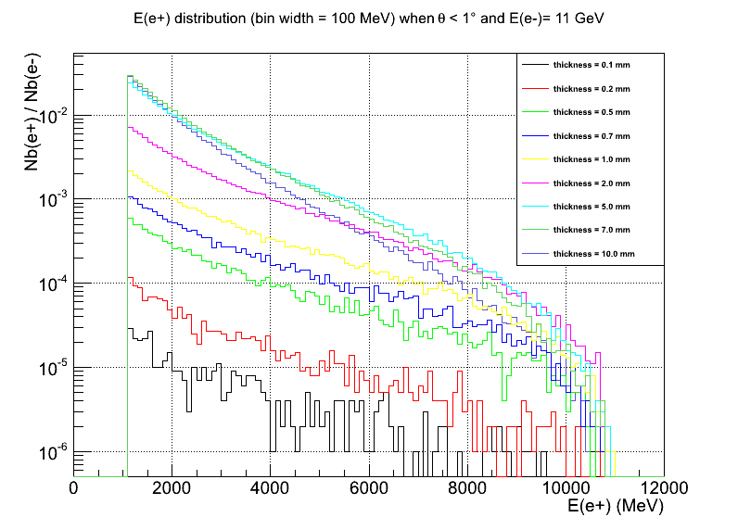
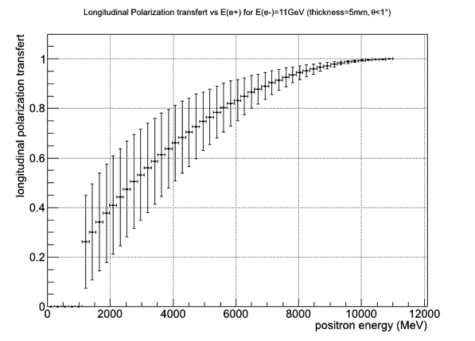
CEBAF: High Energy (11 GeV) with Low Current + Low Bunch Charge

Slide 11

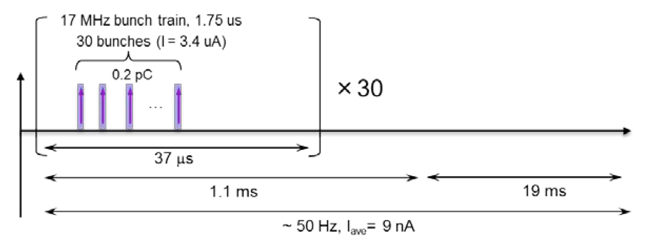
Polarized Positrons at the Jefferson Lab Electron Ion Collider
A polarized positron injector suitable for the Jefferson Lab Electron Ion Collider (JLEIC) has also been considered.
L ≥10³³cm⁻²s⁻¹ P_{e+}≥40%
I_{ave} > 10 nA (~10¹⁰ e+/s)
I_{peak} > 4 μA (~10¹³ e+/s)
e⁺
Challenge is accumulating high positron bunch charge with high rep rate.

Slide 12
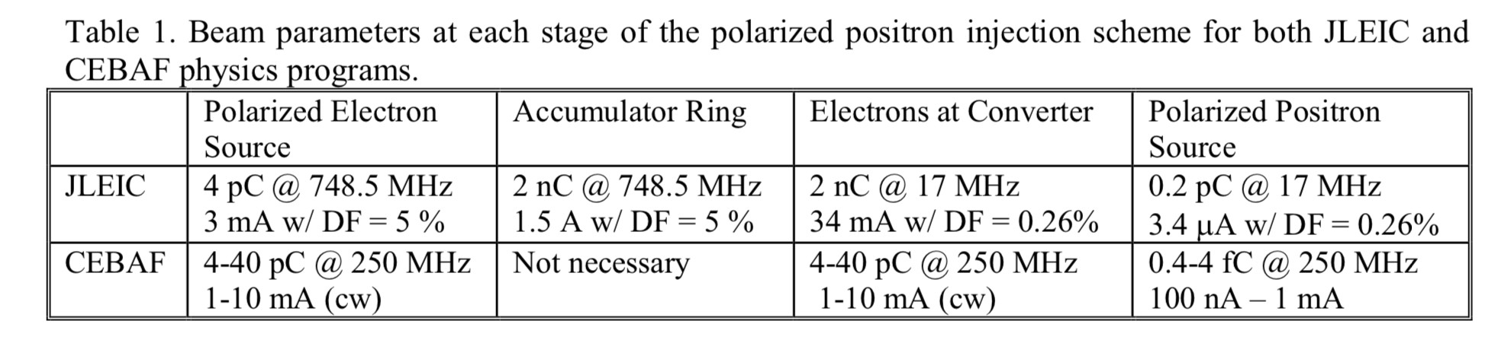
JLEIC: Low Energy (50 MeV) with Low Current + High Bunch Charge
Positron Conversion/Collection Efficiency ~ 5 x 10⁻⁴
60% in polarization
Accumulator Ring (36m)
500-turn
phase-space painting
Power on target
3.4 MW peak power
0.6 kW average
Bunch
Management
Polarized Electron
50 MeV Injector
Harmonic kicker
Extraction
to CEBAF
350 keV polarized e⁻
~ nC @ 17 MHz
3. 4 uA
200 keV polarized e⁻
8 pC @ 748.5 MHz
~6mA
50 MeV polarized e⁻
4 nC bunches @ 748.5 MHz
~25 MeV Polarized e⁺
2 pC @ 17 MHz
50 MeV polarized e⁻
4 nC @ 17 MHz

Slide 13
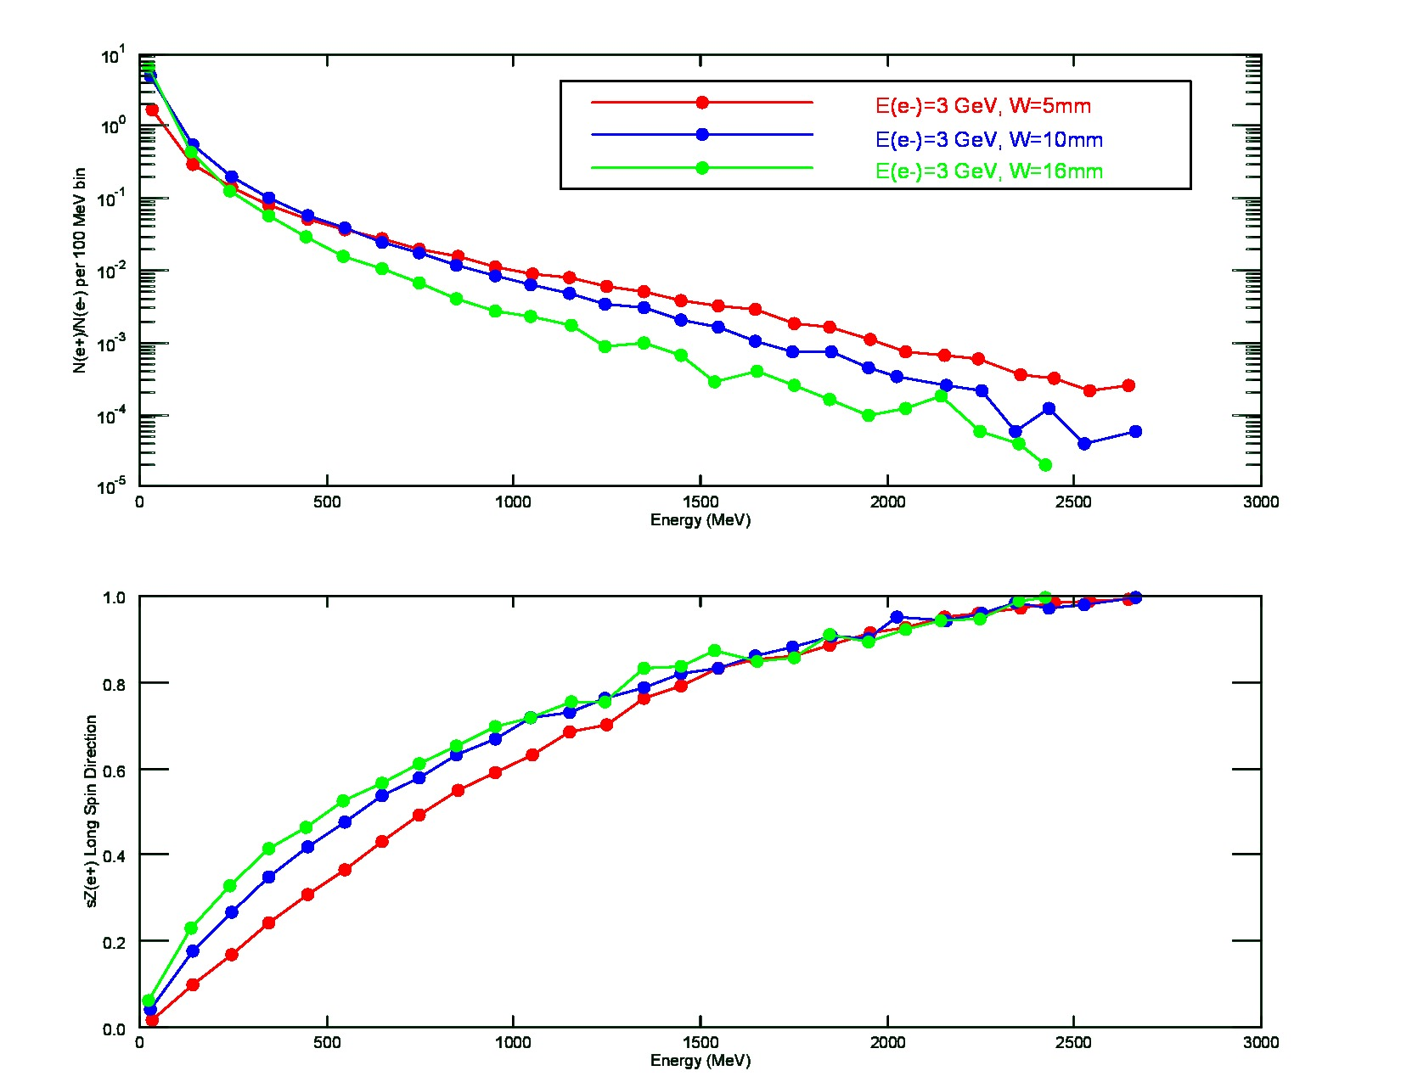
ILC : Spin Polarized Electron Driven Source ?
What is expected (w/o any cuts) for a 3 GeV spin polarized electron beam over range of target thickness (5mm – 16 mm)
Thicker targets improve yield of lowest energy positrons, and provide a degree of spin filtering.
Thinner targets conversely improve yield of highest energy positrons, and with less impact by spin filtering.
E (e+) | Y/100 MeV | <Sz> | <Pz>
100 | 30-60 % | 0.15-0.25 | 15-20 %
300 | 7-10 % | 0.25-0.40 | 20-35 %

Slide 14
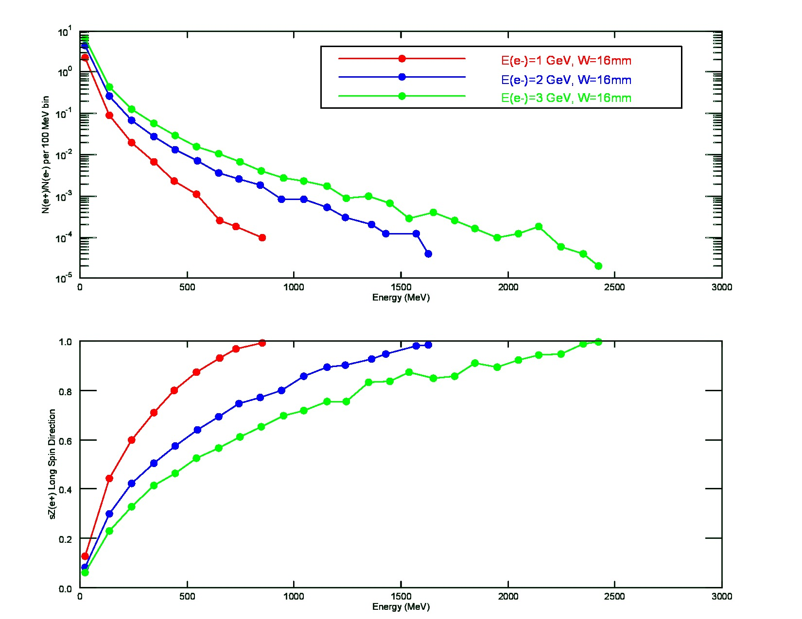
ILC : Spin Polarized Electron Driven Source ?
What is expected (w/o any cuts) if the electron beam energy were lowered, for the same target thickness (16mm).
Lower electron beam energy results in lower yield, expectedly, preferentially at low positron energy.
Lower electron beam energy results in high spin polarization at same positron energy
E (e-) | Y/100 MeV | <Sz> | <Pz>
3 GeV | 50% | 0.25 | 21 %
1 GeV | 9% | 0.45 | 38 %
100
E (e-) | Y/100 MeV | <Sz> | <Pz>
3 GeV | 7% | 0.4 | 34 %
1 GeV | 0.7% | 0.7 | 60 %
300

Slide 15
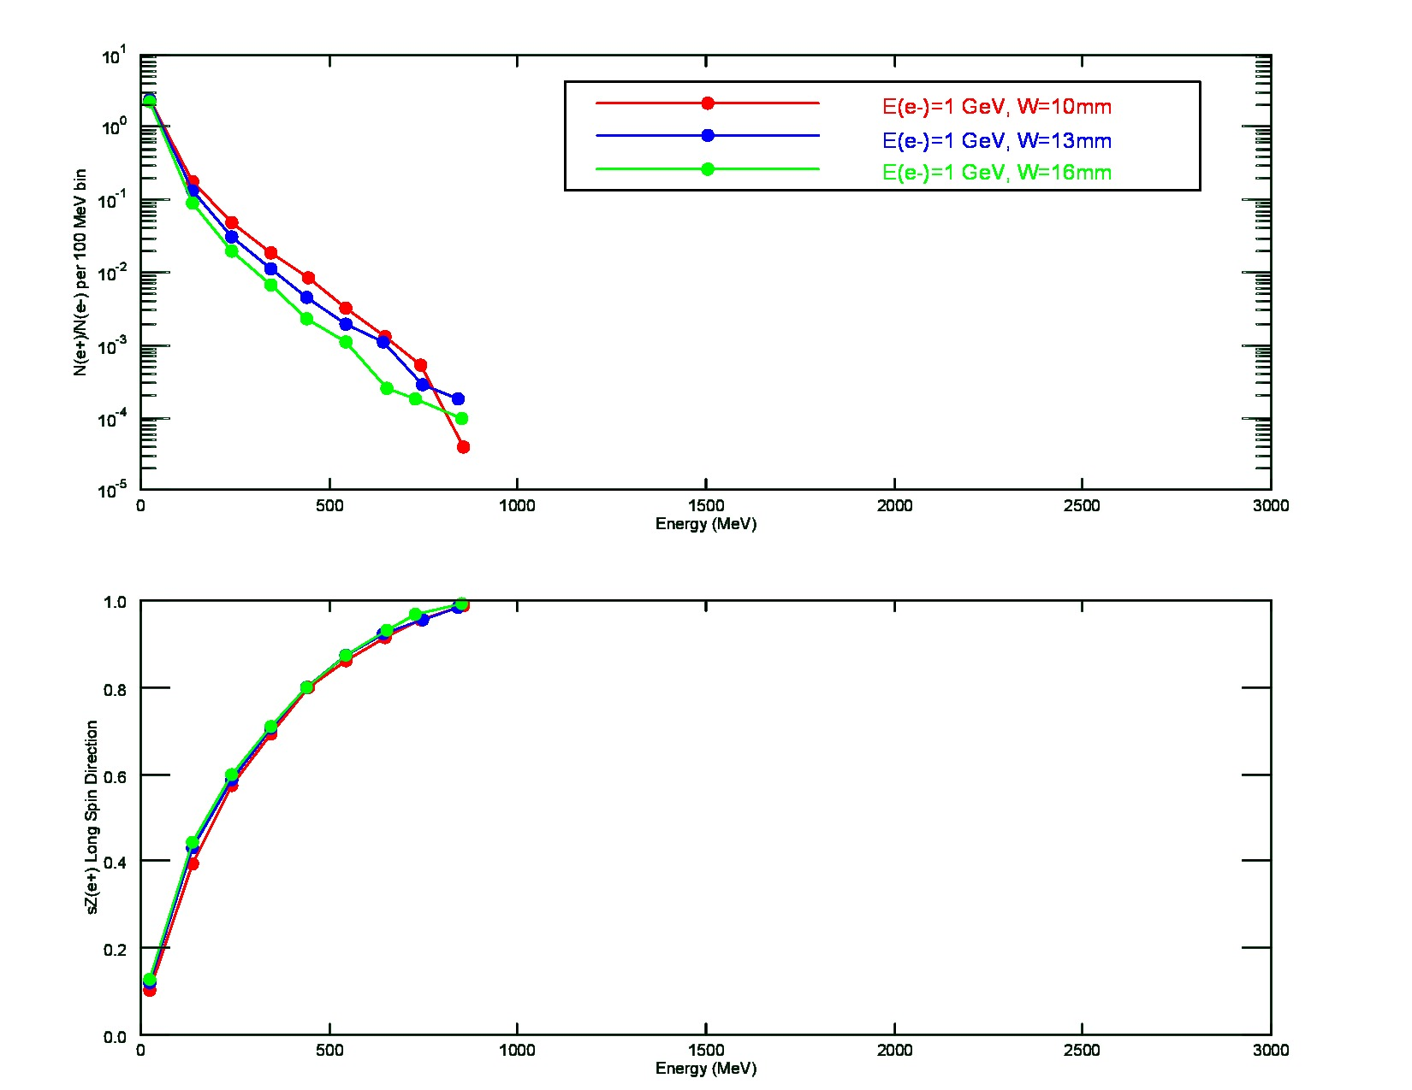
ILC : Spin Polarized Electron Driven Source ?
What is expected (w/o any cuts) if the electron beam energy were 1 GeV, and target thickness reduced.
Small reduction in target thickness has the effect of increasing yield (at this lower electron beam energy).
Target thickness has less impact when positron energy large fraction of electron energy.
E (e+) | Y/100 MeV | <Sz> | <Pz>
100 | 1-20 % | 0.38-0.45 | 32-38 %
300 | 0.7-2 % | 0.75 | 64 %

Slide 16
GaAs Source Parameters Comparison
Parameter | CEBAF | SLC | JLab/FEL | Cornell ERL | LHeC | eRHIC | CLIC | ILC | ILC (e+) | JLEIC(e+) | CEBAF (e+)
Polarization | Yes | Yes | No | No | Yes | Yes | Yes | Yes | Yes | Yes | Yes
Number electrons/microbunch | 2.5 x 10⁶ | 1 x 10¹¹ | 8.3 x 10⁸ | 4.8 x 10⁸ | 1 x 10⁹ | 2.2 x 10¹⁰ | 6 x 10⁹ | 3 x 10¹⁰ |  | 1.2 x 10¹⁰ | 2.5 x 10⁸
Number of microbunches | CW | 2 | CW | CW | CW | CW | 312 | 3000 |  | 900 | CW
Width of microbunch | 50 ps | 2 ns | 35 ps | 2 ps | 100 ps | ~ 100 ps | ~ 100 ps | ~ 1 ns |  | 50 | 50 ps
Time between microbunches | 2 ns | 61.6 ns | 13 ns | 0.77 ns | 25 ns | 71.4 ns | 0.5002 ns | 337 ns |  | 1.33 ns | 4 ns
Microbunch rep rate | 499 MHz | 16 MHz | 75 MHz | 1300 MHz | 40MHz | 14MHz | 1999 MHz | 3 MHz |  | 750 MHz | 250 MHz
Width of macropulse | - | 64 ns | - | - | - | - | 156 ns | 1 ms |  | 1.1 ms | -
Macropulse repetition rate | - | 120 Hz | - | - | - | - | 50 Hz | 5 Hz |  | 50 Hz | -
Charge per micropulse | 0.4 pC | 16 nC | 133 pC | 77 pC | 500 pC | 3.6 nC | 0.96 nC | 4.8 nC | ~nC | 2 nC | 40 pC
Charge per macropulse | - | 32 nC | - | - | - | - | 300 nC | 14420 nC |  | 1800 nC | -
Average current from gun | 200 uA | 2 uA | 10 mA | 100 mA | 20 mA | 50 mA | 15 uA | 72 uA |  | 3.4 uA | 10 mA
Average current in macropulse | - | 0.064 A | - | - | - | - | 1.9 A | 0.0144 A |  |  | -
Duty Factor | 2.5 x 10⁻² | 2.8 x 10⁻⁷ | 2.6 x 10⁻³ | 2.6 x 10⁻³ | 4 x 10⁻³ | 1.4 x 10⁻³ | 0.2 | 3x10⁻³ |  |  | 1.2 x 10⁻²
Peak current of micropulse | 8 mA | 8 A | 3.8 A | 38.5 A | 5 A | 35.7 A | 9.6 A | 4.8 A |  |  | 0.8 A
Current density* | 4 A/cm² | 10 A/cm² | 19 A/cm² | 500 A/cm² | 100 A/cm² | 182 A/cm² | 12 A/cm² | 6 A/cm² |  | 10 A/cm² | 16 A/cm²
Laser Spot Size* | 0.05 cm | 1 cm | 0.5 cm | 0.3 cm | 0.5 cm | 0.5 cm | 1 cm | 1 cm |  | 0.10 cm | 0.10 cm
* Loose estimates
Demonstrated
Proposed (excuse outdated values)
My Speculations

Slide 17
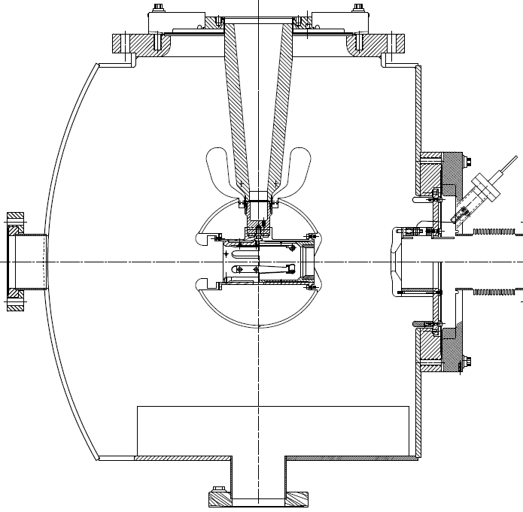

Jefferson Lab: Inverted Insulator Photogun
with optimized triple point shields and mildly conductive insulators
CEBAF 200 kV Gun
350 kV gun for GTS and UITF
Both designs, maximum field strength < 10 MV/m

Slide 18
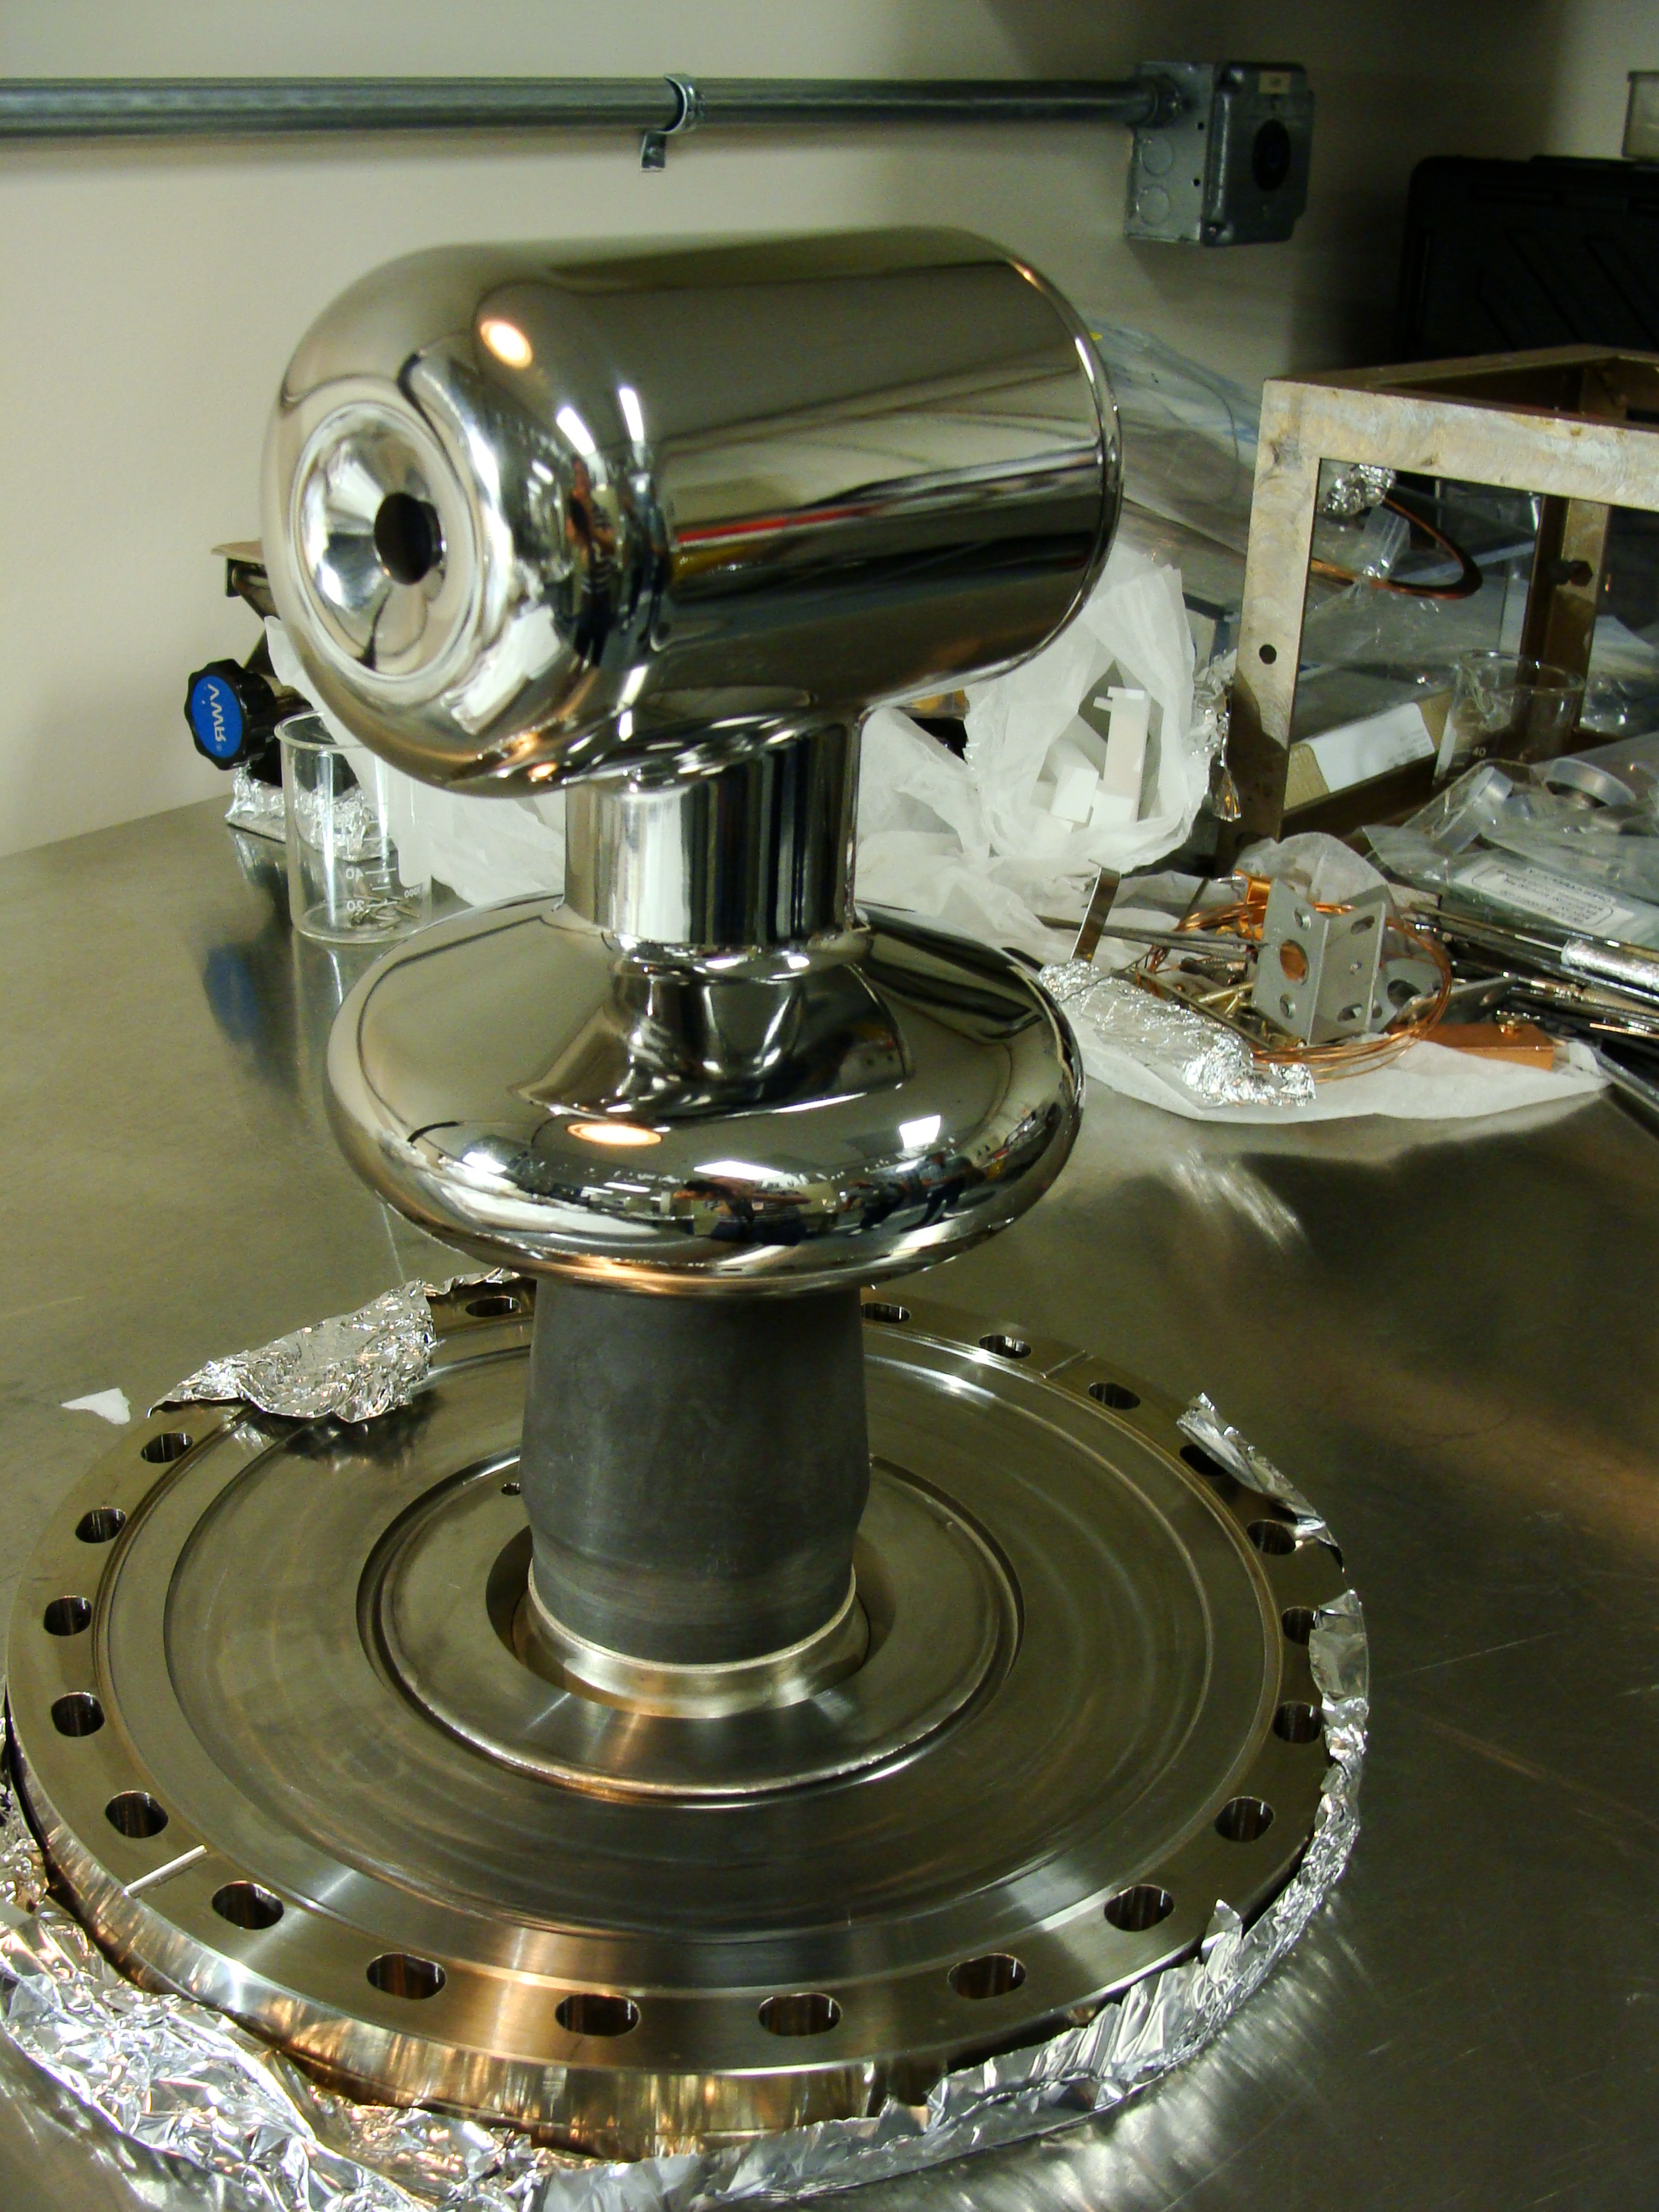
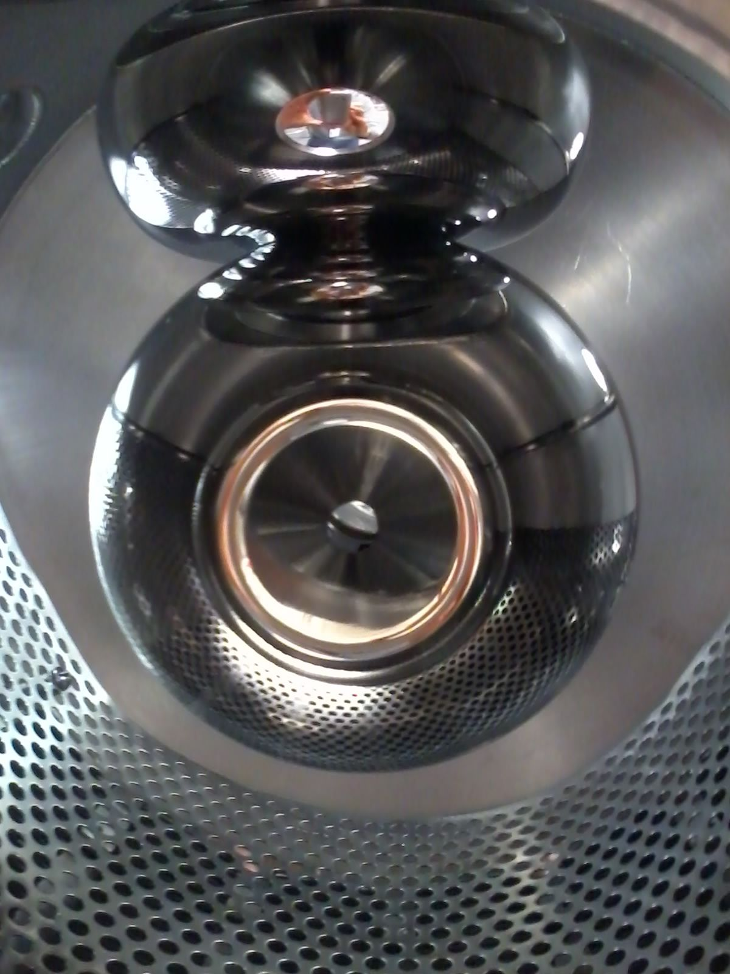
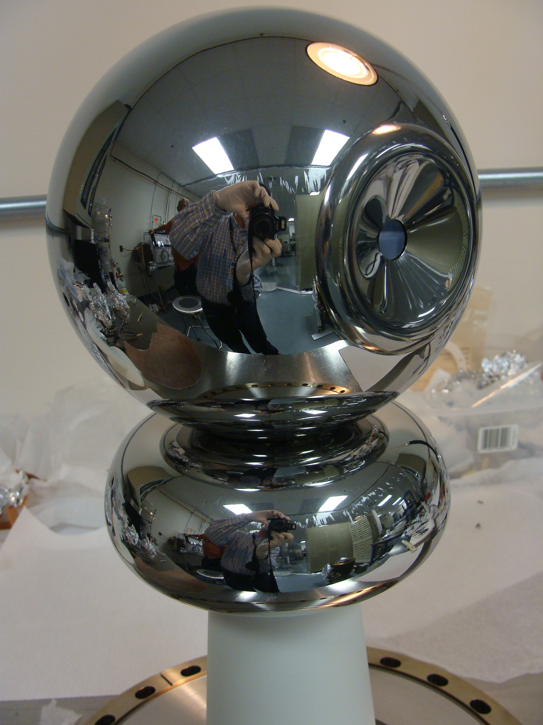
Jefferson Lab: Inverted Insulator Photogun HV Electrodes
CEBAF 200 kV
Installed June 2018
Commissioning now.
GTS 350 kV
In operation since Nov. 2016 with CsK₂Sb photocathode:
500 uA magnetized beam
4.5 mA non-magnetized
UITF 350 kV
Polarized Gun
Under assembly

Slide 19
Metric of Success: High Voltage without Field Emission
Reached
360 kV in 70 hours
10 MV/m at 350 kV
Vacuum and radiation levels indistinguishable from bkgd at 350kV

Slide 20
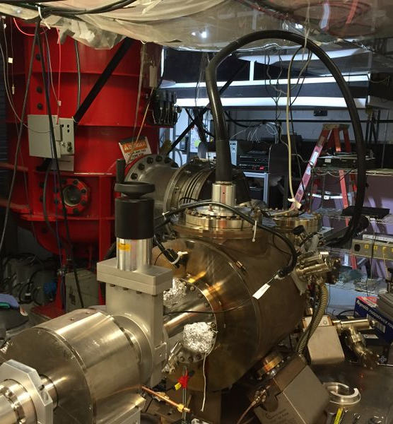
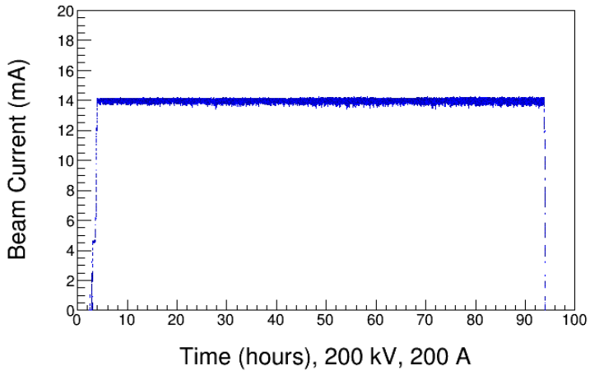
Magnetized Beam Photogun at the Gun Test Stand
Magnetized Beam LDRD, PI's: R. Suleiman and M. Poelker
Load-lock inverted insulator photogun (multiple photocathodes) like CEBAF
Cable connection from HVPS to gun
Over 1000 hours operating >300kV; HV conditioning about 1 week
Operating with CsKSb photocathodes at >10 mA average current, and 0.7nC bunch

Slide 21
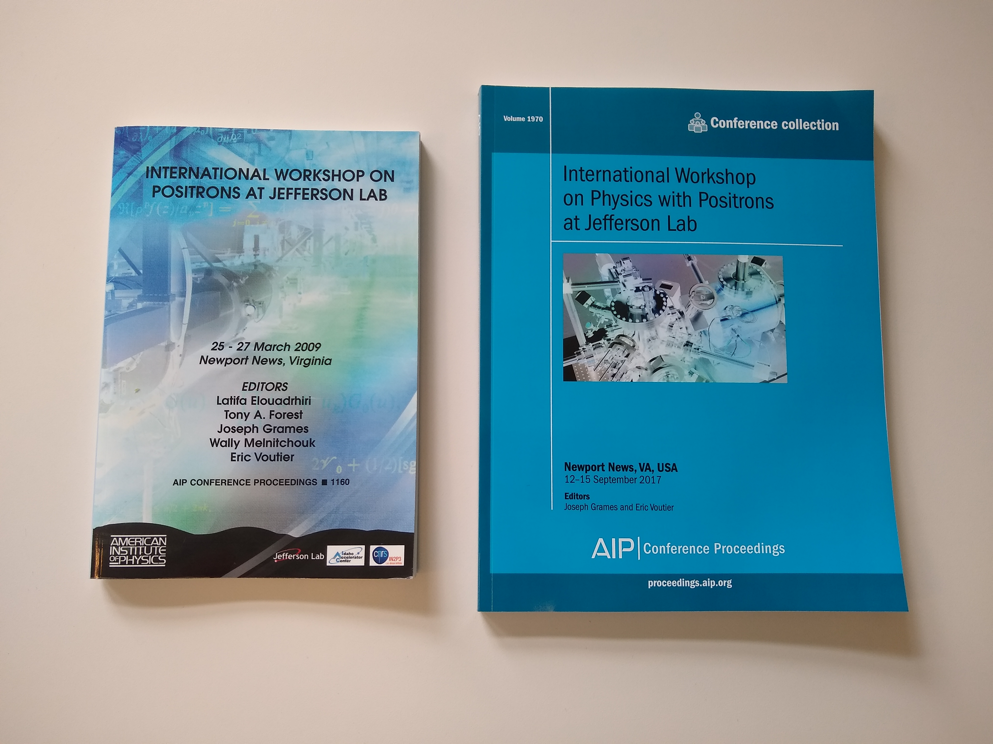
Roadmap: Jefferson Lab
Next priority should be designing, building and testing a positron beam collection system to define and optimize the transverse & longitudinal phase space and spin polarization for RF acceleration.
A conceptual design study report is now essential, and simulations of various concepts to date suggest that a CW polarized positron source can be built to meet the CEBAF requirements.
JPos’09
(2009)
PEPPo
(2012-2015)
JPos’17
(2017)
LOI-12-18-004
(2018)

Slide 22
Summary
Jefferson Lab Users are making the physics case for a high energy polarized and unpolarized positron beam physics program at CEBAF.
PEPPo demonstrated high positron polarization from moderate energy polarized electrons with a small footprint (cost, energy, radioactivity)
We are exploring concepts to produce polarized electrons from high voltage (200-350 kV) photoguns for both CEBAF (CW, pC, mA) and JLEIC (pulsed, nC, uA) regimes.
Recent progress for 350 kV inverted insulator photogun is promising to develop high bunch charge polarized gun capable of nC bunch charge.
PEPPo concept applied to ILC electron driven source can turn a “no polarization” scheme into a “polarization” scheme, even if for a later upgrade.

