Slide 1
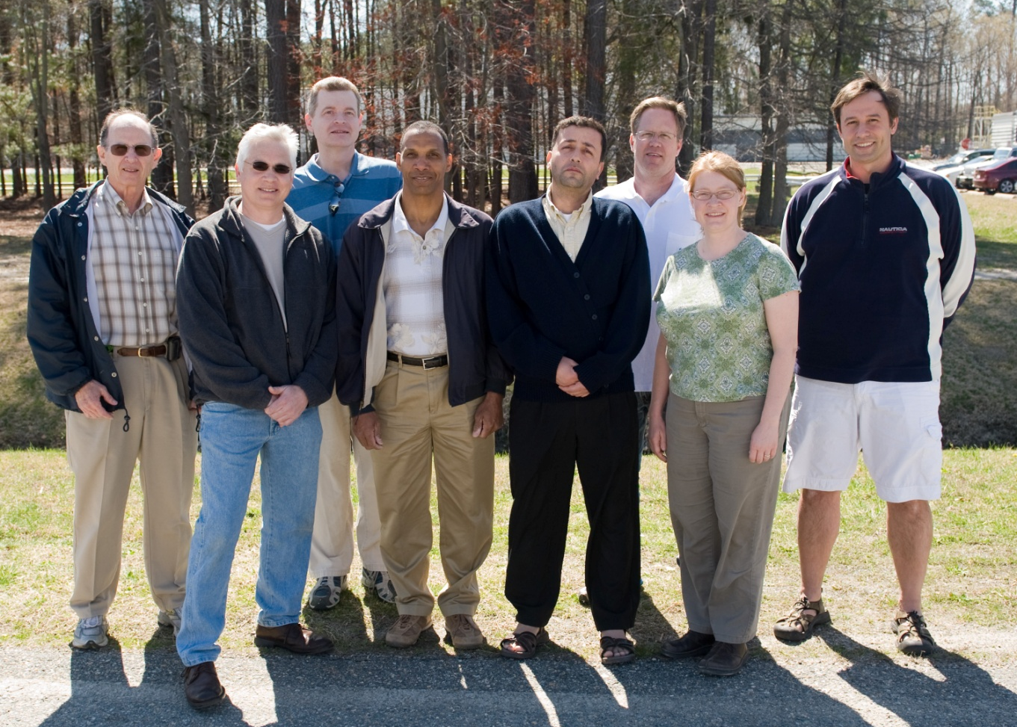
Building a Higher Voltage
Polarized e-Source:
The CEBAF/ILC 200kV Inverted Gun
M. Poelker, P. Adderley, M. BastaniNejad, J. Clark, J. Grames, J. Hansknecht,
C. Hernandez-Garcia, R. Mammei, M. Stutzman, R. Suleiman, K. Surles-Law
ILC rep visit Jan 5-6, 2011

Slide 2
Emittance and Brightness
Normalized Emittance from GaAs is:
q | Bunch Charge (= 0.4 pC, 200 μA and 499 MHz)
E_{s} | Electric Field at GaAs surface
T_{eff} | Effective Temperature of GaAs (300 to 400K, 780 nm)
k_{B}T_{eff} | Thermal Energy (= 34 meV)
Gun HV (kV) | E_{s} (MV/m) | ε_{n} (μm)
100 | 2.0 | 0.011
140 | 2.8 | 0.009
200 | 4.0 | 0.008
Brightness is proportional to Gun HV
Normalized Brightness is:
For ILC, we don’t worry about emittance (because damping ring will take care of it), but we contend photoinjector will benefit from stiffer beam from gun

Slide 3
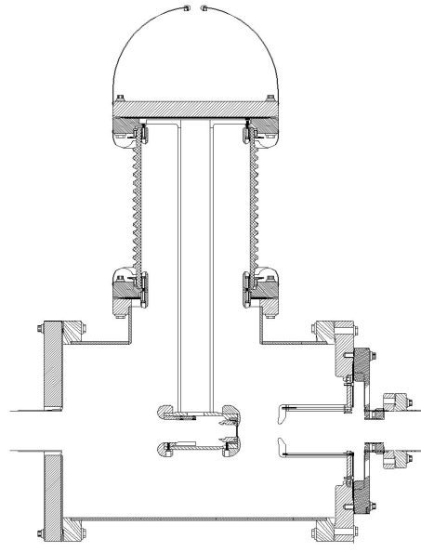
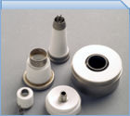
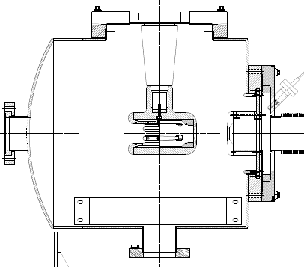
“Inverted” Gun
Old Gun Design
Present Ceramic
Exposed to field emission
Large area
Expensive (~$50k)
Lots of metal at HV
Medical x-ray technology
We had low level field emission
e⁻
New Ceramic
Compact
~$5k
Less metal at HV
No SF6 of N2
New design
Move away from “conventional” insulator used on most GaAs photoguns today – expensive, months to build, prone to damage from field emission.
High gradient locations not related to beam optics, lots of metal to polish

Slide 4

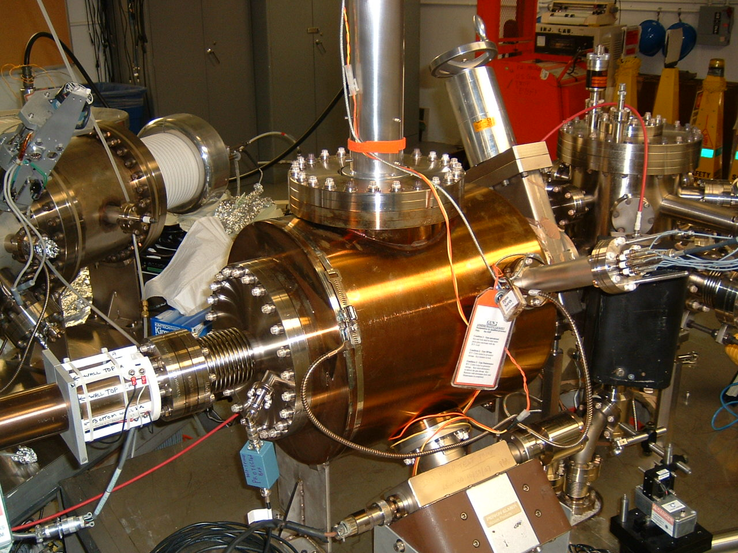
Inverted Gun#1 installed at CEBAF, operational since July 23, 2009
Extractor gauge 2x10⁻¹² Torr (raw value)
100kV Lifetime ~ 70C at 150uA avg. current
Now operating at 130kV, transmission 95% at 180uA
Occasional orbit shifts and vacuum bursts that can decrease QE…
Inverted Gun#2 at Test Cave
Conditioned to 225kV, with large and fine grain Nb electrodes
InvGun2 performs well at 140kV
Problematic ops at 200kV. Small field emission (~nA) and occasional vacuum bursts that ruin QE
“plan B” didn’t work, now working on “plan C”

Slide 5
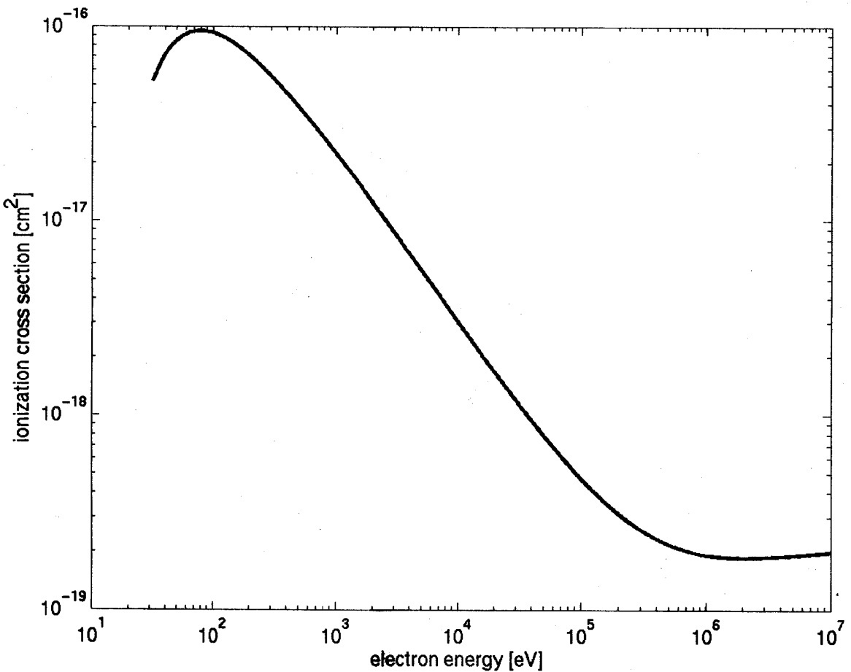
Improve Lifetime with Higher Bias Voltage?
Ionization cross section for H₂
Most ions created at low energy
100kV
Ion energy
250kV
Low energy ion column for 100kV gun
Hypothesis: Double the gun voltage,
halve the # of “bad” ions, improve lifetime by 2
Low energy ion column for 200kV gun

Slide 6
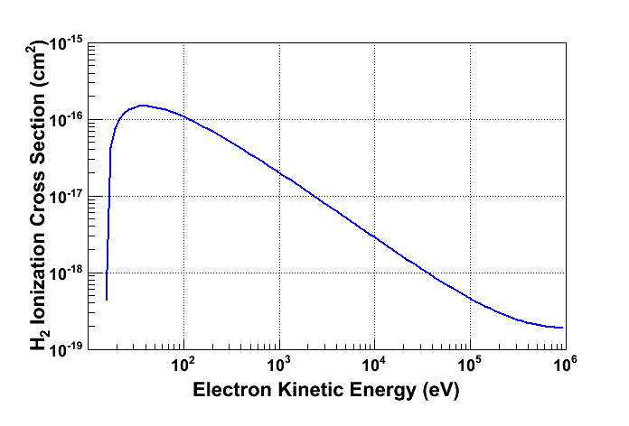
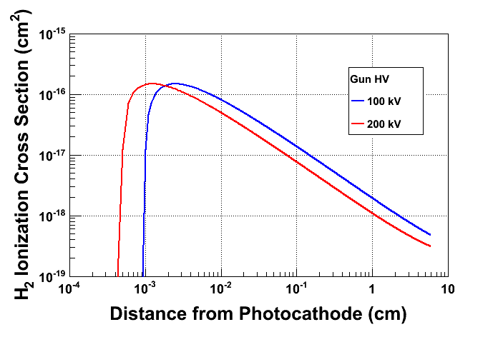
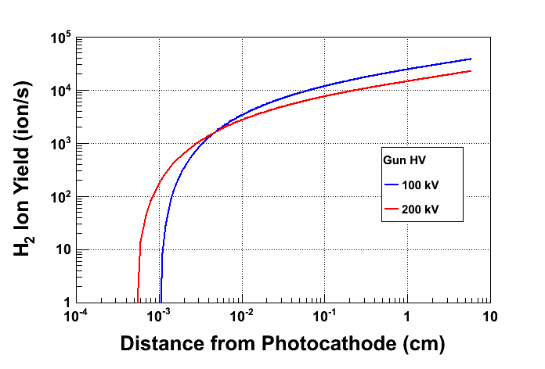
Prolong Photocathode Charge Lifetime
Most ions created at low energy
…and very close to GaAs surface
Beam Current: 2 mA
Vacuum: 8 × 10⁻¹² Torr

Slide 7
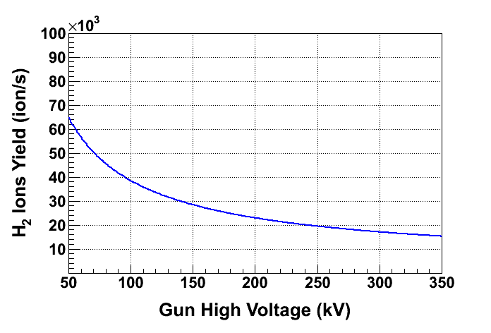
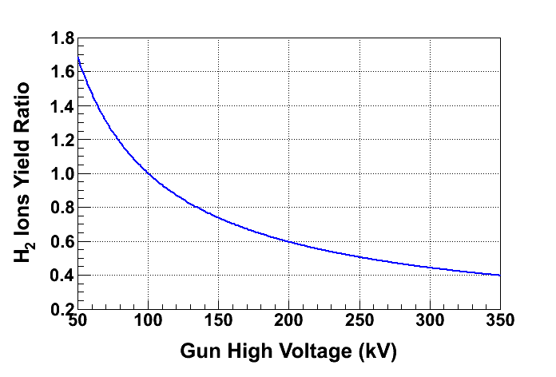
Ion energy
Relative to 100kV ops
Low energy ion column for 100 kV gun
Low energy ion column for 200 kV gun
At 200 kV, only 60% of ions are created compared to 100 kV, longer lifetime

Slide 8
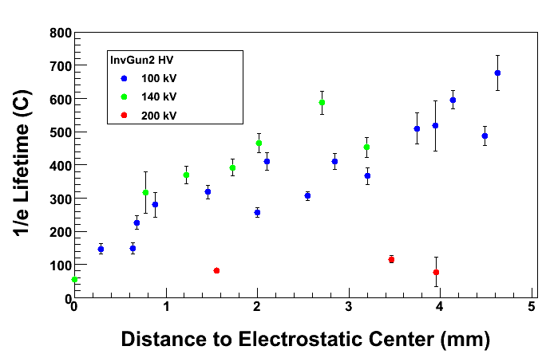
Charge Lifetime vs Bias Voltage
2mA avg. current (unpolarized, DC beam), 350um laser spot and 5mm active area
Poor lifetime at 200kV likely due to low-level field emission (next slides)
And vacuum bursts often killed QE completely…
Problematic high gradient region at the insulator/electrode joint? Or maybe we didn’t bcp long enough?

Slide 9
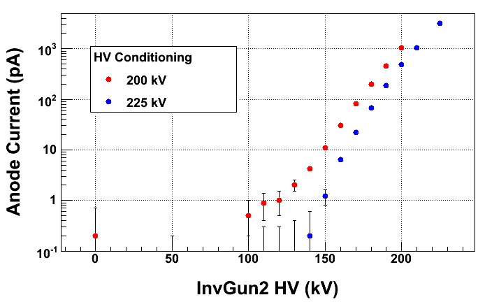
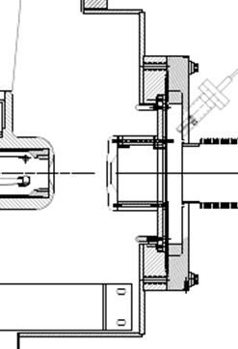
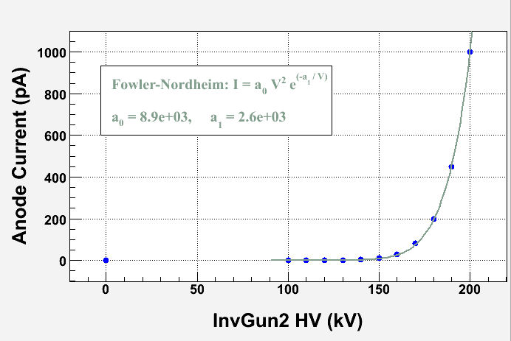
Field Emission measured at (floating) anode versus Gun Bias Voltage
Macor spacer
How much field emission is acceptable?
unfortunately, it seems if you can measure it, it’s too much
Work of Riad Suleiman

Slide 10
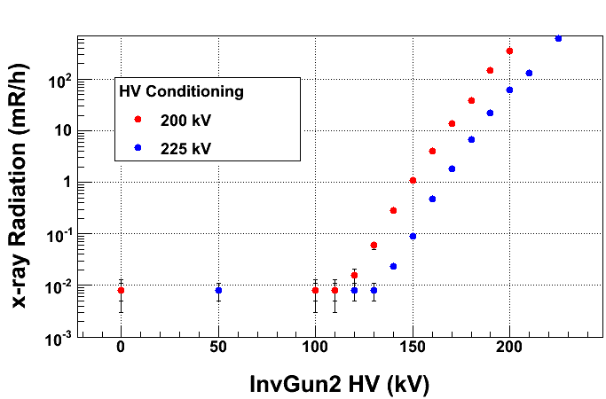

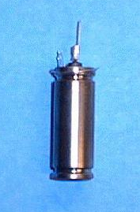
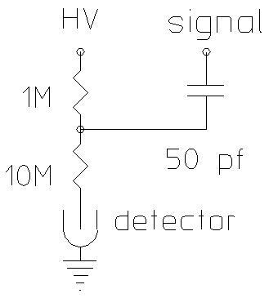
Anode won’t always capture all FE…. Better to look for x-rays….
Building an inexpensive radiation monitoring system: lots of GM tubes, powered by one HV supply and data stream to computer via RS232
2”
50$

Slide 11
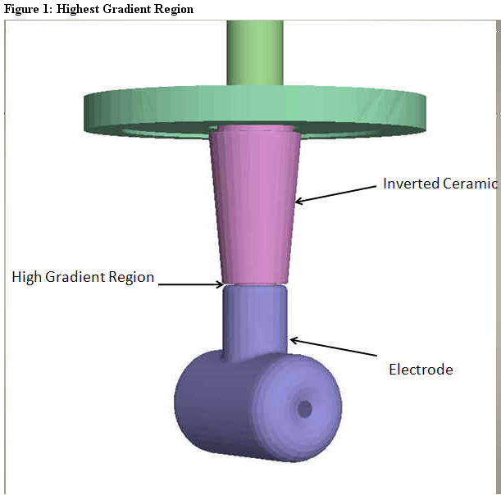
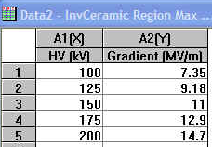
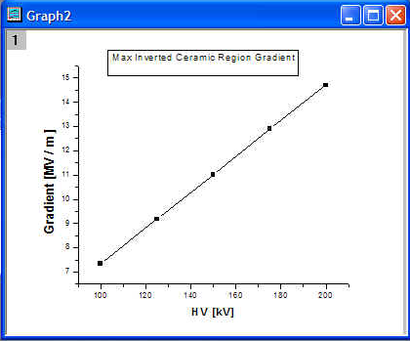
Our design has one region of “unintended” high gradient – could be problematic…..exploring new designs via electrostatic modeling
Work of Ken Surles-Law

Slide 12
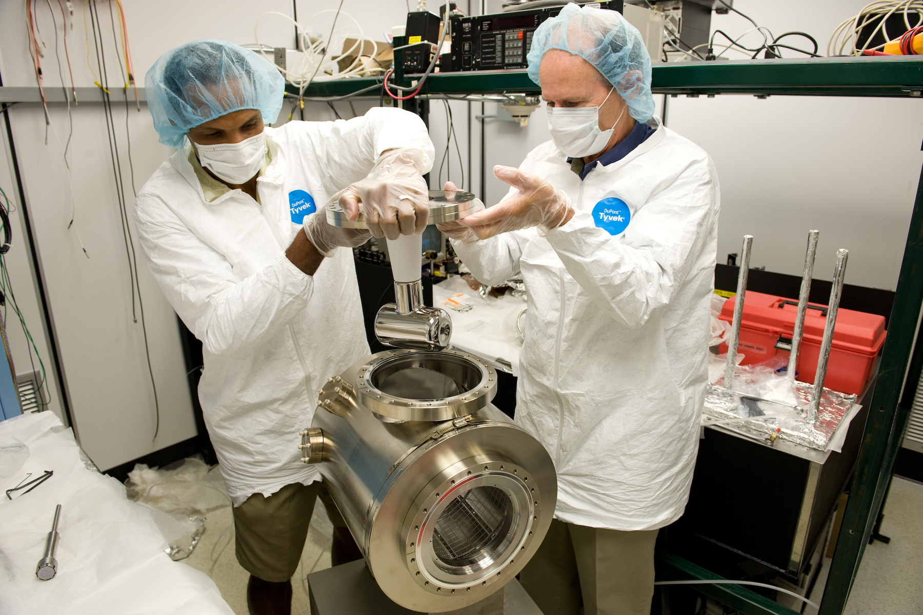

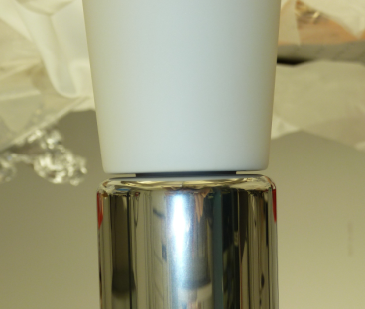
And maybe even higher gradient at the joint…..??
HV breakdown in capacitors with delamination gap
d
E = V/d
V
d1
ε1
d2
ε2
V
V
V ε1
E2 = ~
ε2
d1
d2 + d1 ( )
ε1
“High Voltage Engineering: Fundamentals”, Kuffel, Zaengl, Kuffel

Slide 13
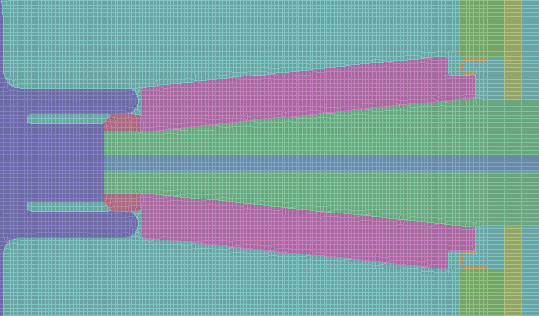
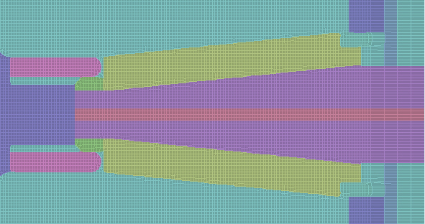
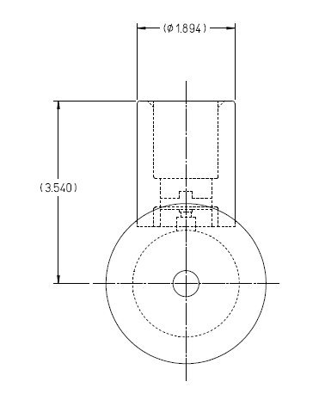
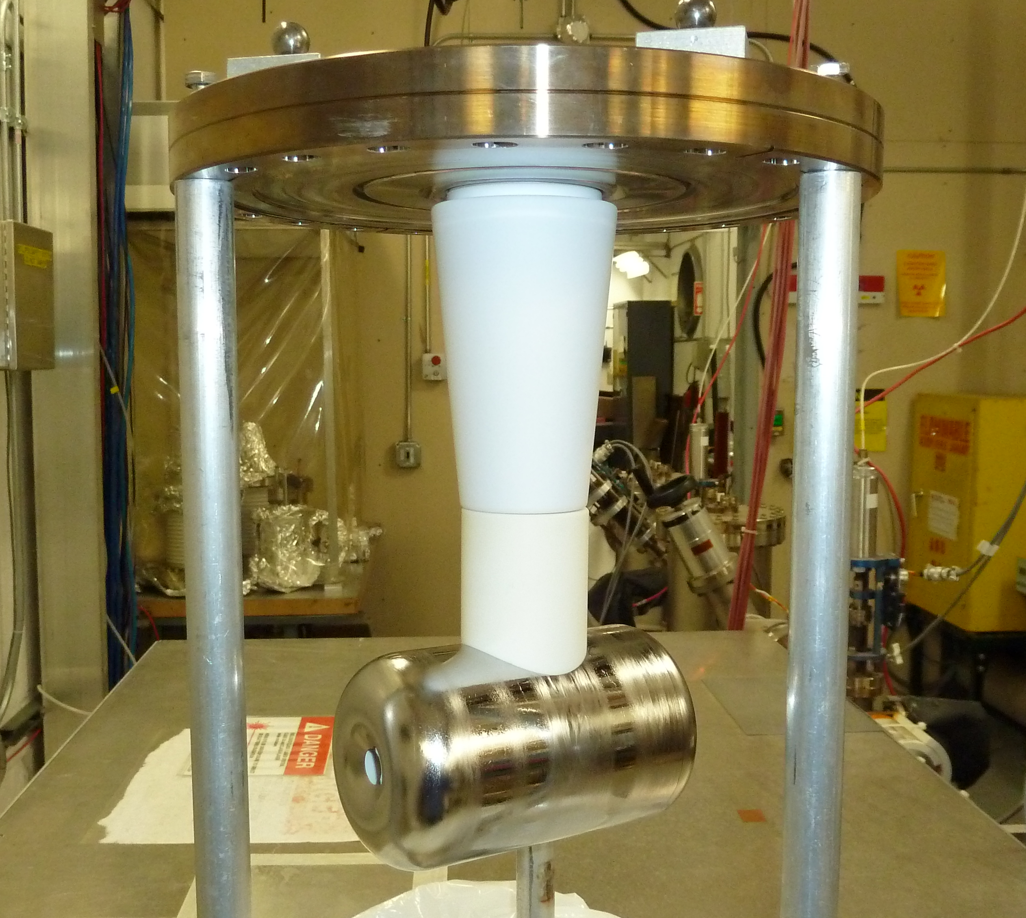
Plan B…..
8.2MV/m
4MV/m
3MV/m
7MV/m
0.3 - 1.6MV/m
3.5MV/m
At 100kV bias
Ceramic sleeve…..
Work of Ken Surles-Law

Slide 14
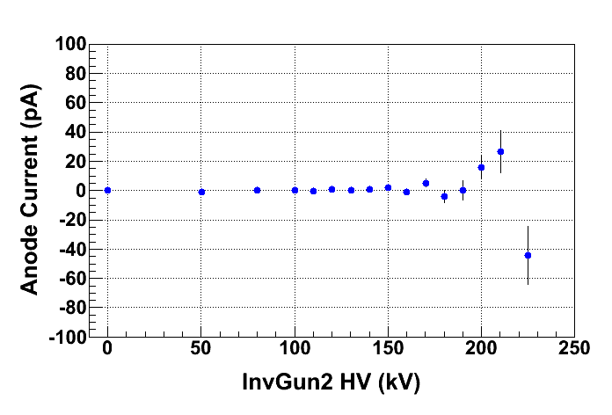
Plan B didn’t work. What’s Next? Plan C
Re-polished large grain Nb Electrode: much better result this time
HV conditioned to 225 kV; anode current just tens of pA, and x-ray level comparable to background (8 E-3 mR/h)
Added a leak valve to HV Chamber in case we need to Krypton-process the electrode to eliminate FE
Ready to run beam at 200 kV in January 2011
Before re-polishing electrode
After re-polishing electrode

Slide 15
Two noteworthy comments:
We used Inverted gun 2 at Test Cave to make interesting lifetime measurements that were written up and submitted for publication to PRST-AB: “Charge Lifetime Measurements of a DC High Voltage GaAs Photogun at High Average Current”, J. Grames, R. Suleiman. We expect a similarly detailed complementary study to happen in 2011
We learned from extensive ops at CEBAF that the insulator appears to “charge up” (theory: x-rays hit insulator and make electron/hole pairs). This can introduce a small orbit shift out of the gun, and sometimes we observe an electrical discharge that can generate a gas load which can hurt photocathode QE. We are purchasing new insulators with small conductivity to bleed away charge. And a symmetric design would help, with insulator directly behind electrode.

Slide 16
Plans for 2011
Continued FE testing: Nb vs Stainless Steel, Kr-processing
Demonstrate long lifetime operation at 200kV and at high average current using today’s Inverted Gun, with superlattice photocathode and rf-pulsed IR light (i.e., polarized beam)
Test today’s side-ceramic design using new insulator with small amount of conductivity (eliminate charging-discharging and associated vacuum bursts, and orbit shifts)
Working on new spherical electrode to reduce gradient
Start building symmetric inverted gun with new, smaller photocathode puck

Slide 17
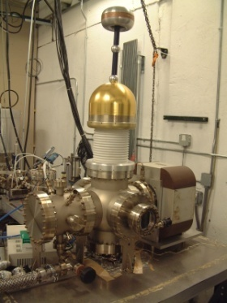
Field Emission – Most Important Issue
Stainless Steel and Diamond-Paste Polishing Good to ~ 5MV/m and 100kV.
5MV/m
Previous measurements with flat electrodes, small gaps and low voltage - not very useful
Want to keep gun dimensions about the same – suggests our 200kV gun needs “quiet” electrodes to 10MV/m
100kV
Work of Ken Surles-Law, Jefferson Lab

Slide 18
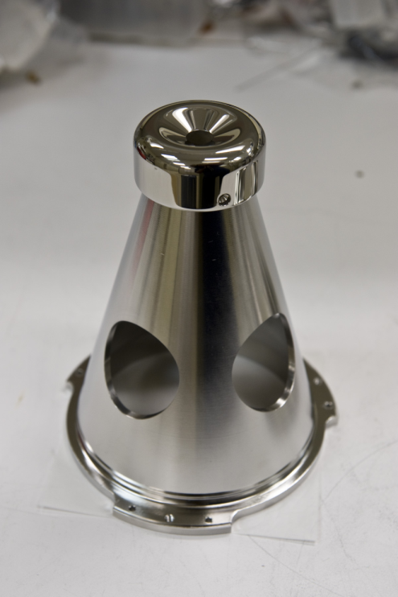
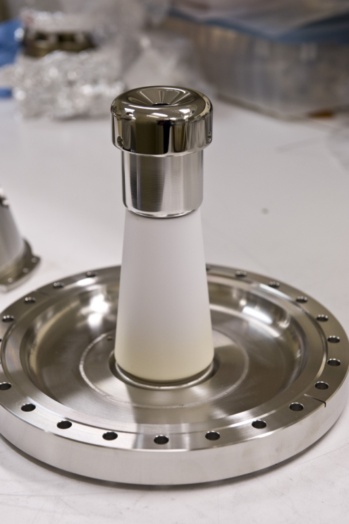
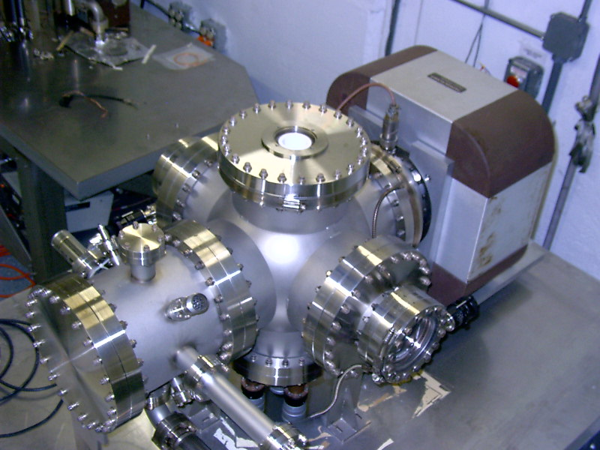
Single Crystal Niobium:
Capable of operation at higher voltage and gradient?
Buffer chemical polish (BCP) much easier than diamond-paste-polish
Conventional geometry: cathode electrode mounted on metal support structure
Replace conventional ceramic insulator with “Inverted” insulator: no SF6 and no HV breakdown outside chamber
Work of Ken Surles-Law, Jefferson Lab

Slide 19
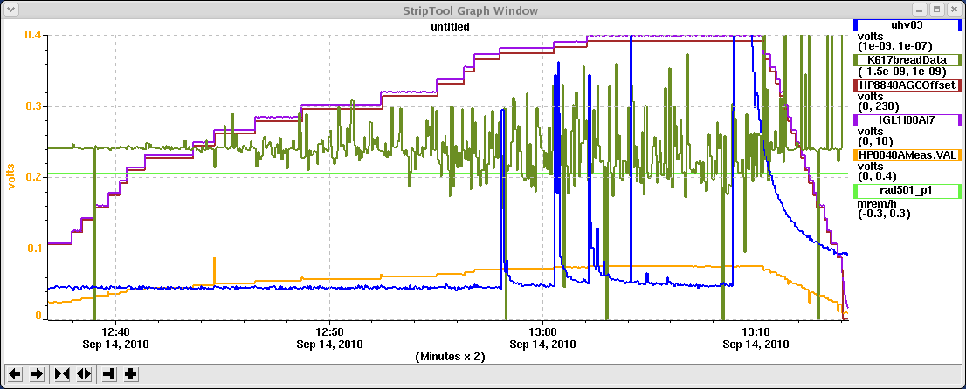
Single Crystal Nb: Good Cathode Electrode Material
~ No field emission at 225kV bias and 50mm gap
Anode Current (i.e. FE current)
2.5nA FS
Voltage induced gas desorption
“Noise” comes from conditioning resistor
Work of M. BastaniNejad

Slide 20
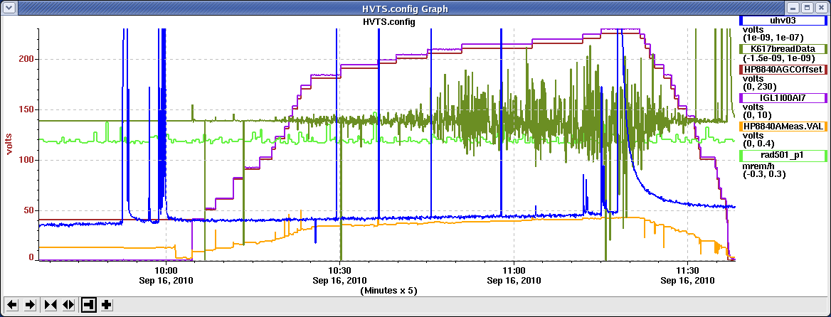
Work of M. BastaniNejad
No field emission at 225kV bias and 20mm gap
Anode Current (i.e. FE current)
Voltage induced gas desorption
But Niobium can be pushed too far, producing (many?) field emission sites. Avoid small gaps.
These field emission sites can be difficult to process out
Krypton processing works
Sometimes, electrode needs to be re-BCP-ed.
Stay on this side

Slide 21
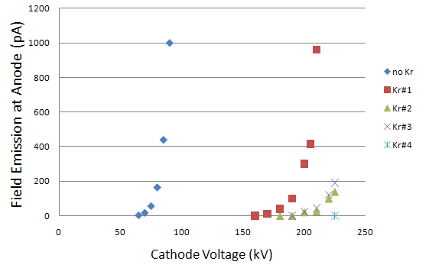
Krypton Processing works…..
No field emission from a diamond-paste polished stainless steel electrode, to 225kV at 50mm gap
This SS electrode now performs as well as any Nb electrode we’ve tested, at least with our 225kV supply
But when stainless goes bad, it seems to be worse than when Nb goes bad….
Work of M. BastaniNejad

Slide 22
Back-up slides

Slide 23
Benefit of Higher Gun Bias Voltage
Reduce space-charge-induced emittance growth, maintain small transverse beam profile and short bunchlength
    In other words, make a “stiff” beam right from the gun
    Particularly important for high bunch charge beam
CEBAF guns have always operated at 100kV (β = 0.55)
Expect better transmission for Qweak at 140kV (and ILC Baseline design) (β = 0.62)
Later, we envision an improved CEBAF photoinjector with a 200kV gun and SRF capture section (β = 0.69)
Indentify what it takes to reach 350kV bias voltage or higher (β= 0.8+). For ILC, CLIC, EIC, etc.,
Biggest obstacle: Field emission and HV breakdown…
which lead to Photocathode Death

Slide 24
Benchmarking PARMELA Simulation Results Against Beam-Based Measurements at CEBAF/Jefferson Lab – work of Ashwini Jayaprakash, JLab
Measurements at CEBAF/JLab
PARMELA Simulation Results
Similar Trends
Message: Beam quality, including transmission, improves at higher gun voltage

Slide 25
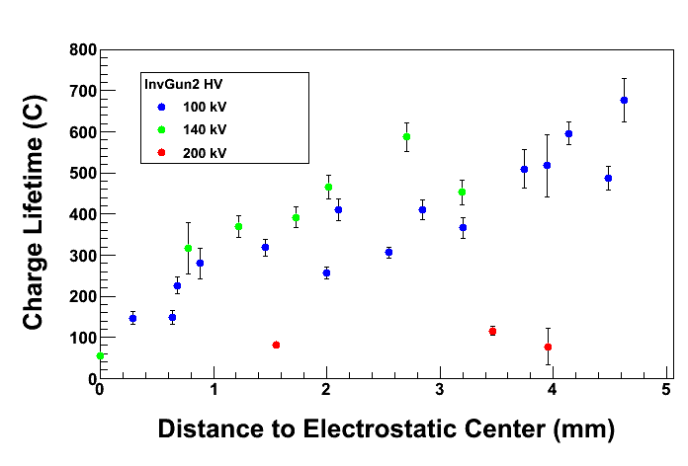
Charge Lifetime vs. Gun High Voltage
Poor lifetime at 200 kV due to field emission
And vacuum bursts often killed QE completely
 | I = 2 mA, Bulk GaAs (5 mm Active Area, 350 μm Laser Spot)
Gun HV | 100 kV | 140 kV | 200 kV
Anode Current (pA) | 0.0 ± 0.3 | -8 ± 1 | -520 ± 20
X-ray Detector (E-2 mR/h) | 1.5 ± 0.5 | 105 ± 5 | 5700 ± 300
Gun Vacuum (pA) | 0 | 0 | 400
Y-Chamber Vacuum (nA) | 3.0 | 3.0 – 3.2 | 3 – 4

Slide 26
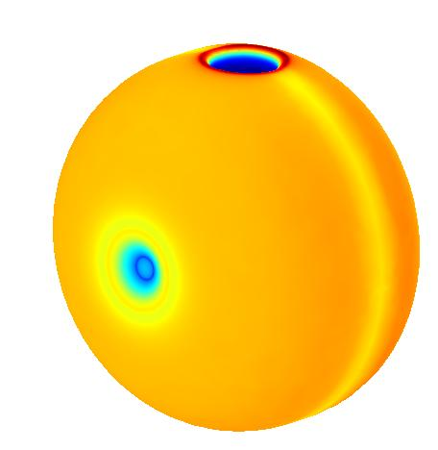
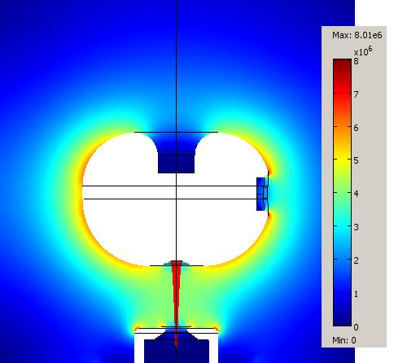
Plan D
From Al Dudas and Mike Neubauer, Muons Inc.
Figure 10. “Ball” type gun electrode with a side support for the inverted ceramic calculated for 250 kV. The maximum gradient was 8 MV/m and but the region around the ceramic is not shielded from the max gradient.

