Slide 1
Small group Mott meeting
4 February 2016

Slide 2
Recent work
First, write up thickness measurement section, refine error bars on data very slightly to avoid double counting
Second, the small χ2 imply overestimated error bars. Do we really need the 2% foil uniformity and 5% batch uniformity specs?
Third, churn through the Run 2 data vs. thickness using original error bars.
Fourth, do we need to talk about the linear fit lopping off points at the end?

Slide 3
 |  | Au_5385_B | Au_3057_C | Au_5134_B | Au_7028_B | Au_5275_C | Au_5613_D | Au_7029_B | Au_6809_B
 | nominal thickness (nm) | 1000 | 870 | 750 | 625 | 500 | 355 | 225 | 50
 | mean thickness (all data, nm) | 943.7 | 836.8 | 774.6 | 561.2 | 482.0 | 389.4 | 215.2 | 52.0
Stat. | Stdev, nom. identical data (nm) | 29.0 | 7.1 | 9.1 | 8.0 | 9.7 | 4.5 | 1.9 | 2.3
 | stdev image reanalysis (nm) | 22.5 | 7.7 | 9.4 | 7.5 | 4.0 | 2.7 | 1.8 | 2.1
Syst. | Image analysis: ± 4 Pixel | 20.0 | 8.0 | 10.0 | 8.0 | 8.0 | 8.0 | 2.6 | 2.6
 | Resolution (1.2 nm inherent) | 1.2 | 1.2 | 1.2 | 1.2 | 1.2 | 1.2 | 1.2 | 1.2
 | Tilt (0.4%) | 4.6 | 4.2 | 3.9 | 2.8 | 2.5 | 1.9 | 1.1 | 0.3
 | Focus (1%) | 9.4 | 8.4 | 7.7 | 5.6 | 4.8 | 3.9 | 2.2 | 0.5
 | Different spots (Lebow: 2%) | 18.9 | 16.7 | 15.5 | 11.2 | 9.6 | 7.8 | 4.3 | 1.0
 | Sibling difference (Lebow:5%) | 47.2 | 41.8 | 38.7 | 28.1 | 24.1 | 19.5 | 10.8 | 2.6
Totals
 | stat uncertainty (nm) | 36.7 | 10.5 | 13.1 | 11.0 | 10.5 | 5.2 | 2.6 | 3.1
 | syst uncertainty (nm) | 55.6 | 46.7 | 43.8 | 31.9 | 27.7 | 22.9 | 12.2 | 4.1
 | total uncertainty (nm) | 66.6 | 47.9 | 45.7 | 33.7 | 29.6 | 23.5 | 12.5 | 5.1

Slide 4
Pade(n,m) orders: Asy vs. Thick With both Lebow Uncertainties
Pade(n,m) | intercept | dA | R² | red. χ² | d.o.f. | Conf | Ftest
(1,0) | 43.8025 | 0.1169 | 0.991 | 1.28 | 9 | <50? | --
(2,0) | 44.0176 | 0.1018 | 0.997 | 0.594 | 8 | >70 | 11.45
(3,0) | 44.1777 | 0.128 | 0.997 | 0.546 | 7 | ~80 | 3.15 (rej F test)
(0,1) | 44.0382 | 0.0786 | 0.997 | .554 | 8 | >80 | 11.23
(0,2) | 44.0484 | 0.1057 | 0.997 | 0.737 | 7 | >60 | 0.022 (rej ftest)
(1,1) | 44.049 | 0.1061 | 0.997 | 0.737 | 7 | >60 | 9.67
(1,2) | 44.0295 | 0.0986 | 0.997 | 0.870 | 6 | >50 | 0.083 (rej. Ftest)
(2,1) | 45.0432 | 4.014 | 0.9977 | 0.6104 | 6 | >70 | 2.25 (rej. Ftest)

Slide 5
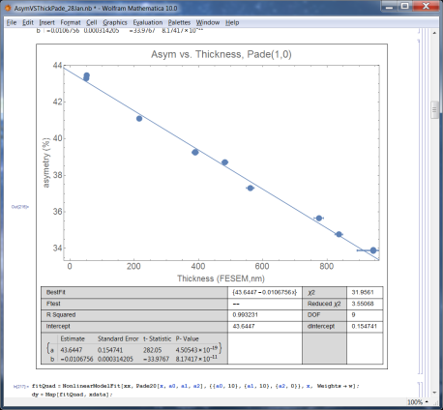
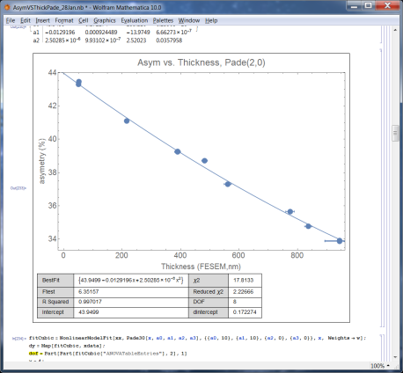
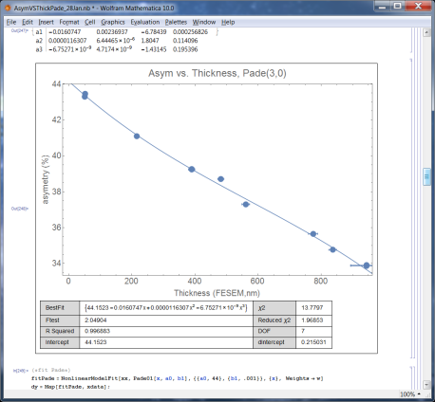
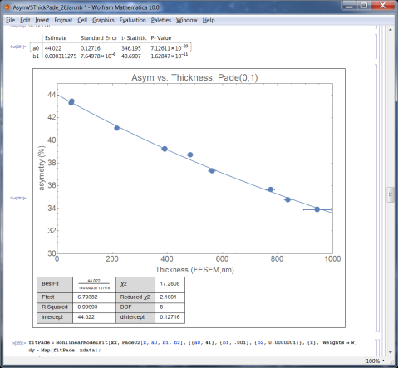
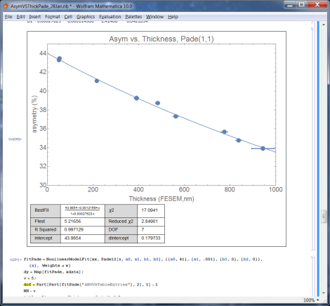
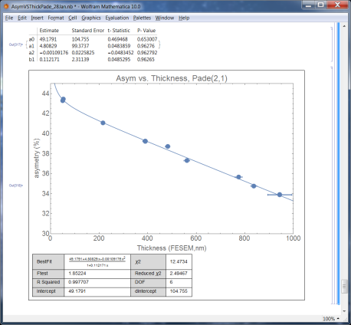
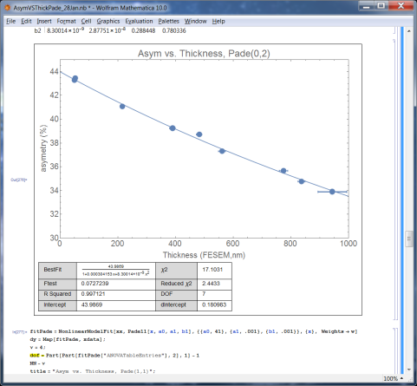
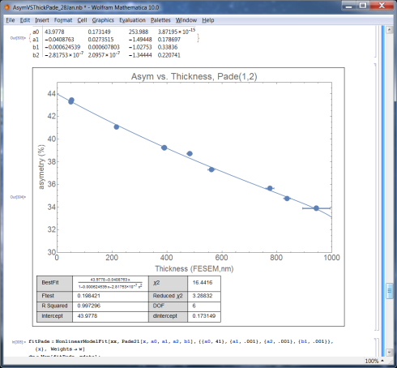
Both 5% batch and 2% uniformity Lebow uncertainties not included

Slide 6
Pade(n,m) orders: Asy vs. Thick, both systematic Lebow removed
Pade(n,m) | intercept | dA | R² | red. χ² | d.o.f. | Conf. | Ftest
(1,0) | 43.645 | .155 | 0.993 | 3.55 | 9 |  | --
(2,0) | 43.95 | .172 | 0.997 | 2.23 | 8 |  | 6.35
(3,0) | 44.1523 | .215 | 0.997 | 1.97 | 7 |  | 2.05
(0,1) | 44.022 | 0.127 | 0.997 | 2.16 | 7 |  | 6.79
(0,2) | 43.987 | 0.181 | .997 | 2.44 | 7 |  | .07
(1,1) | 43.9854 | 0.180 | .997 | 2.85 | 7 |  | 5.22
(1,2) | 43.9778 | 0.173 | .997 | 3.29 | 6 |  | .198
(2,1) | 49.1791 | 104 | .998 | 2.49 | 6 |  | 1.85

Slide 7
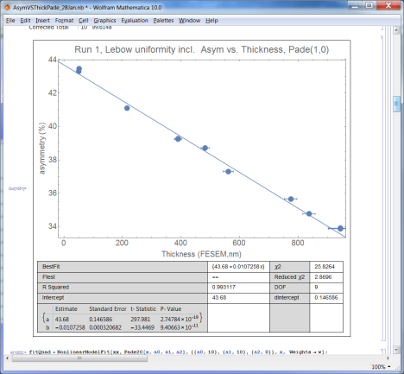
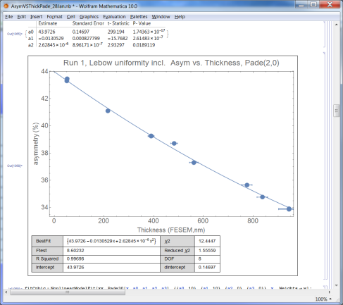
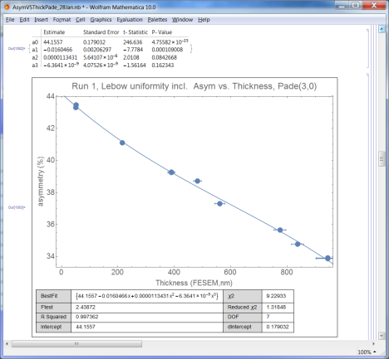
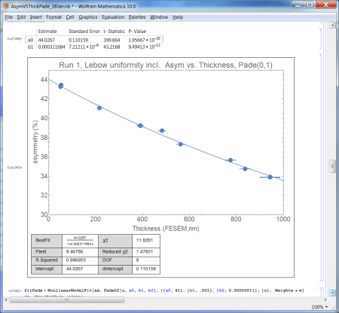
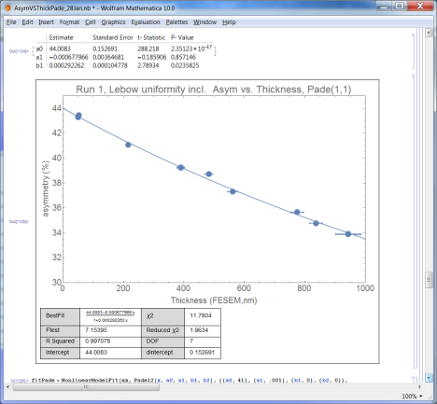
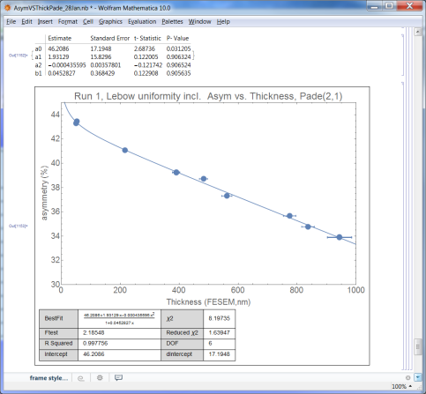
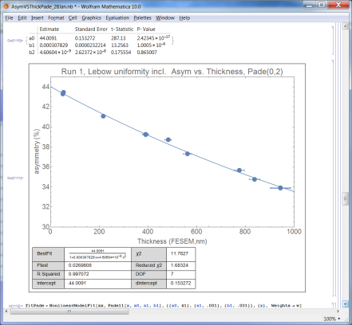
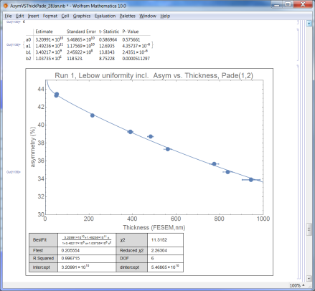
Only 2% uniformity spec from Lebow included

Slide 8
Pade(n,m) orders: Asy vs. Thick With both only 2% Lebow Uncertainty
Pade(n,m) | intercept | dA | R² | red. χ² | d.o.f. | Conf | Ftest
(1,0) | 43.68 | .147 | .993 | 2.87 | 9 |  | --
(2,0) | 43.97 | .147 | .997 | 1.56 | 8 |  | 8.60
(3,0) | 44.156 | .179 | .997 | 1.32 | 7 |  | 2.43
(0,1) | 44.027 | 0.110 | .997 | 1.48 | 8 |  | 9.47
(0,2) | 44.009 | .153 | .997 | 1.68 | 7 |  | 0.027
(1,1) | 44.008 | .153 | .997 | 1.96 | 7 |  | 7.15
(1,2) | 3e10 | 5e10 | .997 | 2.26 | 6 |  | .205
(2,1) | 46.21 | 17.2 | .998 | 1.64 | 6 |  | 2.18

Slide 9
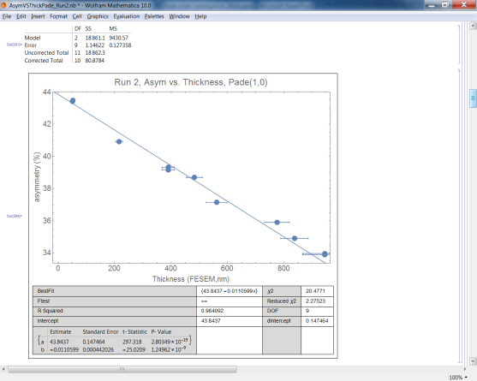
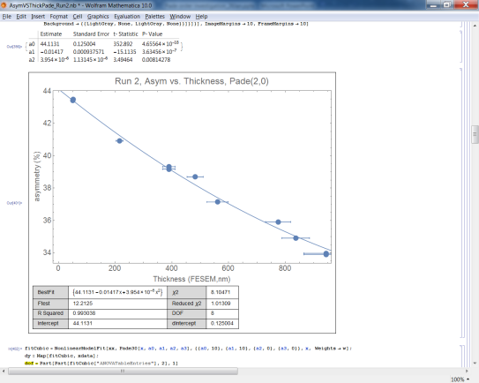
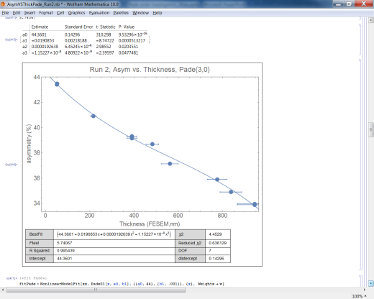
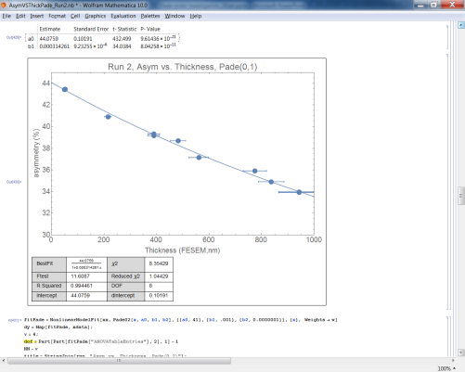
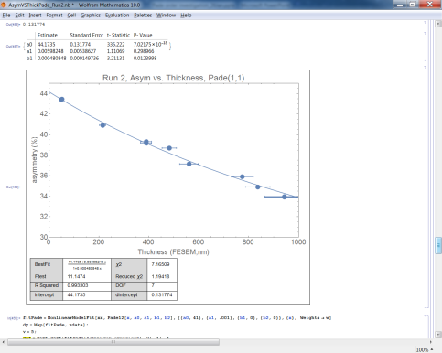
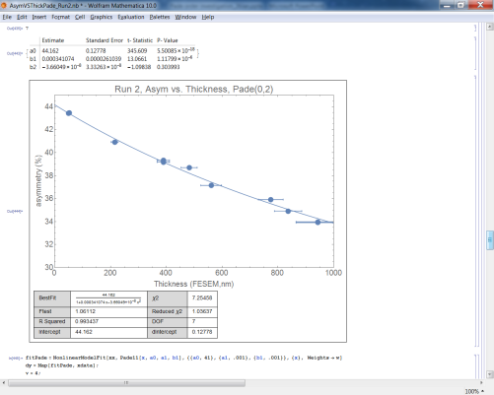
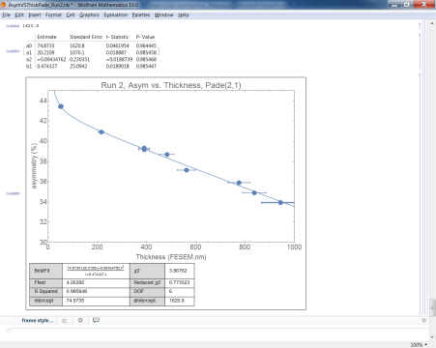
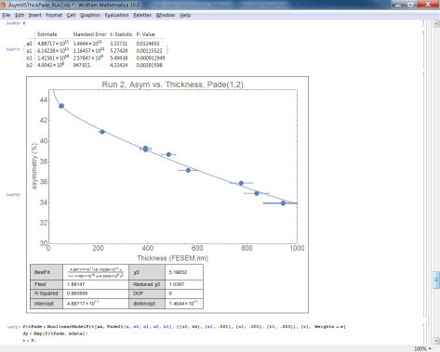
Run two data: Pade terms

Slide 10
Run 1 Pade(n,m) orders: Asy vs. Thick
Pade(n,m) | intercept | dA | R² | red. χ² | d.o.f. | Ftest
(1,0) | 43.8025 | 0.1169 | 0.991 | 1.28 | 9 | --
(2,0) | 44.0176 | 0.1018 | 0.997 | 0.594 | 8 | 11.45
(0,1) | 44.0382 | 0.0786 | 0.997 | .554 | 8 | 11.23
(1,1) | 44.049 | 0.1061 | 0.997 | 0.737 | 7 | 9.67
Run 2 Pade(n,m) orders: Asy vs. Thick
Pade(n,m) | intercept | dA | R² | red. χ² | d.o.f. | Ftest
(1,0) | 43.8437 | 0.1475 | .984 | 2.28 | 9 | --
(2,0) | 44.1131 | 0.125 | .993 | 1.01 | 8 | 12.21
(0,1) | 44.0759 | 0.102 | .994 | 1.04 | 8 | 11.61
(1,1) | 44.1735 | 0.132 | .993 | 1.19 | 7 | 9.67

Slide 11
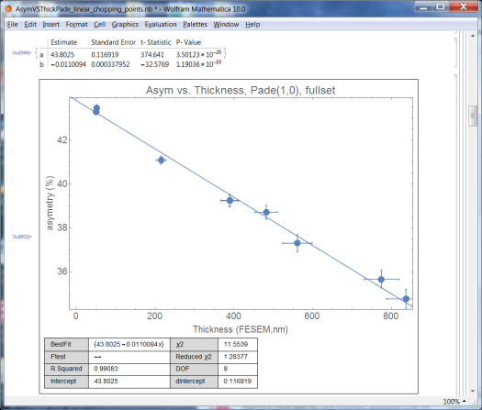
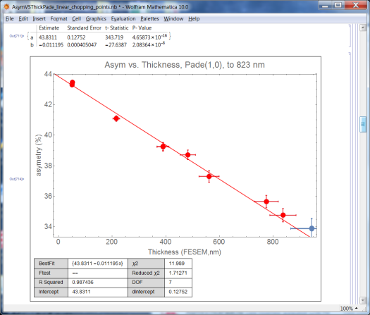
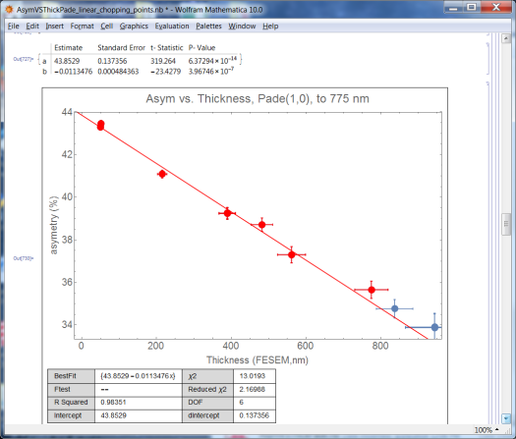
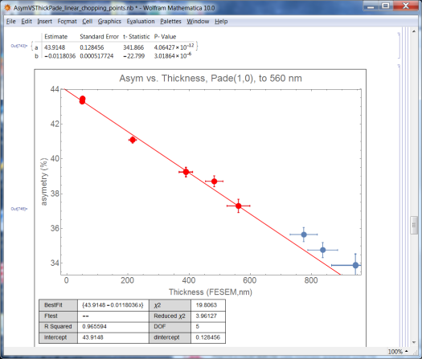
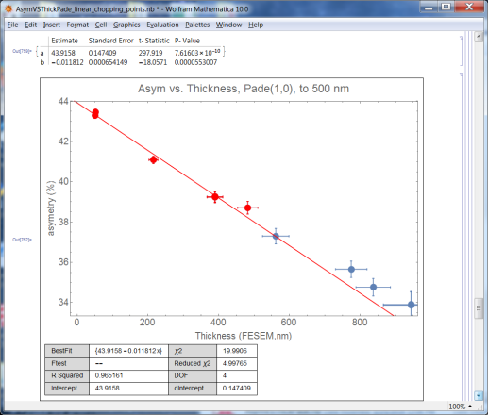
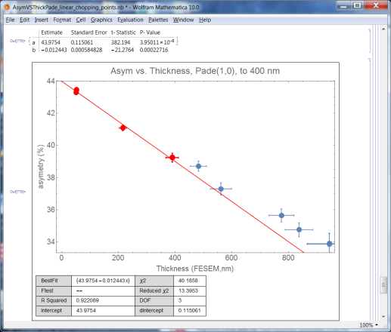
Linear fit: how many points?
Points kept (of 11) | Asym | dA
5 | 43.9754 | 0.115
6 | 43.916 | 0.147
7 | 43.915 | 0.128
8 | 43.853 | 0.137
9 | 43.833 | 0.128
all | 43.803 | 0.117

