Slide 1
Bubble Chamber Radiator Thermal Analysis 5.0 MeV, 9.5 MeV Beam Energy
Fredrik Fors
Mechanical Engineering
8/20/2015

Slide 2
Outline
Background/Objective
Analyzed Geometry
Analysis Model
Results
Conclusion

Slide 3
Overview
Thermal analysis of radiator of a bubble chamber installation.
A 3D solid FE model has been created and analyzed in ANSYS Workbench 16.1
Analysis includes deposited beam energy, surface-to-air convection and coolant tube.
Results indicate maximum temperatures of:
704.2 K with 5.0 MeV, 200 µA beam
627.3 K with 9.5 MeV, 105 µA beam

Slide 4
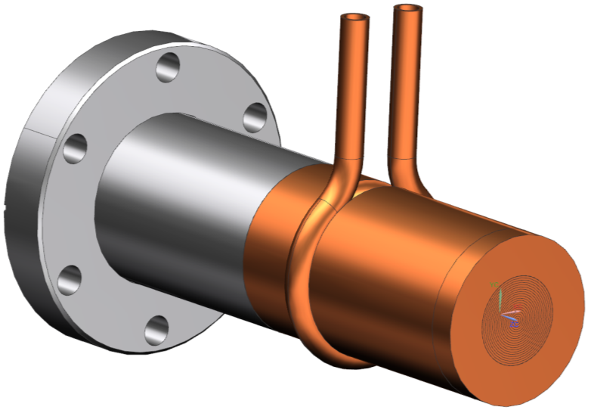
Analyzed Geometry
The component assembly displayed below is included in the thermal analysis
Flange, Tube (Stainless Steel)
Coolant Loop (Copper)
Radiator (Copper)

Slide 5
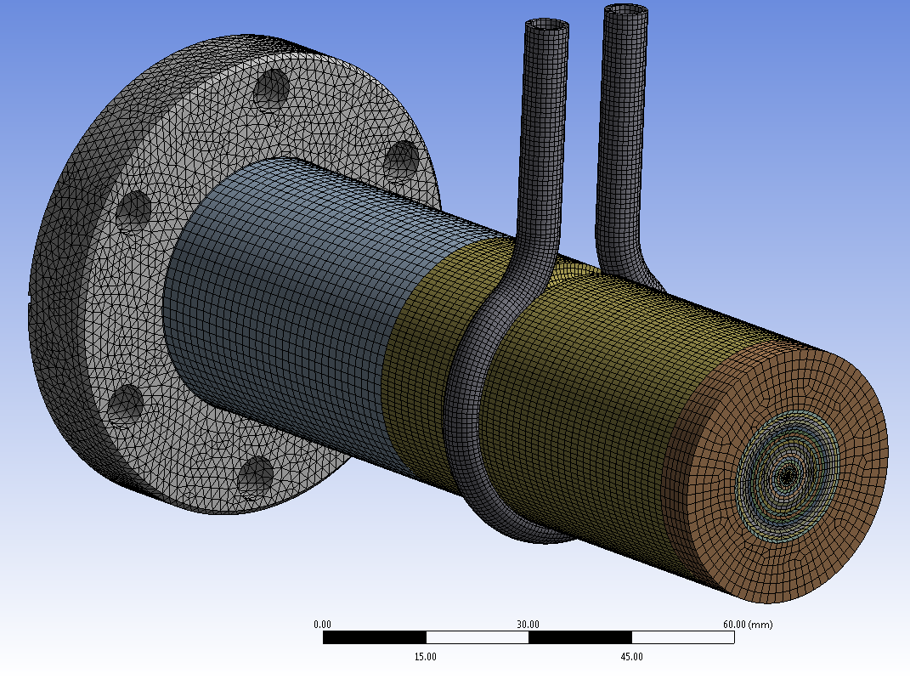
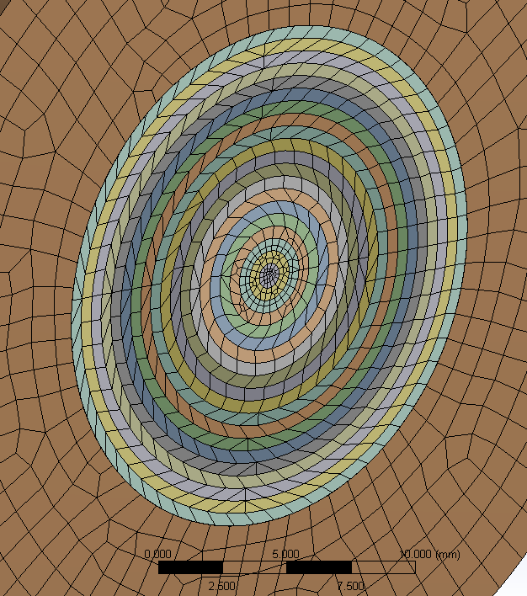
Analysis Model
The CAD geometry is composed into the FE model presented below
Mesh size 0.75-1.5 mm, smaller at beam center
Bonded thermal contact between all bodies
ANSYS standard material properties used
Flange part tet meshed, others hex dominant
Resulting temperature probed at points 1, 2 & 3.
3
2
1

Slide 6
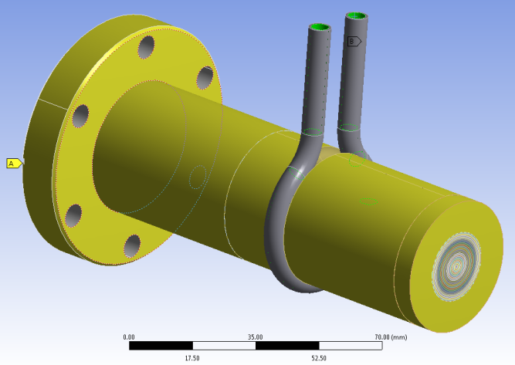
Boundary Conditions
The center front of the radiator is discretized into six 1 mm thick slices divided into 20 concentric areas, with 1 mm radial thickness.
The power deposited by the beam is applied to these 120 bins according to a pre-calculated distribution.
Only the rings with a power deposition of more than 10⁻³ W/mm³ are included for simplicity. In total this comprises 99.8% of the power to the radiator
The analysis has been solved for 5.0 MeV and 9.5 MeV beam energy
Convection BC representing surrounding air applied to outer surfaces of radiator and flange
Convection BC representing coolant flow added to inner surface of coolant loop
Coolant Loop 2.81E-2 W/mm²/K
313.15 K (40°C)
Outer Surfaces 6.0E-6 W/mm²/K
295 K (~22°C)

Slide 7
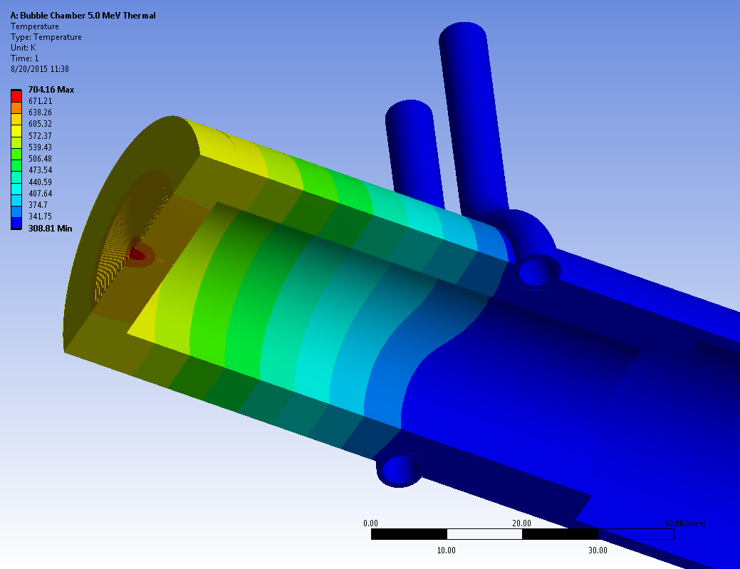
Results – 5.0 MeV
In the plot below the resulting steady-state temperature is plotted on the model. Note that the display is sectioned through the central horizontal plane.
Probe results:
704.2 K (431.0°C)
601.3 K (328.2°C)
474.3 K (201.2°C)
Max. temp:
704.16 K

Slide 8
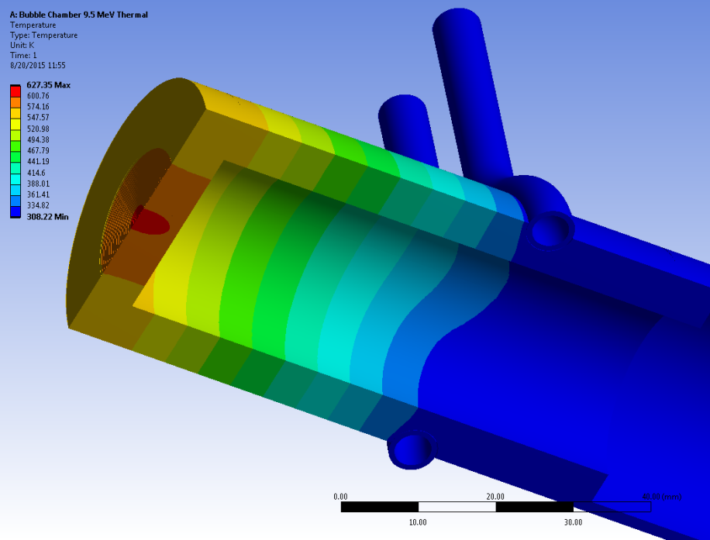
Results – 9.5 MeV
In the plot below the resulting steady-state temperature is plotted on the model. Note that the display is sectioned through the central horizontal plane.
Probe results:
627.3 K (354.2°C)
567.8 K (294.6°C)
455.5 K (182.4°C)
Max. temp:
627.35 K

Slide 9
Conclusions

