Slide 1
Electrodes history on R28 insulators (CEBAF & UITF)
Updated September 2021
Carlos Hernandez-Garcia

Slide 2
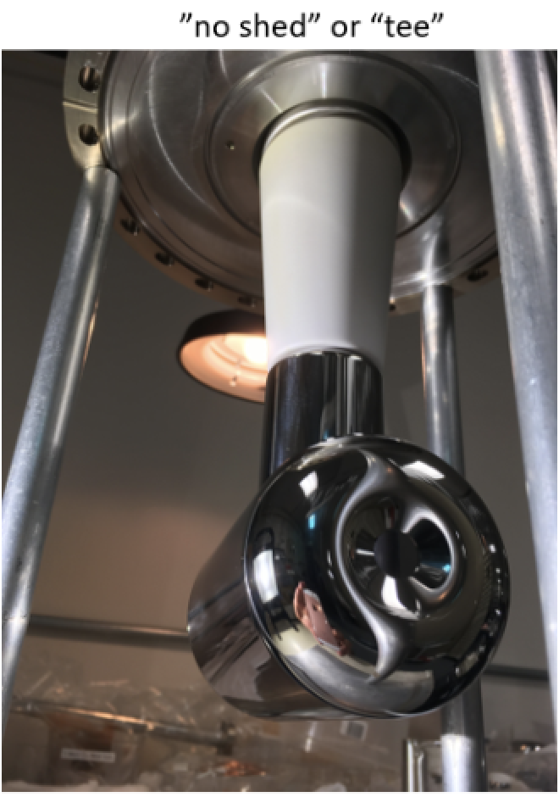
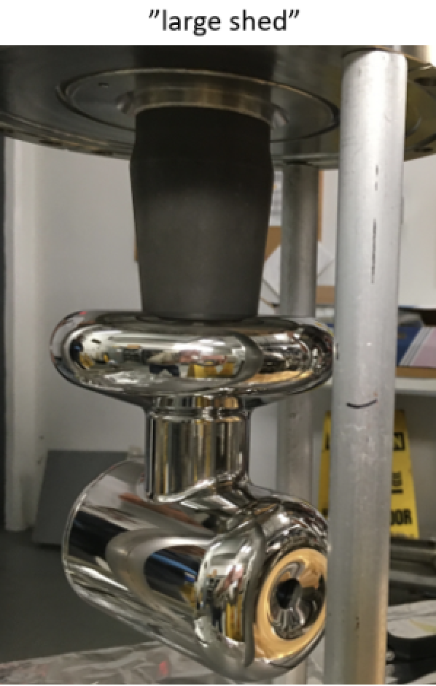
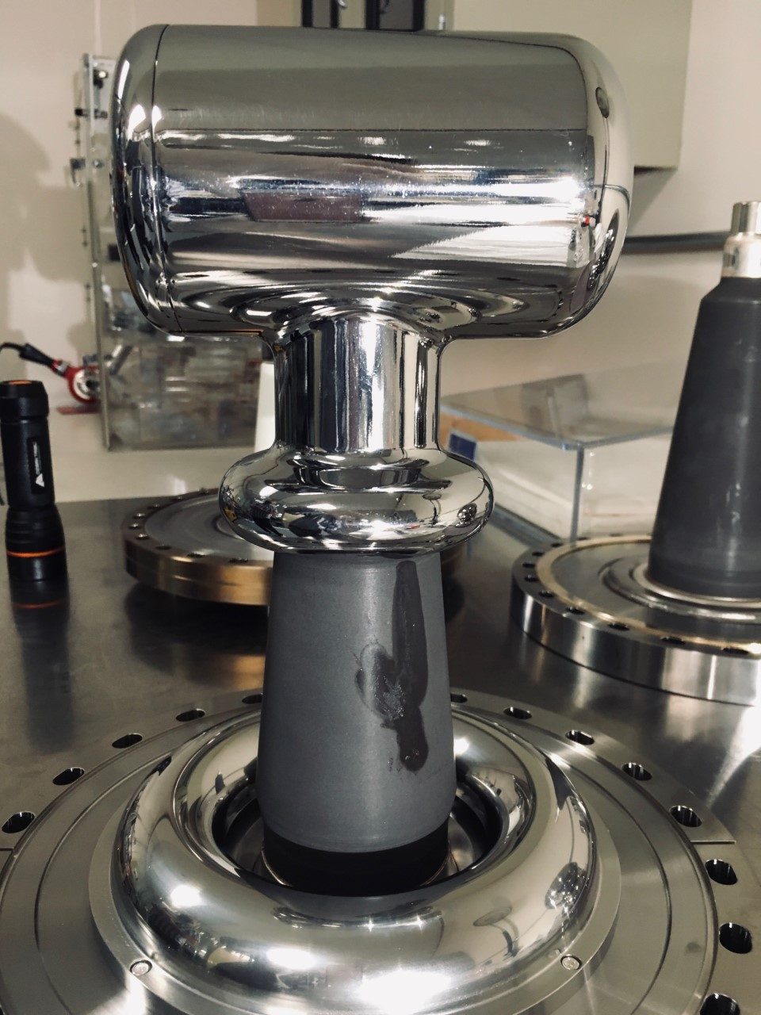
SS Electrodes timeline
2008-2018
6/2018
6/2018-9/2019
9/2019
10/2019-present
Tee no shed
Large shed
Large shed
Small shed
SS Tee no shed
CEBAF
130 kV beam ops no FE
100-130kV
Beam ops
200kV + some beam + FE
100kV FE onset
Could not Kr HV proc.
130kV
Beam ops, FE onset 190 kV
11/2017-5/2018
4/2019
5-7/2019
8-10/2019
10/2019-05/2021
7-8/2021
Large shed
Small shed
Small shed
SS Tee no shed
Small shed
LGNb Tee
150keV lifetime runs
200kV Kr HV, no FE
200keV lifetime runs no FE
UITF
Re-polished
150kV onset FE
225 kV Kr HV + FE 200keV beam +FE
Punctured! During beam ops
Replaced with LGNb: FE 185 kV
220 kV in vacuum + FE
227kV Kr HV + FE
200 keV beam ops + FE
220kV Kr HV no F.E.
Then FE @ 170kV
230kV Kr HV no FE

Slide 3
SS Tee or no shed on pure alumina R28 insulator
2008? Machined from solid SS 316 L (drawing dates from Jan 2009). Diamond Paste Polished, UHV cleaned, 900C vacuum fired, mounted on vacuum fired flange, surveyed and fiducial.
2008- Used at CEBAF 100-130kV, Concerned about triple junction 2018 > 150kV. Nice optics, small broken symmetry (beam deflection).
8/2018 Installed in UITF. Kr HV processed to 230kV, no FE. Kr HV processing summary: https://logbooks.jlab.org/entry/3731443
9/30/2019 Checked in UITF to 130kV, no FE.
10/2019 Installed in CEBAF. Ramped to 130kV in vacuum, no FE. In operation since then delivering beam. Field emission onset: 190 kV.

Slide 4
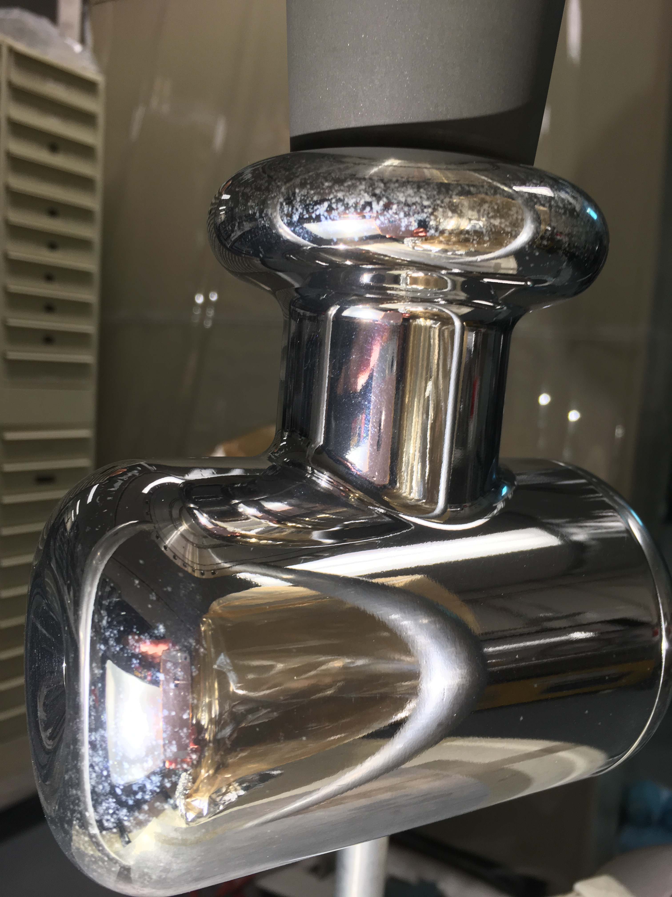
SS small shield on doped R28 insulator
Brand new
2/2019 Machined from solid SS 316L. Barrel Polished, UHV cleaned, 900C vacuum fired, mounted in non-vacuum fired flange, surveyed and fiducial.
4/2019 Installed in UITF gun, S&A. Kr HV to 220 kV no FE. Then FE onset @ 170kV. HV processing summary https://logbooks.jlab.org/entry/3719864
5/2019- Lifetime runs at 150 keV. Kr HV to 200kV no FE. Then lifetime runs at 7/2019 200 keV.
8/2019 Removed from UITF. Moved to a vacuum fired flange. S&A then installed in CEBAF.
9/2019 Started w/ Kr HV processing. FE onset 100kV. Could not processed out. Ramped as high as 285 kV w/Kr in the range 10⁻⁶ - 10⁻³ Torr pressure in HV chamber. Removed from CEBAF. Lots of FE markings all over. Why? CEBAF NEG coated HV chamber? NEG cartridges Kr line ‘scrubbers’? EDS shows no sign of NEG material on electrode.
11/2019 Barrel polished, UHV cleaned, CO₂ jet cleaned, mounted to vacuum fired flange, S&A. Installed in UITF. HV in vacuum but FE onset at 150kV. 200 keV beam despite 200 CPS FE.
2/2020 Tried Kr HV to 225kV. FE worse. Delivering beam with 1500 CPS at 200kV. Then we poked the back end of electrode with long manipulator. FE now 4000 CPS at 200kV. Despite this, 200 keV beam ops continue.
5/2021 Discovered insulator had punctured during beam ops, despite this continued operating at 200 kV.
7/2021 Replaced with LGNb Tee electrode. Kr conditioned to 240 kV but FE onset at 185 kV. Ops at 180 kV.
CEBAF HV+Kr: lots of FE

Slide 5
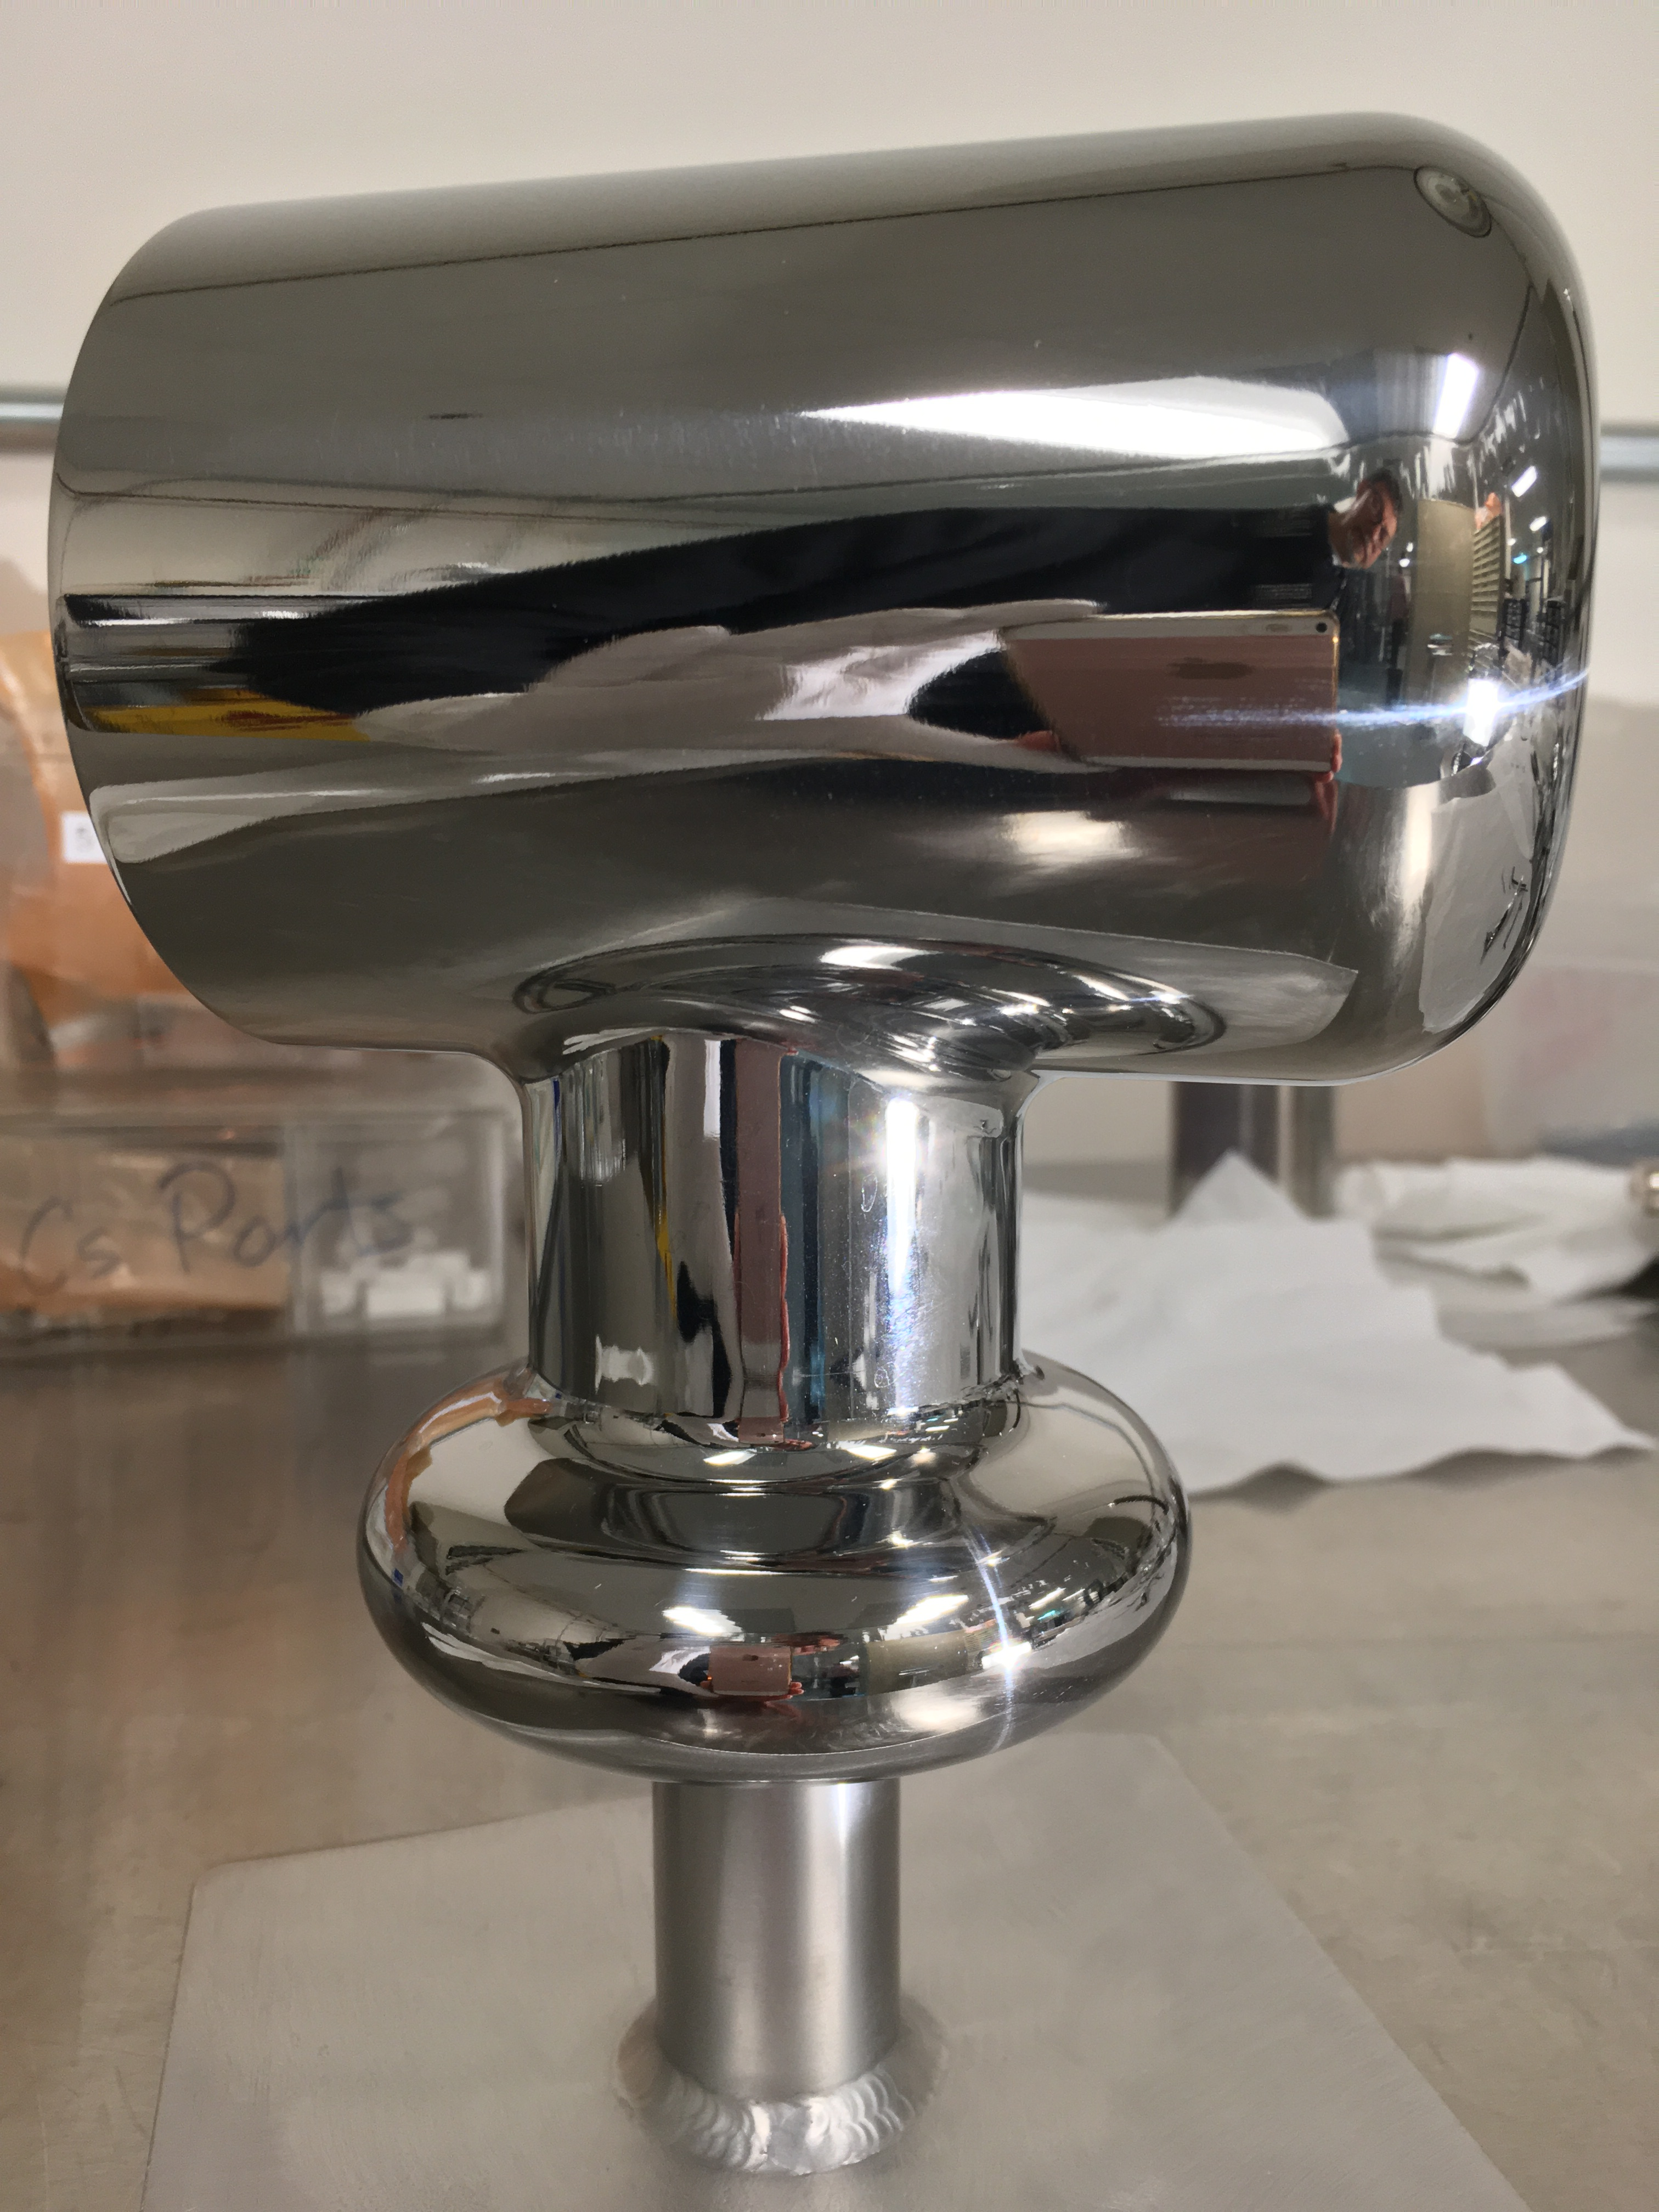
SS Large shield on doped R28 insulator
8/2017 Machined from solid SS 316L. Barrel Polished, UHV cleaned, 900C vacuum fired, mounted in 400C vacuum fired flange, surveyed and fiducial.
11/2017- Installed in UITF gun, S&A. HV in vacuum to 220 kV. FE onset 200kV. 5/2018 Delivered some beam for deflection characterization. HV processing Nov 29 – Dec 13 2017
6/2018- Installed in CEBAF gun. Ramped to 200kV for limited injector 9/2019 beam tests. FE onset 150kV. Used for beam ops at 130kV no FE, but undesired vertical beam deflection.
9/2019 Removed from CEBAF. Stored in TL1137.
2/2020 Machined down into small shield electrode. There’s now two small shield electrodes. Barrel polished + DPP on front end and shield cusp. UHV cleaned + CO₂ jet cleaned.
3/2020 Handed out to Scott Williams for 900 C vacuum firing along with back-end piece and puck holder pieces (excluding sapphire rollers and springs)
7/2020 Re-assembled on black R28 insulator and stored in TL113 cabinet as a spare.
Shield machined down

