Slide 1
Polarized Injector Update
Riad Suleiman
Center for Injectors and Sources
QWeak Collaboration Meeting
July 17-18, 2009

Slide 2
Outline
Higher Gun Voltage & Inverted Gun
Two Wien Slow Helicity Reversal
Fast Helicity Reversal
Other Improvements

Slide 3
Upcoming Parity Experiments
Experiment | Hall | Start | Energy (GeV) | Current (µA) | Target | A_{pv} (ppm) | Maximum Charge Asym (ppm) | Maximum Position Diff (nm)
HAPPEx-III | A | Aug 09 | 3.484 | 85 | ¹H (25 cm) | 16.9±0.4 | 1 | 10
PVDIS | A | Oct 09 | 6.068 | 85 | ²H (25 cm) | 63±3 | 1 | 10
PREx | A | March 10 | 1.056 | 50 | ²⁰⁸Pb (0.5 mm) | 0.500±0.015 | 0.100±0.010 | 2
QWeak | C | May 10 | 1.162 | 180 | ¹H (35 cm) | 0.234±0.005 | 0.100±0.010 | 2
Achieved |  |  |  |  |  |  | 0.4 | 1

Slide 4
Higher Voltage & Inverted Gun
Increase gun voltage up to 150 kV to reduce space charge emittance growth at higher bunch charge (higher current)
Beam quality including transmission improves
Problem: Field emission at higher voltage degrades lifetime → solution: Inverted Gun

Slide 5
Move away from “conventional” insulator used on all GaAs photo-guns today: expensive, months to build, prone to damage from field emission.

Slide 6
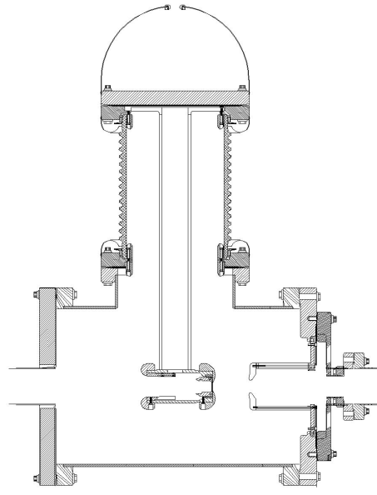
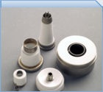
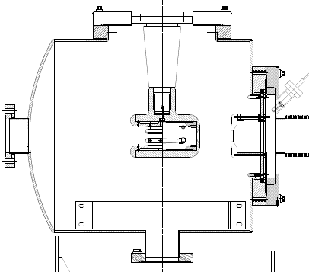
Medical x-ray technology
Present Ceramic
Exposed to field emission
Large area
Expensive ($50k)
e⁻
New Ceramic
Compact
$5k
e⁻
Inverted Gun

Slide 8
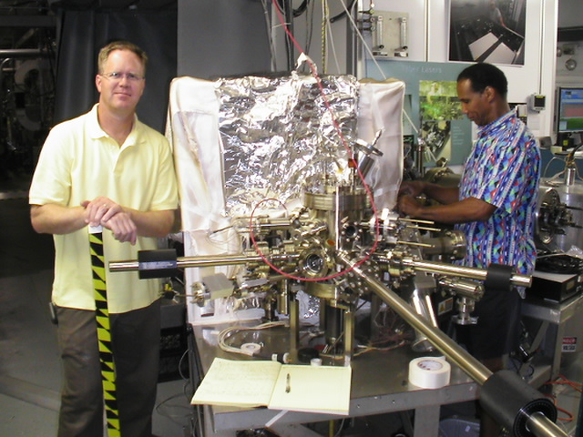
Inverted Gun installed on July 14, 2009, beam in two weeks

Slide 9
Two Wien Slow Helicity Reversal
Insertable Half Wave Plate (IHWP) provides slow helicity reversal of laser polarization:
Cancels Electronic cross talk and Pockels Cell Steering
Residual Linear polarization effects do not cancel
Spot size asymmetry, which we cannot measure, does not cancel
New: Slow helicity reversal of electron polarization using two Wien Filters and solenoid:
Wien settings constant
Solenoid rotates spin by ±90° with ±B but focuses beam as B²
Maintain constant Injector and Accelerator configuration
Cancels all helicity-correlated beam asymmetries from the Injector including spot size
Can be used up to maximum Gun voltage of 140 kV
Will be installed in January 2010

Slide 10
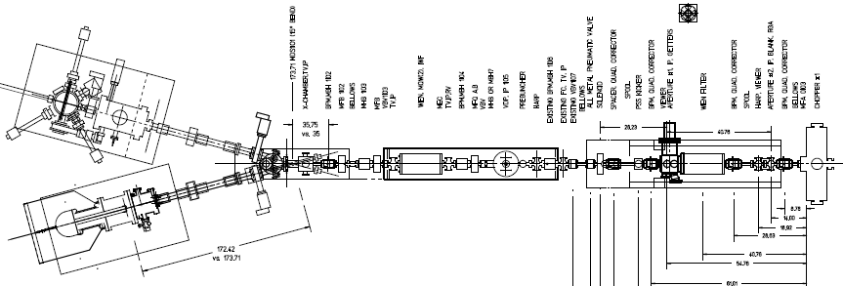
+ Solenoid current
- Solenoid current
“Spin Flipper”
Vertical Wien = 90°
Azimuthal Solenoid = ± 90°
“Long. Pol. for Halls”
Horizontal Wien = -90° → +90°

Slide 11
Fast Helicity Reversal
We have been using 30 Hz helicity reversal:
Power line 60 Hz frequency is major source of noise in parity experiments
For 30 Hz reversal, T_Stable (= 33.333 ms) contains exactly two cycles of 60 Hz line noise → this reversal cancels line noise
Problem:
There are other sources of noise at low frequencies, i.e., target density fluctuations, beam current fluctuations
→ Cause larger widths of helicity correlated distributions, double-horned distributions
Solution: Use fast helicity reversal (faster than 30 Hz)
Studied beam properties at 1 kHz (Oct 2008 – April 2009)
Fast reversal of helicity Pockels Cell was possible using new optically-driven fast high voltage switch designed by J. Hansknecht

Slide 12
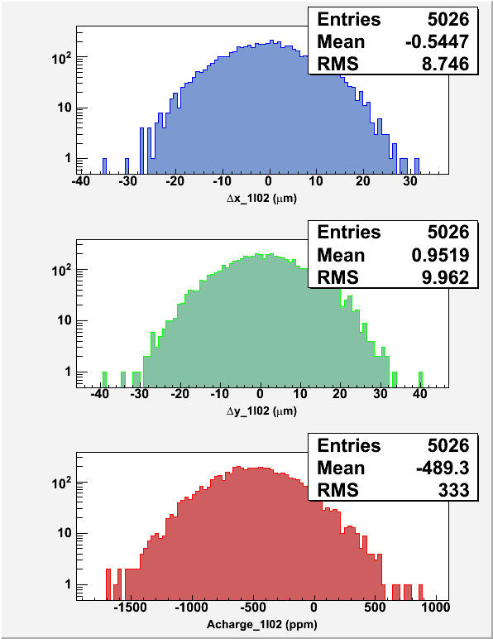
30 Hz, T_Stable = 33.333 ms, T_Settle = 500 µs
1 kHz, T_Stable = 0.980 ms, T_Settle = 60 µs

Slide 13
Summary of Fast Helicity Reversal Studies
Fast Helicity Reversal is needed:
Huge reduction of noise from target density fluctuations
Reduces noise on beam current by factor of 4
Reasonable reduction in beam position noise
Achieved Pockels Cell T_Settle of 60 µs
Future Parity Experiment:
New Helicity Board to be installed in July 2009
Experiment | Frequency | Clock | Pattern
HAPPEx III & PVDIS | 30 Hz | Line-Locked | Quartet
PREx | 240 Hz | Line-Locked | Octet
QWeak | 1 kHz | Free | Quartet

Slide 14
Other Developments
Charge Feedback: Ability to do Charge Feedback using either Pockels Cell or Intensity Attenuator without or with the option to correct for Pockels Cell hysteresis
Helicity Magnets: Ability to do Position Feedback using the newly commissioned helicity magnets located in the 5 MeV region of the Injector
Pockels Cell Motion: Pockels Cell is equipped with remote controlled x & y translational stage for minimizing position differences while measuring the position differences of electron beam
Photocathode Rotation: With Load-Locked Gun, now we can zero the offset term in the charge asymmetry caused by the vacuum window birefringence by rotating the photocathode

