Slide 1
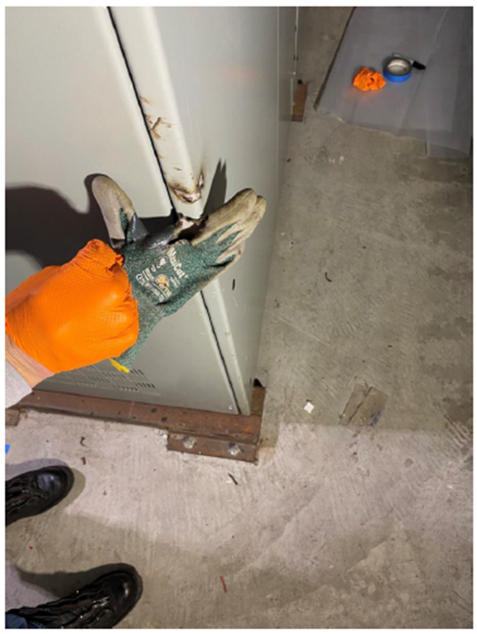
SLAC Shock Event – What happened?
During a maintenance activity, a SLAC electrician made hand contact with a bare energized (live) circuit part inside an electrical cabinet
Work activities should have resulted in the de-energization of this system, but did not
The worker sustained severe injuries to the hands and face

Slide 2
How Did It Happen?
The worker assumed he understood how the cabinet was powered, but this had been changed and he was not aware nor did he read the procedure which reflected this change
The worker did not confirm the equipment had been de-energized per the procedure and training
The worker was not wearing the correct PPE (not causal but contributed to the severity)

Slide 3
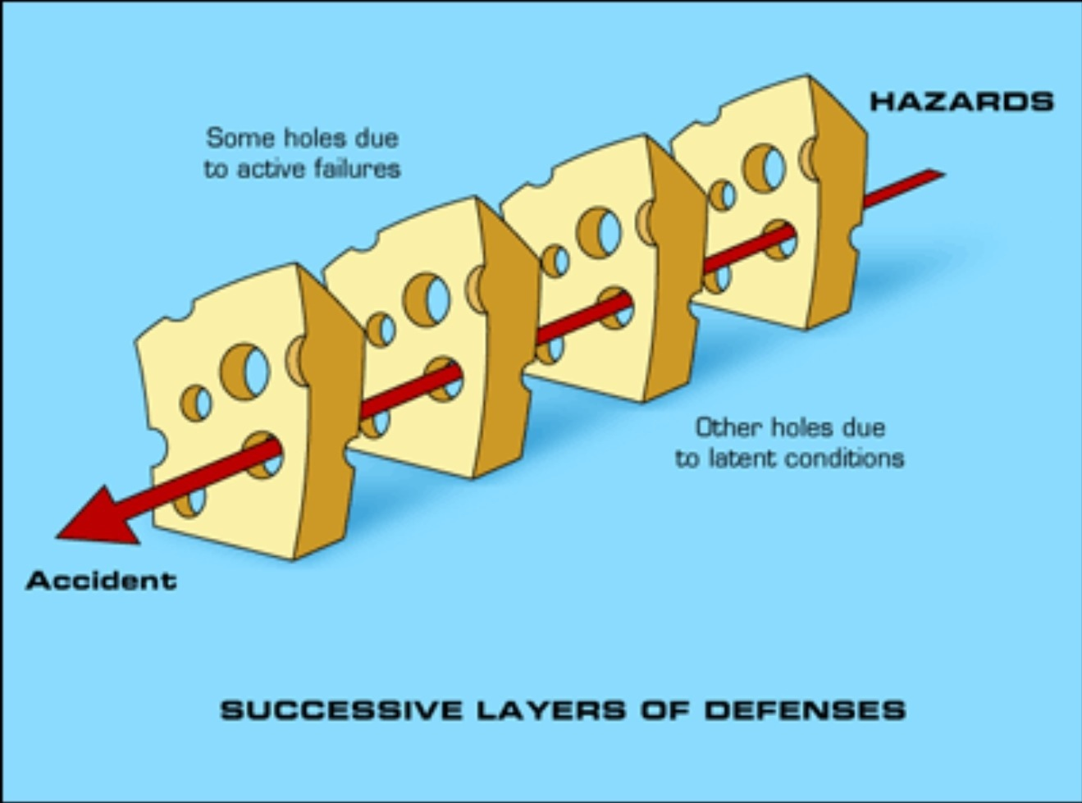
Why Did It Happen?
(2) Previous assessment findings were not quickly corrected
(4) Ineffective supervisor oversight did not correct these problems
(1) Lab allowed “temporary” system changes to become permanent without providing resources to document and communicate changes
(3) Procedure deviation was normalized over time (skill vs rule)

Slide 4
What Can We Learn?
Task Demands / Time pressure (“mission critical” equipment going down)
Less than optimal staffing levels – issue was raised and a “work around” developed
Lack of or unclear expectations - What is a good pre-job? Do we have a good procedure? Are we following the procedure?
Changes/departures from routine – the system did not respond as expected
Unexpected equipment conditions – the system did not react as expected but they convinced themselves it was ok
Inaccurate risk perception – workers had done this in the past with no severe outcomes

