Slide 1
Foil thickness measurements & Elastic rate comparisons

Slide 2
5275: 500 nm center

Slide 3
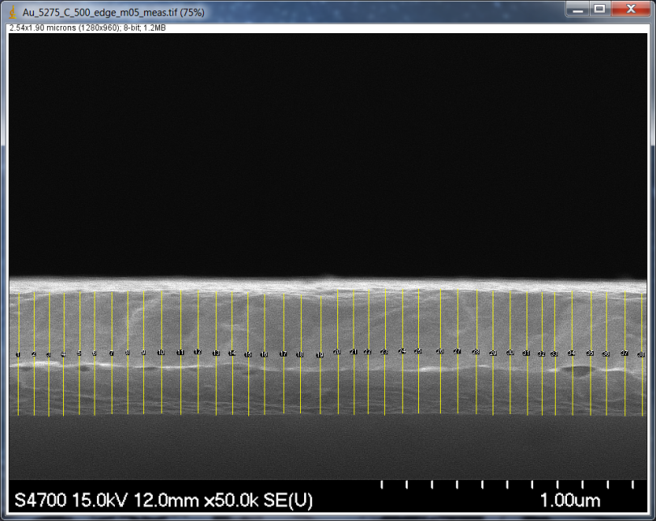
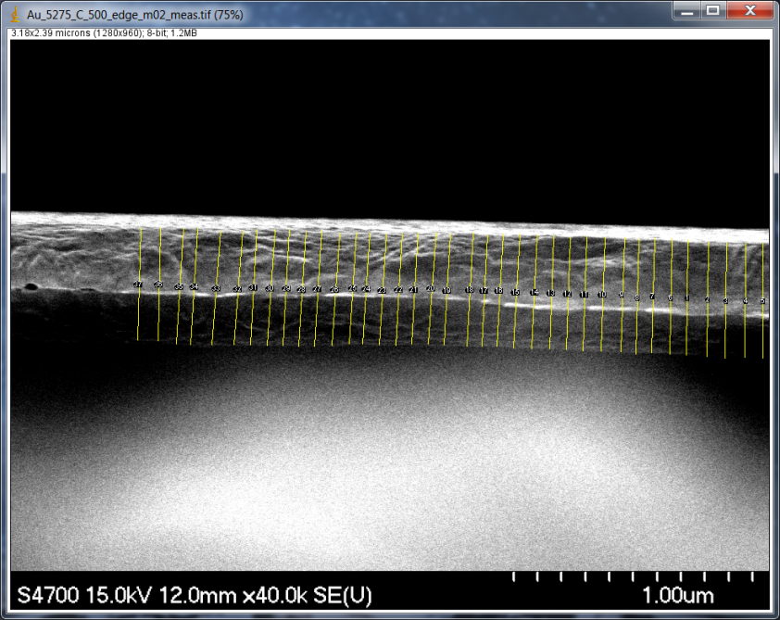
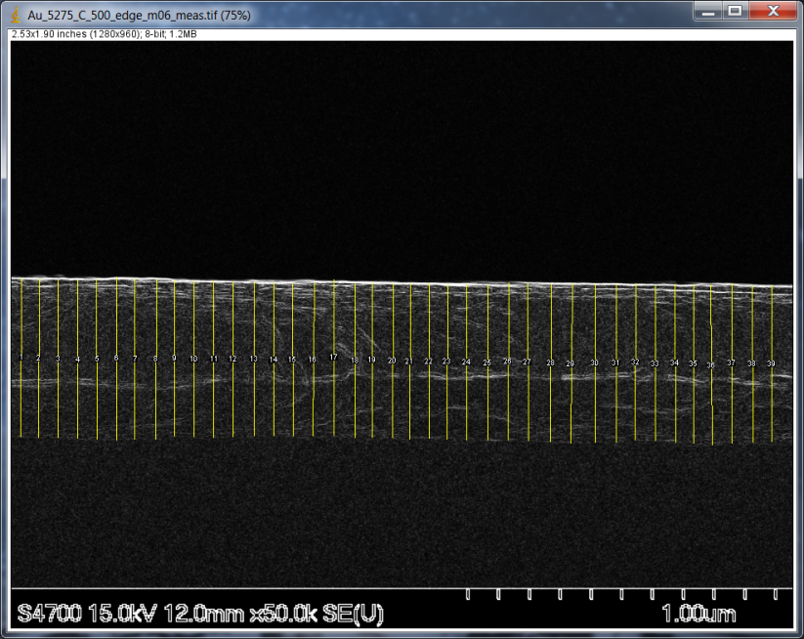
5275: 500 nm edge

Slide 4
Stat. evaluation of measurements
 | edge |  |  |  | center
 | m01 | m02 | m05 | m06 | m07
Mean | 0.534 | 0.477 | 0.489 | 0.508 | 0.465
SD | 0.006 | 0.007 | 0.006 | 0.007 | 0.008
This data on the wiki at Thickness_meas_summary.xlsx for all measured data sets

Slide 5
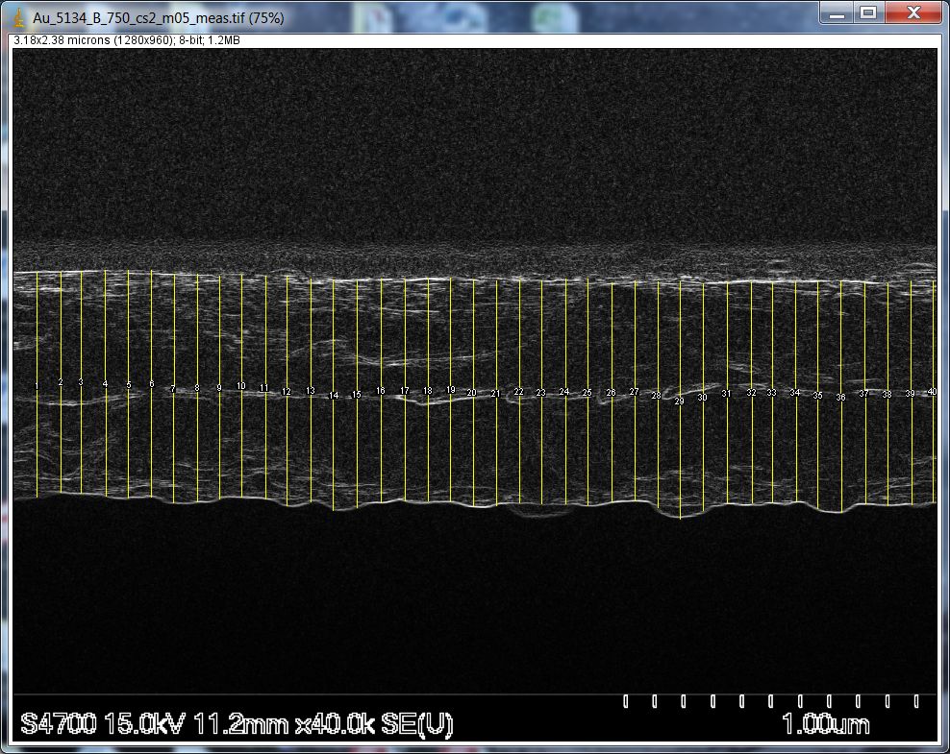
5134: 750 nm

Slide 6
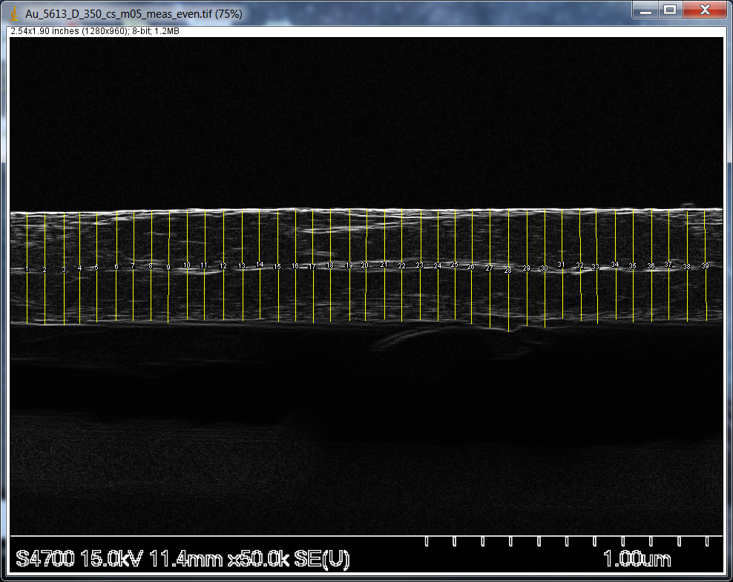
5613: 350 nm

Slide 7
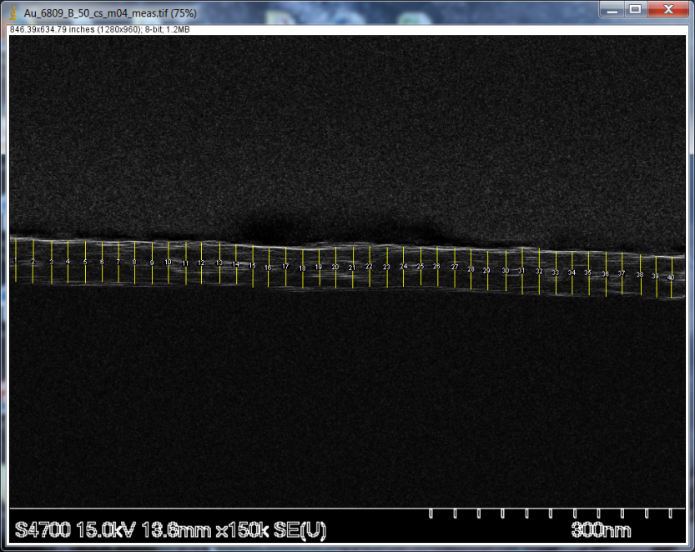
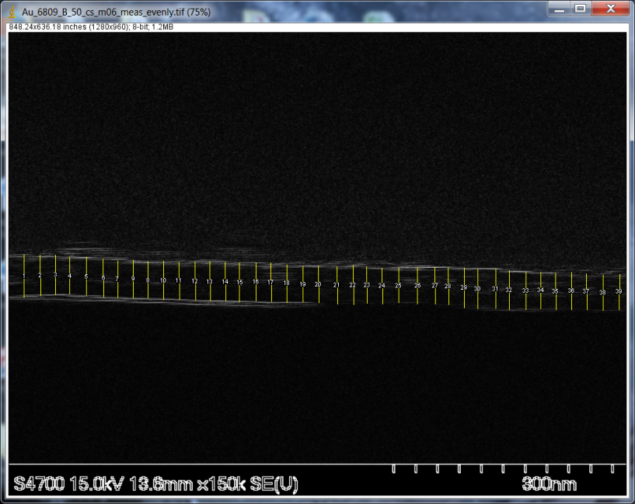
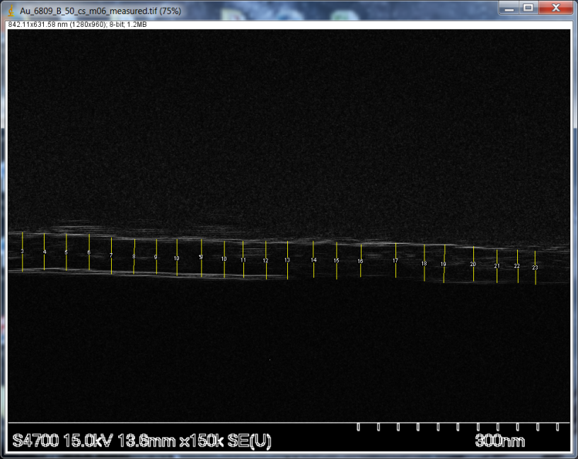
6809: 50 nm

Slide 8
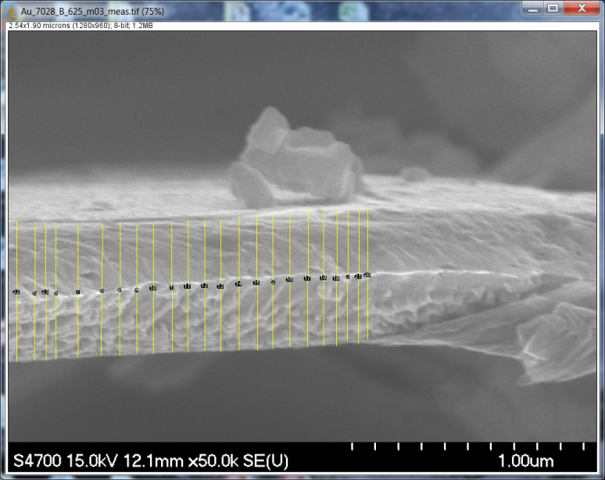
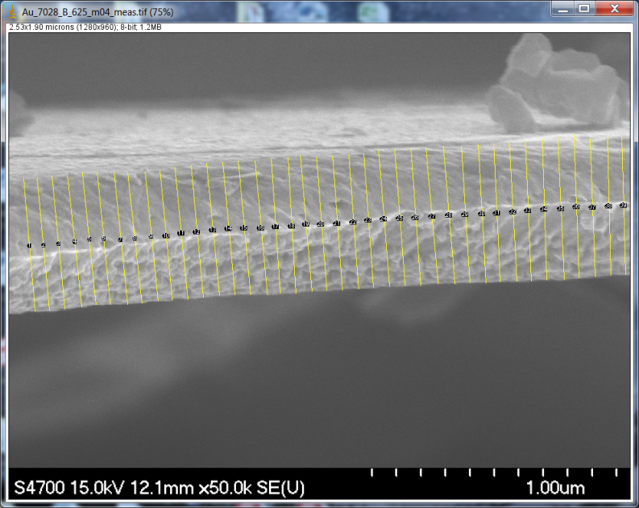
7028: 625 nm

Slide 9
Elastic rate via TDC cut, high threshold

Slide 10
Elastic rate scaling for thickness
We don’t have sibling foil for 50 nm foil # 6845, but measured elastic rate of 60.4346 Hz/uA
Use elastic rates and measured thickness for other ~50 nm foil, 350 nm foils

Slide 11
Conclude foil 6845 ~51.9 nm

Slide 12
Elastic rate via TDC cut, low threshold

Slide 13
Preliminary: predicted thickness from elastics, low threshold

Slide 14
Data that looks to be most “off” from fit line:
500 nm seems like it should be thinner
625 nm foil seems to have been measured too thin – should be thicker

